Slide 1
Divisibility and Modular Arithmetic
Section 4.1

Slide 2

Section Summary
Division vs. Divisibility
Division Algorithm (Theorem to express $a=dq+r$ )
Modular Arithmetic (congruences and clock face arithmetic)

Slide 3
Division
Definition: If a and b are integers with a ≠ 0, then a divides b if there exists an integer c such that b = ac.
When a divides b we say that a is a factor or divisor of b and that b is a multiple of a.
The notation a | b denotes that a divides b.
If a | b, then b/a is an integer.
If a does not divide b, we write a ∤ b.
Example: Determine whether 3 | 7 and whether 3 | 12.
Summary: Divisibility is a predicate: 6|18 is True, but 6|21 is False.
Division is arithmetic operation, e.g. 21/6 = 3.5 (or 21//6 = 3 in Python)

Slide 4
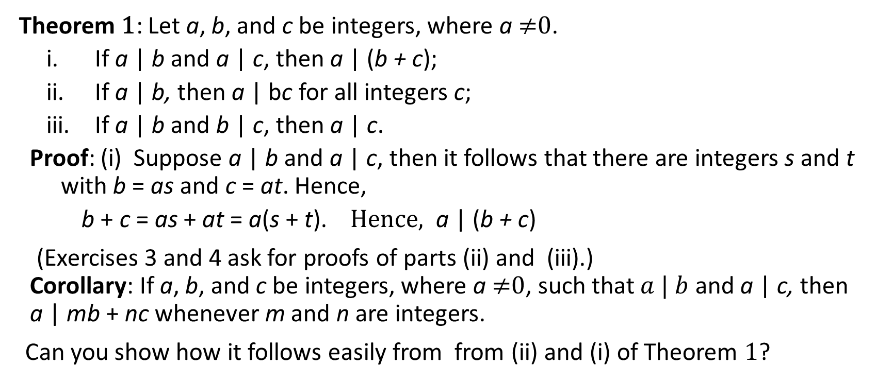
Properties of Divisibility
Theorem 1: Let a, b, and c be integers, where a ≠0.
If a | b and a | c, then a | (b + c);
If a | b, then a | bc for all integers c;
If a | b and b | c, then a | c.
Proof: (i) Suppose a | b and a | c, then it follows that there are integers s and t with b = as and c = at. Hence,
b + c = as + at = a(s + t). Hence, a | (b + c)
(Exercises 3 and 4 ask for proofs of parts (ii) and (iii).) Corollary: If a, b, and c be integers, where a ≠0, such that $a | b$ and a | c, then a | mb + nc whenever m and n are integers.
Can you show how it follows easily from from (ii) and (i) of Theorem 1?

Slide 5
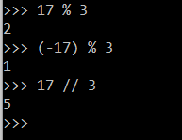
Division Theorem/Algorithm
When an integer is divided by a positive integer, there is a quotient and a remainder.
Division Theorem: If a is an integer and d a positive integer, then there are unique integers q and r, with 0 ≤ r < d, such that a = dq + r (proved in Section 5.2).
d is called the divisor. a is called the dividend.
q is called the quotient. r is called the remainder.
Examples:
What are the quotient and remainder when 101 is divided by 11?
Solution: The quotient when 101 is divided by 11 is 9 = 101 div 11, and the remainder is 2 = 101 mod 11.
What are the quotient and remainder when −11 is divided by 3?
Solution: The quotient when −11 is divided by 3 is −4 = −11 div 3, and the remainder is 1 = −11 mod 3.
Quotient: q = a div d
Remainder:
r = a mod d

Slide 6
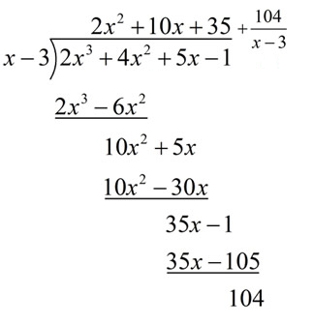
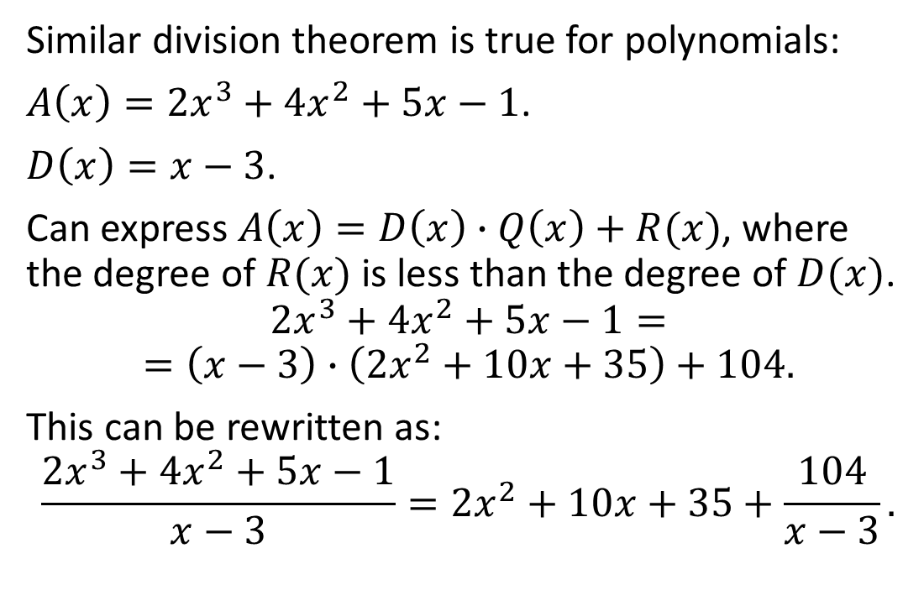
Polinome Division
Similar division theorem is true for polynomials:
$A\left(x\right)=2x^{3}+4x^{2}+5x−1$.
$D\left(x\right)=x−3$.
Can express $A\left(x\right)=D\left(x\right)∙Q\left(x\right)+R(x)$, where the degree of $R(x)$ is less than the degree of $D(x)$.
$$2x^{3}+4x^{2}+5x−1=$$
$$=\left(x−3\right)∙\left(2x^{2}+10x+35\right)+104.$$
This can be rewritten as:
$$\frac{2x^{3}+4x^{2}+5x−1}{x−3}=2x^{2}+10x+35+\frac{104}{x−3}.$$

Slide 7
Congruence Relation
Definition: If a and b are integers and m is a positive integer, then a is congruent to b modulo m if m divides a – b.
The notation a ≡ b (mod m) says that a is congruent to b modulo m.
We say that a ≡ b (mod m) is a congruence and that m is its modulus.
Two integers are congruent mod m if and only if they have the same remainder when divided by m.
If a is not congruent to b modulo m, we write
a ≢ b (mod m)
Example: Determine whether 17 is congruent to 5 modulo 6 and whether 24 and 14 are congruent modulo 6.
Solution:
17 ≡ 5 (mod 6) because 6 divides 17 − 5 = 12.
24 ≢ 14 (mod 6) since 24 − 14 = 10 is not divisible by 6.

Slide 8
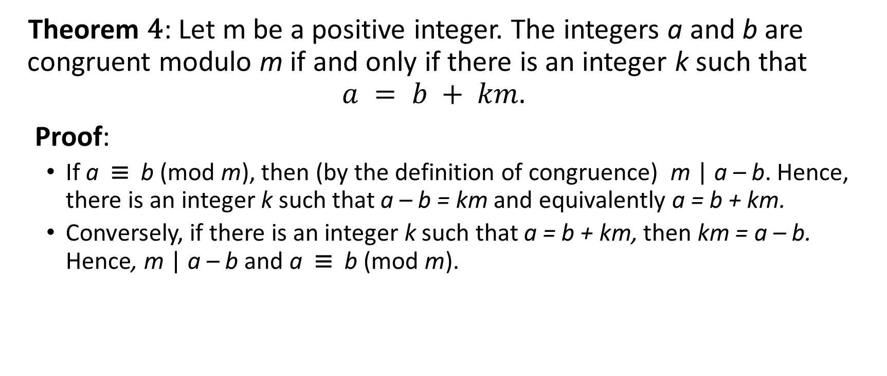
More on Congruences
Theorem 4: Let m be a positive integer. The integers a and b are congruent modulo m if and only if there is an integer k such that
$$a = b + km.$$
Proof:
If a ≡ b (mod m), then (by the definition of congruence) m | a – b. Hence, there is an integer k such that a – b = km and equivalently a = b + km.
Conversely, if there is an integer k such that a = b + km, then km = a – b. Hence, m | a – b and a ≡ b (mod m).

Slide 9
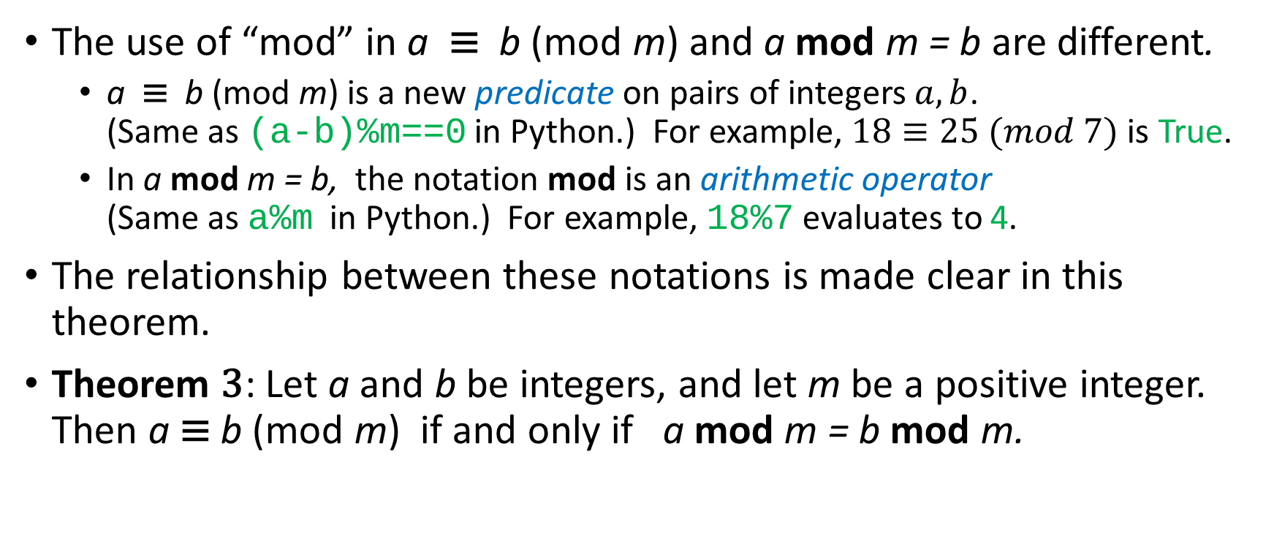
(mod m) and mod m Notations Not the Same!
The use of “mod” in a ≡ b (mod m) and a mod m = b are different.
a ≡ b (mod m) is a new predicate on pairs of integers $a,b$. (Same as (a-b)%m==0 in Python.) For example, $18≡25 (mod 7)$ is True.
In a mod m = b, the notation mod is an arithmetic operator (Same as a%m in Python.) For example, 18%7 evaluates to 4.
The relationship between these notations is made clear in this theorem.
Theorem 3: Let a and b be integers, and let m be a positive integer. Then a ≡ b (mod m) if and only if a mod m = b mod m.

Slide 10
Congruences of Sums and Products
Theorem 5: Let m be a positive integer. If a ≡ b (mod m) and c ≡ d (mod m), then a + c ≡ b + d (mod m) and ac ≡ bd (mod m)
Proof:
By Theorem 4 there are integers s and t with b = a + sm and d = c + tm.
Therefore,
b + d = (a + sm) + (c + tm) = (a + c) + m(s + t) and
b d = (a + sm) (c + tm) = ac + m(at + cs + stm).
Hence, a + c ≡ b + d (mod m) and ac ≡ bd (mod m).
Example: Because 7 ≡ 2 (mod 5) and 11 ≡ 1 (mod 5) , it follows from Theorem 5 that
18 = 7 + 11 ≡ 2 + 1 = 3 (mod 5)
77 = 7 ∙ 11 ≡ 2 ∙ 1 = 2 (mod 5)

Slide 11
Algebraic Manipulation of Congruences
Multiplying both sides of a valid congruence by an integer preserves validity.
If a ≡ b (mod m) holds then c∙a ≡ c∙b (mod m), where c is any integer, holds by Theorem 5 with d = c.
Adding an integer to both sides of a valid congruence preserves validity.
If a ≡ b (mod m) holds then c + a ≡ c + b (mod m), where c is any integer, holds by Theorem 5 with d = c.
Dividing a congruence by an integer does not always produce a valid congruence.
Example: The congruence 14≡ 8 (mod 6) holds. But dividing both sides by 2 does not produce a valid congruence since 14/2 = 7 and 8/2 = 4, but 7≢4 (mod 6).
See Section 4.3 for conditions when division is ok.

Slide 12
mod m Function of Products and Sums
We use the following corollary to Theorem 5 to compute the remainder of the product or sum of two integers when divided by m from the remainders when each is divided by m.
Corollary: Let m be a positive integer and let a and b be integers. Then
(a + b) (mod m) = ((a mod m) + (b mod m)) mod m
and
ab mod m = ((a mod m) (b mod m)) mod m.
(proof in text)

Slide 13
Arithmetic Modulo m
Definitions: Let Z_{m} be nonnegative integers less than m: {0,1, …., m−1}
The operation +_{m} is defined as a +_{m} b = (a + b) mod m. This is addition modulo m.
The operation ∙_{m} is defined as a ∙_{m} b = (a ∙ b) mod m. This is multiplication modulo m.
Using these operations is said to be doing arithmetic modulo m.
Example: Find 7 +₁₁ 9 and 7 ∙₁₁ 9.
Solution: Using the definitions above:
7 +₁₁ 9 = (7 + 9) mod 11 = 16 mod 11 = 5
7 ∙₁₁ 9 = (7 ∙ 9) mod 11 = 63 mod 11 = 8

Slide 14

Addition, Multiplication in ${\text{ℤ}}_{7}$
 | 0 | 1 | 2 | 3 | 4 | 5 | 6
0 | 0 | 1 | 2 | 3 | 4 | 5 | 6
1 | 1 | 2 | 3 | 4 | 5 | 6 | 0
2 | 2 | 3 | 4 | 5 | 6 | 0 | 1
3 | 3 | 4 | 5 | 6 | 0 | 1 | 2
4 | 4 | 5 | 6 | 0 | 1 | 2 | 3
5 | 5 | 6 | 0 | 1 | 2 | 3 | 4
6 | 6 | 0 | 1 | 2 | 3 | 4 | 5
 | 0 | 1 | 2 | 3 | 4 | 5 | 6
0 | 0 | 0 | 0 | 0 | 0 | 0 | 0
1 | 0 | 1 | 2 | 3 | 4 | 5 | 6
2 | 0 | 2 | 4 | 6 | 1 | 3 | 5
3 | 0 | 3 | 6 | 2 | 5 | 1 | 4
4 | 0 | 4 | 1 | 5 | 2 | 6 | 3
5 | 0 | 5 | 3 | 1 | 6 | 4 | 2
6 | 0 | 6 | 5 | 4 | 3 | 2 | 1

Slide 15
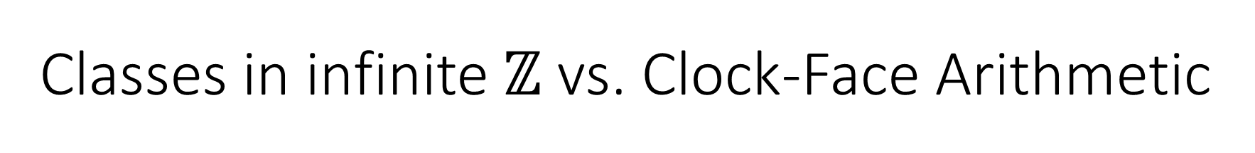


Classes in infinite $\text{ℤ}$ vs. Clock-Face Arithmetic
$\text{ℤ}$, where congruent numbers (mod 7) have same color
-8
-7
-6
-5
-4
-3
-2
-1
0
1
2
3
4
5
6
7
8
9
10
11
12
$\text{ℤ}$, where congruent numbers (mod 6) have same color
-8
-7
-6
-5
-4
-3
-2
-1
0
1
2
3
4
5
6
7
8
9
10
11
12
0
0
6
1
5
1
$${\text{ℤ}}_{7}$$
$${\text{ℤ}}_{6}$$
5
2
4
2
4
3
3

Slide 16
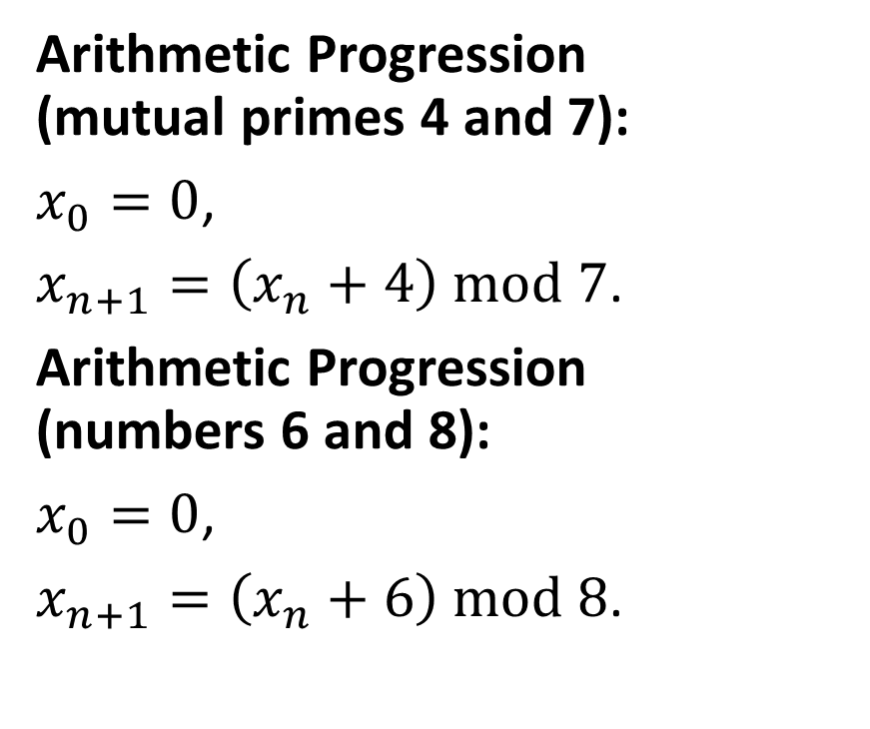
Demo: Arithmetic Progressions
0
6
1
Arithmetic Progression (mutual primes 4 and 7):
$x_{0}=0$,
$x_{n+1}=\left(x_{n}+4\right) mod 7$.
Arithmetic Progression (numbers 6 and 8):
$x_{0}=0$,
$x_{n+1}=\left(x_{n}+6\right) mod 8$.
5
2
4
3
0
7
1
6
2
5
3
4

Slide 17
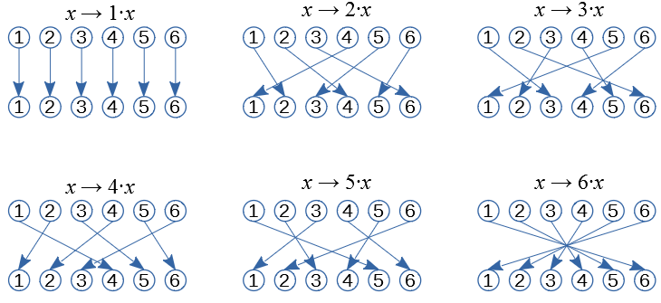
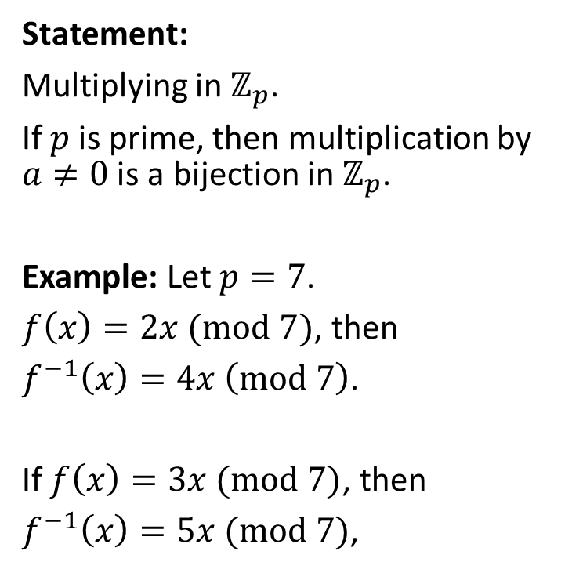
Demo: Multiplication is Bijective
Statement:
Multiplying in ${\text{ℤ}}_{p}$.
If $p$ is prime, then multiplication by $a≠0$ is a bijection in ${\text{ℤ}}_{p}$.
Example: Let $p=7$.
$f\left(x\right)=2x (mod 7)$, then
$f^{−1}\left(x\right)=4x \left(mod 7\right)$.
If $f\left(x\right)=3x (mod 7)$, then
$f^{−1}\left(x\right)=5x (mod 7)$,

Slide 18
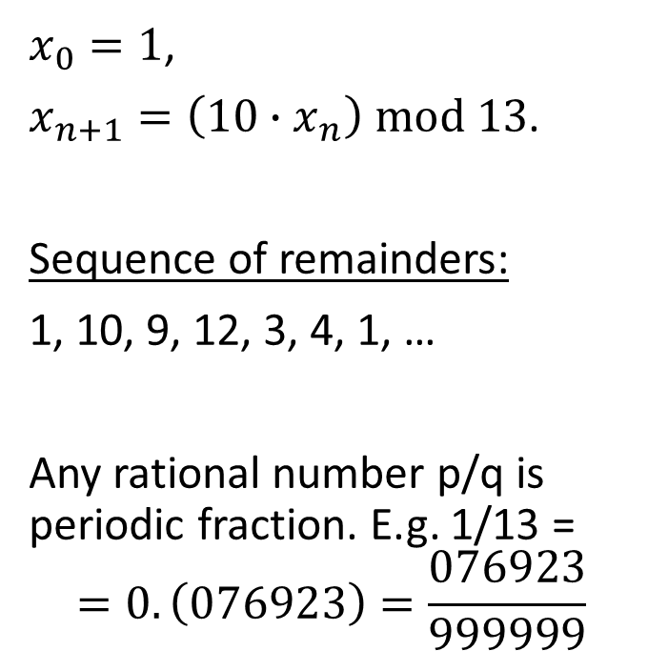
Demo 3: Geometric Progression with ratio 10
1:13=0.076923... 10 00 100 91 90 78
120 117 30 26 40 39 10
0
12
1
$x_{0}=1$,
$x_{n+1}=\left(10∙x_{n}\right) mod 13$.
Sequence of remainders:
1, 10, 9, 12, 3, 4, 1, …
Any rational number p/q is periodic fraction. E.g. 1/13 =
$$=0.\left(076923\right)=\frac{076923}{999999}$$
11
2
10
3
9
4
8
5
7
6

Slide 19
Arithmetic Modulo m (Ring Axioms – 1)
The operations +_{m} and ∙_{m} satisfy many of the same properties as ordinary addition and multiplication.
Closure: If a and b belong to Z_{m} , then a +_{m} b and a ∙_{m} b belong to Z_{m} .
Associativity: If a, b, and c belong to Z_{m} , then (a +_{m} b) +_{m} c = a +_{m} (b +_{m} c) and (a ∙_{m} b) ∙_{m} c = a ∙_{m} (b ∙_{m} c).
Commutativity: If a and b belong to Z_{m} , then a +_{m} b = b +_{m} a and a ∙_{m} b = b ∙_{m} a.
Identity elements: The elements 0 and 1 are identity elements for addition and multiplication modulo m, respectively.
If a belongs to Z_{m} , then a +_{m} 0 = a and a ∙_{m} 1 = a.

Slide 20
Arithmetic Modulo m (Ring Axioms – 2)
Additive inverses: If a≠ 0 belongs to Z_{m} , then m− a is the additive inverse of a modulo m and 0 is its own additive inverse.
a +_{m} (m− a ) = 0 and 0 +_{m} 0 = 0
Distributivity: If a, b, and c belong to Z_{m} , then
a ∙_{m} (b +_{m} c) = (a ∙_{m} b) +_{m} (a ∙_{m} c) and (a +_{m} b) ∙_{m} c = (a ∙_{m} c) +_{m} (b ∙_{m} c).
Exercises 42-44 ask for proofs of these properties.
Multiplicatative inverses have not been included since they do not always exist. For example, there is no multiplicative inverse of 2 modulo 6.
Notes:
(optional) Using the terminology of abstract algebra, Z_{m} with +_{m} is a commutative group and Z_{m} with +_{m} and ∙_{m} is a commutative ring.

Slide 21
Socrative Quiz 6A
Arithmetic progressions (mod m), where the common difference d has (or does not have comon factors with m).
Divide polynomials with a remainder.
Notes:
Star polygon – how fast does it return back to its origin?
Divide one polynome with another; find the remainder.

