Slide 1
Euler and Hamiltonian Graphs
Section 10.5

Slide 2
Section Summary
Euler Paths and Circuits
Hamilton Paths and Circuits
Applications of Hamilton Circuits

Slide 3
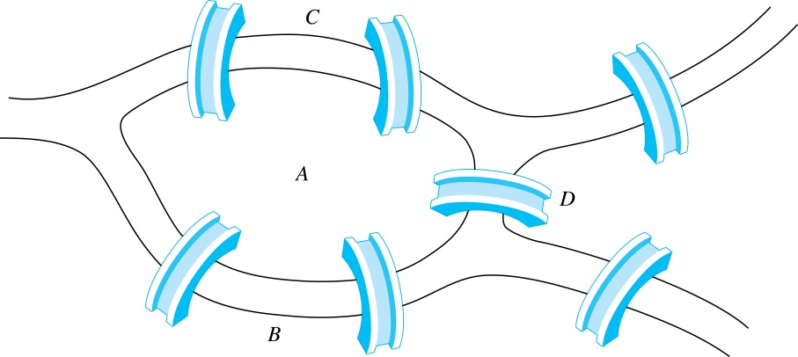
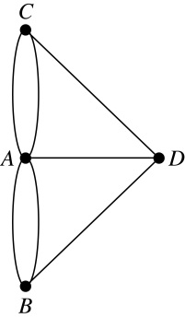
Euler Paths and Circuits
The town of Kӧnigsberg, Prussia (now Kalingrad, Russia) was divided into four sections by the branches of the Pregel river. In the 18th century seven bridges connected these regions.
People wondered whether whether it was possible to follow a path that crosses each bridge exactly once and returns to the starting point.
The Swiss mathematician Leonard Euler proved that no such path exists. This result is often considered to be the first theorem ever proved in graph theory.
Multigraph Model of the Bridges of Kӧnigsberg
The 7 Bridges of Kӧnigsberg

Slide 4
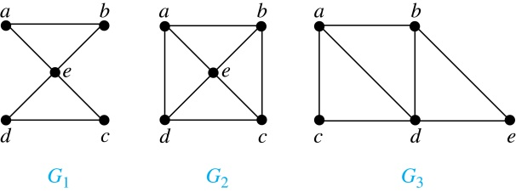
Euler Paths and Circuits (continued)
Definition: An Euler circuit in a graph G is a simple circuit containing every edge of G. An Euler path in G is a simple path containing every edge of G.
Example: Which of the undirected graphs G₁, G₂, and G₃ has a Euler circuit? Of those that do not, which has an Euler path?
Solution: The graph G₁ has an Euler circuit (e.g., a, e, c, d, e, b, a). But, as can easily be verified by inspection, neither G₂ nor G₃ has an Euler circuit. Note that G₃ has an Euler path (e.g., a, c, d, e, b, d, a, b), but there is no Euler path in G₂, which can be verified by inspection.

Slide 5
Necessary Conditions for Euler Circuits and Paths
An Euler circuit begins with a vertex a and continues with an edge incident with a, say {a, b}. The edge {a, b} contributes one to deg(a).
Each time the circuit passes through a vertex it contributes two to the vertex’s degree.
Finally, the circuit terminates where it started, contributing one to deg(a). Therefore deg(a) must be even.
We conclude that the degree of every other vertex must also be even.
By the same reasoning, we see that the initial vertex and the final vertex of an Euler path have odd degree, while every other vertex has even degree. So, a graph with an Euler path has exactly two vertices of odd degree.
In the next slide we will show that these necessary conditions are also sufficient conditions.

Slide 6
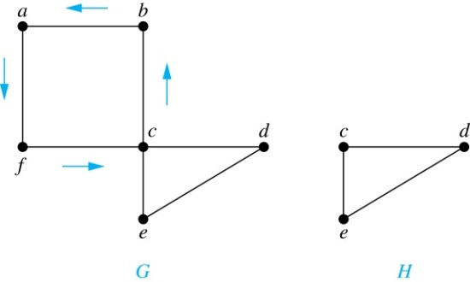
Sufficient Conditions for Euler Circuits and Paths
Suppose that G is a connected multigraph with ≥ 2 vertices, all of even degree. Let x₀ = a be a vertex of even degree. Choose an edge {x₀, x₁} incident with a and proceed to build a simple path {x₀, x₁}, {x₁, x₂}, …, {x_{n-1}, x_{n}} by adding edges one by one until another edge can not be added.
The path begins at a with an edge of the form {a, x}; we show that it must terminate at a with an edge of the form {y, a}. Since each vertex has an even degree, there must be an even number of edges incident with this vertex. Hence, every time we enter a vertex other than a, we can leave it. Therefore, the path can only end at a.
If all of the edges have been used, an Euler circuit has been constructed. Otherwise, consider the subgraph H obtained from G by deleting the edges already used.
We illustrate this idea in the graph G here. We begin at a and choose the edges {a, f}, {f, c}, {c, b}, and {b, a} in succession.
In the example H consists of the vertices c, d, e.

Slide 7
Sufficient Conditions for Euler Circuits and Paths (continued)
Because G is connected, H must have at least one vertex in common with the circuit that has been deleted.
In the example, the vertex is c.
Every vertex in H must have even degree because all the vertices in G have even degree and for each vertex, pairs of edges incident with this vertex have been deleted. Beginning with the shared vertex construct a path ending in the same vertex (as was done before). Then splice this new circuit into the original circuit.
In the example, we end up with the circuit a, f, c, d, e, c, b, a.
Continue this process until all edges have been used. This produces an Euler circuit. Since every edge is included and no edge is included more than once.
Similar reasoning can be used to show that a graph with exactly two vertices of odd degree must have an Euler path connecting these two vertices of odd degree

Slide 8
Algorithm for Constructing an Euler Circuits
In our proof we developed this algorithms for constructing a Euler circuit in a graph with no vertices of odd degree.
procedure Euler(G: connected multigraph with all vertices of even degree)
circuit := a circuit in G beginning at an arbitrarily chosen vertex with edges
successively added to form a path that returns to this vertex.
H := G with the edges of this circuit removed
while H has edges
subciruit := a circuit in H beginning at a vertex in H that also is
an endpoint of an edge in circuit.
H := H with edges of subciruit and all isolated vertices removed
circuit := circuit with subcircuit inserted at the appropriate vertex.
return circuit{circuit is an Euler circuit}

Slide 9
Necessary and Sufficient Conditions for Euler Circuits and Paths (continued)
Theorem: A connected multigraph with at least two vertices has an Euler circuit if and only if each of its vertices has an even degree and it has an Euler path if and only if it has exactly two vertices of odd degree.
Example: Two of the vertices in the multigraph model of the Kӧnigsberg bridge problem have odd degree. Hence, there is no Euler circuit in this multigraph and it is impossible to start at a given point, cross each bridge exactly once, and return to the starting point.

Slide 10
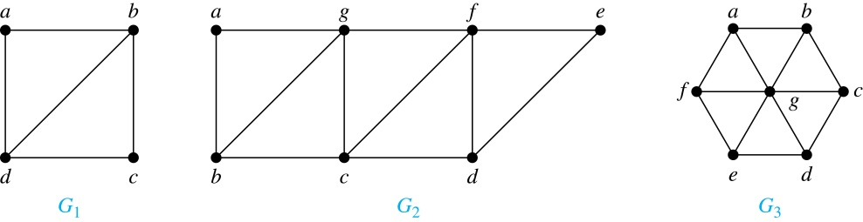
Euler Circuits and Paths
Example:
G₁ contains exactly two vertices of odd degree (b and d). Hence it has an Euler path, e.g., d, a, b, c, d, b.
G₂ has exactly two vertices of odd degree (b and d). Hence it has an Euler path, e.g., b, a, g, f, e, d, c, g, b, c, f, d.
G₃ has six vertices of odd degree. Hence, it does not have an Euler path.

Slide 11
Applications of Euler Paths and Circuits
Euler paths and circuits can be used to solve many practical problems such as finding a path or circuit that traverses each
street in a neighborhood,
road in a transportation network,
connection in a utility grid,
link in a communications network.
Other applications are found in the
layout of circuits,
network multicasting,
molecular biology, where Euler paths are used in the sequencing of DNA.

Slide 12
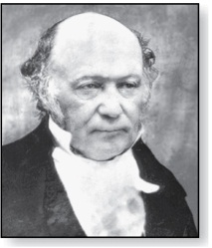
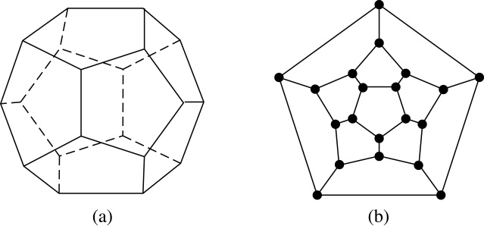
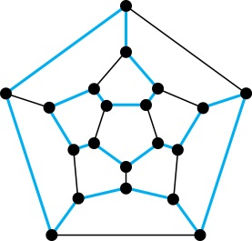
Hamilton Paths and Circuits
William Rowan Hamilton (1805- 1865)
William Hamilton invented the Icosian puzzle in 1857. It consisted of a dodecahedron (with 12 regular pentagons as faces), illustrated in (a), with a peg at each vertex, labeled with the names of different cities. String was used to used to plot a circuit visiting 20 cities exactly once
The graph form of the puzzle is given in (b).

Slide 13
Hamilton Paths and Circuits
Definition: A simple path in a graph G that passes through every vertex exactly once is called a Hamilton path, and a simple circuit in a graph G that passes through every vertex exactly once is called a Hamilton circuit.
That is, a simple path x₀, x₁, …, x_{n-1}, x_{n} in the graph G = (V, E) is called a Hamilton path if V = {x₀, x₁, … , x_{n-1,} x_{n} } and x_{i} ≠ x_{j} for 0≤ i < j ≤ n, and the simple circuit x₀, x₁, …, x_{n-1}, x_{n}, x₀ (with n > 0) is a Hamilton circuit if x₀, x₁, … , x_{n-1}, x_{n} is a Hamilton path.

Slide 14
Hamilton Paths and Circuits (continued)
Example: Which of these simple graphs has a Hamilton circuit or, if not, a Hamilton path?
Solution: G₁ has a Hamilton circuit: a, b, c, d, e, a.
G₂ does not have a Hamilton circuit (Why?), but does have a Hamilton path : a, b, c, d.
G₃ does not have a Hamilton circuit, or a Hamilton path. Why?

Slide 15

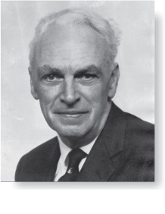
Necessary Conditions for Hamilton Circuits
Gabriel Andrew Dirac
(1925-1984)
Unlike for an Euler circuit, no simple necessary and sufficient conditions are known for the existence of a Hamiton circuit.
However, there are some useful necessary conditions. We describe two of these now.
Dirac’s Theorem: If G is a simple graph with n ≥ 3 vertices such that the degree of every vertex in G is ≥ n/2, then G has a Hamilton circuit.
Ore’s Theorem: If G is a simple graph with n ≥ 3 vertices such that deg(u) + deg(v) ≥ n for every pair of nonadjacent vertices, then G has a Hamilton circuit.
Øysten Ore
(1899-1968)

Slide 16
Applications of Hamilton Paths and Circuits
Applications that ask for a path or a circuit that visits each intersection of a city, each place pipelines intersect in a utility grid, or each node in a communications network exactly once, can be solved by finding a Hamilton path in the appropriate graph.
The famous traveling salesperson problem (TSP) asks for the shortest route a traveling salesperson should take to visit a set of cities. This problem reduces to finding a Hamilton circuit such that the total sum of the weights of its edges is as small as possible.
A family of binary codes, known as Gray codes, which minimize the effect of transmission errors, correspond to Hamilton circuits in the n-cube Q_{n}. (See the text for details.)

