Slide 1
Propositional Equivalences
Section 1.3

Slide 2
Section Summary
Tautologies, Contradictions, and Contingencies.
Logical Equivalence
Important Logical Equivalences
Showing Logical Equivalence
Normal Forms (optional, covered in exercises in text)
Disjunctive Normal Form
Conjunctive Normal Form
Propositional Satisfiability
Sudoku Example

Slide 3
Tautologies, Contradictions, and Contingencies
A tautology is a proposition which is always true.
Example: p ∨¬p
A contradiction is a proposition which is always false.
Example: p ∧¬p
A contingency is a proposition which is neither a tautology nor a contradiction, such as p
P | ¬p | p ∨¬p | p ∧¬p
T | F | T | F
F | T | T | F

Slide 4
Logically Equivalent
Two compound propositions p and q are logically equivalent if p↔q is a tautology.
We write this as p⇔q or as p≡q where p and q are compound propositions.
Two compound propositions p and q are equivalent if and only if the columns in a truth table giving their truth values agree.
This truth table shows that ¬p ∨ q is equivalent to p → q.
p | q | ¬p | ¬p ∨ q | p→ q
T | T | F | T | T
T | F | F | F | F
F | T | T | T | T
F | F | T | T | T

Slide 5
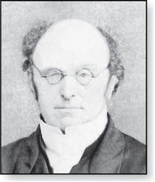
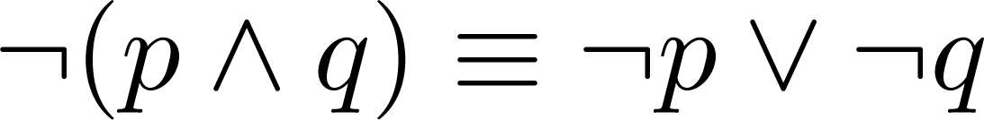
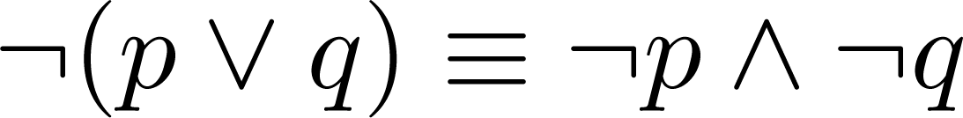
De Morgan’s Laws
Augustus De Morgan
1806-1871
This truth table shows that De Morgan’s Second Law holds.
p | q | ¬p | ¬q | (p∨q) | ¬(p∨q) | ¬p∧¬q
T | T | F | F | T | F | F
T | F | F | T | T | F | F
F | T | T | F | T | F | F
F | F | T | T | F | T | T

Slide 6
Natural Language Examples
If there is a snowstorm or a epidemy-related lockdown, then I will not visit my grandmother for Christmas.
If there is either snowstorm or a epidemy-caused lockdown, then I will not visit my grandmother for Christmas.
Assume that the speaker actually visited his/her grandmother. What can we conclude in both cases?
Parse the logical structure; find the logical connectives.
Split into atomic propositions
Remember about contrapositive implication
Build the negation (use De Morgan's law, if desired).
Notes:
p ∨ q → ¬g
p ⊕q→ ¬g

Slide 7
De Morgan's Law in Government Regulations
"But I have another imperfection. Since I had been working as an editor, I always find faults with verbal expression. And it was written there - 'an agent of the mentioned institutions'. But I cannot be an agent of all the 6 institutions simultaneously, so I wrote NO."
("Bet man ir cits netikums. Tā kā praktiski esmu strādājis arī par redaktoru, vienmēr esmu kasījies pie vārdiem. Un te bija rakstīts – 'minēto institūciju aģents'. Bet es taču nevaru būt vienlaicīgi visu sešu nosaukto [aģents], un es uzrakstīju, ka nē!") A story by Juris Cibulis - on the importance of formal logic in the official papers. https://ir.lv/2019/11/22/nebija-nekadas-atvadu-tiksanas-neka/

Slide 8
Socrative Quiz 1C
Visit https://www.socrative.com/
Select Student Login
In the textbox enter room name APSITIS
Write your own name as a test taker.
Just do the test (3 questions)

Slide 9
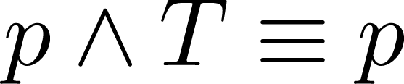
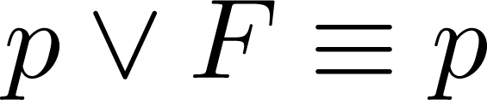
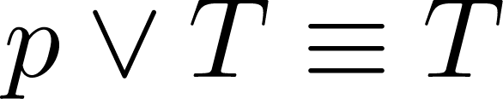
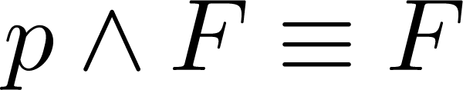
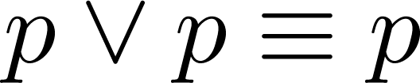
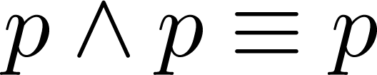
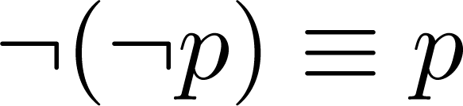
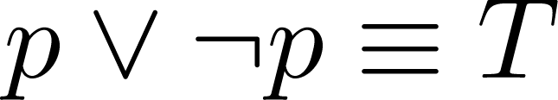
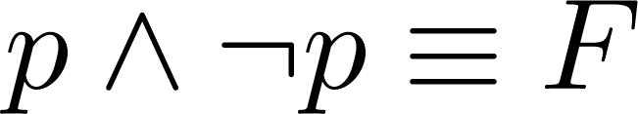
Key Logical Equivalences
Identity Laws:
Domination Laws: ,
Idempotent laws: ,
Double Negation Law:
Negation Laws:

Slide 10
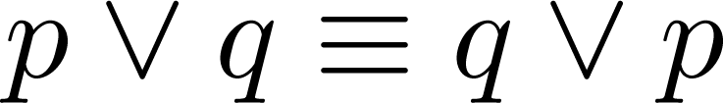
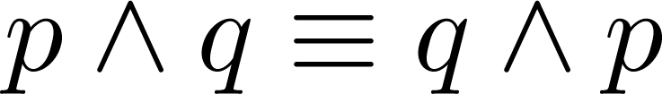
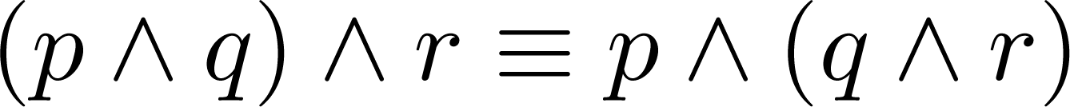
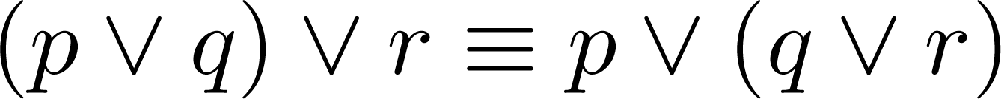
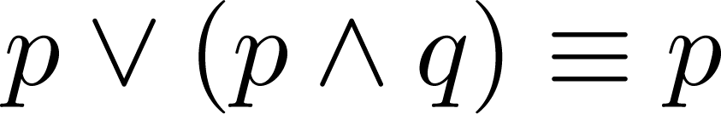
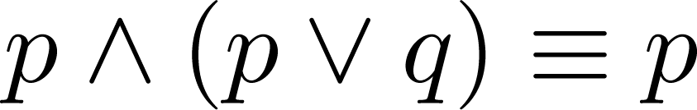
Key Logical Equivalences (cont)
Commutative Laws: ,
Associative Laws:
Distributive Laws:
Absorption Laws:

Slide 11
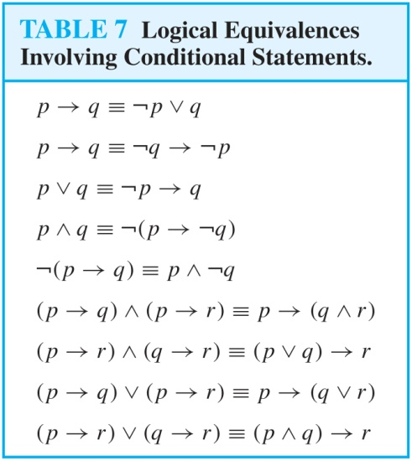
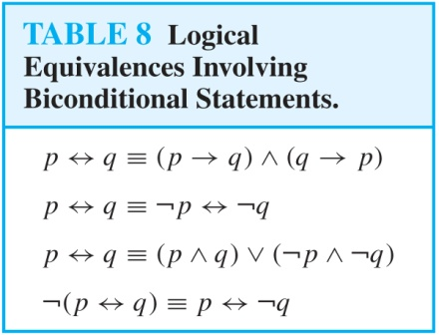
More Logical Equivalences

Slide 12



Constructing New Logical Equivalences
We can show that two expressions are logically equivalent by developing a series of logically equivalent statements.
To prove that we produce a series of equivalences beginning with A and ending with B.
Keep in mind that whenever a proposition (represented by a propositional variable) occurs in the equivalences listed earlier, it may be replaced by an arbitrarily complex compound proposition.

Slide 13
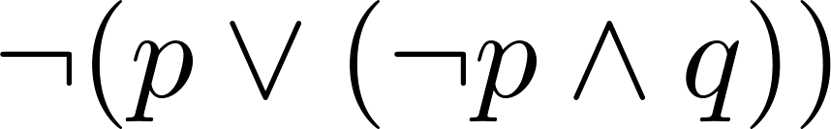
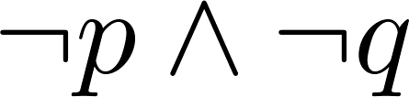
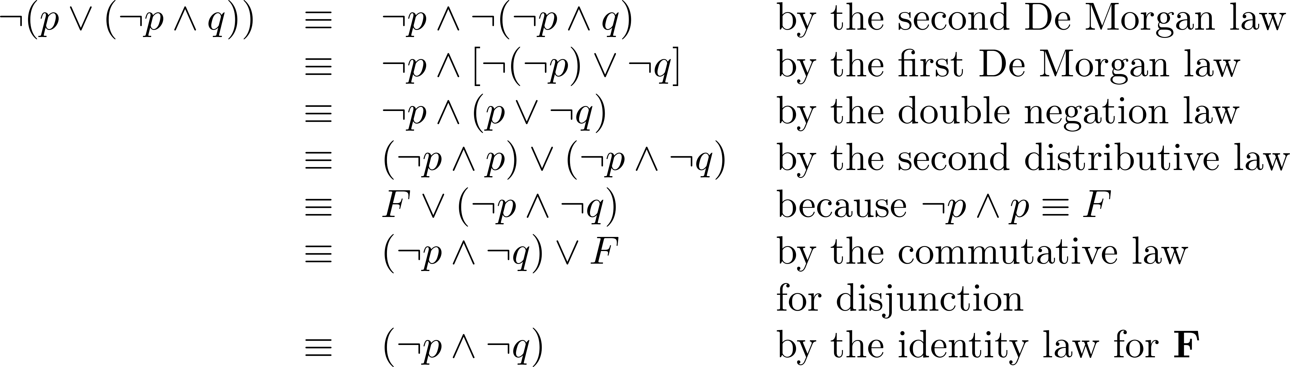
Equivalence Proofs
Example: Show that
is logically equivalent to
Solution:

Slide 14
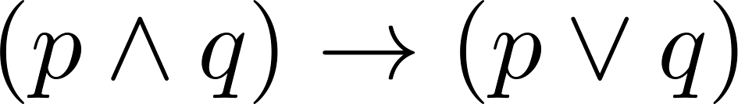
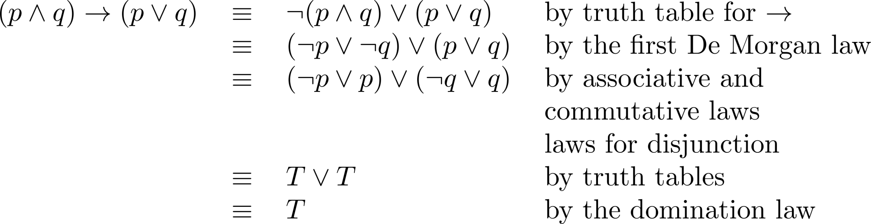
Equivalence Proofs
Example: Show that
is a tautology.
Solution:

Slide 15
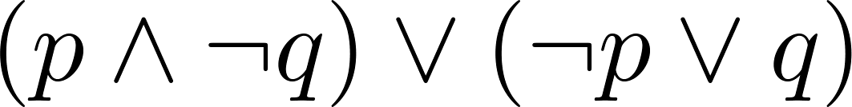
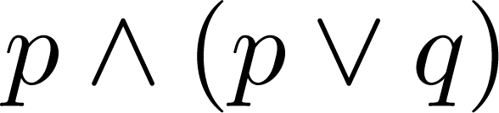
Disjunctive Normal Form (optional)
A propositional formula is in disjunctive normal form if it consists of a disjunction of (1, … ,n) disjuncts where each disjunct consists of a conjunction of (1, …, m) atomic formulas or the negation of an atomic formula.
Yes
No
Disjunctive Normal Form is important for the circuit design methods discussed in Chapter 12.

Slide 16
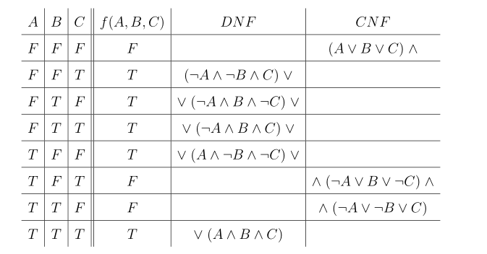
An Example of Building a DNF and CNF

Slide 17
Disjunctive Normal Form (optional)
Example: Show that every compound proposition can be put in disjunctive normal form.
Solution: Construct the truth table for the proposition. Then an equivalent proposition is the disjunction with n disjuncts (where n is the number of rows for which the formula evaluates to T). Each disjunct has m conjuncts where m is the number of distinct propositional variables. Each conjunct includes the positive form of the propositional variable if the variable is assigned T in that row and the negated form if the variable is assigned F in that row. This proposition is in disjunctive normal from.

Slide 18
Disjunctive Normal Form (optional)
Example: Find the Disjunctive Normal Form (DNF) of
(p∨q)→¬r
Solution: This proposition is true when r is false or when both p and q are false.
(¬ p∧ ¬ q) ∨ ¬r

Slide 19
Conjunctive Normal Form (optional)
A compound proposition is in Conjunctive Normal Form (CNF) if it is a conjunction of disjunctions.
Every proposition can be put in an equivalent CNF.
Conjunctive Normal Form (CNF) can be obtained by eliminating implications, moving negation inwards and using the distributive and associative laws.
Important in resolution theorem proving used in artificial Intelligence (AI).
A compound proposition can be put in conjunctive normal form through repeated application of the logical equivalences covered earlier.

Slide 20
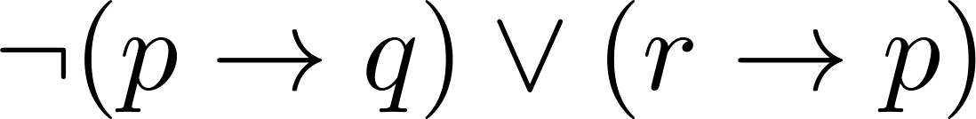
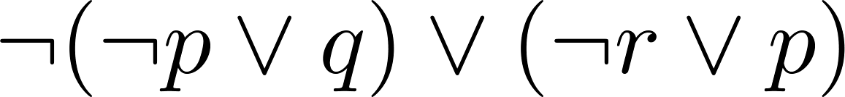
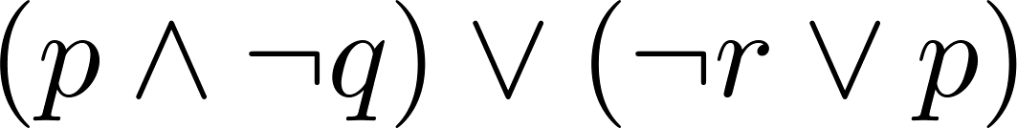
Conjunctive Normal Form (optional)
Example: Put the following into CNF:
Solution:
Eliminate implication signs:
Move negation inwards; eliminate double negation:
Convert to CNF using associative/distributive laws

Slide 21
Propositional Satisfiability
A compound proposition is satisfiable if there is an assignment of truth values to its variables that make it true. When no such assignments exist, the compound proposition is unsatisfiable.
A compound proposition is unsatisfiable if and only if its negation is a tautology.

Slide 22
Questions on Propositional Satisfiability
Example: Determine the satisfiability of the following compound propositions:
Solution: Satisfiable. Assign T to p, q, and r.
Solution: Satisfiable. Assign T to p and F to q.
Solution: Not satisfiable. Check each possible assignment of truth values to the propositional variables and none will make the proposition true.

Slide 23
A Logical Puzzle
A private club has the following rules:
Every non-Scottish member wears red socks.
Every member wears a kilt or does not wear red socks.
The married members do not go out on Sunday.
A member goes out on Sunday if and only if he is Scottish.
Every member who wears a kilt is Scottish and married.
Every Scottish member wears a kilt.

Slide 24
A Logical Puzzle – Continued
Problem: Assign truth values (T or F) to all the variables to make all the rules/hypotheses true.
Hypothesis rule1 : ¬ Scottish -> RedSocks. Hypothesis rule2 : WearKilt \/ ¬ RedSocks. Hypothesis rule3 : Married -> ¬ GoOutSunday. Hypothesis rule4 : GoOutSunday <-> Scottish. Hypothesis rule5 : WearKilt -> Scottish /\ Married. Hypothesis rule6 : Scottish -> WearKilt.
In other words, it is satisfiablity for this formula:
rule1 /\ rule2 /\ rule3 /\ rule4 /\ rule5 /\ rule6

Slide 25
Notation
Needed for the next example.

Slide 26
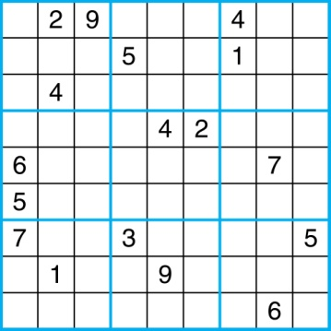
Sudoku
A Sudoku puzzle is represented by a 9×9 grid made up of nine 3×3 subgrids, known as blocks. Some of the 81 cells of the puzzle are assigned one of the numbers 1,2, …, 9.
The puzzle is solved by assigning numbers to each blank cell so that every row, column and block contains each of the nine possible numbers.

Slide 27
Encoding as a Satisfiability Problem
Let p(i,j,n) denote the proposition that is true when the number n is in the cell in the ith row and the jth column.
There are 9×9 × 9 = 729 such propositions.
In the sample puzzle p(5,1,6) is true, but p(5,j,6) is false for j = 2,3,…9

Slide 28
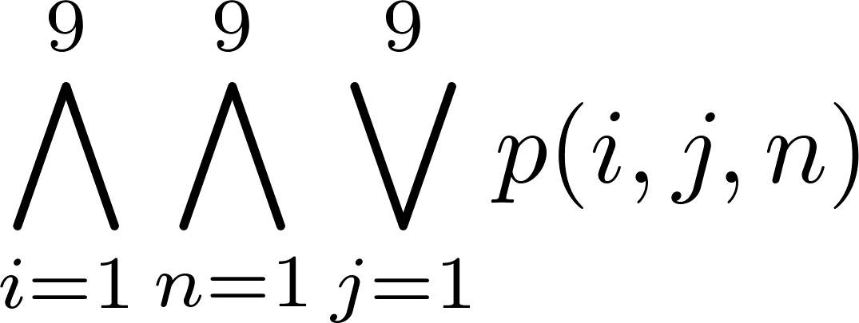
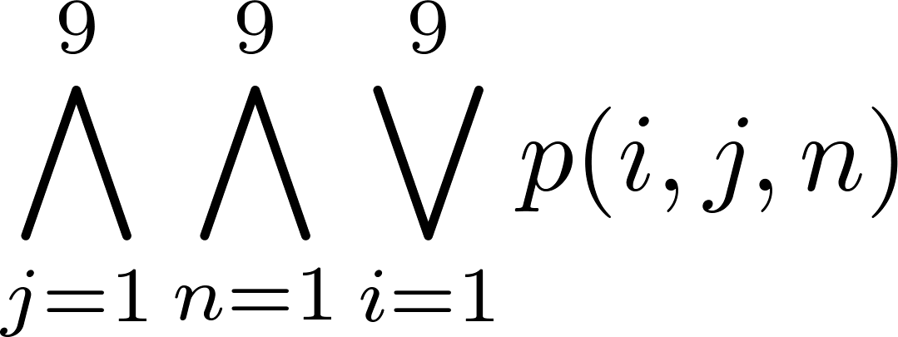
Encoding (cont)
For each cell with a given value, assert p(i,j,n), when the cell in row i and column j has the given value.
Assert that every row contains every number.
Assert that every column contains every number.

Slide 29
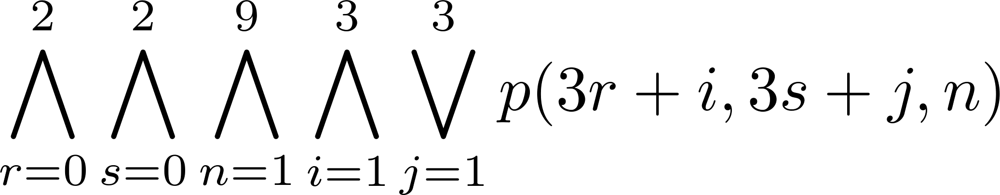
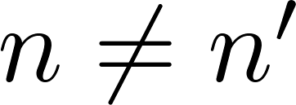
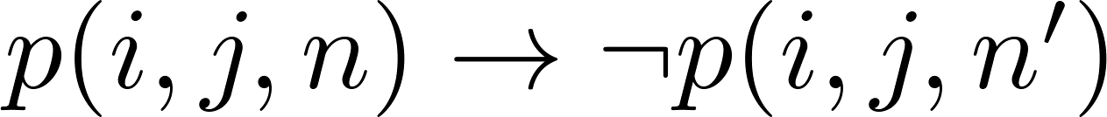
Encoding (cont)
Assert that each of the 3 x 3 blocks contain every number.
(this is tricky - ideas from chapter 4 help)
Assert that no cell contains more than one number. Take the conjunction over all values of n, n’, i, and j, where each variable ranges from 1 to 9 and ,
of

Slide 30
Solving Satisfiability Problems
To solve a Sudoku puzzle, we need to find an assignment of truth values to the 729 variables of the form p(i,j,n) that makes the conjunction of the assertions true. Those variables that are assigned T yield a solution to the puzzle.
A truth table can always be used to determine the satisfiability of a compound proposition. But this is too complex even for modern computers for large problems.
There has been much work on developing efficient methods for solving satisfiability problems as many practical problems can be translated into satisfiability problems.

