Slide 1
Rules of Inference
Section 1.6

Slide 2
Section Summary
Valid Arguments
Inference Rules for Propositional Logic
Using Rules of Inference to Build Arguments
Rules of Inference for Quantified Statements
Building Arguments for Quantified Statements

Slide 3
Revisiting the Socrates Example
We have the two premises:
“All men are mortal.”
“Socrates is a man.”
And the conclusion:
“Socrates is mortal.”
How do we get the conclusion from the premises?

Slide 4
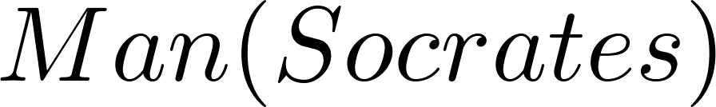
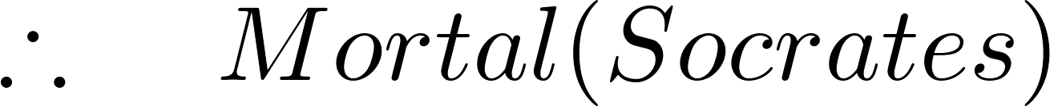
The Argument
We can express the premises (above the line) and the conclusion (below the line) in predicate logic as an argument:
We will see shortly that this is a valid argument.

Slide 5
Valid Arguments
We will show how to construct valid arguments in two stages; first for propositional logic and then for predicate logic. The rules of inference are the essential building block in the construction of valid arguments.
Propositional Logic
Inference Rules
Predicate Logic
Inference rules for propositional logic plus additional inference rules to handle variables and quantifiers.

Slide 6
Arguments in Propositional Logic
A argument in propositional logic is a sequence of propositions. All but the final proposition are called premises. The last statement is the conclusion.
The argument is valid if the premises imply the conclusion. An argument form is an argument that is valid no matter what propositions are substituted into its propositional variables.
If the premises are p₁ ,p₂, …,p_{n} and the conclusion is q then
(p₁ ∧ p₂ ∧ … ∧ p_{n} ) → q is a tautology.
Inference rules are all argument simple argument forms that will be used to construct more complex argument forms.

Slide 7
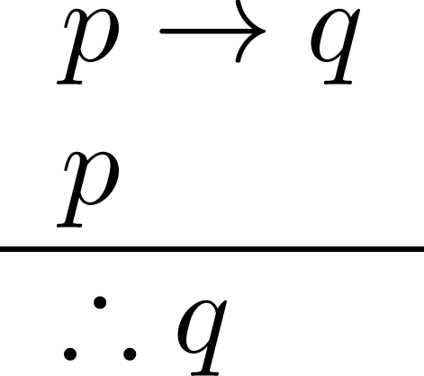
Rules of Inference for Propositional Logic: Modus Ponens
Corresponding Tautology:
(p ∧ (p →q)) → q
Example:
Let p be “It is snowing.”
Let q be “I will study discrete math.”
“If it is snowing, then I will study discrete math.”
“It is snowing.”
“Therefore , I will study discrete math.”

Slide 8
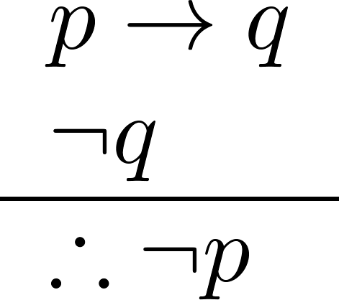
Modus Tollens
Corresponding Tautology:
(¬q∧(p →q))→¬p
Example:
Let p be “it is snowing.”
Let q be “I will study discrete math.”
“If it is snowing, then I will study discrete math.”
“I will not study discrete math.”
“Therefore , it is not snowing.”

Slide 9
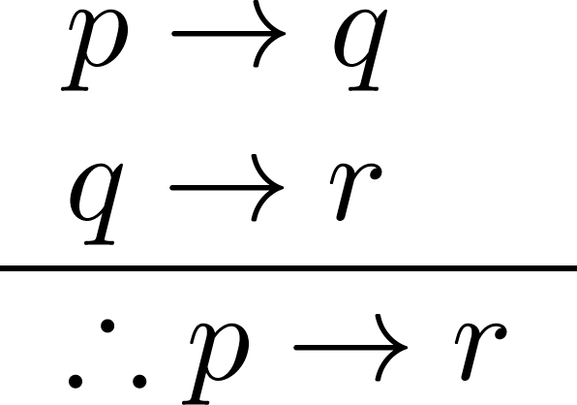
Hypothetical Syllogism
Corresponding Tautology:
((p →q) ∧ (q→r))→(p→ r)
Example:
Let p be “it snows.”
Let q be “I will study discrete math.”
Let r be “I will get an A.”
“If it snows, then I will study discrete math.”
“If I study discrete math, I will get an A.”
“Therefore , If it snows, I will get an A.”

Slide 10
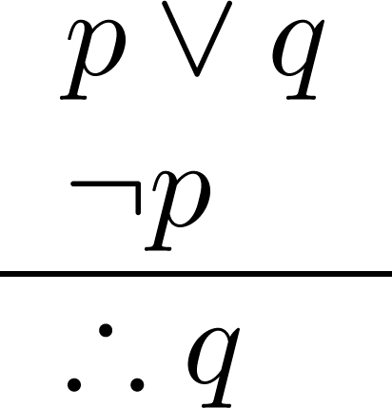
Disjunctive Syllogism
Corresponding Tautology:
(¬p∧(p ∨q))→q
Example:
Let p be “I will study discrete math.”
Let q be “I will study English literature.”
“I will study discrete math or I will study English literature.”
“I will not study discrete math.”
“Therefore , I will study English literature.”

Slide 11
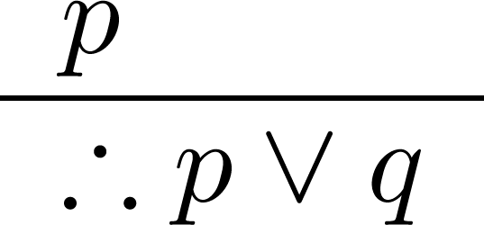
Addition
Corresponding Tautology:
p →(p ∨q)
Example:
Let p be “I will study discrete math.”
Let q be “I will visit Las Vegas.”
“I will study discrete math.”
“Therefore, I will study discrete math or I will visit
Las Vegas.”

Slide 12
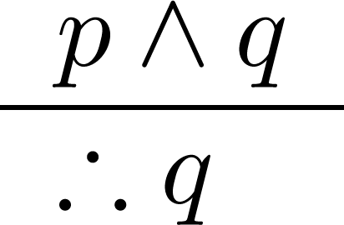
Simplification
Corresponding Tautology:
(p∧q) →p
Example:
Let p be “I will study discrete math.”
Let q be “I will study English literature.”
“I will study discrete math and English literature”
“Therefore, I will study discrete math.”

Slide 13
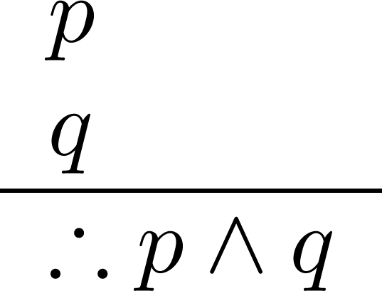
Conjunction
Corresponding Tautology:
((p) ∧ (q)) →(p ∧ q)
Example:
Let p be “I will study discrete math.”
Let q be “I will study English literature.”
“I will study discrete math.”
“I will study English literature.”
“Therefore, I will study discrete math and I will study English literature.”

Slide 14
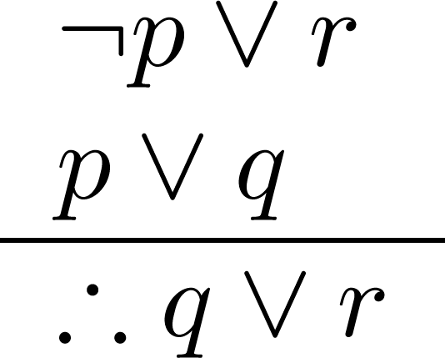
Resolution
Resolution plays an important role in AI and is used in Prolog.
Corresponding Tautology:
((¬p ∨ r ) ∧ (p ∨ q)) →(q ∨ r)
Example:
Let p be “I will study discrete math.”
Let r be “I will study English literature.”
Let q be “I will study databases.”
“I will not study discrete math or I will study English literature.”
“I will study discrete math or I will study databases.”
“Therefore, I will study databases or I will study English literature.”

Slide 15
Using the Rules of Inference to Build Valid Arguments
A valid argument is a sequence of statements. Each statement is either a premise or follows from previous statements by rules of inference. The last statement is called conclusion.

Slide 16
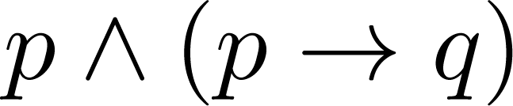
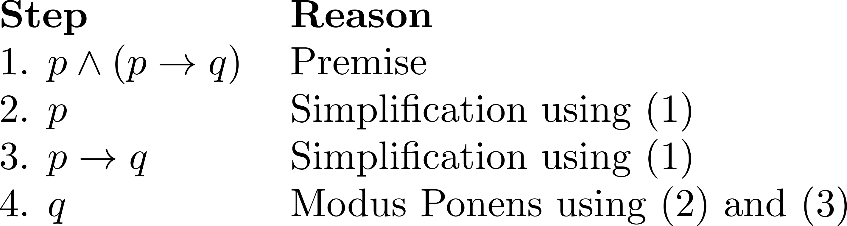
Valid Arguments
Example 1: From the single proposition
Show that q is a conclusion.
Solution:

Slide 17
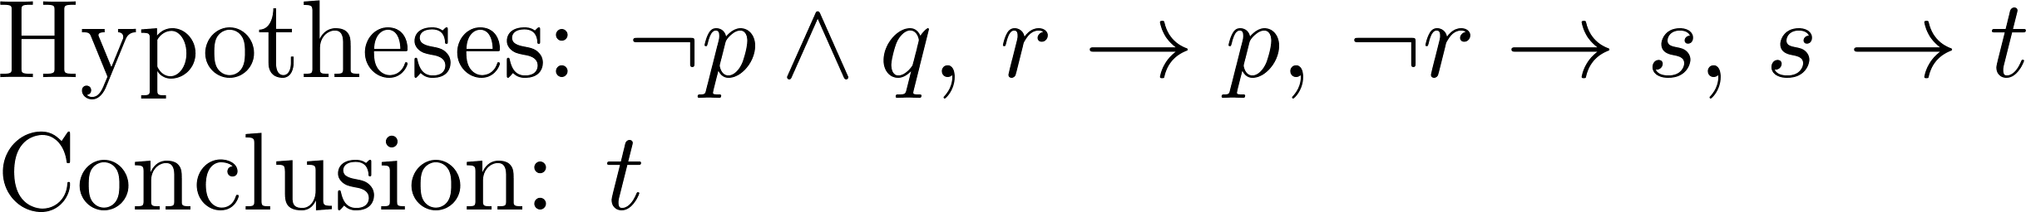
Valid Arguments
Example 2:
With these hypotheses:
“It is not sunny this afternoon and it is colder than yesterday.”
“We will go swimming only if it is sunny.”
“If we do not go swimming, then we will take a canoe trip.”
“If we take a canoe trip, then we will be home by sunset.”
Using the inference rules, construct a valid argument for the conclusion:
“We will be home by sunset.”
Solution:
Choose propositional variables:
p : “It is sunny this afternoon.” r : “We will go swimming.” t : “We will be home by sunset.”
q : “It is colder than yesterday.” s : “We will take a canoe trip.”
Translation into propositional logic:
Continued on next slide →

Slide 18
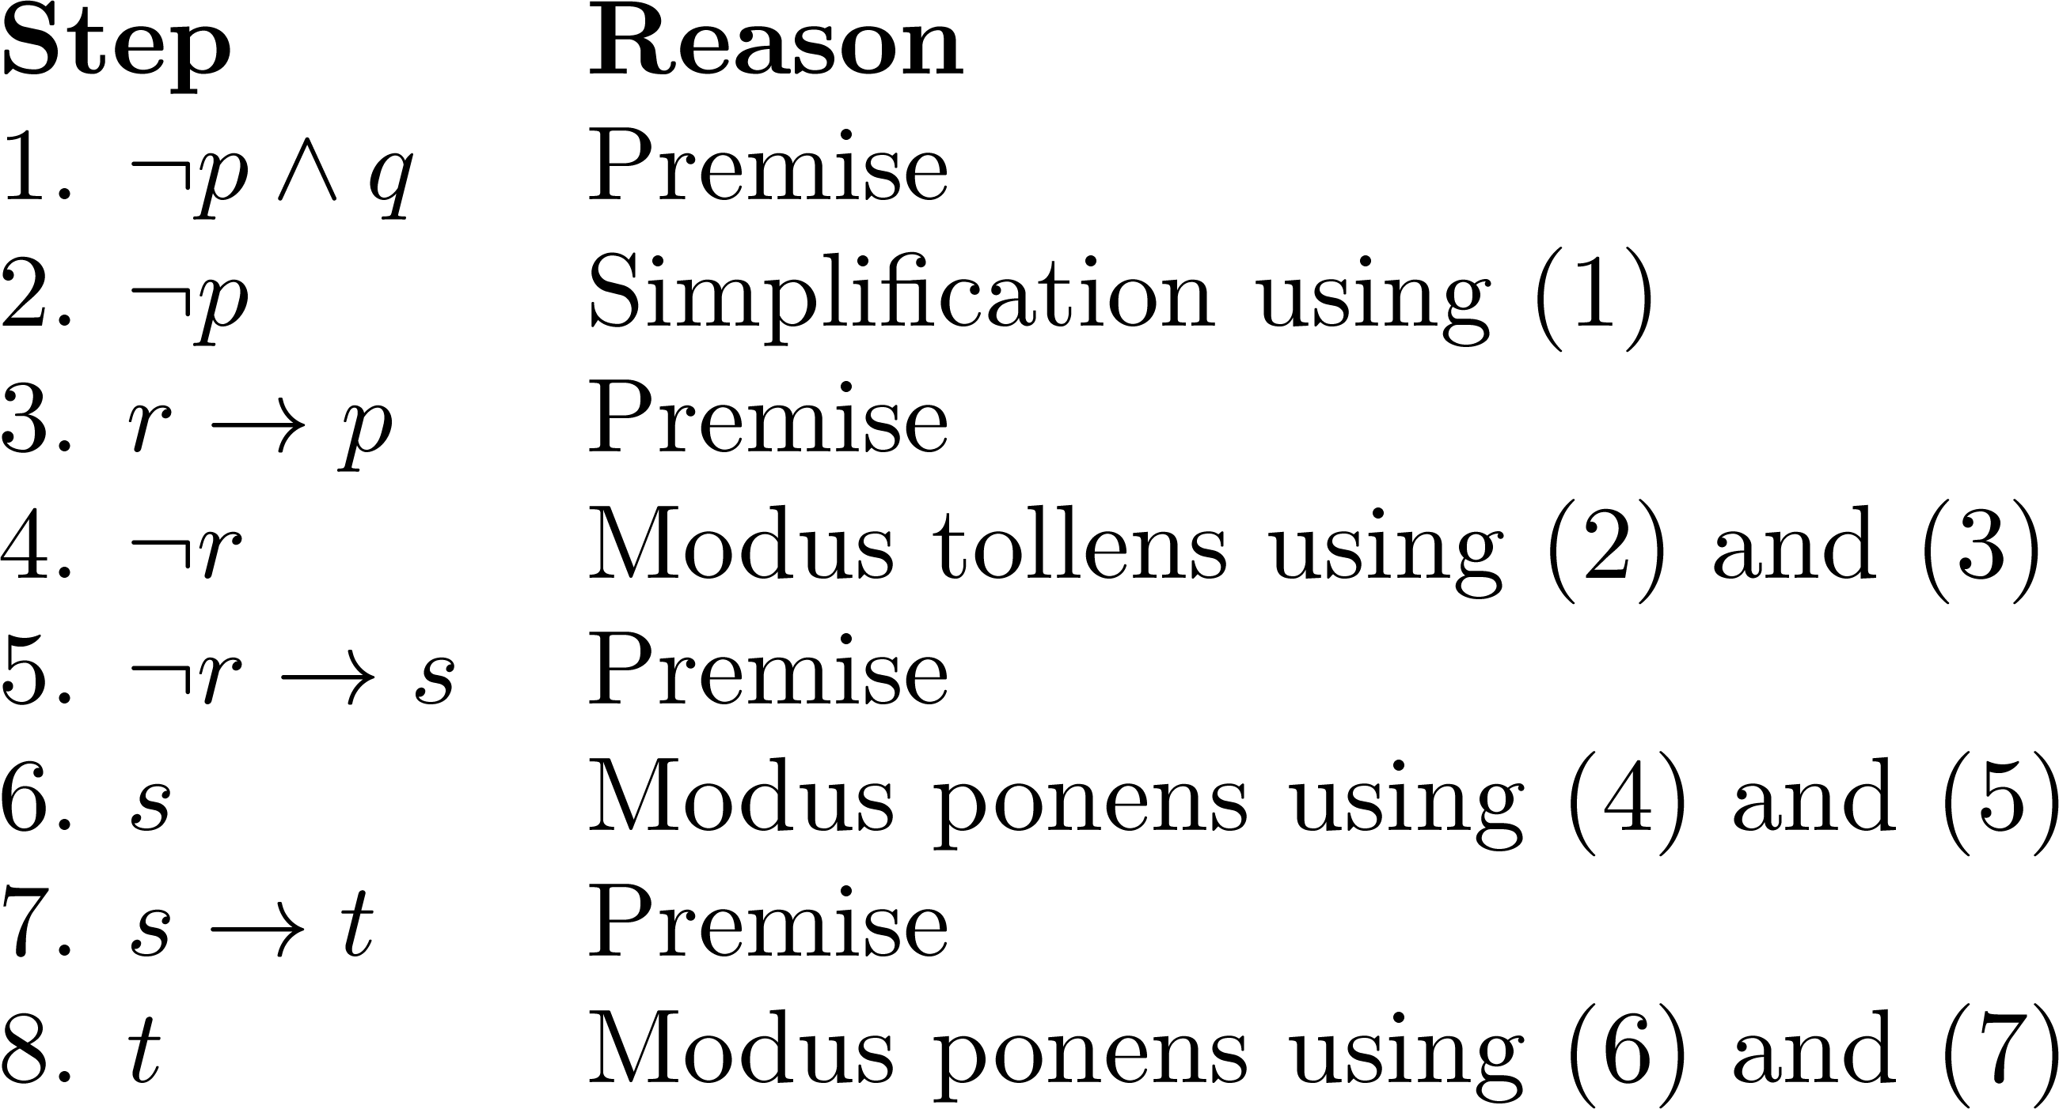
Valid Arguments
3. Construct the Valid Argument
Notes:
Note that a truth table would have 32 rows since we have 5 propositional variables.

Slide 19
Handling Quantified Statements
Valid arguments for quantified statements are a sequence of statements. Each statement is either a premise or follows from previous statements by rules of inference which include:
Rules of Inference for Propositional Logic
Rules of Inference for Quantified Statements
The rules of inference for quantified statements are introduced in the next several slides.

Slide 20
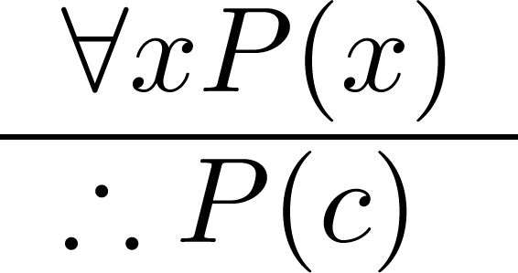
Universal Instantiation (UI)
Example:
Our domain consists of all dogs and Fido is a dog.
“All dogs are cuddly.”
“Therefore, Fido is cuddly.”

Slide 21
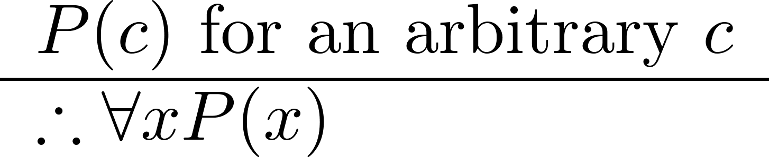
Universal Generalization (UG)
Used often implicitly in Mathematical Proofs.

Slide 22
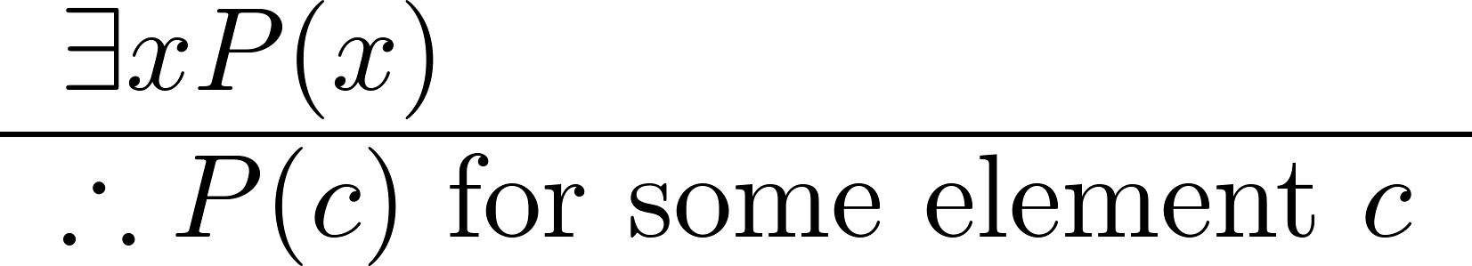
Existential Instantiation (EI)
Example:
“There is someone who got an A in the course.”
“Let’s call her a and say that a got an A”

Slide 23
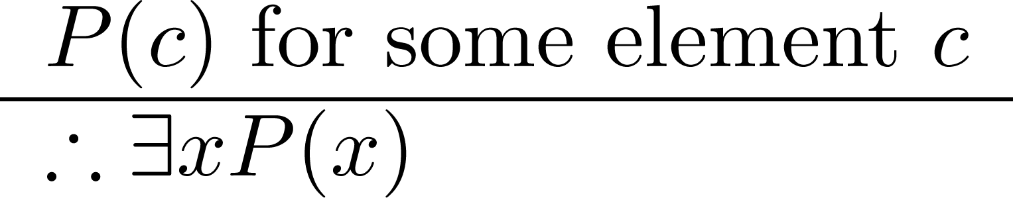
Existential Generalization (EG)
Example:
“Michelle got an A in the class.”
“Therefore, someone got an A in the class.”

Slide 24
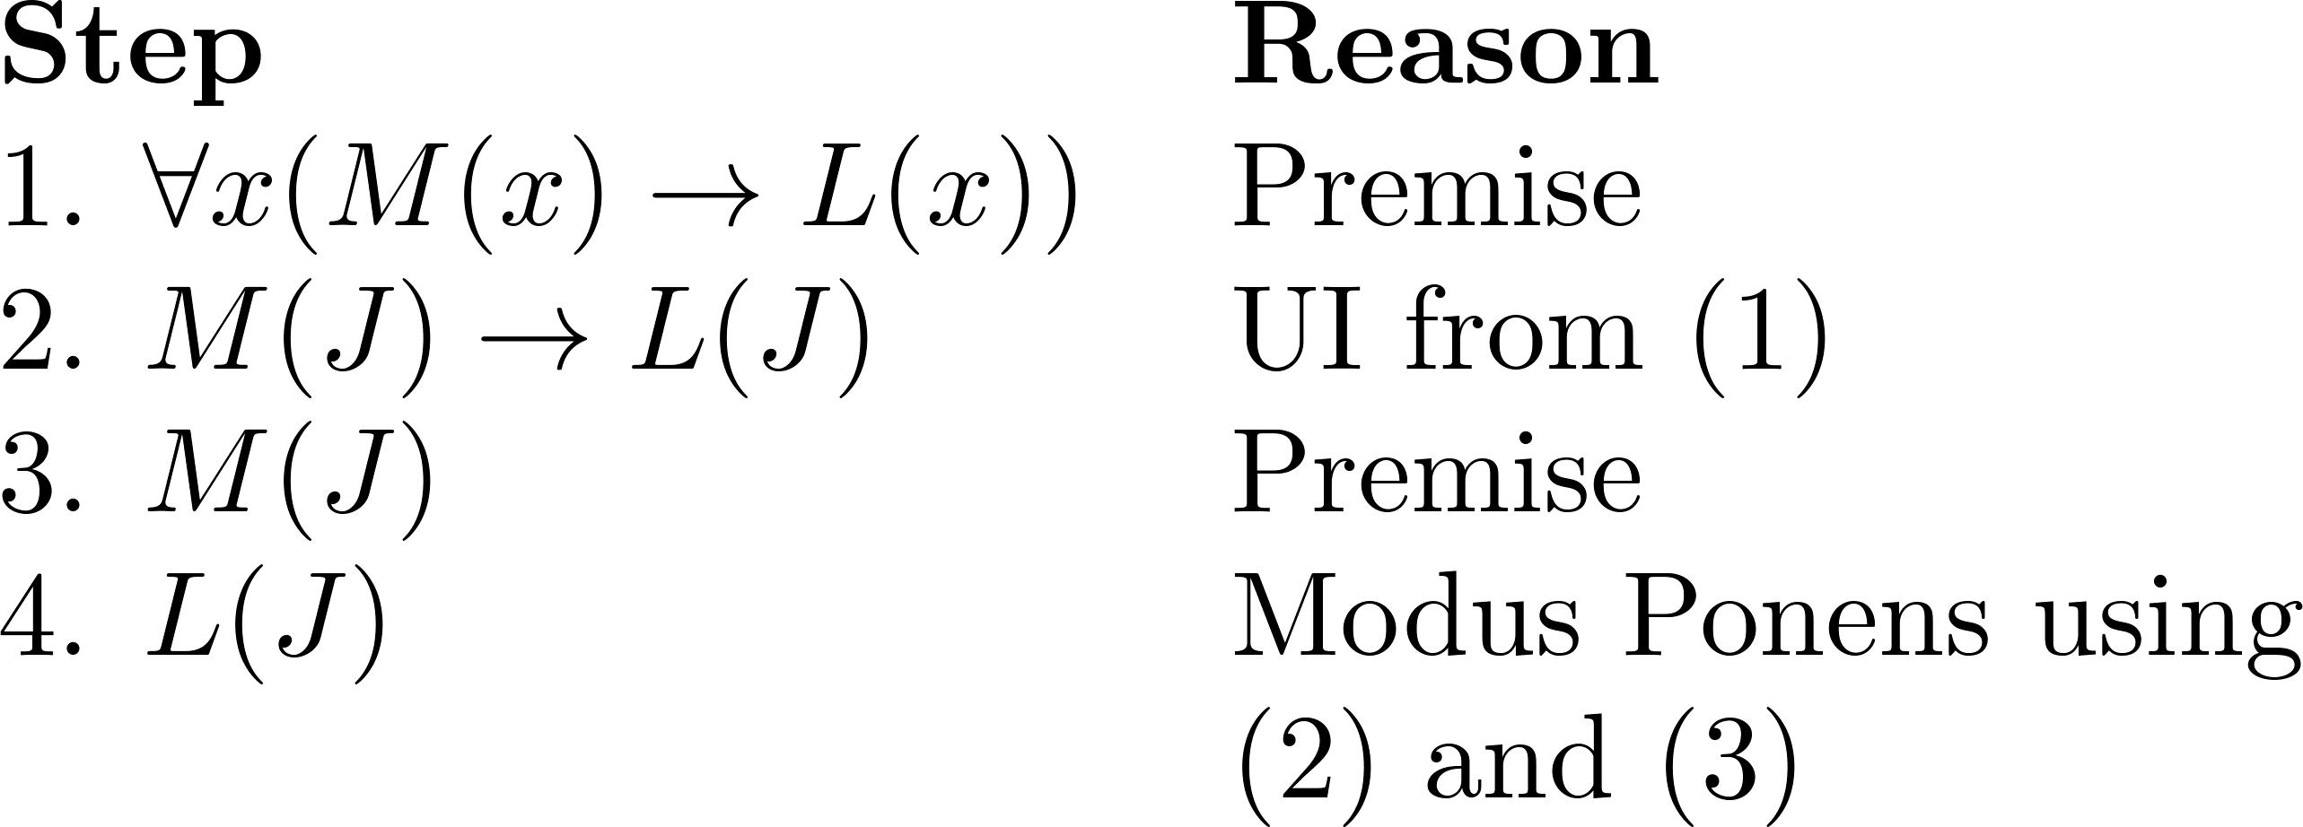
Using Rules of Inference
Example 1: Using the rules of inference, construct a valid argument to show that
“John Smith has two legs”
is a consequence of the premises:
“Every man has two legs.” “John Smith is a man.”
Solution: Let M(x) denote “x is a man” and L(x) “ x has two legs” and let John Smith be a member of the domain.
Valid Argument:

Slide 25
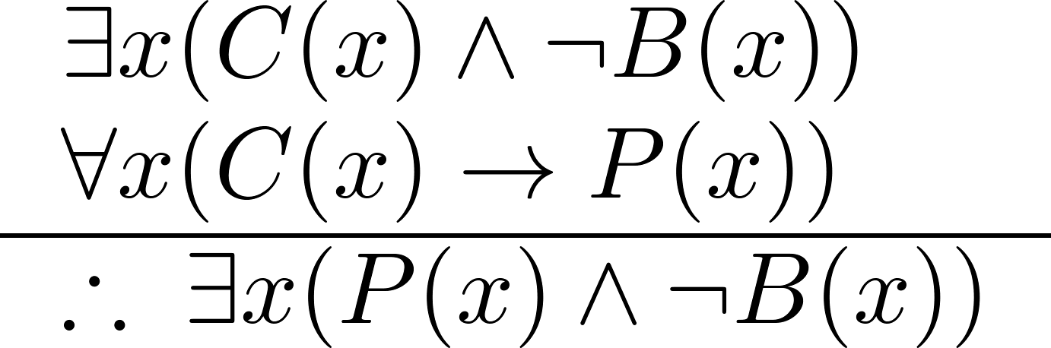
Using Rules of Inference
Example 2: Use the rules of inference to construct a valid argument showing that the conclusion
“Someone who passed the first exam has not read the book.”
follows from the premises
“A student in this class has not read the book.”
“Everyone in this class passed the first exam.”
Solution: Let C(x) denote “x is in this class,” B(x) denote “ x has read the book,” and P(x) denote “x passed the first exam.”
First we translate the
premises and conclusion
into symbolic form.
Continued on next slide →

Slide 26
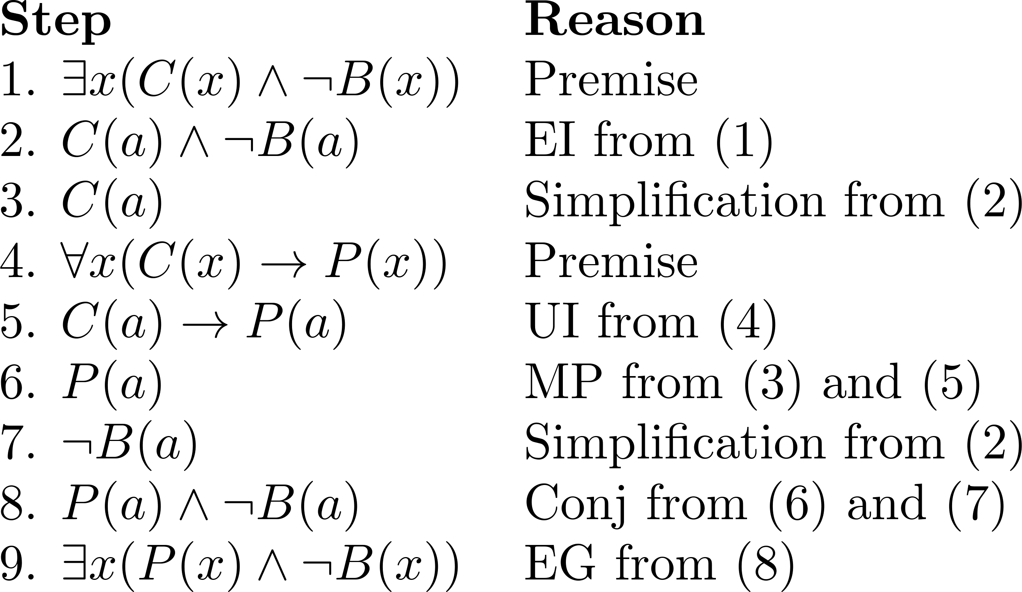
Using Rules of Inference
Valid Argument:

Slide 27
Returning to the Socrates Example

Slide 28
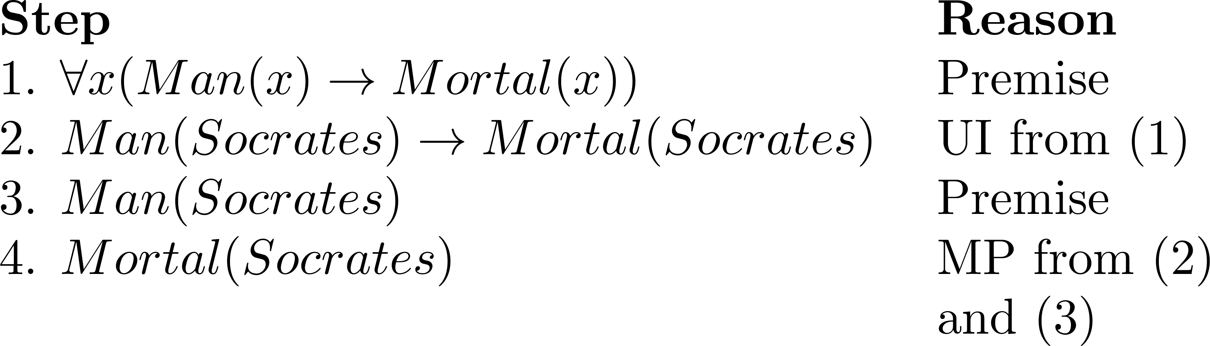
Solution for Socrates Example
Valid Argument

Slide 29
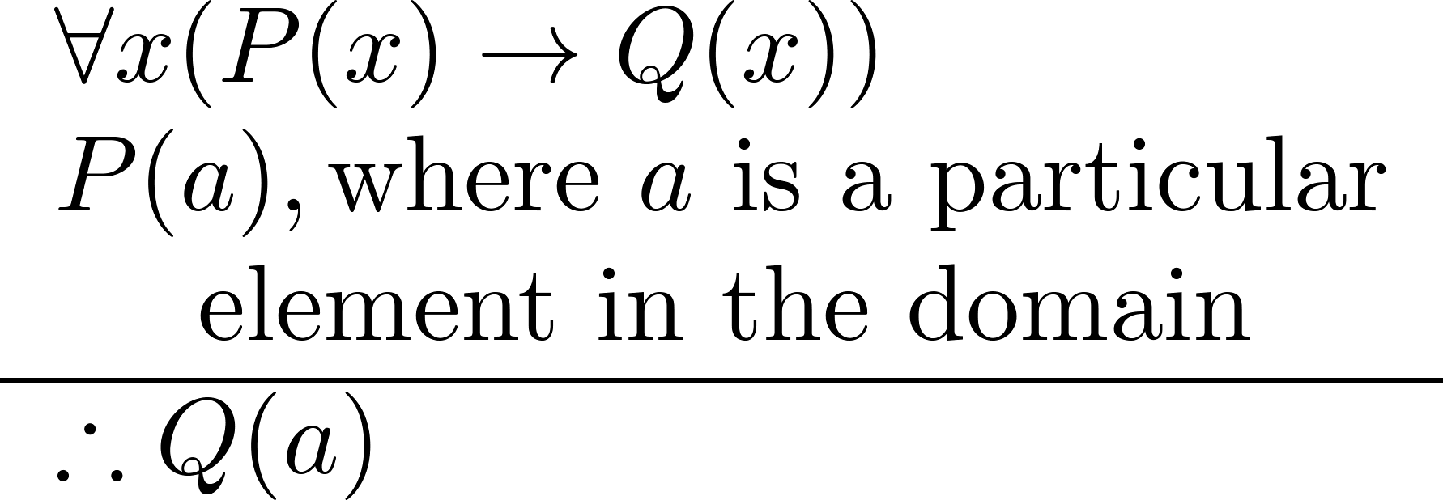
Universal Modus Ponens
Universal Modus Ponens combines universal instantiation and modus ponens into one rule.
This rule could be used in the Socrates example.

