Slide 1
Problem Solving Strategies vs. Proof Methods and Strategies
Section 1.8

Slide 2
Problem Solving Strategies – 1
More general questions of mathematical creativity – how to solve problems where the methods (solution algorithms) are unknown.
George Polya (How to Solve It. 1945)
Paul Zeitz (The Art and Craft of Problem Solving. 1999).
(A) Drawing a picture. Can you write down all the things you need to consider on paper? Can you order them nicely in a list or a table? Can you show them in a two-dimensional or a three-dimensional drawing?
(B) Getting hands dirty. Can you start experimenting with theproblem, plugin specific values, see where they lead you?
(C) Going to the extremes. Can you pick some “borderline case”? Is there the smallest or the largest item that is possible in the problem?

Slide 3
Problem Solving Strategies – 2
(D) Lateral thinking. Could it happen that your current solving approach is not applicable or is too inefficient? Can you pretend that you have not spent many years studying mathematics at school; can you apply lateral/divergent thinking out of the box to come up with something unexpected?
(E) Looking for symmetries. Can we switch two numbers or two letters in our notation? Can we inspect just one item and notice that many others are identical?
(F) Making it easier. Can we make a simpler version of this problem and solve it first? Insert a smaller number? Solve only one particular case of it?
(G) Penultimate step. What precondition must take place before the final solution step is possible? Imagine, which result you would need in order to say that you are “almost done”.
(H) Wishful thinking. Can you apply some outrageous simplification to your initial problem. Imagine for a while that you have already solved it: What would that imply?

Slide 4
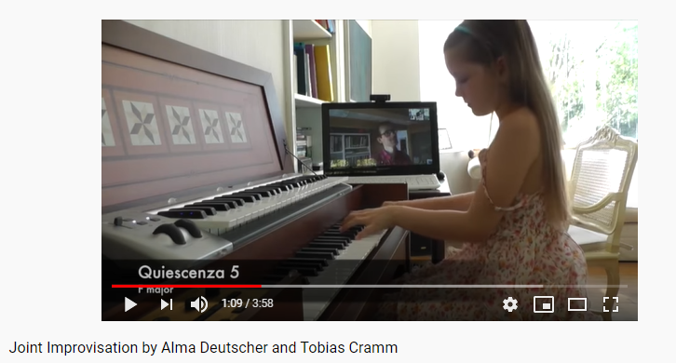
Creativity Can be Learned up to a Point (up to the patterns or "building blocks")
In mathematics we typically distinguish 2 types of questions:
Example-type questions (build a truth table; translate into predicates/quantifiers; prove a tautology) – method already known.
Problem-type questions (all the cases where the method has to be found; you have to improvise)
https://youtu.be/nubC3dktQ24

Slide 5
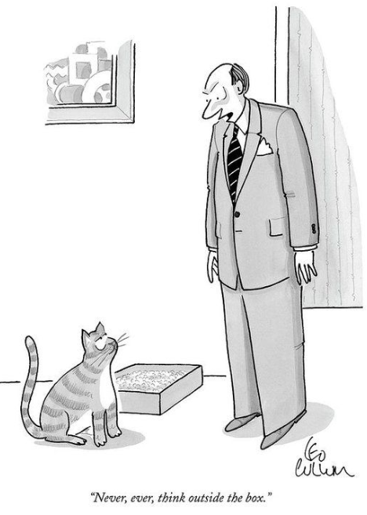
Proofs (like Computer Programs) typically follow the Principle of the Least Surprise
Depending on the statement you have to prove (and the type of your solution), the proofs should follow certain predefined patterns.
Chapter 1.8 (and this slide-deck) has examples for many of them. It is suggested to read this stuff. (Or even better – to practice.)
(c) Leo Cullum, https://www.newyorker.com/

Slide 6
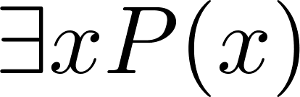
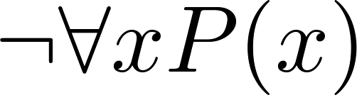
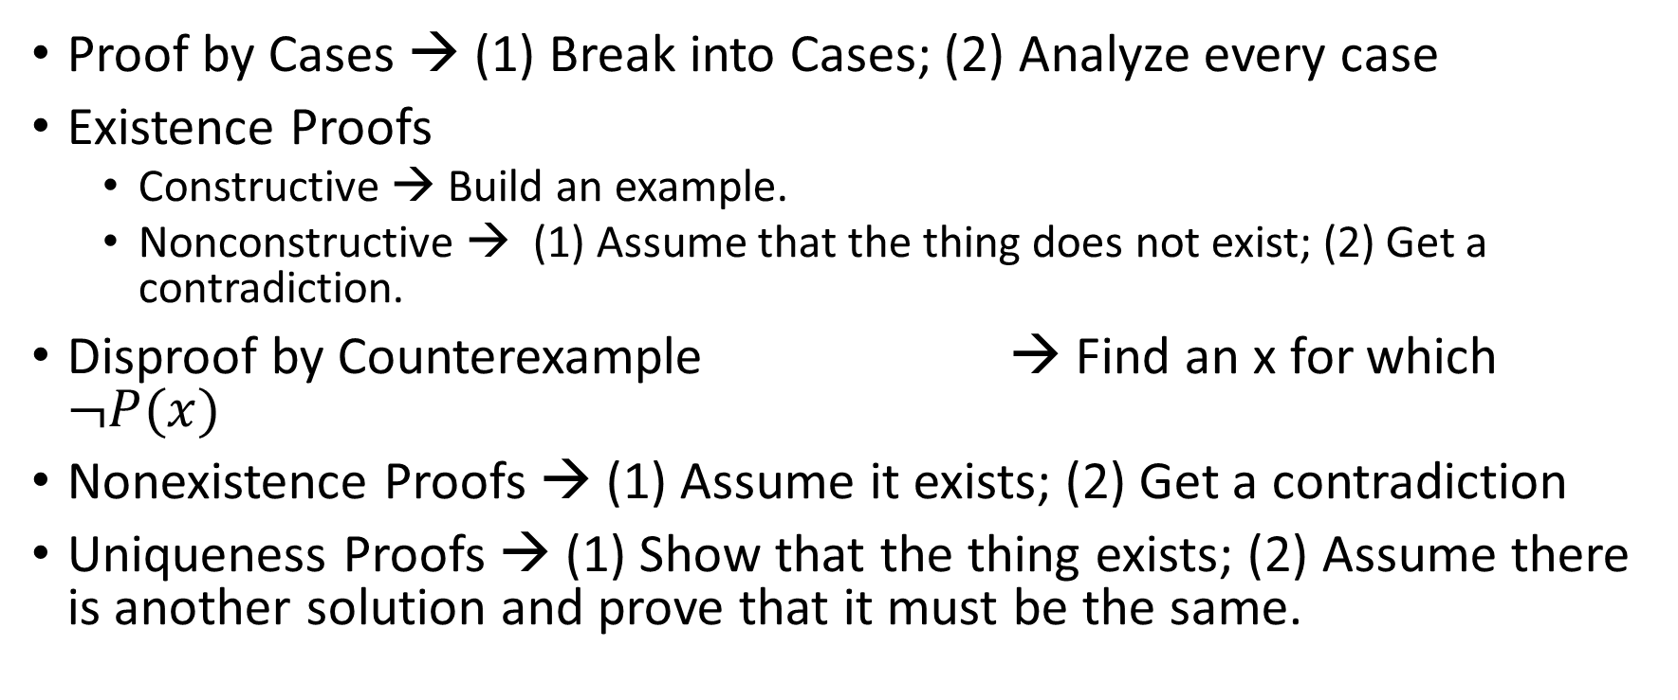
Writing your Proofs (Proof Strategies)
Not same as Problem Solving Strategies / Methods of Creativity
Proof by Cases → (1) Break into Cases; (2) Analyze every case
Existence Proofs
Constructive → Build an example.
Nonconstructive → (1) Assume that the thing does not exist; (2) Get a contradiction.
Disproof by Counterexample → Find an x for which $¬P(x)$
Nonexistence Proofs → (1) Assume it exists; (2) Get a contradiction
Uniqueness Proofs → (1) Show that the thing exists; (2) Assume there is another solution and prove that it must be the same.

Slide 7
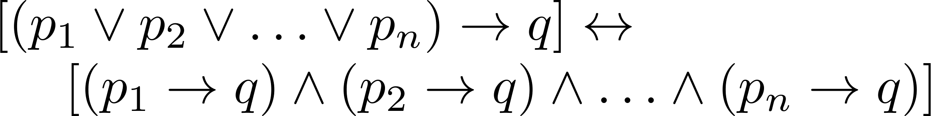

Proof by Cases
To prove a conditional statement of the form:
Use the tautology
Each of the implications is a case.

Slide 8
Proof by Cases (Exhaustive search / Brute force)
Example: Let a @ b = max{a, b} = a if a ≥ b, otherwise a @ b = max{a, b} = b.
Show that for all real numbers a, b, c
(a @b) @ c = a @ (b @ c)
(This means the operation @ is associative.)
Proof: Let a, b, and c be arbitrary real numbers.
Then one of the following 6 cases must hold.
a ≥ b ≥ c
a ≥ c ≥ b
b ≥ a ≥c
b ≥ c ≥a
c ≥ a ≥ b
c ≥ b ≥ a
Continued on next slide →

Slide 9
Proof by Cases
Case 1: a ≥ b ≥ c
(a @ b) = a, a @ c = a, b @ c = b
Hence (a @ b) @ c = a = a @ (b @ c)
Therefore the equality holds for the first case.
A complete proof requires that the equality be shown to hold for all 6 cases. But the proofs of the remaining cases are similar. Try them.

Slide 10
Without Loss of Generality (Apply symmetry in the problem)
Example: Show that if x and y are integers and both x∙y and x+y are even, then both x and y are even.
Proof: Use a proof by contraposition. Suppose x and y are not both even. Then, one or both are odd. Without loss of generality, assume that x is odd. Then x = 2m + 1 for some integer m.
Case 1: y is even. Then y = 2n for some integer n, so x + y = (2m + 1) + 2n = 2(m + n) + 1 is odd.
Case 2: y is odd. Then y = 2n + 1 for some integer n, so x ∙ y = (2m + 1) (2n + 1) = 2(2m ∙ n +m + n) + 1 is odd. ■
We only cover the case where x is odd because the case where y is odd is similar. The use phrase without loss of generality (WLOG) indicates this.

Slide 11
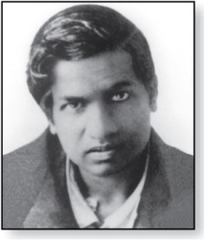
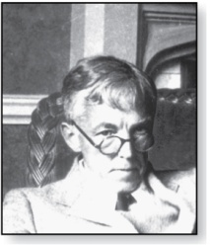
Existence Proofs (or "Examples")
Srinivasa Ramanujan
(1887-1920)
Proof of theorems of the form .
Constructive existence proof:
Find an explicit value of c, for which P(c) is true.
Then is true by Existential Generalization (EG).
Example: Show that there is a positive integer that can be written as the sum of cubes of positive integers in two different ways:
Proof: 1729 is such a number since
1729 = 10³ + 9³ = 12³ + 1³ ■
Godfrey Harold Hardy
(1877-1947)

Slide 12
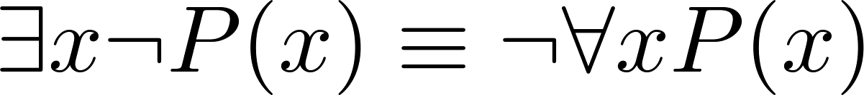
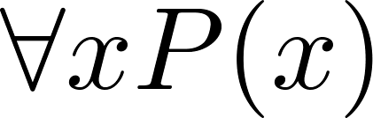
Counterexamples (same as Examples, but about a negation)
Recall .
To establish that is true (or is false) find a c such that ¬P(c) is true or P(c) is false.
In this case c is called a counterexample to the assertion .
Example: “Every positive integer is the sum of the squares of 3 integers.” The integer 7 is a counterexample. So the claim is false.

Slide 13
Uniqueness Proofs (Prove that there is one and only one…)
Some theorems asset the existence of a unique element with a particular property, ∃!x P(x). The two parts of a uniqueness proof are
Existence: We show that an element x with the property exists.
Uniqueness: We show that if y≠x, then y does not have the property.
Example: Show that if a and b are real numbers and a ≠0, then there is a unique real number r such that ar + b = 0.
Solution:
Existence: The real number r = −b/a is a solution of ar + b = 0 because a(−b/a) + b = −b + b =0.
Uniqueness: Suppose that s is a real number such that as + b = 0. Then ar + b = as + b, where r = −b/a. Subtracting b from both sides and dividing by a shows that r = s. ■

Slide 14
Proof Strategies for proving p → q (Various implications)
Choose a method.
First try a direct method of proof.
If this does not work, try an indirect method (e.g., try to prove the contrapositive).
For whichever method you are trying, choose a strategy.
First try forward reasoning. Start with the axioms and known theorems and construct a sequence of steps that end in the conclusion. Start with p and prove q, or start with ¬q and prove ¬p.
If this doesn’t work, try backward reasoning. When trying to prove q, find a statement p that we can prove with the property p → q.

Slide 15
Backward Reasoning (Also creativity strategy "Penultimate step")
Example: Suppose that two people play a game taking turns removing, 1, 2, or 3 stones at a time from a pile that begins with 15 stones. The person who removes the last stone wins the game. Show that the first player can win the game no matter what the second player does.
Proof: Let n be the last step of the game.
Step n: Player₁ can win if the pile contains 1,2, or 3 stones.
Step n-1: Player₂ will have to leave such a pile if the pile that he/she is faced with has 4 stones.
Step n-2: Player₁ can leave 4 stones when there are 5,6, or 7 stones left at the beginning of his/her turn.
Step n-3: Player₂ must leave such a pile, if there are 8 stones .
Step n-4: Player₁ has to have a pile with 9,10, or 11 stones to ensure that there are 8 left.
Step n-5: Player₂ needs to be faced with 12 stones to be forced to leave 9,10, or 11.
Step n-6: Player₁ can leave 12 stones by removing 3 stones.
Now reasoning forward, the first player can ensure a win by removing 3 stones and leaving 12.

Slide 16

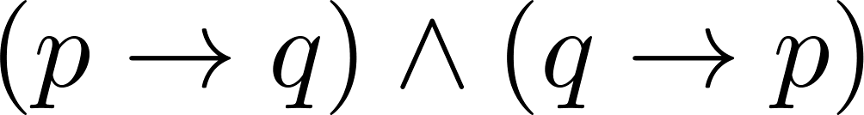
Universally Quantified Assertions (Many methods to Prove "universal statements")
To prove theorems of the form ,assume x is an arbitrary member of the domain and show that P(x) must be true. Using UG it follows that .
Example: An integer x is even if and only if x² is even.
Solution: The quantified assertion is
∀x [x is even ↔ x² is even]
We assume x is arbitrary.
Recall that is equivalent to
So, we have two cases to consider. These are considered in turn.
Continued on next slide →

Slide 17
Universally Quantified Assertions
Case 1. We show that if x is even then x² is even using a direct proof (the only if part or necessity).
If x is even then x = 2k for some integer k.
Hence x² = 4k² = 2(2k² ) which is even since it is an integer divisible by 2.
This completes the proof of case 1.
Case 2 on next slide →

Slide 18
Universally Quantified Assertions
Case 2. We show that if x² is even then x must be even (the if part or sufficiency). We use a proof by contraposition.
Assume x is not even and then show that x² is not even.
If x is not even then it must be odd. So, x = 2k + 1 for some k. Then x² = (2k + 1)² = 4k² + 4k + 1 = 2(2k² + 2k) + 1
which is odd and hence not even. This completes the proof of case 2.
Since x was arbitrary, the result follows by UG.
Therefore we have shown that x is even if and only if x² is even. ■

Slide 19
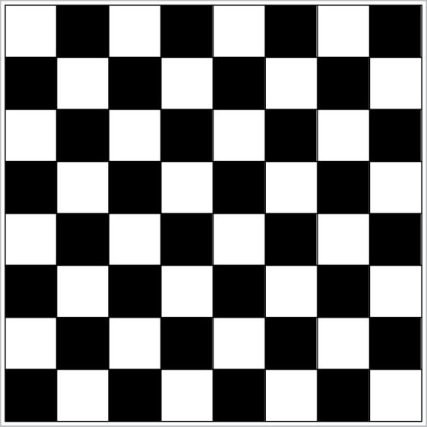
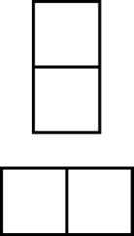
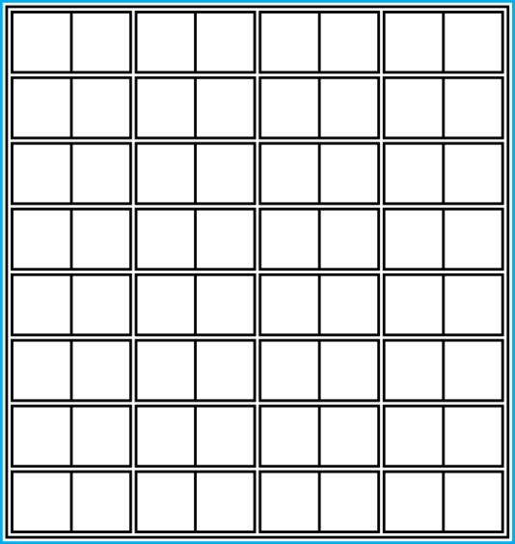
Example of Combining Methods (Tilings) (Proof using Example)
Example 1: Can we tile the standard checkerboard using dominos?
Solution: Yes! One example provides a constructive existence proof.
Two Dominoes
The Standard Checkerboard
One Possible Solution

Slide 20
Example of Combining Methods (Tilings) (Proof by Contradiction)
Example 2: Can we tile a checkerboard obtained by removing one of the four corner squares of a standard checkerboard?
Solution:
Our checkerboard has 64 − 1 = 63 squares.
Since each domino has two squares, a board with a tiling must have an even number of squares.
The number 63 is not even.
We have a contradiction. ■

Slide 21
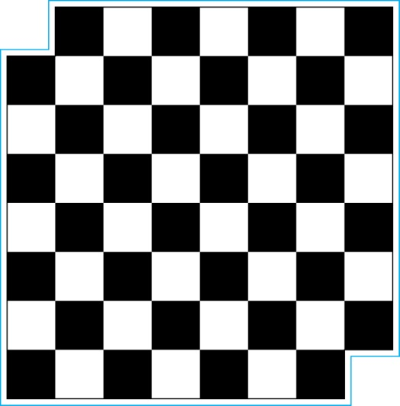
Example of Combining Methods (Tilings) (Introduce new Invariant; Proof by Contradiction)
Example 3: Can we tile a board obtained by removing both the upper left and the lower right squares of a standard checkerboard?
Intrigue:
Can we do this (one counterexample is fine)
General proof -> No matter how you cut, you will always fail.
Nonstandard Checkerboard
Dominoes
Continued on next slide →

Slide 22
Example of Combining Methods (Tilings) (Introduce new Invariant; Proof by Contradiction)
Solution:
There are 62 squares in this board.
To tile it we need 31 dominos.
Key fact: Each domino covers one black and one white square.
Therefore the tiling covers 31 black squares and 31 white squares.
Our board has either 30 black squares and 32 white squares or 32 black squares and 30 white squares.
Contradiction! ■
A typical mistake: We tried a couple of times; we failed every time.
Therefore nobody can do this.

Slide 23
Nonconstructive Proofs
In a nonconstructive existence proof, we assume no c exists which makes P(c) true and derive a contradiction.
Example: Show that there exist irrational numbers x and y such that x^{y} is rational.
Proof: We know that √2 is irrational. Consider the number √2 ^{√2} . If it is rational, we have two irrational numbers x and y with x^{y} rational, namely x = √2 and y = √2. But if √2 ^{√2} is irrational, then we can let x = √2 ^{√2} and y = √2 so that x^{y} = (√2 ^{√2} )^{√2} = √2 ^{(√2 √2)} = √2 ² = 2. ■

Slide 24
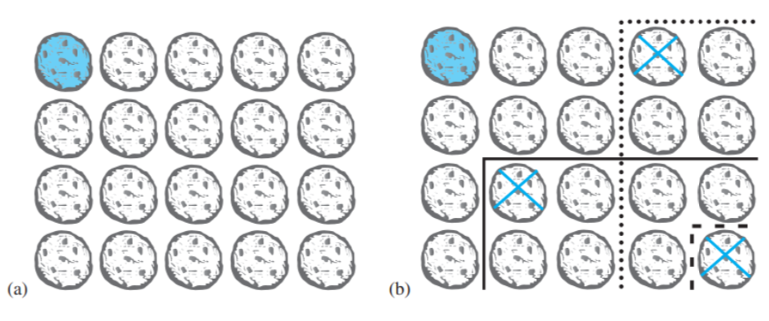
"Strategy Stealing" Argument
https://en.wikipedia.org/wiki/Chomp
Discusses the winning strategy and its generalizations.
Chomp is a game played by two players. In this game, cookies are laid out on a rectangular grid. The cookie in the top left position is poisoned, as shown in Figure 1a. Two players take turns making moves – at every move they point to a cookie on the table; they are then required to eat it (together with everything to the right and/or below it (Figure (b)). The player who has to eat the poisoned cookie, looses. (Example 12, Ch1.8. (Rosen2019).

Slide 25
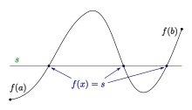
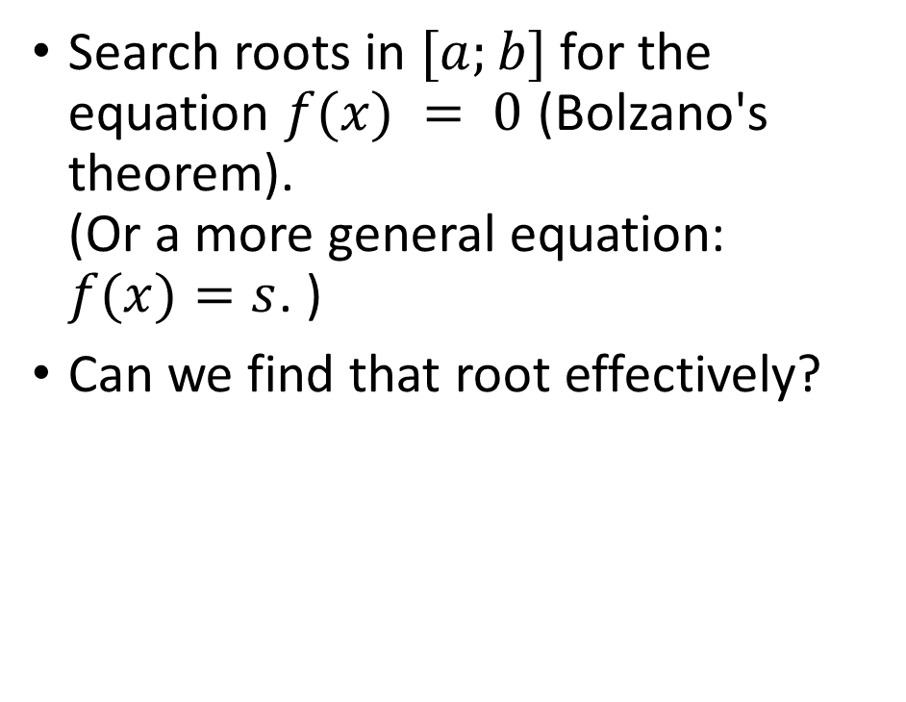
Non-Constructive Mathematics: Intermediate Value Theorem
Search roots in $[a;b]$ for the equation $f(x) = 0$ (Bolzano's theorem). (Or a more general equation: $f(x)=s$. )
Can we find that root effectively?

Slide 26
Non-Constructive Mathematics in Coq – 1
Require Import Classical_Prop.
Lemma Peirce_Law: forall a b: Prop, ((a -> b) -> a) -> a.
Proof.
intros a b.
intros H1.
apply NNPP.
unfold not.
intros aFalse.
apply aFalse.
apply H1.
intros aTrue.
contradiction (aFalse aTrue).
Qed.
Without using the "Classical_Prop" it would be impossible to prove Peirce's Law.
This tautology does not imply the truth of "a" directly. But it is possible to use this

Slide 27
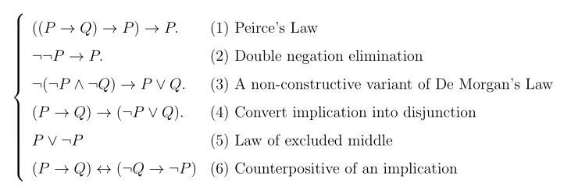
Non-Constructive Mathematics in Coq – 2 (Beware of Nonbreakable Spaces!)
1
NNPP
6
2
classic
5
3
4
https://softwarefoundations.cis.upenn.edu/lf-current/Logic.html#lab204
Axiom ContraPos: forall p q: Prop, (p -> q) <-> (~q -> ~p). (* (6) *)
Lemma Peirce_Law: forall a b: Prop, ((a -> b) -> a) -> a. (* (1) *)
Proof.
(* Your proof here *)
Qed.

Slide 28
The Role of Open Problems
Unsolved problems have motivated much work in mathematics. Fermat’s Last Theorem was conjectured more than 300 years ago. It has only recently been finally solved.
Fermat’s Last Theorem: The equation x^{n} + y^{n} = z^{n}
has no solutions in integers x, y, and z, with xyz≠0 whenever n is an integer with n > 2.
A proof was found by Andrew Wiles in the 1990s.

Slide 29
An Open Problem
The 3x + 1 Conjecture: Let T be the transformation that sends an even integer x to x/2 and an odd integer x to 3x + 1. For all positive integers x, when we repeatedly apply the transformation T, we will eventually reach the integer 1.
For example, starting with x = 13:
T(13) = 3∙13 + 1 = 40, T(40) = 40/2 = 20, T(20) = 20/2 = 10,
T(10) = 10/2 = 5, T(5) = 3∙5 + 1 = 16,T(16) = 16/2 = 8,
T(8) = 8/2 = 4, T(4) = 4/2 = 2, T(2) = 2/2 = 1
The conjecture has been verified using computers up to 5.6 ∙ 10¹³ .

Slide 30
Additional Proof Methods
Later we will see many other proof methods:
Mathematical induction, which is a useful method for proving statements of the form ∀n P(n), where the domain consists of all positive integers.
Structural induction, which can be used to prove such results about recursively defined sets.
Cantor diagonalization is used to prove results about the size of infinite sets.
Combinatorial proofs use counting arguments.

