Slide 1
Sets
Section 2.1

Slide 2
Section Summary
Definition of sets
Describing Sets
Roster Method
Set-Builder Notation
Some Important Sets in Mathematics
Empty Set and Universal Set
Subsets and Set Equality
Cardinality of Sets
Tuples
Cartesian Product

Slide 3
Introduction
Sets are one of the basic building blocks for the types of objects considered in discrete mathematics.
Important for counting.
Programming languages have set operations.
Set theory is an important branch of mathematics.
Many different systems of axioms have been used to develop set theory.
Here we are not concerned with a formal set of axioms for set theory. Instead, we will use what is called naïve set theory.

Slide 4
Sets
A set is an unordered collection of objects.
the students in this class
the chairs in this room
The objects in a set are called the elements, or members of the set. A set is said to contain its elements.
The notation a ∈ A denotes that a is an element of the set A.
If a is not a member of A, write a ∉ A

Slide 5
Describing a Set: Roster Method
S = {a,b,c,d}
Order not important
S = {a,b,c,d} = {b,c,a,d}
Each distinct object is either a member or not; listing more than once does not change the set.
S = {a,b,c,d} = {a,b,c,b,c,d}
Elipses (…) may be used to describe a set without listing all of the members when the pattern is clear.
S = {a,b,c,d, ……,z }

Slide 6
Roster Method
Set of all vowels in the English alphabet:
V = {a,e,i,o,u}
Set of all odd positive integers less than 10:
O = {1,3,5,7,9}
Set of all positive integers less than 100:
S = {1,2,3,……..,99}
Set of all integers less than 0:
S = {…., -3,-2,-1}

Slide 7
Some Important Sets
N = natural numbers = {0,1,2,3….}
Z = integers = {…,-3,-2,-1,0,1,2,3,…}
Z⁺ = positive integers = {1,2,3,…..}
R = set of real numbers
R⁺ = set of positive real numbers
C = set of complex numbers.
Q = set of rational numbers

Slide 8
Set-Builder Notation
Specify the property or properties that all members must satisfy:
S = {x | x is a positive integer less than 100}
O = {x | x is an odd positive integer less than 10}
O = {x ∈ Z⁺ | x is odd and x < 10}
A predicate may be used:
S = {x | P(x)}
Example: S = {x | Prime(x)}
Positive rational numbers:
Q⁺ = {x ∈ R | x = p/q, for some positive integers p,q}

Slide 9
Interval Notation
[a,b] = {x | a ≤ x ≤ b}
[a,b) = {x | a ≤ x < b}
(a,b] = {x | a < x ≤ b}
(a,b) = {x | a < x < b}
closed interval [a,b]
open interval (a,b)

Slide 10
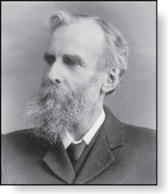
Universal Set and Empty Set
The universal set U is the set containing everything currently under consideration.
Sometimes implicit
Sometimes explicitly stated.
Contents depend on the context.
The empty set is the set with no
elements. Symbolized ∅, but
{} also used.
Venn Diagram
U
V
a e i
o u
John Venn (1834-1923)
Cambridge, UK

Slide 11
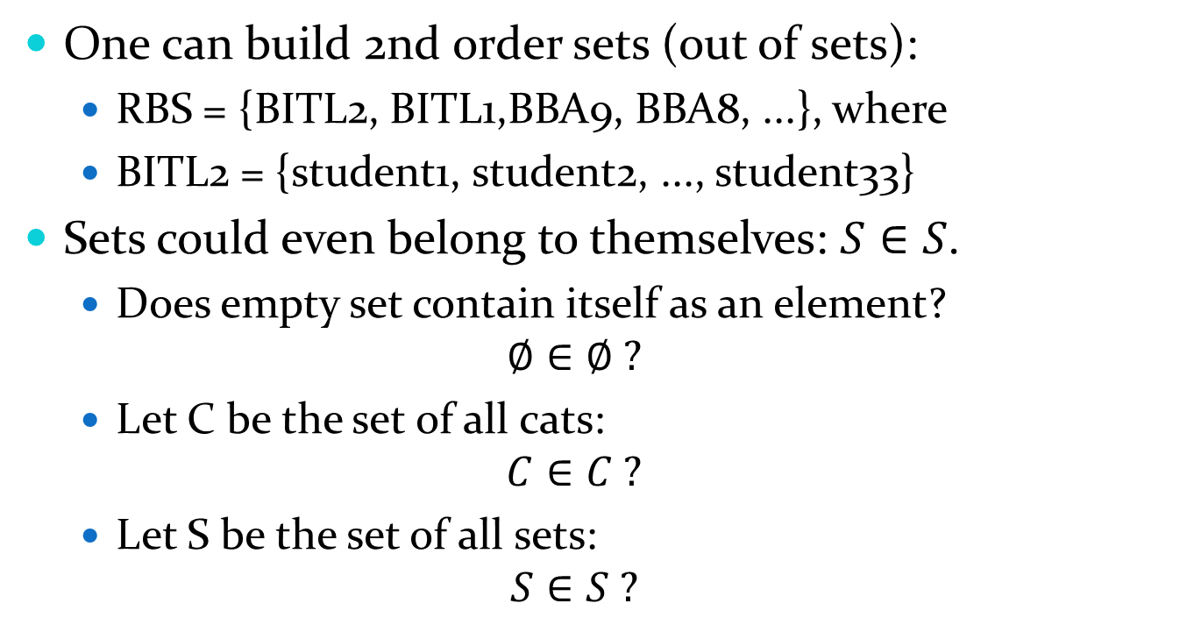
Sets of Sets
One can build 2nd order sets (out of sets):
RBS = {BITL2, BITL1,BBA9, BBA8, ...}, where
BITL2 = {student1, student2, ..., student33}
Sets could even belong to themselves: $S∈S$.
Does empty set contain itself as an element? $∅∈∅ ?$
Let C be the set of all cats:
$$C∈C ?$$
Let S be the set of all sets:
$$S∈S ?$$

Slide 12
Some things to remember
Sets can be elements of sets.
{{1,2,3},a, {b,c}}
{N,Z,Q,R}
The empty set is different from a set containing the empty set.
∅ ≠ { ∅ }

Slide 13
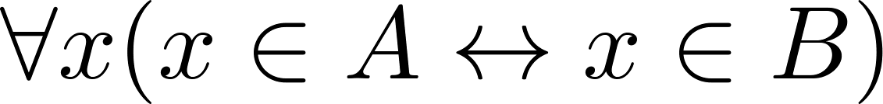
Set Equality
Definition: Two sets are equal if and only if they have the same elements.
Therefore if A and B are sets, then A and B are equal if and only if .
We write A = B if A and B are equal sets.
{1,3,5} = {3, 5, 1}
{1,5,5,5,3,3,1} = {1,3,5}

Slide 14
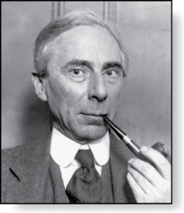
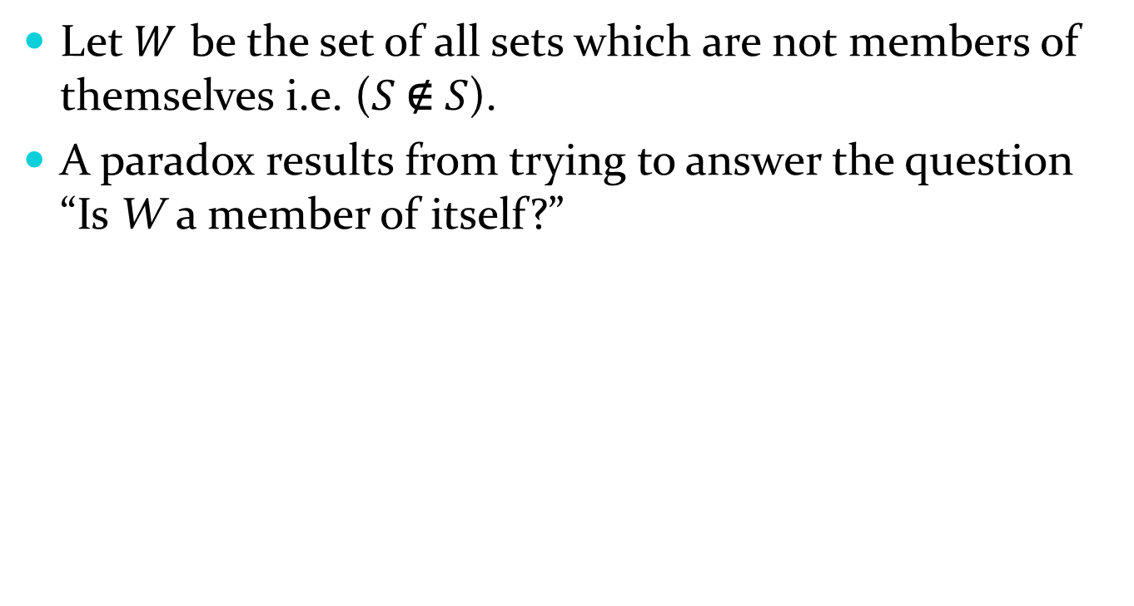
Russell’s Paradox
Let $W$ be the set of all sets which are not members of themselves i.e. ($S \text{∉} S$).
A paradox results from trying to answer the question “Is W a member of itself?”
Bertrand Russell (1872-1970)
Cambridge, UK
Nobel Prize Winner

Slide 15
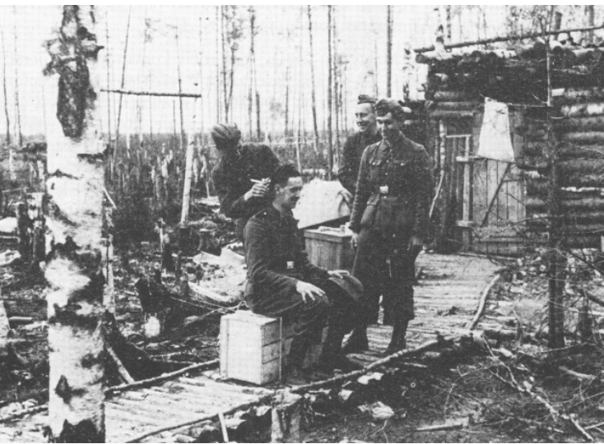
Barber's Paradox
A Related Paradox:
Henry is a barber in an army unit.
His duty is to shave all soldiers who do not shave themselves.
He is forbidden to shave those soldiers who do shave themselves.
Does Henry shave himself? (assuming he is also a soldier in this unit.)
Army Barber at Work.
Marshland near Volkhov, 1943

Slide 16
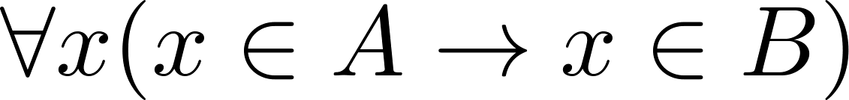
Subsets
Definition: The set A is a subset of B, if and only if every element of A is also an element of B.
The notation A ⊆ B is used to indicate that A is a subset of the set B.
A ⊆ B holds if and only if is true.
Because a ∈ ∅ is always false, ∅ ⊆ S ,for every set S.
Because a ∈ S → a ∈ S, S ⊆ S, for every set S.

Slide 17
Showing a Set is or is not a Subset of Another Set
Showing that A is a Subset of B: To show that A ⊆ B, show that if x belongs to A, then x also belongs to B.
Showing that A is not a Subset of B: To show that A is not a subset of B, A ⊈ B, find an element x ∈ A with x ∉ B. (Such an x is a counterexample to the claim that x ∈ A implies x ∈ B.)
Examples:
The set of all computer science majors at your school is a subset of all students at your school.
The set of integers with squares less than 100 is not a subset of the set of nonnegative integers.

Slide 18
Another look at Equality of Sets
Recall that two sets A and B are equal, denoted by A = B, iff
Using logical equivalences we have that A = B iff
This is equivalent to
A ⊆ B and B ⊆ A

Slide 19
Proper Subsets
Definition: If A ⊆ B, but A ≠B, then we say A is a proper subset of B, denoted by A ⊂ B. If A ⊂ B, then
is true.
Euler Diagram
U
B
A

Slide 20
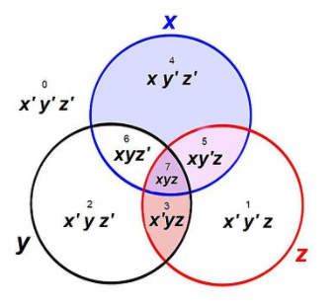
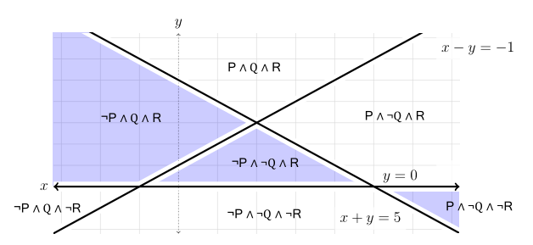
Euler and Venn Diagrams
Euler Diagrams:
If one set is a subset of another, draw it inside.
Not necessary to show all regions.
Venn Diagrams:
Show all the theoretically possible regions.
U
Diagram with half-planes P,Q,R as Euler Diagram.
Courtesy of Romans Prokopjevs.

Slide 21
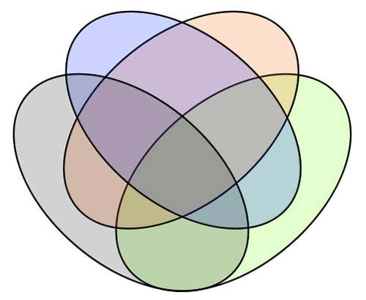
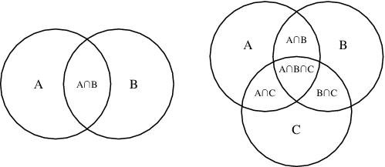
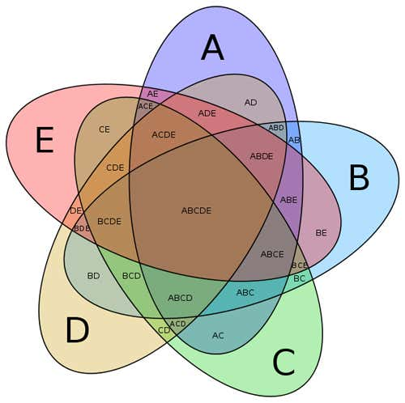


More Venn Diagrams
$$\overline{A}$$
$$A$$

Slide 22
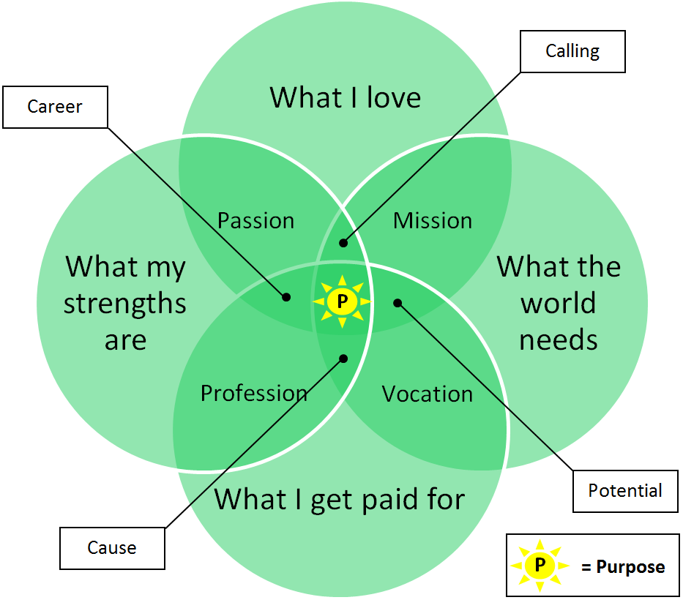
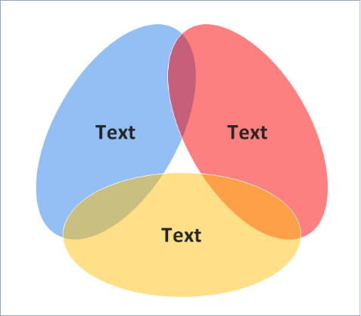
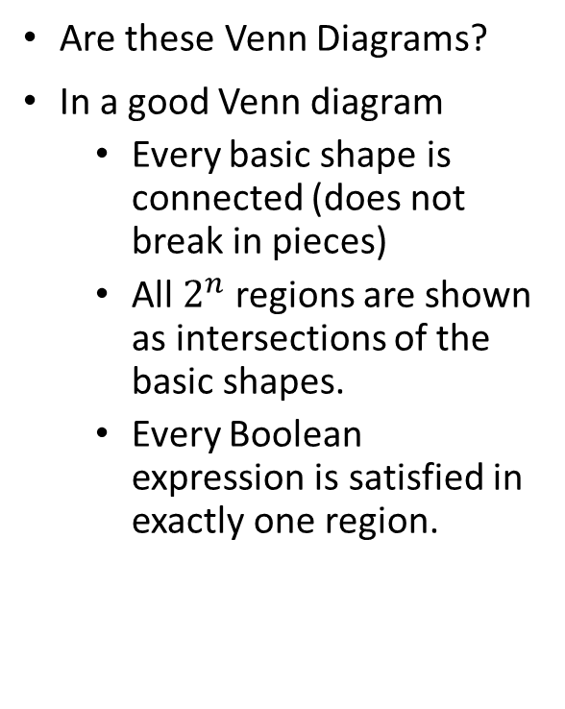
Funny Venn Diagrams
Are these Venn Diagrams?
In a good Venn diagram
Every basic shape is connected (does not break in pieces)
All $2^{n}$ regions are shown as intersections of the basic shapes.
Every Boolean expression is satisfied in exactly one region.
http://www.humanbusiness.eu/purpose-venn-diagram/
https://www.conceptdraw.com/examples/pyramid-venn-diagram

Slide 23
Set Cardinality
Definition: If there are exactly n distinct elements in S where n is a nonnegative integer, we say that S is finite. Otherwise it is infinite.
Definition: The cardinality of a finite set A, denoted by |A|, is the number of (distinct) elements of A.
Examples:
|ø| = 0
Let S be the letters of the English alphabet. Then |S| = 26
|{1,2,3}| = 3
|{ø}| = 1
The set of integers is infinite.

Slide 24
Power Sets
Definition: The set of all subsets of a set A, denoted P(A), is called the power set of A.
Example: If A = {a,b} then
P(A) = {ø, {a},{b},{a,b}}
If a set has n elements, then the cardinality of the power set is 2ⁿ. (In Chapters 5 and 6, we will discuss different ways to show this.)

Slide 25
Tuples
The ordered n-tuple (a₁,a₂,…..,a_{n}) is the ordered collection that has a₁ as its first element and a₂ as its second element and so on until a_{n} as its last element.
Two n-tuples are equal if and only if their corresponding elements are equal.
2-tuples are called ordered pairs.
The ordered pairs (a,b) and (c,d) are equal if and only if a = c and b = d.

Slide 26
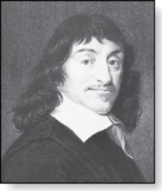
Cartesian Product
René Descartes (1596-1650)
Definition: The Cartesian Product of two sets A and B, denoted by A × B is the set of ordered pairs (a,b) where a ∈ A and b ∈ B .
Example:
A = {a,b} B = {1,2,3}
A × B = {(a,1),(a,2),(a,3), (b,1),(b,2),(b,3)}
Definition: A subset R of the Cartesian product A × B is called a relation from the set A to the set B. (Relations will be covered in depth in Chapter 9. )

Slide 27
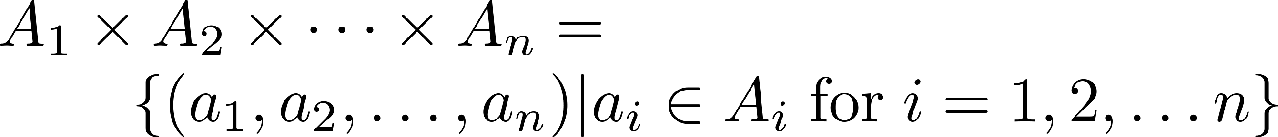
Cartesian Product
Definition: The cartesian products of the sets A₁,A₂,……,A_{n}, denoted by A₁ × A₂ × …… × A_{n} , is the set of ordered n-tuples (a₁,a₂,……,a_{n}) where a_{i} belongs to A_{i} for i = 1, … n.
Example: What is A × B × C where A = {0,1}, B = {1,2} and C = {0,1,2}
Solution: A × B × C = {(0,1,0), (0,1,1), (0,1,2),(0,2,0), (0,2,1), (0,2,2),(1,1,0), (1,1,1), (1,1,2), (1,2,0), (1,2,1), (1,2,2)}

Slide 28
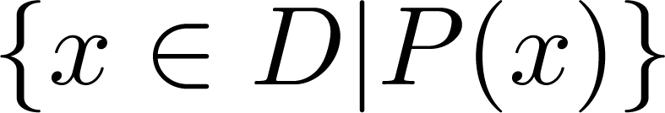
Truth Sets of Quantifiers
Given a predicate P and a domain D, we define the truth set of P to be the set of elements in D for which P(x) is true. The truth set of P(x) is denoted by
Example: The truth set of P(x) where the domain is the integers and P(x) is “|x| = 1” is the set {-1,1}

Slide 29
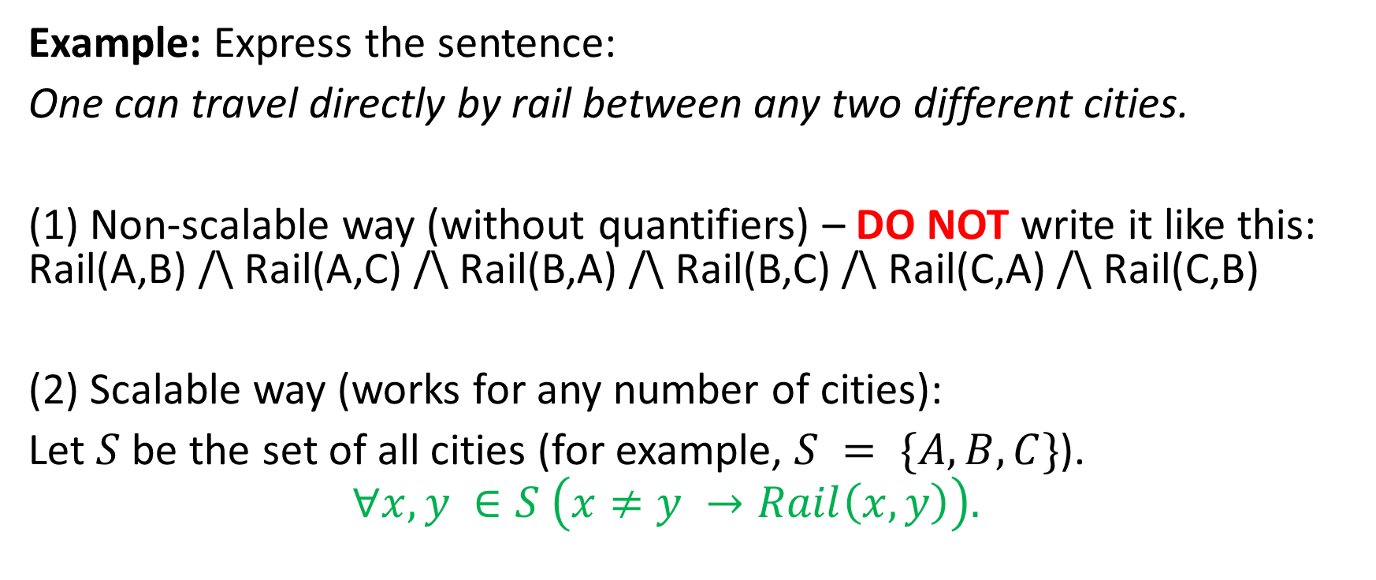
Notes for the Homework2 – Part 1
Example: Express the sentence:
One can travel directly by rail between any two different cities.
(1) Non-scalable way (without quantifiers) – DO NOT write it like this: Rail(A,B) /\ Rail(A,C) /\ Rail(B,A) /\ Rail(B,C) /\ Rail(C,A) /\ Rail(C,B)
(2) Scalable way (works for any number of cities):
Let $S$ be the set of all cities (for example, $S = \{A,B,C\}$).
$$∀x,y ∈S \left(x≠y →Rail\left(x,y\right)\right).$$

Slide 30
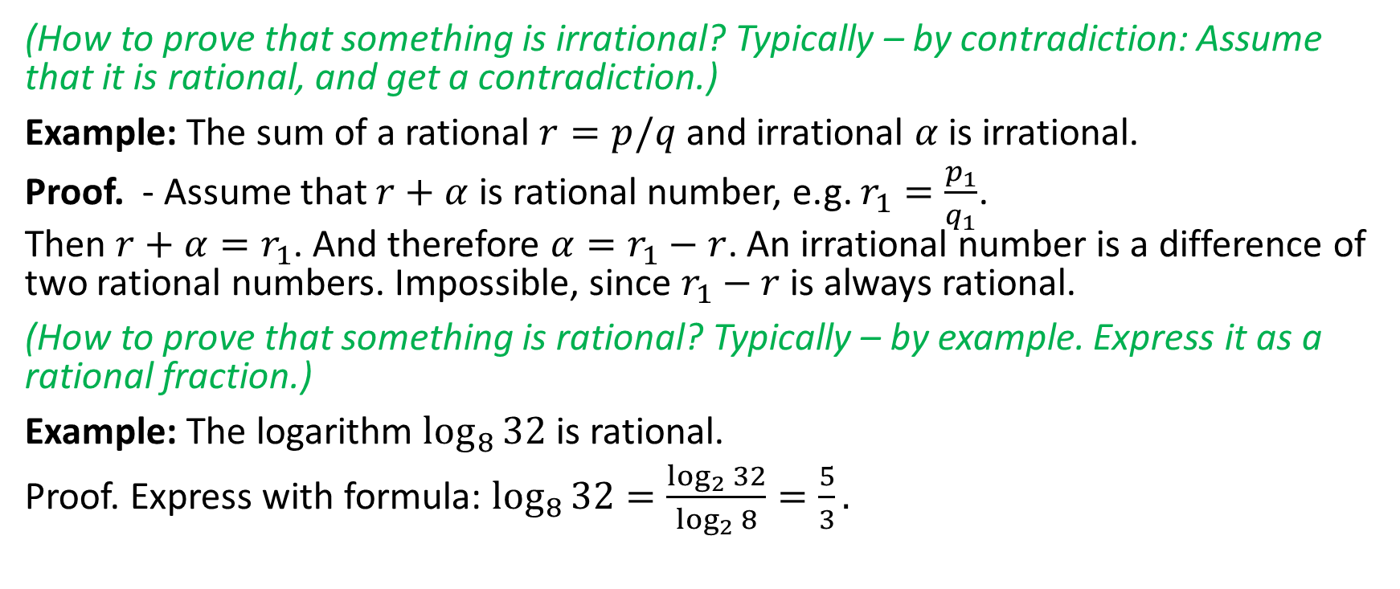
Notes for the Homework2 – Part 2
(How to prove that something is irrational? Typically – by contradiction: Assume that it is rational, and get a contradiction.)
Example: The sum of a rational $r=p/q$ and irrational $α$ is irrational.
Proof. - Assume that $r+α$ is rational number, e.g. $r_{1}=\frac{p_{1}}{q_{1}}$. Then $r+α=r_{1}$. And therefore $α=r_{1}−r$. An irrational number is a difference of two rational numbers. Impossible, since $r_{1}−r$ is always rational.
(How to prove that something is rational? Typically – by example. Express it as a rational fraction.)
Example: The logarithm $\log_{8}{32}$ is rational.
Proof. Express with formula: $\log_{8}{32}=\frac{\log_{2}{32}}{\log_{2}{8}}=\frac{5}{3}.$

Slide 31
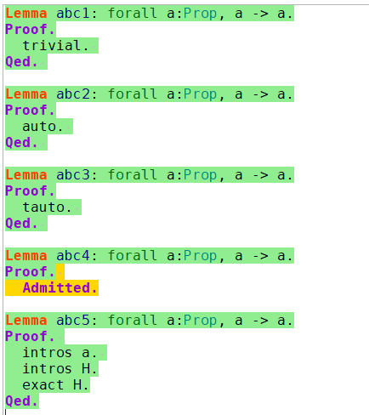
Notes for the Homework2 – Part 3
Sometimes Coq can do "invisible" stuff – there are proof tactics that do some obvious simplifications.
Avoid this cheating in your homework – try to write all steps explicitly. (In later exercises you might want to avoid writing easy stuff.)

