Slide 1
Functions
Section 2.3

Slide 2
Section Summary
Definition of a Function.
Domain, Codomain
Image, Preimage
Injection, Surjection, Bijection
Inverse Function
Function Composition
Graphing Functions
Floor, Ceiling, Factorial
Partial Functions (optional)

Slide 3
Functions
Definition: Let A and B be nonempty sets. A function f from A to B, denoted f: A → B is an assignment of each element of A to exactly one element of B. We write f(a) = b if b is the unique element of B assigned by the function f to the element a of A.
Functions are sometimes
called mappings or
transformations.
Students
Grades
A
Carlota Rodriguez
B
Sandeep Patel
C
Jalen Williams
D
Kathy Scott
F

Slide 4
Functions
A function f: A → B can also be defined as a subset of A×B (a relation). This subset is restricted to be a relation where no two elements of the relation have the same first element.
Specifically, a function f from A to B contains one, and only one ordered pair (a, b) for every element a∈ A.
and

Slide 5
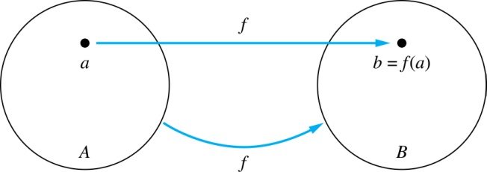
Functions
Given a function f: A → B:
We say f maps A to B or
f is a mapping from A to B.
A is called the domain of f.
B is called the codomain of f.
If f(a) = b,
then b is called the image of a under f.
a is called the preimage of b.
The range of f is the set of all images of points in A under f. We denote it by f(A).
Two functions are equal when they have the same domain, the same codomain and map each element of the domain to the same element of the codomain.

Slide 6
Representing Functions
Functions may be specified in different ways:
An explicit statement of the assignment.
Students and grades example.
A formula.
f(x) = x + 1
A computer program.
A Java program that when given an integer n, produces the nth Fibonacci Number (covered in the next section and also in Chapter 5).

Slide 7
Questions
z
A
B
f(a) = ?
The image of d is ?
z
a
x
The domain of f is ?
A
b
y
The codomain of f is ?
B
c
d
z
The preimage of y is ?
b
f(A) = ?
{y,z}
The preimage(s) of z is (are) ?
{a,c,d}

Slide 8
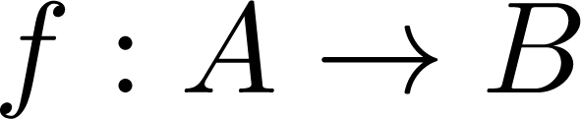
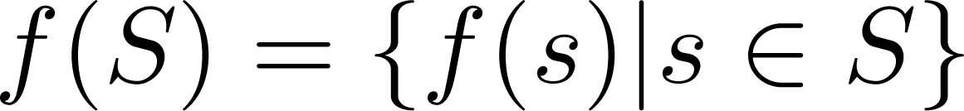
Question on Functions and Sets
If and S is a subset of A, then
A
B
a
f {a,b,c,} is ?
{y,z}
x
b
f {c,d} is ?
y
{z}
c
d
z

Slide 9
Injections
Definition: A function f is said to be one-to-one, or injective, if and only if f(a) = f(b) implies that a = b for all a and b in the domain of f. A function is said to be an injection if it is one-to-one.
B
A
x
a
v
b
y
c
z
d
w

Slide 10


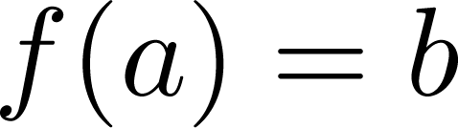
Surjections
Definition: A function f from A to B is called onto or surjective, if and only if for every element there is an element with .
A function f is called a surjection if it is onto.
A
B
a
x
b
y
c
z
d

Slide 11
Bijections
Definition: A function f is a one-to-one correspondence, or a bijection, if it is both one-to-one and onto (surjective and injective).
A
B
a
x
b
y
c
d
z
w

Slide 12
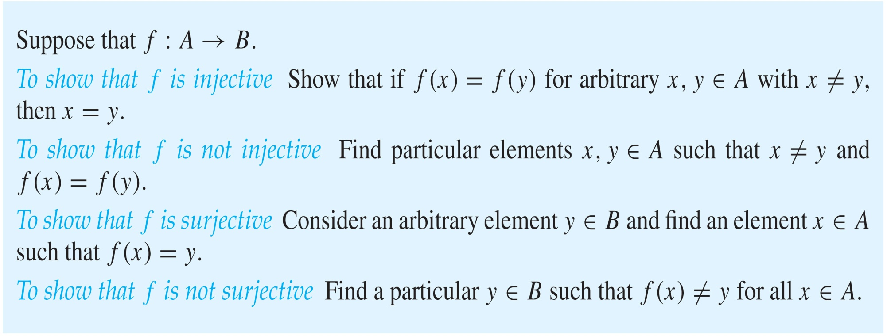
Showing that f is one-to-one or onto

Slide 13
Showing that f is one-to-one or onto
Example 1: Let f be the function from {a,b,c,d} to {1,2,3} defined by f(a) = 3, f(b) = 2, f(c) = 1, and f(d) = 3. Is f an onto function?
Solution: Yes, f is onto since all three elements of the codomain are images of elements in the domain. If the codomain were changed to {1,2,3,4}, f would not be onto.
Example 2: Is the function f(x) = x² from the set of integers to the set of integers onto?
Solution: No, f is not onto because there is no integer x with x² = −1, for example.

Slide 14
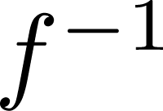
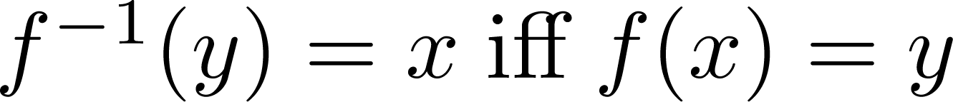
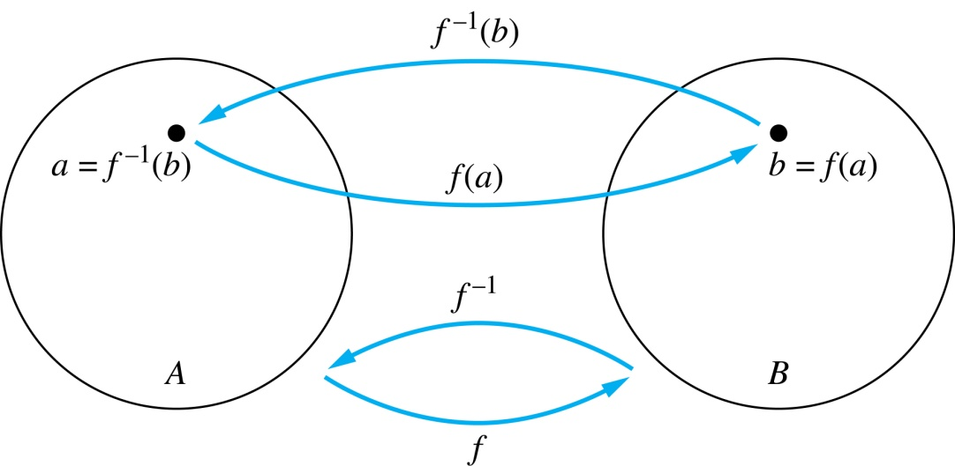
Inverse Functions
Definition: Let f be a bijection from A to B. Then the inverse of f, denoted , is the function from B to A defined as
No inverse exists unless f is a bijection. Why?

Slide 15
Inverse Functions
A
B
A
B
f
a
V
V
a
b
b
W
W
c
c
d
X
X
d
Y
Y

Slide 16
Questions
Example 1: Let f be the function from {a,b,c} to {1,2,3} such that f(a) = 2, f(b) = 3, and f(c) = 1. Is f invertible and if so what is its inverse?
Solution: The function f is invertible because it is a one-to-one correspondence. The inverse function f⁻¹ reverses the correspondence given by f, so f⁻¹ (1) = c, f⁻¹ (2) = a, and f⁻¹ (3) = b.

Slide 17

Questions
Example 2: Let f: Z → Z be such that $f(x) = x + 1$. Is f invertible, and if so, what is its inverse?
Solution: The function f is invertible because it is a one-to-one correspondence. The inverse function f⁻¹ reverses the correspondence so f⁻¹ (y) = y – 1.

Slide 18
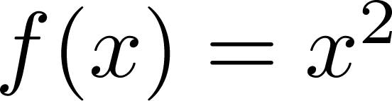
Questions
Example 3: Let f: R → R be such that . Is f invertible, and if so, what is its inverse?
Solution: The function f is not invertible because it is not one-to-one .

Slide 19
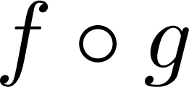
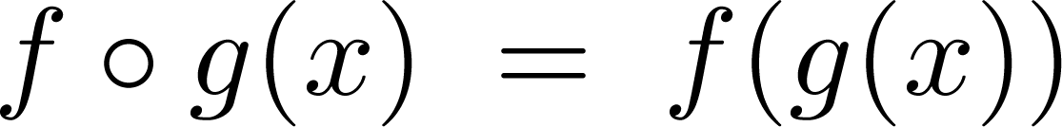
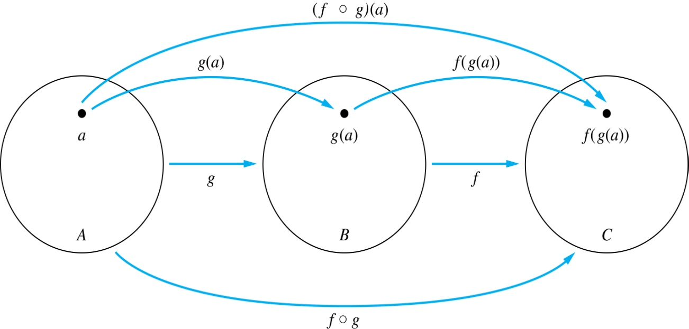
Composition
Definition: Let f: B → C, g: A → B. The composition of f with g, denoted is the function from A to C defined by

Slide 20
Composition
A
g
B
f
C
A
C
V
a
a
h
h
b
i
b
W
i
c
c
X
j
d
d
j
Y

Slide 21
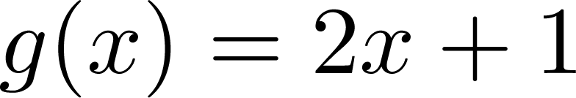
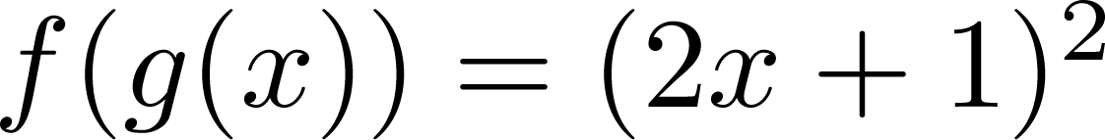
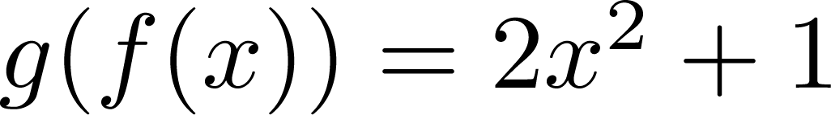
Composition
Example 1: If and , then
and

Slide 22
Composition Questions
Example 2: Let g be the function from the set {a,b,c} to itself such that g(a) = b, g(b) = c, and g(c) = a. Let f be the function from the set {a,b,c} to the set {1,2,3} such that f(a) = 3, f(b) = 2, and f(c) = 1.
What is the composition of f and g, and what is the composition of g and f.
Solution: The composition f∘g is defined by
f∘g (a)= f(g(a)) = f(b) = 2.
f∘g (b)= f(g(b)) = f(c) = 1.
f∘g (c)= f(g(c)) = f(a) = 3.
Note that g∘f is not defined, because the range of f is not a subset of the domain of g.

Slide 23
Composition Questions
Example 2: Let f and g be functions from the set of integers to the set of integers defined by f(x) = 2x + 3 and g(x) = 3x + 2.
What is the composition of f and g, and also the composition of g and f ?
Solution:
f∘g (x)= f(g(x)) = f(3x + 2) = 2(3x + 2) + 3 = 6x + 7
g∘f (x)= g(f(x)) = g(2x + 3) = 3(2x + 3) + 2 = 6x + 11

Slide 24
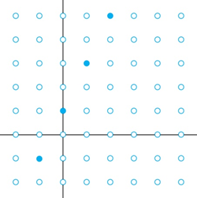
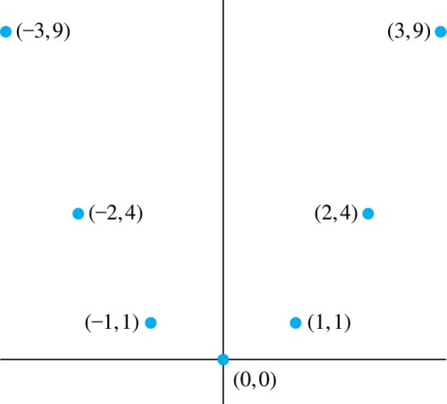
Graphs of Functions
Let f be a function from the set A to the set B. The graph of the function f is the set of ordered pairs {(a,b) | a ∈A and f(a) = b}.
Graph of f(n) = 2n + 1
from Z to Z
Graph of f(x) = x²
from Z to Z

Slide 25
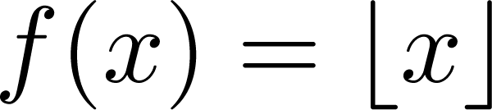
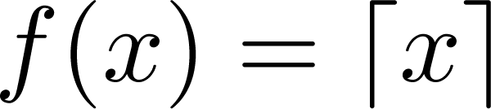
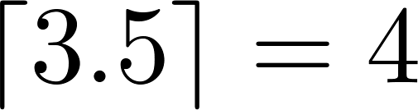
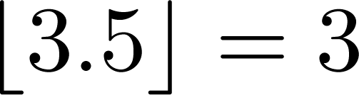
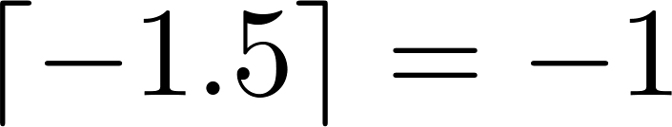
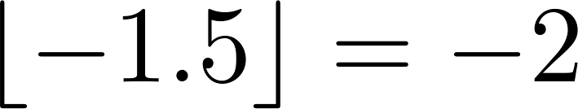
Some Important Functions
The floor function, denoted
is the largest integer less than or equal to x.
The ceiling function, denoted
is the smallest integer greater than or equal to x
Example:

Slide 26
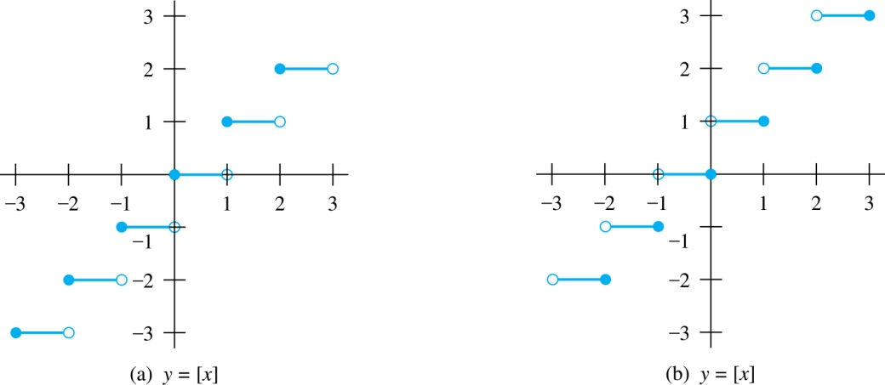
Floor and Ceiling Functions
Graph of (a) Floor and (b) Ceiling Functions

Slide 27
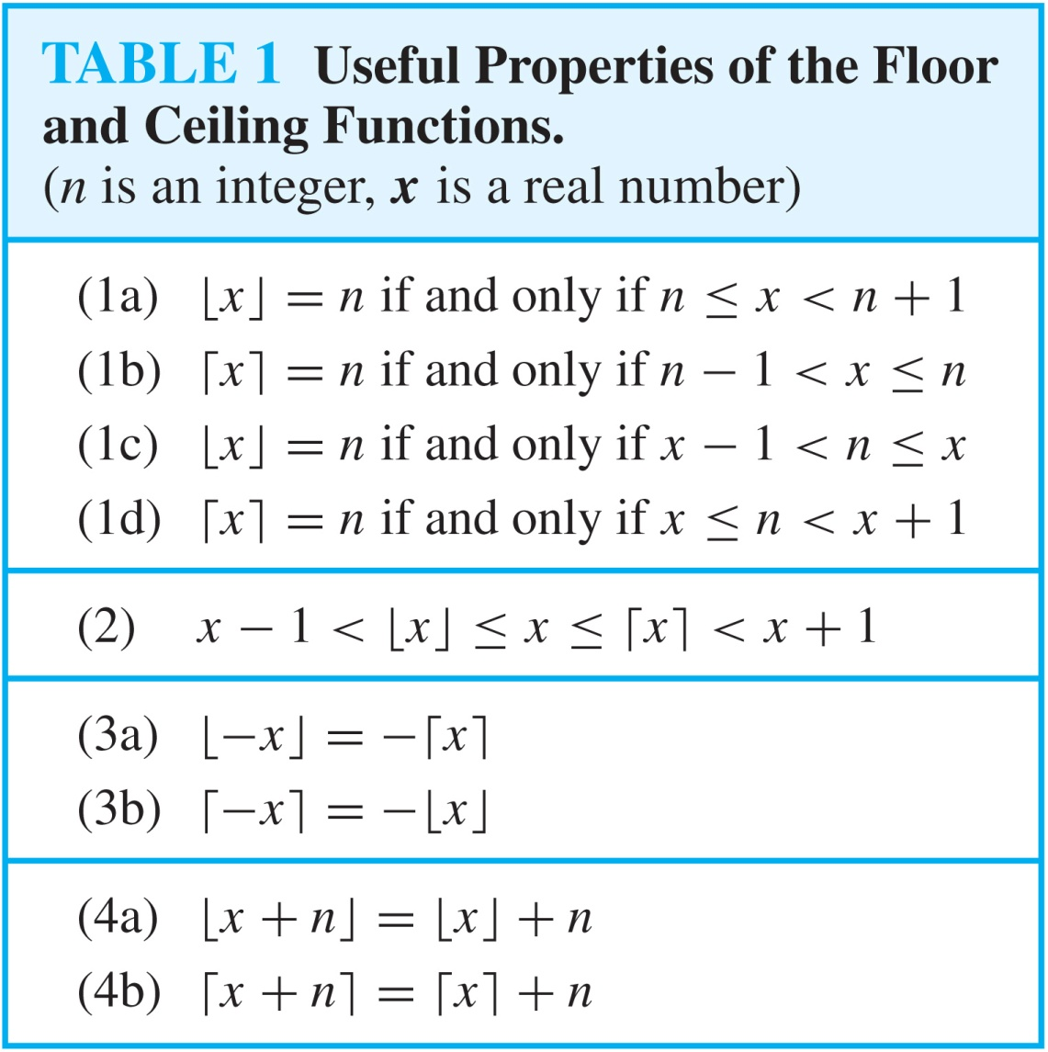
Floor and Ceiling Functions

Slide 28
Proving Properties of Functions
Example: Prove that x is a real number, then
⌊2x⌋= ⌊x⌋ + ⌊x + 1/2⌋
Solution: Let x = n + ε, where n is an integer and 0 ≤ ε< 1.
Case 1: ε < ½
2x = 2n + 2ε and ⌊2x⌋ = 2n, since 0 ≤ 2ε< 1.
⌊x + 1/2⌋ = n, since x + ½ = n + (1/2 + ε ) and 0 ≤ ½ +ε < 1.
Hence, ⌊2x⌋ = 2n and ⌊x⌋ + ⌊x + 1/2⌋ = n + n = 2n.
Case 2: ε ≥ ½
2x = 2n + 2ε = (2n + 1) +(2ε − 1) and ⌊2x⌋ =2n + 1, since 0 ≤ 2 ε - 1< 1.
⌊x + 1/2⌋ = ⌊ n + (1/2 + ε)⌋ = ⌊ n + 1 + (ε – 1/2)⌋ = n + 1 since 0 ≤ ε – 1/2< 1.
Hence, ⌊2x⌋ = 2n + 1 and ⌊x⌋ + ⌊x + 1/2⌋ = n + (n + 1) = 2n + 1.

Slide 29
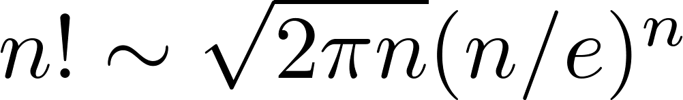
Factorial Function
Definition: f: N → Z⁺ , denoted by f(n) = n! is the product of the first n positive integers when n is a nonnegative integer.
f(n) = 1 ∙ 2 ∙∙∙ (n – 1) ∙ n, f(0) = 0! = 1
Examples:
^{f(1) = 1! = 1}
^{f(2) = 2! = 1 ∙ 2 = 2}
^{f(6) = 6! = 1 ∙ 2 ∙ 3∙ 4∙ 5} ^{∙ 6 = 720}
f(20) = 2,432,902,008,176,640,000.
Stirling’s Formula:

Slide 30
Partial Functions (optional)
Definition: A partial function f from a set A to a set B is an assignment to each element a in a subset of A, called the domain of definition of f, of a unique element b in B.
The sets A and B are called the domain and codomain of f, respectively.
We day that f is undefined for elements in A that are not in the domain of definition of f.
When the domain of definition of f equals A, we say that f is a total function.
Example: f: N → R where f(n) = √n is a partial function from Z to R where the domain of definition is the set of nonnegative integers. Note that f is undefined for negative integers.

