Slide 1
Matrices
Section 2.6

Slide 2
Section Summary
Definition of a Matrix
Matrix Arithmetic
Transposes and Powers of Arithmetic
Zero-One matrices

Slide 3
Matrices
Matrices are useful discrete structures that can be used in many ways. For example, they are used to:
describe certain types of functions known as linear transformations.
Express which vertices of a graph are connected by edges (see Chapter 10).
In later chapters, we will see matrices used to build models of:
Transportation systems.
Communication networks.
Algorithms based on matrix models will be presented in later chapters.
Here we cover the aspect of matrix arithmetic that will be needed later.

Slide 4

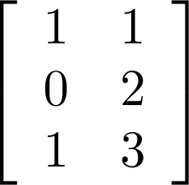
Matrix
Definition: A matrix is a rectangular array of numbers. A matrix with m rows and n columns is called an m n matrix.
The plural of matrix is matrices.
A matrix with the same number of rows as columns is called square.
Two matrices are equal if they have the same number of rows and the same number of columns and the corresponding entries in every position are equal.
3 2 matrix

Slide 5
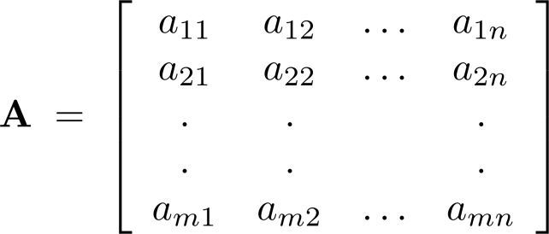
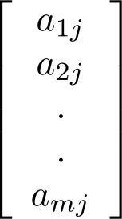
Notation
Let m and n be positive integers and let
The ith row of A is the 1 n matrix [a_{i1}, a_{i2},…,a_{in}]. The jth column of A is the m 1 matrix:
The (i,j)th element or entry of A is the
element a_{ij}. We can use A = [a_{ij} ] to denote the matrix with its (i,j)th element equal to a_{ij}.

Slide 6
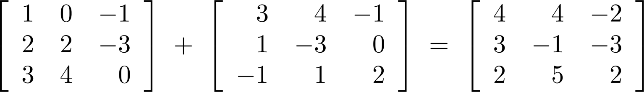
Matrix Arithmetic: Addition
Defintion: Let A = [a_{ij}] and B = [b_{ij}] be m n matrices. The sum of A and B, denoted by A + B, is the m n matrix that has a_{ij} + b_{ij} as its (i,j)th element. In other words, A + B = [a_{ij} + b_{ij}].
Example:
Note that matrices of different sizes can not be added.

Slide 7
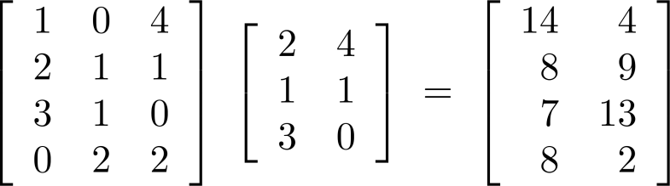
Matrix Multiplication
Definition: Let A be an m k matrix and B be a k n matrix. The product of A and B, denoted by AB, is the m n matrix that has its (i,j)th element equal to the sum of the products of the corresponding elements from the ith row of A and the jth column of B. In other words, if AB = [c_{ij}] then c_{ij} = a_{i1}b_{1j} + a_{i2}b_{2j} + … + a_{kj}b_{2j}.
Example:
The product of two matrices is undefined when the number of columns in the first matrix is not the same as the number of rows in the second.

Slide 8
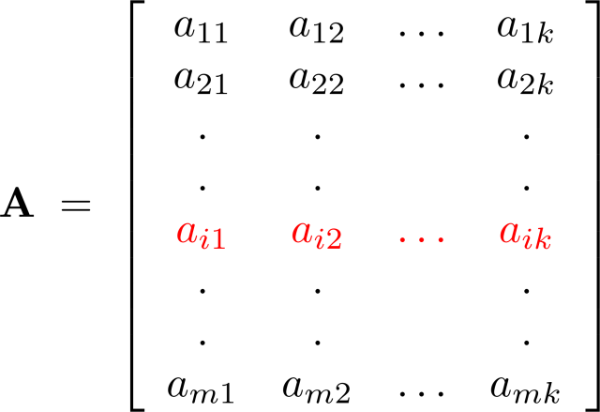
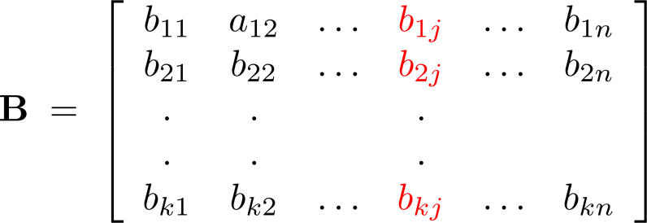
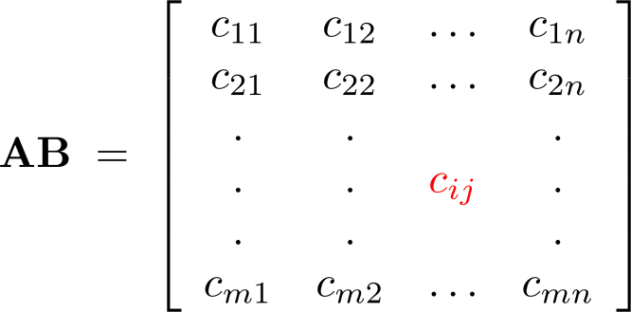
Illustration of Matrix Multiplication
The Product of A = [a_{ij}] and B = [b_{ij}]

Slide 9
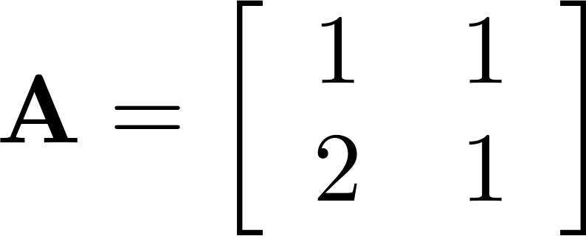
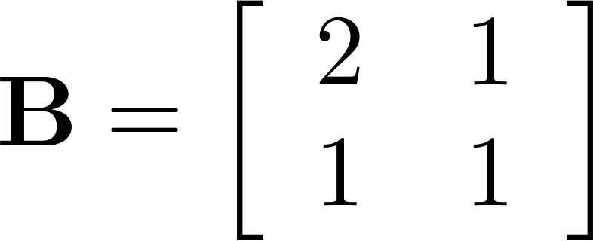
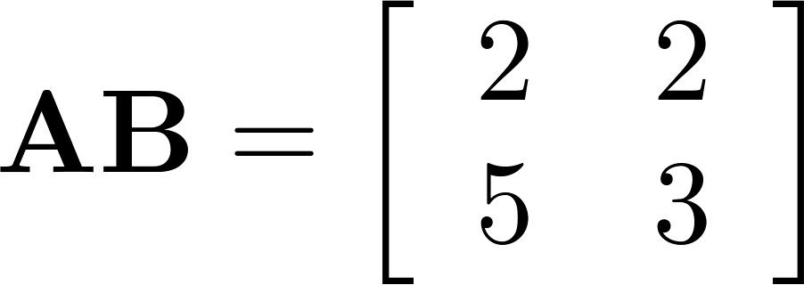
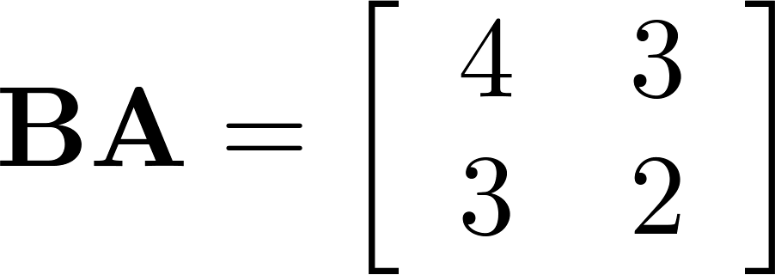
Matrix Multiplication is not Commutative
Example: Let
Does AB = BA?
Solution:
AB ≠ BA

Slide 10
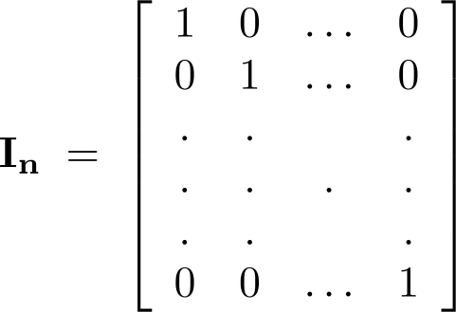
Identity Matrix and Powers of Matrices
Definition: The identity matrix of order n is the m n matrix I_{n} = [δ_{ij}], where δ_{ij} = 1 if i = j and δ_{ij} = 0 if i≠j.
AI_{n} = I_{m}A = A
when A is an m n matrix
Powers of square matrices can be defined. When A is an n × n matrix, we have:
A⁰ = I_{n} A^{r} = AAA∙∙∙A
r times

Slide 11
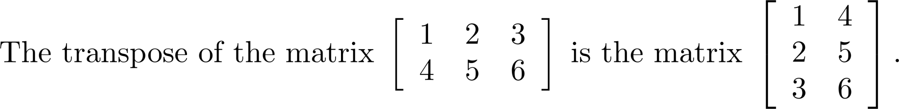
Transposes of Matrices
Definition: Let A = [a_{ij}] be an m n matrix. The transpose of A, denoted by A^{t} ,is the n m matrix obtained by interchanging the rows and columns of A.
If A^{t} = [b_{ij}], then b_{ij} = a_{ji} for i =1,2,…,n and j = 1,2, ...,m.

Slide 12
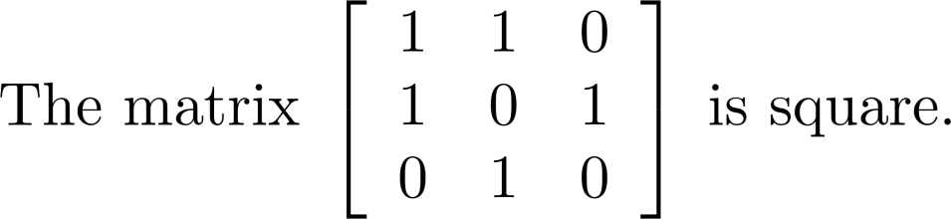
Transposes of Matrices
Definition: A square matrix A is called symmetric if A = A^{t}. Thus A = [a_{ij}] is symmetric if a_{ij} = a_{ji} for i and j with 1≤ i≤ n and 1≤ j≤ n.
Square matrices do not change when their rows and columns are interchanged.

Slide 13
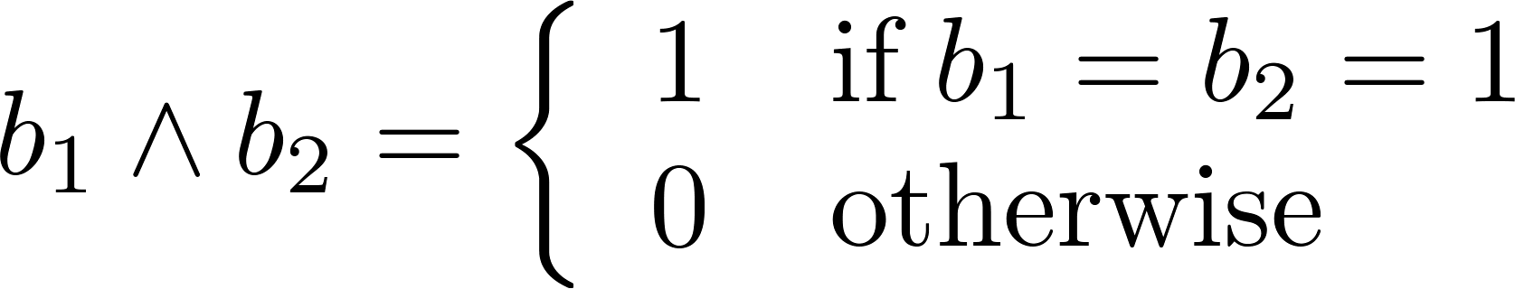
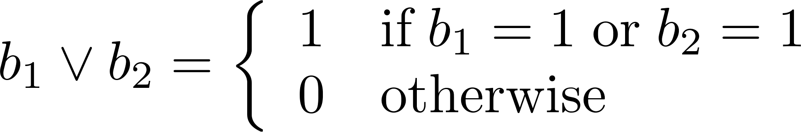
Zero-One Matrices
Definition: A matrix all of whose entries are either 0 or 1 is called a zero-one matrix. (These will be used in Chapters 9 and 10.)
Algorithms operating on discrete structures represented by zero-one matrices are based on Boolean arithmetic defined by the following Boolean operations:

Slide 14
Zero-One Matrices
Definition: Let A = [a_{ij}] and B = [b_{ij}] be an m × n zero-one matrices.
The join of A and B is the zero-one matrix with (i,j)th entry a_{ij} ∨ b_{ij}. The join of A and B is denoted by A ∨ B.
The meet of of A and B is the zero-one matrix with (i,j)th entry a_{ij} ∧ b_{ij}. The meet of A and B is denoted by A ∧ B.

Slide 15
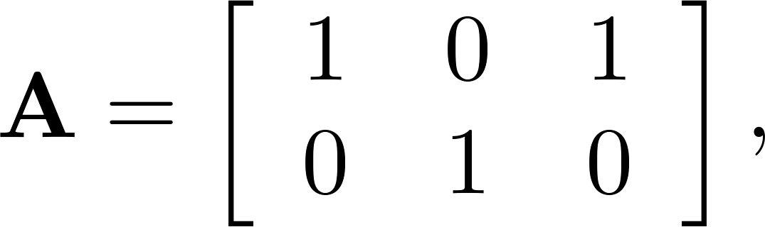
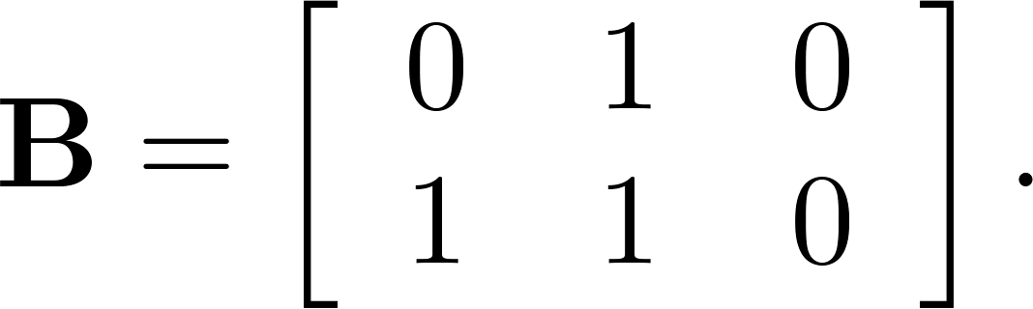
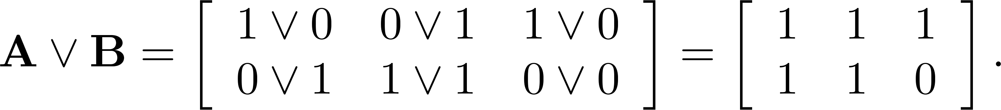
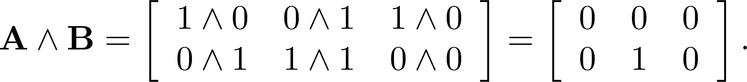
Joins and Meets of Zero-One Matrices
Example: Find the join and meet of the zero-one matrices
Solution: The join of A and B is
The meet of A and B is

Slide 16
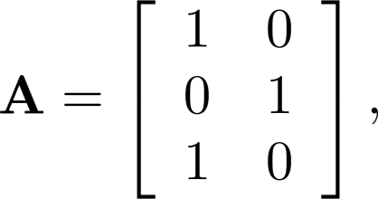
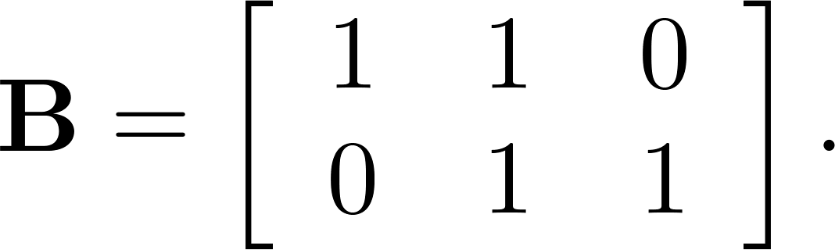
Boolean Product of Zero-One Matrices
Definition: Let A = [a_{ij}] be an m k zero-one matrix and B = [b_{ij}] be a k n zero-one matrix. The Boolean product of A and B, denoted by A ⊙ B, is the m n zero-one matrix with(i,j)th entry
c_{ij} = (a_{i1} ∧ b_{1j})∨ (a_{i2} ∧ b_{2j}) ∨ … ∨ (a_{ik} ∧ b_{kj}).
Example: Find the Boolean product of A and B, where
Continued on next slide →

Slide 17
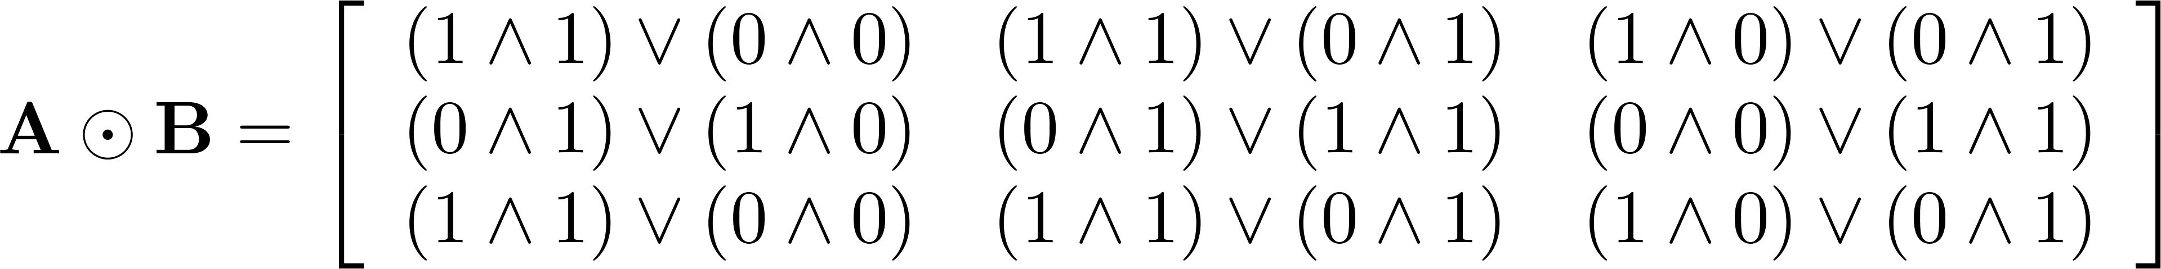
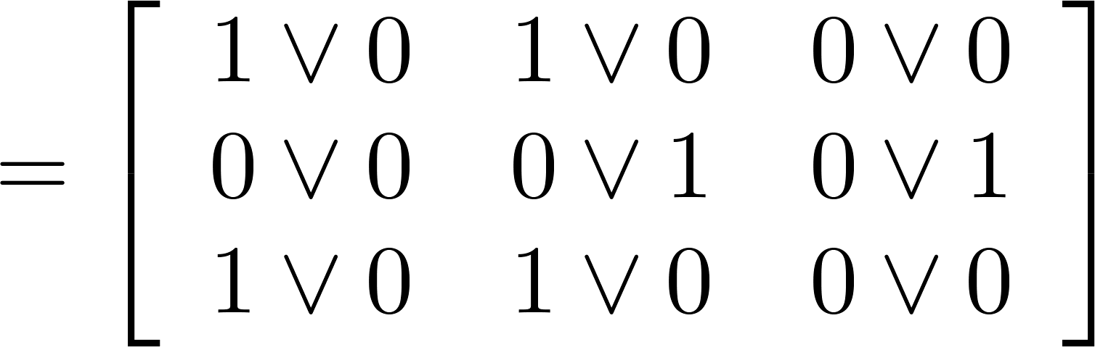
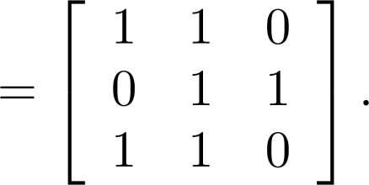
Boolean Product of Zero-One Matrices
Solution: The Boolean product A ⊙ B is given by

Slide 18
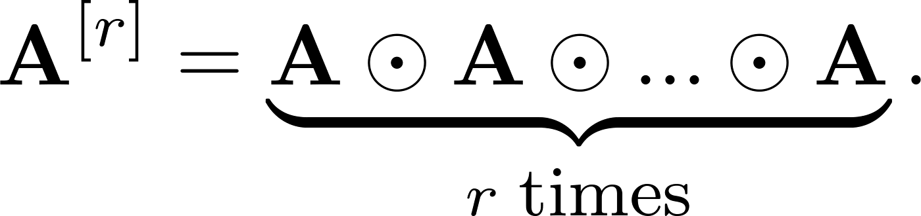
Boolean Powers of Zero-One Matrices
Definition: Let A be a square zero-one matrix and let r be a positive integer. The rth Boolean power of A is the Boolean product of r factors of A, denoted by A^{[r]} . Hence,
We define A^{[r]} to be I_{n}.
(The Boolean product is well defined because the Boolean product of matrices is associative.)

Slide 19
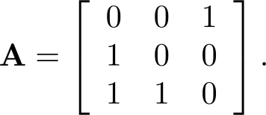
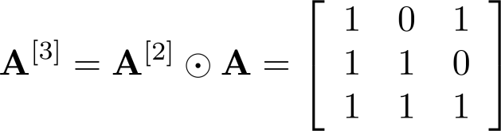
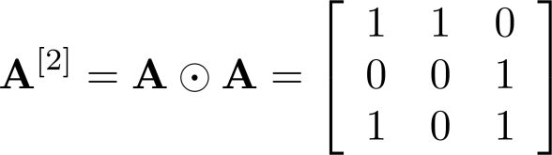
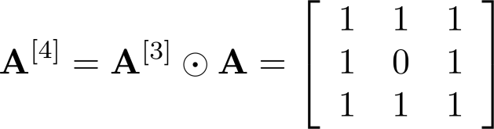
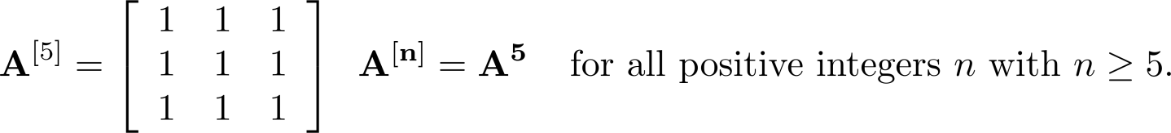
Boolean Powers of Zero-One Matrices
Example: Let
Find A^{n} for all positive integers n.
Solution:

