Slide 1
Partial Orderings
Section 9.6
Notes:
TODO: Shortlex ordering/sorting in Python.
Lexicographic ordering. Shortlex ordering. Ordering pairs/records.

Slide 2
Section Summary
Partial Orderings and Partially-ordered Sets
Lexicographic Orderings
Hasse Diagrams
Lattices (not currently in overheads)
Topological Sorting (not currently in overheads)

Slide 3
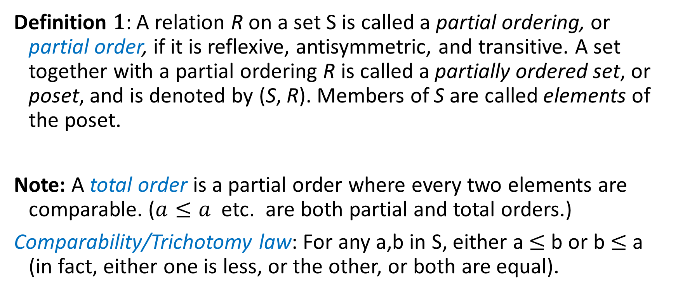
Partial Orders
Definition 1: A relation R on a set S is called a partial ordering, or partial order, if it is reflexive, antisymmetric, and transitive. A set together with a partial ordering R is called a partially ordered set, or poset, and is denoted by (S, R). Members of S are called elements of the poset.
Note: A total order is a partial order where every two elements are comparable. ($a≤a$ etc. are both partial and total orders.)
Comparability/Trichotomy law: For any a,b in S, either a $≤$b or b $≤$a (in fact, either one is less, or the other, or both are equal).

Slide 4
Partial Orderings (continued)
Example 1: Show that the “greater than or equal” relation (≥) is a partial ordering on the set of integers.
Reflexivity: a ≥ a for every integer a.
Antisymmetry: If a ≥ b and b ≥ a , then a = b.
Transitivity: If a ≥ b and b ≥ c , then a ≥ c.
These properties all follow from the order axioms for the integers. (See Appendix 1).

Slide 5
Partial Orderings (continued)
Example 2: Show that the divisibility relation (∣) is a partial ordering on the set of integers.
Reflexivity: a ∣ a for all integers a. (see Example 9 in Section 9.1)
Antisymmetry: If a and b are positive integers with a | b and b | a, then a = b. (see Example 12 in Section 9.1)
Transitivity: Suppose that a divides b and b divides c. Then there are positive integers k and l such that b = ak and c = bl. Hence, c = a(kl), so a divides c. Therefore, the relation is transitive.
(Z⁺, ∣) is a poset.

Slide 6
Partial Orderings (continued)
Example 3: Show that the inclusion relation (⊆) is a partial ordering on the power set of a set S.
Reflexivity: A ⊆ A whenever A is a subset of S.
Antisymmetry: If A and B are positive integers with A ⊆ B and B ⊆ A, then A = B.
Transitivity: If A ⊆ B and B ⊆ C, then A ⊆ C.
The properties all follow from the definition of set inclusion.

Slide 7
Comparability
Definition 2: The elements a and b of a poset (S,≼ ) are comparable if either a ≼ b or b ≼ a. When a and b are elements of S so that neither a ≼ b nor b ≼ a, then a and b are called incomparable.
Definition 3: If (S,≼ ) is a poset and every two elements of S are comparable, S is called a totally ordered or linearly ordered set, and ≼ is called a total order or a linear order. A totally ordered set is also called a chain.
Definition 4: (S,≼ ) is a well-ordered set if it is a poset such that ≼ is a total ordering and every nonempty subset of S has a least element.
The symbol ≼ is used to denote the relation in any poset.

Slide 8
Lexicographic Order
Definition: Given two posets (A₁,≼₁) and (A₂,≼₂), the lexicographic ordering on A₁ ⨉ A₂ is defined by specifying that (a₁, a₂) is less than (b₁,b₂), that is,
(a₁, a₂) ≺ (b₁,b₂),
either if a₁ ≺₁ b₁ or if a₁ = b₁ and a₂ ≺₂ b₂.
This definition can be easily extended to a lexicographic ordering on strings (see text).
Example: Consider strings of lowercase English letters. A lexicographic ordering can be defined using the ordering of the letters in the alphabet. This is the same ordering as that used in dictionaries.
discreet ≺ discrete, because these strings differ in the seventh position and e ≺ t.
discreet ≺ discreetness, because the first eight letters agree, but the second string is longer.

Slide 9
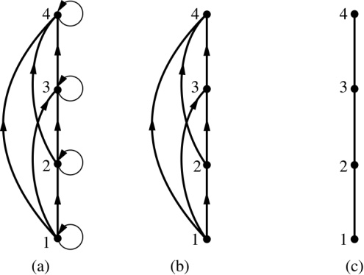
Hasse Diagrams
Definition: A Hasse diagram is a visual representation of a partial ordering that leaves out edges that must be present because of the reflexive and transitive properties.
A partial ordering is shown in (a) of the figure above. The loops due to the reflexive property are deleted in (b). The edges that must be present due to the transitive property are deleted in (c). The Hasse diagram for the partial ordering (a), is depicted in (c).

Slide 10
Procedure for Constructing a Hasse Diagram
To represent a finite poset (S,≼ ) using a Hasse diagram, start with the directed graph of the relation:
Remove the loops (a, a) present at every vertex due to the reflexive property.
Remove all edges (x, y) for which there is an element z ∈ S such that x ≺ z and z ≺ y. These are the edges that must be present due to the transitive property.
Arrange each edge so that its initial vertex is below the terminal vertex. Remove all the arrows, because all edges point upwards toward their terminal vertex.

Slide 11
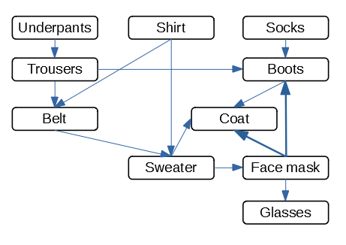
Dressing Routine as Partial Order
DAG (directed acyclical graph) describes how Mr. Bunbury gets dressed during an epidemic – before he goes out.
In larger software projects some tasks depend on others (Gantt charts and similar stuff).

Slide 12
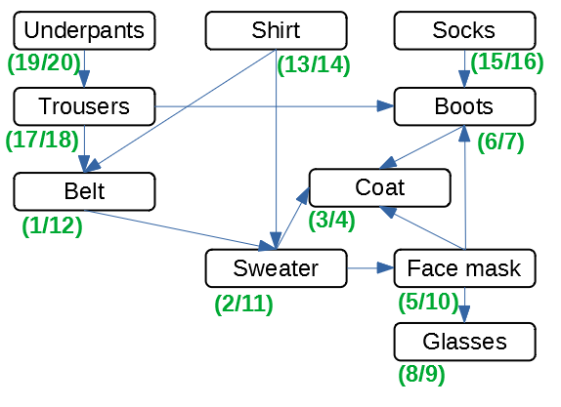
Topological Sorting
(20) Underpants;
(18) Trousers;
(16) Socks;
(14) Shirt;
(12) Belt;
(11) Sweater;
(10) Face mask;
(9) Glasses;
(7) Boots;
(4) Coat.
Notes:
TODO: Move to Trees (Tree traversals, etc)

Slide 13
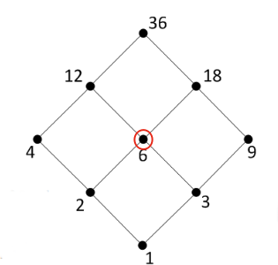
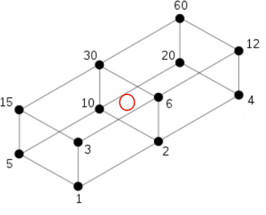
All Divisors for Numbers 60 and 36

Slide 14
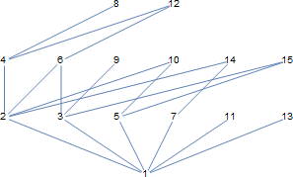
Hasse Diagram for Numbers up to 15
Can imagine divisibility as Hasse Diagram.
Which numbers are directly connected by an edge?
Which edges are in the transitive closure?

Slide 15
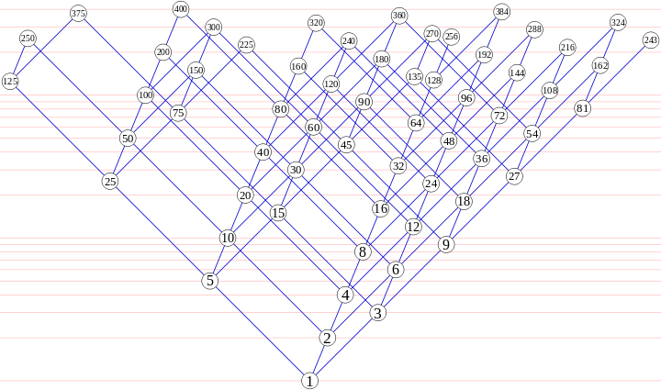
Numbers up to 400 (divisible by 2,3,5)
Divisibility relation can be traced by following the edges.

Slide 16
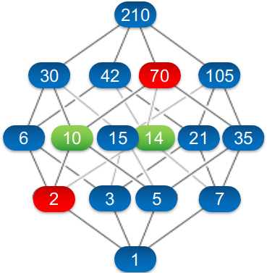
All Divisors of the Number 210
Divisibility where there are 4 "generating primes" - 2, 3, 5, 7.
Hasse diagram as a 4-dimensional cube.
GCD and LCM can be illustrated in the Hasse diagram:
Meet = GCM (downwards)
Join = LCM (upwards)

