Slide 1
Graphs and Graph Models
Section 10.1
Notes:
Graphs and Graph Models
Graph Terminology and Special Types of Graphs
Representing Graphs and Graph Isomorphism
Connectivity
Euler and Hamiltonian Graphs

Slide 2
Section Summary
Introduction to Graphs
Graph Taxonomy
Graph Models

Slide 3
Graphs
Definition: A graph G = (V, E) consists of a nonempty set V of vertices (or nodes) and a set E of edges. Each edge has two endpoints. An edge is said to connect its endpoints.
Remarks:
(Unrelated to function graphs)
All that matters in the graph picture is the connections made by the edges, not the particular geometry depicted. (Lengths of edges, crossings do not matter).
We (following the text) restrict our attention to finite graphs (finitely many vertices)
Example:
This is a graph with four vertices and five edges.
a
b
d
c

Slide 4
Some Terminology
In a simple graph each edge connects two different vertices and no two edges connect the same pair of vertices.
Multigraphs may have multiple edges connecting the same two vertices. When m different edges connect the vertices u and v, we say that {u,v} is an edge of multiplicity m.
An edge that connects a vertex to itself is called a loop.
A pseudograph may include loops, as well as multiple edges connecting the same pair of vertices.
Example: This pseudograph has both multiple edges and a loop.
Remark: There is no standard terminology for graph theory. So, it is crucial that you understand the terminology being used whenever you read material about graphs.
a
b
c

Slide 5
Directed Graphs
Definition: An directed graph (or digraph) G = (V, E) consists of a nonempty set V of vertices (or nodes) and a set E of directed edges (or arcs). Each edge is associated with an ordered pair of vertices. The directed edge associated with the ordered pair (u,v) is said to start at u and end at v.
Remark: Graphs where the end points of an edge are not ordered are said to be undirected graphs.

Slide 6
Some Terminology (continued)
A simple directed graph has no loops and no multiple edges.
Example: This is a directed graph with three vertices and four edges.
A directed multigraph may have multiple directed edges. When there are m directed edges from the vertex u to the vertex v, we say that (u,v) is an edge of multiplicity m.
Example: In this directed multigraph the multiplicity of (a,b) is 1 and the multiplicity of (b,c) is 2.
a
b
a
b
c
c

Slide 7
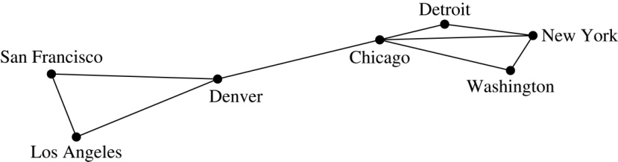
Graph Models: Computer Networks
When we build a graph model, we use the appropriate type of graph to capture the important features of the application.
We illustrate this process using graph models of different types of computer networks. In all these graph models, the vertices represent data centers and the edges represent communication links.
To model a computer network where we are only concerned whether two data centers are connected by a communications link, we use a simple graph. This is the appropriate type of graph when we only care whether two data centers are directly linked (and not how many links there may be) and all communications links work in both directions.

Slide 8
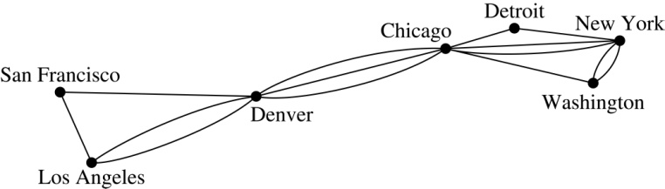
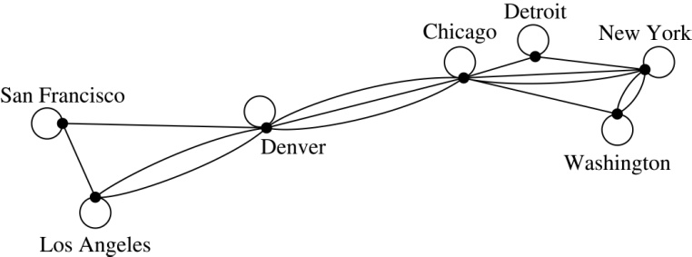
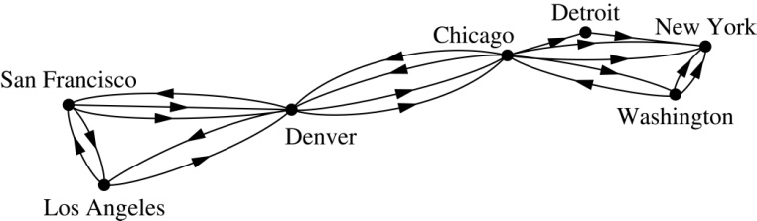
Computer Networks (continued)
To model a computer network where we care about the number of links between data centers, we use a multigraph.
To model a computer network with diagnostic links at data centers, we use a pseudograph, as loops are needed.
To model a network with multiple one-way links, we use a directed multigraph. Note that we could use a directed graph without multiple edges if we only care whether there is at least one link from a data center to another data center.

Slide 9
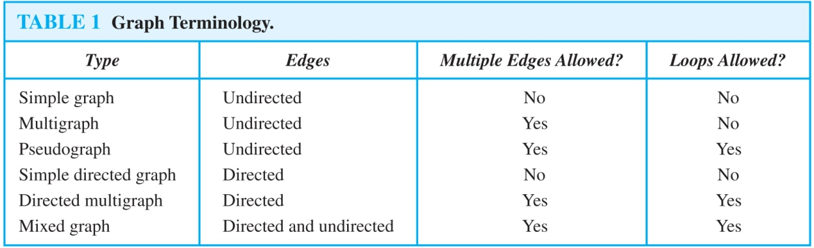
Graph Terminology: Summary
To understand the structure of a graph and to build a graph model, we ask these questions:
Are the edges of the graph undirected or directed (or both)?
If the edges are undirected, are multiple edges present that connect the same pair of vertices? If the edges are directed, are multiple directed edges present?
Are loops present?

Slide 10
Other Applications of Graphs
We will illustrate how graph theory can be used in models of:
Social networks
Communications networks
Information networks
Software design
Transportation networks
Biological networks
It’s a challenge to find a subject to which graph theory has not yet been applied. Can you find an area without applications of graph theory?

Slide 11
Graph Models: Social Networks
Graphs can be used to model social structures based on different kinds of relationships between people or groups.
In a social network, vertices represent individuals or organizations and edges represent relationships between them.
Useful graph models of social networks include:
friendship graphs - undirected graphs where two people are connected if they are friends (in the real world, on Facebook, or in a particular virtual world, and so on.)
collaboration graphs - undirected graphs where two people are connected if they collaborate in a specific way
influence graphs - directed graphs where there is an edge from one person to another if the first person can influence the second person

Slide 12
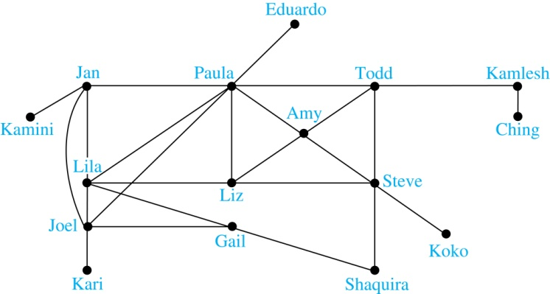
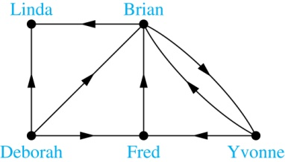
Graph Models: Social Networks (continued)
Example: A friendship graph where two people are connected if they are Facebook friends.
Example: An influence graph
Next Slide: Collaboration Graphs

Slide 13
Examples of Collaboration Graphs
The Hollywood graph models the collaboration of actors in films.
We represent actors by vertices and we connect two vertices if the actors they represent have appeared in the same movie.
We will study the Hollywood Graph in Section 10.4 when we discuss Kevin Bacon numbers.
An academic collaboration graph models the collaboration of researchers who have jointly written a paper in a particular subject.
We represent researchers in a particular academic discipline using vertices.
We connect the vertices representing two researchers in this discipline if they are coauthors of a paper.
We will study the academic collaboration graph for mathematicians when we discuss Erdős numbers in Section 10.4.

Slide 14
Applications to Information Networks
Graphs can be used to model different types of networks that link different types of information.
In a web graph, web pages are represented by vertices and links are represented by directed edges.
A web graph models the web at a particular time.
We will explain how the web graph is used by search engines in Section 11.4.
In a citation network:
Research papers in a particular discipline are represented by vertices.
When a paper cites a second paper as a reference, there is an edge from the vertex representing this paper to the vertex representing the second paper.

Slide 15
Transportation Graphs
Graph models are extensively used in the study of transportation networks.
Airline networks can be modeled using directed multigraphs where
airports are represented by vertices
each flight is represented by a directed edge from the vertex representing the departure airport to the vertex representing the destination airport
Road networks can be modeled using graphs where
vertices represent intersections and edges represent roads.
undirected edges represent two-way roads and directed edges represent one-way roads.

Slide 16
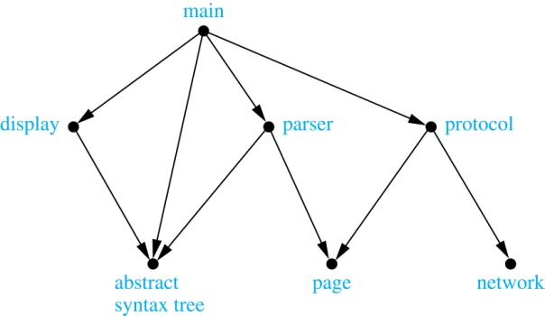
Software Design Applications
Graph models in software design. (1) Can represent the dependency between the software modules. (2) Can represent restrictions in the execution of statements in computer programs.
When a top-down approach is used to design software, the system is divided into modules, each performing a specific task.
In a module dependency graph vertices represent software modules and there is an edge from one module to another if the second module depends on the first.
Example: The dependencies between the seven modules in the design of a web browser are represented by this module dependency graph.

Slide 17
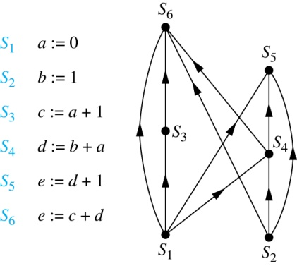
Software Design Applications (continued)
We can use a directed graph called a precedence graph to represent which statements must have already been executed before we execute each statement.
Vertices represent statements in a computer program
There is a directed edge from a vertex to a second vertex if the second vertex cannot be executed before the first.
Example: This precedence graph shows which statements must already have been executed before we can execute each of the six statements in the program.

Slide 18
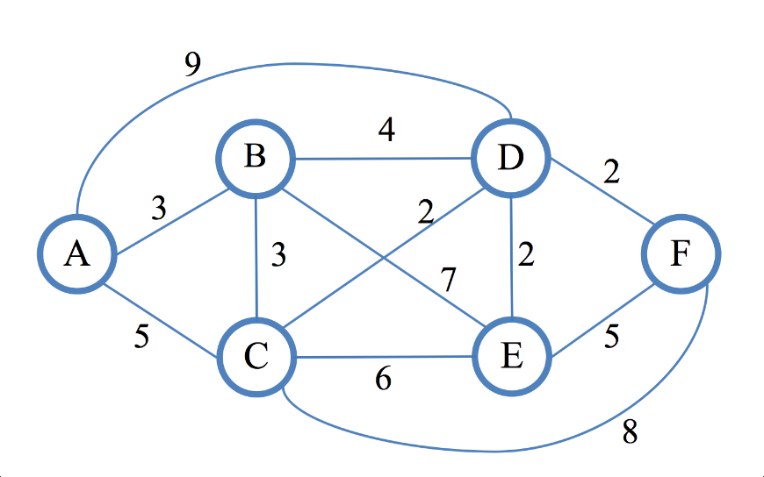
Graph Algorithms (Undirected)
Weighted graphs:
Shortest path (given 2 vertices)
All pairs shortest paths
Minimum spanning tree
Maximum matching
Unweighted graphs:
General "templates":
Depth-first search
Breadth-first search
Specific algorithms:
Connected components
Vertex coloring (also edge coloring)
Matching (creating pairs of vertices – as many as possible)

Slide 19
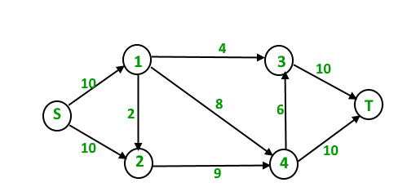
Graph Algorithms (Directed Graphs)
Weighted:
Maximum flow in a flow/transportation network
Shortest paths
Unweighted
Topological sorting
Strongly connected components
Cycle detection
Also different flavors of
Depth-first search
Breadth-first search

Slide 20
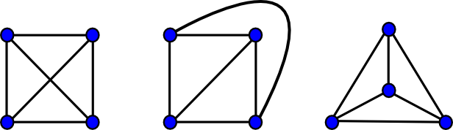
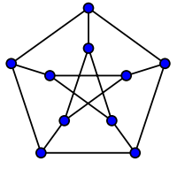
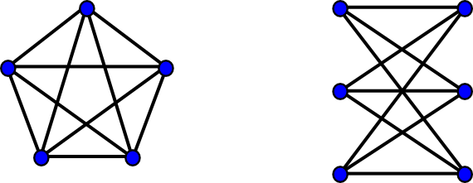
Planar Graphs
A graph is planar if and only if it does not contain a subgraph that is an expansion of either K₅ or K_{3,3}
(Expansion adds new vertices on existing edges)

Slide 21
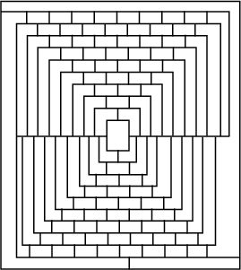
4-Color Theorem
Martin Gardner's example (difficult to color in 4 colors)
Any plane regions (and also any planar graph) can be colored using 4 colors so that neighboring vertices are colored differently.

Slide 22
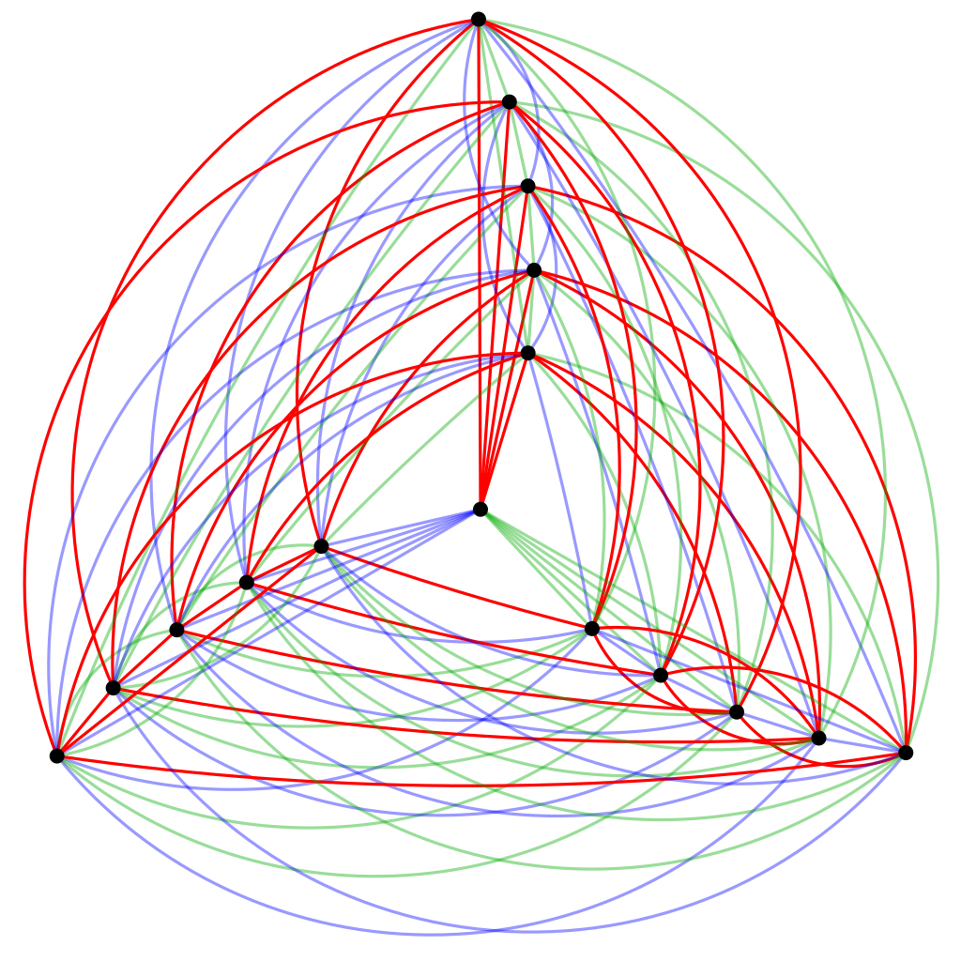
Ramsey Theory
R(3, 3, 3) = 17
If we color edges in a 17-vertice graph in 3 colors; there will be a triangle in the same color.
(For 16-vertice graphs there is a counterexample).

