Slide 1
Graph Terminology and Special Types of Graphs
Section 10.2

Slide 2
Section Summary
Basic Terminology
Some Special Types of Graphs
Bipartite Graphs
Bipartite Graphs and Matchings (not currently included in overheads)
Some Applications of Special Types of Graphs (not currently included in overheads)
New Graphs from Old

Slide 3

Basic Terminology
Definition 1. Two vertices u, v in an undirected graph G are called adjacent (or neighbors) in G if there is an edge e between u and v. Such an edge e is called incident with the vertices u and v and e is said to connect u and v.
Definition 2. The set of all neighbors of a vertex v of G = (V, E), denoted by N(v), is called the neighborhood of v. If A is a subset of V, we denote by N(A) the set of all vertices in G that are adjacent to at least one vertex in A. So,
Definition 3. The degree of a vertex in a undirected graph is the number of edges incident with it, except that a loop at a vertex contributes two to the degree of that vertex. The degree of the vertex v is denoted by deg(v).

Slide 4
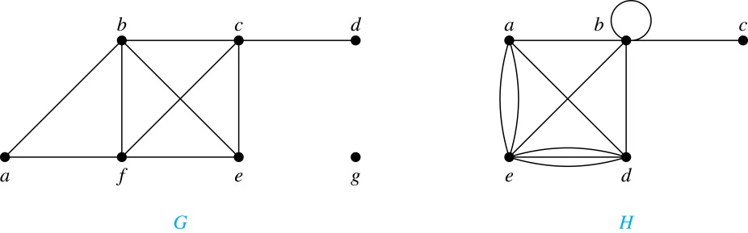
Degrees and Neighborhoods of Vertices
Example: What are the degrees and neighborhoods of the vertices in the graphs G and H?
Solution:
G: deg(a) = 2, deg(b) = deg(c) = deg(f ) = 4, deg(d ) = 1, deg(e) = 3, deg(g) = 0.
N(a) = {b, f }, N(b) = {a, c, e, f }, N(c) = {b, d, e, f }, N(d) = {c},
N(e) = {b, c , f }, N(f) = {a, b, c, e}, N(g) = ∅ .
H: deg(a) = 4, deg(b) = deg(e) = 6, deg(c) = 1, deg(d) = 5.
N(a) = {b, d, e}, N(b) = {a, b, c, d, e}, N(c) = {b}, N(d) = {a, b, e}, N(e) = {a, b ,d}.

Slide 5
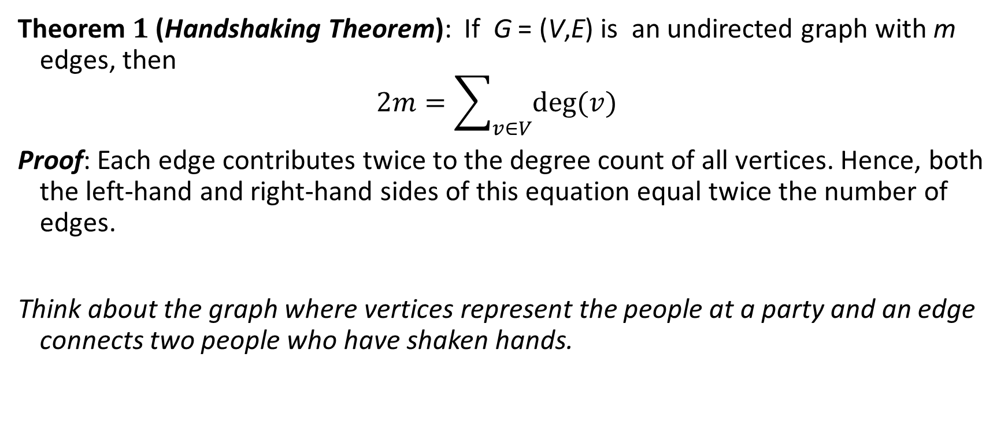
Degrees of Vertices
Theorem 1 (Handshaking Theorem): If G = (V,E) is an undirected graph with m edges, then
$$2m=\sum_{v∈V}{deg⁡(v)}$$
Proof: Each edge contributes twice to the degree count of all vertices. Hence, both the left-hand and right-hand sides of this equation equal twice the number of edges.
Think about the graph where vertices represent the people at a party and an edge connects two people who have shaken hands.

Slide 6
Handshaking Theorem
We now give two examples illustrating the usefulness of the handshaking theorem.
Example: How many edges are there in a graph with 10 vertices of degree six?
Solution: Because the sum of the degrees of the vertices is 6 ⋅ 10 = 60, the handshaking theorem states that 2m = 60. So the edges m = 30.
Example: If a graph has 5 vertices, can each vertex have degree 3?
Solution: This is not possible by the handshaking thorem, because the sum of the degrees of the vertices 3 ⋅ 5 = 15 is odd.

Slide 7
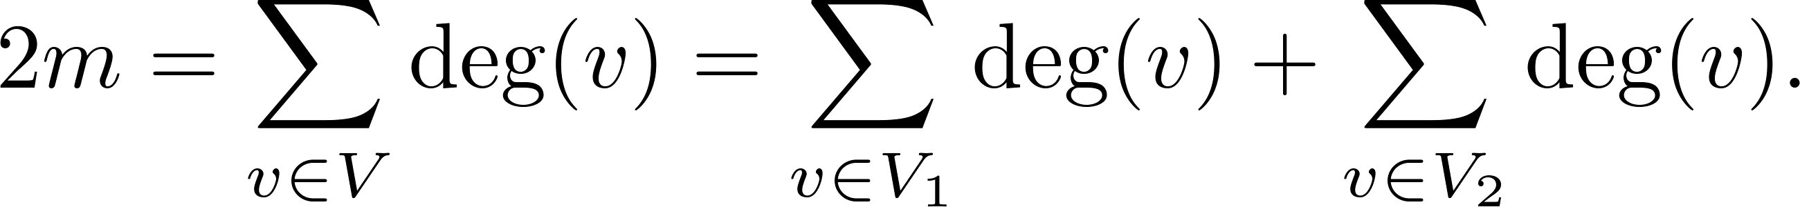
Degree of Vertices (continued)
Theorem 2: An undirected graph has an even number of vertices of odd degree.
Proof: Let V₁ be the vertices of even degree and V₂ be the vertices of odd degree in an undirected graph G = (V, E) with m edges. Then
even
This sum must be even because 2m is even and the sum of the degrees of the vertices of even degrees is also even. Because this is the sum of the degrees of all vertices of odd degree in the graph, there must be an even number of such vertices.
must be even since deg(v) is even for each v ∈ V₁

Slide 8
Directed Graphs
Recall the definition of a directed graph.
Definition: An directed graph G = (V, E) consists of V, a nonempty set of vertices (or nodes), and E, a set of directed edges or arcs. Each edge is an ordered pair of vertices. The directed edge (u,v) is said to start at u and end at v.
Definition: Let (u,v) be an edge in G. Then u is the initial vertex of this edge and is adjacent to v and v is the terminal (or end) vertex of this edge and is adjacent from u. The initial and terminal vertices of a loop are the same.

Slide 9
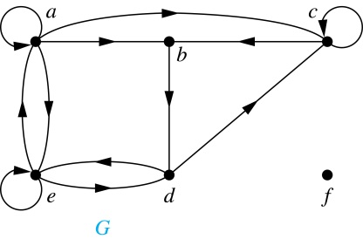
Directed Graphs (continued)
Definition: The in-degree of a vertex v, denoted deg⁻(v), is the number of edges which terminate at v. The out-degree of v, denoted deg⁺(v), is the number of edges with v as their initial vertex. Note that a loop at a vertex contributes 1 to both the in-degree and the out-degree of the vertex.
Example: In the graph G we have
deg⁻(a) = 2, deg⁻(b) = 2, deg⁻(c) = 3, deg⁻(d) = 2,
deg⁻(e) = 3, deg⁻(f) = 0.
deg⁺(a) = 4, deg⁺(b) = 1, deg⁺(c) = 2, deg⁺(d) = 2,
deg⁺ (e) = 3, deg⁺(f) = 0.

Slide 10
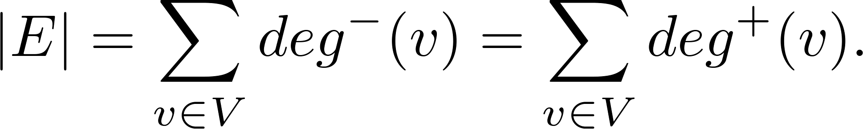
Directed Graphs (continued)
Theorem 3: Let G = (V, E) be a graph with directed edges. Then:
Proof: The first sum counts the number of outgoing edges over all vertices and the second sum counts the number of incoming edges over all vertices. It follows that both sums equal the number of edges in the graph.

Slide 11
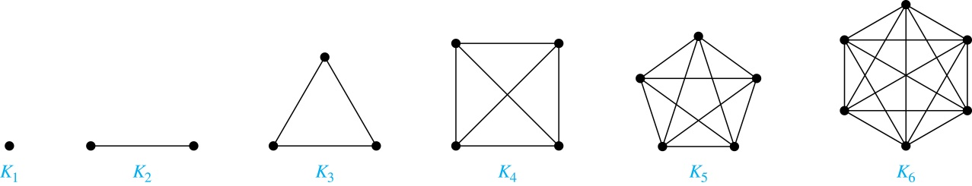

Special Types of Graphs: Complete Graphs
A complete graph on n vertices, denoted by $K_{n}$, is the simple graph that contains exactly one edge between each pair of distinct vertices.

Slide 12
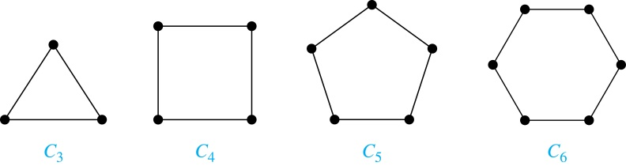
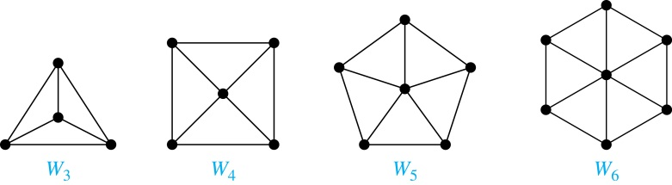
Special Types of Simple Graphs: Cycles and Wheels
A cycle C_{n} for n ≥ 3 consists of n vertices v₁, v₂ ,⋯ , v_{n}, and edges {v₁, v₂}, {v₂, v₃} ,⋯ , {v_{n-1}, v_{n}}, {v_{n}, v₁}.
A wheel W_{n} is obtained by adding an additional vertex to a cycle C_{n} for n ≥ 3 and connecting this new vertex to each of the n vertices in C_{n} by new edges.

Slide 13
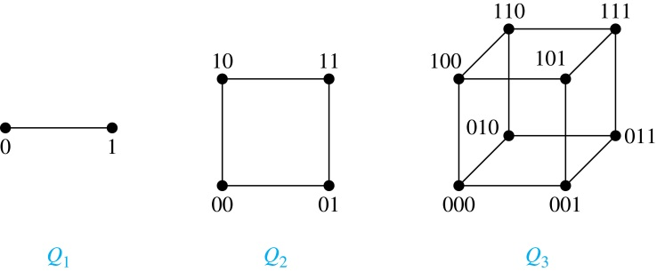
Special Types of Simple Graphs: n-Cubes
An n-dimensional hypercube, or n-cube, Q_{n}, is a graph with 2^{n} vertices representing all bit strings of length n, where there is an edge between two vertices that differ in exactly one bit position.

Slide 14
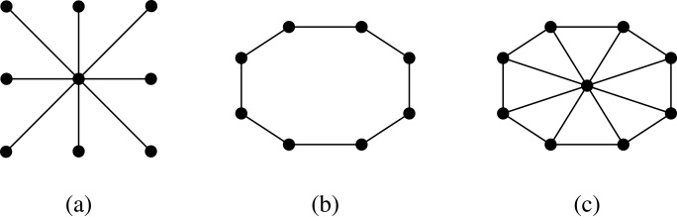
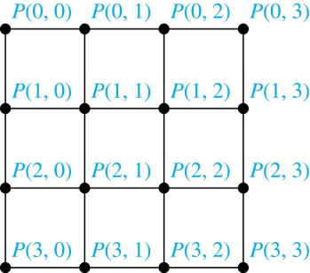
Special Types of Graphs and Computer Network Architecture
Various special graphs play an important role in the design of computer networks.
Some local area networks use a star topology, which is a complete bipartite graph K_{1,n} ,as shown in (a). All devices are connected to a central control device.
Other local networks are based on a ring topology, where each device is connected to exactly two others using C_{n} ,as illustrated in (b). Messages may be sent around the ring.
Others, as illustrated in (c), use a W_{n} – based topology, combining the features of a star topology and a ring topology.
Various special graphs also play a role in parallel processing where processors need to be interconnected as one processor may need the output generated by another.
The n-dimensional hypercube, or n-cube, Q_{n}, is a common way to connect processors in parallel, e.g., Intel Hypercube.
Another common method is the mesh network, illustrated here for 16 processors.

Slide 15
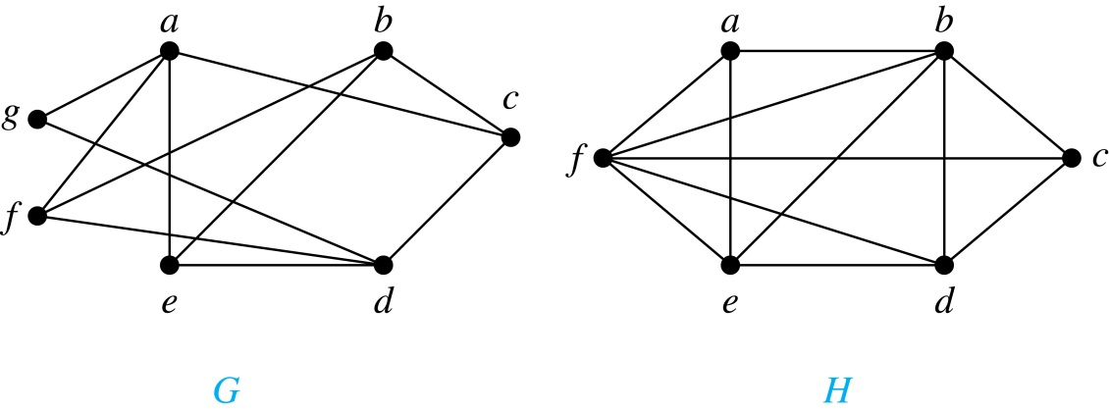
Bipartite Graphs
Definition: A simple graph G is bipartite if V can be partitioned into two disjoint subsets V₁ and V₂ such that every edge connects a vertex in V₁ and a vertex in V₂. In other words, there are no edges which connect two vertices in V₁ or in V₂.
It is not hard to show that an equivalent definition of a bipartite graph is a graph where it is possible to color the vertices red or blue so that no two adjacent vertices are the same color.
H is not bipartite
since if we color a red, then the adjacent vertices f and b must both be blue.
G is bipartite

Slide 16
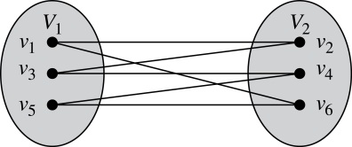
Bipartite Graphs (continued)
Example: Show that C₆ is bipartite.
Solution: We can partition the vertex set into V₁ = {v₁, v₃, v₅} and V₂ = {v₂, v₄, v₆} so that every edge of C₆ connects a vertex in V₁ and V₂ .
Example: Show that C₃ is not bipartite.
Solution: If we divide the vertex set of C₃ into two nonempty sets, one of the two must contain two vertices. But in C₃ every vertex is connected to every other vertex. Therefore, the two vertices in the same partition are connected. Hence, C₃ is not bipartite.

Slide 17
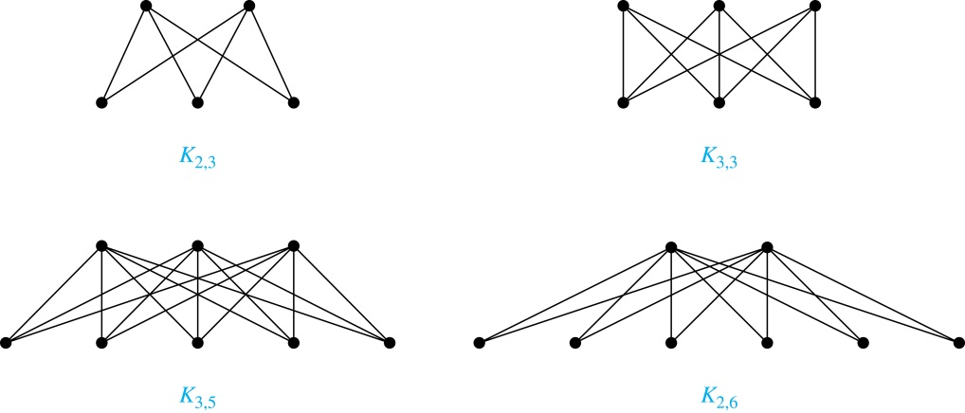
Complete Bipartite Graphs
Definition: A complete bipartite graph K_{m,n} is a graph that has its vertex set partitioned into two subsets V₁ of size m and V₂ of size n such that every vertex in V₁ connects to every vertex in V₂.
Example: We display four complete bipartite graphs here.

Slide 18
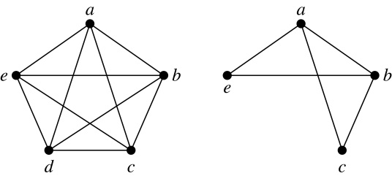
New Graphs from Old
Definition: A subgraph of a graph G = (V,E) is a graph (W,F), where W ⊂ V and F ⊂ E. A subgraph H of G is a proper subgraph of G if H ≠ G.
Example: Here we show K₅ and one of its subgraphs.
Definition: Let G = (V, E) be a simple graph. The subgraph induced by a subset W of the vertex set V is the graph (W,F), where the edge set F contains an edge in E if and only if both endpoints are in W.
Example: Here we show K₅ and the subgraph induced by W = {a,b,c,e}.

Slide 19
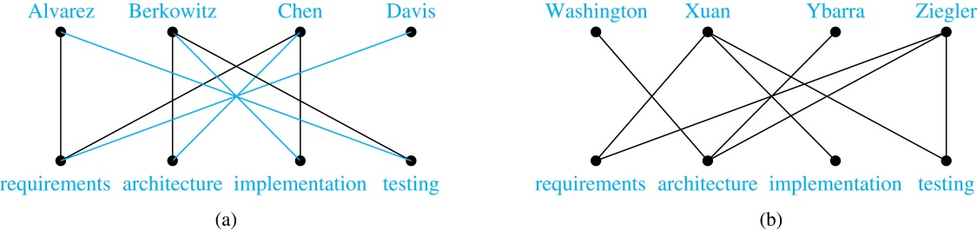
Bipartite Graphs and Matchings
Bipartite graphs are used to model applications that involve matching the elements of one set to elements in another, for example:
Job assignments - vertices represent the jobs and the employees, edges link employees with those jobs they have been trained to do. A common goal is to match jobs to employees so that the most jobs are done.
Marriage - vertices represent the men and the women and edges link a a man and a woman if they are an acceptable spouse. We may wish to find the largest number of possible marriages.
See the text for more about matchings in bipartite graphs.

Slide 20
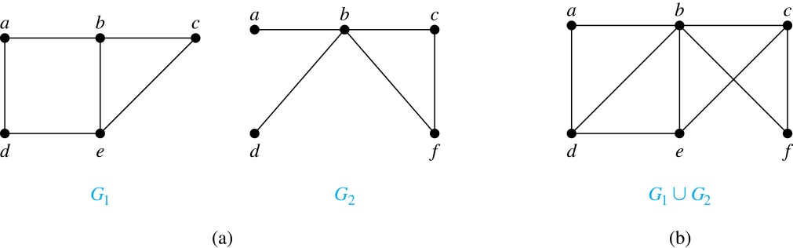
New Graphs from Old (continued)
Definition: The union of two simple graphs G₁ = (V₁, E₁) and G₂ = (V₂, E₂) is the simple graph with vertex set V₁ ⋃ V₂ and edge set E₁ ⋃ E₂. The union of G₁ and G₂ is denoted by G₁ ⋃ G₂.
Example:

Slide 21
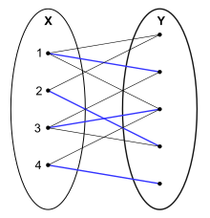
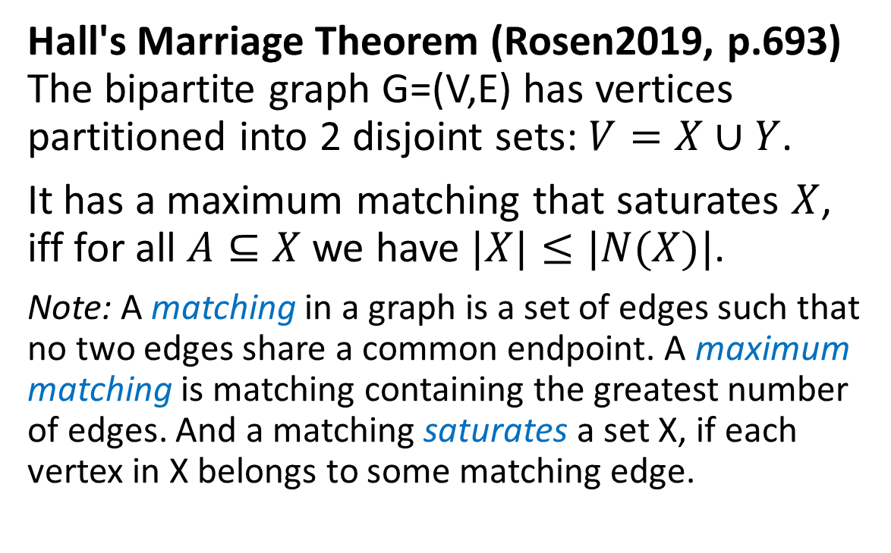
Hall’s «Marriage Theorem»
Hall's Marriage Theorem (Rosen2019, p.693) The bipartite graph G=(V,E) has vertices partitioned into 2 disjoint sets: $V=X∪Y$.
It has a maximum matching that saturates $X$, iff for all $A⊆X$ we have $|X|≤|N(X)|$.
Note: A matching in a graph is a set of edges such that no two edges share a common endpoint. A maximum matching is matching containing the greatest number of edges. And a matching saturates a set X, if each vertex in X belongs to some matching edge.
Philip Hall (1935)

Slide 22
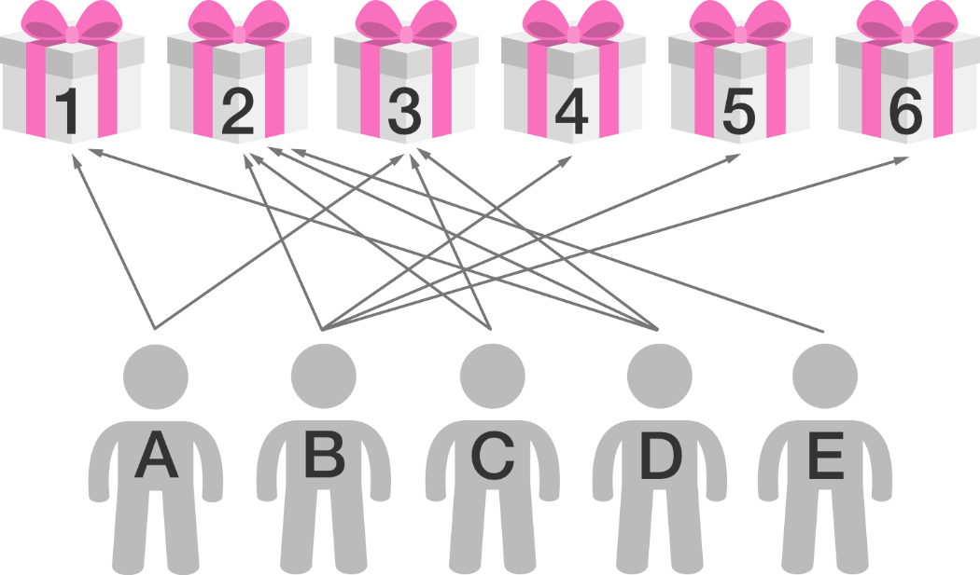
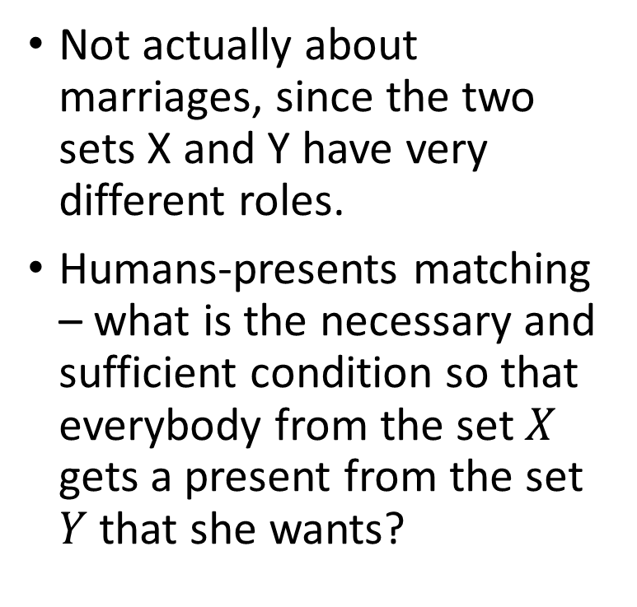
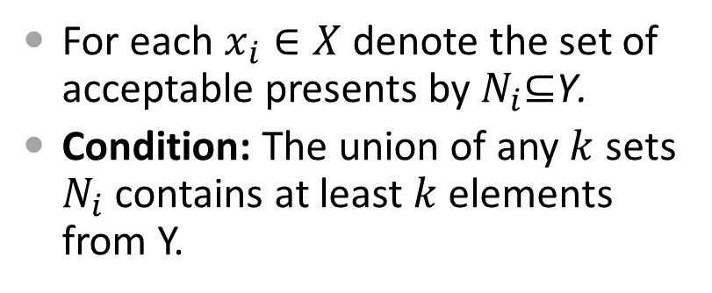


Intuition for the Theorem
Not actually about marriages, since the two sets X and Y have very different roles.
Humans-presents matching – what is the necessary and sufficient condition so that everybody from the set $X$ gets a present from the set $Y$that she wants?
$$Y$$
$$X$$
For each $x_{i}∈X$ denote the set of acceptable presents by $N_{i}\text{⊆}\text{Y}\text{.}$
Condition: The union of any $k$ sets $N_{i}$ contains at least $k$ elements from Y.

Slide 23
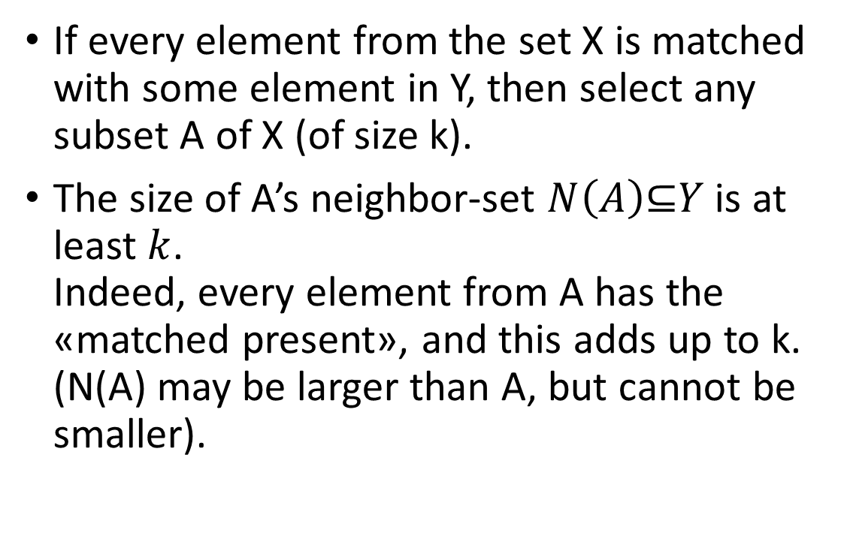
Why the Condition is Necessary?
If every element from the set X is matched with some element in Y, then select any subset A of X (of size k).
The size of A’s neighbor-set $N\left(A\right)\text{⊆}Y$ is at least $k$. Indeed, every element from A has the «matched present», and this adds up to k. (N(A) may be larger than A, but cannot be smaller).

Slide 24
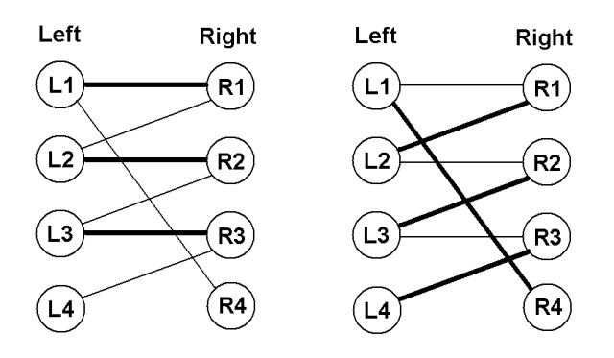
Why the Condition is Sufficient?
From the contrary – assume that some matching between the sets X and Y contains the maximal possible number of edges (but there are still unmatched elements in X).
Consider one such element (say, L4). Consider all «non-matching» edges ((L4,R3) etc. – going to the set Y).
Then go back from Y to X using only «matching» edges.
Then from X to Y, using «non-matching» edges and so on.
Claim: All such «alternating paths» should end on the X’s side.

Slide 25
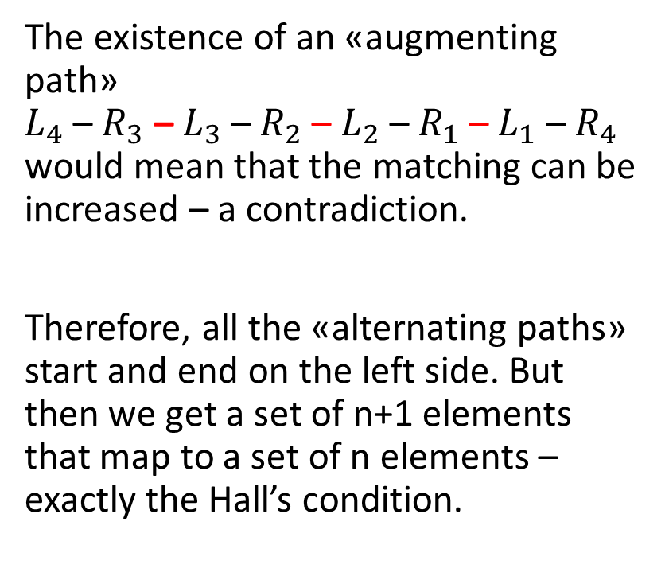
Augmenting Paths
The existence of an «augmenting path» $L_{4}$ – $R_{3}$ – $L_{3}$ – $R_{2}$ – $L_{2}$ – $R_{1}$ – $L_{1}$ – $R_{4}$ would mean that the matching can be increased – a contradiction.
Therefore, all the «alternating paths» start and end on the left side. But then we get a set of n+1 elements that map to a set of n elements – exactly the Hall’s condition.

