Slide 1
Representing Graphs and Graph Isomorphism
Section 10.3
Notes:
https://www.semanticscholar.org/paper/(Knight)-3-%3A-A-Graphical-Perspective-of-the-Tour-on-Neilan/40158e514ca008e03a3c6b1dfddf4c3710579393

Slide 2
Section Summary
Adjacency Lists
Adjacency Matrices
Incidence Matrices
Isomorphism of Graphs

Slide 3
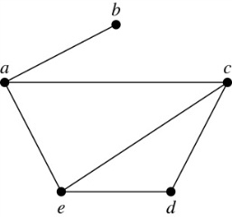
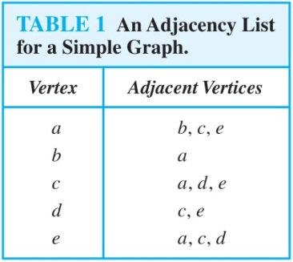
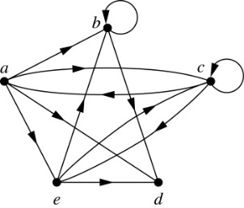
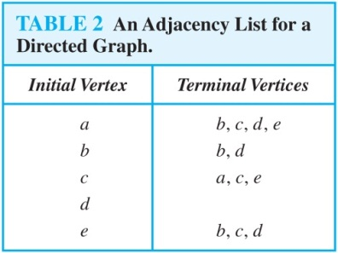
Representing Graphs: Adjacency Lists
Definition: An adjacency list can be used to represent a graph with no multiple edges by specifying the vertices that are adjacent to each vertex of the graph.

Slide 4
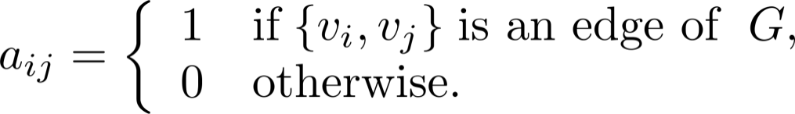

Representation of Graphs
Definition: Suppose that G = (V, E) is a simple graph where |V| = n. List the vertices of G as v₁, v₂, … , v_{n}. The adjacency matrix A_{G} of G, is the n × n zero-one matrix where $a_{ij}=1$ iff v_{i} and v_{j} are adjacent.

Slide 5
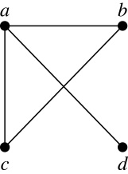
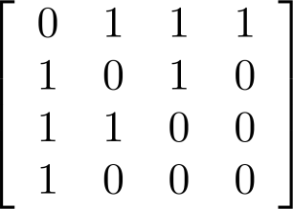
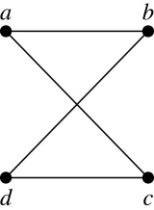
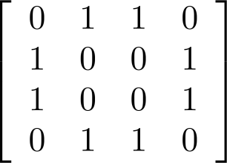
Adjacency Matrices – 1
Example:
When a graph is sparse, that is, it has few edges relatively to the total number of possible edges, it is much more efficient to represent the graph using an adjacency list than an adjacency matrix. But for a dense graph, which includes a high percentage of possible edges, an adjacency matrix is preferable.
The ordering of
vertices is a, b, c, d.
The ordering of
vertices is a, b, c, d.
Note: The adjacency matrix of a simple graph is symmetric, i.e., a_{ij} = a_{ji}
Also, since there are no loops, each diagonal entry a_{ij} for i = 1, 2, 3, …, n, is 0.

Slide 6
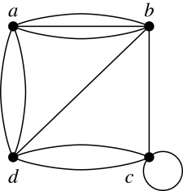
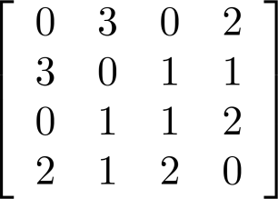
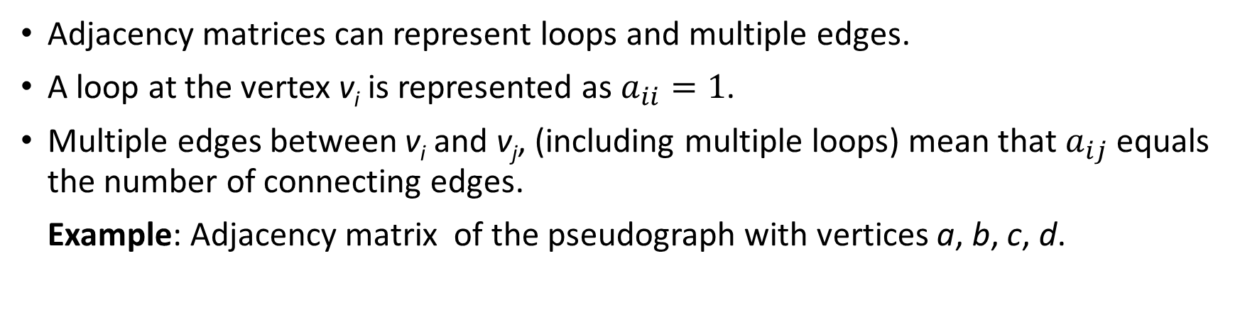
Adjacency Matrices (continued)
Adjacency matrices can represent loops and multiple edges.
A loop at the vertex v_{i} is represented as $a_{ii}=1$.
Multiple edges between v_{i} and v_{j}, (including multiple loops) mean that $a_{ij}$ equals the number of connecting edges.
Example: Adjacency matrix of the pseudograph with vertices a, b, c, d.

Slide 7
Adjacency Matrices (continued)
Adjacency matrices can also be used to represent directed graphs. The matrix for a directed graph G = (V, E) has a 1 in its (i, j)th position if there is an edge from v_{i} to v_{j}, where v₁, v₂, … v_{n} is a list of the vertices.
In other words, if the graphs adjacency matrix is A_{G} = [a_{ij}], then
The adjacency matrix for a directed graph does not have to be symmetric, because there may not be an edge from v_{i} to v_{j}, when there is an edge from v_{j} to v_{i}.
To represent directed multigraphs, the value of a_{ij} is the number of edges connecting v_{i} to v_{j}.

Slide 8
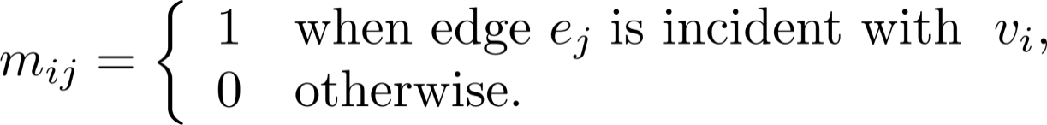
Representation of Graphs: Incidence Matrices
Definition: Let G = (V, E) be an undirected graph with vertices where v₁, v₂, … v_{n} and edges e₁, e₂, … e_{m}. The incidence matrix with respect to the ordering of V and E is the n × m matrix M = [m_{ij}], where

Slide 9
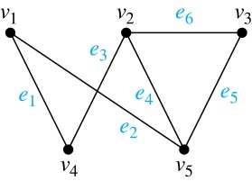
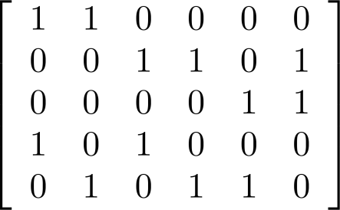
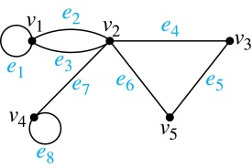
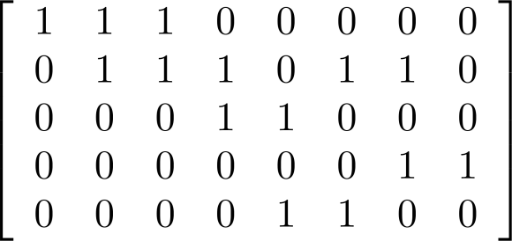
Incidence Matrices (continued)
Example: Simple Graph and Incidence Matrix
The rows going from top to bottom represent v₁ through v₅ and the columns going from left to right represent e₁ through e₆.
Example: Pseudograph and Incidence Matrix
The rows going from top to bottom represent v₁ through v₅ and the columns going from left to right represent e₁ through e₈.

Slide 10
Graph Isomorphism: Definition
Definition: The simple graphs G₁ = (V₁, E₁) and G₂ = (V₂, E₂) are isomorphic if there is a one-to-one and onto function f from V₁ to V₂ with the property that a and b are adjacent in G₁ if and only if f(a) and f(b) are adjacent in G₂ , for all a and b in V₁ . Such a function f is called an isomorphism. Two simple graphs that are not isomorphic are called nonisomorphic.

Slide 11
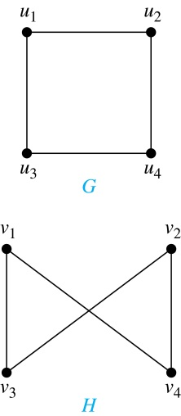
Graph Isomorphism: Example 1
Example: Show that the graphs G =(V, E) and H = (W, F) are isomorphic.
Solution: The function f with f(u₁) = v₁,
f(u₂) = v₄, f(u₃) = v₃, and f(u₄) = v₂ is a
one-to-one correspondence between V and W. Note that adjacent vertices in G are u₁ and u₂, u₁ and u₃, u₂ and u₄, and u₃ and u₄. Each of the pairs f(u₁) = v₁ and f(u₂) = v₄, f(u₁) = v₁ and f(u₃) = v₃ , f(u₂) = v₄ and f(u₄) = v₂ , and f(u₃) = v₃ and f(u₄) = v₂ consists of two adjacent vertices in H.

Slide 12
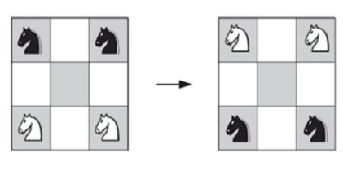
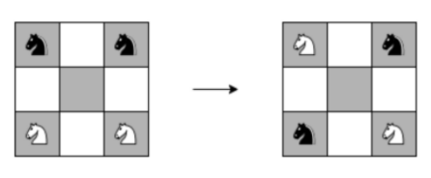
Graph Isomorphism: Example 2
Guarini Problem (around 1512)
Can the chess knights exchange their positions as shown in the diagrams?

Slide 13
Graph Isomorphism: Complexity
It is difficult to determine whether two simple graphs are isomorphic using brute force because there are n! possible one-to-one correspondences between the vertex sets of two simple graphs with n vertices.
The best algorithms for determining weather two graphs are isomorphic have exponential worst case complexity in terms of the number of vertices of the graphs.
Sometimes it is not hard to show that two graphs are not isomorphic. We can do so by finding a property, preserved by isomorphism, that only one of the two graphs has. Such a property is called graph invariant.
There are many different useful graph invariants that can be used to distinguish nonisomorphic graphs, such as the number of vertices, number of edges, and degree sequence (list of the degrees of the vertices in nonincreasing order). We will encounter others in later sections of this chapter.

Slide 14
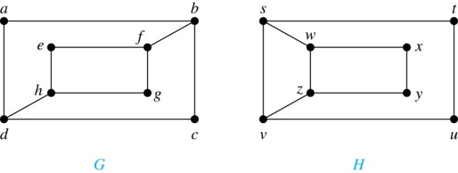
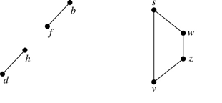
Graph Isomorphism: Disproving
Example: Determine whether these two graphs are isomorphic.
Proof 1: Both graphs have eight vertices and ten edges. Both have four vertices of degree two and four of degree three. However, G and H are not isomorphic. Since deg(a) = 2 in G, a must correspond to t, u, x, or y in H, because these are the vertices of degree 2. But each of these vertices is adjacent to another vertex of degree two in H (cannot be true in G).
Proof 2: The subgraphs of G and H made up of vertices of degree three and the edges connecting them must be isomorphic. But the subgraphs, as shown at the right, are not isomorphic.

Slide 15
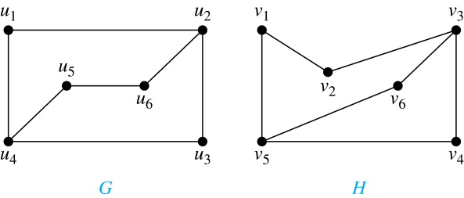
Graph Isomorphism: Proving
Example: Determine whether these two graphs are isomorphic.
Solution: Both graphs have six vertices and seven edges.
They also both have four vertices of degree two and two of degree three.
The subgraphs of G and H consisting of all the vertices of degree two and the edges connecting them are isomorphic. So, it is reasonable to try to find an isomorphism f.
The function f with f(u₁) = v₆, f(u₂) = v₃, f(u₃) = v₄, and f(u₄) = v₅ , f(u₅) = v₁, and f(u₆) = v₂ is a one-to-one correspondence between G and H. Showing that this correspondence preserves edges is straightforward, so we will omit the details here. Because f is an isomorphism, it follows that G and H are isomorphic graphs.

