Slide 1
Connectivity
Section 10.4

Slide 2
Section Summary
Paths
Connectedness in Undirected Graphs
Vertex Connectivity and Edge Connectivity (not currently included in overheads)
Connectedness in Directed Graphs
Paths and Isomorphism (not currently included in overheads)
Counting Paths between Vertices

Slide 3
Paths
Informal Definition: A path is a sequence of edges that begins at a vertex of a graph and travels from vertex to vertex along edges of the graph. As the path travels along its edges, it visits the vertices along this path, that is, the endpoints of these.
Applications: Numerous problems can be modeled with paths formed by traveling along edges of graphs such as:
determining whether a message can be sent between two computers.
efficiently planning routes for mail delivery.

Slide 4
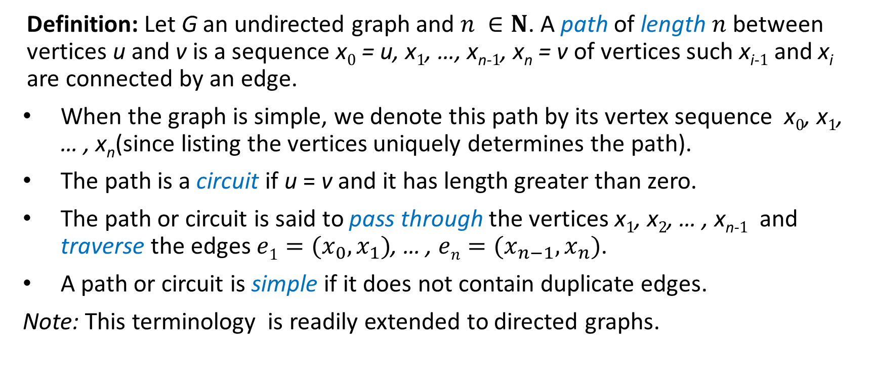
Paths
Definition: Let G an undirected graph and $n ∈N$. A path of length $n$ between vertices u and v is a sequence x₀ = u, x₁, …, x_{n-1}, x_{n} = v of vertices such x_{i-1} and x_{i} are connected by an edge.
When the graph is simple, we denote this path by its vertex sequence x₀, x₁, … , x_{n}(since listing the vertices uniquely determines the path).
The path is a circuit if u = v and it has length greater than zero.
The path or circuit is said to pass through the vertices x₁, x₂, … , x_{n-1} and traverse the edges $e1=(x_{0},x_{1})$, … , $en=(x_{n−1},x_{n})$.
A path or circuit is simple if it does not contain duplicate edges.
Note: This terminology is readily extended to directed graphs.

Slide 5
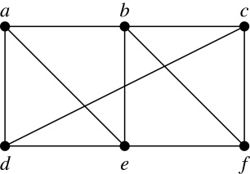
Paths (continued)
Example: In the simple graph here:
a, d, c, f, e is a simple path of length 4.
d, e, c, a is not a path because e is not connected to c.
b, c, f, e, b is a circuit of length 4.
a, b, e, d, a, b is a path of length 5, but it is not a simple path.

Slide 6
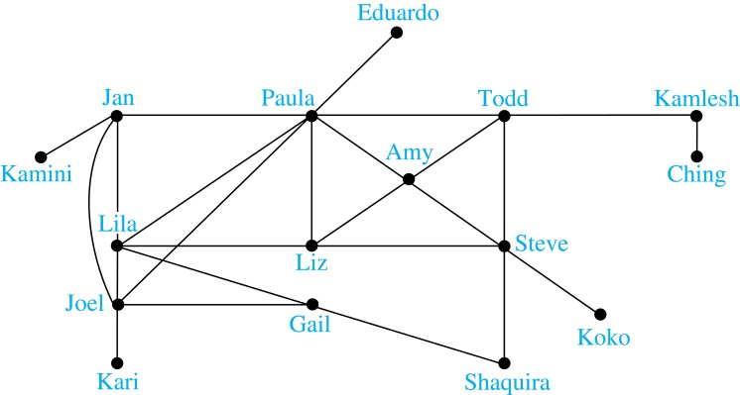
Degrees of Separation
Example: Paths in Acquaintanceship Graphs. In an acquaintanceship graph there is a path between two people if there is a chain of people linking these people, where two people adjacent in the chain know one another. In this graph there is a chain of six people linking Kamini and Ching.
Notes:
Some have speculated that almost every pair of people in the world are linked by a small chain of no more than six, or maybe even, five people. The play Six Degrees of Separation by John Guare is based on this notion.

Slide 7

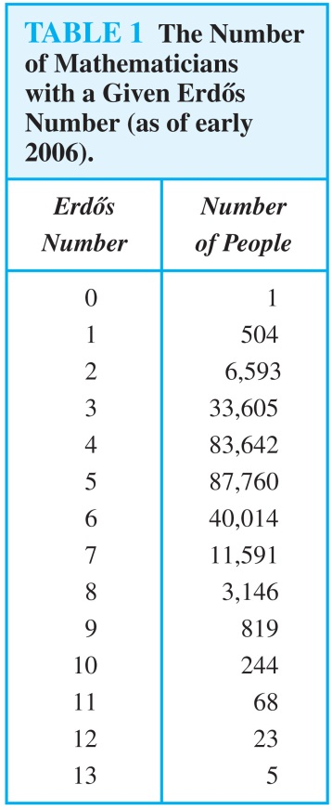
Erdős numbers
Paul Erdős
Example: Erdős numbers. In a collaboration graph, two people a and b are connected by a path when there is a sequence of people starting with a and ending with b such that the endpoints of each edge in the path are people who have collaborated.
In the academic collaboration graph of people who have written papers in mathematics, the Erdős number of a person m is the length of the shortest path between m and the prolific mathematician Paul Erdős.
To learn more about Erdős numbers, visit
http://www.ams.org/mathscinet/collaborationDistance.html

Slide 8
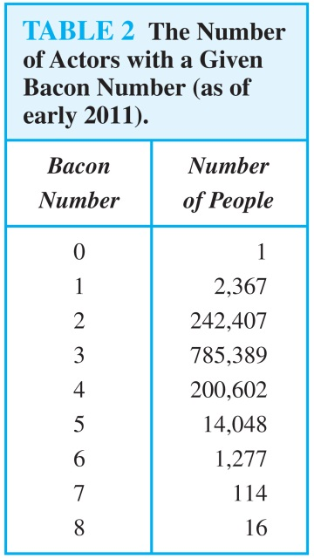
Bacon Numbrers
In the Hollywood graph, two actors a and b are linked when there is a chain of actors linking a and b, where every two actors adjacent in the chain have acted in the same movie.
The Bacon number of an actor c is defined to be the length of the shortest path connecting c and the well-known actor Kevin Bacon. (Note that we can define a similar number by replacing Kevin Bacon by a different actor.)
The oracle of Bacon web site http://oracleofbacon.org/how.php provides a tool for finding Bacon numbers.

Slide 9
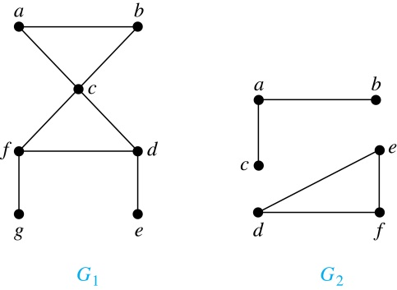
Connectedness in Undirected Graphs
Definition: An undirected graph is called connected if there is a path between every pair of vertices. An undirected graph that is not connected is called disconnected. We say that we disconnect a graph when we remove vertices or edges, or both, to produce a disconnected subgraph.
Example: G₁ is connected because there is a path between any pair of its vertices, as can be easily seen. However G₂ is not connected because there is no path between vertices a and f, for example.

Slide 10
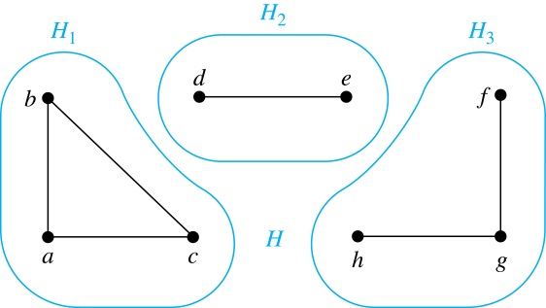
Connected Components
Definition: A connected component of a graph G is a connected subgraph of G that is not a proper subgraph of another connected subgraph of G. A graph G that is not connected has two or more connected components that are disjoint and have G as their union.
Example: The graph H is the union of three disjoint subgraphs H₁, H₂, and H₃, none of which are proper subgraphs of a larger connected subgraph of G.These three subgraphs are the connected components of H.

Slide 11
Connectedness in Directed Graphs
Definition: A directed graph is strongly connected if there is a path from a to b and a path from b to a whenever a and b are vertices in the graph.
Definition: A directed graph is weakly connected if there is a path between every two vertices in the underlying undirected graph, which is the undirected graph obtained by ignoring the directions of the edges of the directed graph.

Slide 12
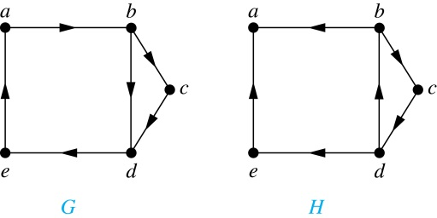
Connectedness in Directed Graphs (continued)
Example: G is strongly connected because there is a path between any two vertices in the directed graph. Hence, G is also weakly connected. The graph H is not strongly connected, since there is no directed path from a to b, but it is weakly connected.
Definition: The subgraphs of a directed graph G that are strongly connected but not contained in larger strongly connected subgraphs, that is, the maximal strongly connected subgraphs, are called the strongly connected components or strong components of G.
Example (continued): The graph H has three strongly connected components, consisting of the vertex a; the vertex e; and the subgraph consisting of the vertices b, c, d and edges (b,c), (c,d), and (d,b).

Slide 13
The Connected Components of the Web Graph
Recall that at any particular instant the web graph provides a snapshot of the web, where vertices represent web pages and edges represent links. According to a 1999 study, the Web graph at that time had over 200 million vertices and over 1.5 billion edges. (The numbers today are several orders of magnitude larger.)
The underlying undirected graph of this Web graph has a connected component that includes approximately 90% of the vertices.
There is a giant strongly connected component (GSCC) consisting of more than 53 million vertices. A Web page in this component can be reached by following links starting in any other page of the component. There are three other categories of pages with each having about 44 million vertices:
pages that can be reached from a page in the GSCC, but do not link back.
pages that link back to the GSCC, but can not be reached by following links from pages in the GSCC.
pages that cannot reach pages in the GSCC and can not be reached from pages in the GSCC.

Slide 14
Counting Paths between Vertices
We can use the adjacency matrix of a graph to find the number of paths between two vertices in the graph.
Theorem: Let G be a graph with adjacency matrix A with respect to the ordering v₁, … , v_{n} of vertices (with directed or undirected edges, multiple edges and loops allowed). The number of different paths of length r from v_{i} to v_{j}, where r >0 is a positive integer, equals the (i,j)th entry of A^{r}.
Proof by mathematical induction:
Basis Step: By definition of the adjacency matrix, the number of paths from v_{i} to v_{j} of length 1 is the (i,j)th entry of A.
Inductive Step: For the inductive hypothesis, we assume that that the (i,j)th entry of A^{r} is the number of different paths of length r from v_{i} to v_{j}.
Because A^{r+1} = A^{r} A, the (i,j)th entry of A^{r+1} equals b_{i1}a_{1j} + b_{i2}a_{2j} + ⋯ + b_{in}a_{nj}, where b_{ik} is the (i,k)th entry of A^{r}. By the inductive hypothesis, b_{ik} is the number of paths of length r from v_{i} to v_{k}.
A path of length r + 1 from v_{i} to v_{j} is made up of a path of length r from v_{i} to some v_{k} , and an edge from v_{k} to v_{j}. By the product rule for counting, the number of such paths is the product of the number of paths of length r from v_{i} to v_{k} (i.e., b_{ik} ) and the number of edges from from v_{k} to v_{j} (i.e, a_{kj}). The sum over all possible intermediate vertices v_{k} is b_{i1}a_{1j} + b_{i2}a_{2j} + ⋯ + b_{in}a_{nj} .

Slide 15
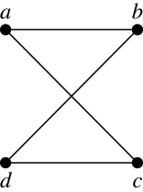
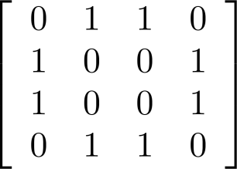
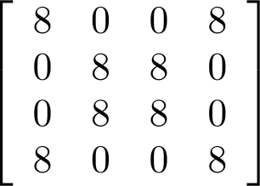
Counting Paths between Vertices (continued)
Example: How many paths of length four are there from a to d in the graph G.
Solution: The adjacency matrix of G (ordering the vertices as a, b, c, d) is given above. Hence the number of paths of length four from a to d is the (1, 4)th entry of A⁴ . The eight paths are as:
adjacency matrix of G
G
A =
A⁴ =
a, b, a, b, d a, b, a, c, d
a, b, d, b, d a, b, d, c, d
a, c, a, b, d a, c, a, c, d
a, c, d, b, d a, c, d, c, d

