Slide 1
Introduction to Trees
Section 11.1

Slide 2
Section Summary
Introduction to Trees
Rooted Trees
Trees as Models
Properties of Trees

Slide 3
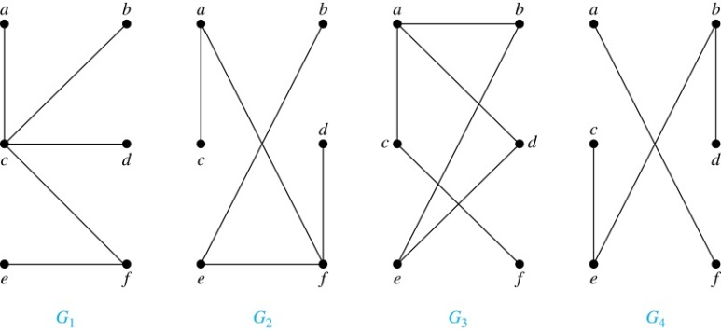
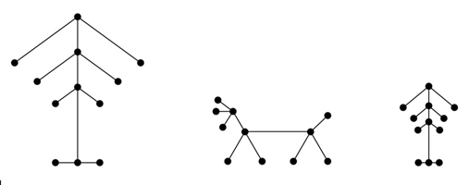
Trees – 1
Definition: A tree is a connected undirected graph with no simple circuits.
Example: G₁ and G₂ are trees. Because e, b, a, d, e is a simple circuit, G₃ is not a tree. G₄ is not a tree because it is not connected.
Definition: A forest is a graph that has no simple circuit, but is not connected. Each of the connected components in a forest is a tree.
Example: Picture shows a graph with 3 connected components

Slide 4
Trees – 2
Theorem: An undirected graph is a tree iff there is a unique simple path between any two of its vertices.
Proof: (⇒) Assume that T is a tree. Then T is connected with no simple circuits. Hence, if x and y are distinct vertices of T, there is a simple path between them (if there were a second path, there would be a simple circuit in T). Hence, there is a unique simple path between any two vertices of a tree.
(⇐) Assume that there is a unique simple path between any two vertices of a graph T. Then T is connected because there is a path between any two of its vertices. Furthermore, T can have no simple circuits since if there were a simple circuit, there would be two paths between some two vertices.
Hence, a graph with a unique simple path between any two vertices is a tree.

Slide 5
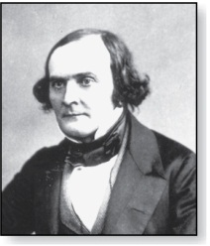
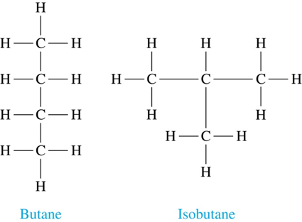
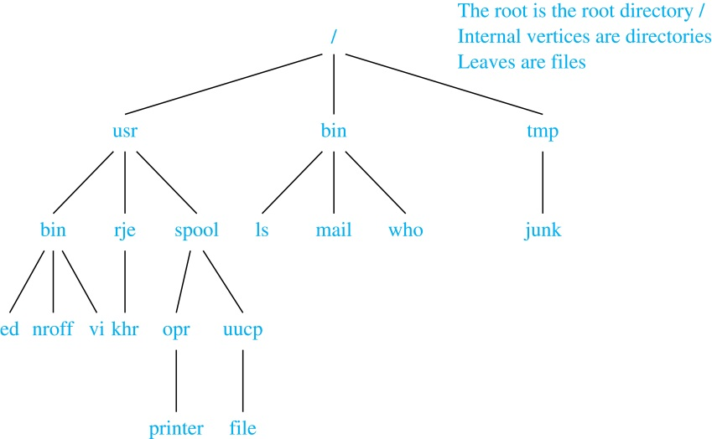
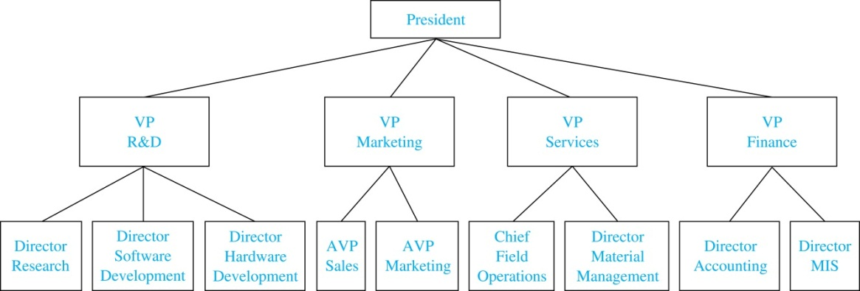
Trees as Models
Arthur Cayley
(1821-1895)
Trees in IT, chemistry, plant biology etc.
Trees introduced by Cayley in 1857 counting the number of isomers of saturated hydrocarbons (isomers of butane etc.)
File system into directories, subdirectories, and files is a tree
Trees are used to represent the structure of organizations.

Slide 6
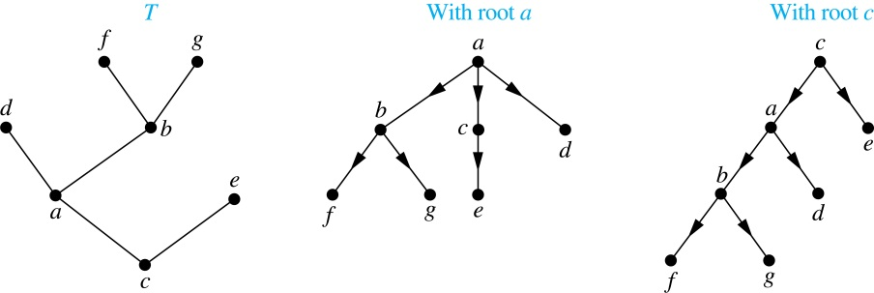
Rooted Trees
Definition: A rooted tree is a tree in which one vertex has been designated as the root and every edge is directed away from the root.
An unrooted tree is converted into different rooted trees when different vertices are chosen as the root.

Slide 7
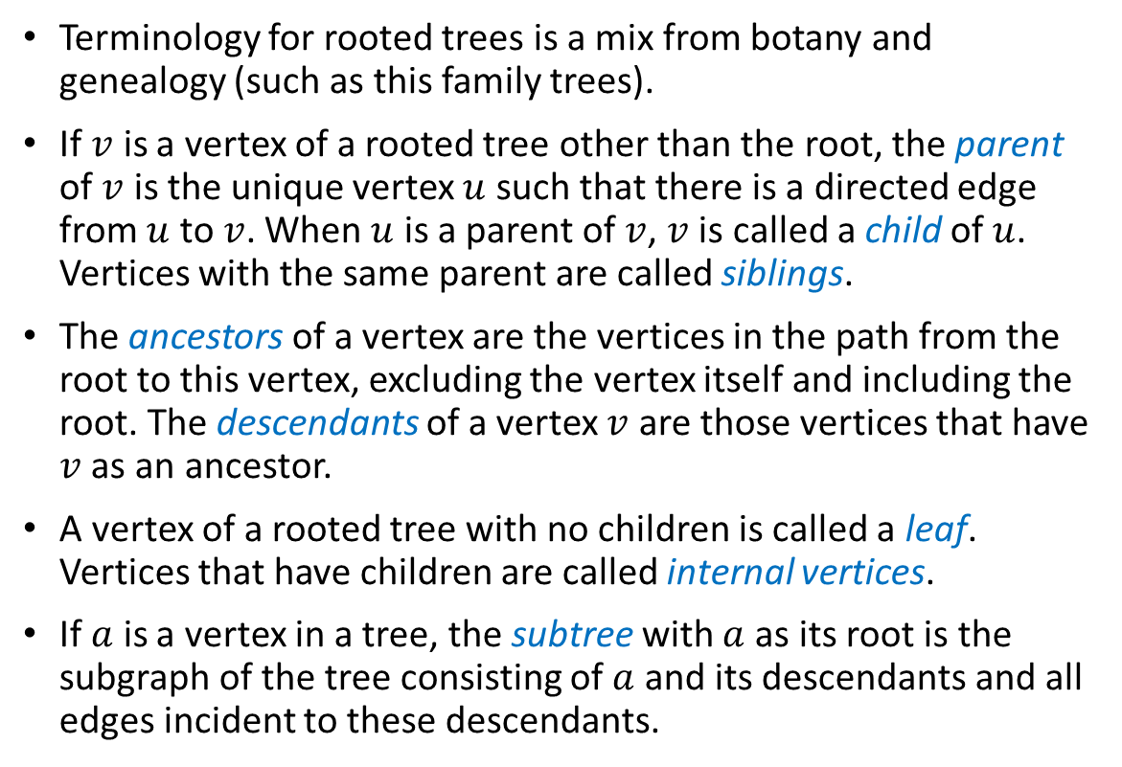
Rooted Tree Terminology
Terminology for rooted trees is a mix from botany and genealogy (such as this family trees).
If $v$ is a vertex of a rooted tree other than the root, the parent of $v$ is the unique vertex $u$ such that there is a directed edge from $u$ to $v$. When $u$ is a parent of $v$, $v$ is called a child of $u$. Vertices with the same parent are called siblings.
The ancestors of a vertex are the vertices in the path from the root to this vertex, excluding the vertex itself and including the root. The descendants of a vertex $v$ are those vertices that have $v$ as an ancestor.
A vertex of a rooted tree with no children is called a leaf. Vertices that have children are called internal vertices.
If $a$ is a vertex in a tree, the subtree with $a$ as its root is the subgraph of the tree consisting of $a$ and its descendants and all edges incident to these descendants.

Slide 8
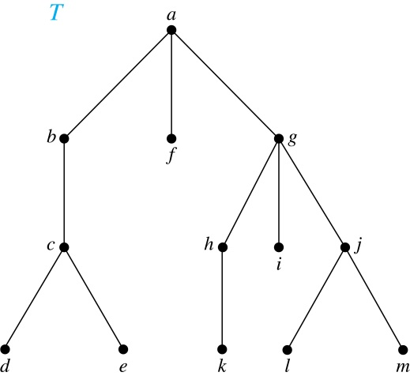
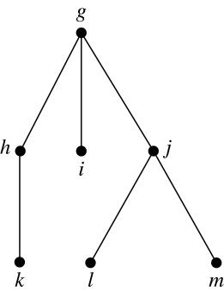
Terminology for Rooted Trees
Example: In the rooted tree T (with root a):
Find the parent of c, the children of g, the siblings of h, the ancestors of e, and the descendants of b.
Find all internal vertices and all leaves.
What is the subtree rooted at g?
Solution:
The parent of c is b. The children of g are h, i, and j. The siblings of h are i and j. The ancestors of e are c, b, and a. The descendants of b are c, d, and e.
The internal vertices are a, b, c, g, h, and j. The leaves are d, e, f, i, k, l, and m.
We display the subtree rooted at g.

Slide 9
Quiz 14A

Slide 10
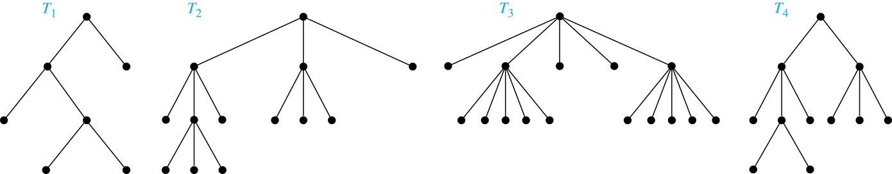
m-ary Rooted Trees
Definition: A rooted tree is called an m-ary tree if every internal vertex has no more than m children. The tree is called a full m-ary tree, if all internal vertices have exactly m children. An m-ary tree with m = 2 is called a binary tree.
Example: Are the following rooted trees full m-ary trees for some positive integer m?
Solution: T₁ is a full binary tree because each of its internal vertices has two children. T₂ is a full 3-ary tree because each of its internal vertices has three children. In T₃ each internal vertex has five children, so T₃ is a full 5-ary tree. T₄ is not a full m-ary tree for any m because some of its internal vertices have two children and others have three children.

Slide 11
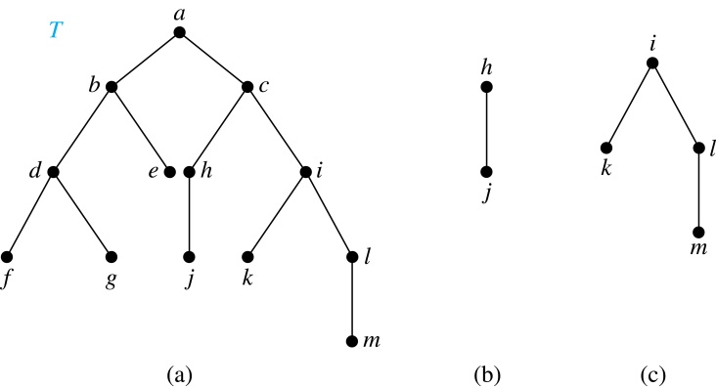
Ordered Rooted Trees
Definition: An ordered rooted tree is a rooted tree where the children of each internal vertex are ordered.
We draw ordered rooted trees so that the children are shown in order from left to right.
Definition: A binary tree is an ordered rooted where where each internal vertex has at most two children. If an internal vertex of a binary tree has two children, the first is called the left child and the second the right child. The tree rooted at the left child of a vertex is called the left subtree of this vertex, and the tree rooted at the right child of a vertex is called the right subtree of this vertex.
Example: Consider the binary tree T.
(i) What are the left and right children of d?
(ii) What are the left and right subtrees of c?
Solution:
(i) The left child of d is f and the right child is g.
(ii) The left and right subtrees of c are displayed in
(b) and (c).

Slide 12
Properties of Trees
Theorem 2: A tree with n vertices has n − 1 edges.
Proof (by mathematical induction):
Base Case: When n = 1, a tree with one vertex has no edges. Hence, the theorem holds when n = 1.
Inductive Step: Assume that every tree with k vertices has k − 1 edges. Suppose that a tree T has k + 1 vertices and that v is a leaf of T. Let w be the parent of v. Removing the vertex v and the edge connecting w to v produces a tree T′ with k vertices. By the inductive hypothesis, T′ has k − 1 edges. Because T has one more edge than T′, we see that T has k edges. This completes the inductive step.

Slide 13
Counting Vertices in Full m-Ary Trees – 1
Theorem 3: A full m-ary tree with i internal vertices has n = mi + 1 vertices.
Proof : Every vertex, except the root, is the child of an internal vertex. Because each of the i internal vertices has m children, there are mi vertices in the tree other than the root. Hence, the tree contains n = mi + 1 vertices.

Slide 14
Counting Vertices in Full m-Ary Trees – 2
Theorem 4: A full m-ary tree with
(i)
(ii)
(iii)
Proof (of part i): Solving for i in n = mi + 1 (from Theorem 3) gives i = (n − 1)/m. Since each vertex is either a leaf or an internal vertex, n = l + i. By solving for l and using the formula for i, we see that
n vertices has i = (n − 1)/m internal vertices and l = [(m − 1)n + 1]/m leaves,
i internal vertices has n = mi + 1 vertices and l = (m − 1)i + 1 leaves,
proofs of parts (ii) and (iii) are left as exercises
l leaves has n = (ml − 1)/(m − 1) vertices and i = (l − 1)/ (m − 1) internal vertices.
l = n − i = n − (n − 1)/m = [(m − 1)n + 1]/m .

Slide 15
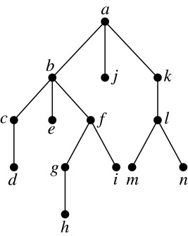
Level of vertices and height of trees
When working with trees, we often want to have rooted trees where the subtrees at each vertex contain paths of approximately the same length.
The level of a vertex v in a rooted tree is the length of the unique path from the root to this vertex.
The height of a rooted tree is the maximum of the levels of the vertices.
Example:
(i) Find the level of each vertex in
the tree to the right.
(ii) What is the height of the tree?
Solution:
(i) The root a is at level 0. Vertices b, j, and k are at level 1.
Vertices c, e, f, and l are at level 2. Vertices d, g, i, m, and n are at level 3.
Vertex h is at level 4.
(ii) The height is 4, since 4 is the largest level of any vertex.

Slide 16
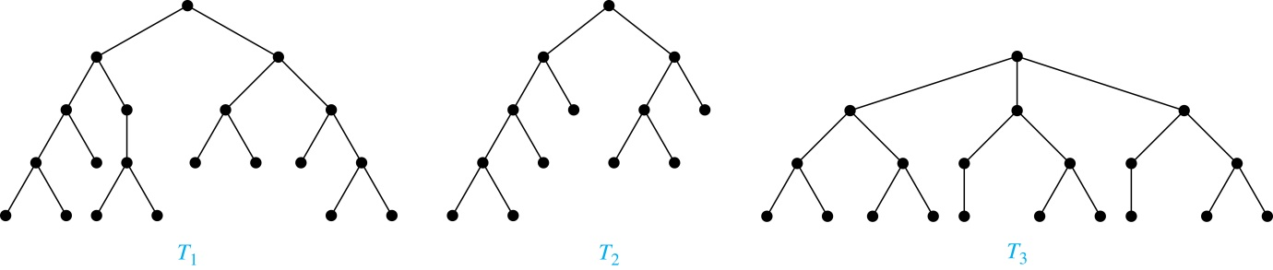
Balanced m-Ary Trees
Definition: A rooted m-ary tree of height h is balanced if all leaves are at levels h or h − 1.
Example: Which of the rooted trees shown below is balanced?
Solution: T₁ and T₃ are balanced, but T₂ is not because it has leaves at levels 2, 3, and 4.

Slide 17
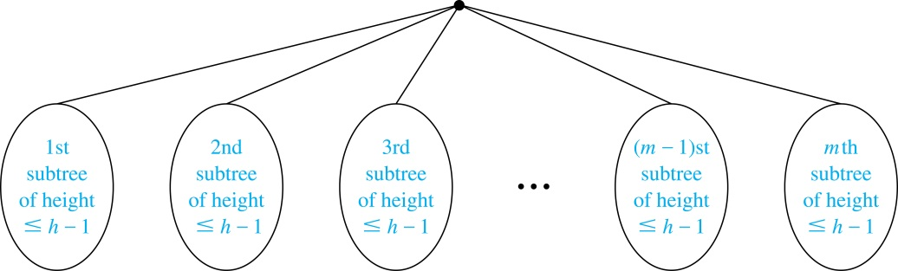
Number of Leaves in an m-Ary Tree
Theorem: There are at most m^{h} leaves in an m-ary tree of height h.
Proof by induction:
Base Case (h=1): Consider an m-ary trees of height 1. The tree has a root and no more than m leaves.
Inductive Step: Assume the result is true for all m-ary trees of height < h. Let T be an m-ary tree of height h. The leaves of T are the leaves of the subtrees of T we get when we delete the edges from the root to each of the vertices of level 1.
Each of these subtrees has height ≤ h− 1. By the inductive hypothesis, each of these subtrees has at most m^{h− 1} leaves. Since there are at most m such subtees, there are at most m⋅ m^{h− 1} = m^{h} leaves in the tree.
Corollary 1: If an m-ary tree of height h has l leaves, then h ≥ ⌈log_{m} l⌉. If the m-ary tree is full and balanced, then h = ⌈log_{m} l⌉.

