Slide 1
Tree Traversal
Section 11.3

Slide 2
Section Summary
Universal Address Systems (not currently included in overheads)
Traversal Algorithms
Infix, Prefix, and Postfix Notation

Slide 3
Tree Traversal
Procedures for systematically visiting every vertex of an ordered tree are called traversals.
The three most commonly used traversals are preorder traversal, inorder traversal, and postorder traversal.

Slide 4
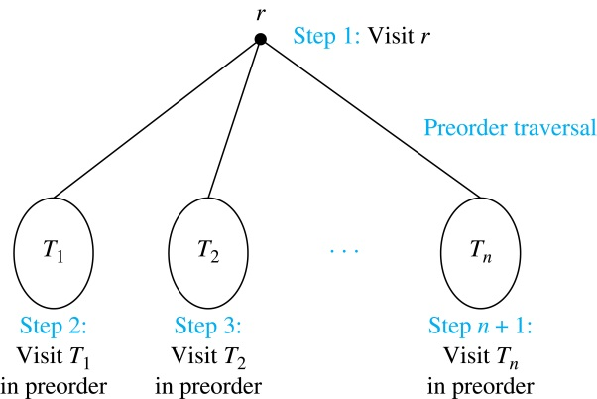
Preorder Traversal
Definition: Let T be an ordered rooted tree with root r. If T consists only of r, then r is the preorder traversal of T. Otherwise, suppose that T₁, T₂, …, T_{n} are the subtrees of r from left to right in T. The preorder traversal begins by visiting r, and continues by traversing T₁ in preorder, then T₂ in preorder, and so on, until T_{n} is traversed in preorder.

Slide 5
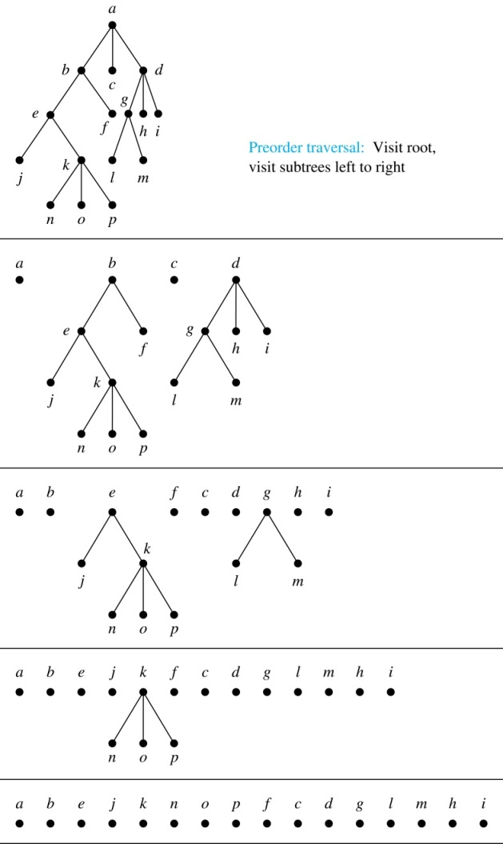
Preorder Traversal (continued)
procedure preorder (T: ordered rooted tree)
r := root of T
list r
for each child c of r from left to right
T(c) := subtree with c as root
preorder(T(c))

Slide 6
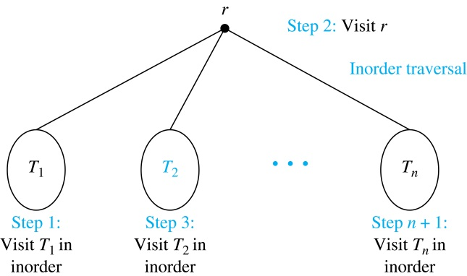
Inorder Traversal
Definition: Let T be an ordered rooted tree with root r. If T consists only of r, then r is the inorder traversal of T. Otherwise, suppose that T₁, T₂, …, T_{n} are the subtrees of r from left to right in T. The inorder traversal begins by traversing T₁ in inorder, then visiting r, and continues by traversing T₂ in inorder, and so on, until T_{n} is traversed in inorder.

Slide 7
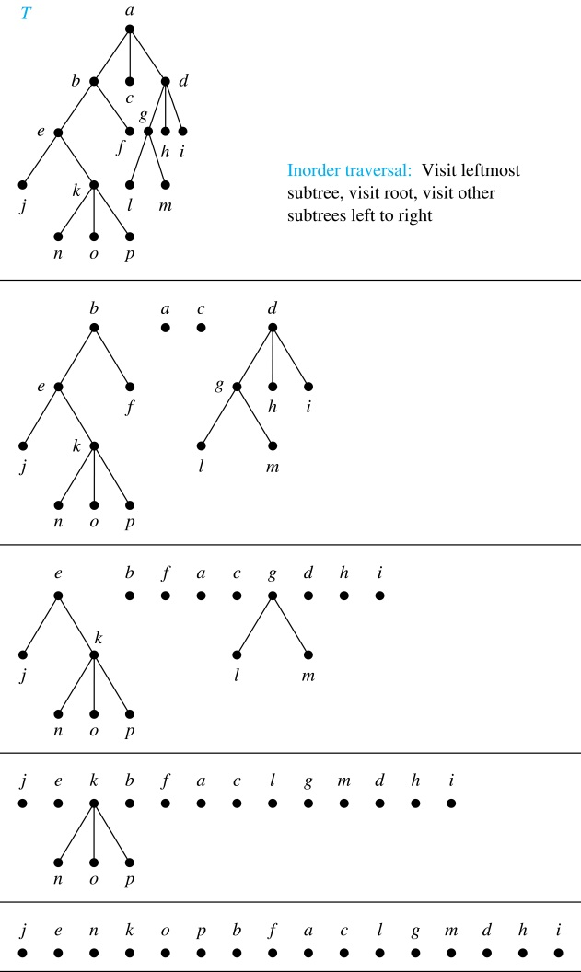
Inorder Traversal (continued)
procedure inorder (T: ordered rooted tree)
r := root of T
if r is a leaf then list r
else
l := first child of r from left to right
T(l) := subtree with l as its root
inorder(T(l))
list(r)
for each child c of r from left to right
T(c) := subtree with c as root
inorder(T(c))

Slide 8
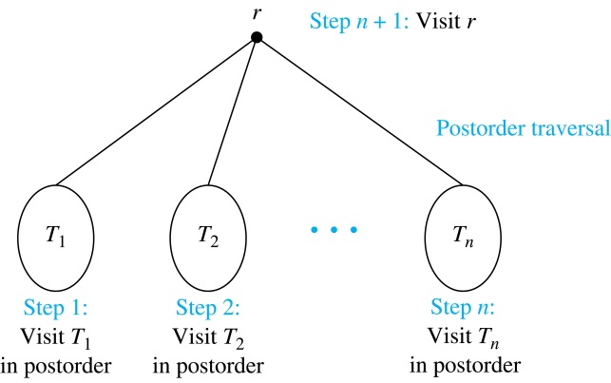
Postorder Traversal
Definition: Let T be an ordered rooted tree with root r. If T consists only of r, then r is the postorder traversal of T. Otherwise, suppose that T₁, T₂, …, T_{n} are the subtrees of r from left to right in T. The postorder traversal begins by traversing T₁ in postorder, then T₂ in postorder, and so on, after T_{n} is traversed in postorder, r is visited.

Slide 9
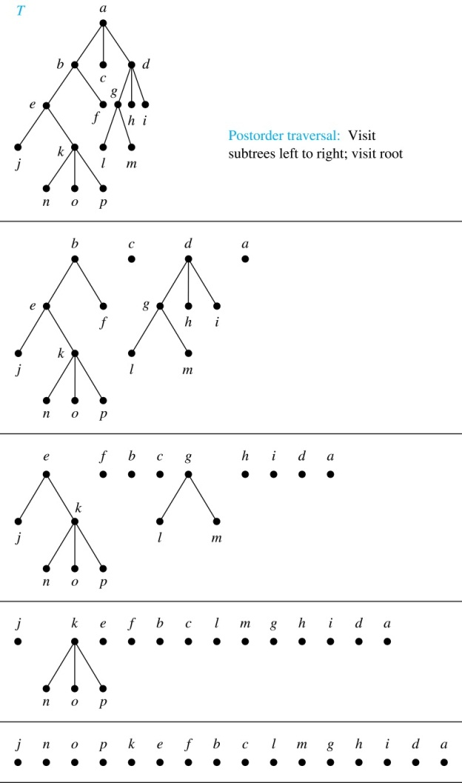
Postorder Traversal (continued)
procedure postordered (T: ordered rooted tree)
r := root of T
for each child c of r from left to right
T(c) := subtree with c as root
postorder(T(c))
list r

Slide 10
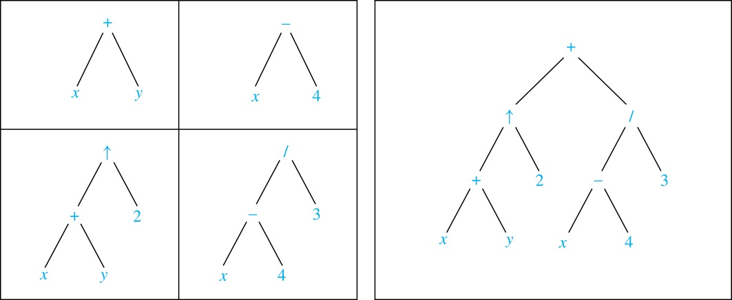
Expression Trees
Complex expressions can be represented using ordered rooted trees.
Consider the expression ((x + y) ↑ 2 ) + ((x − 4)/3).
A binary tree for the expression can be built from the bottom up:

Slide 11
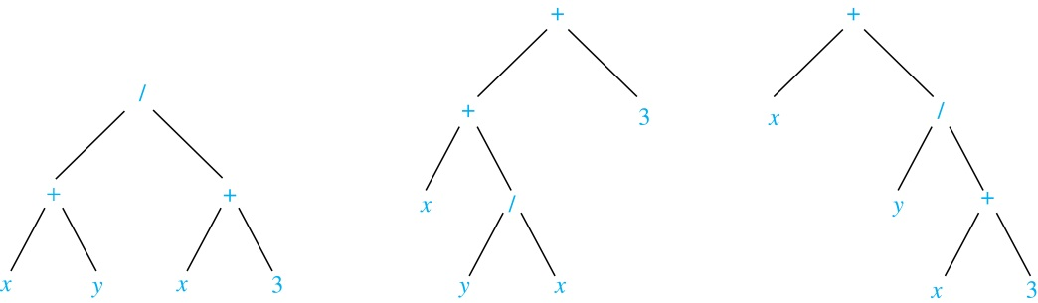
Infix Notation
An inorder traversal of the tree representing an expression produces the original expression when parentheses are included except for unary operations, which now immediately follow their operands.
We illustrate why parentheses are needed with an example that displays three trees all yield the same infix representation.

Slide 12
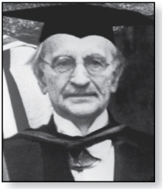
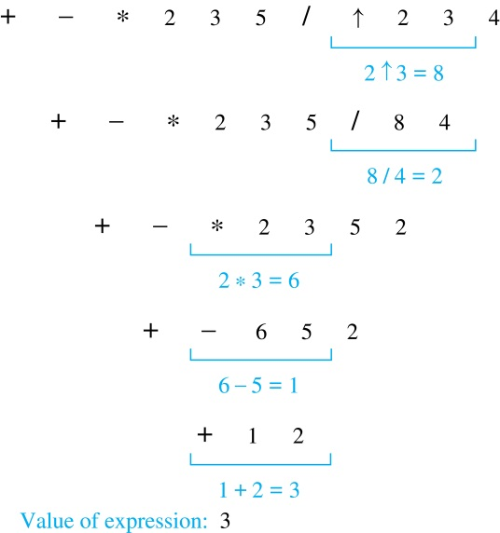
Prefix Notation
Jan Łukasiewicz (1878-1956)
When we traverse the rooted tree representation of an expression in preorder, we obtain the prefix form of the expression. Expressions in prefix form are said to be in Polish notation, named after the Polish logician Jan Łukasiewicz.
Operators precede their operands in the prefix form of an expression. Parentheses are not needed as the representation is unambiguous.
The prefix form of ((x + y) ↑ 2 ) + ((x − 4)/3)
is + ↑ + x y 2 / − x 4 3.
Prefix expressions are evaluated from right to left. When we encounter an operator, we perform the corresponding operation with the two operations to the right.
Example: We show the steps used to evaluate a particular prefix expression:

Slide 13
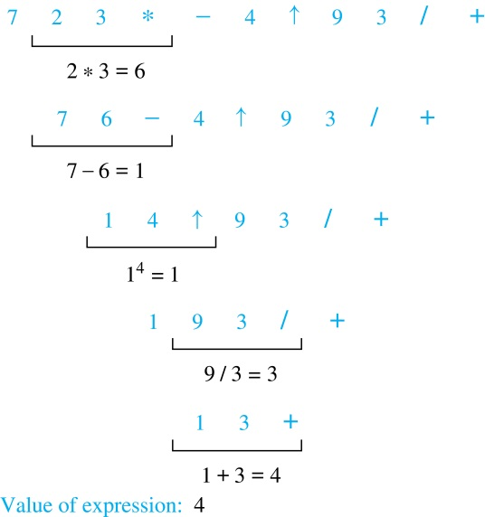
Postfix Notation
Example: We show the steps used to evaluate a particular postfix expression.
We obtain the postfix form of an expression by traversing its binary trees in postorder. Expressions written in postfix form are said to be in reverse Polish notation.
Parentheses are not needed as the postfix form is unambiguous.
x y + 2 ↑ x 4 − 3 / + is the postfix form of ((x + y) ↑ 2 ) + ((x − 4)/3).
A binary operator follows its two operands. So, to evaluate an expression one works from left to right, carrying out an operation represented by an operator on its preceding operands.

