Slide 1
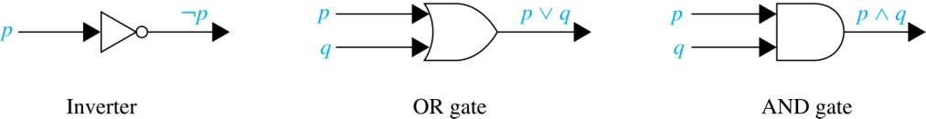
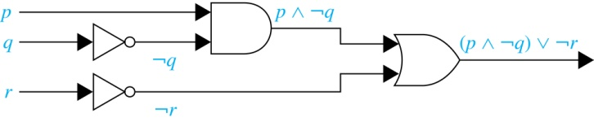
Logic Circuits (Studied in depth in Chapter 12)
Electronic circuits; each input/output signal can be viewed as a 0 or 1.
0 represents False
1 represents True
Complicated circuits are constructed from three basic circuits called gates.
The inverter (NOT gate) computes negation
The OR gate takes two input bits and produces the disjunction.
The AND gate takes two input bits and produces the conjunction of the two bits.
More complicated digital circuits can be constructed by combining these basic circuits to produce the desired output given the input signals by building a circuit for each piece of the output expression and then combining them. For example:

Slide 2
Electrical System Diagram
Outside Power
s1
cb1
Have lights (L1, L2), switches (s1, s2, s3), and circuit breakers (cb1)
How to do disjunction with electric switches?
Conjunction with switches?
Biconditional with switches?
Negation with switches?
w2
s2
s3
L1
L2

Slide 3
Notation
Needed for the next example.

Slide 4
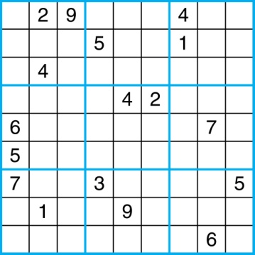
Sudoku
A Sudoku puzzle is represented by a 9×9 grid made up of nine 3×3 subgrids, known as blocks. Some of the 81 cells of the puzzle are assigned one of the numbers 1,2, …, 9.
The puzzle is solved by assigning numbers to each blank cell so that every row, column and block contains each of the nine possible numbers.

Slide 5
Encoding as a Satisfiability Problem
Let p(i,j,n) denote the proposition that is true when the number n is in the cell in the ith row and the jth column.
There are 9×9 × 9 = 729 such propositions.
In the sample puzzle p(5,1,6) is true, but p(5,j,6) is false for j = 2,3,…9

Slide 6
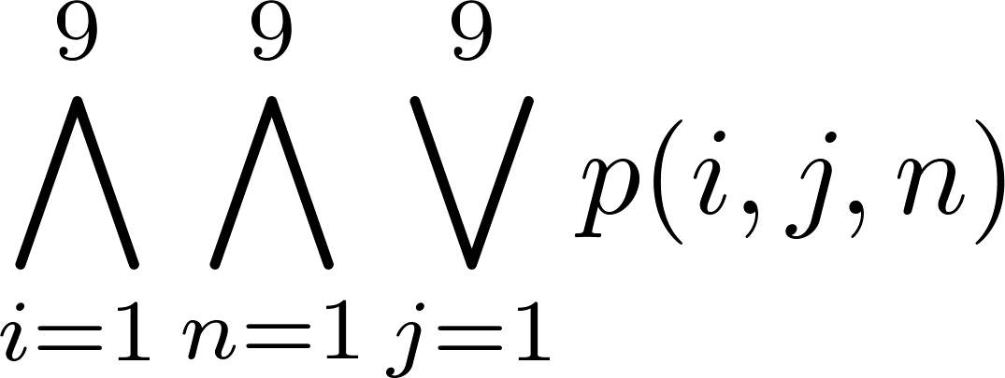
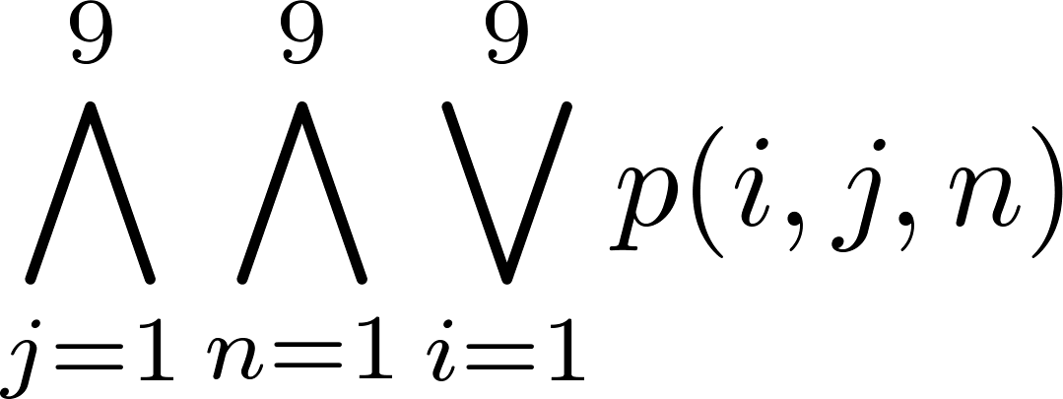
Encoding (cont)
For each cell with a given value, assert p(i,j,n), when the cell in row i and column j has the given value.
Assert that every row contains every number.
Assert that every column contains every number.

Slide 7
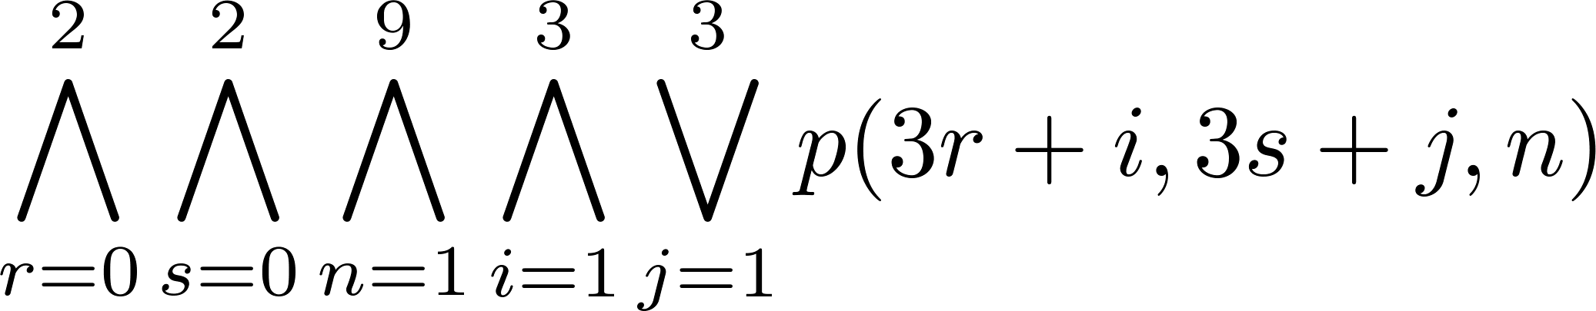
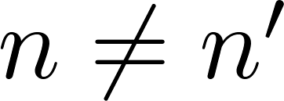
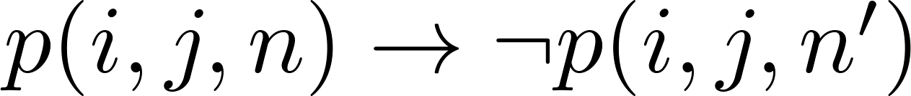
Encoding (cont)
Assert that each of the 3 x 3 blocks contain every number.
(this is tricky - ideas from chapter 4 help)
Assert that no cell contains more than one number. Take the conjunction over all values of n, n’, i, and j, where each variable ranges from 1 to 9 and ,
of

Slide 8
Solving Satisfiability Problems
To solve a Sudoku puzzle, we need to find an assignment of truth values to the 729 variables of the form p(i,j,n) that makes the conjunction of the assertions true. Those variables that are assigned T yield a solution to the puzzle.
A truth table can always be used to determine the satisfiability of a compound proposition. But this is too complex even for modern computers for large problems.
There has been much work on developing efficient methods for solving satisfiability problems as many practical problems can be translated into satisfiability problems.

Slide 9
Pseudoprimes
By Fermat’s little theorem n > 2 is prime, where
2^{n-1} ≡ 1 (mod n).
But if this congruence holds, n may not be prime. Composite integers n such that 2^{n-1} ≡ 1 (mod n) are called pseudoprimes to the base 2.
Example: The integer 341 is a pseudoprime to the base 2.
341 = 11 ∙ 31
2³⁴⁰ ≡ 1 (mod 341) (see in Exercise 37)
We can replace 2 by any integer b ≥ 2.
Definition: Let b be a positive integer. If n is a composite integer, and b^{n-1} ≡ 1 (mod n), then n is called a pseudoprime to the base b.

Slide 10
Pseudoprimes
Given a positive integer n, such that 2^{n-1} ≡ 1 (mod n):
If n does not satisfy the congruence, it is composite.
If n does satisfy the congruence, it is either prime or a pseudoprime to the base 2.
Doing similar tests with additional bases b, provides more evidence as to whether n is prime.
Among the positive integers not exceeding a positive real number x, compared to primes, there are relatively few pseudoprimes to the base b.
For example, among the positive integers less than 10¹⁰ there are 455,052,512 primes, but only 14,884 pseudoprimes to the base 2.

Slide 11
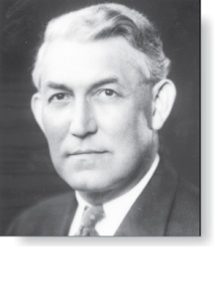
Carmichael Numbers (optional)
Robert Carmichael
(1879-1967)
There are composite integers n that pass all tests with bases b such that gcd(b,n) = 1.
Definition: A composite integer n that satisfies the congruence b^{n-1} ≡ 1 (mod n) for all positive integers b with gcd(b,n) = 1 is called a Carmichael number.
Example: The integer 561 is a Carmichael number. To see this:
561 is composite, since 561 = 3 ∙ 11 ∙ 13.
If gcd(b, 561) = 1, then gcd(b, 3) = 1, then gcd(b, 11) = gcd(b, 17) =1.
Using Fermat’s Little Theorem: b² ≡ 1 (mod 3), b¹⁰ ≡ 1 (mod 11), b¹⁶ ≡ 1 (mod 17).
Then
b⁵⁶⁰ = (b²) ²⁸⁰ ≡ 1 (mod 3),
b⁵⁶⁰ = (b¹⁰) ⁵⁶ ≡ 1 (mod 11),
b⁵⁶⁰ = (b¹⁶) ³⁵ ≡ 1 (mod 17).
It follows (see Exercise 29) that b⁵⁶⁰ ≡ 1 (mod 561) for all positive integers b with gcd(b,561) = 1. Hence, 561 is a Carmichael number.
Even though there are infinitely many Carmichael numbers, there are other tests (described in the exercises) that form the basis for efficient probabilistic primality testing. (see Chapter 7)

Slide 12
Example: Fast Multiplication of Integers
An algorithm for the fast multiplication of two 2n-bit integers (assuming n is even) first splits each of the 2n-bit integers into two blocks, each of n bits.
Suppose that a and b are integers with binary expansions of length 2n. Let a = (a_{2n−1}a_{2n−2} … a₁a₀)₂ and b = (b_{2n−1}b_{2n−2} … b₁b₀)₂ .
Let a = 2^{n}A₁ + A₀, b = 2^{n}B₁ + B₀ , where A₁ = (a_{2n−1} … a_{n+1}a_{n})₂ , A₀ = (a_{n−1} … a₁a₀)₂ , B₁ = (b_{2n−1} … b_{n+1}b_{n})₂ , B₀ = (b_{n−1} … b₁b₀)₂.
The algorithm is based on the fact that ab can be rewritten as:
ab = (2^{2n} + 2^{n})A₁B₁ +2^{n} (A₁−A₀)(B₀ − B₁) +(2^{n} + 1)A₀B₀.
This identity shows that the multiplication of two 2n-bit integers can be carried out using three multiplications of n-bit integers, together with additions, subtractions, and shifts.
Hence, if f(n) is the total number of operations needed to multiply two n-bit integers, then
f(2n) = 3f(n) + Cn
where Cn represents the total number of bit operations; the additions, subtractions and shifts that are a constant multiple of n-bit operations.

Slide 13
Complexity of Fast Integer Multiplication Algorithm
Integer Multiplication Example: Give a big-O estimate for the number of bit operations used needed to multiply two n-bit integers using the fast multiplication algorithm.
Solution: We have shown that f(n) = 3f(n/2) + Cn, when n is even, where f(n) is the number of bit operations needed to multiply two n-bit integers. Hence by the master theorem with a = 3, b = 2, c = C, and d = 0 (so that we have the case where a > b^{d}), it follows that f(n) is O(n^{log 3}).
Note that log 3 ≈ 1.6. Therefore the fast multiplication algorithm is a substantial improvement over the conventional algorithm that uses O(n²) bit operations.

Slide 14
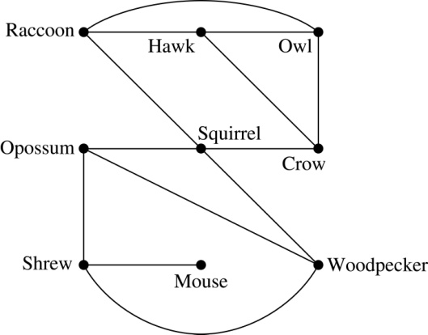
Biological Applications
Graph models are used extensively in many areas of the biological science. We will describe two such models, one to ecology and the other to molecular biology.
Niche overlap graphs model competition between species in an ecosystem
Vertices represent species and an edge connects two vertices when they represent species who compete for food resources.
Example: This is the niche overlap graph for a forest ecosystem with nine species.

Slide 15
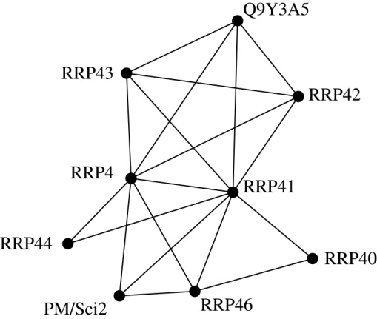
Biological Applications (continued)
We can model the interaction of proteins in a cell using a protein interaction network.
In a protein interaction graph, vertices represent proteins and vertices are connected by an edge if the proteins they represent interact.
Protein interaction graphs can be huge and can contain more than 100,000 vertices, each representing a different protein, and more than 1,000,000 edges, each representing an interaction between proteins
Protein interaction graphs are often split into smaller graphs, called modules, which represent the interactions between proteins involved in a particular function.
Example: This is a module of the protein interaction graph of proteins that degrade RNA in a human cell.

Slide 16
Algorithms for Graph Isomorphism
The best algorithms known for determining whether two graphs are isomorphic have exponential worst-case time complexity (in the number of vertices of the graphs).
However, there are algorithms with linear average-case time complexity.
You can use a public domain program called NAUTY to determine in less than a second whether two graphs with as many as 100 vertices are isomoprhic.
Graph isomorphism is a problem of special interest because it is one of a few NP problems not known to be either tractable or NP-complete (see Section 3.3).

Slide 17
Applications of Graph Isomorphism
The question whether graphs are isomorphic plays an important role in applications of graph theory. For example,
chemists use molecular graphs to model chemical compounds. Vertices represent atoms and edges represent chemical bonds. When a new compound is synthesized, a database of molecular graphs is checked to determine whether the graph representing the new compound is isomorphic to the graph of a compound that this already known.
Electronic circuits are modeled as graphs in which the vertices represent components and the edges represent connections between them. Graph isomorphism is the basis for
the verification that a particular layout of a circuit corresponds to the design’s original schematics.
determining whether a chip from one vendor includes the intellectual property of another vendor.

