Slide 1
Consultation Week: Day 1 Relations
Binary Relations: Functional relations, equivalence and order.
Manipulating Relations: Closures, n-ary relations and relational algebra.
(We occasionally refer to other topics: Sets, Functions, Images and Preimages, Function Composition, Bipartite Graphs vs. Directed Graphs, Matrix operations and Warshall algorithm for transitive closure)

Slide 2
Section Summary
Different ways to describe relations.
Which relations are functional and which are not.
Composition of relations vs. composition of functions.
Properties of relations and equivalences.
Transitive Closure, Warshall Algorithm

Slide 3
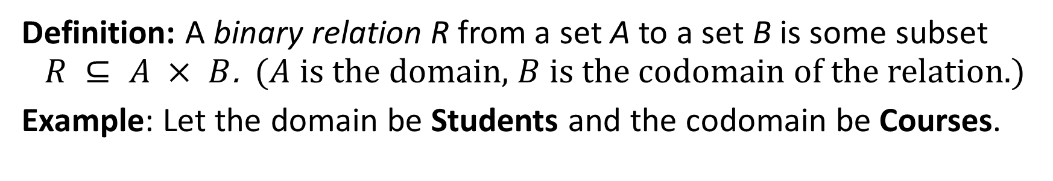


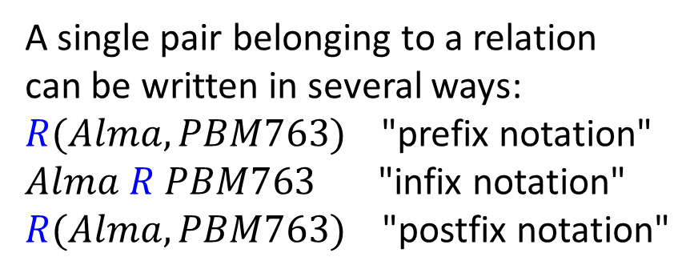
Binary Relations – Intro and Notation
Definition: A binary relation R from a set A to a set B is some subset $R ⊆ A × B$. ($A$ is the domain, $B$ is the codomain of the relation.)
Example: Let the domain be Students and the codomain be Courses.
Students
Courses
$$R$$
A single pair belonging to a relation
can be written in several ways:
$R(Alma,PBM763)$"prefix notation"
$Alma R PBM763$ "infix notation"
$R(Alma,PBM763)$ "postfix notation"
Alma
PBM704
Jason
PBM763
Miķelis
PBM005
Relation $(sRc)$ shows that a student $s$
is registered to a course $c$.
Notes:
Relations are more general than functions. A function is a relation where exactly one element of B is related to each element of A.

Slide 4
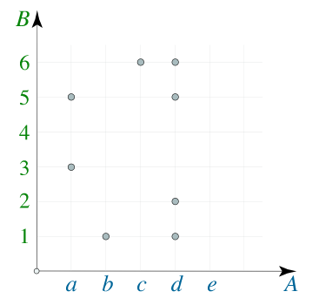
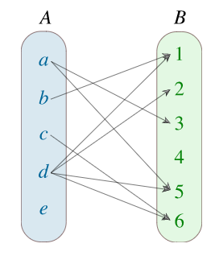
Binary Relations: Various Descriptions
$A=\{a,b,c,d,e\}$; $B=\{1,2,3,4,5,6\}$.
Roster/Set description: $R=\{(a,3),(a,5),(b,1),(c,6),(d,1),(d,2),(d,5),(d,6)\}$.
Arrow Diagram/ Bipartite Graph:
Plane Graph/
Cartesian Graph:
Matrix Representation:
0 | 0 | 1 | 0 | 1 | 0
1 | 0 | 0 | 0 | 0 | 0
0 | 0 | 0 | 0 | 0 | 1
1 | 1 | 0 | 0 | 1 | 1
0 | 0 | 0 | 0 | 0 | 0
Notes:
https://www.math24.net/binary-relations

Slide 5
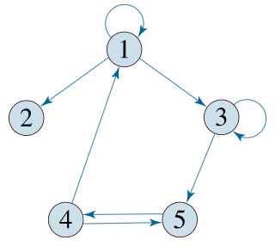

Binary Relation on the Same Set
Domain and subdomain coincide ($A=B$).
Example: A={1,2,3,4,5},
R={(1,1),(1,2),(1,3),(3,3),(3,5),(4,1),(4,5),(5,4)} a subset of $A×A$
Directed Graph/ Digraph:
Matrix Representation:
1 | 1 | 1 | 0 | 0
0 | 0 | 0 | 0 | 0
0 | 0 | 1 | 0 | 1
1 | 0 | 0 | 0 | 1
0 | 0 | 0 | 1 | 0

Slide 6
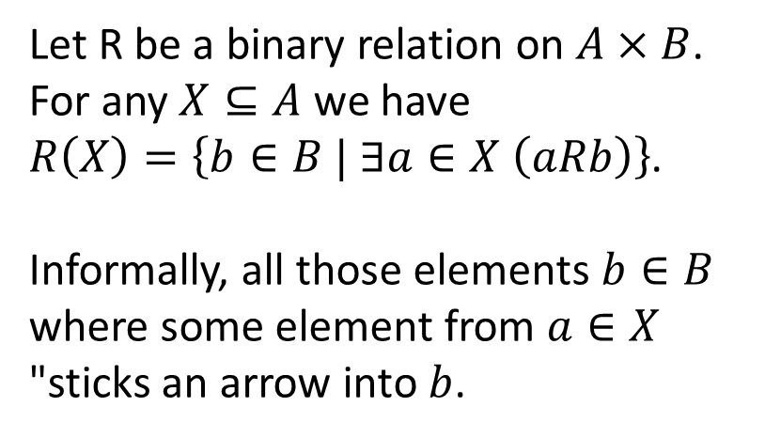
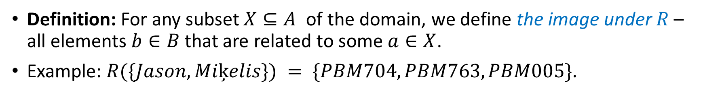
An Image under a Relation
Definition: For any subset $X⊆A$ of the domain, we define the image under $R$ – all elements $b∈B$ that are related to some $a∈X$.
Example: $R(\{Jason, Miķelis\}) = \{PBM704, PBM763, PBM005\}$.
Students
Courses
Let R be a binary relation on $A×B$.
For any $X⊆A$ we have $R\left(X\right)=\left\{b∈B | ∃a∈X \left(aRb\right)\right\}$.
Informally, all those elements $b∈B$ where some element from $a∈X$ "sticks an arrow into $b$.
PBM704
Alma
PBM763
Jason
Miķelis
PBM005
Nobody
PBM006

Slide 7
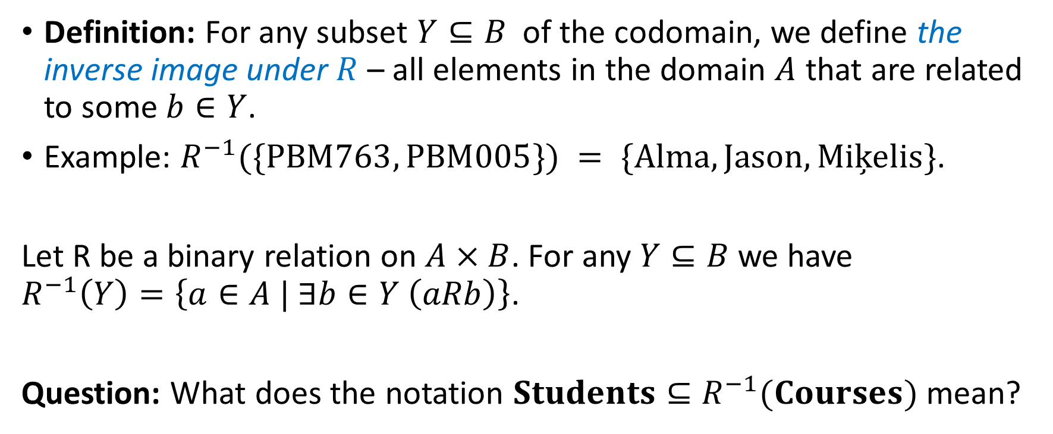
An Inverse Image under a Relation
Definition: For any subset $Y⊆B$ of the codomain, we define the inverse image under $R$ – all elements in the domain $A$ that are related to some $b∈Y$.
Example: $R^{−1}(\{PBM763, PBM005\}) = \{Alma,Jason,Miķelis\}$.
Let R be a binary relation on $A×B$. For any $Y⊆B$ we have $R^{−1}\left(Y\right)=\left\{a∈A | ∃b∈Y \left(aRb\right)\right\}$.
Question: What does the notation $Students⊆R^{−1}(Courses)$ mean?

Slide 8
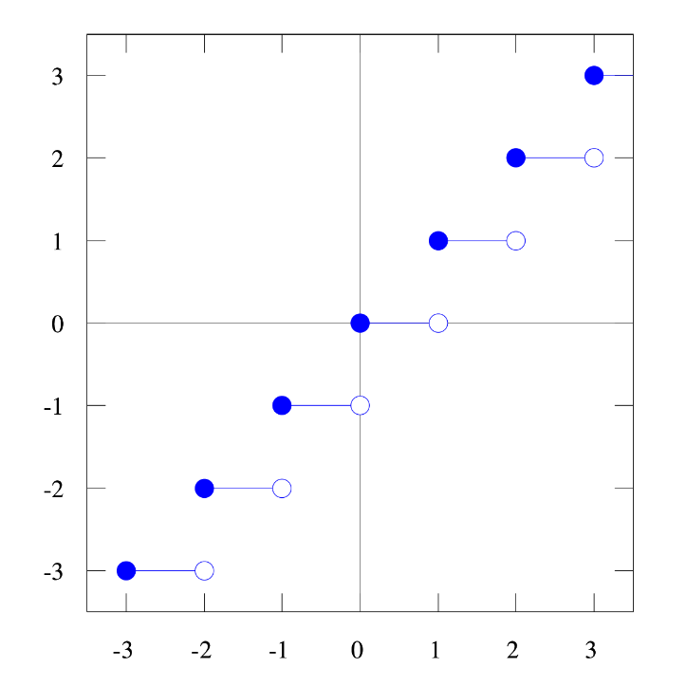
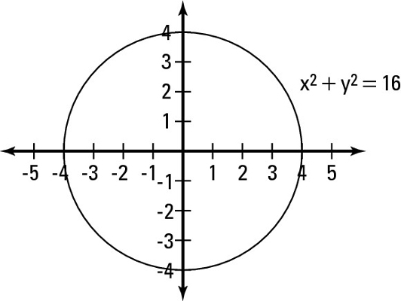

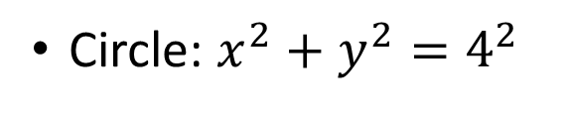
Relations and Functions on Infinite Sets
Floor: $y=\left\lfloor x\right\rfloor$
Circle: $x^{2}+y^{2}=4^{2}$

Slide 9
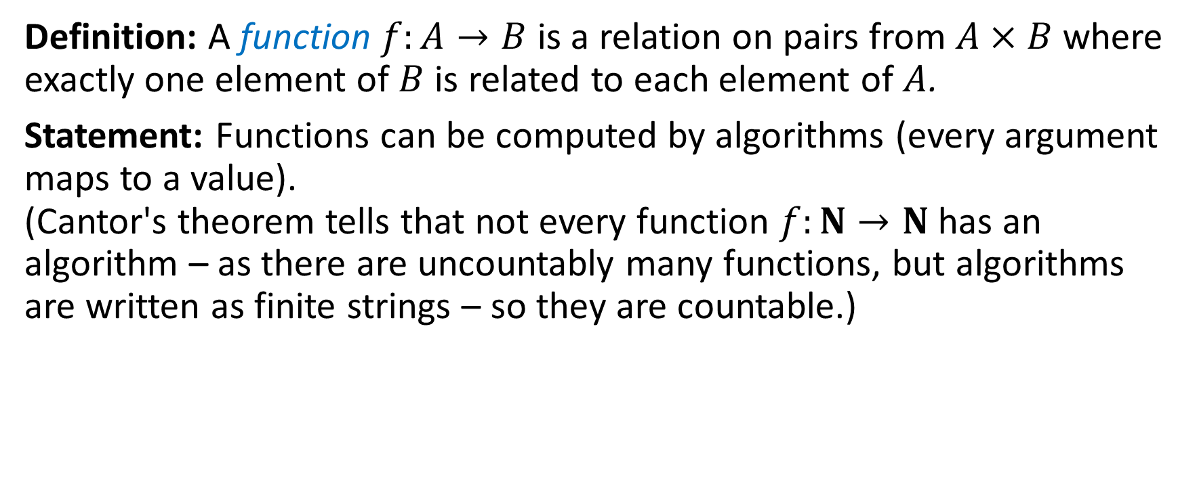
Function as Relations
Definition: A function $f:A→B$ is a relation on pairs from $A×B$ where exactly one element of $B$ is related to each element of $A$.
Statement: Functions can be computed by algorithms (every argument maps to a value). (Cantor's theorem tells that not every function $f:N→N$ has an algorithm – as there are uncountably many functions, but algorithms are written as finite strings – so they are countable.)

Slide 10
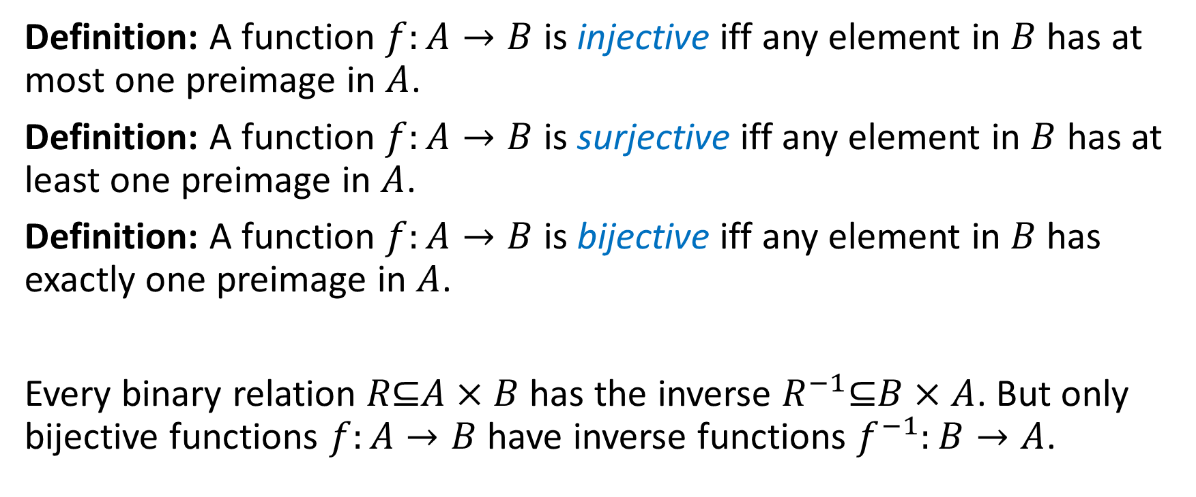
Functions and Inverses
Definition: A function $f:A→B$ is injective iff any element in $B$ has at most one preimage in $A$.
Definition: A function $f:A→B$ is surjective iff any element in $B$ has at least one preimage in $A$.
Definition: A function $f:A→B$ is bijective iff any element in $B$ has exactly one preimage in $A$.
Every binary relation $R\text{⊆}A×B$ has the inverse $R^{−1}\text{⊆}B×A$. But only bijective functions $f:A→B$ have inverse functions $f^{−1}:B→A$.
Notes:
(Functions do not guarantee anything for the codomain.)

Slide 11
Binary Relations with Set Builder Notation
Example: Consider these relations on the set of integers:
R₁ = {(a,b) | a ≤ b}, R₄ = {(a,b) | a = b},
R₂ = {(a,b) | a > b}, R₅ = {(a,b) | a = b + 1},
R₃ = {(a,b) | a = b or a = −b}, R₆ = {(a,b) | a + b ≤ 3}.
Note: These relations are on an infinite set (and they are infinite subsets)
Which relations contain all the pairs (1,1), (1, 2), (2, 1), (1, −1), and (2, 2)?
Solution: Checking the conditions that define each relation, we see that the pair (1,1) is in R₁, R₃, R₄ , and R₆: (1,2) is in R₁ and R₆: (2,1) is in R₂, R₅, and R₆: (1, −1) is in R₂, R₃, and R₆ : (2,2) is in R₁, R₃, and R₄.

Slide 12
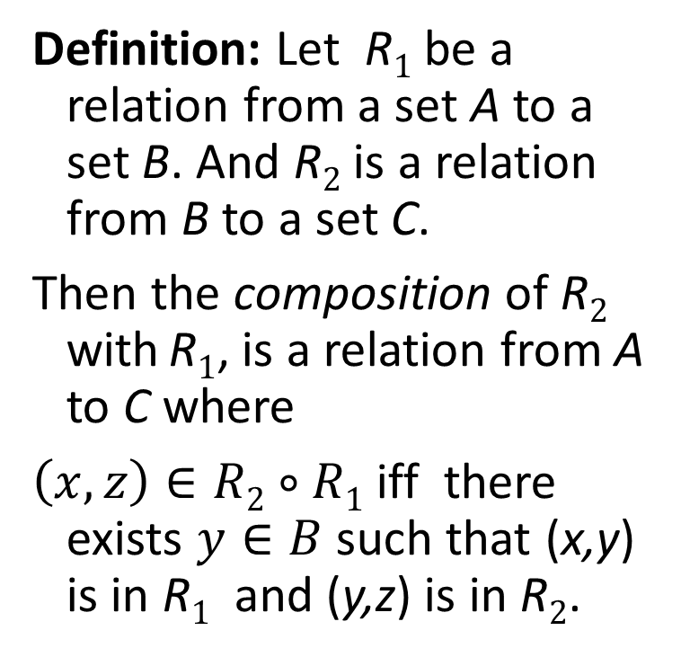
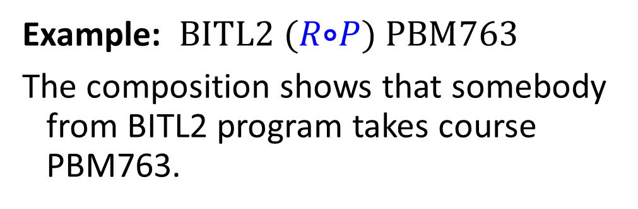


Composition
Programs
Students
Courses
Definition: Let R₁ be a relation from a set A to a set B. And R₂ is a relation from B to a set C.
Then the composition of R₂ with R₁, is a relation from A to C where
$\left(x,z\right)∈R2∘R1$ iff there exists $y∈B$ such that (x,y) is in R₁ and (y,z) is in R₂.
$$R$$
BBA8
$$P$$
Alma
PBM704
BBA9
Jason
PBM763
BITL1
BITL2
Miķelis
PBM005
Example: $BITL2 (R\text{∘}P) PBM763$
The composition shows that somebody from BITL2 program takes course PBM763.
Notes:
https://www.math24.net/composition-relations

Slide 13



Composition as Boolean Product of Matrices
To find the matrix of the composition relation $R\text{∘}P$ compute the Boolean product $M_{P}∙M_{R}$
Programs
Students
Courses
$$R$$
BBA8
$$P$$
Alma
PBM704
BBA9
Jason
PBM763
BITL1
BITL2
Miķelis
PBM005

Slide 14
Composition with Itself
Definition: Let R be a binary relation on A. Then the powers R^{n} of the relation R can be defined inductively by:
Basis Step: R¹ = R
Inductive Step: R^{n+1} = R^{n} ∘ R
Also the powers can be computed by multiplying matrices.

Slide 15
Representing the Composition of a Relation
R₂
R₁
w
m
a
x
n
b
y
o
c
p
z
R₁∘ R₂ = {(b,x),(b,z)}

Slide 16
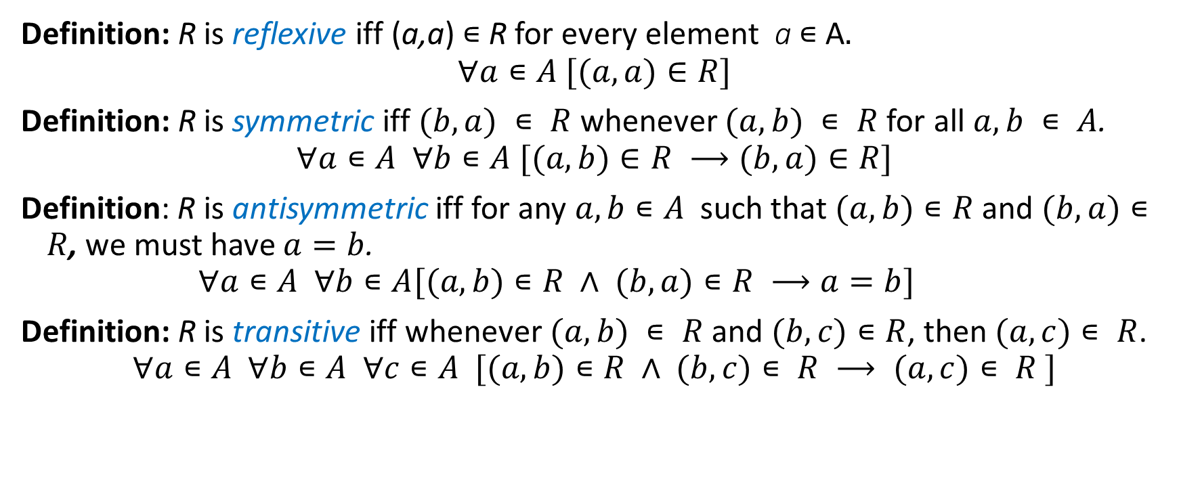

Properties of Binary Relations on $A×A$
Definition: R is reflexive iff (a,a) ∊ R for every element a ∊ A. $$∀a∊A [(a,a)∈R]$$
Definition: R is symmetric iff $(b,a) ∊ R$whenever $(a,b) ∊ R$for all $a,b ∊ A$. $$∀a∊A ∀b∊A [(a,b)∈R ⟶(b,a)∈R]$$
Definition: R is antisymmetric iff for any $a,b∊A$ such that $(a,b)∊R$ and $(b,a)∊R$, we must have $a=b$.
$$∀a∊A ∀b∊A[(a,b)∊R ∧ (b,a)∊R ⟶a=b]$$
Definition: R is transitive iff whenever $(a,b) ∊ R$ and $(b,c)∊R$, then $(a,c)∊ R$.
$$∀a∊A ∀b∊A ∀c∊A [(a,b)∊R ∧ (b,c)∊ R ⟶ (a,c)∊ R ]$$

Slide 17
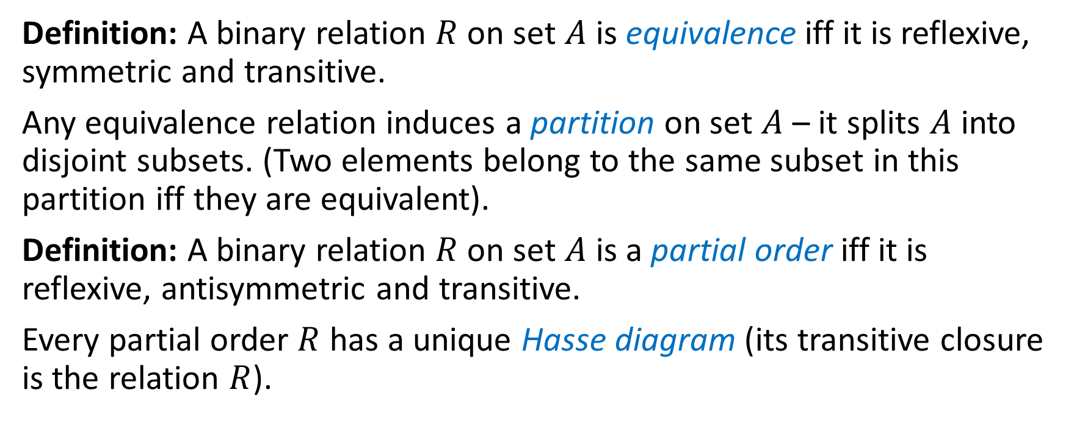
Equivalences and Partial Orders
Definition: A binary relation $R$ on set $A$ is equivalence iff it is reflexive, symmetric and transitive.
Any equivalence relation induces a partition on set $A$ – it splits $A$ into disjoint subsets. (Two elements belong to the same subset in this partition iff they are equivalent).
Definition: A binary relation $R$ on set $A$ is a partial order iff it is reflexive, antisymmetric and transitive.
Every partial order $R$ has a unique Hasse diagram (its transitive closure is the relation $R$).

Slide 18
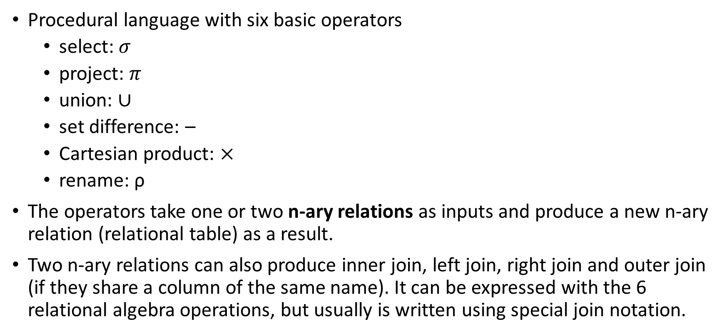
Relational Algebra
Procedural language with six basic operators
select: $σ$
project: $π$
union: $∪$
set difference: –
Cartesian product: $×$
rename: ρ
The operators take one or two n-ary relations as inputs and produce a new n-ary relation (relational table) as a result.
Two n-ary relations can also produce inner join, left join, right join and outer join (if they share a column of the same name). It can be expressed with the 6 relational algebra operations, but usually is written using special join notation.

