Slide 1

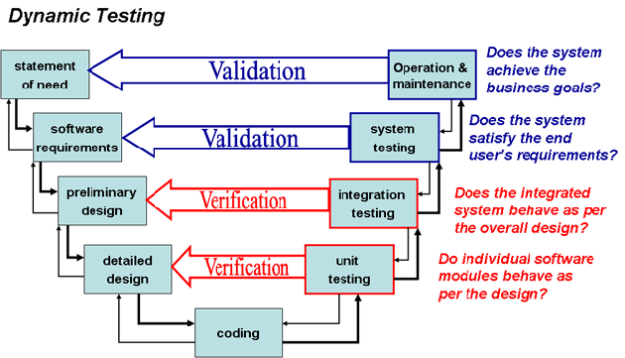
Tests, Trainings and Validations
Notes:
Fulfilment

Slide 2
What is CMM
CMM (Capability and Maturity Model) is developed by Carnegie Mellon University. It is meant to improve the software creation processes
PEOPLE
Even the finest people cannot perform well when the process is not understood or not operating “at its best.”
TECHNOLOGY
PROCESS
Major determinants of product cost, schedule, and quality

Slide 3
Capability Levels
CMM Levels
A capability level is a well-defined evolutionary plateau describing the organization’s capability in a process area.
There are 5 capability levels. The capability levels are cumulative, i.e., a higher capability level includes the attributes of the lower levels.
Maturity Levels Cannot be Skipped
Higher level processes have less chance of success without the discipline provided by lower levels.
The effect of innovation can be obscured in a noisy process.

Slide 4
Soccer Teams
Amateur Team | Professional Team
Everyone runs around at random. They might do right and wrong things. | Everyone moves in a coordinated fashion, based on practicing their tactics many times.
The next time the ball is hit in the same place, they may do something entirely different. | Sometimes they fail to make the right play, but they almost always try to do the right thing.
When losing a top player, an amateur team is likely to get much worse. | A Professional team often has someone waiting to fill in.
When results are bad Amateur players don’t know what went wrong, or they blame each other. | Professional teams try to discuss their play and look for ways to improve.

Slide 5
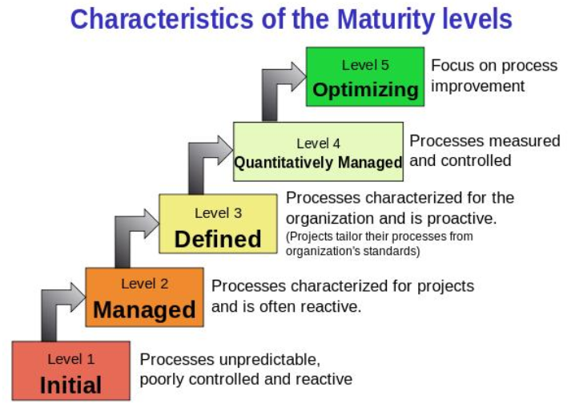
CMM Levels (Carnegie Mellon Univ.)

Slide 6

CMM L1: Initial
Level 1: Chaos and Hero Mentality
Software processes not defined
Planning and controls not used at all times
Success depends on some people only (personal motivation and sacrifice)
Success does not depend on proven processes; it is not repeatable.

Slide 7
CMM L2: Managed
Level 2: Repeatable and uses milestones
Basic project management controls implemented
Planning, monitor and quality control, cost and functionality
Processes are still not transparent («black boxes»), but with milestones and reviews.

Slide 8

CMM L3: Defined
Level 3: Defined software process
Processes are documented and used across the entire organization
The boxes are now internally visible
Staff understands their roles and responsibilities of processes

Slide 9

CMM L4: Quantitatively Managed
Level 4: Measurable processes
Quantitative quality goals set for software processes and products
Processes are predictable, measured
Management makes informed, objective decisions

Slide 10
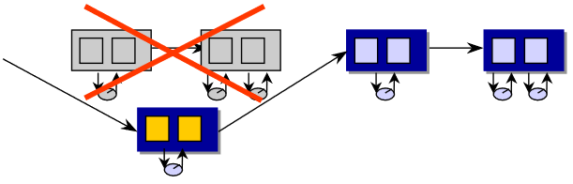
CMM L5: Optimizing
Level 5: Software process optimizing
Able to identify weaknesses and strengths proactively in processes
Continually improving range of processes capabilities
Continually improving processes performance

Slide 11
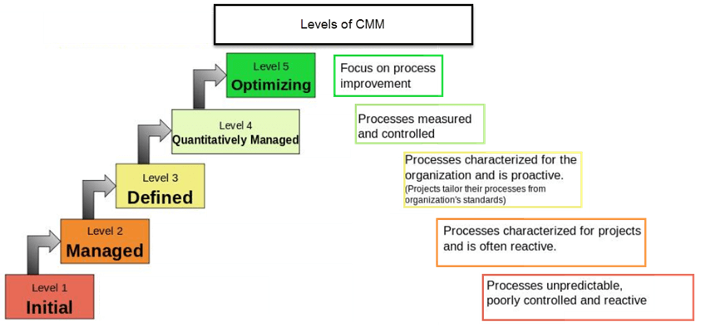
CMM: Summary

Slide 12
Process Areas by Maturity
Level
Focus
Process Areas
Continuous process improvement
Organizational Innovation and Deployment
Causal Analysis and Resolution
5 Optimizing
4 Quantitatively
Managed
Quantitative
management
Organizational Process Performance
Quantitative Project Management
Requirements Development
Technical Solution
Product Integration
Verification and Validation
Organizational Process Definition
Organizational Training Risk Management
Decision Analysis and Resolution
Organizational Environment for Integration
Integrated Teaming
3 Defined
Process
standardization
Basic
project
management
Requirements Management
Project Planning, Monitoring and Control
Process and Product Quality Assurance
Configuration Management
2 Managed
1 Initial

Slide 13
Clickable Content: Sample Titles
Banks HATE him. See how he made $10,000 in an afternoon with one simple trick.
10 tips to improve your CV.
Things that only People who Work from Home will Find Funny.

Slide 14
Addressing 3 essential questions
Why: Why do you do something? Why others should care about your product/service? Simon Sinek: Start with WHY (TED talk, 6 minutes) https://www.youtube.com/watch?v=_I-_0cnj_xQ
How: How you can respond to a problem? How is your value proposition different from the competitor?
What: What your product actually does.

Slide 15

Lead Paragraph
What is a Lead Paragraph in a news article?
Why is it important?
What items should be present?
Attention Hook
Author/Source
Context
Theme

Slide 16
Using Google Analytics
Google Analytics is primarily aimed at for-profit websites that are selling something. Conversions, Goals, Ad Traffic analysis are designed to help sites sell something.
The trick is to ask yourself “what am I selling?” What on your website translates to a successful sale?
Downloading a manual?
Having a career question answered?
Clicking a link on a map?
What is the ultimate goal of your website? What specific, measurable Visitor interaction means success?

Slide 17
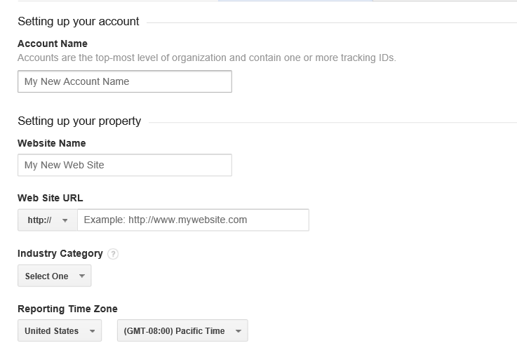
How to set up an account
Need a Google account
If you have not used Google Analytics before visit www.google.com/analytics/
Register your domain (no actual check that you own this domain, but you need to insert a JavaScript snippet into all HTML files.
You are given a “Tracking ID”.

Slide 18
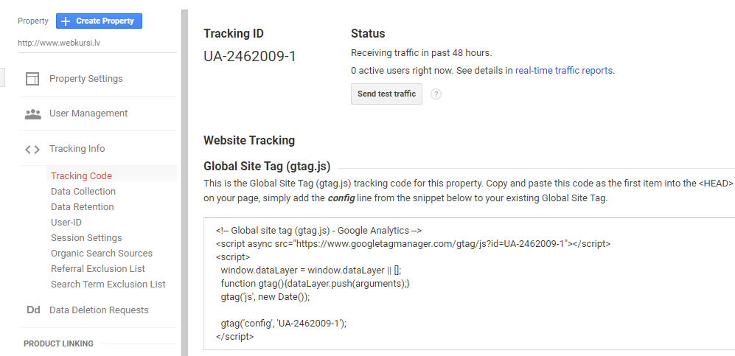
Tracking Code
Add or select existing domain
Under “Property” click Tracking Info > Tracking Code.
Copy-paste as the first child under <HEAD> of every page you want to track (also PHP, Python templates, and other server side stuff that creates client-side HTML).

Slide 19
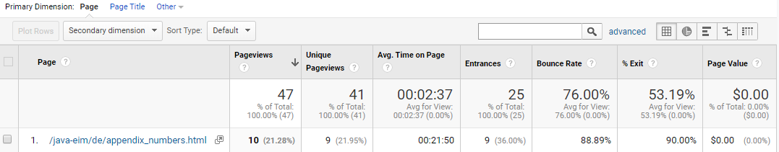
Tracking Content
Pageviews: # of requests
Unique Pageviews: How many users visited this
Avg. Time on Page: Hearbeats from the Web page
Entrances: How many times this was the 1st page visited
Bounce Rate: How often this was the only page visited (Bounce = Closed browsers + Clicked links + Session expires)
Exit: How many times this was the last page visited

Slide 20
What Does the Tracker See?
User’s IP address and approximate location (unless they use VPNs or SSH tunnels)
Can estimate user’s age/gender
Can distinguish user sessions
Can measure time
Can learn, where the users came from (traffic sources)
If you assign goals or money values, can add it up.
What the Tracker Cannot See?
Any meaningful actions the user did on your site
Did they actually look at your page during that time (or was it in another tab or minimized)
How did they leave? (Clicked a link, closed browser window/tab…)

Slide 21
Limitations and Notes
Users should have JavaScript enabled (almost always true)
Users should have cookies enabled (if they play with Incognito pages or clear their history, you get another “unique visitor”)
Google Analytics track even content that is reloaded and served from a cache.
Real-time reports
Check, if your tracking code works
Check response from recent social media posts
Check
Normally you would use Summary Reports

Slide 22
How is Google Analytics Implemented
The data that Google Analytics uses to provide all the information in your reports comes from these sources:
The HTTP request of the user (also HTTP REFERER)
Browser/system information
First-party cookies (=same domain as Google Analytics)
All that is submitted as parameters to a single pixel GIF image request.

