Slide 1
Data Structures 1.2. Expressions, control statements, functions
Data Structures and Algorithms
http://linen-tracer-682.appspot.com/data-structures/index.html
Notes:
**Terminology:** * Operator – operators (lv)
* Expression – izteiksme (lv)
* Statement – komanda (lv)

Slide 2
Table of Contents
Part 1: Use C++ and Object Orientation (6 modules, 3W)
Part 2: Express algorithms with Abstract Data Types (ADTs) and libraries (5 modules, 2W)
Part 3: Analyze the implementations of some data structures (10 modules, 5W)
Part 4: Introduce general paradigms for algorithms (7 modules, 3W)
1.1. HelloWorld Programs
1.2. Expressions, control statements, functions
1.3. C++ classes
1.4. Arrays, pointers, references

Slide 3
Why all sorts of algorithms are expressed as statements and expressions in C++?
What is the difference between compile-time and run-time analysis of C++ code?

Slide 4
Objectives
Fundamental types – bool, int types, char, float/double; initializations; default type casts.
Notes:
Language constructs to express algorithms
* Sequential order of execution
* Expressions and Statements
* Selection
* Iteration
* Functions
* Vectors

Slide 5
Bool and Int Literals
Fundamental Types Revisited
true // bool literal
false // bool literal
212 // int
215u // int unsigned
0xDace // int (hex)
032LLU // int (octal)
078 // 8 - invalid digit
032UU // use just one U
85 // int (decimal)
0213 // int (octal)
0x4b // int (hexadecimal)
30 // int
30u // unsigned int
30l // long
30ul // unsigned long

Slide 6
Initialize with Literals
int main()
{
int a = 0123;
long long b = 0123;
long long c = 0123LL;
long unsigned d = -17LLU;
bool e = 0123;
bool f = 0xFACE;
double avogadro = 6.02214E23;
}

Slide 7
Overflow Variables
int i1 = 2000000000;
int i2 = 2000000000;
cout << i1 << " + " << i2 << " = " << i1 + i2 << endl;
typedef unsigned long long ulong;
ulong L = (ulong)i1 + (ulong)i2;
cout << i1 << " + " << i2 << " = " << L << endl;
2000000000 + 2000000000 = -294967296
2000000000 + 2000000000 = 4000000000

Slide 8
Float and Double Literals
float a = 3.14159 // 4 bytes
double b = 314159E-5 // still 4 bytes (?)
long double c = 314159E-5L // 8 bytes
510E // Illegal: incomplete exponent
210f // Illegal: no decimal or exponent
.e55 // Illegal: missing integer or fraction
The actual length of "double" and "long" may be hardware dependent.
"long double" and "long long" are typically 8 bytes long.

Slide 9
Type Safety: Narrowing Type Casts
int main()
{
int a = 20000;
char c = a;
int b = c;
if (a != b) // != means “not equal”
cout << "oops!: " << a << "!=" << b << '\n';
else
cout << "Wow! We have large characters\n";
}
// Beware: C++ does not prevent you from unsafe
// type casts (compiler might warn)
// Try it to see what value b gets on your machine
a
20000
c:
???

Slide 10
Type Safety: Uninitialized Variables
// Beware: C++ does not prevent you from trying to use a variable
// before you have initialized it (though a compiler typically warns)
int main()
{
int x; // x gets a “random” initial value
char c; // c gets a “random” initial value
double d; // d gets a “random” initial value
// not every bit pattern is a valid floating-point value
double dd = d; // potential error: some implementations
// can’t copy invalid floating-point values
cout << " x: " << x << " c: " << c << " d: " << d << '\n';
}
// Always initialize your variables (except "input variables")

Slide 11
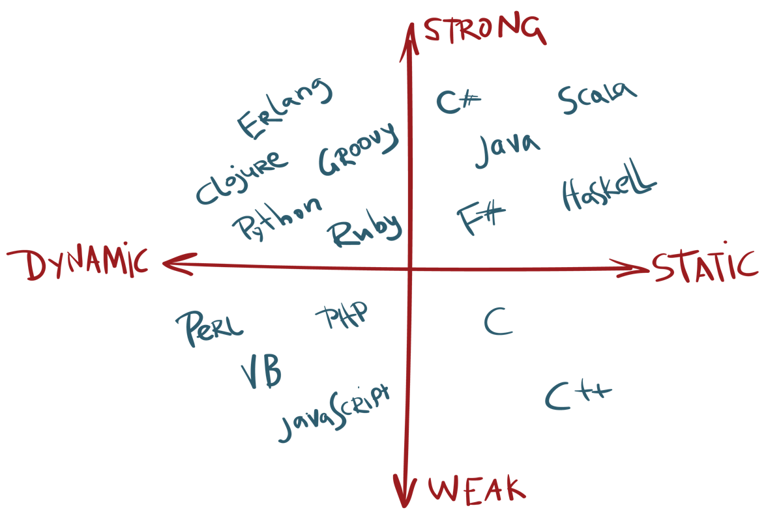
Languages by Type Safety
Dynamically Typed – catch type errors during runtime.
Statically Typed – catch (many) type errors during compile-time.
Weak-Typing – does not warn about dangerous type-casts that lose info. (Strong-Typing – nasty warnings.)
Coq
Notes:
https://android.jlelse.eu/magic-lies-here-statically-typed-vs-dynamically-typed-languages-d151c7f95e2b
Every object will be used only according to its type
A variable will be used only after it has been initialized
Only operations defined for the variable's declared type will be applied
Every operation defined for a variable leaves the variable with a valid value
Static type safety: A program that violates type safety will not compile – very limiting approach (partly true in functional languages like Coq or Scala).
Dynamic type safety: If you write a program that violates type safety it will be detected at run time.
In practice static and dynamic type safety ideals are not achievable (and some languages may use the mix of static/dynamic approach).

Slide 12
Type safety in C++
Type safety is a very big deal
Try very hard not to violate it
"when you program, the compiler is your best friend"
C++ is not (completely) statically or dynamically type safe
No widely-used language is (completely) statically type safe
Being completely statically type safe may interfere with your ability to express ideas
C++ is not (completely) dynamically type safe
Many languages are dynamically type safe
Being completely dynamically type safe may interfere with the ability to express ideas and often makes generated code bigger and/or slower
Almost all of what you’ll be taught here is type safe
We’ll specifically mention anything that is not

Slide 13
Expressions
Expressions
// compute area:
int length = 20; // simplest expression: a literal (here, 20)
// (here used to initialize a variable)
int width = 40;
int area = length*width; // a multiplication
int average = (length+width)/2; // addition and division
The usual rules of precedence apply:
a*b+c/d means (a*b)+(c/d) and not a*(b+c)/d.
If in doubt, parenthesize.

Slide 14
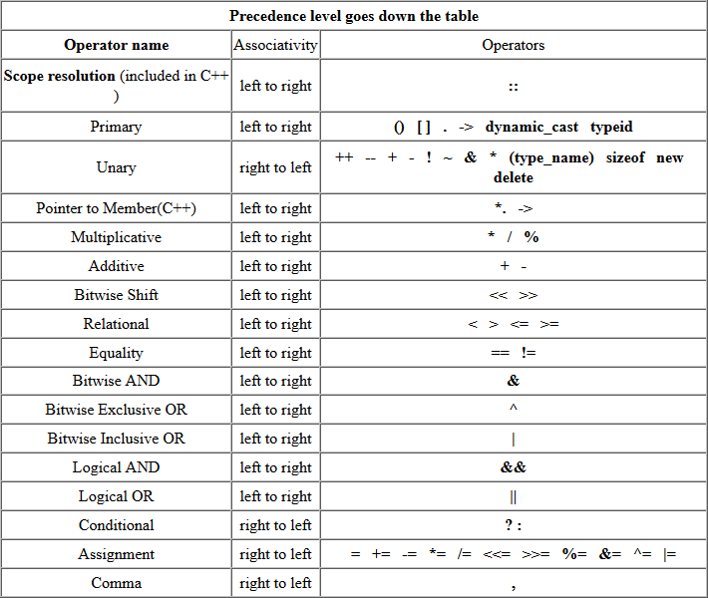
Boolean and Bitwise Operations
int a = 13;
int b = 17;
int c = 15;
int max = -1;
max = (a>b) ? a : b;
a += b = 6;
a++ = 100; // error
++a = 1000;
error C2106: '=': left operand must be l-value
Notes:
error C2106: '=': left operand must be l-value

Slide 15
Bitwise Operations
int a = 13;
int b = 17;
cout << max << endl;
cout << (b << 2) << endl; // 68 (17*4)
cout << (b >> 2) << endl; // 4 (17/4)
cout << (a & b) << endl; // 1
cout << (a | b) << endl; // 29
cout << (~b) << endl; // -18
cout << (a && b) << endl; // 1 (true)
cout << (a || b) << endl; // 1 (true)
cout << (!b) << endl; // 0 (false)

Slide 16
Expressions
Expressions are made out of operators and operands
Operators specify what is to be done
Operands specify the data for the operators to work with
Boolean type: bool (true and false)
Equality operators: = = (equal), != (not equal)
Logical operators: && (and), || (or), ! (not)
Relational operators: < (less than), > (greater than), <=, >=
Character type: char (e.g., 'a', '7', and '@')
Integer types: short, int, long
arithmetic operators: +, -, *, /, % (remainder)
Floating-point types: e.g., float, double (e.g., 12.45 and 1.234e3)
arithmetic operators: +, -, *, /

Slide 17
Concise Operators
For many binary operators, there are (roughly) equivalent more concise operators
a += c means a = a+c
a *= scale means a = a*scale
++a means a += 1
or a = a+1
“Concise operators” help to write standard stuff
for (int i=0; i<10; i++) { … }

Slide 18
String streams
A stringstream reads/writes from/to a string (rather than console or file)
double str_to_double(string s)
// if possible, convert characters in s to floating-point value
{
istringstream is {s}; // make a stream so that we can read from s
double d;
is >> d;
if (!is) error("double format error: “,s);
return d;
}
double d1 = str_to_double("12.4"); // testing
double d2 = str_to_double("1.34e-3");
double d3 = str_to_double("twelve point three"); // will call error()

Slide 19
Reading 1 Item per Line
#include <iostream>
#include <vector>
#include <string>
#include <sstream>
int main() {
string mode;
cin >> mode;
string inputString;
long long unsigned a;
cin.ignore(10000,'\n');
string inputLine;
int period = -1;
while (getline(cin, inputLine)) {
istringstream sstr(inputLine);
if (sstr.peek() == '#') {
continue; // ignore
}
else {
sstr >> a;
}
}
}

Slide 20
Reading Characters (vs. Peeking)
for (char ch; cin>>ch; ) { // read, but skip whitespace
if (isalpha(ch)) {
// do something
}
}
for (char ch; cin.get(ch); ) { // don’t skip whitespace
if (isspace(ch)) {
// do something
}
else if (isalpha(ch)) {
// do something else
}
}

Slide 21
Character classification functions
If you use character input, you often need one or more of these (from header <cctype> ):
isspace(c) // is c whitespace? (' ', '\t', '\n', etc.)
isalpha(c) // is c a letter? ('a'..'z', 'A'..'Z') note: not '_'
isdigit(c) // is c a decimal digit? ('0'..'9')
isupper(c) // is c an upper case letter?
islower(c) // is c a lower case letter?
isalnum(c) // is c a letter or a decimal digit?
etc.

Slide 22
Line-oriented input
Prefer >> to getline()
i.e. avoid line-oriented input when you can
People often use getline() because they see no alternative
But it easily gets messy
When trying to use getline(), you often end up
using >> to parse the line from a stringstream
using get() to read individual characters

Slide 23
Statements
If-Else and Switch Statements
A statement is
an expression followed by a semicolon, or
a declaration, or
a “control statement” that determines the flow of control
For example
a = b;
double d2 = 2.5;
if (x == 2) y = 4;
while (cin >> number) numbers.push_back(number);
int average = (length+width)/2;
return x;

Slide 24
Selection
Sometimes we must select between alternatives
For example, suppose we want to identify the larger of two values. We can do this with an if statement
if (a<b) // Note: No semicolon here
max = b;
else // Note: No semicolon here
max = a;
The syntax is
if (condition)
statement-1 // if the condition is true, do statement-1
else
statement-2 // if not, do statement-2

Slide 25
Iteration (while loop)
Loop Statements
The world’s first “real program” running on a stored-program computer (David Wheeler, Cambridge, May 6, 1949)
// calculate and print a table of squares 0-99:
int main()
{
int i = 0;
while (i<100) {
cout << i << '\t' << square(i) << '\n';
++i ; // increment i
}
}
// (No, it wasn’t actually written in C++ ☺.)

Slide 26
Iteration (while loop)
What it takes
A loop variable (control variable); here: i
Initialize the control variable; here: int i = 0
A termination criterion; here: if i<100 is false, terminate
Increment the control variable; here: ++i
Something to do for each iteration; here: cout << …
int i = 0;
while (i<100) {
cout << i << '\t' << square(i) << '\n';
++i ; // increment i
}

Slide 27
Iteration (for loop)
Another iteration form: the for loop
You can collect all the control information in one place, at the top, where it’s easy to see
for (int i = 0; i<100; ++i) {
cout << i << '\t' << square(i) << '\n';
}
That is,
for (initialize; condition ; increment )
controlled statement
Note: what is square(i)?

Slide 28
Break and Continue
for (int i=0; i<100; ++i)
{
a = f();
if (cond(a))
{
break;
}
g();
}
for (int i=0; i<100; ++i)
{
a = f();
if (cond(a))
{
continue;
}
g();
}

Slide 29
Nested Loops
Assume that you have two "for" loops nested in one another.
You search something – and then you find it (at this point you need to break out of BOTH loops).
How to do that?

Slide 30
Functions
Functions
A call of the function square()
int square(int x)
{
return x*x;
}
We define a function when we want to separate a computation because it
is logically separate
makes the program text clearer (by naming the computation)
is useful in more than one place in our program
eases testing, distribution of labor, and maintenance

Slide 31
Control Flow
int main()
{
i=0;
while (i<100)
{
square(i);
}
}
int square(int x)
{
// compute square
return x * x;
}
i<100
i==100

Slide 32
Functions
Our function
int square(int x)
{
return x*x;
}
is an example of
Return_type function_name ( Parameter list )
// (type name, etc.)
{
// use each parameter in code
return some_value; // of Return_type
}

Slide 33
Another Example
Earlier we looked at code to find the larger of two values. Here is a function that compares the two values and returns the larger value.
int max(int a, int b) // this function takes 2 parameters
{
if (a<b)
return b;
else
return a;
}
int x = max(7, 9); // x becomes 9
int y = max(19, -27); // y becomes 19
int z = max(20, 20); // z becomes 20

Slide 34
Arrays
Arrays and Vectors
// static arrays (size known in compile-time)
int a[5];
int a[] = {1,3,5,7};
// dynamic arrays (size known in run-time)
int N; cin >> N;
int *a = new int[N];
// do something with a[i]
delete a;

Slide 35
Data for Iteration - Vector
We can store collection of data in a vector. For example:
// read some temperatures into a vector:
int main()
{
vector<double> temps; // declare a vector of type double to store // temperatures – like 62.4
double temp; // a variable for a single temperature value
while (cin>>temp) // cin reads a value and stores it in temp
temps.push_back(temp); // store the value of temp in the vector
// … do something …
}
// cin>>temp will return true until we reach the end of file or encounter
// something that isn’t a double: like the word “end”

Slide 36
Vector
Vector is the most useful standard library data type
a vector<T> holds an sequence of values of type T
Think of a vector this way
A vector named v contains 5 elements: {1, 4, 2, 3, 5}:
size()
v:
5
v[0]
v[1]
v[2]
v[3]
v[4]
v’s elements:
1
4
2
3
5

Slide 37
Vectors
v:
0
vector<int> v; // start off empty
v.push_back(1); // add an element with the value 1
v.push_back(4); // add an element with the value 4 at end (“the back”)
v.push_back(3); // add an element with the value 3 at end (“the back”)
v[0] v[1] v[2]
v:
1
1
v:
2
1
4
v:
3
1
4
3

Slide 38
Vectors
Once you get your data into a vector you can easily manipulate it
// compute mean (average) and median temperatures:
int main()
{
vector<double> temps; // temperatures in Fahrenheit, e.g. 64.6
double temp;
while (cin>>temp) temps.push_back(temp); // read and put into vector
double sum = 0;
for (int i = 0; i< temps.size(); ++i) sum += temps[i]; // sums temperatures
cout << "Mean temperature: " << sum/temps.size() << '\n';
sort(temps); // from std_lib_facilities.h
// or sort(temps.begin(), temps.end();
cout << "Median temperature: " << temps[temps.size()/2] << '\n';
}

Slide 39
Traversing a vector
Once you get your data into a vector you can easily manipulate it
Initialize with a list
vector<int> v = { 1, 2, 3, 5, 8, 13 }; // initialize with a list
often we want to look at each element of a vector in turn:
for (int i = 0; i< v.size(); ++i) cout << v[i] << '\n'; // list all elements
// there is a simpler kind of loop for that (a range-for loop):
for (int i : v) cout << x << '\n'; // list all elements
// for each x in v …

Slide 40
Combining Language Features
You can write many new programs by combining language features, built-in types, and user-defined types in new and interesting ways.
So far, we have
Variables and literals of types bool, char, int, double
vector, push_back(), [ ] (subscripting)
!=, ==, =, +, -, +=, <, &&, ||, !
max( ), sort( ), cin>>, cout<<
if, for, while
You can write a lot of different programs with these language features! Let’s try to use them in a slightly different way…

Slide 41
Example – Word List
// “boilerplate” left out
vector<string> words;
for (string s; cin>>s && s != "quit“; ) // && means AND
words.push_back(s);
sort(words); // sort the words we read
for (string s : words)
cout << s << '\n';
/*
read a bunch of strings into a vector of strings, sort
them into lexicographical order (alphabetical order),
and print the strings from the vector to see what we have.
*/

Slide 42
Word list – Eliminate Duplicates
// Note that duplicate words were printed multiple times. For
// example “the the the”. That’s tedious, let’s eliminate duplicates:
vector<string> words;
for (string s; cin>>s && s!= "quit"; )
words.push_back(s);
sort(words);
for (int i=1; i<words.size(); ++i)
if(words[i-1]==words[i])
"get rid of words[i]" // (pseudocode)
for (string s : words)
cout << s << '\n';
// there are many ways to “get rid of words[i]”; many of them are messy
// (that’s typical). Our job as programmers is to choose a simple clean
// solution – given constraints – time, run-time, memory.

Slide 43
Example (cont.) Eliminate Words!
// Eliminate the duplicate words by copying only unique words:
vector<string> words;
for (string s; cin>>s && s!= "quit"; )
words.push_back(s);
sort(words);
vector<string>w2;
if (0<words.size()) { // note style { }
w2.push_back(words[0]);
for (int i=1; i<words.size(); ++i) // note: not a range-for
if(words[i-1]!=words[i])
w2.push_back(words[i]);
}
cout<< "found " << words.size()-w2.size() << " duplicates\n";
for (string s : w2)
cout << s << "\n";

Slide 44
Algorithm
We just used a simple algorithm
An algorithm is (from Google search)
“a logical arithmetical or computational procedure that, if correctly applied, ensures the solution of a problem.” – Harper Collins
“a set of rules for solving a problem in a finite number of steps, as for finding the greatest common divisor.” – Random House
“a detailed sequence of actions to perform or accomplish some task. Named after an Iranian mathematician, Al-Khawarizmi. Technically, an algorithm must reach a result after a finite number of steps, …The term is also used loosely for any sequence of actions (which may or may not terminate).” – Webster’s
We eliminated the duplicates by first sorting the vector (so that duplicates are adjacent), and then copying only strings that differ from their predecessor into another vector.

Slide 45
Declarations
A declaration introduces a name into a scope.
A declaration also specifies a type for the named object.
Sometimes a declaration includes an initializer.
A name must be declared before it can be used in a C++ program.
Examples:
int a = 7; // an int variable named ‘a’ is declared
const double cd = 8.7; // a double-precision floating-point constant
double sqrt(double); // a function taking a double argument and // returning a double result
vector<Token> v; // a vector variable of Tokens (variable)

Slide 46
Declarations
Declarations are frequently introduced into a program through “headers”
A header is a file containing declarations providing an interface to other parts of a program
This allows for abstraction – you don’t have to know the details of a function like cout in order to use it.
In order to use "cin", "cout" and other input/output facilities, write the following:
#include <iostream>

Slide 47
Definitions
A declaration that (also) fully specifies the entity declared is called a definition
Examples
int a = 7;
int b; // an (uninitialized) int
vector<double> v; // an empty vector of doubles
double sqrt(double) { … }; // a function with a body
struct Point { int x; int y; };
Examples of declarations that are not definitions
double sqrt(double); // function body missing
struct Point; // class members specified elsewhere
extern int a; // extern means “not definition”
// “extern” is archaic; we will hardly use it

Slide 48
Declarations and definitions
You can’t define something twice. A definition says what something is
Examples
int a; // definition
int a; // error: double definition
double sqrt(double d) { … } // definition
double sqrt(double d) { … } // error: double definition
You can declare something twice. A declaration says how something can be used
int a = 7; // definition (also a declaration)
extern int a; // declaration
double sqrt(double); // declaration
double sqrt(double d) { … } // definition (also a declaration)

Slide 49
Why both declarations and definitions?
To refer to something, we need (only) its declaration
Often we want the definition “elsewhere”
Later in a file
In another file
preferably written by someone else
Declarations are used to specify interfaces
To your own code
To libraries
Libraries are key: we can’t write all ourselves, and wouldn’t want to
In larger programs
Place all declarations in header files to ease sharing

Slide 50
Kinds of declarations
The most interesting are
Variables
int x;
vector<int> vi2 {1,2,3,4};
Constants
void f(const X&);
constexpr int = isqrt(2);
Functions (see §8.5)
double sqrt(double d) { /* … */ }
Namespaces (see §8.7)
Types (classes and enumerations; see Chapter 9)
Templates (see Chapter 19)

Slide 51
Header Files and the Preprocessor
A header is a file that holds declarations of functions, types, constants, and other program components.
The construct
#include "std_lib_facilities.h"
is a “preprocessor directive” that adds declarations to your program
Typically, the header file is simply a text (source code) file
A header gives you access to functions, types, etc. that you want to use in your programs.
Usually, you don’t really care about how they are written.
The actual functions, types, etc. are defined in other source code files
Often as part of libraries

Slide 52
Source files
// declarations:
class Token { … };
class Token_stream {
Token get();
…
};
extern Token_stream ts;
…
token.h:
token.cpp:
#include "token.h"
//definitions:
Token Token_stream::get()
{ /* … */ }
Token_stream ts;
…
use.cpp:
#include "token.h"
…
Token t = ts.get();
…
A header file (here, token.h) defines an interface between user code and implementation code (usually in a library)
The same #include declarations in both .cpp files (definitions and uses) ease consistency checking

Slide 53
Scope
A scope is a region of program text
Global scope (outside any language construct)
Class scope (within a class)
Local scope (between { … } braces)
Statement scope (e.g. in a for-statement)
A name in a scope can be seen from within its scope and within scopes nested within that scope
Only after the declaration of the name (“can’t look ahead” rule)
Class members can be used within the class before they are declared
A scope keeps “things” local
Prevents my variables, functions, etc., from interfering with yours
Remember: real programs have many thousands of entities
Locality is good!
Keep names as local as possible

Slide 54
Scope
#include "std_lib_facilities.h" // get max and abs from here
// no r, i, or v here
class My_vector {
vector<int> v; // v is in class scope
public:
int largest() // largest is in class scope
{
int r = 0; // r is local
for (int i = 0; i<v.size(); ++i) // i is in statement scope
r = max(r,abs(v[i]));
// no i here
return r;
}
// no r here
};
// no v here

Slide 55
Scopes nest
int x; // global variable – avoid those where you can
int y; // another global variable
int f()
{
int x; // local variable (Note – now there are two x’s)
x = 7; // local x, not the global x
{
int x = y; // another local x, initialized by the global y
// (Now there are three x’s)
++x; // increment the local x in this scope
}
}
// avoid such complicated nesting and hiding: keep it simple!

Slide 56
Recap: Why functions?
More
Functions
Chop a program into manageable pieces
“divide and conquer”
Match our understanding of the problem domain
Name logical operations
A function should do one thing well
Functions make the program easier to read
A function can be useful in many places in a program
Ease testing, distribution of labor, and maintenance
Keep functions small
Easier to understand, specify, and debug

Slide 57
Functions
General form:
return_type name (formal arguments); // a declaration
return_type name (formal arguments) body // a definition
For example
double f(int a, double d) { return a*d; }
Formal arguments are often called parameters
If you don’t want to return a value give void as the return type
void increase_power_to(int level);
Here, void means “doesn’t return a value”
A body is a block or a try block
For example
{ /* code */ } // a block
try { /* code */ } catch(exception& e) { /* code */ } // a try block
Functions represent/implement computations/calculations

Slide 58
Functions: Call by Value
// call-by-value (send the function a copy of the argument’s value)
int f(int a) { a = a+1; return a; }
int main()
{
int xx = 0;
cout << f(xx) << ′\n′; // writes 1
cout << xx << ′\n′; // writes 0; f() doesn’t change xx
int yy = 7;
cout << f(yy) << ′\n′; // writes 8; f() doesn’t change yy
cout << yy << ′\n′; // writes 7
}
a:
0
copy the value
xx:
0
a:
7
copy the value
yy:
7

Slide 59
Functions: Call by Reference
a:
// call-by-reference (pass a reference to the argument)
int f(int& a) { a = a+1; return a; }
int main()
{
int xx = 0;
cout << f(xx) << ′\n′; // writes 1
// f() changed the value of xx
cout << xx << ′\n′; // writes 1
int yy = 7;
cout << f(yy) << ′\n′; // writes 8
// f() changes the value of yy
cout << yy << ′\n′; // writes 8
}
1st call (refer to xx)
xx:
0
2nd call (refer to yy)
yy:
7

Slide 60
Functions
Avoid (non-const) reference arguments when you can
They can lead to obscure bugs when you forget which arguments can be changed
int incr1(int a) { return a+1; }
void incr2(int& a) { ++a; }
int x = 7;
x = incr1(x); // pretty obvious
incr2(x); // pretty obscure
So why have reference arguments?
Occasionally, they are essential
E.g., for changing several values
For manipulating containers (e.g., vector)
const reference arguments are very often useful

Slide 61
Call by value/by reference/ by const-reference
void f(int a, int& r, const int& cr) { ++a; ++r; ++cr; } // error: cr is const
void g(int a, int& r, const int& cr) { ++a; ++r; int x = cr; ++x; } // ok
int main()
{
int x = 0;
int y = 0;
int z = 0;
g(x,y,z); // x==0; y==1; z==0
g(1,2,3); // error: reference argument r needs a variable to refer to
g(1,y,3); // ok: since cr is const we can pass “a temporary”
}
// const references are very useful for passing large objects

Slide 62
References
r
“reference” is a general concept
Not just for call-by-reference
int i = 7;
int& r = i;
r = 9; // i becomes 9
const int& cr = i;
// cr = 7; // error: cr refers to const
i = 8;
cout << cr << endl; // write out the value of i (that’s 8)
You can
think of a reference as an alternative name for an object
You can’t
modify an object through a const reference
make a reference refer to another object after initialization
i:
7
cr

Slide 63
For example
A range-for loop:
for (string s : v) cout << s << ″\n″; // s is a copy of some v[i]
for (string& s : v) cout << s << ″\n″; // no copy
for (const string& s : v) cout << s << ″\n″; // and we don’t modify v

Slide 64
Compile-time functions
You can define functions that can be evaluated at compile time: constexpr functions
constexpr double xscale = 10; // scaling factors constexpr double yscale = .8;
constexpr Point scale(Point p) { return {xscale*p.x,yscale*p.y}; };
constexpr Point x = scale({123,456}); // evaluated at compile time
void use(Point p)
{
constexpr Point x1 = scale(p); // error: compile-time evaluation // requested for variable argument
Point x2 = scale(p); // OK: run-time evaluation
}

Slide 65
Guidance for Passing Variables
Use call-by-value for very small objects
Use call-by-const-reference for large objects
Use call-by-reference only when you have to
Return a result rather than modify an object through a reference argument
For example
class Image { /* objects are potentially huge */ };
void f(Image i); … f(my_image); // oops: this could be s-l-o-o-o-w
void f(Image& i); … f(my_image); // no copy, but f() can modify my_image
void f(const Image&); … f(my_image); // f() won’t mess with my_image
Image make_image(); // most likely fast! (“move semantics” – later)

Slide 66
Namespaces
Consider this code from two programmers Jack and Jill
class Glob { /*…*/ }; // in Jack’s header file jack.h
class Widget { /*…*/ }; // also in jack.h
class Blob { /*…*/ }; // in Jill’s header file jill.h
class Widget { /*…*/ }; // also in jill.h
#include "jack.h"; // this is in your code
#include "jill.h"; // so is this
void my_func(Widget p) // error: multiple defns of Widget
{ /* … */ }

Slide 67
Namespaces
One way to prevent this problem is with namespaces:
namespace Jack { // in Jack’s header file
class Glob{ /*…*/ };
class Widget{ /*…*/ };
}
#include "jack.h"; // this is in your code
#include "jill.h"; // so is this
void my_func(Jack::Widget p) // OK, Jack’s Widget will not
{ // clash with a different Widget class
// ...
}

Slide 68
Namespaces
A namespace is a named scope
The :: syntax is used to specify which namespace you are using and which (of many possible) objects of the same name you are referring to
For example, cout is in namespace std, you could write:
std::cout << "Enter an integer in Hex notation" << std::endl;
std::cin >> std::hex >> myInt;

Slide 69
using Declarations and Directives
To avoid the tedium of std::cout << "Please enter stuff… \n";
you could write a “using declaration”
using std::cout; // when I say cout, I mean std::cout
cout << "Please enter stuff… \n"; // ok: std::cout
cin >> x; // ERROR! cin not in scope
or you could write a “using directive”
using namespace std; // all names from namespace std available cout << "Please enter stuff… \n"; // ok: std::cout cin >> x; // ok: std::cin

Slide 70
Exceptions and Errors
Why do we need exceptions and errors? (Also things like event logging or hardware interceptions?)
Situations where functions (or the entire software module) do not return the expected result type.
“The most likely way for the world to be destroyed, most experts agree, is by accident. That's where we come in; we are computer professionals. We cause accidents.”
Nathaniel Borenstein. (Programming as If People Mattered, 1991.)

Slide 71
Abstract
When we program, we have to deal with errors. Our most basic aim is correctness, but we must deal with incomplete problem specifications, incomplete programs, and our own errors. Here, we’ll concentrate on a key area: how to deal with unexpected function arguments. We’ll also discuss techniques for finding errors in programs: debugging and testing.

Slide 72
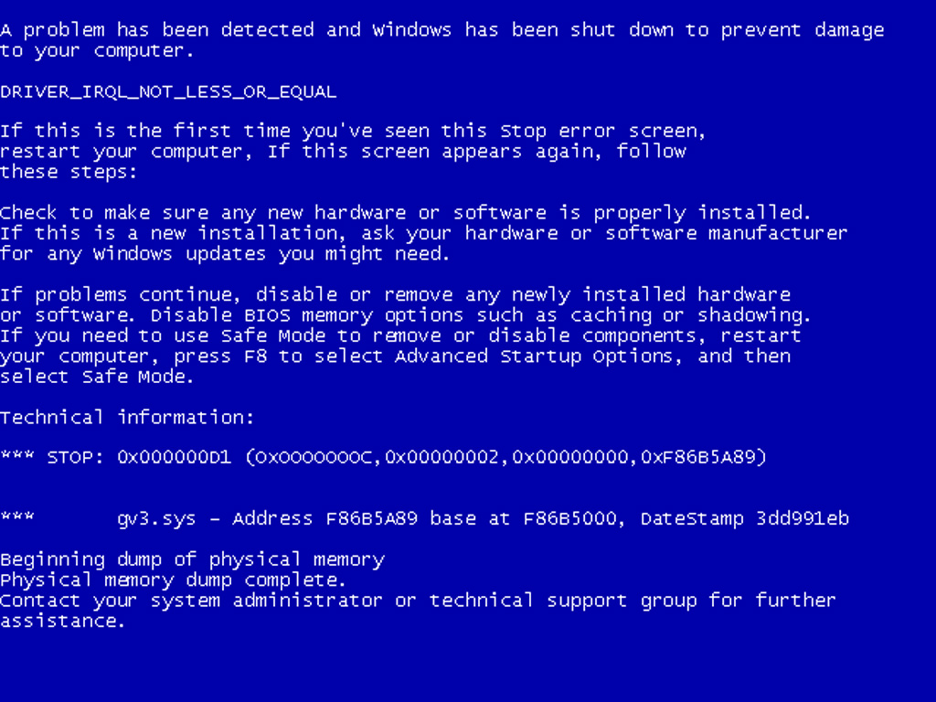
Overview
Kinds of errors
Argument checking
Error reporting
Error detection
Exceptions
Debugging
Testing

Slide 73
Errors
“ … I realized that from now on a large part of my life would be spent finding and correcting my own mistakes.”
Maurice Wilkes, 1949
When we write programs, errors are natural and unavoidable; the question is, how do we deal with them?
Organize software to minimize errors.
Eliminate most of the errors we made anyway.
Debugging
Testing
Make sure the remaining errors are not serious.
My guess is that avoiding, finding, and correcting errors is 95% or more of the effort for serious software development.
You can do much better for small programs.
or worse, if you’re sloppy

Slide 74
Your Program
Should produce the desired results for all legal inputs
Should give reasonable error messages for illegal inputs
Need not worry about misbehaving hardware
Need not worry about misbehaving system software
Is allowed to terminate after finding an error
3, 4, and 5 are true for beginner’s code; often, we have to worry about those in real software.

Slide 75
Sources of errors
Poor specification
“What’s this supposed to do?”
Incomplete programs
“but I’ll not get around to doing that until tomorrow”
Unexpected arguments
“but sqrt() isn’t supposed to be called with -1 as its argument”
Unexpected input
“but the user was supposed to input an integer”
Code that simply doesn’t do what it was supposed to do
“so fix it!”

Slide 76
Kinds of Errors
Compile-time errors
Syntax errors
Type errors
Link-time errors
Run-time errors
Detected by computer (crash)
Detected by library (exceptions)
Detected by user code
Logic errors
Detected by programmer (code runs, but produces incorrect output)

Slide 77
Check your inputs
Before trying to use an input value, check that it meets your expectations/requirements
Function arguments
Data from input (istream)

Slide 78
Bad function arguments
The compiler helps:
Number and types of arguments must match
int area(int length, int width)
{
return length*width;
}
int x1 = area(7); // error: wrong number of arguments
int x2 = area("seven", 2); // error: 1st argument has a wrong type
int x3 = area(7, 10); // ok
int x5 = area(7.5, 10); // ok, but dangerous: 7.5 truncated to 7;
// most compilers will warn you
int x = area(10, -7); // this is a difficult case:
// the types are correct,
// but the values make no sense

Slide 79
Bad Function Arguments
So, how about int x = area(10, -7); ?
Alternatives
Just don’t do that
Rarely a satisfactory answer
The caller should check
Hard to do systematically
The function should check
Return an “error value” (not general, problematic)
Set an error status indicator (not general, problematic – don’t do this)
Throw an exception
Note: sometimes we can’t change a function that handles errors in a way we do not like
Someone else wrote it and we can’t or don’t want to change their code

Slide 80
Bad function arguments
Why worry?
You want your programs to be correct
Typically the writer of a function has no control over how it is called
Writing “do it this way” in the manual (or in comments) is no solution – many people don’t read manuals
The beginning of a function is often a good place to check
Before the computation gets complicated
When to worry?
If it doesn’t make sense to test every function, test some

Slide 81
How to report an error
Return an “error value” (not general, problematic)
int area(int length, int width) // return a negative value for bad input
{
if(length <=0 || width <= 0) return -1;
return length*width;
}
So, “let the caller beware”
int z = area(x,y);
if (z<0) error("bad area computation");
// …
Problems
What if I forget to check that return value?
For some functions there isn’t a “bad value” to return (e.g., max())

Slide 82
How to report an error
Set an error status indicator (not general, problematic, don’t!)
int errno = 0; // used to indicate errors
int area(int length, int width)
{
if (length<=0 || width<=0) errno = 7; // || means or
return length*width;
}
So, “let the caller check”
int z = area(x,y);
if (errno==7) error("bad area computation");
// …
Problems
What if I forget to check errno?
How do I pick a value for errno that’s different from all others?
How do I deal with that error?

Slide 83
How to report an error
Report an error by throwing an exception
class Bad_area { }; // a class is a user defined type
// Bad_area is a type to be used as an exception
int area(int length, int width)
{
if (length<=0 || width<=0) throw Bad_area{}; // note the {} – a value
return length*width;
}
Catch and deal with the error (e.g., in main())
try {
int z = area(x,y); // if area() doesn’t throw an exception
} // make the assignment and proceed
catch(Bad_area) { // if area() throws Bad_area{}, respond
cerr << "oops! Bad area calculation – fix program\n";
}

Slide 84
Exceptions
Exception handling is general
You can’t forget about an exception: the program will terminate if someone doesn’t handle it (using a try … catch)
Just about every kind of error can be reported using exceptions
You still have to figure out what to do about an exception (every exception thrown in your program)
Error handling is never really simple

Slide 85
Out of range
Try this
vector<int> v(10); // a vector of 10 ints,
// each initialized to the default value, 0,
// referred to as v[0] .. v[9]
for (int i = 0; i<v.size(); ++i) v[i] = i; // set values
for (int i = 0; i<=10; ++i) // print 10 values (???)
cout << "v[" << i << "] == " << v[i] << endl;
vector’s operator[ ] (subscript operator) reports a bad index (its argument) by throwing a Range_error if you use #include "std_lib_facilities.h"
The default behavior can differ
You can’t make this mistake with a range-for

Slide 86
Exceptions – for now
For now, just use exceptions to terminate programs gracefully, like this
int main()
try
{
// …
}
catch (out_of_range&) { // out_of_range exceptions
cerr << "oops – some vector index out of range\n";
}
catch (…) { // all other exceptions
cerr << "oops – some exception\n";
}

Slide 87
A function error()
Here is a simple error() function as provided in std_lib_facilities.h
This allows you to print an error message by calling error()
It works by disguising throws, like this:
void error(string s) // one error string
{
throw runtime_error(s);
}
void error(string s1, string s2) // two error strings
{
error(s1 + s2); // concatenates
}

Slide 88
Using error( )
Example
cout << "please enter integer in range [1..10]\n";
int x = -1; // initialize with unacceptable value (if possible)
cin >> x;
if (!cin) // check that cin read an integer
error("didn’t get a value");
if (x < 1 || 10 < x) // check if value is out of range
error("x is out of range");
// if we get this far, we can use x with confidence

Slide 89
Summary

