Slide 1
Midterm Overview
Data Structures and Algorithms
http://linen-tracer-682.appspot.com/data-structures/index.html

Slide 2
Topics for the Midterm
Algorithms should not feel like "Defense Against the Dark Arts" → need mathematical models.
Conditionals, loops, flowcharts
Expressions and their side-effects
Function calls by value, by reference
Static/dynamic arrays
Pointer arithmetic
Class members/constructors/destructors
Object assignments, shallow vs. deep copy
Class inheritance, virtual functions
Polymorphism, template functions/classes
Using STL classes: vector, queue, deque, set, map.
Algorithm Analysis
Test g(n) in O(f(n)) by definition
Test various Big-O, Big-Omega, Big-Theta statements (true/false)
Assumptions for time complexity
Time analysis for code samples
Array implementations for stacks, queues, circular queues.
Run linked-list-related pointer pseudocode
Compare stack/queue operation complexity
Tree terminology; recognize full, complete, perfect trees.
Pre-order, in-order, post-order traversals.
Build stacks during tree traversal.
Notes:
https://www.toptal.com/c-plus-plus/top-10-common-c-plus-plus-developer-mistakes

Slide 3
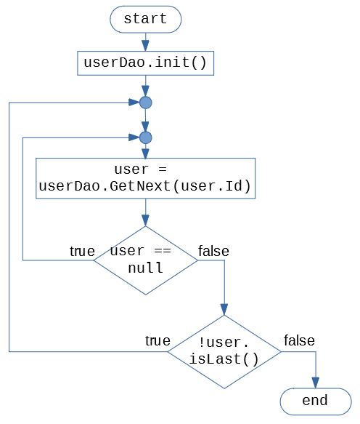
Flowchart to Code
1. Loops, conditionals,
Does this flowchart need conditionals? (What kind is better – If? If/else? Switch?)
Does this flowchart need loops? (What kind fits better – For? While? Do-While?). Any "break" or "continue"?
Write main() function that runs this flowchart (assume that all the functions referred here are implemented somewhere).

Slide 4
Flowchart to Code: Solution
int main() {
userDao.init();
do {
user = userDao.getNext();
if (user == null) { continue;
}
} while (!user.isLast());
}

Slide 5
Pseudocode to Code
1. Loops, conditionals.
Problem: Write a function that receives a 2D array of integers (and its width/height). It should print those row numbers where all array entries are equal.
1. What is the correct prototype of printEqual(…) in C++
2. Rewrite this pseudocode entirely in C++
Pseudocode.
printEqual(arr, rows, cols):
outer: for i in range(0,rows):
first = arr[i][0]
inner: for j in range(0,cols):
if (arr[i][j] != first):
continue outer loop;
print(i)
arr[0][0]=1 | arr[0][1]=3 | arr[0][2]=2
arr[1][0]=17 | 17 | 17
arr[2][0]=3 | 3 | 2
For this array should print: 1

Slide 6
Pseudocode to Code: Hints
The prototype (=declaration) of this function in C++ looks like this:
void printEqual( int** arr, int rows,
int cols);
No labels for loops in C++ → Cannot "continue" the outer loop.
Could write using "goto"
Could write calling bool allEqualOnRow(int* row, int cols); Returns "true" if all elements equal.
Can avoid nested loops altogether

Slide 7
Array-parameters, pre-increment and post-increment
2. Expressions, Side-Effects
#include<iostream>
using namespace std;
int& left(int i, int* a) {
cout << "In left i=" << i << endl;
return a[i];
}
int right(int i, int* a) {
cout << " In right i=" << i << endl;
return a[i];
}
int main() {
int mm [] = {10,11,12,13,14};
int a = 0;
//left(a++, mm) = right(a++, mm)+5;
//left(a++, mm) = right(++a, mm)+5;
//left(++a, mm) = right(a++, mm)+5;
//left(++a, mm) = right(++a, mm)+5;
for (int i = 0; i < 5; i++) {
cout << " " << mm[i];
}
cout << endl;
}
In right i = 2
In left i = 2
10 11 17 13 14
Can you uncomment some line to get this output:

Slide 8
Array-parameters, pre-increment and post-increment
2. Expressions, Side-Effects
Answer. 4th line left(++a, mm) = right(++a, mm)+5;
Expressions in C++ can have side-effects (as you evaluate them, some variables change during the evaluation itself).
Evaluation order for an assignment operator:
Compute actual parameters (pre-increment increments a two times)
Evaluate the right-hand side.
Evaluate the left-hand side (must be int& or similar "lvalue").
Assign right to the left.
In right i = 2
In left i = 2
10 11 17 13 14

Slide 9
Parameter passing by value/by reference
3. Function calls by value and by reference
#include <iostream>
void swap(int* a, int b, int c) {
int temp = a[0];
a[0] = a[1];
a[1] = temp;
temp = b;
b = c;
c = temp;
}
using namespace std;
int main() {
int arr[] = {1,2};
int b = 4, c = 5;
swap(arr, b, c);
// values of arr[0], arr[1]
// values of b,c
}
Problem: (1) What are the values of arr,b,c at the end of main()?
(2) What happens as we change function to:
void swap(int*& a, int& b, int& c) {
// same code }

Slide 10
Parameter passing by value/by reference: Solution
#include <iostream>
void swap(int* a, int b, int c) {
int temp = a[0];
a[0] = a[1];
a[1] = temp;
temp = b;
b = c;
c = temp;
}
using namespace std;
int main() {
int arr[] = {1,2};
int b = 4, c = 5;
swap(arr, b, c);
// values of arr[0], arr[1]
// values of b,c
}
Variable | By value | By ref.
arr[0] | 2 | 2
arr[1] | 1 | 1
b | 4 | 5
c | 5 | 4
Problem: (1) What are the values of arr,b,c at the end of main()?
(2) Passing by reference – allows to swap variables. Does not affect the array (as we do not change the pointer (int* a) inside swap()).

Slide 11
Overriding Virtual Method
8. Class Inheritance, Virtual Functions
#include <iostream>
using namespace std;
class Base {
public:
virtual void show() {
cout<<" In Base n"; }
};
class Derived: public Base {
public:
void show() {
cout<<"In Derived n"; }
};
int main(void) {
Base *bp = new Derived;
bp->show();
Base &br = *bp;
br.show();
return 0;
}
Problem: What is the output of this program? Describe, how the keyword "virtual" affects your answer.

Slide 12
Overriding Virtual Method: Solution
#include <iostream>
using namespace std;
class Base {
public:
virtual void show() {
cout<<"In Base\n"; }
};
class Derived: public Base {
public:
void show() {
cout<<"In Derived\n"; }
};
int main(void) {
Base *bp = new Derived;
bp->show();
Base &br = *bp;
br.show();
return 0;
}
Output: In Derived In Derived
"virtual" means applying runtime type when picking overridden functions.

Slide 13

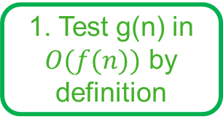
Various Exponent Functions
1. Test g(n) in $O(f(n))$ by definition
Problem. Given functions $g\left(n\right)=5^{n}$, $f_{1}\left(n\right)=2^{n}$, and $f_{2}\left(n\right)={10}^{n}$, test if $g(n)$ is in $O(f_{1}\left(n\right))$ and also in $O(f_{2}(n))$. In both cases (if it is in $O(f_{1}\left(n\right))$ and also if it is not) provide justification by the definition of Big-O, i.e. some reasoning using quantifiers.

Slide 14
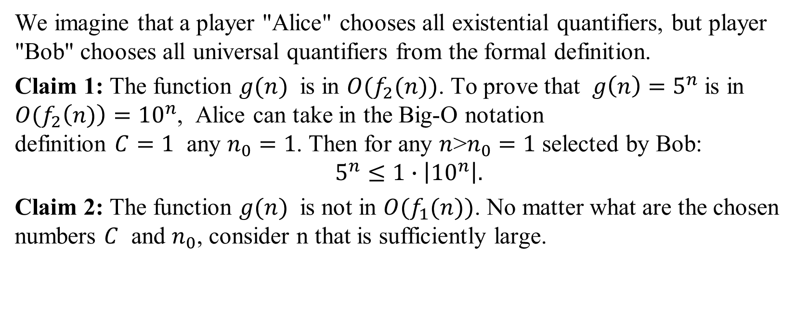
Various Exponent Functions: Solution
We imagine that a player "Alice" chooses all existential quantifiers, but player "Bob" chooses all universal quantifiers from the formal definition.
Claim 1: The function $g(n)$ is in $O(f_{2}(n))$. To prove that $g\left(n\right)=5^{n}$ is in ${O(f}_{2}\left(n)\right)={10}^{n}$, Alice can take in the Big-O notation definition $C=1$ any $n_{0}=1$. Then for any $n$>$n_{0}=1$ selected by Bob: $$5^{n}≤1∙\left|{10}^{n}\right|.$$
Claim 2: The function $g(n)$ is not in $O(f_{1}(n))$. No matter what are the chosen numbers $C$ and $n_{0}$, consider n that is sufficiently large.

Slide 15
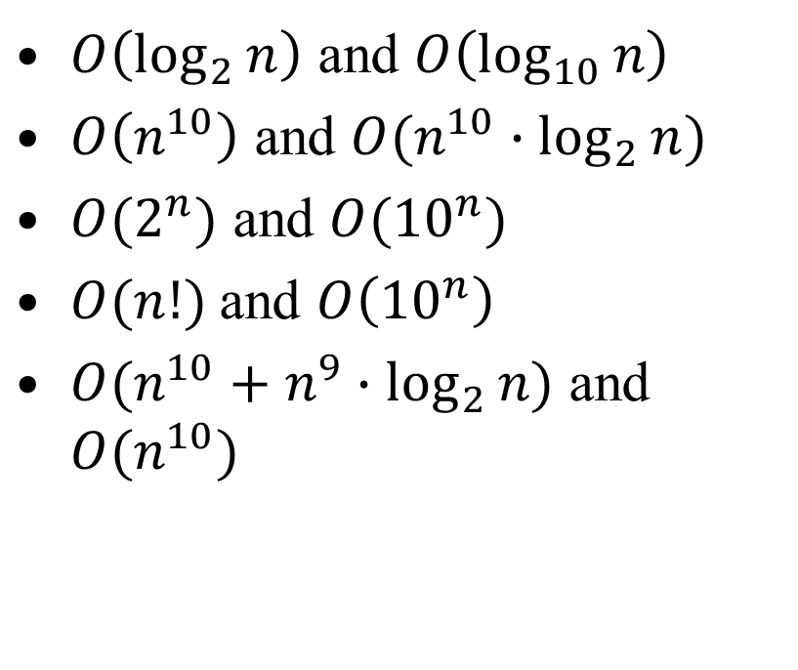
Comparing Big-O Sets
2. Test Big-O, Big- Ω, Big- Θ Statements
$O\left(\log_{2}{n}\right)$ and $O\left(\log_{10}{n}\right)$
$O\left(n^{10}\right)$ and $O(n^{10}∙\log_{2}{n})$
$O(2^{n})$ and $O({10}^{n})$
$O(n!)$and $O\left({10}^{n}\right)$
$O(n^{10}+n^{9}∙\log_{2}{n})$ and $O(n^{10})$
For each pair of Big-O notations decide, if the left-side class of functions is larger than the right-side class. Or are they equal?

Slide 16
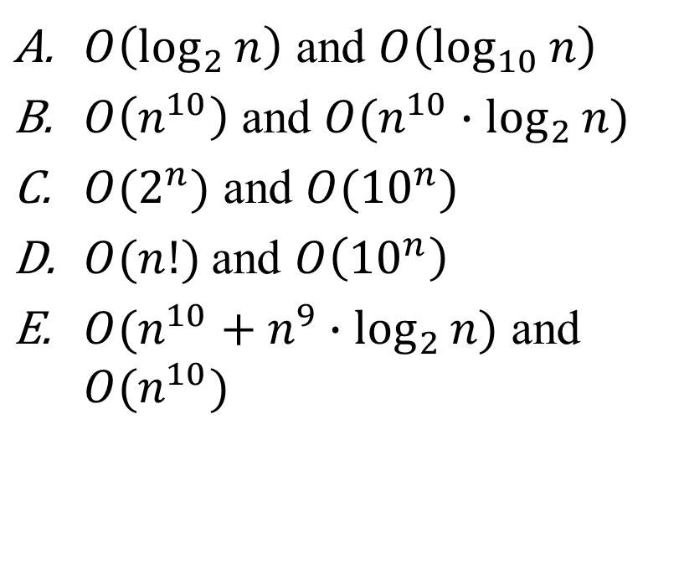
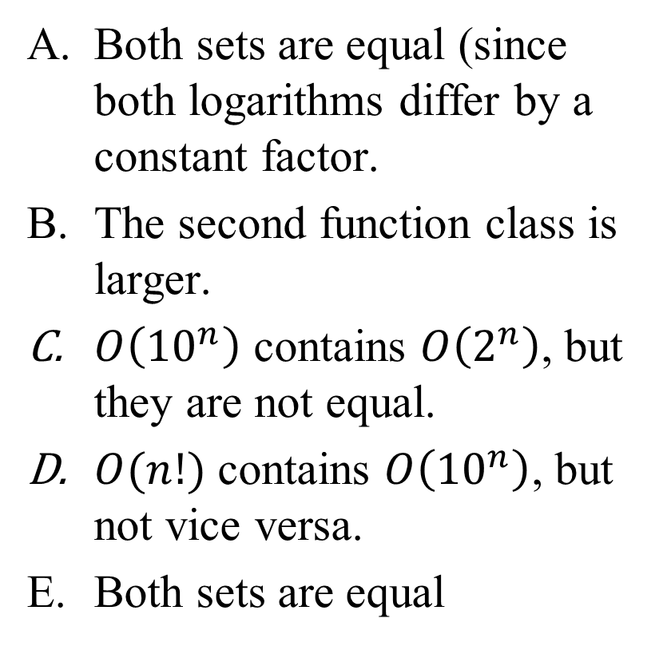
Comparing Big-O Sets: Solution
$O\left(\log_{2}{n}\right)$ and $O\left(\log_{10}{n}\right)$
$O\left(n^{10}\right)$ and $O(n^{10}∙\log_{2}{n})$
$O(2^{n})$ and $O({10}^{n})$
$O(n!)$and $O\left({10}^{n}\right)$
$O(n^{10}+n^{9}∙\log_{2}{n})$ and $O(n^{10})$
Both sets are equal (since both logarithms differ by a constant factor.
The second function class is larger.
$O\left({10}^{n}\right)$ contains $O\left(2^{n}\right)$, but they are not equal.
$O(n!)$ contains $O\left({10}^{n}\right)$, but not vice versa.
Both sets are equal

Slide 17
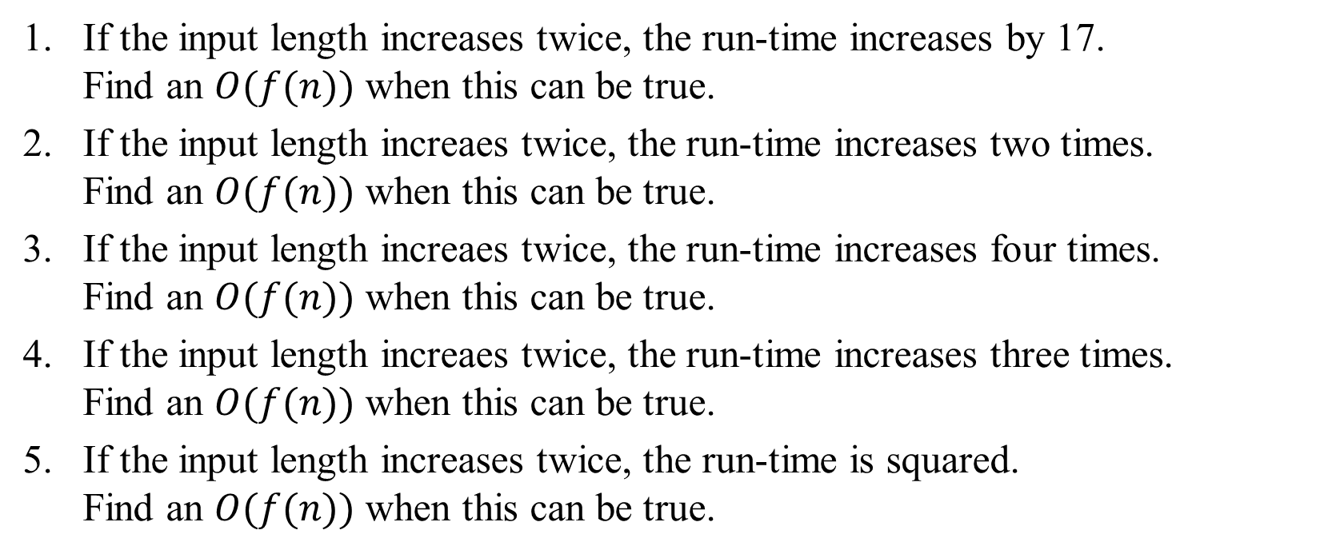
Doubling Input Length
3. Assumptions about the Time Comlexity
If the input length increases twice, the run-time increases by 17. Find an $O(f(n))$ when this can be true.
If the input length increaes twice, the run-time increases two times. Find an $O(f(n))$ when this can be true.
If the input length increaes twice, the run-time increases four times. Find an $O(f(n))$ when this can be true.
If the input length increaes twice, the run-time increases three times. Find an $O(f(n))$ when this can be true.
If the input length increases twice, the run-time is squared. Find an $O(f(n))$ when this can be true.

Slide 18
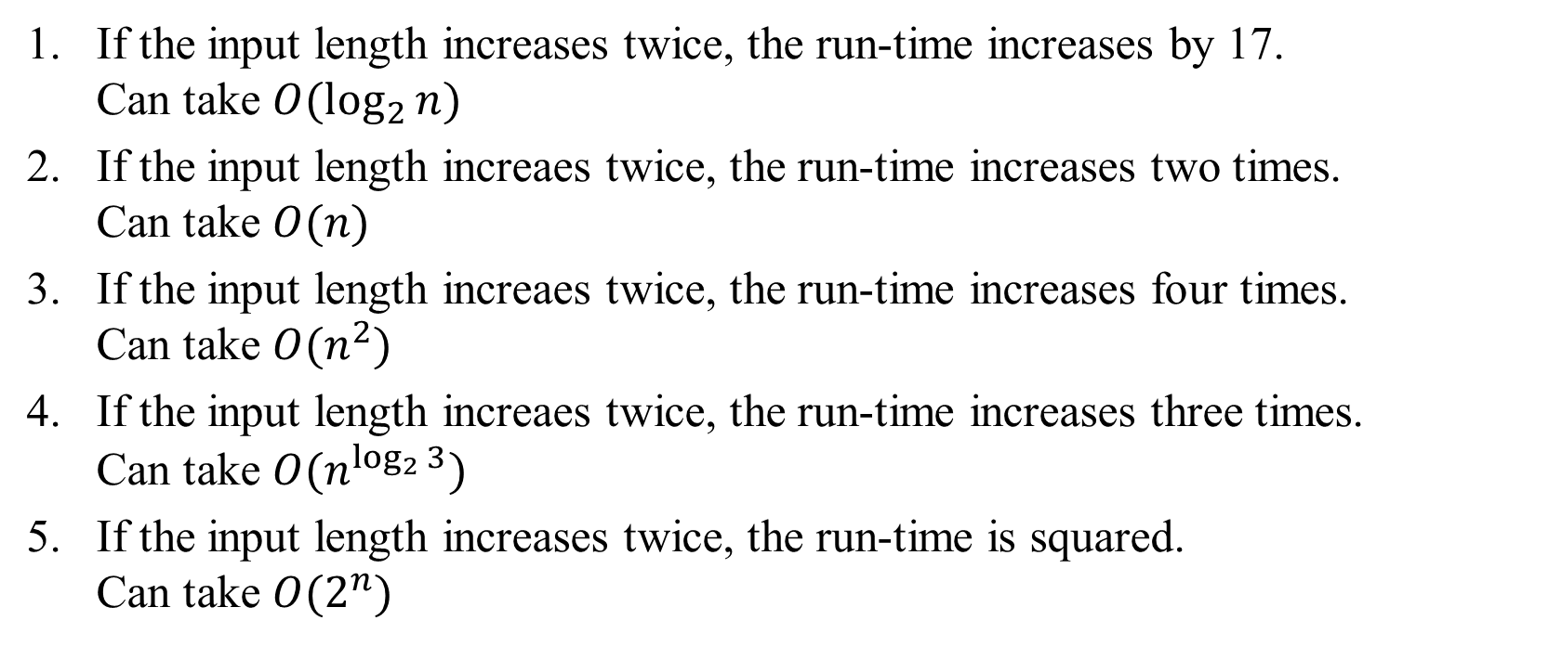
Doubling Input Length: Solutions
If the input length increases twice, the run-time increases by 17. Can take $O(\log_{2}{n})$
If the input length increaes twice, the run-time increases two times. Can take $O(n)$
If the input length increaes twice, the run-time increases four times. Can take $O(n^{2})$
If the input length increaes twice, the run-time increases three times. Can take $O(n^{\log_{2}{3}})$
If the input length increases twice, the run-time is squared. Can take $O(2^{n})$

Slide 19
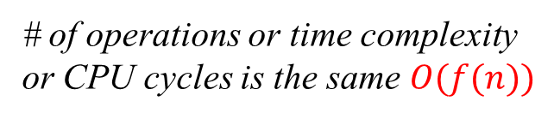
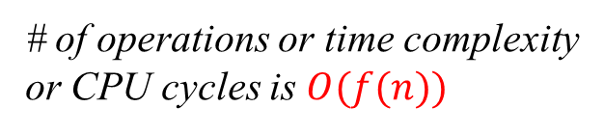
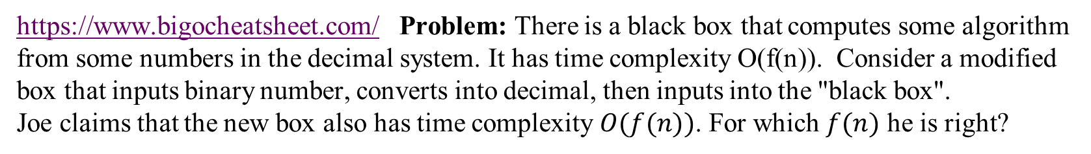
Does the Input Encoding Matter?
3. Assumptions about the Time Comlexity
https://www.bigocheatsheet.com/ Problem: There is a black box that computes some algorithm from some numbers in the decimal system. It has time complexity O(f(n)). Consider a modified box that inputs binary number, converts into decimal, then inputs into the "black box". Joe claims that the new box also has time complexity $O(f(n))$. For which $f(n)$ he is right?
# of operations or time complexity
or CPU cycles is the same $O(f(n))$
# of operations or time complexity
or CPU cycles is $O(f(n))$
Input binary
number N
of length n
Input decimal
number N
of length n
Some output that
depends on N
Output
that depends
on N
Convert from binary to decimal
$$O(f\left(n\right))$$ | $$O(\log_{2}{n})$$ | $$O(n)$$ | $$O(n\log_{2}{n})$$ | $$O(n^{3})$$ | $$O(3^{n})$$ | $$O(n!)$$
True/False?

Slide 20
Does the Input Encoding Matter: Solution
$$O(f\left(n\right))$$ | $$O(\log_{2}{n})$$ | $$O(n)$$ | $$O(n\log_{2}{n})$$ | $$O(n^{3})$$ | $$O(3^{n})$$ | $$O(n!)$$
True/False? | False | True | True | True | False | False
For polynomial time algorithms (vast majority of practical algorithms) the encoding (decimal/binary) does not affect the time complexity.
For logarithmic time algorithm (something very fast – does not even read all the input), converting from binary to decimal "dominates" the time (it is O(n)).
For exponential time algorithms (something very slow) multiplying or dividing argument n by some factor changes the O(f(n)).

Slide 21
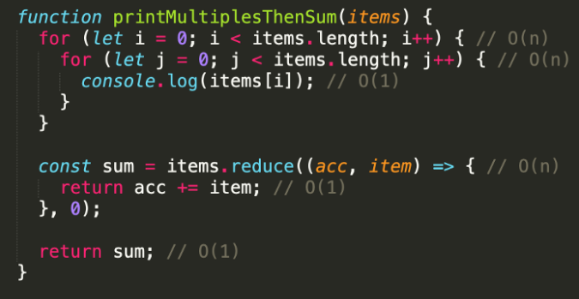
Drop the non-dominant terms in Big-O Notation
4. Time analysis for code samples
Problem: In this program, "items" is a list received by a JavaScript program – this list has length "n".
Method "reduce" goes through the list and adds the current "item" to the "acc" (adds all together).
Find the time complexity in terms of O(f(n)).
Guideline: The notation for the function f(n) should be as small (and short) as possible.
Notes:
https://medium.com/better-programming/big-o-notation-a-simple-explanation-with-examples-a56347d1daca

Slide 22
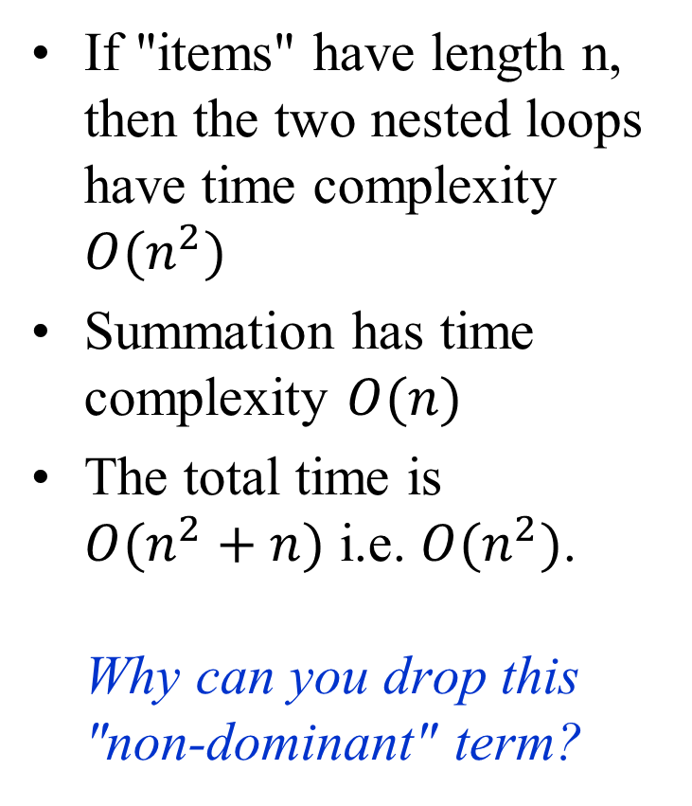
Drop the non-dominant terms in Big-O Notation: Solution
If "items" have length n, then the two nested loops have time complexity $O(n^{2})$
Summation has time complexity $O(n)$
The total time is $O(n^{2}+n)$ i.e. $O(n^{2})$. Why can you drop this "non-dominant" term?

Slide 23
Surroundings of a Node
8. Tree Terminology
A
Item Name | Count/Value
Parent of F | Node
Children of F | List of nodes
Ancestors of F (parent to root) | List of nodes
Successors of F | count
Depth of F | value
Height of F | value
Nodes visited before F in preorder/inorder/postorder | 3 values
Nodes visited after F in preorder/inorder/postorder | 3 values
Level of F | value
Siblings of F | List of nodes
Siblings to the left of F | count
B
C
D
E
F
G
I
J
Note: Please pay attention to the type requested in the answer
node,
list of nodes,
integer value,
multiple integer values

Slide 24
Surroundings of a Node: Solution
Item Name | Count/Value
Parent of F | C
Children of F | [ ]
Ancestors of F (parent to root) | [C,A]
Successors of F | 0
Depth of F | 2
Height of F | 0
Nodes visited before F in preorder/inorder/postorder | (5,4,3)
Nodes visited after F in preorder/inorder/postorder | (3,4,5)
Level of F | 2
Siblings of F | [ ]
Siblings to the left of F | 0
A
B
C
D
E
F
G
I
J

Slide 25
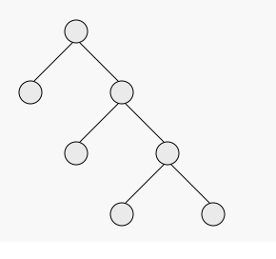
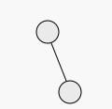
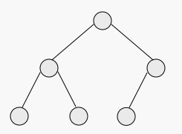
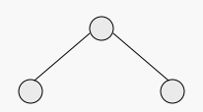
N-ary Trees
8. Tree Terminology
(A)
(B)
Property | (A) | (B) | (C) | (D)
Tree is n-ary for some n
Tree is full
Tree is complete
Tree is perfect
Note: All answers are Yes or No.
(C)
(D)

Slide 26
N-ary Trees: Solution
(A)
(B)
Property | (A) | (B) | (C) | (D)
Tree is n-ary for some n | Yes | Yes | Yes | Yes
Tree is full | Yes | No | No | Yes
Tree is complete | No | No | Yes | Yes
Tree is perfect | No | No | No | Yes
(C)
(D)

Slide 27
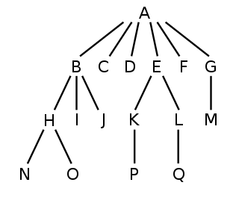
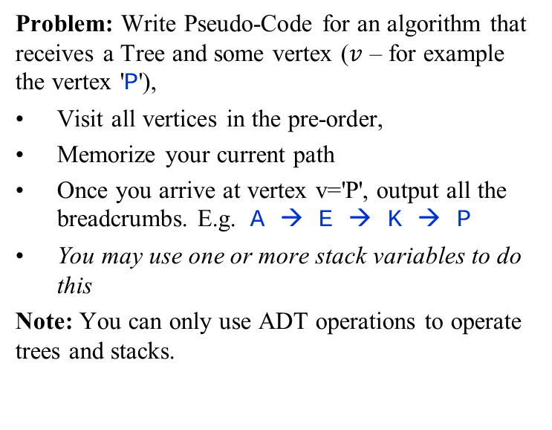
Memorizing Breadcrumbs in a Stack
10. Build stacks during tree traversal
Tree ADT
parent(v): Return the parent of vertex v (or Λ, if v is the root).
children(v): Return the list of all children of v (this set is empty, if v is a leaf).
isLeaf(v): Return true, if v is a leaf, false - if v is not a leaf.
Stack ADT
emptyStack(): Return an empty stack
s.push(elt): inserts (pushes) an element
s.pop(): removes the last inserted element
s.top(): returns the last inserted element without removing it
s.size(): returns the number of elements stored
s.empty(): indicates whether the stack is empty
Problem: Write Pseudo-Code for an algorithm that receives a Tree and some vertex ($v$ – for example the vertex 'P'),
Visit all vertices in the pre-order,
Memorize your current path
Once you arrive at vertex v='P', output all the breadcrumbs. E.g. A → E → K → P
You may use one or more stack variables to do this
Note: You can only use ADT operations to operate trees and stacks.

Slide 28
Memorizing Breadcrumbs in a Stack: Solution
Read the problem carefully. It contains keyword "pre-order".
Find some code to do this:
Preorder(T,v):
Visit(v)
for each child w of v do
Preorder(T,w)
Rewrite this pseudocode using allowed Tree ADT operations.
Every time you "visit" some node, push it to the stack. Every time you return from the "Preorder()", pop that node.
Preorder(v, s):
s.push(v)
foreach child w of v do
Preorder(w)
Main(r,v):
bcs = Stack.empty() // breadcrumb stack
Preorder(r,bcs)

Slide 29
Evaluating Postfix Expression
10. Build stacks during tree traversal
function PostorderEvaluate(E array[1..n]): integer
stack = emptyStack()
for i from 1 to n do
if isNumber(E[i]) then:
stack.push(E[i])
else:
x1 = stack.pop()
x2 = stack.pop()
res = ApplyOp(E[i], x1, x2)
stack.push(res)
+
×
×
2
−
3
4
17
1
Sample array (post-order traversal of syntax tree)
2 | 17 | 1 | - | * | 3 | 4 | * | +
Problem: Given the pseudocode for PostorderEvaluate(E), write the current state of the stack right after the E[6], i.e. the number is insered.
4

Slide 30
Evaluating Postfix Expression: Solution
Answer: The state of the stack at the point when "4" is pushed is this:
2 | 17 | 1 | - | * | 3 | 4 | * | +
2
2
17
32
3
4
2
17
1
2
16
minus
32
times
32
3

