Slide 1
First Year Seminar Fall 2020, Week 5
Kalvis Apsītis

Slide 2
Prototype Grading (max 300 points)
Teamwork (max 50 points): Team Working Agreement Delegation and Task/Issue Management Bookmarks in GitHub. | Functional Specification (50 points) Requirements alligned with Value Proposition. Functional Design document Peer-reviews and reacting to these reviews. | Config. Mgmt. (max 100 points): Orderly procedure to apply changes. "Deliver Early and Often" Testability of your solution. | Iteration Planning (max 50 points): Planning, reviewing and retrospecting your iterations by Agile/Scrum methodology. Iteration 1 Iteration 2 Iteration 3 | Validation/Data (max 50 points): Perceiving real-world feedback. Metrics and Reports External data integration (mandatory for BITL teams)

Slide 3
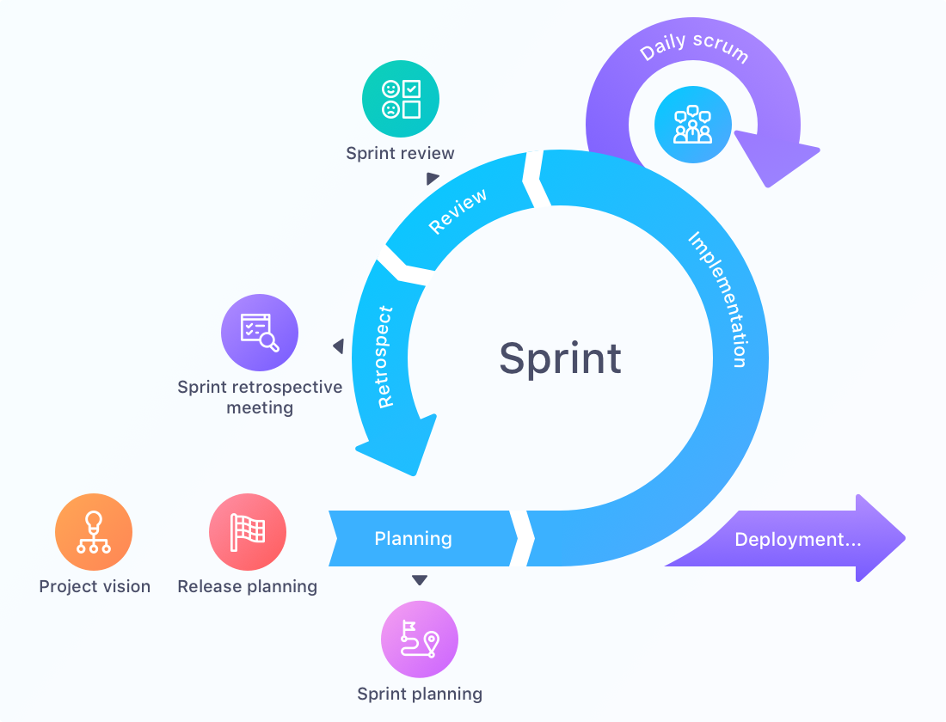
Prototype Activities #4: Iteration Planning
Starting October 16: 3 Iterations (2 weeks per iteration)
Each iteration is planned, done, reviewed, retrospected.
https://startinfinity.com/product-management-framework/scrum-sprint

Slide 4

One Iteration = Some "User Stories" + Some Maintenance "Stories"
Ceremonies with Iterations
Iteration Planning
Iteration Completion (Burn-down)
Iteration Review
Iteration Retrospective
(cf. "Friday night" or "Birthday" or "Christmas" rituals)
Non-functional Requirements
Functional
Requirements

Slide 5
Two Extremes planning Iterations
Extreme 1:
We know how to write software, so we create and deploy value every week.
New functionality is driven by our own earlier decisions so we never run out of work.
Extreme 2:
We need to create the right thing. So we ask the stakeholders for guidance.
Customers can have unclear or conflicting priorities
Paralysis by Analysis
Notes:
(New things are invented by product creators.)

Slide 6

Acting in the Face of Uncertainty: What POC was meant for?
POC adds customer value (selects "low hanging fruit" as in Pareto principle)
First meaningful step towards your goal.
Takes risks early and validates your assumptions.

Slide 7
How was your First "User Story"?
Feedback on Doing POC
Thing to Avoid:
Setting goals that are too general or vague.
Summary of your overall solution.
Submit your whole TODO list.
Any remedies?

Slide 8
How to Eat an Elephant?
Our task: Eat an elephant. (Disclaimer: it is a metaphor).
What is difficult about eating elephants?
What if you do not want to eat any elephants? Continue a sentence: "I cannot eat an elephant until/unless..."
How to make ourselves at ease with this task? How do we make elephants look small and manageable?
What are alternatives?
Notes:
http://ocw.uc3m.es/ingenieria-informatica/principios-de-ingenieria-informatica/the-elephant-technique

Slide 9
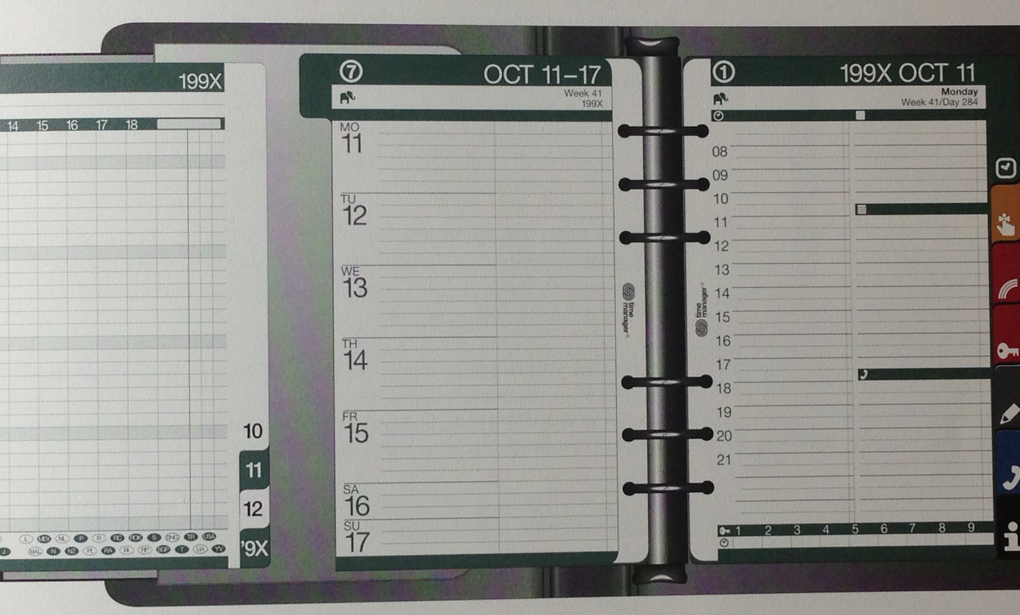

Morale: Do something long-term every day ☺
Icon from Time Manager International (TMI) Planners

Slide 10
Guidelines when Building your Prototype
Have just 1-2 week perspective and contact your "Project Owner" often.
Do not overdesign and start with "the simplest thing that could possibly work".
Release early and often. Your high-level prototype can serve as a conversation prop – as you meet the customers.
Feedback is important: (A) Feedback from your technology;
(B) feedback from your customers.

Slide 11
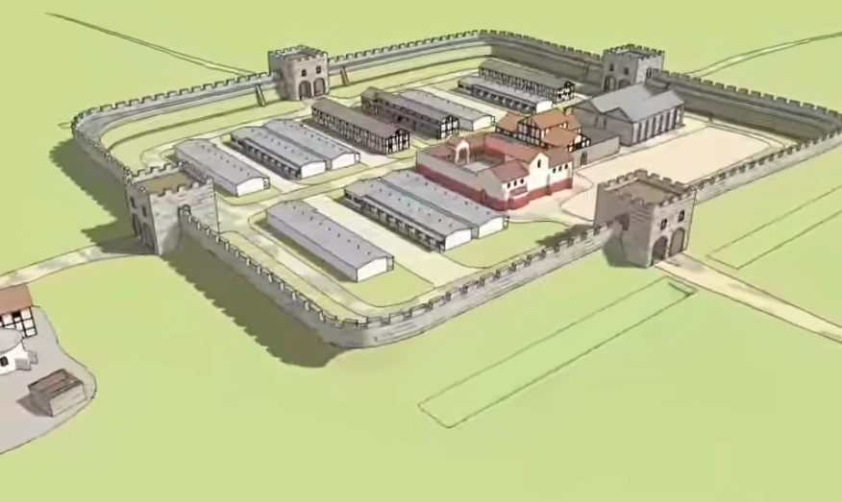
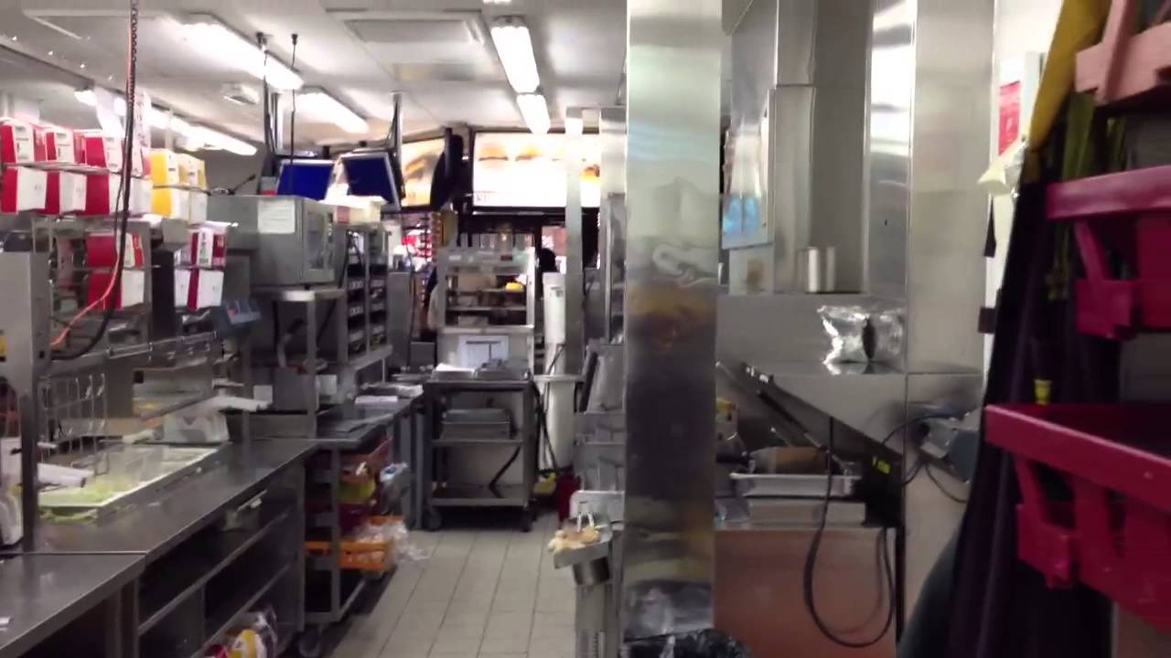
Configuration Management: Initially used by military personell
Configuration Management
Roman fort (Castrum)
McDonald's kitchen

Slide 12
What is the Configuration in your Project?
What you want to solve:
How to get your "latest and greatest" solution running on a team member's laptop?
How to demonstrate the solution to the customer?
What could be the Solutions
Ask ... for files ... and ...
If the Web server does not work, ask ... to fix it.
Install ... and ..., but if it fails, try ...
Do not forget to change the domain name when you copy files to the public domain.
It did work yesterday; why doesn't it work today?

Slide 13
Prototype Activity #3: Configuration Management
Definition: A configuration is a set of artefacts (hardware, software items, files, settings) that enable to create your solution.
Even a static website or a social-media ad campaign has a configuration.
Configurations will be reviewed; they should be:
Easy to change yet stable
Easy to replicate
Ensure early prototyping and "proof of concept"
Testable

Slide 14



Configuration Management Questions
Files? (HTML....)
Google Docs? Other Cloud? (Spreadsheets...)
Database? (MySQL...)
Setup of existing software (Wordpress?)
What are the files or other artefacts that your team creates?
How do you modify your solution? Who can contribute?
How do you test (also re-test, if you changed something)?
How do you monitor health and the behavior of your prototype?

Slide 15
Suggested Timeline
Four 2-week Slots | What
2020-10-02 ... 2020-10-16 | Iteration 0: POC is done. Development Environment exists. Everybody knows how to contribute.
2020-10-16 … 2020-10-30 | Iteration 1: (Plan by yourselves. Depends on project)
2020-10-30 … 2020-11-13 | Iteration 2: (Plan by yourselves. Depends on project)
2020-11-13 … 2020-11-27 | Iteration 3: (Depends on project. Can release MVP)
After Nov.27 | Product is live, can demo, can get real-world interactions, final presentations, other TOI/conservation activity.

Slide 16
Remainder: Upcoming tasks
Config Mgmt Guide (Job Aid) for 1 role in your project. Discussed during an Office Hour: Outline the process – how can a team member contribute to your solution (Continuous integration or other approach as appropriate.) (Due on October 13)
Your "Iteration 1 plan" (Will create on the next class by October 16)
Peer-reviewing Functional Specifications for 2 other teams (Due on October 20 – instructions will follow).
One Physical A4 Page (single side)

