Slide 1
First Year Seminar Fall 2020, Week 7
Kalvis Apsītis

Slide 2
Prototype Grading (max 300 points)
Teamwork (max 50 points): Team Working Agreement Delegation and Task/Issue Management Bookmarks in GitHub. | Functional Specification (50 points) Requirements alligned with Value Proposition. Functional Design document Peer-reviews and reacting to these reviews. | Config. Mgmt. (max 100 points): Orderly procedure to apply changes. "Deliver Early and Often" Testability of your solution. | Iteration Planning (max 50 points): Planning, reviewing and retrospecting your iterations by Agile/Scrum methodology. Iteration 1 Iteration 2 Iteration 3 | Validation/Data (max 50 points): Perceiving real-world feedback. Metrics and Reports External data integration (mandatory for BITL teams)

Slide 3
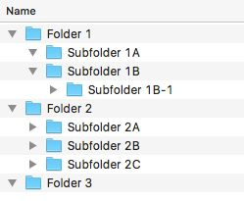
Job Aid defines your Configuration
Revisiting
Job Aids
Your development platform?
Prerequisite skills?
Access credentials?
Directory/file layout?
Typical developer task(s)?
Some best practices?
How to deploy?
Web, mobile, "facebook"...
Edit HTML, ...
URLs, passwords...
How to structure files
Edit webpage, update DB...
Check out before you edit...
How to test your work...

Slide 4
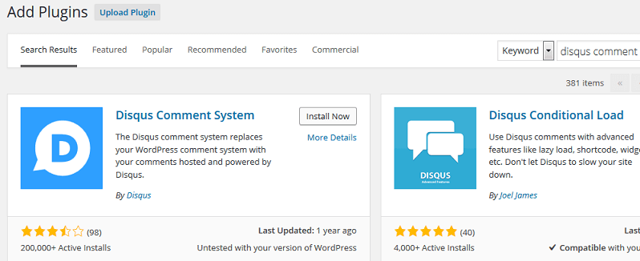
Custom Development vs. Packaged Development
Build your project from source files.
Custom website
Android app
Build on top of existing platform
Facebook app
Wix
Wordpress
Adding "plugins" for comments, voting, etc.

Slide 5
Client-side interactivity vs. Server-side interactivity
Client-side
HTML links
Images and videos
Some JavaScript (expanding menus, buttons)
Games (without Internet) inside a browser or a phone
Server-side:
Authentication
Persistent data (remember what users did before?)
(Usually need databases and considerably more programming.)

Slide 6
End-User Platform
Browsers
No need to install anything else for the user.
Most people are comfortable with this
Somewhat limited in what you can do
Android etc. mobile apps:
Considerable control of the device, permissions to use contacts, geolocation, photocamera, etc.
Even harder than Websites to attract user traffic (in early days of Android people were eager to install and try new things).

Slide 7
Authenticating Users
Anonymous users Easiest for the user – but has limited ability on what you can "remember" about the user.
Persistent cookies etc. can remember quite much about anonymous users (but not easy to connect with real people and requires some programming).
Delegated authentication: (Use Gmail or Facebook credentials; easier for the user; some trust issues.) Integrating with Gmail/Facebook be a tricky task for your chosen platform – so test this early, if you need this.
Your own custom authentication (Do NOT store cleartext user passwords in your databases, apply hashing!)

Slide 8
User Interactions and Other Data for Validation
General Websites can use Google Analytics (or Alexa Rank or other JavaScript counters)
Social media can count interactions for your content (used by influencers).
HTTP Referer header – where does the incoming traffic come from?
Your solution typically needs some other data from the users – that is more specific (and useful) than just the interactions = mouse clicks.
Not difficult to attract traffic (banners, Google ads etc. can do this).
Difficult to convert the users – ask them to do something useful for your purposes.
How do you know, when you are not "converting" your traffic?

Slide 9
Iterations
Introduction to Agile
Iterative development acknowledges that we will get things wrong before we get them right, and do things poorly before do them right
Incremental development is based on the age-old principle of “Build some of it before you build all of it”
Allows us to learn about the unknown unknowns by exploring the environment
Sprints/Iterations use timeboxing, a time management technique that helps organize the performance of work and manage scope.

Slide 10
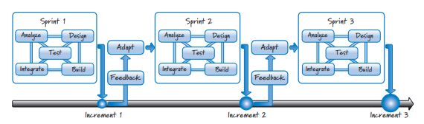
3 Sprints (2 weeks each)
Sprint (Agile jargon) – same as iteration.
Analyze, Design, Build/Test, Integrate – all happens in increments.

Slide 11
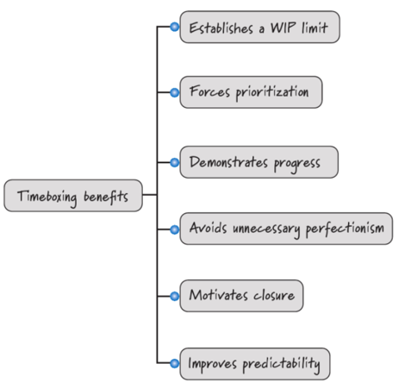
Timeboxing Benefits
Also, the ability to "sign-off" tasks is psychologically important, shows progress.
Teaching is divided into "modules" for the same reason.

Slide 12
Risks and uncertainties
External risks (government decisions, etc.)
Lack of information or lack of cooperation from the Product Owner → Constant concern (known unknowns)
“The things that we do not yet know that we don’t know” (unknown unknowns)
Address the uncertainties;
Do not build brilliant products for the wrong markets.

Slide 13
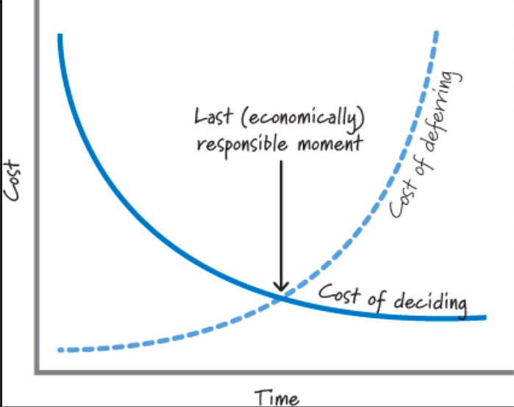
Last Responsible Moment
Procrastination may be a good thing – up to a certain point.
The best laid schemes of mice and men Gang aft a-gley (=go often awry) (Robert Burns)

Slide 14
Done vs. "Done Done"
Done
All official documentation is checked and accepted by supervisors; it does not need any other amendments
Code which properly works un Bauska’s webpage
"Definition of 'Done'"?
Done Done
Approval from municipality
Engagement in project from all stakeholders

Slide 15
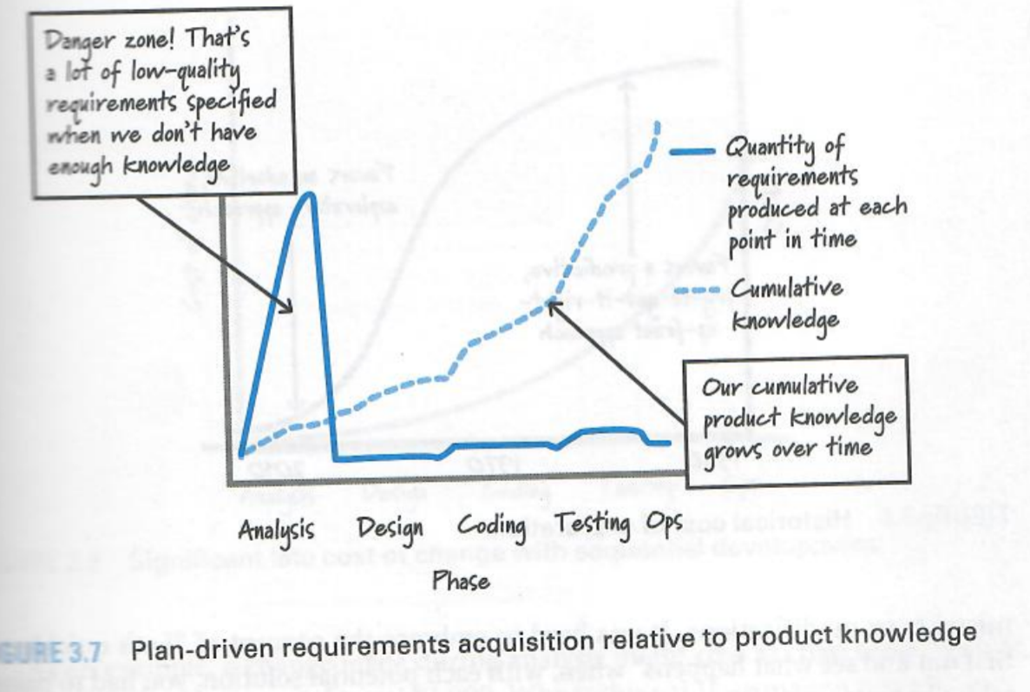
Don't Plan Too Much in Advance

Slide 16
Some Principles from the List
Focus on Idle Work, Not Idle Workers Scrum teams are aware that finding the bottlenecks in the flow of work and focusing their efforts on eliminating them far more sensible activity than trying to keep everyone 100% busy.
Adapt and Replan: Scrum teams mostly do not have a strict plan that they follow, however, they are quick to adapt to new information.

Slide 17

Summary of Your Tasks
Plan for your Iteration 1 (Due on October 16).
Just a few "User Stories". 1 story = 1 note (Not larger than A6 postcard; 1-3 sentences.)
The user stories you select should reflect the highest value (per your current analysis).
Commitment to finish (and to be able to demonstrate) by October 30.
(If you need more planning – warn me today!)
Note: You submit a very short artefact today, but it involves lots of prior knowledge about your problem/solution.

