Slide 1
First Year Seminar Fall 2020, Week 9
Kalvis Apsītis

Slide 2
Prototype Grading (max 300 points)
Teamwork (max 50 points): Team Working Agreement Delegation and Task/Issue Management Bookmarks in GitHub. | Functional Specification (50 points) Requirements alligned with Value Proposition. Functional Design document Peer-reviews and reacting to these reviews. | Config. Mgmt. (max 100 points): Orderly procedure to apply changes. "Deliver Early and Often" Testability of your solution. | Iteration Planning (max 50 points): Planning, reviewing and retrospecting your iterations by Agile/Scrum methodology. Iteration 1 Iteration 2 Iteration 3 | Validation/Data (max 50 points): Perceiving real-world feedback. Metrics and Reports External data integration (mandatory for BITL teams)

Slide 3
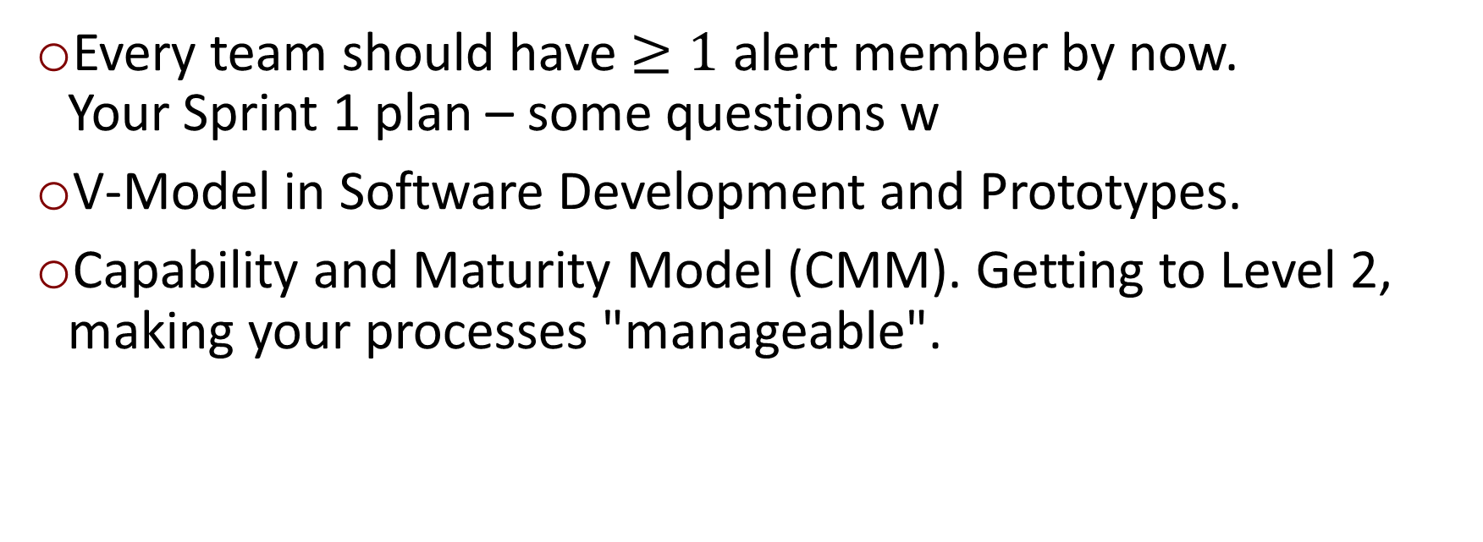
Objectives
Every team should have $≥1$ alert member by now. Your Sprint 1 plan – some questions w
V-Model in Software Development and Prototypes.
Capability and Maturity Model (CMM). Getting to Level 2, making your processes "manageable".

Slide 4
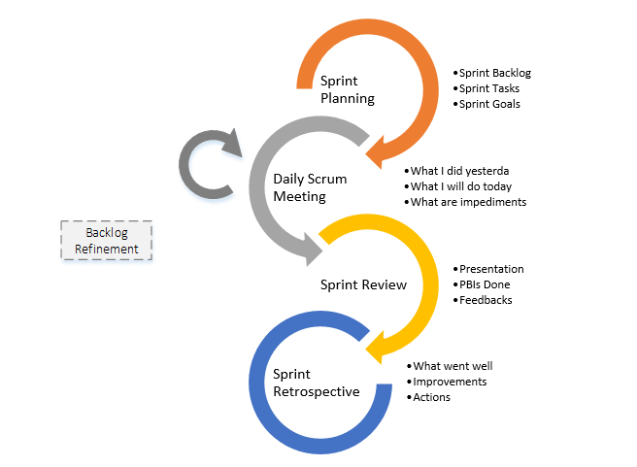
Sprint 1 is (should be) Complete
Finishing Sprint 1
Objective: Sprint should result in a prototype (or workable version) of the final project deliverable.
Sprint Review (Demo of newly implemented features)
Sprint Retrospective (New Situation? Adjustments?)
Sprint Planning (Iteration/Sprint 2)
Daily Standups (what I did? what I plan to do? any blockers?)
Where we aim to be now

Slide 5
Sprint/Iteration Planning
Assumptions: Should have a Product Owner and a Backlog.
Sprint Goal: Team agrees on a few tasks that have high priority (highest customer value, risks involved, etc.)
Sustainable Pace: Team should be able to maintain the rhythm.
Estimate hours: Complexity estimated in hours for each task (can average estimates).
Task: user story or non-functional requirement.
Just-in-time planning: Take decisions at the right time.

Slide 6
Team "The Big 6"
Create a window where users can input their credentials to register/log in.
Make it possible to register using a Google account.
Implement a map (without location markers of bins).
Set up a database where users’ credentials will be stored (not hosted).
Create a window where the information about proper recycling will be seen.
Goals? What makes your Sprint1 user stories valuable?
Sustainable pace? Too many (too few) tasks? Did the time estimates match?
Conclusions? Is there a need to change your approach in Spring2?

Slide 7
Team "Clouds"
Сontact the Bauska school of art and discuss cooperation (students’ participation in our project).
Explore the place for drawings (sports stadium).
Develop photoshop skills, create a better prototype (photos of the stadium).
Goals? What makes your Sprint1 user stories valuable?
Sustainable pace? Too many (too few) tasks? Did the time estimates match?
Conclusions? Is there a need to change your approach in Spring2?

Slide 8
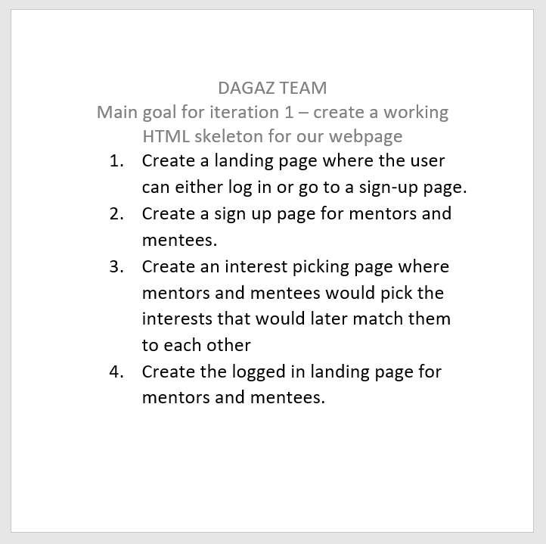
Team DAGAZ
Goals? What makes your Sprint1 user stories valuable?
Sustainable pace? Too many (too few) tasks? Did the time estimates match?
Conclusions? Is there a need to change your approach in Spring2?

Slide 9
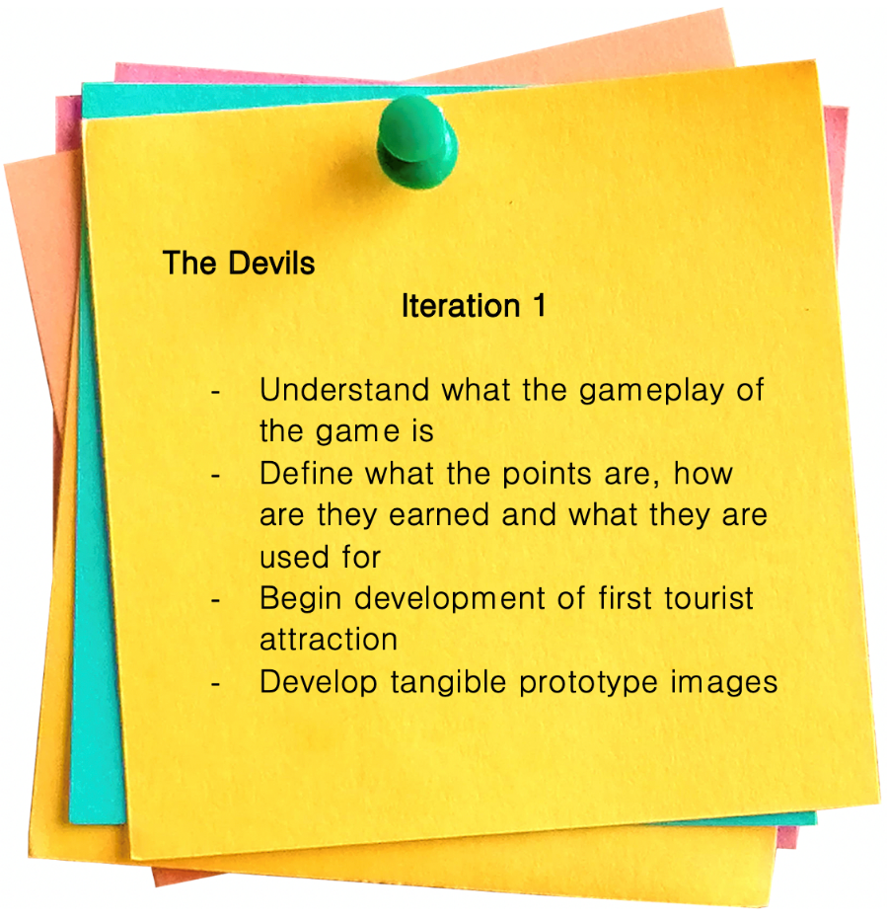
Team "The Devils"
Goals? What makes your Sprint1 user stories valuable?
Sustainable pace? Too many (too few) tasks? Did the time estimates match?
Conclusions? Is there a need to change your approach in Spring2?

Slide 10
Team "Fireball"
A student can review the courses
A student can apply to a course
A student can inspect schedule for a course (all courses?)
A student can cancel an appointment
Goals? What makes your Sprint1 user stories valuable?
Sustainable pace? Too many (too few) tasks? Did the time estimates match?
Conclusions? Is there a need to change your approach in Spring2?

Slide 11
Team "Five of a Kind"
On www.bauskaadvertising.com an advertising platform has to open.
"Make an Order" opens an order submission form.
5 boxes can be filled in and form can be submitted pressing a button.
Goals? What makes your Sprint1 user stories valuable?
Sustainable pace? Too many (too few) tasks? Did the time estimates match?
Conclusions? Is there a need to change your approach in Spring2?

Slide 12
Team "Half and Half"
Users can find out the latest information about upcoming events in Bauska.
Artists can find the application form to perform.
Subscribers receive ads for events, special offers etc. in their email.
Bloggers can write about the event visited.
Goals? What makes your Sprint1 user stories valuable?
Sustainable pace? Too many (too few) tasks? Did the time estimates match?
Conclusions? Is there a need to change your approach in Spring2?

Slide 13
Team "Innovators"
App “Bauska Explorer” in Android Play Store.
Users can authenticate by username and mobile #.
User can pick option: car, bicycle or by foot by tapping on window; user can then select route.
Goals? What makes your Sprint1 user stories valuable?
Sustainable pace? Too many (too few) tasks? Did the time estimates match?
Conclusions? Is there a need to change your approach in Spring2?

Slide 14
Team "IZT"
Google search “Invest in Bauska” shows “investbauska.eu” in the top 5 search listings.
User can watch a video on that site.
User can interact with a map, seeing the available properties with additional info.
Goals? What makes your Sprint1 user stories valuable?
Sustainable pace? Too many (too few) tasks? Did the time estimates match?
Conclusions? Is there a need to change your approach in Spring2?

Slide 15
Team Kowalski
A user can open an educational webpage on garbage sorting.
A user sees icons when entering a page (color-coded garbage containers)
Clicking yellow container shows things that can go in there.
Users can click on icons (such as paper icon) to see what to do with that material.
Goals? What makes your Sprint1 user stories valuable?
Sustainable pace? Too many (too few) tasks? Did the time estimates match?
Conclusions? Is there a need to change your approach in Spring2?

Slide 16
Team MakeA
Design web pages, (mock) screenshots.
Web-page prototype put together based on the previously made screenshots.
Goals? What makes your Sprint1 user stories valuable?
Sustainable pace? Too many (too few) tasks? Did the time estimates match?
Conclusions? Is there a need to change your approach in Spring2?

Slide 17
Team Synergy
Demonstrate the site menu with content divided into sections
Clicking on Contacts shows the contact info of the industrial center administration.
Clicking on About Us shows info on Bauska Industrial park
Clicking on Investors shows potential investors
Clicking on the References shows the sources of information collected
Goals? What makes your Sprint1 user stories valuable?
Sustainable pace? Too many (too few) tasks? Did the time estimates match?
Conclusions? Is there a need to change your approach in Spring2?

Slide 18
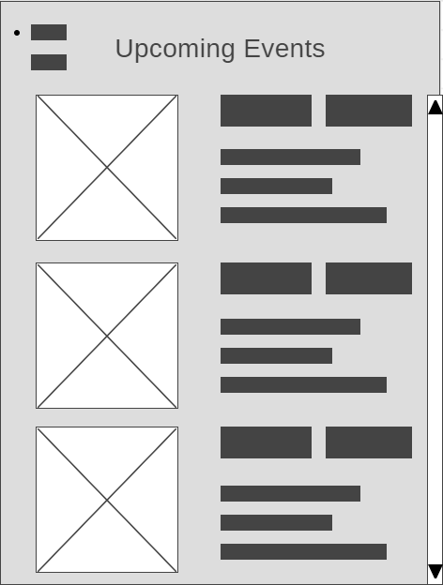
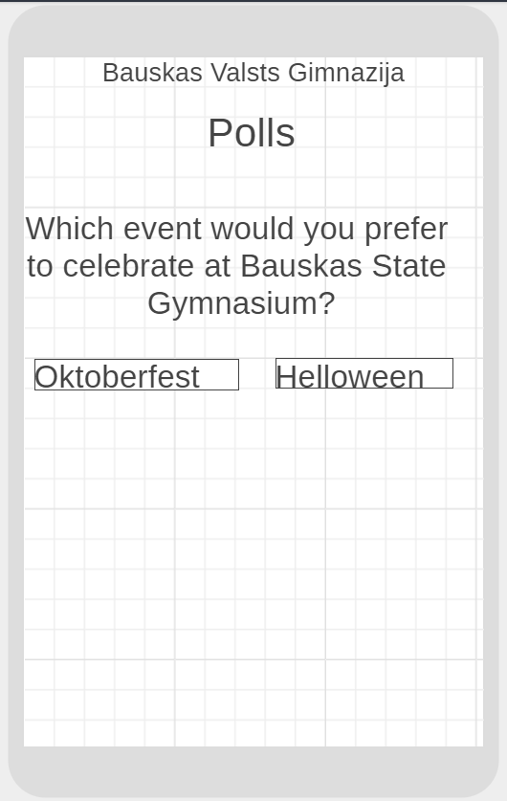
Team Stonks
The students can see the upcoming events and their descriptions.
The Student Union or the teachers will be able to create a poll and the students will be able to respond to it.
Goals? What makes your Sprint1 user stories valuable?
Sustainable pace? Too many (too few) tasks? Did the time estimates match?
Conclusions? Is there a need to change your approach in Spring2?

Slide 19
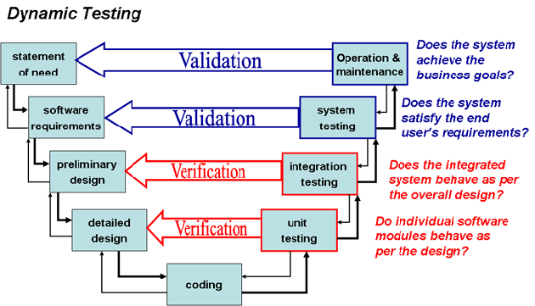
IT Product Development: V-Model
V-Model and Prototypes
Business analysis (including low-level and high-level prototypes, interviews with stakeholders) happens near the beginning and near the end of a project.
In software development considerable effort is in the middle (bottom) part of the V-Model.
Notes:
Fulfilment

Slide 20
What is CMM
Intro to Capability and Maturity Model
CMM (Capability and Maturity Model) was developed by Carnegie Mellon University. It is meant to improve the software creation processes
Even the finest people cannot perform well when the process is not understood or not operating “at its best.”
PEOPLE
TECHNOLOGY
PROCESS
Major determinants of product cost, schedule, and quality

Slide 21
Capability Levels
A capability level is a well-defined evolutionary plateau describing the organization’s capability in a process area.
There are 5 capability levels. The capability levels are cumulative: a higher capability level includes the attributes of the lower levels.
Maturity Levels Cannot be Skipped
Higher level processes have less chance of success without the discipline provided by lower levels.
The effect of innovation can be obscured in a noisy process.

Slide 22
Maturity by Example: Soccer Teams
Amateur Team | Professional Team
Everyone runs around at random. They might do right and wrong things. | Everyone moves in a coordinated fashion, based on practicing their tactics many times.
The next time the ball hits the same place, they may try something entirely different. | They may fail to make the right play, but they almost always try to do the right thing.
When losing a top player, an amateur team is likely to get much worse. | A Professional team often has someone waiting to fill in.
When results are bad Amateur players don’t know what went wrong, or they blame each other. | Professional teams also discuss their play, they look for (and find) how to improve.
Mature = матёрый (profesionāls/attīstīts/nobriedis = highly evolved)

Slide 23
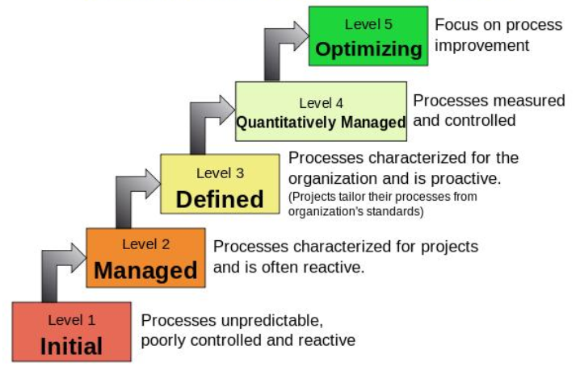
CMM Levels

Slide 24

CMM Level 1 (Initial)
Level 1: Chaos and Hero Mentality
Software processes not defined
Planning and controls not used at all times
Success depends on some people only (personal motivation and sacrifice)
Success does not depend on proven processes; it is not repeatable.

Slide 25
CMM Level 2: Managed
Level 2: Repeatable and uses milestones
Basic project management controls implemented
Planning, monitor and quality control, cost and functionality
Processes are still not transparent («black boxes»), but with milestones and reviews.

Slide 26

CMM Level 3 (Defined)
Level 3: Defined software process
Processes are documented and used across the entire organization
The boxes are now internally visible
Staff understands their roles and responsibilities of processes

Slide 27

CMM Level 4 (Quantitatively Managed)
Level 4: Measurable processes
Quantitative quality goals set for software processes and products
Processes are predictable, measured
Management makes informed, objective decisions

Slide 28
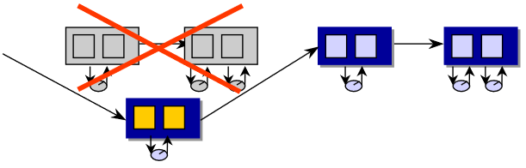
CMM Level 5 (Optimizing)
Level 5: Software process optimizing
Able to identify weaknesses and strengths proactively in processes
Continually improving range of processes capabilities
Continually improving processes performance

Slide 29
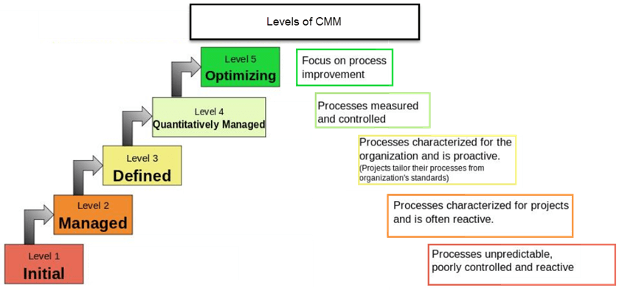
CMM: Summary
Notes:
1. **Initial Level:** Focus and Process Areas not defined.
2. **Managed Level:** Focus is Basic Project Management. It includes Requirements Management. Project Planning, Monitoring and Control. Process and Product Quality Assurance. Configuration Management 3. **Defined Level:** Focus is Process standardization. It includes Requirements Development. Technical Solution. Product Integration. Verification and Validation. Organizational Process Definition. Organizational Training. Risk Management. Decision Analysis and Resolution. Organizational Environment for Integration. Integrated Teaming.
4. **Measurable:** Focus is Quantitative Management. Organizational Process Performance. Quantitative Project Management
5. **Optimizing:** Focus is Continuous Process Improvement. Organizational Innovation and Deployment. Causal Analysis and Resolution.

Slide 30
Sample Titles for Your Content
Web Marketing = Attracting Traffic to your Website
Banks HATE him. See how he made $10,000 in an afternoon with one simple trick.
Compare several titles (texts on links or banners leading to your project page)
10 tips to improve your CV.
Things that only People who Work from Home will Find Funny.

Slide 31

Lead Paragraph and Other Content
What is a Lead Paragraph in a news article?
Why is it important?
What items should be present?
Attention Hook
Author/Source
Context
Theme

Slide 32

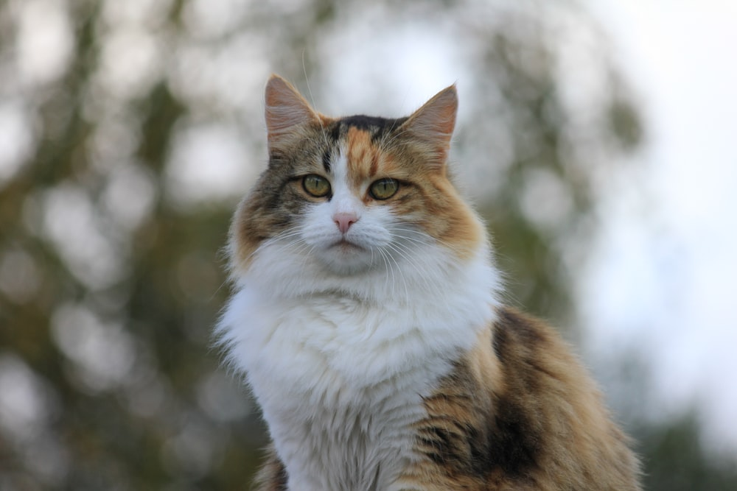
Split your Content in Pieces of Right Size
Images may dramatically increase user interactions
In the "click economy" chunking and labeling matters.
A great novel can get the same attention as a great cat image.

Slide 33
Using Google Analytics
Google Analytics is primarily aimed at for-profit websites that are selling something. Conversions, Goals, Ad Traffic analysis are designed to help sites do their "conversions".
The trick is to ask yourself “what am I selling?” What user activity on your website means success for your effort?
Downloading a manual?
Having a career question answered?
Clicking a link on a map?
What is the ultimate goal of your website? What specific, measurable Visitor interaction means success?

Slide 34
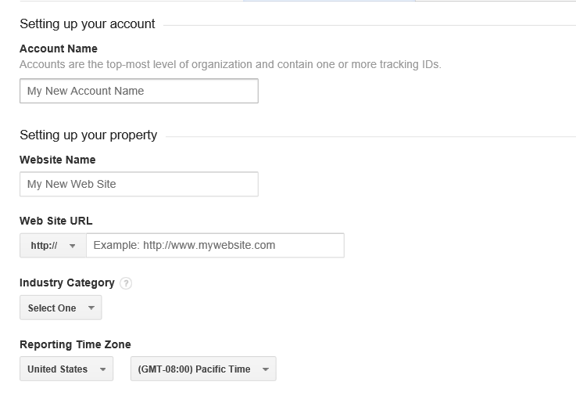
How to set up an account
Need a Google account
If you have not used Google Analytics before visit www.google.com/analytics/
Register your domain (no actual check that you own this domain, but you need to insert a JavaScript snippet into all HTML files.
You are given a “Tracking ID”.

Slide 35
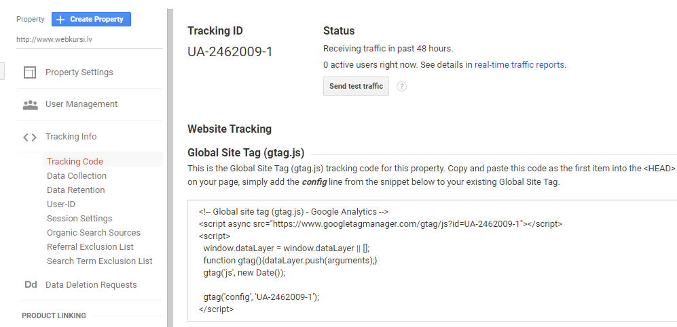
Tracking Code
Add or select existing domain
Under “Property” click Tracking Info > Tracking Code.
Copy-paste as the first child under <HEAD> of every page you want to track (also PHP, Python templates, and other server side stuff that creates client-side HTML).

Slide 36
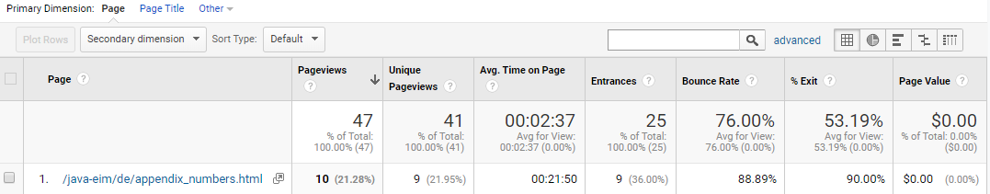
Tracking Your Content
Pageviews: # of requests
Unique Pageviews: How many users visited this
Avg. Time on Page: Hearbeats from the Web page
Entrances: How many times this was the 1st page visited
Bounce Rate: How often this was the only page visited (Bounce = Closed browsers + Clicked links + Session expires)
Exit: How many times this was the last page visited

Slide 37
What does the GA Tracker See
User’s IP address and approximate location (unless they use VPNs or SSH tunnels)
Can estimate user’s age/gender
Can distinguish user sessions
Can measure time
Can learn, where the users came from (traffic sources)
If you assign goals or money values, can add it up.
What the Tracker Cannot See?
Any meaningful actions the user did on your site
Did they actually look at your page during that time (or was it in another tab or minimized)
How did they leave? (Clicked a link, closed browser window/tab…)

Slide 38
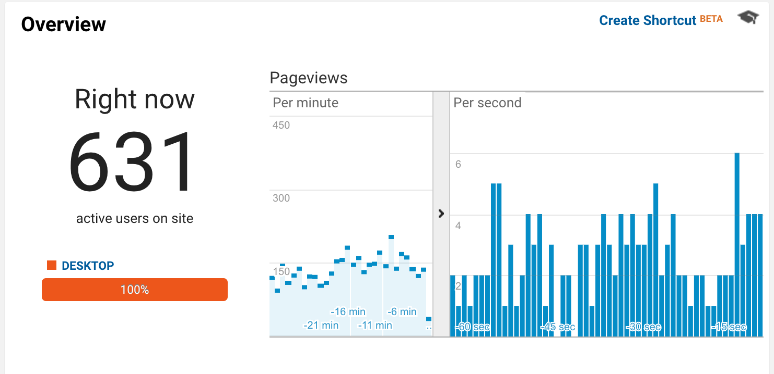
Limitations and Notes on GA
Users should have JavaScript and cookies enabled.
Google Analytics track even content that is reloaded and served from a cache.
Real-time reports
Check, if your tracking code works
Check response from recent social media posts
Normally you would use Summary Reports

Slide 39
Technologies behind "Google Analytics"
The data that Google Analytics uses to provide all the information in your reports comes from these sources:
The HTTP request of the user (Referer header)
Browser/system information (User-Agent header)
First-party cookies (=same domain as Google Analytics)
All that is submitted as parameters to a single pixel GIF image request (or to a "collect" script on GA).

Slide 40
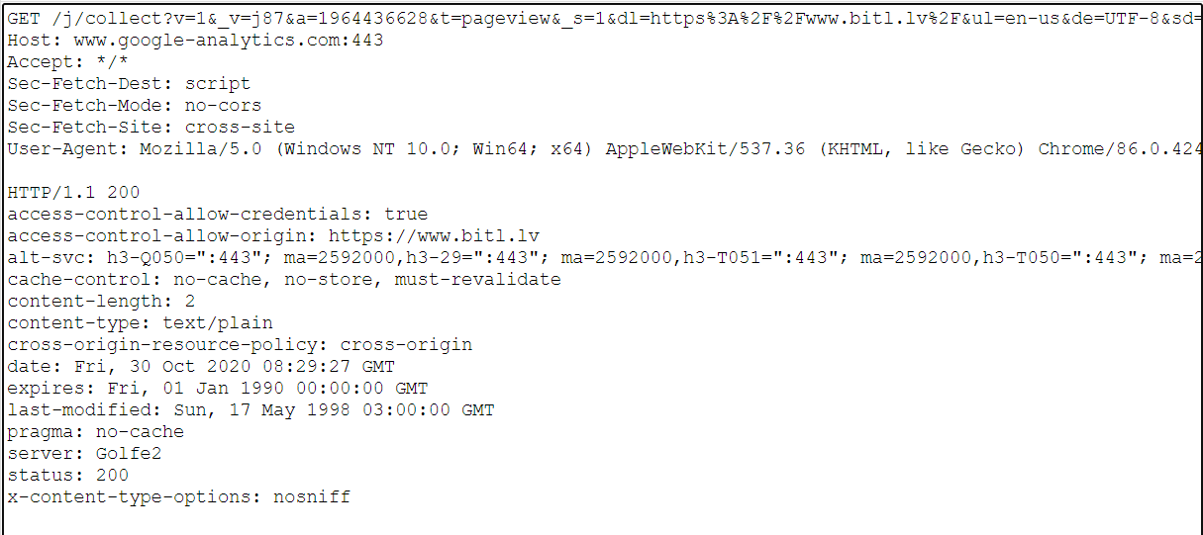
Chrome Plugin: Live HTTP Headers

Slide 41
Summary of Your Tasks
Summary of your Tasks
Plan and submit your Iteration 2. Once again these are 3-5 User Stories.
Deadline is Tuesday, November 3, 2020.
You could discuss between yourselves and submit it today.
If delaying allows to take a better decision, postpone until Tuesday.

