Slide 1
Data Structures 1.1. HelloWorld Programs
Data Structures and Algorithms
http://linen-tracer-682.appspot.com/data-structures/index.html
Notes:
# Every module has the following content
* Title (1 slide)
* Table of Contents (1 slide) – where are we in the material?
* Motivation (1 slide) – why do we need this module?
* Anchor Task (1x) – introduce the key problem handled by this module
* Objectives (1x)
* Theory Section (1 subtitle + more slides) or Demo Section (1 subtitle + more slides)
* Summary (1x) * References (1x)

Slide 2
Table of Contents
Part 1: Use C++ and Object Orientation (6 modules, 3W)
Part 2: Express algorithms with Abstract Data Types (ADTs) and libraries (5 modules, 2W)
Part 3: Analyze the implementations of some data structures (10 modules, 5W)
Part 4: Introduce general paradigms for algorithms (7 modules, 3W)
1.1. HelloWorld Programs
1.2. Expressions, control structures, functions.
1.3. C++ classes.
1.4. Multi-file programs.
1.5. Object orientation.
1.6. C++ memory model.

Slide 3
Why care about code on text-based input/output?
What makes algorithms special among other types of software?
What algorithmic characeristics can we learn from "Hello, World" and similar examples?
Why learn C++ language?
Notes:
* For people who want to become professionals = can create systems that others will use
* For people who like to challenge themselves with difficult problems.
* For highly motivated people who also want to sleep; who take normal course-load, but typically do not work full-time yet.

Slide 4
Syllabus: Objectives
Topics: Arrays, vectors, lists, stacks, queues, trees, hash tables and more.
High-level language: C++ is used to implement algorithms.
Theory: Time-space analysis and tradeoffs; patterns of algorithm design.

Slide 5
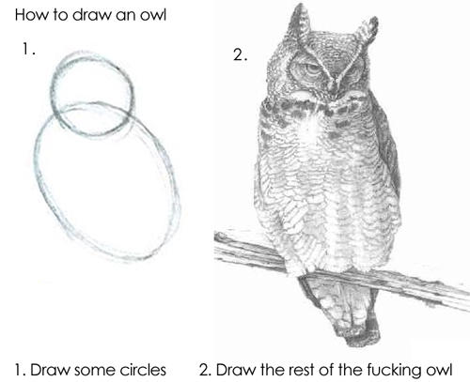
Syllabus: Teaching Methods
Theory sessions: About 2 out of 3 classes per week explain theory concepts, solve problems on paper, introduce other assignments.
Practice sessions: About 1 out of 3 classes – finish lose ends, introduce the coding exercises and labs.
Coding exercises (the first 5 weeks): Small programs using C++ constructs.
Larger labs (the last 10 weeks): About 5 larger coding exercises that build the "core" of this course.
In-class assignments (throughout the class): Short written exercises. For example, running some algorithm on sample data.
Notes:
If we overdo exercises with paper and pseudocode, we can end up in a situation, where people do not get real programming skills. On the other hand – these methods (written exercises, pseudocode and its analysis) are the ones we have. There has to be a way to resolve the tension between the teaching and the objectives.

Slide 6
What this course is NOT
This is not "a washout course". If you could handle your previous year, you should be doing fine.
The course tries to avoid obscure details of C++. It prefers common patterns.
The course avoids "spoon feeding". Need to search for answers.
The course skips complex software development methodologies. The development cycle (design, code, test, submit) is the same.
Notes:
*Apophatic reasoning* is trying to define some concept by telling what it is **not** (for example, "a rose is not a camel", "a rose is not a table" and so on). It is usually insufficient to clarify anything; but it clears away common misconceptions. Apophatic methods are used in theology – as it may be easier to explain the concept of G-d by what it is not (rather by what it is).

Slide 7
Syllabus: Cooperation/Honesty Balance
Except for the work you hand in as individual contributions, we strongly encourage you to collaborate and help each other
If in doubt if a collaboration is legitimate: ask!
Do not study alone, but write the code you submit by yourself.
Copy-pasting C++ syntax constructs might be OK (but you will become fluent faster, if you type them yourself).
Copy-pasting implementations of entire algorithms (even from the public Internet) totally defeats the purpose of this class.
Use your office hours. Come with your questions prepared. There are no stupid questions.
BUT there might be "lazy questions" – if you can look them up in the documentation.

Slide 8
Why care about programming and C++?
Building your own software often causes more problems than it solves. BUT
Our civilization runs on software; engineering always involves software. (Most programs do not run on devices resembling PCs and laptops. On alternative hardware platforms C++ is widespread.)
C++ is used in olympiads (>90% of teams in ICPC International Collegiate Programming Contest use C++).
C++ algorithms are common in coding interviews – even for positions using other languages.
Notes:
* Need *some* language to implement algorithms.
* More recent languages isolate the user from concerns like memory management or garbage collection.
* The purpose of a programming language is to allow you to express your ideas in code. C++ allows you to express ideas from many application areas; see the consequences in hardware directly.

Slide 9
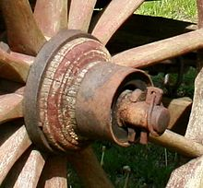
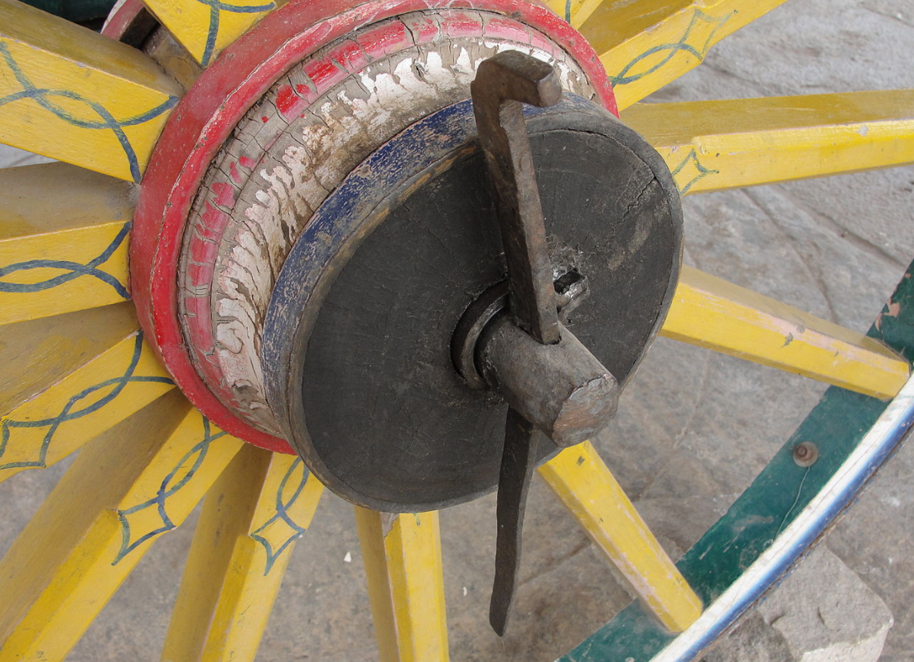
Hello World Demo
1.1.1
Linchpins prevent wheels from falling off. In training these are called anchor activities. Major steps in PBM763 (the Data Structures)?
Read problem in the handout
Design your solution.
Implement and test your solution.
Submit your solution.
Notes:
**Goal:** We want to show that the approach (for this module – the large steps used in this course to analyze the data structure algorithms) are "natural". Or, perhaps, they are not, but then we will experience a sense of surprise, which is OK.
* Reading the problem is not obvious – you should skip all the prose that is irrelevant for the algorithm; only keep the essential parts; ask if the information is sufficient (or redundant? or contradictory?)
* Designing the solution – analyzing the data structures to be used, the relevant algorithms implemented
## Some concepts
* Linchpin (de: Achsnagel, lv: Riteņa fiksācijas tapa).
* Anchor Activity (lv: Āķa uzdevums).

Slide 10

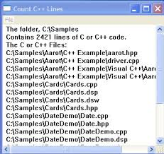


Anchor Activity: Summary
Stories are analyzed to pseudocode with ADT calls.
ADTs are implemented as C++ source (library calls or your code).
C++ code builds and runs on hardware.
1
2
3
Arrays; Stacks;
Queues; Lists;
Graphs; Trees.

Slide 11
Fundamental Types in C++
1.1.2

Slide 12
Arrays, Pointers, References
1.1.3

Slide 13
Namespaces, Variables, Scopes
1.1.4

Slide 15
Identify Periodic Strings
1.1.5

Slide 16
Palindromes: User Story

Slide 17
Palindromes: Pseudocode

Slide 18
Palindromes: Implementation

Slide 19
Palindromes: Submitting

