Slide 1
15-853:Algorithms in the Real World
Indexing and Searching III (well actually II)
  Link Analysis
  Near duplicate removal

Slide 2
Indexing and Searching Outline
Introduction: model, query types
Inverted Indices: Compression, Lexicon, Merging
Vector Models: Weights, cosine distance
Latent Semantic Indexing:
Link Analysis: PageRank (Google), HITS
Near Duplicate Removal:

Slide 3
Link Analysis
The goal is to rank pages.
We want to take advantage of the link structure to do this.
Two main approaches:
  Static: we will use the links to calculate a ranking of the pages offline (Google)
  Dynamic: we will use the links in the results of a search to dynamically determine a ranking (Clever – hubs and authorities)

Slide 4
The Link Graph
View documents as graph nodes and the hyperlinks between documents as directed edges.
Can give weights on edges (links) based on
position in the document
weight of anchor term
# of occurrences of link
…
d4
d5
d2
d6
d7
d9
d3
d1
d8

Slide 5
The Link Matrix
An adjacency matrix of the link graph.
Each row corresponds to the Out-Links of a vertex
Each column corresponds to the In-links of a vertex
Often normalize columns to sum to 1 so the dot-product with self is 1.
d4
d5
d2
d6
d7
d9
d3
d1
d8

Slide 6
The Link Matrix
0 | 0 | 0 | 0 | 0 | 0 | 1 | 1 | 1
1 | 0 | 0 | 0 | 1 | 0 | 0 | 0 | 1
0 | 0 | 0 | 0 | 1 | 1 | 0 | 0 | 0
0 | 0 | 0 | 0 | 0 | 0 | 0 | 0 | 0
0 | 1 | 0 | 1 | 0 | 0 | 1 | 0 | 0
1 | 0 | 0 | 0 | 0 | 0 | 0 | 0 | 0
1 | 0 | 0 | 0 | 0 | 0 | 0 | 0 | 0
1 | 0 | 0 | 0 | 0 | 0 | 0 | 0 | 1
0 | 0 | 1 | 0 | 0 | 0 | 0 | 0 | 0
d4
d5
d2
d6
d7
d9
d3
d1
d8

Slide 7
Google: Page Rank (1)
Goal: to give a total order (rank) on the “importance” of all pages they index
Possible Method: count the number of in-links.
Problems?
d4
d5
d2
d6
d7
d9
d3
d1
d8

Slide 8
Google: Page Rank (2)
Refined Method: weigh the source by its importance.
Seems like this is a self recursive definition.
Imagine the following:
Jane Surfer, has a lot of time to waste, and randomly selects an outgoing link each time she gets to a page.
She counts how often she visits each page.
d4
d5
d2
d6
d7
d9
d3
d1
d8
Problem?

Slide 9
Side Topic: Markov Chains
A discrete time stochastic process is a sequence of random variables {X₀, X₁, …, X_{n}, …} where the 0, 1, …, n, … are discrete points in time.
A Markov chain is a discrete-time stochastic process defined over a finite (or countably infinite) set of states S in terms of a matrix P of transition probabilities.
Memorylessness property: for a Markov chain
Pr[X_{t+1} = j | X₀ = i₀, X₁ = i₁, …, X_{t} = i] =
Pr[X_{t+1} = j | X_{t} = i]

Slide 10
Side Topic: Markov Chains
Let π_{i}(t) be the probability of being in state i at time step t.
Let π(t) = [π₀(t), π₁(t), … ] be the vector of probabilities at time t.
For an initial probability distribution π(0), the probabilities at time n are
π(n) = π(0) P^{n}
A probability distribution π is stationary if π = π P (i.e. is an eigenvector of P with eigenvalue 1)

Slide 11
Side Topic: Markov Chains
A markov chain is irreducible if the underlying graph (of P) consists of a single strong component (i.e. all states are reachable from all other states.
A period of a state i is the integer t such that
P^{n}_{ii} = 0 for all n ≠ t, 2t, 3t, …
(i.e. only comes back to itself every t steps).
A state is aperiodic if it has period 1.
A Markov chain is aperiodic if all states are aperiodic.
A state is recurrent if upon entering this state the process will definitely return to the state

Slide 12
Side Topic: Markov Chains
Fundamental Theorem of Markov Chains:
Any irreducible, finite, and aperiodic Markov chain has the following properties:
All states are ergodic (aperiodic and recurrent)
There is a unique stationary distribution π > 0 for all states.
Let N(i,t) be the number of times the Markov chain visits state i in t steps. Then
lim_{t ! 1} N(i,t) = π_{i} t

Slide 13
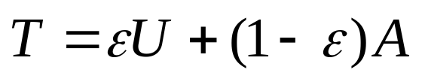
Google: Page Rank (3)
Stationary probability of a Markov Chain.
Transition probability matrix is simply matrix with equal probability of leaving on each link
Remaining problem: Gives too high of a rank to the Yahoo’s of the world, and too low to clusters with low connectivity into the cluster.
Solution: With some probability jump to a random page instead a random outgoing link.
Transition probability matrix is:
U is the uniform matrix, and A is the normalized link matrix (each column sums to 1).

Slide 14
Google: Page Rank (4)
Want to find π, such that Tπ = π
This corresponds to finding the principal eigenvector.
Methods:
  Power method: iterate p_{i+1} = Tp_{i} until it settles
  pick p₀ randomly,
  decomposing p₀ into eigenvectors a₁ e₁ + a₂ e₂ + …
  we have p_{i} = λ₁^{i} a₁ e₁ + λ₂^{i} a₂ e₂ + …
  Multilevel method: solve on contracted graph, use as initial vector for power method on the expanded graph.
  Lancoz method: diagonalize, then iterate
All methods are quite expensive

Slide 15
Hubs and Authorities (1)
Goal: To get a ranking for a particular query (instead of the whole web)
Assume: We have a search engine that can give a set of pages P that match a query
Find all pages that point to P (back set) and that P point to (forward set).
Include b, d and f in a document set D.
b1
f1
d1
b2
f2
d2
b3
f3
d3
b4
f4
search
results
P
back set
forward set

Slide 16
Hubs and Authorities (2)
For a particular query we might want to find:
The “authorities” on the topic (where the actual information is kept)
The “hub” sites that point to the best information on the topic (typically some kind of link site)
Important authorities will have many pages that point to them
Important hubs will point to many pages
But: As with page-rank, just having a lot of pointers does not mean much

Slide 17
Hubs and Authorities (3)
h1
f1
vector h is a weight for each document in D for how good a hub it is
vector a is a weight for each document in D for how good an authority it is
T is the adjacency matrix
Now repeat:
h = T^{T}a
a = Th
until it settles.
h2
f2
h3
f3
h4
f4
hubs
authorities

Slide 18
Hubs and Authorities (4)
What is this process doing?
a_{i+1} = (TT^{T}) a_{i}
h_{i+1} = (T^{T}T) h_{i}
Power method for eigenvectors of TT^{T} and T^{T}T
SVD(T) : first column of U and first row of V

Slide 19
Hubs and Authorities (5)
Problem (Topic Drift): Hubs and Authorities will tend to drift to the general, instead of specific.
e.g. you search for “Indexing Algorithms” which identifies all pages with those terms in it, and the back and forward pages.
Now you use the SVD to find Hubs + Authorities
These will most likely be pages on Algorithms in general rather than Indexing Algorithms.
Solution: weight the documents with “indexing” prominently in them, more heavily.
a = TWh, h = T^{T}Wa, where W is a diagonal matrix with weights on the diagonal.
Same as finding SVD of T’ = TW

Slide 20
Extensions
What about second eigenvectors?
Mix terms and links.

Slide 21
Indexing and Searching Outline
Introduction: model, query types
Inverted Indices: Compression, Lexicon, Merging
Vector Models: Weights, cosine distance
Latent Semantic Indexing:
Link Analysis: PageRank (Google), HITS
Near Duplicate Removal:

Slide 22
Syntacting Clustering of the Web
Problem: Many pages on the web are almost the same but not exactly the same.
  Mirror sites with local identifier and/or local links.
  Spam sites that try to improve their “pagerank”
  Plagiarized sites
  Revisions of the same document
  Program documentation converted to HTML
  Legal documents
These near duplicates cause web indexing sites a huge headache.

Slide 23
Syntactic Clustering
Goal: find pages for which either
  Most of the content is the same
  One is contained in the other (possibly with changes
Constraints:
  Need to do it with only a small amount of information per document: a sketch
  Comparison of documents should take time linear in the size of the sketch
  Should be reasonably robust against adversary

Slide 24
Syntactic Clustering
Any ideas?

Slide 25
w-Shingling
w
View each shingle as a value.
S_{w}(A) : the set of w-shingles for document A.
As shorthand, I will often drop the w subscript.

Slide 26
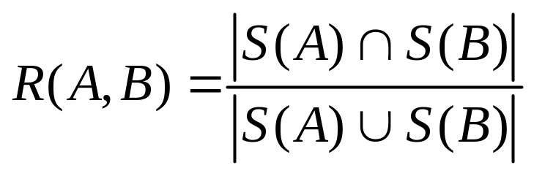
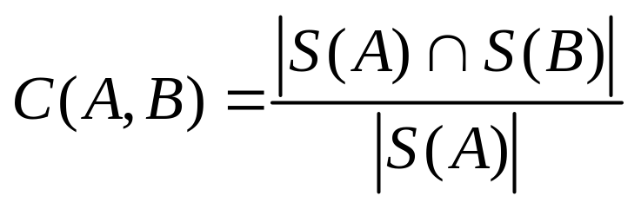
Resemblance and Containment
c
c
d
Resemblance:
Containment:
R =
A
B
d
f
e
f
C =
A
B
e

Slide 27
Calculating Resemblance/Containment
Method 1:
Keep all shingles and calculate union and intersection of the shingles directly.
Problem: can take |D|w space per document (larger than original document)
Other ideas?
  First 100 shingles?
  Shingles from every k^{th} position?
  Shingles from random positions (preselected)?
  e.g. 23, 786, 1121, 1456, …
Notes:
Other ideas: choosing firs 100 shingles. Choosing a random subset. Choosing every kth.

Slide 28
Using Min Valued Shingles
How about viewing each shingle as a number and selecting the 100 minimum valued shingles?
  e.g. append the ASCII codes
Possible problem?
Notes:
The minimum values might correspond to common idioms, e.g. a bunch of blank spaces

Slide 29
Hash
How about a random hash?
i.e. for each shingle x take h(x), then pick the minimum k values.
S_{k}(A) = min_{k}{h(x) : x 2 S(A)}

Slide 30
Some Theory: Pairwise independent
Universal Hash functions: (Pairwise independent)
  H : a finite collection (family) of hash functions mapping U ! {0...m-1}
  H is universal if,
    for h 2 H picked uniformly at random,
    and for all x₁, x₂ 2 U, x₁ ≠ x₂
    Pr(h(x₁) = h(x₂)) · 1/m
The class of hash functions
  h_{ab}(x) = ((a x + b) mod p) mod m
is universal (p ¸ m is a prime, a = {1…p-1}, b = {0…p-1})

Slide 31
Some Theory: Minwise independent
Minwise independent permutations:
  S_{n} : a finite collection (family) of permutations mapping {1…n} ! {1…n}
  H is minwise independent if,
    for π 2 S_{n} picked uniformly at random,
    and for X µ {1…n}, and all x 2 X
    Pr(min{π(X)} = π(x)) · 1/|X|
It is actually hard to find a “compact” collection of hash functions that is minwise independent, but we can use an approximation.

Slide 32
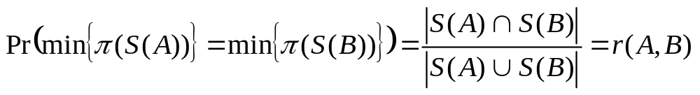
Back to similarity
If π 2 S_{n} and S_{n} is minwise independent then:
This suggests we could just keep one minimum value as our “sketch”, but our confidence would be low.
What we want for a sketch of size k is either
  use k π’s,
  or keep the k minimum values for one π

