Slide 1
Remote Math Competition (Proposal)
Kalvis.Apsitis@rbs.lv
Math olympiad-related activity:
http://nms.lu.lv/izlases-nodarbibas/
http://linen-tracer-682.appspot.com/numtheory/slides.html

Slide 2
Why add one more STEM activity for high-schools?
All math education undergoing major changes
"Top talent" is educated in very few places
Epidemic and disruptions can force changes
3 Lenses of Innovation (desirability, feasibility, viability)

Slide 3
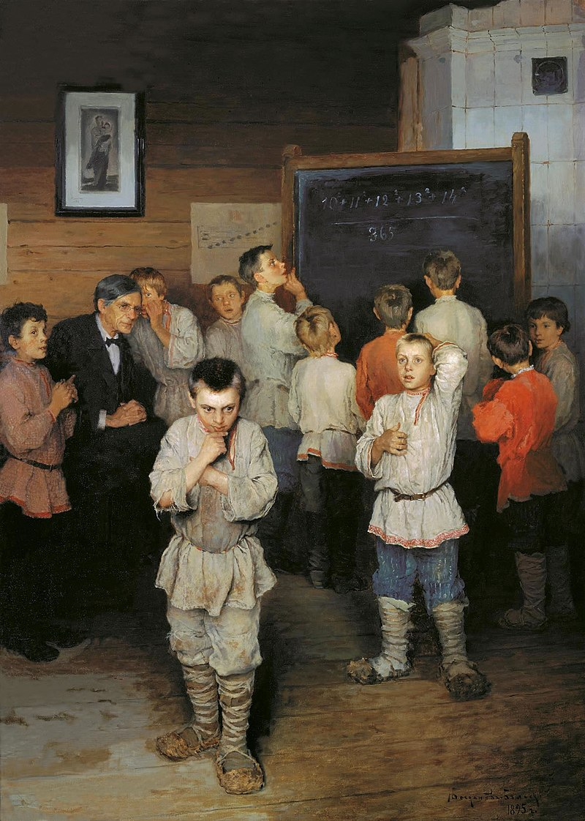
Procedural Math
PhotoMath, Wolfram Alpha and other CRM, Internet Search, AI applications are very capable.
Procedural math is easy to test and an important part in the math education – so it will probably dominate the graduation exams in Latvia; still some students will view such math as pointless. That is OK.
Computing in the head at the universal school of S.Rachinski. (A painting by Nikolai Bogdanov-Belskii. 1895.)

Slide 4

Math Education: Shifting Accents
In practice this change is not easy.
Math teachers in Latvia mostly agree on the following: Math knowledge is an interrelated system, all complex (and useful) skills build on simpler ones.
In physics, chemistry and computing you are sometimes allowed to use facts that you cannot fully prove.
Some similarity to music education – to create good music, children would need to spend many hours every week playing scales, arpeggios, etc. Not good, if nearly 100% of the time is spent playing scales.
Math education usually reflects what is important for the society at large.
Trigonometry → Spherical geometry (High seas navigation, 19th century)
Algebra → Calculus → Diff. Equations (1960ies; complex tasks, few computers)
Probabilities → Statistics (Modern world)

Slide 5
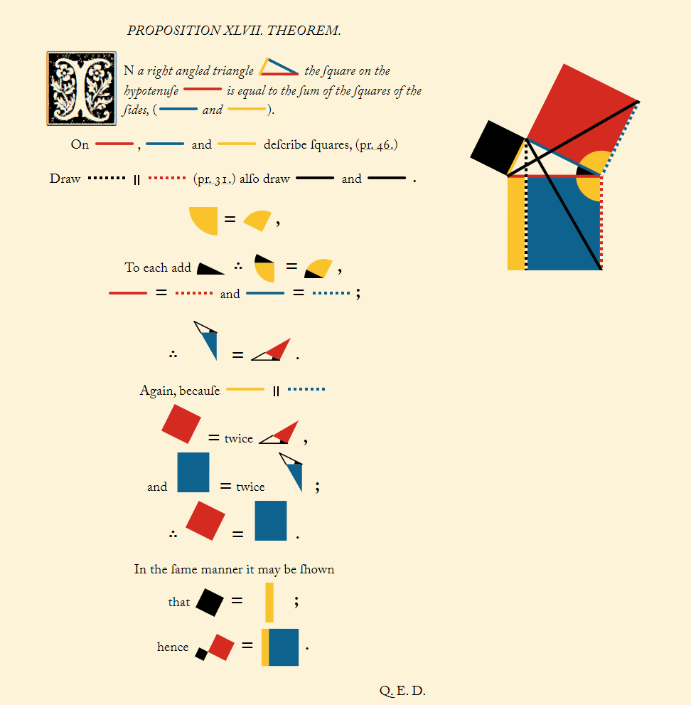
Math Reasoning
"Let no one ignorant of geometry enter" (6th century source on Plato Academy).
Euclid Elements (Byrne) - https://www.c82.net/euclid/book1/
Abraham Lincoln quotes on this book. http://gogeometry.com/math_geometry_quotes/lincoln_abraham_geometry_euclid.html

Slide 6

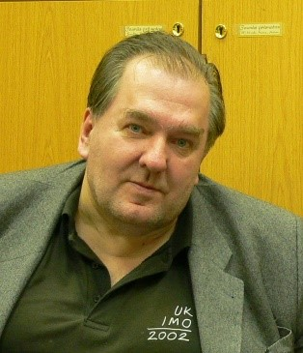
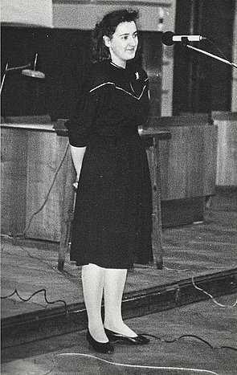
Math Olympiads – History and Structure
Austria-Hungary: The Kürschák-Eötvös Math Competition – founded in 1894, for students up to the first year of university.
Since 1951 in Latvia ("regional", "republic-wide")
Since 1974 – Open Olympiads (Agnis Andžāns).
 | In BITL/BBA?
Algebra | Used in 1st year math, Statistics
Combinatorics | Used in Discrete Structures
Geometry | (Some computer graphics class?)
Number Theory | Used in Discrete Structures
"School-problem"
A.Andžāns.
Mārīte Stupāne (Seile) – a student-organizer of olympiads in 1980ies.

Slide 7
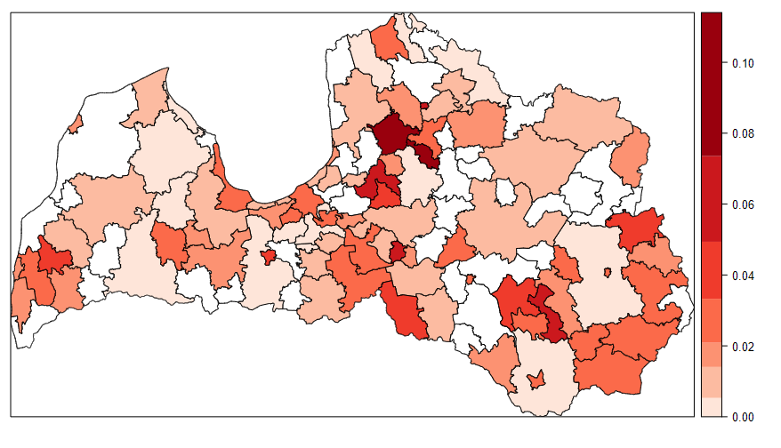
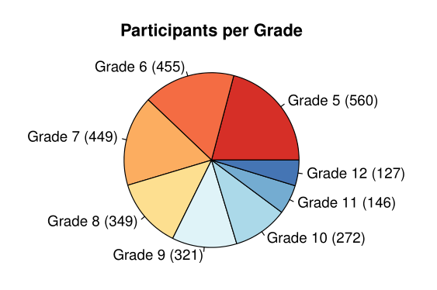
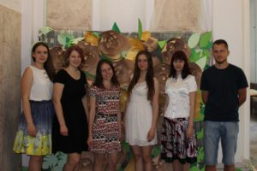
Open Math Olympiad Involvement
Grades 5-12; ages 12-19.
Some Grade 3,4 students (ages 10-11) join Grade 5.
Some 3000 participants; 2-3% of all eligible high-school students.
Involvement heavily depends on the support of local teachers, school directors etc.
50:50 gender balance.
Olympiad organizers (LU NMS – Remote School of Mathematics) now.

Slide 8
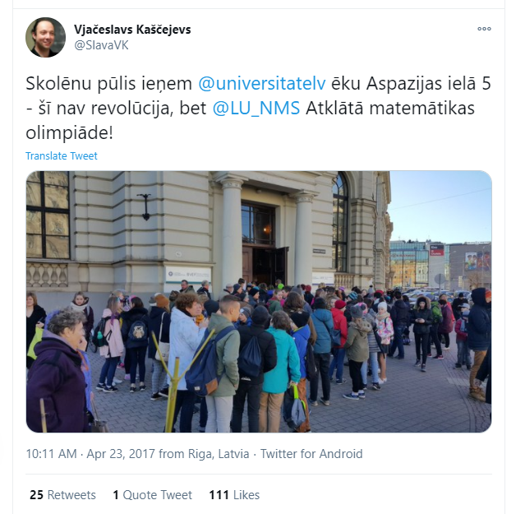
Motivational Stories for the Olympiad
For the organizers/participants it feels like a Song Festival (Dziesmusvētki).
"Marketing story" in 1980-ies: Olympiads is a way to identify people having special talents all around the country; they should be helped to serve the scientifically-technical progress (and/or our new nation-state).
Currently nearly all prize-winners in grades 9-12 come from a few top schools – the "social lift" story is not very convincing.
Participation is still very high – but need some reason for the less privileged participants

Slide 9
Epidemic Changes
The Open Olympiad in April 2020 was canceled due to epidemic.
Olympiad preparation is now done by NMS (Neklātienes matemātikas skola – Remote School of Mathematics at University of Latvia) via MS Teams and Zoom.
(Originally, in 1970ies and 1980ies NMS was a remote school in a different sense – they graded hand-written exams sent by participants via regular mail.)
There are also plans to organize a statewide 100% remote olympiad (in two stages – regional and nation-wide).
Open Olympiad has been announced as well (end of April, 2021).
http://nms.lu.lv/olimpiades/atklata/m-g/

Slide 10
Remote Competition Guidelines
(Note: This is about non-Olympiad competitions that serve similar goals to the Olympiads).
Math skills = Ability to write proofs. Nevertheless, proofs are time-consuming to grade (Open Olympiad takes about 1 month). Some skills can be taught in tests – such as US AIME.
Tests can develop reading skills. One of the key human skill is to create the mathematical problem from a word problem (teksta uzdevums). Test questions with non-traditional wording.
In remote exams problems should pass the "Google criterion". Not OK, if solution can be found with Google, or Wolfram Alpha, or PhotoMath. Remote students use Internet anyway.
Competition should be accessible to "non-elite" participants. The usual risk – have only hard problems and give "zeroes" to all (except students prepared by "olympiad insiders").
Select the time and communication strategy carefully. Competitions need to happen to avoid overlaps with other school events; in convenient time (working day afternoons?). Carefully decide when and to whom the information is sent.
(Includes feedback from Elīza Gaile – who organizes yet another olympiad, "Atvērtā kopa" – "The Open Set"; team olympiad planning to introduce some remote elements.)

Slide 11
Remote Competition/Test - Alternatives
Probably need to target the Grades 9-12 only. One or two problem-sets?
Math by itself is interdisciplinary. (Reading, writing, computations.) Socialization is also important. Is it team competition or an individual one?
How the responses are written. Is the goal to compute something? To prove something? Short answer + short justification?
Any warm-up exercises. Success of the competitions depend on the preparedness of the learners; having proper skills and interests.
Friendly user interface: Answers are submitted all at once. "Mobile-first design" and some instant feedback to the participants. Question order – mixed.

Slide 12
3 Lenses of Innovation
Name | How it applies to our solution
Desirability | The competition format should develop skills that the students (their parents, their future universities and/or employers) actually need.
Feasibility | There are substantial initial costs to create good courseware (training materials and problem sets).
Viability | Unless we have another A.Andžāns who knows how to get public money, some services have to be monetized. The participants (or their parents) could cover some costs. Some interest from advertizers – banks, insurance companies, IT enterprises. A service that spends little money per single participant (as most MOOC courses) could survive for a modest registration fee (or a whole set of subscription levels). Individual grading effort would cost more.

