Slide 1
Data Structures 3.1. List Structures
Data Structures and Algorithms
http://linen-tracer-682.appspot.com/data-structures/index.html

Slide 2
Table of Contents
3.1 List-like structures
3.2 Tree-like structures
3.3 Priority queues and heaps
3.4 Maps and dictionaries
3.5 Balancing BST
3.6 Sorting algorithms
3.7 Sets and hashing
3.8 Graphs and traversals
3.9 Shortest Paths and MST
Part 1: Use C++ and Object Orientation (6 modules, 3W)
Part 2: Express algorithms with Abstract Data Types (ADTs) and libraries (5 modules, 2W)
Part 3: Analyze the implementations of some data structures (10 modules, 5W)
Part 4: Introduce general paradigms for algorithms (7 modules, 3W)

Slide 3
Why care about code on text-based input/output?
What makes algorithms special among other types of software?
What algorithmic characeristics can we learn from "Hello, World" and similar examples?
Why learn C++ language?
Notes:
* For people who want to become professionals = can create systems that others will use
* For people who like to challenge themselves with difficult problems.
* For highly motivated people who also want to sleep; who take normal course-load, but typically do not work full-time yet.

Slide 4
Singly Linked List
A singly linked list is a concrete data structure consisting of a sequence of nodes
Each node stores
element
link to the next node
next
elem
node
∅
A
B
C
D

Slide 5
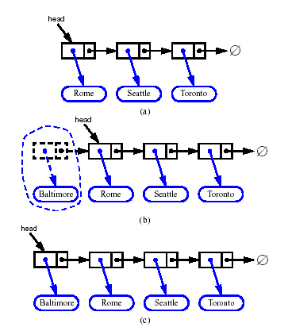
Inserting at the Head
Allocate a new node
Insert new element
Have new node point to old head
Update head to point to new node

Slide 6
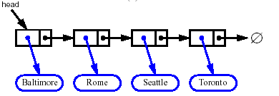


Removing at the Head
Update head to point to next node in the list
Allow garbage collector to reclaim the former first node

Slide 7
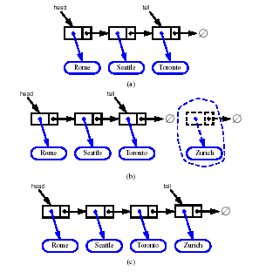
Inserting at the Tail
Allocate a new node
Insert new element
Have new node point to null
Have old last node point to new node
Update tail to point to new node

Slide 8
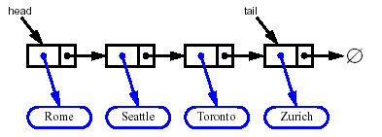
Removing at the Tail
Removing at the tail of a singly linked list is not efficient!
There is no constant-time way to update the tail to point to the previous node

Slide 9
Containers and Iterators
An iterator abstracts the process of scanning through a collection of elements
A container is an abstract data structure that supports element access through iterators
begin(): returns an iterator to the first element
end(): return an iterator to an imaginary position just after the last element
An iterator behaves like a pointer to an element
*p: returns the element referenced by this iterator
++p: advances to the next element
Extends the concept of position by adding a traversal capability

Slide 10
Containers
Data structures that support iterators are called containers
Examples include Stack, Queue, Vector, List
Various notions of iterator:
(standard) iterator: allows read-write access to elements
const iterator: provides read-only access to elements
bidirectional iterator: supports both ++p and –p
random-access iterator: supports both p+i and p-i

Slide 11
Iterating through a Container
Let C be an array-type container and p be an iterator for C
for (p = C.begin(); p != C.end(); ++p)
loop_body
Example: (with an STL vector)
typedef vector<int>::iterator Iterator;
int sum = 0;
for (Iterator p = V.begin(); p != V.end(); ++p)
sum += *p;
return sum;

Slide 12
Implementing Iterators
Array-based
array A of the n elements
index i that keeps track of the cursor
begin() = 0
end() = n (index following the last element)
Linked list-based
doubly-linked list L storing the elements, with sentinels for header and trailer
pointer to node containing the current element
begin() = front node
end() = trailer node (just after last node)

Slide 13
STL Iterators in C++
Each STL container type C supports iterators:
C::iterator – read/write iterator type
C::const_iterator – read-only iterator type
C.begin(), C.end() – return start/end iterators
This iterator-based operators and methods:
*p: access current element
++p, --p: advance to next/previous element
C.assign(p, q): replace C with contents referenced by the iterator range [p, q) (from p up to, but not including, q)
insert(p, e): insert e prior to position p
erase(p): remove element at position p
erase(p, q): remove elements in the iterator range [p, q)

Slide 14
Sequence ADT
List-based methods:
begin(), end()
insertFront(o), insertBack(o)
eraseFront(), eraseBack()
insert (p, o), erase(p)
Bridge methods:
atIndex(i), indexOf(p)
The Sequence ADT is the union of the Array List and Node List ADTs
Elements accessed by
Index, or
Position
Generic methods:
size(), empty()
ArrayList-based methods:
at(i), set(i, o), insert(i, o), erase(i)

Slide 15
Applications of Sequences
The Sequence ADT is a basic, general-purpose, data structure for storing an ordered collection of elements
Direct applications:
Generic replacement for stack, queue, vector, or list
small database (e.g., address book)
Indirect applications:
Building block of more complex data structures

Slide 16
Linked List Implementation
Position-based methods run in constant time
Index-based methods require searching from header or trailer while keeping track of indices; hence, run in linear time
A doubly linked list provides a reasonable implementation of the Sequence ADT
Nodes implement Position and store:
element
link to the previous node
link to the next node
Special trailer and header nodes
header
nodes/positions
trailer
elements

Slide 17
Array-based Implementation
elements
We use a circular array storing positions
A position object stores:
Element
Index
Indices f and l keep track of first and last positions
0
1
2
3
positions
S
f
l

Slide 18
Comparing Sequence Implementations
Operation | Array | List
size, empty | 1 | 1
atIndex, indexOf, at | 1 | n
begin, end | 1 | 1
set(p,e) | 1 | 1
set(i,e) | 1 | n
insert(i,e), erase(i) | n | n
insertBack, eraseBack | 1 | 1
insertFront, eraseFront | n | 1
insert(p,e), erase(p) | n | 1

Slide 19
Position ADT
The Position ADT models the notion of place within a data structure where a single object is stored
It gives a unified view of diverse ways of storing data, such as
a cell of an array
a node of a linked list
Just one method:
object p.element(): returns the element at position
In C++ it is convenient to implement this as *p

Slide 20
Node List ADT
The Node List ADT models a sequence of positions storing arbitrary objects
It establishes a before/after relation between positions
Generic methods:
size(), empty()
Iterators:
begin(), end()
Update methods:
insertFront(e), insertBack(e)
removeFront(), removeBack()
Iterator-based update:
insert(p, e)
remove(p)

Slide 21
Doubly Linked List
A doubly linked list provides a natural implementation of the Node List ADT
Nodes implement Position and store:
element
link to the previous node
link to the next node
Special trailer and header nodes
prev
next
elem
node
header
nodes/positions
trailer
elements

Slide 22
Insertion
We visualize operation insert(p, x), which inserts x before p
p
a
b
c
p
a
b
c
q
x
q
p
a
b
x
c

Slide 23
Insertion Algorithm
Algorithm insert(p, e): {insert e before p}
Create a new node v
v→element = e
u = p→prev
v→next = p; p→prev = v {link in v before p}
v→prev = u; u→next = v {link in v after u}

Slide 24
Deletion
p
We visualize remove(p)
a
b
c
d
a
b
c
p
d
a
b
c

Slide 25
Deletion Algorithm
Algorithm remove(p):
u = p→prev
w = p→next
u→next = w {linking out p}
w→prev = u

Slide 26
Performance
In the implementation of the List ADT by means of a doubly linked list
The space used by a list with n elements is O(n)
The space used by each position of the list is O(1)
All the operations of the List ADT run in O(1) time
Operation element() of the Position ADT runs in O(1) time

