Slide 1
Week04 List Structures

Slide 2
Why Lists can be Preferred (w.r.t to Vector, Stack, Queue)?
Common aspects of list-like data structures?
Lists with their "minimal" ADT.
Notes:
* For people who want to become professionals = can create systems that others will use
* For people who like to challenge themselves with difficult problems.
* For highly motivated people who also want to sleep; who take normal course-load, but typically do not work full-time yet.

Slide 3
Objectives
Looking ahead – in this chapter, we’ll consider:
Singly Linked Lists
Doubly Linked Lists
Circular Lists
Lists in the Standard Template Library

Slide 4
Introduction
Arrays are useful in many applications but suffer from two significant limitations
The size of the array must be known at the time the code is compiled
The elements of the array are the same distance apart in memory, requiring potentially extensive shifting when inserting a new element
This can be overcome by using linked lists, collections of independent memory locations (nodes) that store data and links to other nodes
Moving between the nodes is accomplished by following the links, which are the addresses of the nodes
There are numerous ways to implement linked lists, but the most common utilizes pointers, providing great flexibility

Slide 5
Abstract Data Type
List is the first Abstract Data Type in this course.
Data container supporting some operations.
https://en.wikipedia.org/wiki/List_(abstract_data_type)
https://opendsa-server.cs.vt.edu/ODSA/Books/CS3/html/ListADT.html
Constructor for an empty list;
Test if list is empty;
Prepend an element to a list
Append an element to a list
References to the head (first) and tail (last) elements.

Slide 6
Singly Linked Lists
If a node contains a pointer to another node, we can string together any number of nodes, and need only a single variable to access the sequence
In its simplest form, each node is composed of a datum and a link (the address) to the next node in the sequence
This is called a singly linked list
Notice the single variable p used to access the entire list
Also note the last node in the list has a null pointer ( \ )

Slide 7
Singly Linked List
A singly linked list is a concrete data structure consisting of a sequence of nodes
Each node stores
info (useful element of some type)
link to the next node
next
info
Node
∅
A
B
C
D

Slide 8
Singly Linked Node type
class IntSLLNode {
public:
IntSLLNode() {
next = 0;
}
IntSLLNode(int i, IntSLLNode *in = 0){
info = i; next = in;
}
int info;
IntSLLNode *next;
}
As can be seen here and in the previous figure, a node consists of two data members, info and next
Notes:
The info member stores the node’s information content; the next member points to the next node in the list
Notice that the definition refers to the class itself, because the next pointer points to a node of the same type being defined
Objects that contain this type of reference are called self-referential objects
The definition also contains two constructors
One sets the next pointer to 0 and leaves info member undefined
The other initializes both members

Slide 9
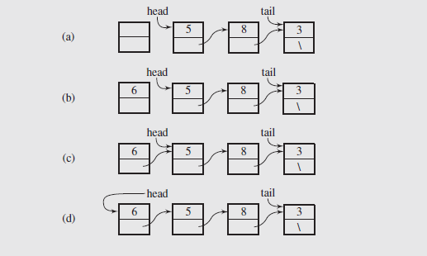
List storing Integers
Note: Some textbooks use tail to refer to the remaining part of the list (everything except the head).

Slide 10
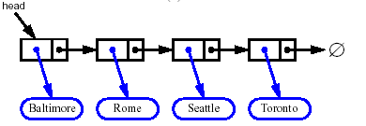
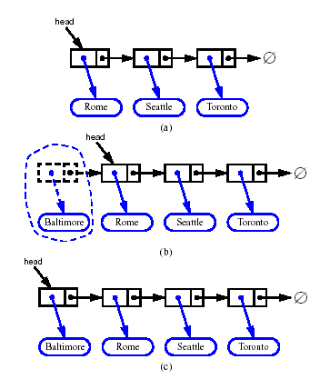


Insert/Delete at the Head
What if list is initially empty?
Notes:
Note that if the list is initially empty, both head and tail would be set to point to the new node
Allocate a new node
Insert new element
Have new node point to old head
Update head to point to new node
Update head to point to next node in the list
Allow garbage collector to reclaim the former first node

Slide 11
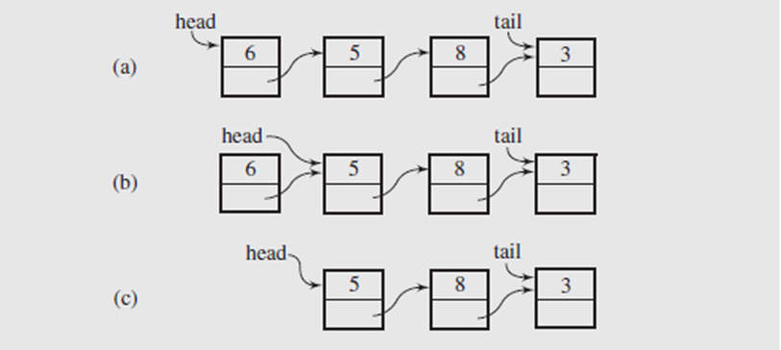
Special Cases at Deletion
Two special cases exist when carrying out this deletion
The first arises when the list is empty, in which case the caller must be notified of the action to take
The second occurs when a single node is in the list, requiring that head and tail be set to null to indicate the list is now empty
Notes:
Deletion
The operation of deleting a node consists of returning the value stored in the node and releasing the memory occupied by the node
Again, we can consider operations at the beginning and end of the list
To delete at the beginning of the list, we first retrieve the value stored in the first node (head → info)
Then we can use a temporary pointer to point to the node, and set head to point to head → next
Finally, the former first node can be deleted, releasing its memory
These operations are illustrated in figure 3.6(a) – (c)

Slide 12
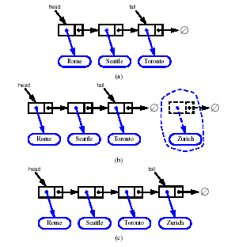
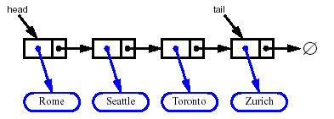
Insert/Delete at the Tail
Allocate a new node
Have old last node point to new node
Update tail to point to new node
Delete at the tail of a singly linked list is not efficient!
Notes:
Inserting a node at the end of a list is likewise easy to accomplish as illustrated in the next slide
The new node is created and the info member of the node is initialized
The next member is initialized to null, since the node is at the end of the list
The next member of the current last node is set to point to the new node Since the new node is now the end of the list, the tail pointer has to be updated to point to it
As before, if the list is initially empty, both head and tail would be set to point to the new node
Deleting at the end of a list requires additional processing
This is because the tail pointer must be backed up to the previous node in the list
Since this can’t be done directly, we need a temporary pointer to traverse the list until tmp → next = tail

Slide 13
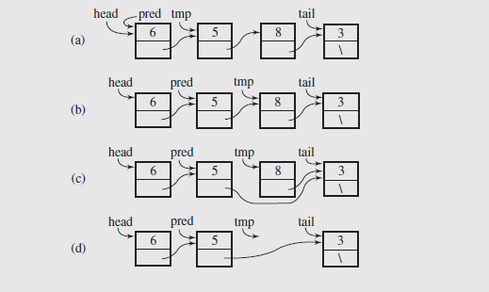
Locate and Delete
Notes:
What if we want to delete a specific node based on its info member?
In that case we have to locate the specific node, then link around it by linking the previous node to the following node
But again, to do this we need to keep track of the previous node, and we need to keep track of the node containing the target value
As can be seen, the two extra pointers, pred and tmp, are initialized to the first and second nodes in the list
They traverse the list until tmp → info matches the target value

Slide 14
Searching in Singly Linked Lists
The purpose of a search is to scan a linked list to find a particular data member
No modification is made to the list, so this can be done easily using a single temporary pointer
We simply traverse the list until the info member of the node tmp points to matches the target, or tmp → next is null
If the latter case occurs, we have reached the end of the list and the search fails

Slide 15
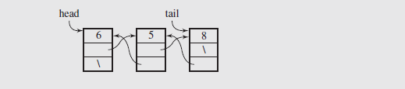
Doubly Linked Lists – Enable Stepping Back
In a singly-linked list we continually have to scan to the node just before the end in order to delete correctly
If the nature of processing requires frequent deletions of that type, this significantly slows down operations
The methods that manipulate these types of lists are slightly more complicated than their singly linked counterparts; constant slow-down (but much larger savings, if you need to step back).

Slide 16
Doubly Linked List
Nodes implement Position and store:
info - useful payload
prev - link to the previous node
next - link to the next node
Pointers to head and to tail.
prev
next
info
Node
head
nodes/positions
tail
elements

Slide 17
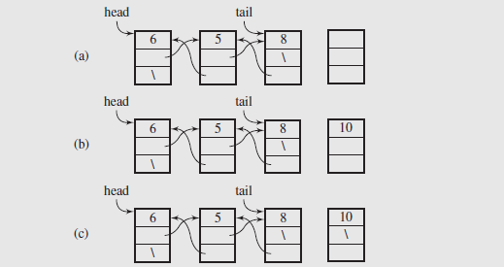
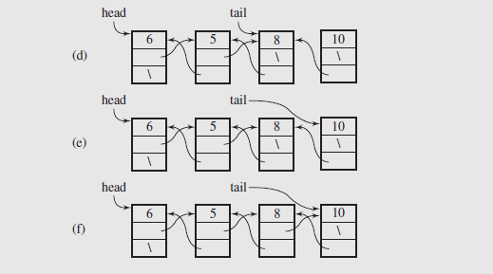
Doubly Linked Lists (continued)
Notes:
First, the new node is created and the data member is initialized
Since the node is being inserted at the end of the list, its next member is set to null
The prev member is set to tail to link it back to the former end of the list
The tail pointer is now set to point to this new node
To complete the link, the next member of the previous node is set to point to the new node

Slide 18
Insertion
We visualize operation insert(p, x), which inserts x before p
p
a
b
c
p
a
b
c
q
x
q
p
a
b
x
c

Slide 19
Insertion to Doubly Linked Lists
Insertion (continued)
A special case exists if the node being inserted is the only node in the list
In this case there is no previous node, so both head and tail point to the new node and in the last step, head would be set to point to the new node
Algorithm insert(p, e): {insert e before p}
Create a new node v
v→element = e
u = p→prev
v→next = p; p→prev = v {link in v before p}
v→prev = u;
u→next = v {link in v after u}
Notes:
Deleting a node from the end of a doubly linked list is also easy, because there is a direct link to the previous node in the list
This eliminates the need to traverse the list to find the previous node
To do this, we retrieve the data member from the node, then set tail to the node’s predecessor

Slide 20
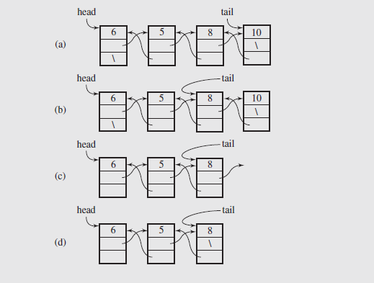
Doubly Linked Lists (continued)
Deletion
The node can then be deleted, and the next pointer of the new last node set to null
A couple of special cases:
If the node being deleted is the only node in the list, head and tail need to be set to null
Also, if the list is empty, an attempt to delete a node should be handled and reported to the user

Slide 21
Deletion
p
We visualize remove(p)
a
b
c
d
a
b
c
p
d
a
b
c
Notes:
Algorithm remove(p):
u = p→prev
w = p→next
u→next = w {linking out p}
w→prev = u

Slide 22
Performance
In the implementation of the List ADT by means of a doubly linked list
The space used by a list with n elements is O(n)
The space used by each position of the list is O(1)
All the operations of the List ADT run in O(1) time
Operation element() of the Position ADT runs in O(1) time

Slide 23
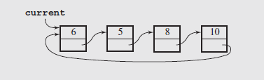
Circular Lists
Another useful arrangement of nodes is the circular list; in this structure the nodes form a ring
Fig. 3-13 A circular singly linked list
The implementation requires only one permanent pointer (usually referred to as tail)
Insertions at the front and the end of this type of list are shown in figure 3-14(a) and (b)

Slide 24
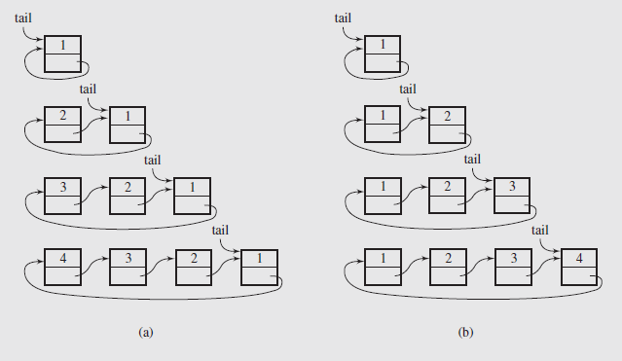
Circular Lists (continued)

Slide 25
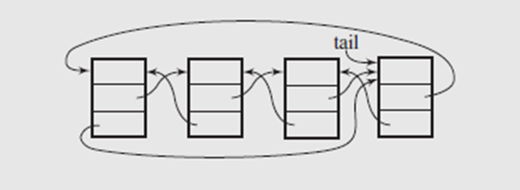
Circular Lists (continued)
The simplicity of this list does present a few problems
Deleting nodes requires a loop to locate the predecessor of the tail node, much as we saw with singly linked lists
Operations that require processing the list in reverse are going to be inefficient
To deal with this, the list can be made doubly linked
This forms two rings, one going forward through the next pointers, and the other backwards through the prev pointers
This is illustrated in figure 3-15
Fig. 3-15 A circular doubly linked list

Slide 26
Lists in the Standard Template Library
The STL implements lists as generic doubly linked lists with head and tail pointers
The class is available in a program through the directive #include <list>, and a list of the methods in the list container is shown in (pages 110 – 112) of Drozdek textbook.

Slide 27
The STL
Part of the ISO C++ Standard Library
Mostly non-numerical
Only 4 standard algorithms specifically do computation
Accumulate, inner_product, partial_sum, adjacent_difference
Handles textual data as well as numeric data
E.g. string
Deals with organization of code and data
Built-in types, user-defined types, and data structures
Optimizing disk access was among its original uses
Performance was always a key concern

Slide 28

The STL
Designed by Alex Stepanov
General aim: The most general, most efficient, most flexible representation of concepts (ideas, algorithms)
Represent separate concepts separately in code
Combine concepts freely wherever meaningful
General aim to make programming “like math”
or even “Good programming is math”
works for integers, for floating-point numbers, for polynomials, for …

Slide 29
Basic model
Separation of concerns
Algorithms manipulate data, but don’t know about containers
Containers store data, but don’t know about algorithms
Algorithms and containers interact through iterators
Each container has its own iterator types
Algorithms
sort, find, search, copy, …
iterators
Containers
vector, list, map, unordered_map, …

Slide 30
The STL
An ISO C++ standard framework of about 10 containers and about 60 algorithms connected by iterators
Other organizations provide more containers and algorithms in the style of the STL
Boost.org, Microsoft, SGI, …
Probably the currently best known and most widely used example of generic programming
Notes:
Documentation
SGI
http://www.sgi.com/tech/stl/ (recommended because of clarity)
Dinkumware
http://www.dinkumware.com/refxcpp.html (beware of several library versions)
Rogue Wave
http://www.roguewave.com/support/docs/sourcepro/stdlibug/index.html

Slide 31
Basic model
A pair of iterators defines a sequence
The beginning (points to the first element – if any)
The end (points to the one-beyond-the-last element)
begin:
end:
…
An iterator is a type that supports the “iterator operations”
++ Go to next element
* Get value
== Does this iterator point to the same element as that iterator?
Some iterators support more operations (e.g. --, +, and [ ])

Slide 32
Containers (hold sequences in difference ways)
0
1
2
3
vector
list
(doubly linked)
set
(a kind of tree)
0
1
2
6
2
7
0
1
5
3
4

Slide 33
"Generic algorithm": find()
…
begin:
// Find the first element that equals a value
template<class In, class T>
In find(In first, In last, const T& val)
{
while (first!=last && *first != val) ++first;
return first;
}
void f(vector<int>& v, int x) // find an int in a vector
{
vector<int>::iterator p = find(v.begin(),v.end(),x);
if (p!=v.end()) { /* we found x */ }
// …
}
end:

Slide 34
find() – Different Types/Containers
void f(vector<int>& v, int x) // works for vector of ints
{
vector<int>::iterator p = find(v.begin(),v.end(),x);
if (p!=v.end()) { /* we found x */ }
// …
}
void f(list<string>& v, string x) // works for list of strings
{
list<string>::iterator p = find(v.begin(),v.end(),x);
if (p!=v.end()) { /* we found x */ }
// …
}
void f(set<double>& v, double x) // works for set of doubles
{
set<double>::iterator p = find(v.begin(),v.end(),x);
if (p!=v.end()) { /* we found x */ }
// …
}

Slide 35
Algorithms and iterators
An iterator points to (refers to, denotes) an element of a sequence
The end of the sequence is “one past the last element”
not “the last element”
That’s necessary to elegantly represent an empty sequence
One-past-the-last-element isn’t an element
You can compare an iterator pointing to it
You can’t dereference it (read its value)
Returning the end of the sequence is the standard idiom for “not found” or “unsuccessful”
An empty sequence:
begin: end:
some iterator:
the end:
0
1
2
3

Slide 36
Simple algorithm: find_if()
Find the first element that matches a criterion (predicate)
Here, a predicate takes one argument and returns a bool
template<class In, class Pred>
In find_if(In first, In last, Pred pred)
{
while (first!=last && !pred(*first)) ++first;
return first;
}
void f(vector<int>& v)
{
vector<int>::iterator p = find_if(v.begin(),v.end,Odd());
if (p!=v.end()) { /* we found an odd number */ }
// …
}
A predicate

Slide 37
Predicates
A predicate (of one argument) is a function or a function object that takes an argument and returns a bool
For example
A function
bool odd(int i) { return i%2; } // % is the remainder (modulo) operator
odd(7); // call odd: is 7 odd?
A function object
struct Odd {
bool operator()(int i) const { return i%2; }
};
Odd odd; // make an object odd of type Odd
odd(7); // call odd: is 7 odd?

Slide 38
Concluding Remarks
The motivation for introducing linked lists was to allow dynamic allocation of memory, using only what was needed
Insertion and deletion of data was also easily effected
This does not eliminate the need for arrays; random access to elements cannot be achieved with lists
However for specific elements, or for algorithms that focus on changing the structure of the data, lists are preferable
Arrays also have less overhead in space utilization; all that is needed is the space for data
Lists need to allocate pointers, which can add substantial space overhead depending on the application

Slide 39
Containers and Iterators
An iterator abstracts the process of scanning through a collection of elements
A container is an abstract data structure that supports element access through iterators
begin(): returns an iterator to the first element
end(): return an iterator to an imaginary position just after the last element
An iterator behaves like a pointer to an element
*p: returns the element referenced by this iterator
++p: advances to the next element
Extends the concept of position by adding a traversal capability

Slide 40
Containers
Data structures that support iterators are called containers
Examples include Stack, Queue, Vector, List
Various notions of iterator:
(standard) iterator: allows read-write access to elements
const iterator: provides read-only access to elements
bidirectional iterator: supports both ++p and –p
random-access iterator: supports both p+i and p-i

Slide 41
Iterating through a Container
Let C be an array-type container and p be an iterator for C
for (p = C.begin(); p != C.end(); ++p)
loop_body
Example: (with an STL vector)
typedef vector<int>::iterator Iterator;
int sum = 0;
for (Iterator p = V.begin(); p != V.end(); ++p)
sum += *p;
return sum;

Slide 42
Implementing Iterators
Array-based
array A of the n elements
index i that keeps track of the cursor
begin() = 0
end() = n (index following the last element)
Linked list-based
doubly-linked list L storing the elements, with sentinels for header and trailer
pointer to node containing the current element
begin() = front node
end() = trailer node (just after last node)

Slide 43
STL Iterators in C++
Each STL container type C supports iterators:
C::iterator – read/write iterator type
C::const_iterator – read-only iterator type
C.begin(), C.end() – return start/end iterators
This iterator-based operators and methods:
*p: access current element
++p, --p: advance to next/previous element
C.assign(p, q): replace C with contents referenced by the iterator range [p, q) (from p up to, but not including, q)
insert(p, e): insert e prior to position p
erase(p): remove element at position p
erase(p, q): remove elements in the iterator range [p, q)

Slide 44
Sequence ADT
The Sequence ADT is the union of the Array List and Node List ADTs
Elements accessed by
Index, or
Position
Generic methods:
size(), empty()
ArrayList-based methods:
at(i), set(i, o), insert(i, o), erase(i)
List-based methods:
begin(), end()
insertFront(o), insertBack(o)
eraseFront(), eraseBack()
insert (p, o), erase(p)
Bridge methods:
atIndex(i), indexOf(p)

Slide 45
Applications of Sequences
The Sequence ADT is a basic, general-purpose, data structure for storing an ordered collection of elements
Direct applications:
Generic replacement for stack, queue, vector, or list
small database (e.g., address book)
Indirect applications:
Building block of more complex data structures

Slide 46
Linked List Implementation
Position-based methods run in constant time
Index-based methods require searching from header or trailer while keeping track of indices; hence, run in linear time
A doubly linked list provides a reasonable implementation of the Sequence ADT
Nodes implement Position and store:
element
link to the previous node
link to the next node
Special trailer and header nodes
header
nodes/positions
trailer
elements

Slide 47
Array-based Implementation
elements
We use a circular array storing positions
A position object stores:
Element
Index
Indices f and l keep track of first and last positions
0
1
2
3
positions
S
f
l

Slide 48
Comparing Sequence Implementations
Operation | Array | List
size, empty | 1 | 1
atIndex, indexOf, at | 1 | n
begin, end | 1 | 1
set(p,e) | 1 | 1
set(i,e) | 1 | n
insert(i,e), erase(i) | n | n
insertBack, eraseBack | 1 | 1
insertFront, eraseFront | n | 1
insert(p,e), erase(p) | n | 1

Slide 49
Position ADT
The Position ADT models the notion of place within a data structure where a single object is stored
It gives a unified view of diverse ways of storing data, such as
a cell of an array
a node of a linked list
Just one method:
object p.element(): returns the element at position
In C++ it is convenient to implement this as *p

Slide 50
Node List ADT
The Node List ADT models a sequence of positions storing arbitrary objects
It establishes a before/after relation between positions
Generic methods:
size(), empty()
Iterators:
begin(), end()
Update methods:
insertFront(e), insertBack(e)
removeFront(), removeBack()
Iterator-based update:
insert(p, e)
remove(p)

