Slide 1
Data Structures Priority Queues and Heaps
Data Structures and Algorithms
Notes:
**Concepts:**
* Priority queue; rinda ar prioritāti (lv)
* Heap; kaudze (lv)

Slide 2
Why some uses of ordering do not require explicit sorting?
What is a priority queue?
What are the operations that can or cannot be performed in a priority queue?

Slide 3
Priority Queue
Characteristics of a priority queue
every element in the priority queue has
Key/priority K of type key
Information I of type info
Element is denoted by a pair <K, I>
Key K does not need to be unique
Element removal strategy defines how to remove the elements according to the priority (dependent on the key K).

Slide 4

Supported operations
Insert element $x$
View and return the minimum (maximum) element.
Remove and return the minimum (maximum) element.
Change the key of an element by $k$units. (Need to identify and to search elements for this).

Slide 5
Uses of Priority Queues
HeapSort algorithm
Dijkstra's algorithm for single-source shortest paths
Huffman's compression
Prim’s Minimal Spanning Tree algorithm
Many more piecemeal transformation and greedy tactics need this (but the above are mentioned in our course).

Slide 6
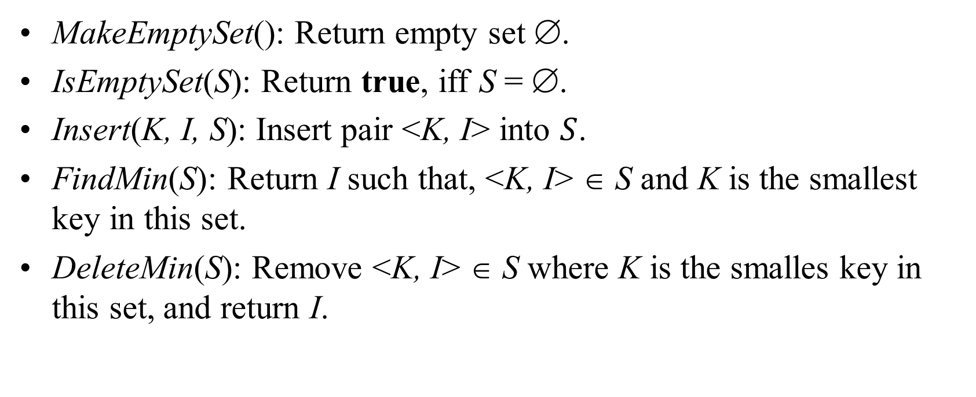
Priority Queues: ADT
MakeEmptySet(): Return empty set ∅.
IsEmptySet(S): Return true, iff S = ∅.
Insert(K, I, S): Insert pair <K, I> into $S$.
FindMin(S): Return I such that, <K, I> ∈ S and K is the smallest key in this set.
DeleteMin(S): Remove <K, I> ∈ S where K is the smalles key in this set, and return I.

Slide 7
Priority Queue Implementations
Unordered list (easy to build, but most operations are expensive)
Ordered list (some operations are still expensive)
Ordered tree (some overhead: Priority Queue does not need to be fully sorted)
Binary heap (binary tree)
Tree with pointers
Tree implemented as an array (most popular priority queue – Heap)

Slide 8
Binary Relations of Total Order
Keys in a priority queue can be arbitrary objects on which an order is defined
Two distinct entries in a priority queue can have the same key
Mathematical concept of total order relation ≤
Reflexive property: x ≤ x
Antisymmetric property: x ≤ y ∧ y ≤ x ⇒ x = y
Transitive property: x ≤ y ∧ y ≤ z ⇒ x ≤ z

Slide 9
Sequence-based Priority Queue
Implementation with an unsorted list
Performance:
insert takes O(1) time since we can insert the item at the beginning or end of the sequence
removeMin and min take O(n) time since we have to traverse the entire sequence to find the smallest key
Implementation with a sorted list
Performance:
insert takes O(n) time since we have to find the place where to insert the item
removeMin and min take O(1) time, since the smallest key is at the beginning
4
5
2
3
1
1
2
3
4
5

Slide 10
Entry and Priority Queue ADTs
A priority queue stores a collection of entries
Typically, an entry is a pair (key, value), where the key indicates the priority
The priority queue is associated with a comparator C, that compares two entries
Priority Queue ADT:
insert(e) inserts entry e
removeMin() removes the entry with smallest key
min() returns, but does not remove, an entry with smallest key
size(), empty()

Slide 11
Example
Online trading system where orders to purchase and sell a stock are stored in two priority queues (one for sell orders and one for buy orders) as (p,s) entries:
The key, p, of an order is the price
The value, s, for an entry is the number of shares
A buy order (p,s) is executed when a sell order (p’,s’) with price p’<p is added (the execution is complete if s’>s)
A sell order (p,s) is executed when a buy order (p’,s’) with price p’>p is added (the execution is complete if s’>s)
What if someone wishes to cancel their order before it executes?
What if someone wishes to update the price or number of shares for their order?

Slide 12
Methods of the Adaptable Priority Queue ADT
insert(e): Insert the entry e into P and return a position referring to this entry
remove(p): Remove from P the entry referenced by position p
replace(p, e): Replace with e the element associated with the entry referenced by p and return the position of the altered entry

Slide 13
Example
Operation Output P
insert(5,A) p₁ (5,A)
insert(3,B) p₂ (3,B), (5,A)
insert(7,C) p₃ (3,B), (5,A), (7,C)
min() p₂ (3,B), (5,A), (7,C)
p₂.key() 3 (3,B), (5,A), (7,C)
remove(p₁) – (3,B), (7,C)
replace(p₂,(9,D)) p₄ (7,C), (9,D)
replace(p₃,(7,E)) p₅ (7,E), (9,D)
remove(p₄) – (7,D)

Slide 14
Performance
Improved times thanks to location-aware entries are highlighted in red
Method Unsorted List Sorted List Heap
size, empty O(1) O(1) O(1)
insert O(1) O(n) O(log n)
min O(n) O(1) O(1)
removeMin O(n) O(1) O(log n)
remove O(1) O(1) O(log n)
replace O(1) O(n) O(log n)

Slide 15
Heap
Heap is a binary tree with elements with their priorities, but the nodes are ordered so that every node has priority less or equal with the priorities of its children.
Therefore at the top there is an element with the smallest priority and the priorities grow as we move down any path.
Implementation: Inserting an element; Removing the minimum-key element.

Slide 16
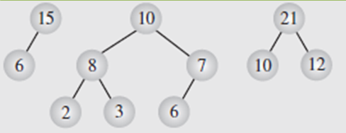
Binary Heap
Min-Heap: The value of each node is smaller than the values stored in its children.
Max-Heap: The value of each node is greater than or equal to the values stored in its children
06
14
45
78
18
47
53
83
91
81
77
84
99
64

Slide 17
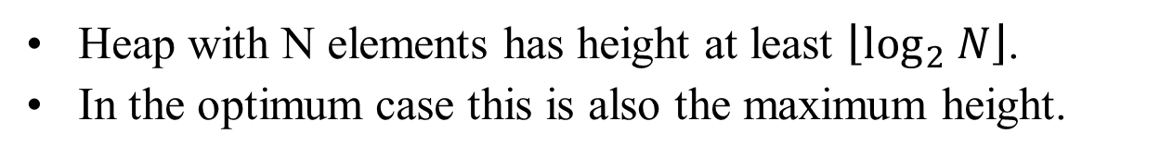
Properties of the binary heap
Heap with N elements has height at least $\left\lfloor \log_{2} N\right\rfloor$.
In the optimum case this is also the maximum height.
06
N = 14 Height = 3
14
45
78
18
47
53
83
91
81
77
84
99
64

Slide 18
Binary heap in an array
Parent(i) = ⎣(i-1)/2⎦
Left(i) = 2i + 1
Right(i) = 2i + 2
06
0
14
45
1
2
78
18
47
53
3
4
5
6
83
91
81
77
84
99
64
7
8
9
10
11
12
13

Slide 19
Inserting an element
Insert the new element (42) in the next free slot and, if necessary, raise it up to its permanent place.
06
14
45
78
18
47
53
83
91
81
77
84
99
64
42
Free slot

Slide 20
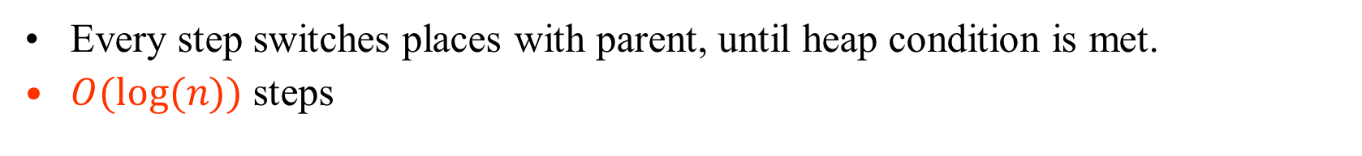
Inserting: Exchange with Parent
06
06
06
14
45
14
42
14
45
78
18
47
53
78
18
47
45
78
18
47
42
83
91
81
77
84
99
64
42
83
91
81
77
84
99
64
53
83
91
81
77
84
99
64
53
Stop, when the right
place has been reached.
Every step switches places with parent, until heap condition is met.
$O(log⁡(n))$ steps

Slide 21
Removing an element
The last leaf switches places with the (removed) root and then bubbles down to its proper place.
06
53
14
42
14
42
78
18
47
45
78
18
47
45
83
91
81
77
84
99
64
53
83
91
81
77
84
99
64
6

Slide 22
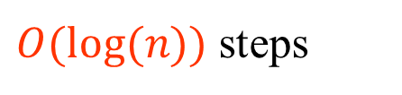
Removing an Element
53
14
14
14
42
53
42
18
42
78
18
47
45
78
18
47
45
78
53
47
45
83
91
81
77
84
99
64
83
91
81
77
84
99
64
83
91
81
77
84
99
64
Exchange with either child, if it is smaller
Stop, if the right place is reached
$O(log⁡(n))$ steps

Slide 23
Inserting an element
function HeapInsert(key K, info I, heap h):
// Add the pair <K,I> to the heap h.
H = Table(h)
n = Size(h)
if n = N then error // Heap is full. N – the length of array.
m = n // m is a pointer that moves up a tree branch
while m > 0 and K < Key(H[⎣(m-1)/2⎦]) do
H[m] = H[⎣(m-1)/2⎦] // Move some heap element down the tree.
m = ⎣(m-1)/2⎦ // Pointer m becomes Parent(m).
Key(H[m]) = K
Info(H[m]) = I // Insert the element into its proper location.
Size(h) = n+1

Slide 24
Removing an Element
procedure HeapDeleteMin(heap h): info
H = Table(h); n = Size(h)
if n = 0 then error {Heap is empty.}
I = Info(H[0]) {Element to be returned.}
K = Key(H[n-1]) {Priority of the element to be moved}
m = 0 {m is a pointer that traverses the tree.}
while 2m+1 < n and K > Key(H[2m+1]) or 2m+2 < n and K > Key(H[2m+2]) do
if 2m+2 < n then {Node m has two child nodes.}
if Key(H[2m+1]) < Key(H[2m+2]) then
p = 2m+1
else
p = 2m+2
else {Node m has just one child (the last leaf in the tree)}
p = n-1
H[m] = H[p] {Push child upwards}
m = p {Set the pointer downwards.}
H[m] = H[n-1] {Finally move the element to its position.}
Size(h) = n-1 {New size of the heap.}
return I

Slide 25
Height of a Heap
Theorem: A heap storing n keys has height O(log n)
Proof: (we apply the complete binary tree property)
Let h be the height of a heap storing n keys
Since there are 2^{i} keys at depth i = 0, … , h − 1 and at least one key at depth h, we have n ≥ 1 + 2 + 4 + … + 2^{h−1} + 1
Thus, n ≥ 2^{h} , i.e., h ≤ log n
depth
keys
0
1
1
2
h−1
2^{h−1}
h
1

Slide 26
Heaps and Priority Queues
We can use a heap to implement a priority queue
We store a (key, element) item at each internal node
We keep track of the position of the last node
(2, Sue)
(5, Pat)
(6, Mark)
(9, Jeff)
(7, Anna)

Slide 27
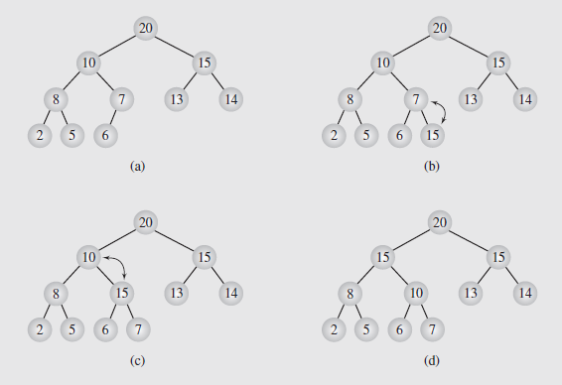
After Insert – Upheap
After the insertion of a new key k, the heap-order property may be violated
Algorithm upheap restores the heap-order property by swapping k along an upward path from the insertion node
Upheap terminates when the key k reaches the root or a node whose parent has a key smaller than or equal to k
Since a heap has height O(log n), upheap runs in O(log n) time

Slide 28
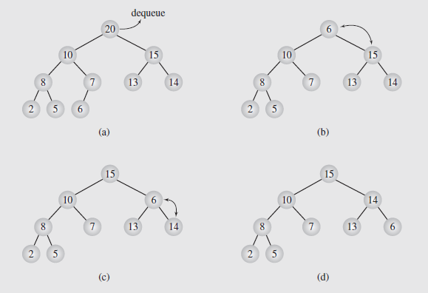
After Removal – Downheap
After replacing the root key with the key k of the last node, the heap-order property may be violated
Algorithm downheap restores the heap-order property by swapping key k along a downward path from the root
Upheap terminates when key k reaches a leaf or a node whose children have keys greater than or equal to k
Since a heap has height O(log n), downheap runs in O(log n) time

Slide 29
Location-Aware Entries
Operations remove(p) and replace(p) need fast ways of locating an entry p in a priority queue.
A location-aware entry – can look it up after it has been inserted into a tree.
Since entries are created and returned from the data structure itself, it can return location-aware entries, thereby making future updates easier
2
d
4
a
6
b
header
nodes/positions
trailer
2
c
4
c
5
c
8
c
entries
8
g
5
e
9
c
Notes:
Various heap implementations can be made "location aware".

Slide 30
Recall PQ Sorting
We use a priority queue
Insert the elements with a series of insert operations
Remove the elements in sorted order with a series of removeMin operations
The running time depends on the priority queue implementation:
Unsorted sequence gives selection-sort: O(n²) time
Sorted sequence gives insertion-sort: O(n²) time
Can we do better?
Algorithm PQ-Sort(S, C)
Input sequence S, comparator C for the elements of S
Output sequence S sorted in increasing order according to C
P ← priority queue with comparator C
while ¬S.empty ()
e ← S.front(); S.eraseFront()
P.insert (e, ∅)
while ¬P.empty()
e ← P.removeMin()
S.insertBack(e)

Slide 31
Selection-Sort
Selection-sort is the variation of PQ-sort where the priority queue is implemented with an unsorted sequence
Running time of Selection-sort:
Inserting the elements into the priority queue with n insert operations takes O(n) time
Removing the elements in sorted order from the priority queue with n removeMin operations takes time proportional to 1 + 2 + …+ n
Selection-sort runs in O(n²) time

Slide 32
Selection-Sort Example
Sequence S Priority Queue P
Input: (7,4,8,2,5,3,9) ()
Phase 1
(a) (4,8,2,5,3,9) (7)
(b) (8,2,5,3,9) (7,4)
.. .. ..
(g) () (7,4,8,2,5,3,9)
Phase 2
(a) (2) (7,4,8,5,3,9)
(b) (2,3) (7,4,8,5,9)
(c) (2,3,4) (7,8,5,9)
(d) (2,3,4,5) (7,8,9)
(e) (2,3,4,5,7) (8,9)
(f) (2,3,4,5,7,8) (9)
(g) (2,3,4,5,7,8,9) ()

Slide 33
Insertion-Sort
Insertion-sort is the variation of PQ-sort where the priority queue is implemented with a sorted sequence
Running time of Insertion-sort:
Inserting the elements into the priority queue with n insert operations takes time proportional to
1 + 2 + …+ n
Removing the elements in sorted order from the priority queue with a series of n removeMin operations takes O(n) time
Insertion-sort runs in O(n²) time

Slide 34
Insertion-Sort Example
Sequence S Priority queue P
Input: (7,4,8,2,5,3,9) ()
Phase 1
(a) (4,8,2,5,3,9) (7)
(b) (8,2,5,3,9) (4,7)
(c) (2,5,3,9) (4,7,8)
(d) (5,3,9) (2,4,7,8)
(e) (3,9) (2,4,5,7,8)
(f) (9) (2,3,4,5,7,8)
(g) () (2,3,4,5,7,8,9)
Phase 2
(a) (2) (3,4,5,7,8,9)
(b) (2,3) (4,5,7,8,9)
.. .. ..
(g) (2,3,4,5,7,8,9) ()

Slide 35
In-place Insertion-Sort
Instead of using an external data structure, we can implement selection-sort and insertion-sort in-place
A portion of the input sequence itself serves as the priority queue
For in-place insertion-sort
We keep sorted the initial portion of the sequence
We can use swaps instead of modifying the sequence
5
4
2
3
1
5
4
2
3
1
4
5
2
3
1
2
4
5
3
1
2
3
4
5
1
1
2
3
4
5
1
2
3
4
5

Slide 36
Heap-Sort
Consider a priority queue with n items implemented by means of a heap
the space used is O(n)
methods insert and removeMin take O(log n) time
methods size, empty, and min take time O(1) time
Using a heap-based priority queue, we can sort a sequence of n elements in O(n log n) time
The resulting algorithm is called heap-sort
Heap-sort is much faster than quadratic sorting algorithms, such as insertion-sort and selection-sort

Slide 37
Vector-based Heap Implementation
We can represent a heap with n keys by means of a vector of length n + 1
For the node at rank i
the left child is at rank 2i
the right child is at rank 2i + 1
Links between nodes are not explicitly stored
The cell of at rank 0 is not used
Operation insert corresponds to inserting at rank n + 1
Operation removeMin corresponds to removing at rank n
Yields in-place heap-sort
2
5
6
9
7
2
5
6
9
7
0
1
2
3
4
5

Slide 38
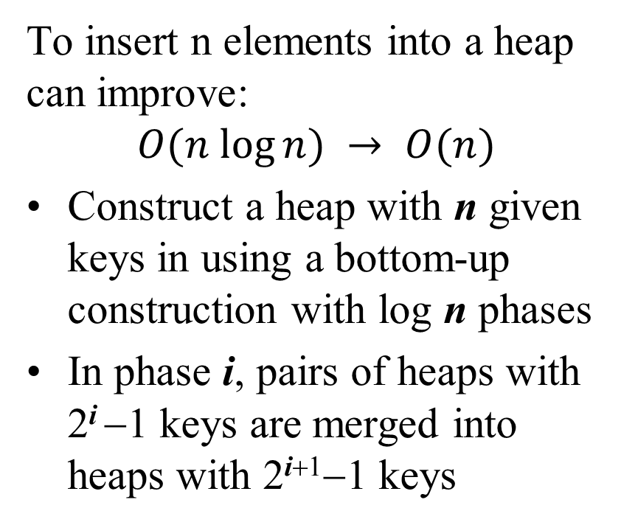
Efficient Heap Construction
To insert n elements into a heap can improve:
$$O(n log⁡n) → O(n)$$
Construct a heap with n given keys in using a bottom-up construction with log n phases
In phase i, pairs of heaps with 2^{i} −1 keys are merged into heaps with 2^{i+1}−1 keys
2^{i} −1
2^{i} −1
2^{i+1}−1

Slide 39
Example
16
15
4
12
6
7
23
20
25
5
11
27
16
15
4
12
6
7
23
20

Slide 40
Example (contd.)
25
5
11
27
16
15
4
12
6
9
23
20
15
4
6
23
16
25
5
12
11
9
27
20

Slide 41
Example (contd.)
7
8
15
4
6
23
16
25
5
12
11
9
27
20
4
6
15
5
8
23
16
25
7
12
11
9
27
20

Slide 42
Example (end)
10
4
6
15
5
8
23
16
25
7
12
11
9
27
20
4
5
6
15
7
8
23
16
25
10
12
11
9
27
20

Slide 43
Analysis
Since each node is traversed by at most two proxy paths, the total number of nodes of the proxy paths is O(n)
Thus, bottom-up heap construction runs in O(n) time
Bottom-up heap construction is faster than n successive insertions and speeds up the first phase of heap-sort

Slide 44
Robert Floyd Algorithm
3
2
We are given two two heaps and a key k
We create a new heap with the root node storing k and with the two heaps as subtrees
We perform downheap to restore the heap-order property
8
5
4
6
7
3
2
8
5
4
6
2
3
4
8
5
7
6

Slide 45
Robert Floyd Algorithm – Continued
Organizing Arrays as Heaps (continued)
A bottom-up approach that starts by forming small heaps and merging them into larger heaps was proposed by Robert Floyd
The algorithm follows:
FloydAlgorithm(data[])
for i = index of the last nonleaf down to 0
restore the heap property for the tree whose root is
data[i] by calling moveDown(data, i, n-1);

