Slide 1
Search Trees and Balancing
Notes:
# Every module has the following content
* Title (1 slide)
* Table of Contents (1 slide) – where are we in the material?
* Motivation (1 slide) – why do we need this module?
* Anchor Task (1x) – introduce the key problem handled by this module
* Objectives (1x)
* Theory Section (1 subtitle + more slides) or Demo Section (1 subtitle + more slides)
* Summary (1x) * References (1x)

Slide 2
Why care about code on text-based input/output?
Binary Search Trees – node order invariant.
Performance Issues – Skinny vs. Bushy trees
Balancing techniques.
Notes:
* For people who want to become professionals = can create systems that others will use
* For people who like to challenge themselves with difficult problems.
* For highly motivated people who also want to sleep; who take normal course-load, but typically do not work full-time yet.

Slide 3
Ordered Maps
Keys come from a total order
New operations:
Each returns an iterator to an entry:
firstEntry(): smallest key in the map
lastEntry(): largest key in the map
floorEntry(k): largest key ≤ k
ceilingEntry(k): smallest key ≥ k
All return end if the map is empty

Slide 4
Binary Search
Binary search can perform operations get, floorEntry and ceilingEntry on an ordered map implemented by means of an array-based sequence, sorted by key
similar to the high-low game
at each step, the number of candidate items is halved
terminates after O(log n) steps
Example: find(7)
0
1
3
4
5
7
8
9
11
14
16
18
19
l
m
h
0
1
3
4
5
7
8
9
11
14
16
18
19
l
m
h
0
1
3
4
5
7
8
9
11
14
16
18
19
l
m
h
0
1
3
4
5
7
8
9
11
14
16
18
19
l=m =h

Slide 5
Search Tables
A search table is an ordered map implemented by means of a sorted sequence
We store the items in an array-based sequence, sorted by key
We use an external comparator for the keys
Performance:
get, floorEntry and ceilingEntry take O(log n) time, using binary search
get takes O(n) time since in the worst case we have to shift n/2 items to make room for the new item
erase take O(n) time since in the worst case we have to shift n/2 items to compact the items after the removal
The lookup table is effective only for dictionaries of small size or for dictionaries on which searches are the most common operations, while insertions and removals are rarely performed (e.g., credit card authorizations)

Slide 6
Binary Search Trees
A binary search tree is a binary tree storing keys (or key-value entries) at its internal nodes and satisfying the following property:
Let u, v, and w be three nodes such that u is in the left subtree of v and w is in the right subtree of v. We have key(u) ≤ key(v) ≤ key(w)
External nodes do not store items
An inorder traversal of a binary search trees visits the keys in increasing order
6
2
9
1
4
8

Slide 7
Search
Algorithm TreeSearch(k, v)
if v.isExternal ()
return v
if k < v.key()
return TreeSearch(k, v.left())
else if k = v.key()
return v
else { k > v.key() }
return TreeSearch(k, v.right())
To search for a key k, we trace a downward path starting at the root
The next node visited depends on the comparison of k with the key of the current node
If we reach a leaf, the key is not found
Example: get(4):
Call TreeSearch(4,root)
The algorithms for floorEntry and ceilingEntry are similar
<
6
2
>
9
1
4
=
8

Slide 8
Insertion – 1
<
6
Insertion should preserve the Binary Search Tree (BST) ordering property. Also should be fast.
To perform operation put(k, o), we search for key k (using TreeSearch)
Assume k is not already in the tree, and let w be the leaf reached by the search
We insert k at node w and expand w into an internal node
Example: insert 5
2
>
9
1
4
>
8
w
6
2
9
1
4
8
w
5

Slide 9
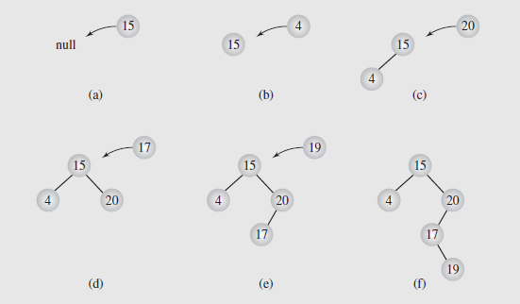
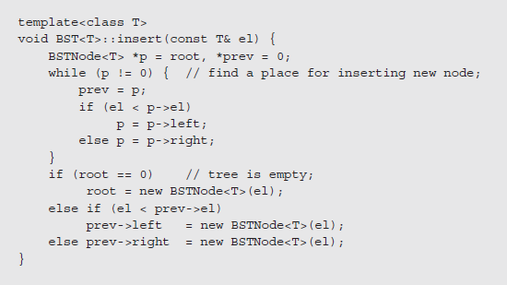
Insertion – 2
Notes:
Searching a binary tree does not modify the tree
Traversals may temporarily modify the tree, but it is usually left in its original form when the traversal is done
Operations like insertions, deletions, modifying values, merging trees, and balancing trees do alter the tree structure
We’ll look at how insertions are managed in binary search trees first
In order to insert a new node in a binary tree, we have to be at a node with a vacant left or right child
This is performed in the same way as searching:
1. Compare the value of the node to be inserted to the current node
2. If the value to be inserted is smaller, follow the left subtree; if it is larger, follow the right subtree
3. If the branch we are to follow is empty, we stop the search and insert the new node as that child
In looking at tree traversal, we considered three approaches: stack-based, thread-based, and via transformations
Stack based traversals don’t change the trees; transformations change the tree but restore it when done
Threaded approaches, though, do modify the tree by adding threads to the structure
While it may be possible to add and remove the threads as needed, if the tree is processed frequently, we might want to make the threads a permanent part of the tree
This requires incorporating threads into the insertion process

Slide 10
Deletion – 1
<
6
To perform operation erase(k), we search for key k
Assume key k is in the tree, and let let v be the node storing k
If node v has a leaf child w, we remove v and w from the tree with operation removeExternal(w), which removes w and its parent
Example: remove 4
2
>
9
1
4
v
8
w
5
6
2
9
1
5
8
Notes:
1. The main approach to handling deleting is called deletion by copying and was proposed by Thomas Hibbard and Donald Knuth in the 1960s
2. Initially, this works much like the merging process
3. We locate the node’s predecessor by searching for the rightmost node in the left subtree
4. The key of this node replaces the key of the node to be deleted
5. We then recall the two simple cases of deletion: if the rightmost node was a leaf, we delete it; if it has one child, we set the parent’s pointer to the node to point to the node’s child
6. This way, we delete a key k₁ by overwriting it by a key k₂ and then deleting the node holding k₂

Slide 11
Deletion – 2
1
v
We consider the case where the key k to be removed is stored at a node v whose children are both internal
we find the internal node w that follows v in an inorder traversal
we copy key(w) into node v
we remove node w and its left child z (which must be a leaf) by means of operation removeExternal(z)
Example: remove 3
3
2
8
6
9
w
5
z
1
v
5
2
8
6
9

Slide 12
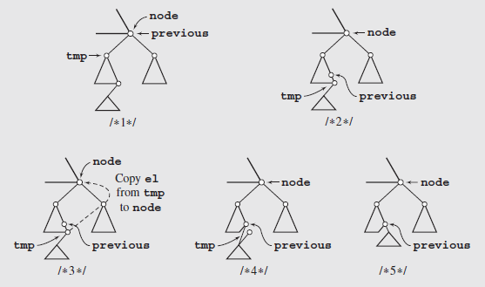
Deletion – 3
Algorithm always deletes the immediate predecessor of the key being replaced, the left subtree can shrink while the right subtree is unchanged, making the algorithm asymmetric.
Eventually the tree becomes unbalanced to the right, and the right subtree is bushier and larger than the left
A simple improvement can make this symmetric; we alternately delete the node’s predecessor from the left subtree and its successor from the right subtree.

Slide 13
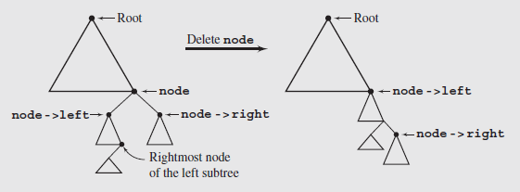
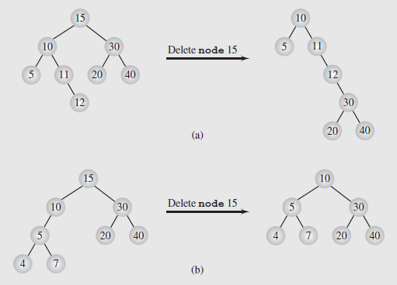
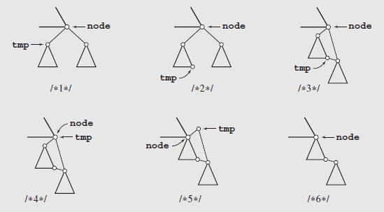
Deletion by Merging (More Asymmetric)
Alternative algorithm to delete nodes.

Slide 14
Performance
Consider an ordered map with n items implemented by means of a binary search tree of height h
the space used is O(n)
methods get, floorEntry, ceilingEntry, put and erase take O(h) time
The height h is O(n) in the worst case and O(log n) in the best case

Slide 15
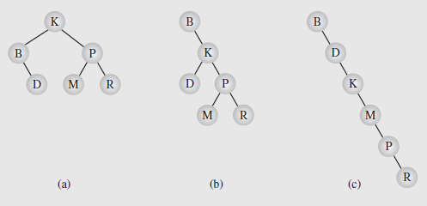
Balancing a Tree
A binary tree is height balanced (or simply, balanced) if the difference in height of the subtrees of any node in the tree is zero or one
It is perfectly balanced if it is balanced and all leaves are on one or two levels
Notes:
Two arguments have been presented in favor of trees:
They represent hierarchical data particularly well
Searching trees is much faster than searching lists
However, this second point depends on the structure of the tree
As we’ve seen, skewed trees search no better than linear lists

Slide 16
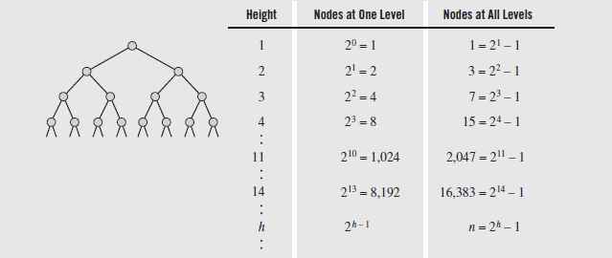

Balancing a Tree (continued)
The number of nodes that can be stored in binary trees of different heights
We see that storing n elements in a perfect tree, the height is $\left\lceil \text{lg}\left(n+1\right)\right\rceil$

Slide 17
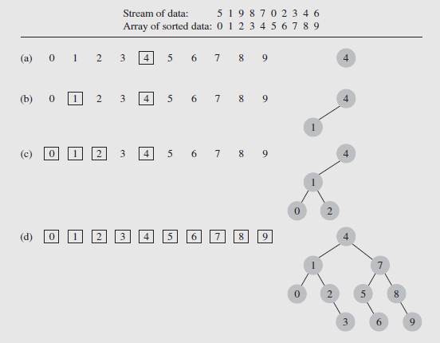
Convert Array To a Balanced Tree
Inspired by the binary search technique on an array: Arriving data is stored in an array, then sorted.
The element in the middle of the array is designated as the root
The elements in the middle of the left and right subarrays become the roots of the left and right subtrees, etc.
Notes:
This algorithm does suffer from one significant drawback
All the data needs to be in the array before the tree can be created
So it can be unsuitable for a tree that needs to be used while it is being constructed
On the other hand, an unbalanced tree can be balanced easily by carrying out an inorder traversal and writing the output to an array
This array can then be used to create a balanced version of the tree

Slide 18
Day-Stout-Warren (DSW) Algorithm
Make tree well-balanced, edit in place (no external sorting, etc.)
One such algorithm by Colin Day and modified by Quentin F. Stout and Bette L. Warren; it is called the DSW algorithm
Idea of rotation, introduced by Adel’son-Vel’skii and Landis in 1962
Two types of rotation can occur, left and right, which are symmetric
rotateRight(Gr, Par, Ch)
if Par is not the root of the tree //i.e.,if Gr is not null
grandparent Gr of child Ch becomes Ch’s parent;
right subtree of Ch becomes left subtree of Ch’s parent Par;
node Ch acquires Par as its right child;
The heart of this process is the third step, when parent and child swap roles
The first and second steps ensure that the tree remains a search tree after the rotation is completed

Slide 19
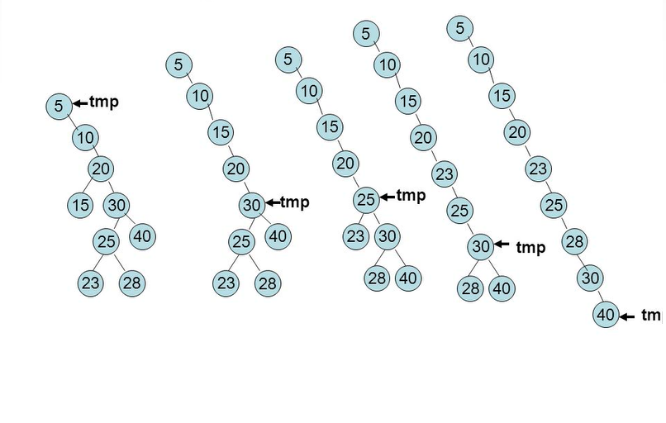
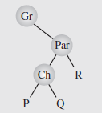
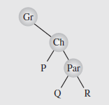
Transform BST into a Backbone
Rotation of Ch around Par
Notes:
The algorithm to create the backbone, which is the first step of the process, is as follows:
createBackbone(root)
tmp = root;
while (tmp != 0)
if tmp has a left child
rotate this child about tmp; // hence the left child
// becomes parent of tmp
set tmp to the child that just became parent;
else set tmp to its right child;

Slide 20
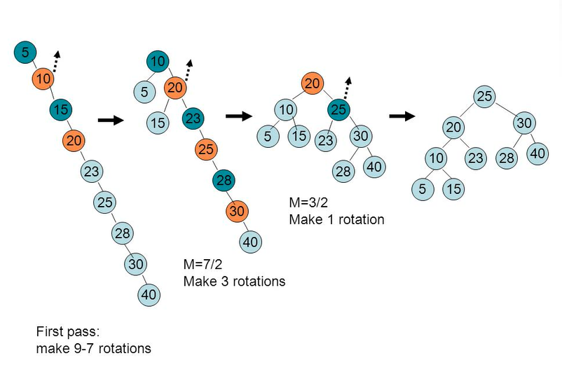
Transform Backbone into a Balanced BST
Do various numbers of rotations to achieve balanced form.
Notes:
In the second step of the transformation, the backbone is transformed into a perfectly balanced tree
In each pass down the backbone, every second node is rotated about its parent
The first pass handles the difference between the number of nodes in the backbone and the number of nodes in the closest complete binary tree
Overflowing nodes are treated separately

Slide 21
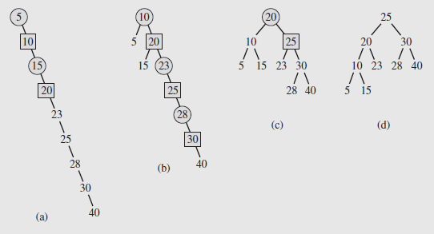
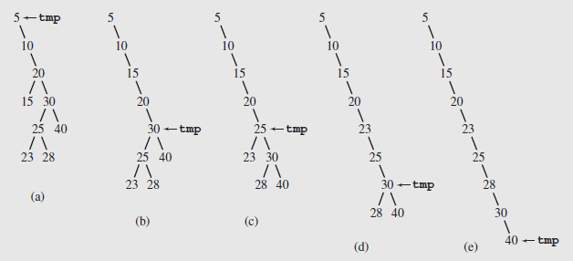
Balancing a Tree (continued)
In these diagrams, the nodes being promoted one level by left rotations are shown as squares
The circles are the parents about which they are rotated

Slide 22
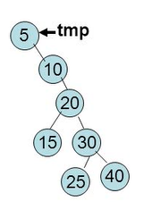
Exercise on DSW Algorithm
Transform this into a backbone.
Then create a perfect, balanced Binary Search Tree.

Slide 23
AVL Tree Definition
Georgij Adelson-Velski + Evgeny Landis (1962)
AVL trees are balanced
An AVL Tree is a binary search tree such that for every internal node v of T, the heights of the children of v can differ by at most 1
An example of an AVL tree where the heights are shown next to the nodes:

Slide 24
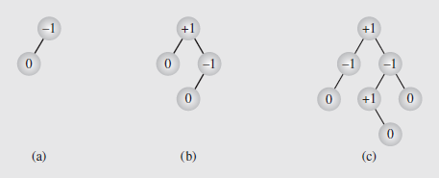
AVL Trees (Adjust when Editing)
An AVL tree (also called an admissible tree) is one where the height of the left and right subtrees of every node differ by at most one
Numbers in the nodes are the balance factors, which is the difference between the height of the right and left subtrees and should be +1, 0, or -1 for AVL trees
In addition, the process of balancing an AVL tree does not guarantee a perfectly balanced tree

Slide 25
Height of an AVL Tree
Fact: The height of an AVL tree storing n keys is O(log n).
Proof: Let us bound n(h): the minimum number of internal nodes of an AVL tree of height h.
We easily see that n(1) = 1 and n(2) = 2
For n > 2, an AVL tree of height h contains the root node, one AVL subtree of height n-1 and another of height n-2.
That is, n(h) = 1 + n(h-1) + n(h-2)
Knowing n(h-1) > n(h-2), we get n(h) > 2n(h-2). So
n(h) > 2n(h-2), n(h) > 4n(h-4), n(h) > 8n(n-6), … (by induction),
n(h) > 2^{i}n(h-2i)
Solving the base case we get: n(h) > 2 ^{h/2-1}
Taking logarithms: h < 2log n(h) +2
Thus the height of an AVL tree is O(log n)
n(2)
3
4
n(1)

Slide 26
Restructuring (as Single Rotations)
Single Rotations:

Slide 27
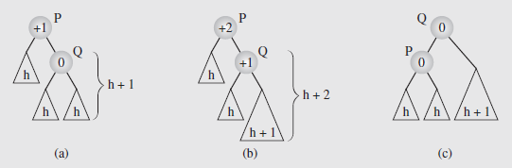
Balancing an unbalanced AVL Tree – 1
Balancing a tree after insertion of a node in the right subtree of node Q
The subtrees involved in the rotation have their heights indicated
After a new node is inserted somewhere in the right subtree of Q to unbalance the tree, Q rotates around is parent P to rebalance the tree

Slide 28
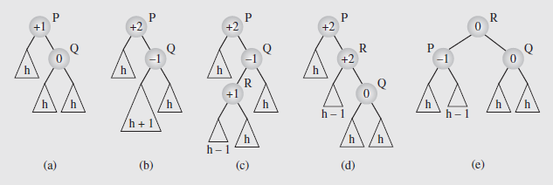
Balancing an unbalanced AVL Tree – 2
The imbalance is solved by a double rotation:
first R around Q (Fig (d)),
then R around P (Fig (e))

Slide 29
Restructuring (as Double Rotations)
double rotations:

Slide 30
Balancing an AVL Tree after Insert – 1
unbalanced...
T
4
1
44
2
3
x
17
y
62
z
1
2
2
32
50
78
1
1
1
...balanced
48
54
88
T
2
T
0
T
1
T
3

Slide 31
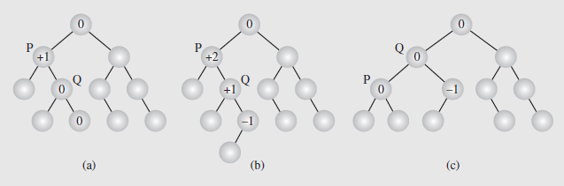
Balancing an AVL Tree after Insert – 2
A node is inserted and the resulting updates cause a node to become imbalanced

Slide 32
Show Delete Step by Step
Let z be the first unbalanced node encountered while travelling up the tree from w. Also, let y be the child of z with the larger height, and let x be the child of y with the larger height
We perform restructure(x) to restore balance at z
As this restructuring may upset the balance of another node higher in the tree, we must continue checking for balance until the root of T is reached
62
a=z
44
w
b=y
44
78
17
62
c=x
17
50
88
50
78
48
54
48
54
88

Slide 33
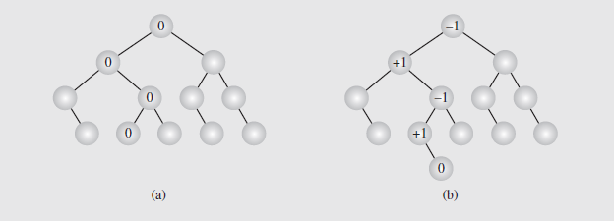
Balancing an AVL Tree after Delete – 1
Deleting a node may require more work
The deleteByCopying()algorithm is applied to delete the node
The balance factors of all nodes from the parent of the deleted node to the root are then updated
Each node whose balance factor becomes ± 2 will be rebalanced

Slide 34
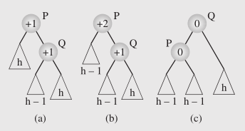
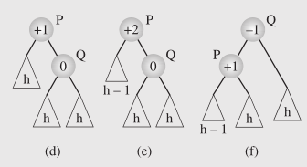
Balancing an AVL Tree after Delete – 2
In the first case, P’s balance factor is +1, and its right child, Q, is also at +1; this is shown in (a). Deleting a node from P’s left child leads to the tree in Figure (b), with P at +2; this is rebalanced by rotating P around Q, Figure (c)
In the second case, P’s balance factor is +1, and its right child, Q, is 0; Figure (d). Deleting a node from P’s left child leads to the tree in Figure (e), with P at +2; this is rebalanced as in the first case by rotating P around Q, Figure (f).

Slide 35
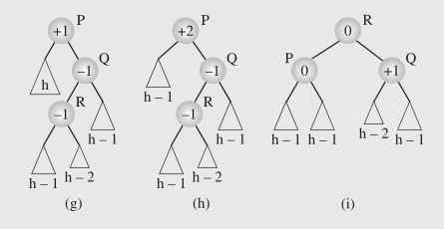
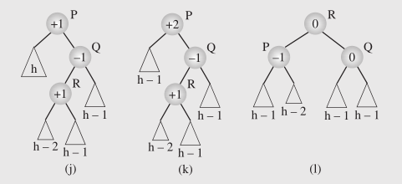
Balancing an AVL Tree after Delete – 3
The third case arises when the left subtree of Q, rooted at R, has a balance factor of -1 (g). Rebalancing after deletion requires a double rotation; first of R about Q and then of R about P, Figures (h) and (i).
The fourth case is similar to the third, but differs in that the balance factor of R is +1, rather than -1. However, rebalancing can be done with the same two rotations as the third case.

Slide 36
AVL Tree Performance
a single restructure takes O(1) time
using a linked-structure binary tree
find takes O(log n) time
height of tree is O(log n), no restructures needed
put takes O(log n) time
initial find is O(log n)
Restructuring up the tree, maintaining heights is O(log n)
erase takes O(log n) time
initial find is O(log n)
Restructuring up the tree, maintaining heights is O(log n)
6
v
3
8
z
4

Slide 37
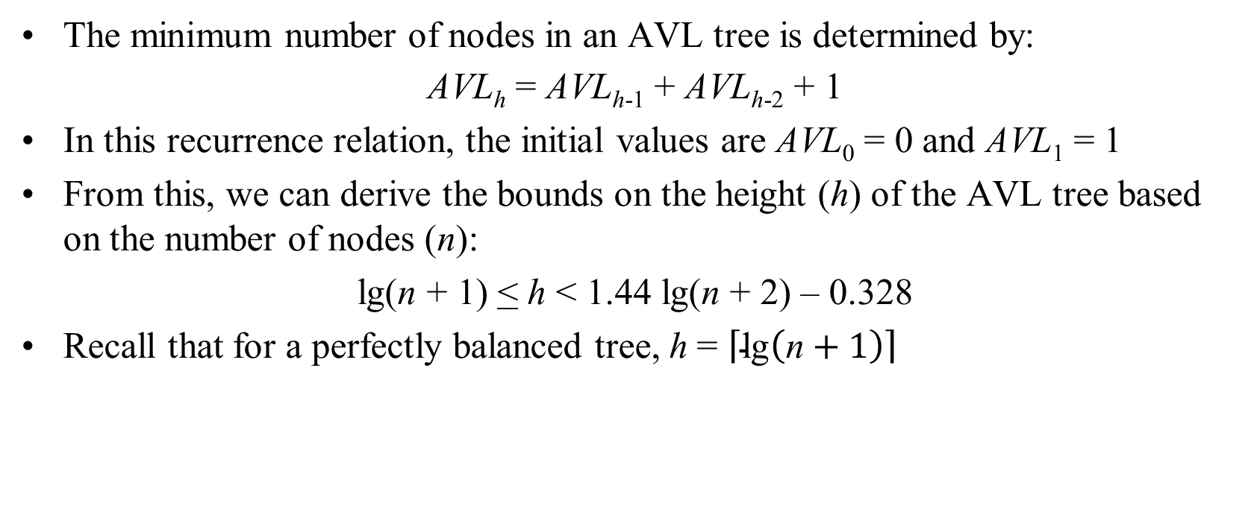
Balancing a Tree (continued)
The minimum number of nodes in an AVL tree is determined by:
AVL_{h} = AVL_{h-1} + AVL_{h-2} + 1
In this recurrence relation, the initial values are AVL₀ = 0 and AVL₁ = 1
From this, we can derive the bounds on the height (h) of the AVL tree based on the number of nodes (n):
lg(n + 1) < h < 1.44 lg(n + 2) – 0.328
Recall that for a perfectly balanced tree, h = $\left\lceil \text{lg}\left(\text{n}+1\right)\right\rceil$

Slide 38
Multi-Way Search Tree
A multi-way search tree is an ordered tree such that
Each internal node has at least two children and stores d −1 key-element items (k_{i}, o_{i}), where d is the number of children
For a node with children v₁ v₂ … v_{d} storing keys k₁ k₂ … k_{d−1}
keys in the subtree of v₁ are less than k₁
keys in the subtree of v_{i} are between k_{i−1} and k_{i} (i = 2, …, d − 1)
keys in the subtree of v_{d} are greater than k_{d−1}
The leaves store no items and serve as placeholders
11 24
2 6 8
15
27 32
30

Slide 39
Multi-Way Inorder Traversal
We can extend the notion of inorder traversal from binary trees to multi-way search trees
Namely, we visit item (k_{i}, o_{i}) of node v between the recursive traversals of the subtrees of v rooted at children v_{i} and v_{i} ₊ ₁
An inorder traversal of a multi-way search tree visits the keys in increasing order
11 24
8
12
2 6 8
15
27 32
2
4
6
10
14
18
30
1
3
5
7
9
11
13
16
19
Leaves are visited, but produce no output during inorder traversal.
15
17

Slide 40
Multi-Way Searching
Similar to search in a binary search tree
A each internal node with children v₁ v₂ … v_{d} and keys k₁ k₂ … k_{d−1}
k = k_{i} (i = 1, …, d − 1): the search terminates successfully
k < k₁: we continue the search in child v₁
k_{i−1} < k < k_{i} (i = 2, …, d − 1): we continue the search in child v_{i}
k > k_{d−1}: we continue the search in child v_{d}
Reaching an external node terminates the search unsuccessfully
Example: search for 30
11 24
2 6 8
15
27 32
30

Slide 41
(2,4) Trees
A (2,4) tree (also called 2-4 tree or 2-3-4 tree) is a multi-way search with the following properties
Node-Size Property: every internal node has at most four children
Depth Property: all the external nodes have the same depth
Depending on the number of children, an internal node of a (2,4) tree is called a 2-node, 3-node or 4-node
10 15 24
2 8
12
18
27 32

Slide 42
Height of a (2,4) Tree
Theorem: A (2,4) tree storing n items has height O(log n)
Proof:
Let h be the height of a (2,4) tree with n items
Since there are at least 2^{i} items at depth i = 0, … , h − 1 and no items at depth h, we have n ≥ 1 + 2 + 4 + … + 2^{h−1} = 2^{h} − 1
Thus, h ≤ log (n + 1)
Searching in a (2,4) tree with n items takes O(log n) time
depth
items
0
1
1
2
h−1
2^{h−1}
h
0

Slide 43
Insertion
We insert a new item (k, o) at the parent v of the leaf reached by searching for k
We preserve the depth property but
We may cause an overflow (i.e., node v may become a 5-node)
Example: inserting key 30 causes an overflow
10 15 24
v
2 8
12
18
27 32 35
10 15 24
v
2 8
12
18
27 30 32 35

Slide 44
Overflow and Split
We handle an overflow at a 5-node v with a split operation:
let v₁ … v₅ be the children of v and k₁ … k₄ be the keys of v
node v is replaced nodes v' and v"
v' is a 3-node with keys k₁ k₂ and children v₁ v₂ v₃
v" is a 2-node with key k₄ and children v₄ v₅
key k₃ is inserted into the parent u of v (a new root may be created)
The overflow may propagate to the parent node u
u
u
15 24
15 24 32
v
v'
v"
12
18
27 30 32 35
12
18
27 30
35
v₁
v₂
v₃
v₄
v₅
v₁
v₂
v₃
v₄
v₅

Slide 45
Analysis of Insertion
Algorithm put(k, o)
1. We search for key k to locate the insertion node v
2. We add the new entry (k, o) at node v
3. while overflow(v)
if isRoot(v)
create a new empty root above v
v ← split(v)
Let T be a (2,4) tree with n items
Tree T has O(log n) height
Step 1 takes O(log n) time because we visit O(log n) nodes
Step 2 takes O(1) time
Step 3 takes O(log n) time because each split takes O(1) time and we perform O(log n) splits
Thus, an insertion in a (2,4) tree takes O(log n) time

Slide 46
Deletion
We reduce deletion of an entry to the case where the item is at the node with leaf children
Otherwise, we replace the entry with its inorder successor (or, equivalently, with its inorder predecessor) and delete the latter entry
Example: to delete key 24, we replace it with 27 (inorder successor)
10 15 24
2 8
12
18
27 32 35
10 15 27
2 8
12
18
32 35

Slide 47
Underflow and Fusion
Deleting an entry from a node v may cause an underflow, where node v becomes a 1-node with one child and no keys
To handle an underflow at node v with parent u, we consider two cases
Case 1: the adjacent siblings of v are 2-nodes
Fusion operation: we merge v with an adjacent sibling w and move an entry from u to the merged node v'
After a fusion, the underflow may propagate to the parent u
u
u
9 14
9
w
v
v'
2 5 7
10
2 5 7
10 14

Slide 48
Underflow and Transfer
To handle an underflow at node v with parent u, we consider two cases
Case 2: an adjacent sibling w of v is a 3-node or a 4-node
Transfer operation:
1. we move a child of w to v
2. we move an item from u to v
3. we move an item from w to u
After a transfer, no underflow occurs
u
u
4 9
4 8
w
v
w
v
2
6 8
2
6
9

Slide 49
Analysis of Deletion
Let T be a (2,4) tree with n items
Tree T has O(log n) height
In a deletion operation
We visit O(log n) nodes to locate the node from which to delete the entry
We handle an underflow with a series of O(log n) fusions, followed by at most one transfer
Each fusion and transfer takes O(1) time
Thus, deleting an item from a (2,4) tree takes O(log n) time

Slide 50
Comparison of Map Implementations
 | Find | Put | Erase | Notes
Hash Table | 1 expected | 1 expected | 1 expected | no ordered map methods simple to implement
Skip List | log n high prob. | log n high prob. | log n high prob. | randomized insertion simple to implement
AVL and (2,4) Tree | log n worst-case | log n worst-case | log n worst-case | complex to implement

Slide 51
From (2,4) to Red-Black Trees
A red-black tree is a representation of a (2,4) tree by means of a binary tree whose nodes are colored red or black
In comparison with its associated (2,4) tree, a red-black tree has
same logarithmic time performance
simpler implementation with a single node type
4
3 5
2 6 7
4
5
3
6
OR
3
5
2
7

Slide 52
Red-Black Trees
A red-black tree can also be defined as a binary search tree that satisfies the following properties:
Root Property: the root is black
External Property: every leaf is black
Internal Property: the children of a red node are black
Depth Property: all the leaves have the same black depth
9
4 9
4
15
2
6 7
12 15 21
2
6
12
21
7

Slide 53
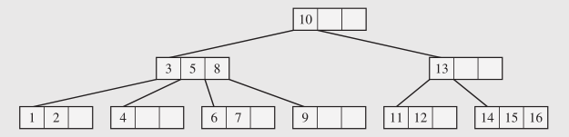
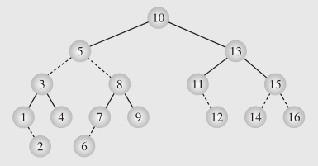
Another View on Red-Black Trees
Convert (2,4)-tree into a binary tree.
Continuous edge – between two (2,4)-nodes.
Dashed edge – inside the same (2,4)-node.
A node is red iff it connects to its parent with a dashed edge. (Drozdek p.341)

Slide 54
Height of a Red-Black Tree
Theorem: A red-black tree storing n entries has height O(log n)
Proof:
The height of a red-black tree is at most twice the height of its associated (2,4) tree, which is O(log n)
The search algorithm for a binary search tree is the same as that for a binary search tree
By the above theorem, searching in a red-black tree takes O(log n) time

Slide 55
Insertion
To perform operation put(k, o), we execute the insertion algorithm for binary search trees and color red the newly inserted node z unless it is the root
We preserve the root, external, and depth properties
If the parent v of z is black, we also preserve the internal property and we are done
Else (v is red ) we have a double red (i.e., a violation of the internal property), which requires a reorganization of the tree
Example where the insertion of 4 causes a double red:
6
6
v
v
3
8
3
8
z
z
4

Slide 56
Remedying a Double Red
Consider a double red with child z and parent v, and let y be the sibling of v
Case 1: y is black
The double red is an incorrect replacement of a 4-node
Restructuring: we change the 4-node replacement
Case 2: y is red
The double red corresponds to an overflow
Recoloring: we perform the equivalent of a split
w
4
v
w
4
v
2
z
7
2
z
7
6
6
4 6 7
2 4 6 7
.. 2 ..

Slide 57
Restructuring – 1
A restructuring remedies a child-parent double red when the parent red node has a black sibling
It is equivalent to restoring the correct replacement of a 4-node
The internal property is restored and the other properties are preserved
z
4
6
w
v
v
2
7
4
7
z
w
6
2
4 6 7
4 6 7
.. 2 ..
.. 2 ..

Slide 58
Restructuring – 2
There are four restructuring configurations depending on whether the double red nodes are left or right children
2
6
6
2
6
2
4
4
4
4
2
6
4
2
6

Slide 59
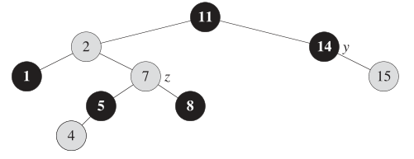
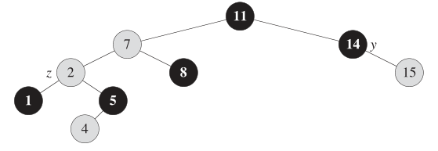
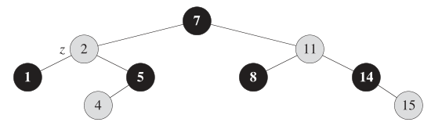
Restructuring Example

Slide 60
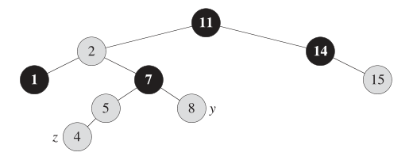
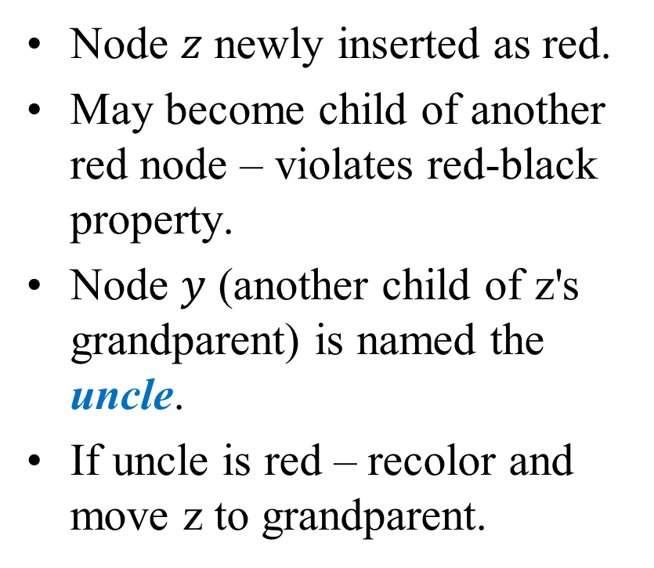
Recoloring Below the Root
Node $z$ newly inserted as red.
May become child of another red node – violates red-black property.
Node $y$ (another child of z's grandparent) is named the uncle.
If uncle is red – recolor and move z to grandparent.

Slide 61
Recoloring at the Root
A recoloring remedies a child-parent double red when the parent red node has a red sibling
The parent v and its sibling w become black and the grandparent u becomes red, unless it is the root
It is equivalent to performing a split on a 5-node
The double red violation may propagate to the grandparent u
w
4
v
w
4
v
2
z
7
2
z
7
6
6
4
2 4 6 7
2
6 7

Slide 62
Analysis of Insertion
Algorithm put(k, o)
1. We search for key k to locate the insertion node z
2. We add the new entry (k, o) at node z and color z red
3. while doubleRed(z)
if isBlack(sibling(parent(z)))
z ← restructure(z)
return
else { sibling(parent(z) is red }
z ← recolor(z)
Recall that a red-black tree has O(log n) height
Step 1 takes O(log n) time because we visit O(log n) nodes
Step 2 takes O(1) time
Step 3 takes O(log n) time because we perform
O(log n) recolorings, each taking O(1) time, and
at most one restructuring taking O(1) time
Thus, an insertion in a red-black tree takes O(log n) time

Slide 63
Deletion
To perform operation erase(k), we first execute the deletion algorithm for binary search trees
Let v be the internal node removed, w the external node removed, and r the sibling of w
If either v of r was red, we color r black and we are done
Else (v and r were both black) we color r double black, which is a violation of the internal property requiring a reorganization of the tree
Example where the deletion of 8 causes a double black:
6
6
v
r
3
8
3
r
w
4
4

Slide 64
Remedying a Double Black
The algorithm for remedying a double black node w with sibling y considers three cases
Case 1: y is black and has a red child
We perform a restructuring, equivalent to a transfer , and we are done
Case 2: y is black and its children are both black
We perform a recoloring, equivalent to a fusion, which may propagate up the double black violation
Case 3: y is red
We perform an adjustment, equivalent to choosing a different representation of a 3-node, after which either Case 1 or Case 2 applies
Deletion in a red-black tree takes O(log n) time

Slide 65
Red-Black Tree Reorganization
Insertion | remedy double red
Red-black tree action | (2,4) tree action | result
restructuring | change of 4-node representation | double red removed
recoloring | split | double red removed or propagated up
Deletion | remedy double black
Red-black tree action | (2,4) tree action | result
restructuring | transfer | double black removed
recoloring | fusion | double black removed or propagated up
adjustment | change of 3-node representation | restructuring or recoloring follows

