Slide 1
Chapter 1
An Overview of Computers and Programming Languages

Slide 2
Objectives
In this chapter, you will:
Explore the hardware and software components of a computer system
Learn about the evolution of programming languages
Examine high-level programming languages
Describe what a compiler is and what it does
Examine a C++ program
Explore how a C++ program is processed
Learn what an algorithm is and explore problem-solving techniques
Become aware of Standard C++, C++17, etc.

Slide 3
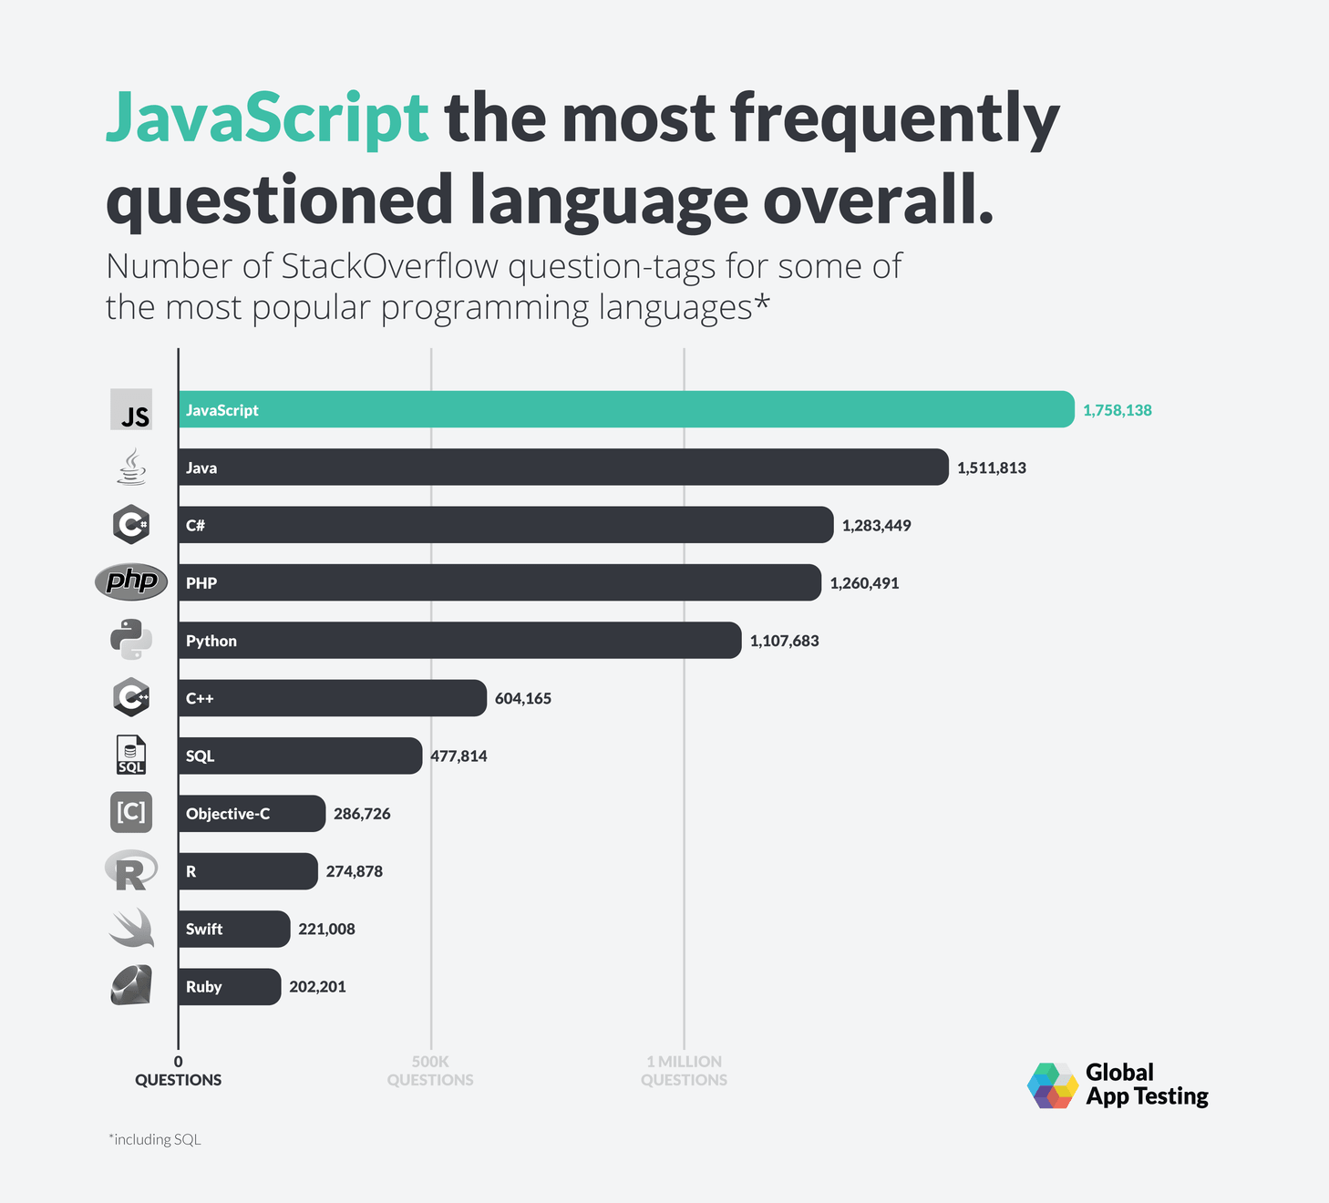
Introduction
Computer has hardware and software.
Without software, a computer is useless
Software is developed with programming languages, including C++

Slide 4
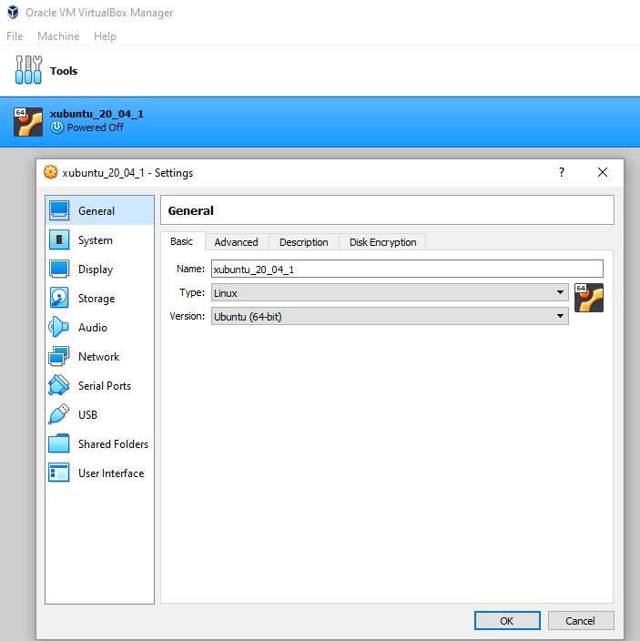
Hardware
Central processing unit (CPU)
Main memory (MM) or random access memory (RAM)
Secondary storage
Input/output devices

Slide 5
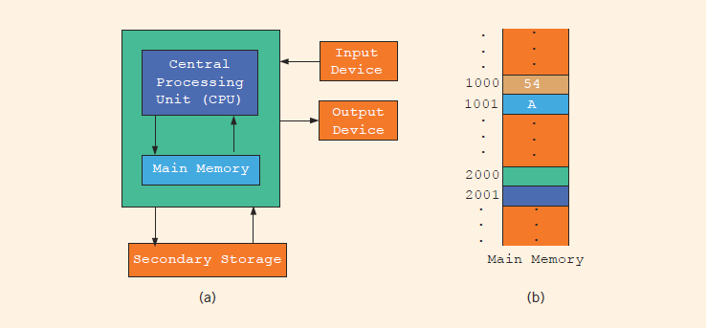
CPU and RAM
Hardware components of a computer and main memory
Notes:
Random access memory (or main memory) is directly connected to the CPU
All programs must be loaded into main memory before they can be executed
All data must be brought into main memory before it can be manipulated
When computer power is turned off, everything in main memory is lost
Main memory is an ordered sequence of memory cells
Each cell has a unique location in main memory, called the address of the cell
Each cell can contain either a programming instruction or data

Slide 6
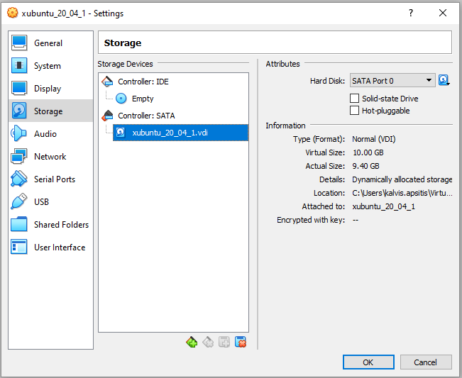
More Hardware: Disks and I/O
Input devices feed data and programs into computers: Keyboard, Mouse, Scanner, Camera
Output devices display results: Monitor, Printer
Secondary storage: device that stores information permanently: Hard disks etc. Secondary storage can be both input and output device.

Slide 7
Software
Software are programs written to perform specific tasks
System programs control the computer
Operating system monitors the overall activity of the computer and provides services such as: Memory management, Input/Output, Hardware drivers.
Application programs perform a specific task. (Unlike OS they are meant to run for a certain time and their resources are managed by the Operating System.)
Some application-type programs are services – they may run continuously and serve clients. (In this course we care about algorithms with finite execution.)

Slide 8
What is in Computer Memory
Byte: a sequence of eight bits
Kilobyte (KB): 2¹⁰ bytes = 1024 bytes. Also – Kibibyte (KiB).
Megabyte (MB): 2²⁰ bytes. Also – Mibibyte (MiB).
ASCII Table
128 characters (only 7 bits are needed).
A is encoded as 1000001 (the 65th character in 0-based counting)
The character 3 is encoded as 0110011 (51st character)
Number systems
The decimal system (base 10) is used in our daily life
The computer uses the binary (or base 2) number system

Slide 9
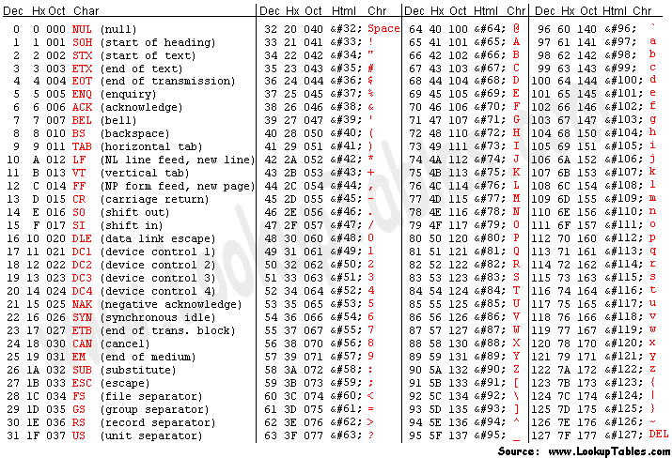

Slide 10
Binary Units
Unit | Symbol | Bits/Bytes
Byte |  | 8 bits
Kilobyte | KB | 2¹⁰ bytes = 1024 bytes
Megabyte | MB | 10²⁴ KB = 2¹⁰ KB = 2²⁰ bytes = 1,048,576 bytes
Gigabyte | GB | 10²⁴MB = 2¹⁰ MB = 2³⁰ bytes = 1,073,741,824 bytes
Terabyte | TB | 10²⁴ GB = 2¹⁰ GB = 2⁴⁰ bytes = 1,099,511,627,776 bytes
Petabyte | PB | 10²⁴ TB = 2¹⁰ TB = 2⁵⁰ bytes = 1,125,899,906,842,624 bytes
Exabyte | EB | 10²⁴ PB = 2¹⁰ PB = 2⁶⁰ bytes = 1,152,921,504,606,846,976 bytes
Zettabyte | ZB | 10²⁴ EB5 2¹⁰ EB = 270 bytes = 1,180,591,620,717,411,303,424 bytes

Slide 11
The Language of a Computer
Unicode is another coding scheme
65,536 characters
Two bytes (16 bits) to store a character. (Ofetn Unicode is encoded using variable length codes for its characters 1-3 bytes per character.)
To interpret physical bytes (in some file) as Unicode you would need to know encoding (such as UTF-8, Cp1257 or Baltic Windows etc.).
In this course we will mostly use ASCII character set to avoid this mess.

Slide 12
Processing a C++ Program
#include <iostream>
using namespace std;
int main()
{
cout << "My first C++ program." << endl;
return 0;
}
Sample Run:
My first C++ program.

Slide 13
Processing a C++ Program (3 of 4)
IDEs are quite user friendly
Compiler identifies the syntax errors and also suggests how to correct them
Build or Rebuild is a simple command that links the object code with the resources used from the IDE

Slide 14
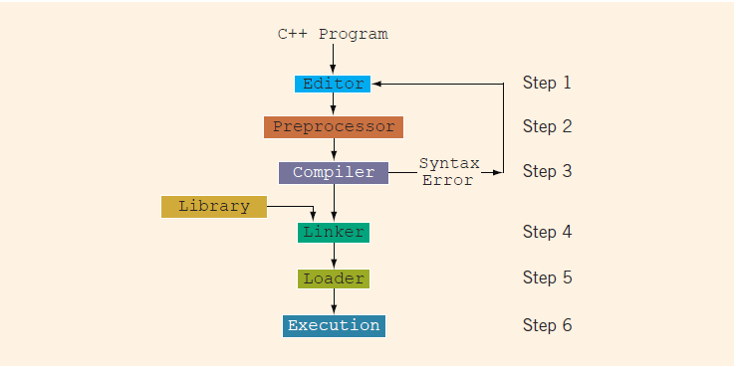
Processing a C++ Program
Notes:
Steps needed to process a C++ program
Use a text editor to create the source code (source program) in C++
Include preprocessor directives
Begin with the symbol # and are processed by the preprocessor
Use the compiler to:
Check that the program obeys the language rules
Translate the program into machine language (object program)
Use an integrated development environment (IDE) to develop programs in a high-level language
Programs such as mathematical functions are available
The library contains prewritten code you can use
A linker combines object program with other programs in the library to create executable code
The loader loads executable program into main memory
The last step is to execute the program

Slide 15
Analysis–Coding–Execution
Once compiled and linked, the loader can place program into main memory for execution
The final step is to execute the program
Compiler guarantees that the program follows the rules of the language
Does not guarantee that the program will run correctly

Slide 16
ANSI/ISO Standard C++
C++ evolved from C
C++ designed by Bjarne Stroustrup at Bell Laboratories in early 1980s.
In mid-1998, ANSI/ISO C++ language standards were approved
C++17, was approved in 2017. (New standard every 3 years).

Slide 17
Quick Review
Computers are electronic devices to do arithmetic and logical operations
A computer system has hardware (CPU, RAM, Storage and various I/O devices) and software components
Compiler: translates high-level language into machine code
Algorithm - Step-by-step problem-solving process, Arrives at a solution in a finite amount of time
Problem-solving process – Analyze, Code, Execute (rinse and repeat).

