Slide 1
Chapter 2
Elements of C++ Language

Slide 2
Objectives
In this chapter, you will:
Use basic elements including functions, special symbols, and identifiers
Explore simple data types and arithmetic operators
Introduce string data type
Use assignment statements
Learn about variable declaration
Use Input/Output statements
Use Preprocessor directives.

Slide 3
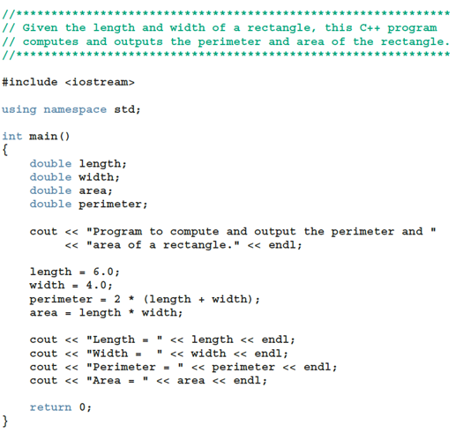
A Quick Look at a C++ Program (1 of 5)
Can have hardcoded variable values.
Declaration differs from Definition.
Should always initialize variables (originally they contain garbage).

Slide 4
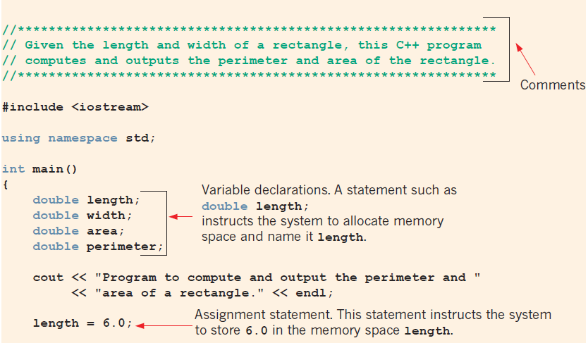
A Quick Look at a C++ Program (3 of 5)

Slide 5

A Quick Look at a C++ Program (4 of 5)

Slide 6
Comments
Comments ignored by the compiler
Two types
Single line: begins with //
//**************************************************************
// Given the length and width of a rectangle, this C++ program
// computes and outputs the perimeter and area of the rectangle.
//**************************************************************
Multiple line: enclosed between /* and */
/*
You can include comments that can
occupy several lines.
*/

Slide 7
Special Symbols
A token is the smallest individual unit of a program written in any language
C++ tokens include special symbols, word symbols, and identifiers
Special symbols in C++ include:
+ - * /
. ; ? ,
<= != == >=

Slide 8
Reserved Words (Keywords)
Reserved word symbols. Cannot be used to name variables.
int
float
double
char
const
void
return

Slide 9
Identifiers (1 of 2)
An identifier is the name of something that appears in a program
Consists of letters, digits, and the underscore character (_)
Must begin with a letter or underscore
C++ is case sensitive
NUMBER is not the same as number
Two predefined identifiers are cout and cin
Unlike reserved words, predefined identifiers may be redefined, but it is not a good idea

Slide 10
Identifiers
Legal identifiers in C++
first
conversion
payRate
pay_rate
__name__
Illegal Identifier | Reason | A Correct Identifier
employee Salary | There can be no space between employee and Salary. | employeeSalary
Hello! | The exclamation mark cannot be used in an identifier. | Hello
one+two | The symbol + cannot be used in an identifier. | onePlusTwo
2nd | An identifier cannot begin with a digit. | second

Slide 11
Whitespaces
Every C++ program contains whitespaces (spaces, tabs, newlines)
Whitespaces separate special symbols, reserved words, and identifiers
Proper utilization of whitespaces is important
Can be used to make the program more readable

Slide 12
Simple Data Types (1 of 2)
Three categories of simple data
Integral: integers (numbers without a decimal)
Can be further categorized: char, short, int, long, bool, unsigned char, unsigned short, unsigned int, unsigned long
Floating-point: decimal numbers
Enumeration: a user-defined data type

Slide 13
Simple Data Types (2 of 2)
Different compilers may allow different ranges of values
Data Type | Values | Storage (in bytes)
int | –147483648 (= –2³¹ ) to 2147483647 (= 2³¹ – 1) | 4
bool | true and false | 1
char | –128 (= –2⁷ ) to 127 (= 2⁷ – 1) | 1
long long | –9223372036854775808 (–2⁶³ ) to 9223372036854775807(2⁶³ – 1) | 64

Slide 14
int Data Type
Examples
-6728
0
78
+763
Positive integers do not require a + sign
A comma cannot be used within an integer
Commas are only used for separating items in a list

Slide 15
bool Data Type
bool type
Two values: true and false
Purpose: to manipulate logical (Boolean) expressions
true and false
Logical values
bool, true, and false
Reserved words

Slide 16
char Data Type
Data type char is the smallest integral data type
It is used for single characters: letters, digits, and special symbols
Each character is enclosed in single quotes
'A', 'a', '0', '*', '+', '$', '&'
A blank space is a character
Written ' ', with a space left between the single quotes

Slide 17
Floating-Point Types – 1
C++ uses scientific notation to represent real numbers (floating-point notation)
Decimal Number | Scientific Notation | C++ Floating-Point Notation
75.924 | 7.5924 * 10¹ | 7.592400E1
0.18 | 1.8 * 10⁻¹ | 1.800000E-1
0.0000453 | 4.53 * 10⁻⁵ | 4.530000E-5
–1.482 | -1.482 * 10⁰ | -1.482000E0
7800.0 | 7.8 * 10³ | 7.800000E3

Slide 18
Floating-Point Types – 2
float: represents any real number
Range: -3.4 * 10³⁸ to 3.4 * 10³⁸ (four bytes)
double: represents any real number
Range: –1.7 * 10³⁰⁸ to 1.7 * 10³⁰⁸ (eight bytes)
Max significant digits (decimal places) for float values: 6 or 7
Max significant digits for double: 15
float values are called single precision
double values are called double precision
(Not universally true. Precision/min/max of data types are system dependent.)

Slide 19
Types, Variables, and Assignments
To declare a variable, must specify its data type
Syntax rule to declare a variable is:
dataType identifier;
Examples include:
int counter;
double interestRate;
char grade;
Assignment statement has the form: variable = expression
Example: interestRate = 0.05;

Slide 20
Order of Precedence
All operations inside () are evaluated first
*, /, and % (remainder) are at the same level of precedence
+ and - have the same level of precedence and are evaluated last
For same precedence - operations are done from left to right (associativity):
3 * 7 - 6 + 2 * 5 % 4 + 6 means (((3 * 7) – 6) + ((2 * 5) % 4 )) + 6

Slide 21
Expressions
Integral expression: all operands are integers
Yields an integral result
Example: 2 + 3 * 5
Floating-point (decimal) expression: all operands are floating-point
Yields a floating-point result
Example: 12.8 * 17.5 - 34.50
Examples of mixed expressions
2 + 3.5
6 / 4 + 3.9
5.4 * 2 – 13.6 + 18 / 2
If operator has both types of operands, integers change to floats.

Slide 22
string Type
Data type string is a programmer-defined type supplied in ANSI/ISO Standard C++ library
A string is a sequence of zero or more characters enclosed in double quotation marks
A null (or empty) string is a string with no characters
Each character has a relative position in the string
Position of first character is 0
The length of a string is the number of characters in it
Example: length of "William Jacob" is 13

Slide 23

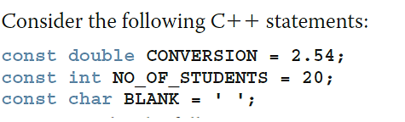
Constants vs. Variables
Named constant: memory location whose content cannot change during execution
Syntax to declare a named constant
In C++, const is a reserved word

Slide 24
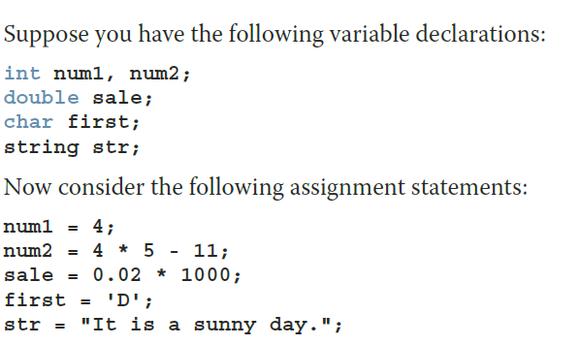
Assignment Statement – 1
A variable is said to be initialized the first time a value is placed into it
In C++, = is called the assignment operator

Slide 25
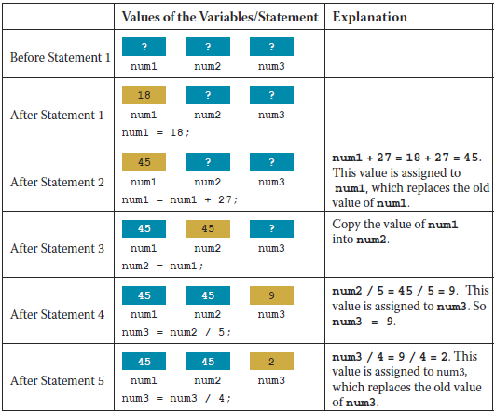
Assignment Statement – 2
Note the uninitialized variables (?).
Integer division does not give float result.
9/4 equals 2 (int)
9.0/4 equals 2.25 (double)

Slide 26
Assignment Statement – 3
Given int variables x, y, and z. How is this legal C++ statement evaluated?
x = y = z
The assignment operator is evaluated from right to left
The associativity of the assignment operator is from right to left

Slide 27
Assignment Statement – 4
Simple and compound assignment operators
Compound operators more concise
Compound operators: +=, -=, *=, /=, %=
Simple assignment operator
x = x * y;
Compound assignment operator
x *= y;

Slide 28
Declaring and Initializing Variables
Not all types of variables are initialized automatically
Variables can be initialized when declared:
int first = 13, second = 10;
char ch = ' ';
double x = 12.6;
All variables must be initialized before they are used
But not necessarily during declaration

Slide 29
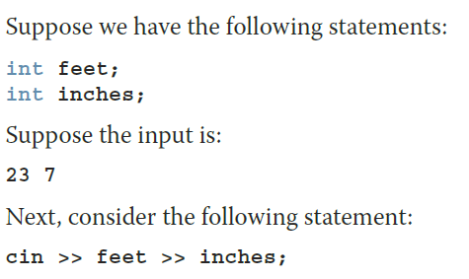

Input (Read) Statement
cin is used with >> to gather one or more inputs
This is called an input (read) statement
The stream extraction operator is >>
For example, if miles is a double variable: cin >> miles;
Causes the computer to get a value of type double and places it in the variable miles

Slide 30
Increment and Decrement Operators
Increment operator (++): increase variable by 1
Pre-increment: ++variable
Post-increment: variable++
Decrement operator: (--) decrease variable by 1
Pre-decrement: --variable
Post-decrement: variable--
What is the difference between the following?
x = 5;
y = ++x;
x = 5;
y = x++;

Slide 31
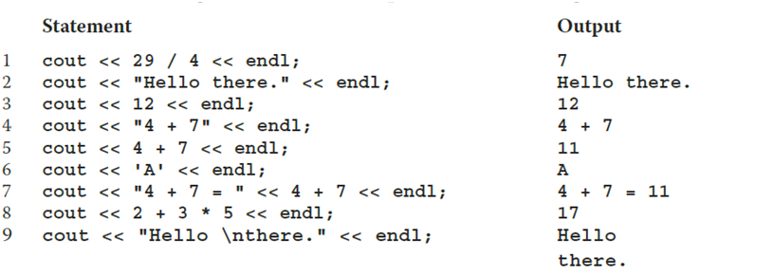
Output – 1
endl causes the insertion point to move to beginning of next line

Slide 32
Output – 2
 | Escape Sequence | Description
\n | Newline | Cursor moves to the beginning of the next line
\t | Tab | Cursor moves to the next tab stop
\b | Backspace | Cursor moves one space to the left
\r | Return | Cursor moves to the beginning of the current line (not the next line)
\\ | Backslash | Backslash is printed
\' | Single quotation | Single quotation mark is printed
\" | Double quotation | Double quotation mark is printed

Slide 33

Preprocessor Directives (2 of 2)
Syntax to include a header file
For example:
#include <iostream>
Causes the preprocessor to include the header file iostream in the program
Preprocessor commands are processed before the program goes through the compiler
Notes:
C++ has a small number of operations
Many functions and symbols needed to run a C++ program are provided as collection of libraries
Every library has a name and is referred to by a header file
Preprocessor directives are processed by the preprocessor program
All preprocessor commands begin with #
No semicolon is placed at the end of these commands

Slide 34
namespace and using cin and cout
cin and cout are declared in the header file iostream, but within std namespace
To use cin and cout in a program, use the following two statements:
#include <iostream>
using namespace std;

Slide 35
Using the string Data Type in a Program
To use the string type, you need to access its definition from the header file string
Include the following preprocessor directive:
#include <string>

Slide 36
Program Style and Form: Syntax
Syntax rules indicate what is legal and what is not legal
Errors in syntax are found in compilation
int x; //Line 1
int y //Line 2
double z; //Line 3
y = w + x; //Line 4
Compilation errors would occur at:
Line 2 (missing semicolon)
Line 4 (identifier w used but not declared)

Slide 37
Use of Semicolons, Brackets, and Commas
All C++ statements end with a semicolon
Also called a statement terminator
("terminators" unlike "separators" are used after the last statement as well).
{ and } are delimiters for code blocks (for variable scope)
Commas separate items in a list
Declaring more than one variable following a data type

Slide 38
Quick Review
A C++ program has functions, one is called main
Identifiers have letters, digits, and underscores, begin with a letter or _
The arithmetic operators in C++ are addition (+), subtraction (-), multiplication (*), division (/), and modulus (%)
Arithmetic expressions use precedence and associativity (from the left, except assignments evaluate from the right)
All variables must be declared before used
Use cin and the stream extraction operator >> to input from the standard input device
Use cout and the stream insertion operator << to output to the standard output device

