Slide 1
Chapter 3
Input/Output

Slide 2
Objectives
In this chapter, you will:
Learn about input and output streams
Read data from STDIN
Use predefined functions and objects in a program (#include ...)
Use the input stream functions get, ignore, peek
Write to STDOUT, STDERR

Slide 3
I/O Streams and Standard I/O Devices
Stream is a sequence of bytes received from source to destination
Bytes can be text, but can be binary (to write archives, images, etc.)
Input stream: sequence of characters from an input device to the computer
Output stream: sequence of characters from the computer to an output device

Slide 4
I/O Streams and Standard I/O Devices
Use iostream header file to receive data from keyboard and send output to the screen
Contains definitions of two data types:
istream: input stream
ostream: output stream
Has two variables: cin and cout
istream cin: stands for common input
ostream cout: stands for common output

Slide 5
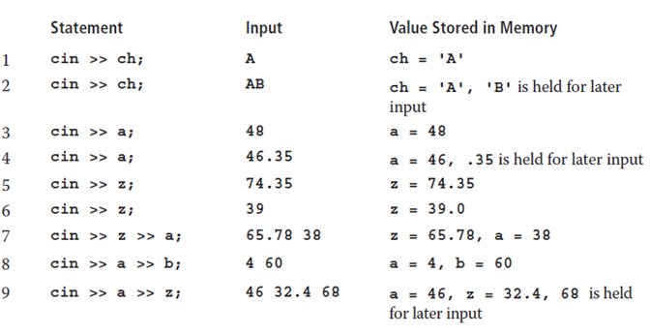
cin and Operator >>
char ch; int a, b; double z;

Slide 6
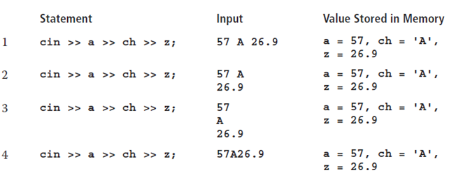
cin and the Extraction Operator >>
char ch; int a, b; double z;

Slide 7
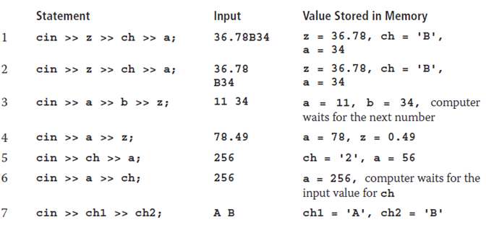
cin and the Extraction Operator >>
char ch, ch1, ch2; int a, b; double z;

Slide 8

cin and the get Function
The get function
Inputs next character (including whitespace)
Stores in memory location indicated by its argument
The syntax of cin and the get function
varChar is a char variable
It is the argument (or parameter) of the function

Slide 9
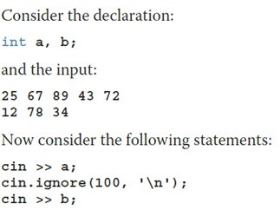

cin and the ignore Function (1 of 2)
ignore function
Discards a portion of the input
intExp is an integer expression
chExp is a char expression
If intExp is a value m, the statement says to ignore the next m characters or all characters until the character specified by chExp

Slide 10


The putback and peek Functions
Syntax for putback (Places previous character extracted by the get function)
istreamVar: an input stream variable (such as cin)
ch is a char variable
Syntax for peek (next character from the input stream; does not remove)
istreamVar: an input stream variable (such as cin)
ch is a char variable

Slide 11

Input Failure
Trying to read a letter into an int or double results in an input failure
If an error occurs when reading data
Input stream enters the fail state
The clear function restores the input stream to a working state
The syntax of the function clear is:

Slide 12

setprecision Manipulator
Syntax
Outputs decimal numbers with up to n decimal places
Must include the header file iomanip
#include <iomanip>

Slide 13

Input/Output and the string Type
An input stream variable (such as cin) and >> operator can read a string into a variable of the data type string
The extraction operator:
Skips any leading whitespace characters
Stops reading at a whitespace character
The function getline reads until end of the current line

Slide 14
Quick Review (1 of 3)
Stream: sequence of characters from a source to a destination
Input stream: from a source to a computer (like cin)
Output stream: from a computer to a destination (like cout)
get reads data character-by-character
ignore skips data in a line
putback puts last character retrieved by get back to the input stream
peek returns next character from input stream, but does not remove it
Include iomanip for the "manipulator" setprecision

