Slide 1
Chapter 4
Conditional/Selection Statements

Slide 2
Objectives
In this chapter, you will:
Learn about control structures
Examine relational operators, bool data types, logical operators
relational operators work with the string type
Use short-circuit Boolean evaluation
Use conditional structures if, if…else; conditional operator, ?:,
Use a switch statement in a program
Use assert function to terminate a program

Slide 3
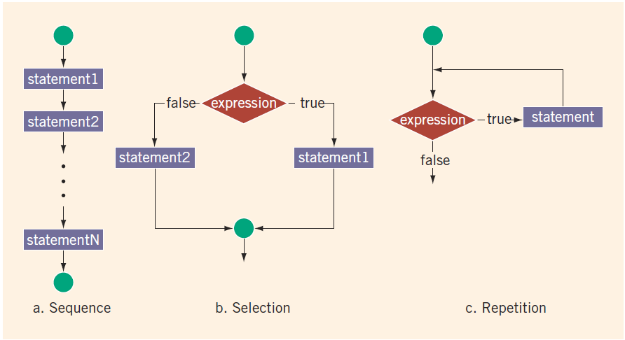
Control Structures

Slide 4
Relational Operators
Each relational operator is a binary operator (requires two operands)
Expressions using these operators always evaluate to true or false
Operator | Description
== | equal to
!= | not equal to
< | less than
<= | less than or equal to
> | greater than
>= | greater than or equal to

Slide 5
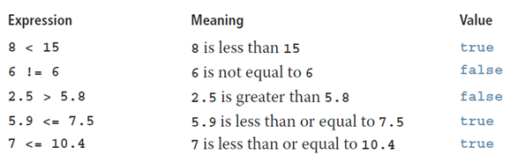
Relational Operators on Simple Data Types

Slide 6
Comparing Characters
In an expression of char values using relational operators:
The result depends on the machine’s collating sequence
ASCII character set
Logical (Boolean) expressions:
Include expressions such as 4 < 6 and 'R' > 'T’
Return an integer value of 1 if the logical expression evaluates to true
Return an integer value of 0 otherwise

Slide 7

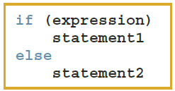
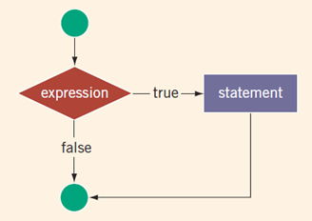
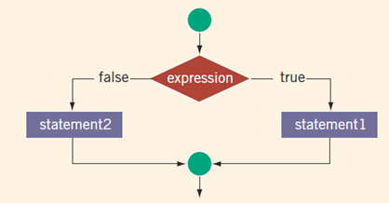
One-Way and Two-Way Conditionals

Slide 8
int vs. bool in Boolean Expressions
Logical expressions evaluate to either 1 (true) or 0 (false)
Boolean value can be stored in a variable of the data type int
Can use int data type (4 bytes) to manipulate logical (Boolean) expressions.
Better use bool (1 byte) that also has values true and false
bool, true, and false are reserved words
The identifier true has the value 1
The identifier false has the value 0

Slide 9

Logical Negation (!)
Expression | !(Expression)
true (nonzero) | false (0)
false (0) | true (1)

Slide 10
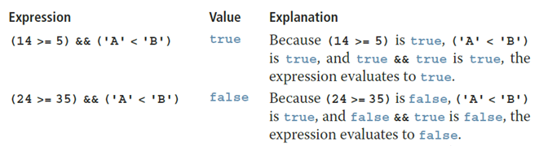
Logical Conjunction (&&)
Expression1 | Expression2 | Expression1 && Expression2
true (nonzero) | true (nonzero) | true (1)
true (nonzero) | false (0) | false (0)
false (0) | true (nonzero) | false (0)
false (0) | false (0) | false (0)

Slide 11
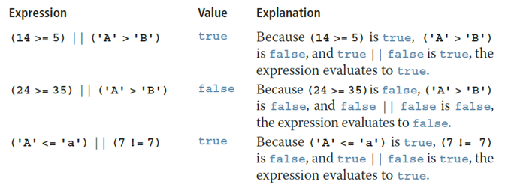
Logical Disjunction (||)
Expression1 | Expression2 | Expression1 || Expression2
true (nonzero) | true (nonzero) | true (1)
true (nonzero) | false (0) | true (1)
false (0) | true (nonzero) | true (1)
false (0) | false (0) | false (0)

Slide 12
Order of Precedence
Operators | Precedence
!, +, - (unary operators) | first
*, /, % | second
+, - | third
<, <=, >=, > | fourth
==, != | fifth
&& | sixth
|| | seventh
= (assignment operator) | last
Notes:
Relational and logical operators are evaluated from left to right
The associativity is left to right
Parentheses can override precedence

Slide 13
Relations on string
Expression | Value/Explanation
str1 < str2 | true str1 = "Hello" and str2 = "Hi". The first character of str1 and str2 are the same, but the second character 'e' of str1 is less than the second character 'i' of str2.
str1 > "Hen" | false str1 = "Hello". The first two characters of str1 and "Hen" are the same, but the third character 'l' of str1 is less than the third character 'n' of "Hen".
str3 < "An" | true str3 = "Air". The first characters of str3 and "An" are the same, but the second character 'i' of "Air" is less than the second character 'n' of "An".
Notes:
Relational operators can be applied to variables of type string
Strings are compared character by character, starting with the first character
Comparison continues until either a mismatch is found or all characters are found equal
If two strings of different lengths are compared and the comparison is equal to the last character of the shorter string
The shorter string is less than the larger string

Slide 14
Relations on string
Expression | Value/Explanation
str1 == "hello" | false str1 = "Hello". The first character 'H' of str1 is less than the first character 'h' of "hello" because the ASCII value of 'H' is 72, and the ASCII value of 'h' is 104.
str3 <= str4 | true str3 = "Air" and str4 = "Bill". The first character 'A' of str3 is less than the first character 'B' of str4.
str4 >= "Billy" | false str4 = "Bill". It has four characters and "Billy" has five characters. Therefore, str4 is the shorter string. All four characters of str4 are the same as the corresponding first four characters of "Billy", and "Billy" is the larger string.

Slide 15
Nested if and Dangling else
else associates with the closest unmatched if ("dangling else")
if (C1)
if (C2) { f(); }
else { g(); }
Subcase | What is called?
C1==true; C2==true | ?
C1==true; C2==false | ?
C1==false; C2==true | ?
C1==false; C2==false | ?

Slide 16
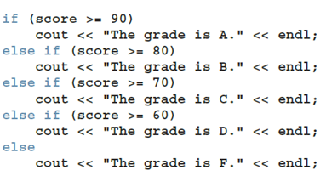
Cascading if-else
When one control statement is located within another, it is said to be nested.
Can make longer "cascades" or "chains" of if-else.

Slide 17
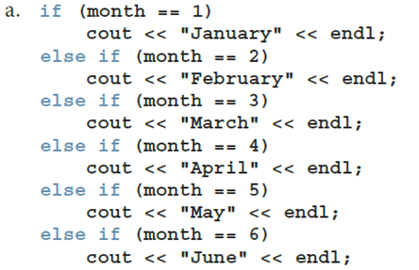
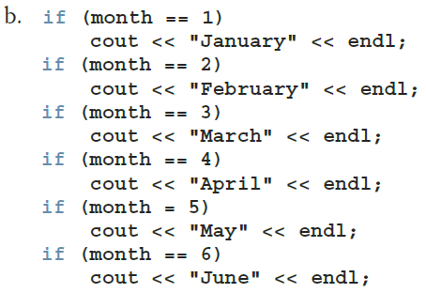
Comparing if…else with if

Slide 18
Short-Circuit Evaluation
Short-circuit evaluation: evaluation of a logical expression stops as soon as the value of the expression is known.
if (x != 0 && y%x != 0) { ... }
If x is 0, never test the remainder dividing by x.
if (person.age < 12 || person.vaccinated()) { ... }
If person is younger than 12, do not care about checking vaccination.

Slide 19
Comparing Floating-Point Numbers with "Tolerance Value"
Equality of floating-point numbers is risky
Example:
1.0 == 3.0/7.0 + 2.0/7.0 + 2.0/7.0 evaluates to false
Why? 3.0/7.0 + 2.0/7.0 + 2.0/7.0 = 0.99999999999999989
A solution is checking for a tolerance value
Example: if (fabs(x – y) < 1E-7) { ... }

Slide 20
Associativity of Relational Operators
num = 5
num = 20
0 <= num <= 10 | = 0 <= 5 <= 10
 | = (0 <= 5) <= 10 | (Because relational operators are evaluated from left to right)
 | = 1 <= 10 | (Because 0 <= 5 is true, 0 <= 5 evaluates to 1)
 | = 1 (true)
0 <= num <= 10 | = 0 <= 20 <= 10
 | = (0 <= 20) <= 10 | (Because relational operators are evaluated from left to right)
 | = 1 <= 10 | (Because 0 <= 20 is true, 0 <= 20 evaluates to 1)
 | = 1 (true)

Slide 21
Avoiding Bugs by Avoiding Partially Understood Concepts and Techniques
Must use concepts and techniques correctly
Otherwise solution will be either incorrect or deficient
If you do not understand a concept or technique completely
Do not use it
Save yourself an enormous amount of debugging time

Slide 22
Input Failure and the if Statement
If an input stream enters a fail state:
All subsequent input statements associated with that stream are ignored
Program continues to execute
The code may produce erroneous results
Use if statements to check status of input stream
If the input stream enters the fail state, include instructions that stop program execution

Slide 23
Confusion Between the Equality (==) and Assignment (=) Operators
C++ allows you to use any expression that can be evaluated to either true or false as an expression in the if statement
if (x = 5)
cout << "The value is five." << endl;
Since value 5 is not 0, this evaluates to true and always succeeds (and assigns)
Appearance of = in place of == is a semantical error. (Frequent cause for "silent bugs" – as it is syntactically correct.)

Slide 24
Conditional Operator (?:)
Conditional operator (?:)
Ternary operator: takes three arguments
Syntax for the conditional operator
If expression1 is true, the result of the conditional expression is expression2
Otherwise, the result is expression3
Example: max = (a >= b) ? a : b;

Slide 25
Program Style and Form (Revisited): Indentation
A properly indented program:
Helps you spot and fix errors quickly
Shows the natural grouping of statements
Insert a blank line between statements that are naturally separate
Two commonly used styles for placing braces
On a line by themselves
Or left brace is placed after the expression, and the right brace is on a line by itself

Slide 26
Using Pseudocode to Develop, Test, and Debug a Program
Pseudocode (or just pseudo) is an informal mixture of C++ and ordinary language
Helps you quickly develop the correct structure of the program and avoid making common errors
Use a wide range of values in a walk-through to evaluate the program

Slide 27
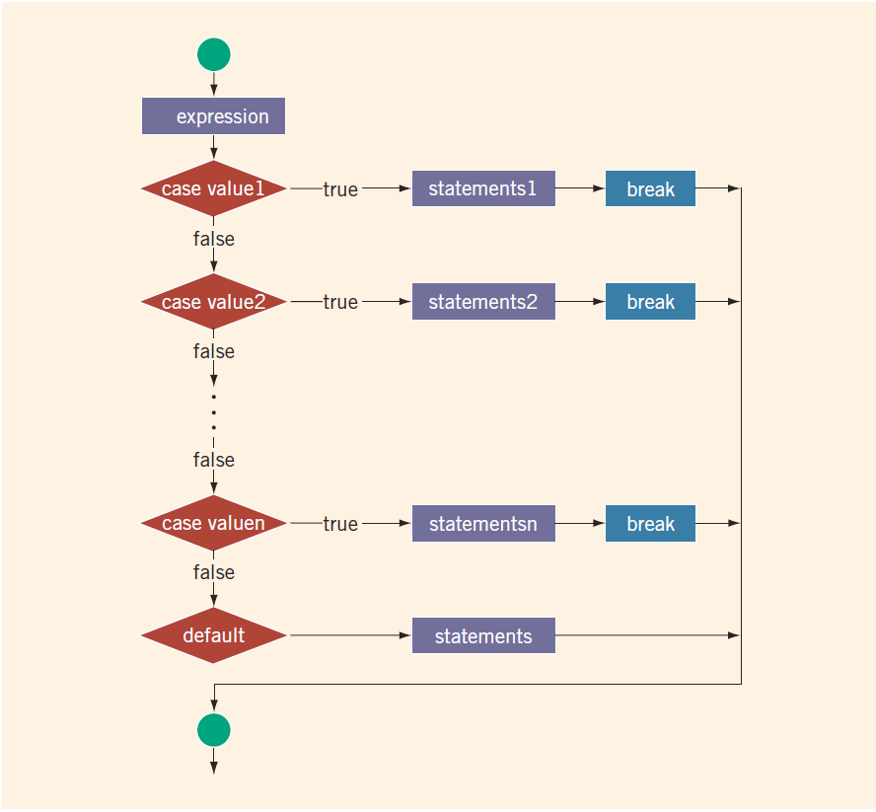
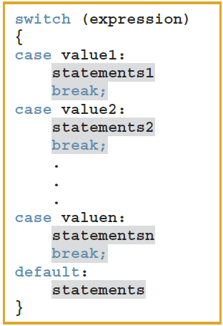
switch Structures – 1

Slide 28
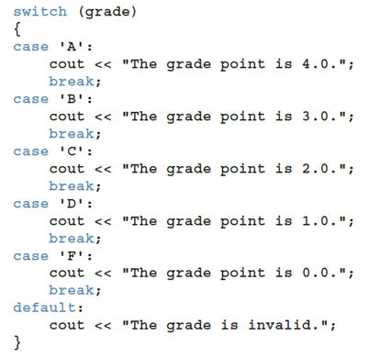
switch Structures – 2
Could we rewrite?
if (grade == 'A') {...} else if (grade == 'B') { ... } else if (grade =='C') {...}
...
else { ... }
What is the difference?

Slide 29

The assert Function
Syntax
expression is any logical expression
If expression evaluates to true, the next statement executes
If expression evaluates to false, the program terminates and indicates where in the program the error occurred
To use assert, include cassert header file
After developing and testing a program, remove or disable assert statements
The preprocessor directive #define NDEBUG must be placed before the directive #include <cassert> to disable the assert statement

Slide 30
Quick Review
Control structures alter normal control flow (Conditionals and Loops)
Relational operators: ==, <, <=, >, >=, !=
Bool values 1 (true) or 0 (false), operators ! (not), && (and), || (or)
The expression in an if or if...else structure is usually a logical expression
Using assignment (=) in place of the equality (==) creates a semantic error
The execution of a switch structure handles multiway selection
The execution of a break statement ends a switch statement
Use assert to terminate a program if certain conditions are not met

