Slide 1
Chapter 5
Control Structures II (Repetition)

Slide 2
Objectives (1 of 2)
In this chapter, you will:
Learn about repetition (looping) control structures
Learn how to use a while loop in a program
Explore how to construct and use counter-controlled, sentinel-controlled, flag-controlled, and EOF-controlled repetition structures
Learn how to use a for loop in a program
Learn how to use a do…while loop in a program

Slide 3
Objectives (2 of 2)
Examine break and continue statements
Discover how to form and use nested control structures
Learn how to avoid bugs by avoiding patches
Learn how to debug loops

Slide 4
Why Is Repetition Needed?
Repetition allows efficient use of variables
It is possible to input, add, and average multiple numbers using a limited number of variables
Consider the code to determine the average number of calories burned each day doing regular exercise
Method 1: Declare a variable for each day and enter the number of calories burned, add the values and store in a variable for the week’s total, and divide the total by 7 to find the average
Method 2: Create a loop that reads a number into a variable and adds it to a variable that contains the sum of the numbers (only two variables needed)

Slide 5

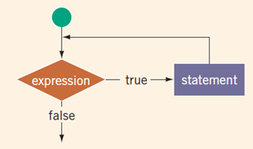
while Looping (Repetition) Structure (2 of 3)

Slide 6
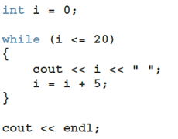
while loop with a counter
Produce this output:
0 5 10 15 20
With the loop control variable (LCV) can also imitate for-loops.

Slide 7
while loop with a sentinel
A sentinel variable is tested in the condition
The loop ends when the sentinel is encountered
cin >> variable; //initialize the loop control variable
while (variable != sentinel) //test the loop control variable
{
.
.
.
cin >> variable; //update the loop control variable
.
.
.
}

Slide 8

while loop with a bool flag
Flag-controlled while loop: uses a bool variable to control the loop
bool isFound = false; //initialize the flag
while (!isFound) //test the flag
{
...
if (expression)
isFound = true; //update the flag
...
}

Slide 9
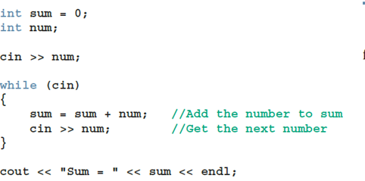
while loops controlled by EOF
The function eof can determine the end of file status
eof is a member of data type istream
Syntax for the function eof: cin.eof()

Slide 10
for Looping (Repetition) Structure (1 of 7)
for loop: called a counted or indexed for loop
Syntax of the for statement
The initial statement, loop condition, and update statement are called for loop control statements

Slide 11
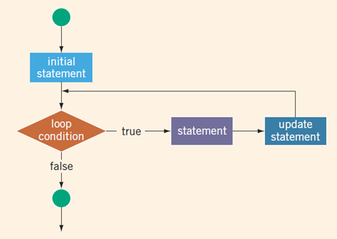
for Loops

Slide 12
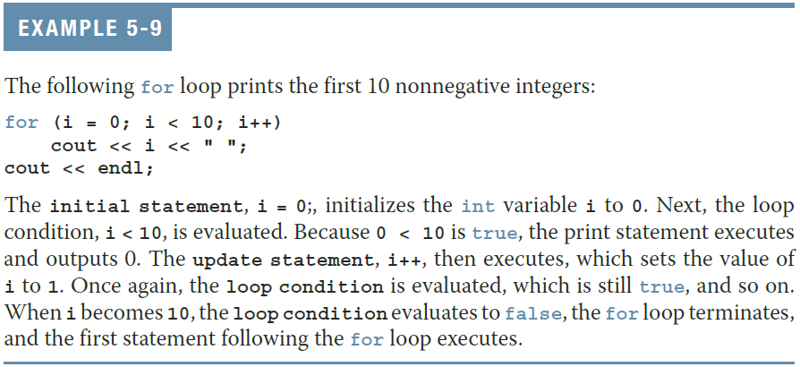
for Looping (Repetition) Structure (3 of 7)

Slide 13
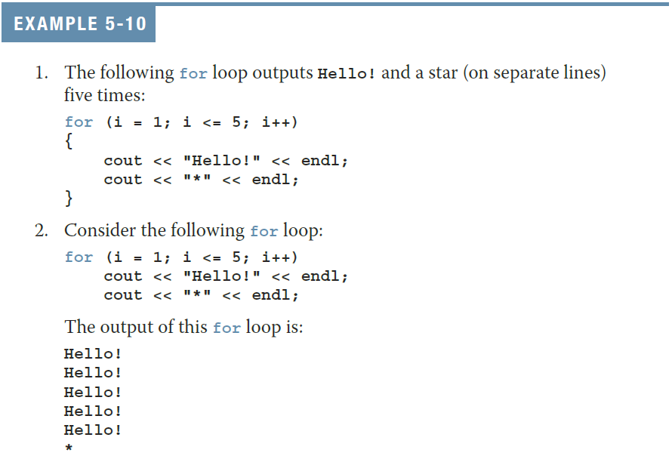
for Looping (Repetition) Structure (4 of 7)

Slide 14
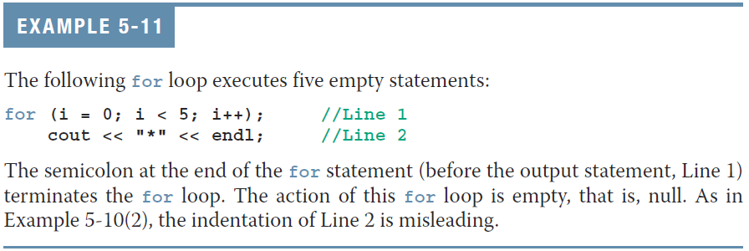
for Looping (Repetition) Structure (5 of 7)
The following is a semantic error:
The following is a legal (but infinite) for loop:
for (;;)
cout << "Hello" << endl;

Slide 15
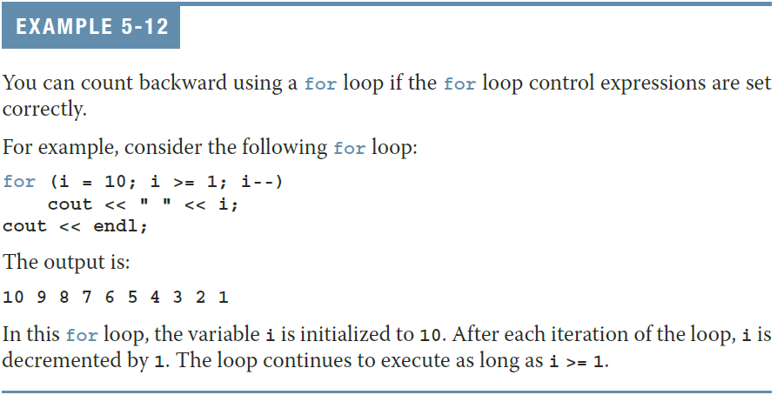
for Looping (Repetition) Structure (6 of 7)

Slide 16
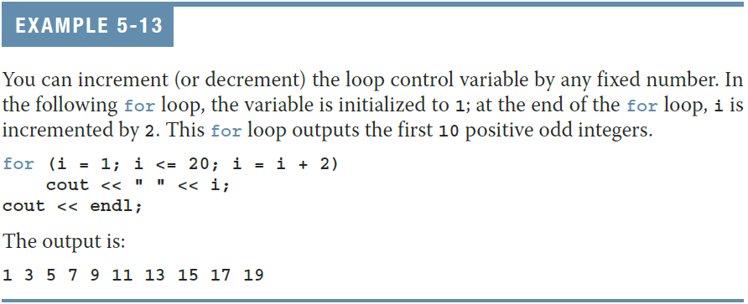
for Looping (Repetition) Structure (7 of 7)

Slide 17
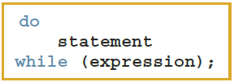
do…while Looping (Repetition) Structure (1 of 6)
Syntax of a do...while loop
The statement executes first, and then the expression is evaluated
As long as expression is true, loop continues
To avoid an infinite loop, body must contain a statement that makes the expression false

Slide 18
do…while Looping (Repetition) Structure (2 of 6)
The statement can be simple or compound
Loop always iterates at least once

Slide 19
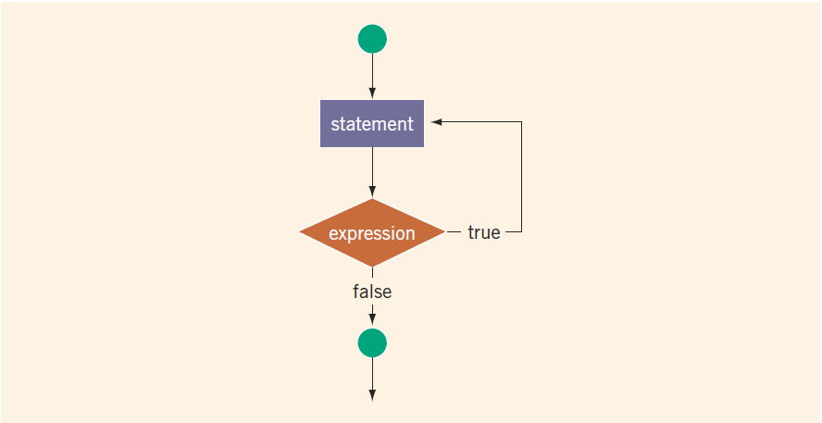
do…while Looping (Repetition) Structure (3 of 6)
FIGURE 5-3 do. . .while loop

Slide 20
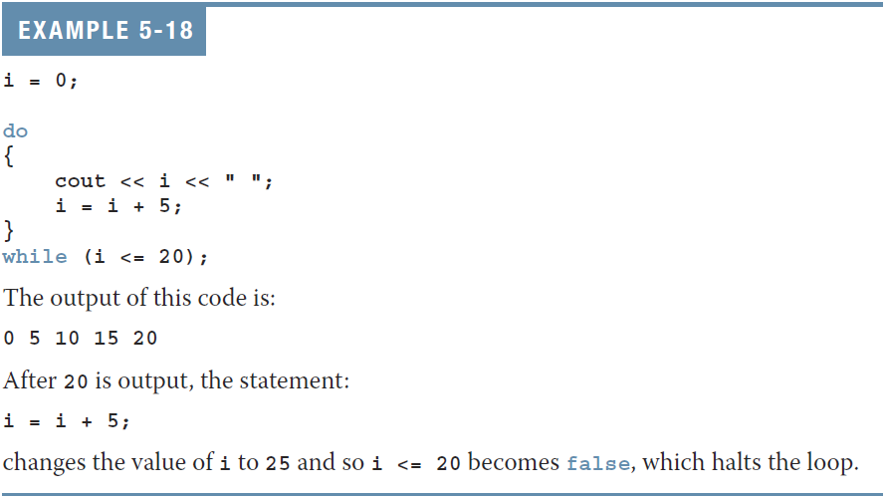
do…while Looping (Repetition) Structure (4 of 6)

Slide 21
do…while Looping (Repetition) Structure (5 of 6)
Note that while and for loops are pretest loops
It is possible that these loops many never activate due to entry conditions
In contrast, do. . .while loops are posttest loops
These loops always execute at least once

Slide 22
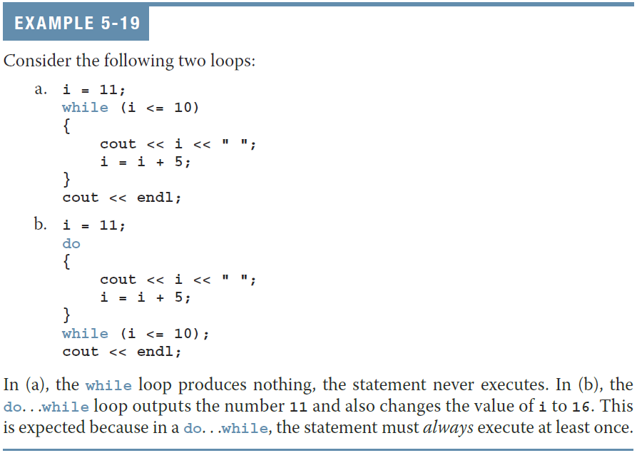
do…while Looping (Repetition) Structure (6 of 6)

Slide 23
Choosing the Right Looping Structure
All three loops have their place in C++
If you can determine in advance the number of repetitions needed, the for loop is the correct choice
If you do not know and cannot determine in advance the number of repetitions needed, and it could be zero, use a while loop
If you do not know and cannot determine in advance the number of repetitions needed, and it is at least one, use a do...while loop

Slide 24
break and continue Statements (1 of 2)
break and continue alter the flow of control
break statement is used for two purposes:
To exit early from a loop
To skip the remainder of a switch structure
After break executes, the program continues with the first statement after the structure
A break statement in a loop can eliminate the use of certain (flag) variables

Slide 25
break and continue Statements (2 of 2)
continue is used in while, for, and do…while structures
When executed in a loop
It skips remaining statements and proceeds with the next iteration of the loop

Slide 26
Nested Control Structures (1 of 2)
To create the following pattern:
*
**
***
****
*****
We can use the following code:
for (i = 1; i <= 5; i++) //Line 1
{ //Line 2
for (j = 1; j <= i; j++) //Line 3
cout << "*"; //Line 4
cout << endl; //Line 5
} //Line 6

Slide 27
Nested Control Structures (2 of 2)
What is the result if we replace the first for statement with this?
for (i = 5; i >= 1; i--)
Answer:
*****
****
***
**
*

Slide 28
Avoiding Bugs by Avoiding Patches
A software patch is a piece of code written on top of an existing piece of code
Intended to fix a bug in the original code
Some programmers address the symptom of the problem by adding a software patch
A programmer should instead resolve the underlying issue

Slide 29
Debugging Loops
Loops are harder to debug than sequence and selection structures
Use a loop invariant
Set of statements that remains true each time the loop body is executed
The most common error associated with loops is off-by-one

Slide 30
Quick Review (1 of 3)
C++ has three looping (repetition) structures:
while, for, and do…while
while, for, and do are reserved words
while and for loops are called pretest loops
do...while loop is called a posttest loop
while and for may not execute at all, but do...while always executes at least once

Slide 31
Quick Review (2 of 3)
In a while loop:
The expression is the decision maker
The statement is the body of the loop
A while loop can be:
Counter-controlled
Sentinel-controlled
EOF-controlled
In the Windows console environment, the end-of-file marker is entered using Ctrl+z

Slide 32
Quick Review (3 of 3)
A for loop simplifies the writing of a counter-controlled while loop
Putting a semicolon at the end of the for loop is a semantic error
Executing a break statement in the body of a loop immediately terminates the loop
Executing a continue statement in the body of a loop skips to the next iteration

Slide 33
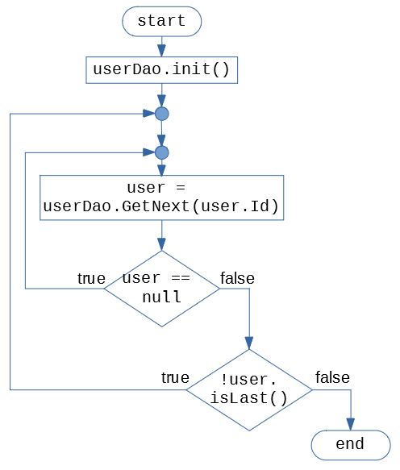
Flowchart to Code
Does this flowchart need conditionals? (What kind is better – If? If/else? Switch?)
Does this flowchart need loops? (What kind fits better – For? While? Do-While?). Any "break" or "continue"?
Write main() function that runs this flowchart (assume that all the functions referred here are implemented somewhere).

Slide 34
Flowchart to Code: Solution
int main() {
userDao.init();
do {
user = userDao.getNext();
if (user == null) { continue;
}
} while (!user.isLast());
}

