Slide 1
Chapter 6
User-Defined Functions

Slide 2
Objectives (1 of 2)
In this chapter, you will:
Use predefined functions
Use user-defined functions
Examine void and value-returning functions
Distinguish function prototypes/declarations and definitions.
Distinguish between value and reference parameters
Learn function overloading

Slide 3
Introduction
Functions allow complicated programs to be divided into manageable pieces
In C++, a function is similar to that of a function in algebra
It has a name
It does some computation
Some of the predefined mathematical functions are:
pow(x, y), sqrt(x), floor(x)
C++ is not algebra – functions not only return values; they may have "side-effects" (sometimes they even change the parameter passed to that function).

Slide 4
Value-Returning Functions (3 of 3)
Heading (or function header): the first line of the function
Example: int abs(int number) { ... }
Formal parameter: a variable declared in the heading
Example: number
Actual parameter: a variable or expression listed in a call to a function
Example: x = abs(v)

Slide 5
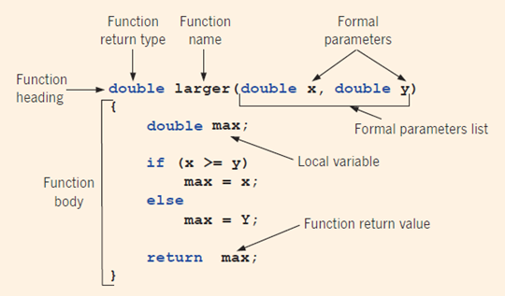
Parts of the Function Definition
int a = 3;
int b = 7;
double r = larger(a,b);
Variables a,b are actual parameters.
They are copied during the function call.

Slide 6
Value-Returning Functions
int secret(int x) {
if (x > 5)
return 2*x;
}
int funcRet2(int z) {
int a = 2;
int b = 3;
return 2*a+b, z+b;
}
Need to return value on all branches of a function. (Compilation should fail.)
This example compiles, but only returns the last value.
Problem: What if 2 numbers should be returned?

Slide 7
Command return similar to break
char courseGrade(int score) {
switch (score / 10) {
case 1:
case 2:
case 3:
case 4:
case 5:
return 'F';
case 6:
return 'D';
case 7:
return 'C';
case 8:
return 'B';
case 9:
case 10:
return 'A';
}
}
No need to write "break" (as "return" immediately jumps out from the function – not just the switch or the loop).

Slide 8
Function Declaration Order Matters
Tricky, if functions are mutually recursive (not clear, which goes above).
Function declarations often appear before the definitions.
For example, a "void" functions are placed after the function main
The function prototype must be placed before the function main
class Hofstadter {
public:
static int F(int n);
static int M(int n);
};
int Hofstadter::F(int n) {
if ( n == 0 ) return 1;
return n - M(F(n-1));
}
int Hofstadter::M(int n) {
if ( n == 0 ) return 0;
return n - F(M(n-1));
}

Slide 9
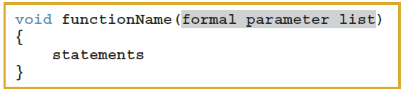
Void Functions (1 of 4)
User-defined void functions can be placed either before or after the function main
If user-defined void functions are placed after the function main
The function prototype must be placed before the function main
A void function does not have a return type
A return statement without any value is typically used to exit the function early

Slide 10
Scope of an Identifier
Scope of an identifier: where in the program the identifier is accessible
Local identifier: identifiers declared within a function (or block)
Global identifier: identifiers declared outside of every function definition
C++ does not allow nested functions
Definition of one function cannot be included in the body of another function

Slide 11
Static and Automatic Variables
Automatic variable: memory is allocated at block entry and deallocated at block exit
By default, variables declared within a block are automatic variables
Static variable: memory remains allocated as long as the program executes
Global variables declared outside of any block are static variables

Slide 12
Function Overloading: An Introduction
In a C++ program, several functions can have the same name
Function overloading (or overloading a function name) occurs when creating several functions with the same name
Two functions should have different formal parameter lists
The signature: does not include the return type of the function
int max(int a, int b) { ... }
int max(int a, int b, int c) {... }
double max(double a, double b) { ... }

Slide 13
Parameter passing by value/by reference
#include <iostream>
void swap(int* a, int b, int c) {
int temp = a[0];
a[0] = a[1];
a[1] = temp;
temp = b;
b = c;
c = temp;
}
using namespace std;
int main() {
int arr[] = {1,2};
int b = 4, c = 5;
swap(arr, b, c);
}
Question: (1) What are the values of arr,b,c at the end of main()?
(2) What happens as we change function to:
void swap(int*& a, int& b, int& c) {
// same code }

Slide 14
Quick Review
Functions divide a program into manageable tasks
There are Value-returning functions and void functions
Params in heading are formal parameters; in call are called actual parameters
A prototype/declaration is the function heading without the body
An automatic variable is a variable for which memory is allocated on function/block entry and deallocated on function/block exit
A static variable is a variable for which memory remains allocated throughout the execution of the program

