Slide 1
Chapter 9
Records (structs)

Slide 2
Objectives
In this chapter, you will:
Learn about records (structs)
Examine various operations on a struct
Explore ways to manipulate data using a struct
Learn about the relationship between a struct and functions
Examine the difference between arrays and structs
Discover how arrays are used in a struct
Learn how to create an array of struct items
Learn how to create structs within a structs

Slide 3
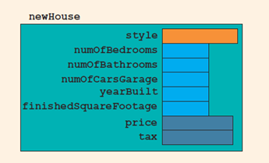
Records (structs)
A struct is a definition, not a declaration
Must declare a variable of that type to use it
struct houseType
{
string style;
int numOfBedrooms;
int numOfBathrooms;
int numOfCarsGarage;
int yearBuilt;
int finishedSquareFootage;
double price;
double tax;
};
//variable declaration
houseType newHouse;

Slide 4
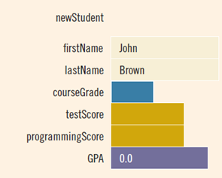
Accessing struct Members (2 of 2)
To initialize the members of newStudent:
newStudent.GPA = 0.0;
newStudent.firstName = "John";
newStudent.lastName = "Brown";

Slide 5
Assignment of structs
The assignment statement:
student = newStudent;
is equivalent to the following statements:
student.firstName = newStudent.firstName;
student.lastName = newStudent.lastName;
student.courseGrade = newStudent.courseGrade;
student.testScore = newStudent.testScore;
student.programmingScore = newStudent.programmingScore;
student.GPA = newStudent.GPA;

Slide 6
Comparison (Relational Operators)
Compare struct variables member-wise
No aggregate relational operations are allowed
To compare the values of student and newStudent:
if (student.firstName == newStudent.firstName &&
student.lastName == newStudent.lastName)
.
.
.

Slide 7
Input/Output
No aggregate input/output operations are allowed on a struct variable
Data in a struct variable must be read or written one member at a time
The following code would output newStudent contents:
cout << newStudent.firstName << " " << newStudent.lastName
<< " " << newStudent.courseGrade
<< " " << newStudent.testScore
<< " " << newStudent.programmingScore
<< " " << newStudent.GPA << endl;

Slide 8
struct Variables and Functions
A struct variable can be passed as a parameter by value or by reference
A function can return a value of type struct
The following function displays the contents a struct variable of type studentType:
void printStudent(studentType student)
{
cout << student.firstName << " " << student.lastName
<< " " << student.courseGrade
<< " " << student.testScore
<< " " << student.programmingScore
<< " " << student.GPA << endl;
}

Slide 9
Arrays versus structs
Data Type | Array | struct
Arithmetic | No | No
Assignment | No | Yes
Input/output | No (except strings) | No
Comparison | No | No
Parameter passing | By reference only | By value or by reference
Function returning a value | No | Yes

Slide 10
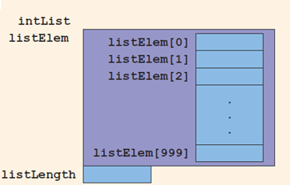
Arrays in structs (1 of 3)
Two items are associated with a list:
Values (elements)
Length of the list
Define a struct containing both items:
const int ARRAY_SIZE = 1000;
struct listType {
int listElem[ARRAY_SIZE];
int listLength;
};

Slide 11
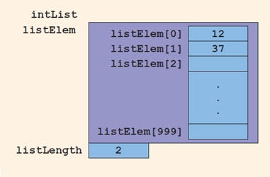
Arrays in structs (3 of 3)
Consider these statements and refer to the figure below showing the results following execution of the statements:
intList.listLength = 0;
intList.listElem[0] = 12;
intList.listLength++;
intList.listElem[1] = 37;
intList.listLength++;

Slide 12
structs in Arrays – 1
struct employeeType
{
string firstName;
string lastName;
int personID;
string deptID;
double yearlySalary;
double monthlySalary
double yearToDatePaid;
double monthlyBonus;
};

Slide 13
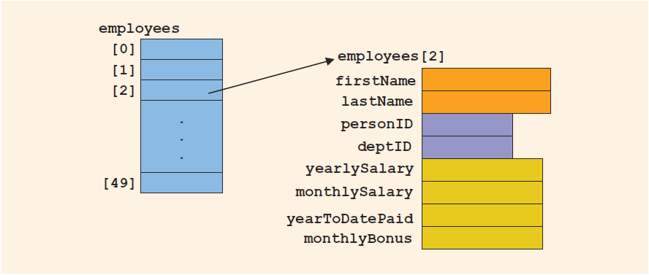
structs in Arrays – 2
employeeType employees[50]
Declares the array employees of 50 components of type employeeType

Slide 14
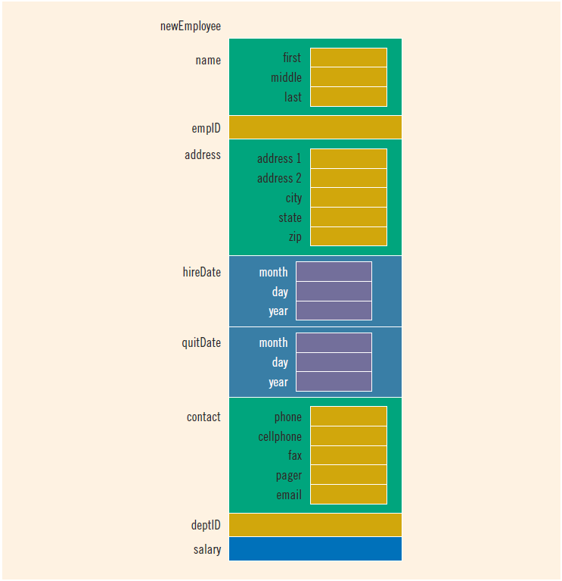
structs within a struct

Slide 15
Quick Review
A struct is a collection of a fixed number of components
Components of a struct can be of different types called by name
Memory is allocated only when struct variables are declared
In C++, the dot (.) operator is called the member access operator
Used to access members of a struct
A struct can be passed by value or reference
A function can return a value of type struct
A struct can be a member of another struct
The only built-in operations on a struct are the assignment and member access operations

