Slide 1
Chapter 10
Classes and Data Abstraction

Slide 2
Objectives
In this chapter, you will:
Learn about classes
Learn about private, protected, and public members of a class
Use accessor and mutator functions
Use constructors and destructors
Learn about encapsulation and information hiding
Learn about the static members of a class
Object: combines data and the operations on that data in a single unit
Class: a collection of a fixed number of components
Member: an attribute or a method (function)

Slide 3
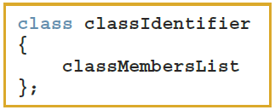
Declaring Classes
The general syntax for defining a class:
A class member can be a variable or a function
If a member of a class is a variable
It is declared like any other variable
You cannot initialize a variable when you declare it

Slide 4
Private, Public, Protected
Three categories of class members:
private (default)
Member cannot be accessed outside the class
public
Member is accessible outside the class
protected

Slide 5
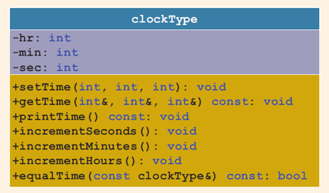
Unified Modeling Language (UML) Class Diagrams
Unified Modeling Language (UML) notation: used to graphically describe a class and its members
+: member is public
-: member is private
#: member is protected

Slide 6
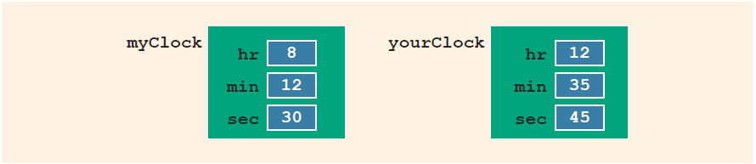
Variable (Object) Declaration
Once defined, you can declare variables of that class type
clockType myClock;
clockType yourClock;
A class variable is called a class object or class instance

Slide 7

Accessing Class Members
Once an object is declared, it can access the members of the class
The general syntax for an object to access a member of a class:
If an object is declared in the definition of a member function of the class, it can access the public and private members
Built-in operations that are valid for class objects:
Member access (.)
Assignment (=)

Slide 8
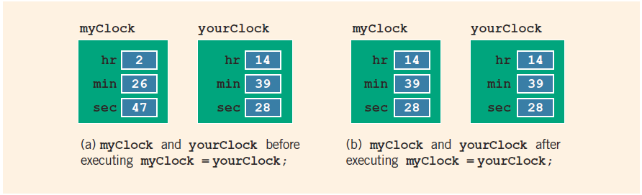
Assignment Operator and Classes
myClock = yourClock;

Slide 9
Class Scope
A class object can be automatic or static
Automatic: created when the declaration is reached and destroyed when the surrounding block is exited
Static: created when the declaration is reached and destroyed when the program terminates
A member of a class has the same scope as a member of a struct
A member of the class is local to the class
You access a class member outside the class by using the class object name and the member access operator (.)

Slide 10
Functions and Classes
Objects can be passed as parameters to functions and returned as function values
As parameters to functions:
Class objects can be passed by value or by reference
If an object is passed by value:
Contents of data members of the actual parameter are copied into the corresponding data members of the formal parameter

Slide 11
Reference Parameters and Class Objects
Passing by value might require a large amount of storage space and a considerable amount of computer time to copy the value of the actual parameter into the formal parameter
Pass by reference is an efficient way to pass a variable as a parameter
Problem: when passing by reference, the actual parameter may change
Solution: use const in the formal parameter declaration
// inefficient as it may need lots of copying:
void f1(Huge arg) { ... }
// usually better
void f2(const Huge& arg) { ... }

Slide 12
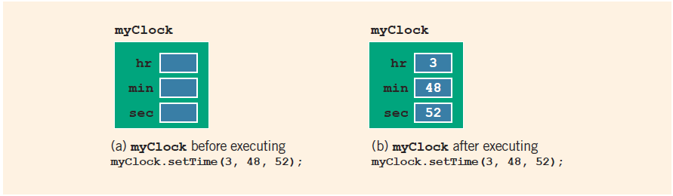
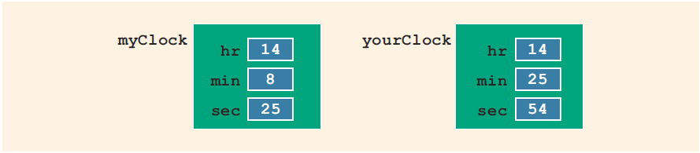
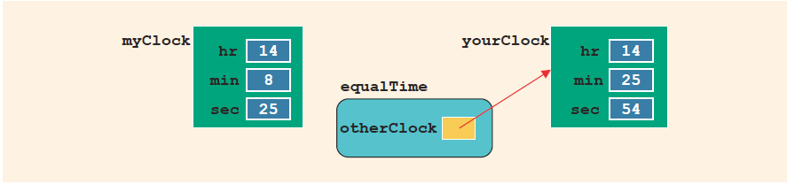
Setters and Objects
Instance variables:
Are two objects filled in
the same attributes equal?
if (myClock==yourClock) {
// ...
}

Slide 13
Implementation of Member Functions
Once a class is properly defined and implemented, it can be used in a program
A program that uses/manipulates objects of a class is called a client of that class
When you declare objects of the class clockType, each object has its own copy of the member variables (hr, min, and sec)
These variables are called instance variables of the class
Every object has its own copy of the data

Slide 14
Accessor and Mutator Functions
Accessor function: member function that only accesses the value(s) of member variable(s)
Mutator function: member function that modifies the value(s) of member variable(s)
Constant member function
Member function that cannot modify member variables of that class
Member function heading with const at the end

Slide 15
Order of public and private Members of a Class
C++ has no fixed order in which to declare public and private members
By default, all members of a class are private
Use the member access specifier public to make a member available for public access

Slide 16
Constructors (1 of 2)
Use constructors to guarantee that member variables of a class are initialized
Two types of constructors: With or without parameters MyClass aa[100];
(This code presumes that there is default/no-param constructor
MyClass() {... })
Name of a constructor is the same as the name of the class.
A constructor has no return type
Notes:
A class can have more than one constructor
Each must have a different formal parameter list
Constructors execute automatically when a class object enters its scope
They cannot be called like other functions
A constructor is automatically executed when a class variable is declared
Because a class may have more than one constructor, you can invoke a specific constructor

Slide 17

Invoking the Default Constructor
Syntax to invoke the default constructor is:
The statement:
clockType yourClock;
declares yourClock to be an object of type clockType and the default constructor executes.
The syntax to invoke a constructor with a parameter is:
How about this?
clockType yourClock();
Notes:
Number and type of arguments should match the formal parameters (in the order given) of one of the constructors
Otherwise, C++ uses type conversion and looks for the best match
Any ambiguity causes a compile-time error
A constructor can have default parameters
Rules for declaring formal parameters are the same as for declaring default formal parameters in a function
Actual parameters are passed according to the same rules for functions
A default constructor is a constructor with no parameters or with all default parameters

Slide 18
Destructors
Destructors are functions without any type
The name of a destructor is the tilde character (~) followed by the class name
Example: ~clockType();
The destructor automatically executes when the class object goes out of scope. Should never call destructors explicitly.
Notes:
A class can have only one destructor
The destructor has no parameters

Slide 19
A struct versus a class
By default, members of a struct are public
private specifier can be used in a struct to make a member private
By default, the members of a class are private
classes and structs have the same capabilities
If all member variables of a class are public and there are no member functions, use a struct

Slide 20
Information Hiding
The header file (or interface file) contains the specification details
The header file has an extension h
The implementation file contains the definitions of the functions to implement the operations of an object
This file has an extension cpp
Implementation file must include the header file via the include statement
In the include statement:
User-defined header files are enclosed in double quotes
System-provided header files are enclosed between angular brackets

Slide 21
static Members of a Class
Use the keyword static to declare a function or variable of a class as static
A public static function or member of a class can be accessed using the class name and the scope resolution operator
static member variables of a class exist even if no object of that class type exists
Multiple objects of a class each have their own copy of non-static member variables
All objects of a class share any static member of the class

Slide 22
Quick Review
A class is a collection of a fixed number of components
Components of a class are called the members of the class
Accessed by name; three categories: private, protected, and public
In C++, class variables are called class objects or class instances or, simply, objects
Constructors ensure that data members are initialized for an object.
A class can have only one destructor. The destructor has no parameters
A public static member, function or data, of a class can be accessed using the class name and the scope resolution operator, ::
static member variables of a class exist before any objects of that class.
Instance variables are non-static data members

Slide 23
Chapter 11
Inheritance and Composition

Slide 24
Objectives
In this chapter, you will:
Learn about inheritance; derived and base classes
Explore how to redefine the member functions
Examine how the constructors of base and derived classes work
Learn how the destructors of base and derived classes work
Explore three types of inheritance: public, protected, and private
Learn about composition (aggregation)
Name basic principles of object-oriented design

Slide 25
Introduction
Two common ways to relate two classes in a meaningful way are:
Inheritance (“is-a” relationship)
Composition or aggregation: (“has-a” relationship)

Slide 26
Inheritance
Inheritance is an “is-a” relationship
Example: “every employee is a person”
Inheritance has
Derived classes: new classes created from the existing classes
Base class: the original class
Single inheritance: derived class has a single base class
Multiple inheritance: derived class has more than one base class
Public inheritance: all public members of base class are inherited as public members by derived class
Notes:
public members of the base class can be inherited as public or private members
The derived class can include additional members (data and/or functions)
The derived class can redefine public member functions of the base class
Applies only to the objects of the derived class
All member variables of the base class are also member variables of the derived class

Slide 27
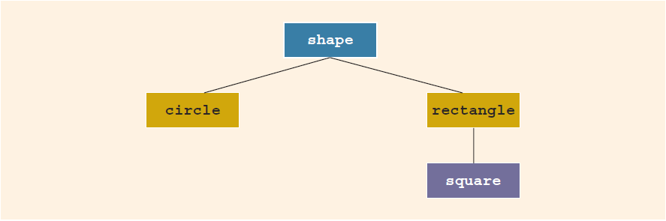
Inheritance Hierarchy
Inheritance can be viewed as a tree-like, or hierarchical, structure between the base class and its derived classes.
Subclass is often a "subset" (each Manager is Employee; each Square is a Rectangle). But what matters more – can you inherit behaviors?

Slide 28
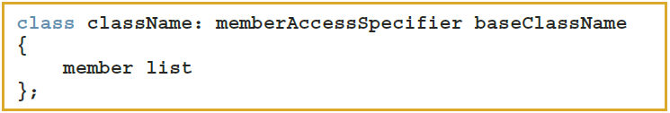
Inheritance Syntax
Syntax of a derived class:
memberAccessSpecifier is public, protected, or private (default)
private members of a base class are private to the base class
Derived class cannot directly access them

Slide 29
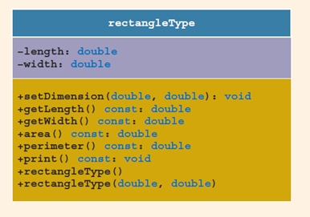
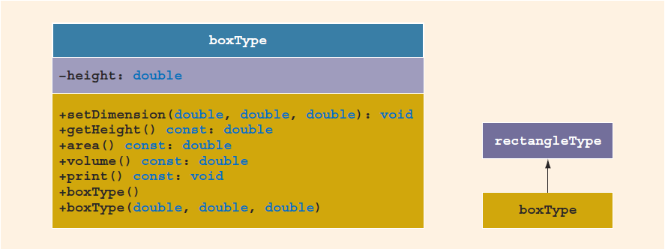
Overriding Members of the Base Class
To redefine a public member function:
The corresponding function in the derived class must have the same name, number, and types of parameters

Slide 30
Inheritance as public, protected, or private
Assume class B is derived from class A with
class B: public A
public members of A are public in B and can be directly accessed in class B
protected members of A are protected in B and can be directly accessed by member functions (and friend functions) of B
private members of A are hidden in B and can be accessed only through public or protected members of A
(Can also inherit in "protected" or "private" way...)
Notes:
If memberAccessSpecifier is protected:
public members of A are protected members of B and can be accessed by the member functions (and friend functions) of B
protected members of A are protected members of B and can be accessed by the member functions (and friend functions) of B
private members of A are hidden in B and can be accessed only through public or protected members of A
If memberAccessSpecifier is private:
public members of A are private members of B and can be accessed by member functions of B
protected members of A are private members of B and can be accessed by member functions (and friend functions) of B
private members of A are hidden in B and can be accessed only through public or protected members of A

Slide 31
Constructors of Derived and Base Classes
A derived class constructor cannot directly access private members of the base class
Can directly initialize only public member variables of the base class
When a derived object is declared, it must execute one of the base class constructors
A call to the base class constructor is specified in the heading of the derived class constructor definition

Slide 32
Destructors in a Derived Class
Destructors deallocate dynamic memory allocated by the objects of a class
When a derived class object goes out of scope
Automatically invokes its destructor
When the destructor of the derived class executes
Automatically invokes the destructor of the base class

Slide 33
Header File of a Derived Class
To define new classes, create new header files
To create new derived classes, include commands that specify where the base class definitions can be found
Definitions of the member functions can be placed in a separate file

Slide 34
Multiple Inclusions of a Header File
Use the preprocessor command (#include) to include a header file in a program
The preprocessor processes the program before it is compiled
To avoid multiple inclusions of a file in a program, use certain preprocessor commands in the header file:
#ifndef MYCLASS_H
#define MYCLASS_H
// your header code
#endif

Slide 35
Composition (Aggregation)
In composition, one or more member(s) of a class are objects of another class type
Composition (aggregation) is a “has-a” relation
Arguments to the constructor of a member-object are specified in the heading part of the definition of the constructor
Member-objects of a class are constructed in the order they are declared
Not in the order listed in the constructor’s member initialization list
They are constructed before the containing class objects are constructed

Slide 36
Quick Review
Inheritance and composition are meaningful ways to relate two or more classes
Single inheritance: a derived class is derived from one class – base class
Multiple inheritance: a derived class is derived from more than one base class
public members of a base class can be inherited either as public or private
Composition is a “has-a” relation
Three basic principles of OOD: Encapsulation, Inheritance, Polymorphism
A call to a base class constructor (with parameters) is specified in the heading of the definition of the derived class constructor
When initializing object of a derived class, the base class constructor is executed first

Slide 37
Chapter 12
Pointers

Slide 38
Objectives
In this chapter, you will:
Learn about the pointer data type and pointer variables
Explore how to declare and manipulate pointer variables
Learn about the address of the operator and the dereferencing operator
Learn how pointers work with classes and structs
Use dynamic variables
Use the new and delete operators to manipulate dynamic variables
Become familiar with the shallow and deep copies of data
Discover the peculiarities of classes with pointer member variables
Learn about virtual functions
Become aware of abstract classes

Slide 39

Declaring Pointer Variables (1 of 2)
The general syntax to declare a pointer variable is:
The statements below each declare a pointer:
int *p;
char *ch;
These statements are equivalent:
int *p;
int* p;
int * p;
In the statement:
int* p, q;
Only p is a pointer variable
q is an int variable
To avoid confusion, attach the character * to the variable name:
int *p, q;
int *p, *q;

Slide 40
Address of Operator (&)
Address of operator (&):
A unary operator that returns the address of its operand
Example:
int x;
int *p;
p = &x; //Assigns the address of x to p

Slide 41
Dereferencing Operator (*)
Dereferencing operator (or indirection operator):
When used as a unary operator, * refers to object to which its operand points
Example:
cout << *p << endl;
Prints the value stored in the memory location pointed to by p

Slide 42
Classes, structs, and Pointers – 1
You can declare pointers to other data types, such as a struct:
struct studentType
{
char name[26];
double gpa;
int sID;
char grade;
};
studentType student;
studentType* studentPtr;
student is an object of type studentType
studentPtr is a pointer variable of type studentType

Slide 43

Classes, structs, and Pointers – 2
To store address of student in studentPtr:
studentPtr = &student;
To store 3.9 in component gpa of student:
(*studentPtr).gpa = 3.9;
( ) used because dot operator has higher precedence than dereferencing operator
Alternative: use member access operator arrow (->)
studentPtr -> gpa = 3.9;

Slide 44
Initializing Pointer Variables
C++ does not automatically initialize variables
Pointer variables must be initialized if you do not want them to point to anything
Initialized to the value 0 using the null pointer
Or, use the NULL named constant
The number 0 is the only number that can be directly assigned to a pointer variable
C++11 Standard includes a nullptr
Notes:
Assignment: value of one pointer variable can be assigned to another pointer of same type
Relational operations: two pointer variables of same type can be compared for equality, etc.
Some limited arithmetic operations
Integer values can be added and subtracted from a pointer variable
Value of one pointer variable can be subtracted from another pointer variable

Slide 45
Dynamic Variables
Dynamic variables are created during execution
C++ creates dynamic variables using pointers
new and delete operators: used to create and destroy dynamic variables
new and delete are reserved words in C++

Slide 46
Operator new
new has two forms:
new allocates memory (a variable) of the designated type and returns a pointer to it. The allocated memory is uninitialized
Example: p = new int;
Creates a variable during program execution somewhere in memory
Stores the address of the allocated memory in p
To access allocated memory, use *p
A dynamic variable cannot be accessed directly, because it is unnamed

Slide 47
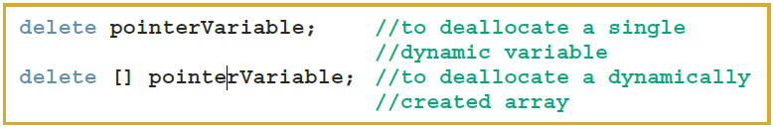
Operator delete
Memory leak: previously allocated memory that cannot be reallocated
To avoid a memory leak, when a dynamic variable is no longer needed, destroy it to deallocate its memory
delete operator: used to destroy dynamic variables
Syntax:

Slide 48
Dynamic Arrays
Always exercise extra care when doing pointer arithmetic
Dynamic array: array created during program execution
Example:
int *p;
p = new int[10];
*p = 25; //stores 25 in the first memory location
p++; //to point to next array component
*p = 35; // stores 35 into the 2nd memory location

Slide 49
Functions and Pointers
Pointer variable can be passed as a parameter either by value or by reference
As a reference parameter in a function heading, use &:
void pointerParameters(int* &p, double *q) { ... }
A function can return a value of type pointer:
int* testExp(...) { ... }

Slide 50
Dynamic Two-Dimensional Arrays
You can create dynamic multidimensional arrays
Examples:
int *board[4]; //declares board to be an array of four
//pointers wherein each pointer is of type
for (int row = 0; row < 4; row++)
board[row] = new int[6]; //creates the rows of board
int **board; //declares board to be a pointer to a pointer

Slide 51
Shallow versus Deep Copy and Pointers
Shallow copy: when two or more pointers of the same types point to the same memory
They point to the same data
Danger: deleting one deletes the data pointed to by all of them
Deep copy: when the contents of the memory pointed to by a pointer are copied to the memory location of another pointer
Two copies of the data

Slide 52
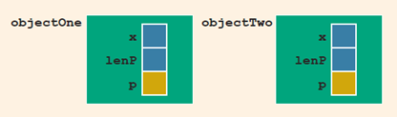
Classes with Pointer Attributes – 1
class ptrMemberVarType {
public:
setX(int x) { this->x = x; }
private:
int x;
int lenP;
int *p;
};
Example program statements:
ptrMemberVarType objectOne;
objectOne.setX();
// other initialization; assign "p"
ptrMemberVarType objectTwo = objectOne;

Slide 53
Classes with Pointer Attributes – 2
If objectOne goes out of scope, its member variables are destroyed
Memory space of a dynamic array stays marked as allocated, even though it cannot be accessed
Solution: In destructor, ensure that array memory is deallocated:
ptrMemberVarType::~ptrMemberVarType()
{
delete [] p;
}

Slide 54
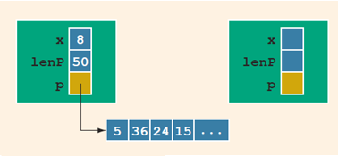
Classes with Pointer Attributes – 3
After a shallow copy: if objectTwo.p deallocates memory space to which it points, objectOne.p becomes invalid
Solution: extend definition of the assignment operator to avoid shallow copying of data

Slide 55
Array Pointers – 1
Pointers and Arrays (continued)
For example, an array declared:
int temp[7];
would appear in memory as:
In array notation, we access the elements by subscripting: temp[0], temp[1], … etc.
But we can also dereference the pointer to achieve the same results: *temp is equivalent to temp[0]
And we can access additional elements through pointer arithmetic

Slide 56
Array Pointers – 2
Pointers and Arrays (continued)
In pointer arithmetic, we can add an offset to the base address of the array: temp + 1, temp + 2, … etc. and dereference the result
So *(temp + 1) is the same as temp[1], *(temp + 2) is equivalent to temp[2], etc.
And as long as we don’t try to change the value of temp, we can use this alternate approach to access the array’s elements
Now remember that a pointer can be used in the allocation of memory without a name, through the use of new
This means that we can also declare an array dynamically, via
int *p; p = new int[n];
As long as the value of n is known when the declaration is executed, the array can be of arbitrary size

Slide 57
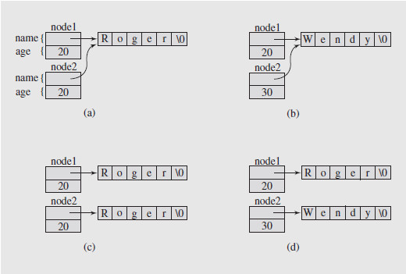
Pointers and Copy Constructors
Pointers and Copy Constructors (continued)
Illustrating the necessity of using a copy constructor for objects with pointer members

Slide 58
Pointers vs. References – 1
Reference variables are implemented as constant pointers
Given the declarations:
int n = 5, *p = &n, &r = n;
a change to the value of n via any of the three means the same:
n = 7;
*p = 7; // dereference a pointer
r = 7; // refer to "n" via alias/reference

Slide 59
Pointers vs. References – 2
Can use constant pointers instead of references.
BUT
int *const a = &myInteger; // cannot reassign a
declares a constant pointer to an integer (cannot be reassigned).
At the same time
const int* b = &myInteger; // b can be reassigned
// but *b cannot be reassigned
declares a pointer to a constant integer
The latter can cause errors if we attempt to assign a value through a dereferenced pointer

Slide 60
Pointers vs. References – 3
A reference variables is a "constant pointer"
int a = 17;
int* const p = &a;
int& r = a;
References are convenient in functions, as they allow us to modify the values of arguments
References can also be returned from a function
Pointers can be used instead of references, but they have to be dereferenced (slightly longer syntax).
https://www.geeksforgeeks.org/difference-between-const-int-const-int-const-and-int-const/

Slide 61
Pointers vs. References – 4
Advantages of pointers
We do have to be careful when we use references in classes
It is possible to compromise information hiding if a public method returns a reference to a private data member
Reference allows bypassing of the protection mechanisms provided in the class definition. Data corruption can result

Slide 62
Quick Review
Pointer variables contain the addresses of other variables as their values
Declare a pointer variable with an asterisk, * after the data type.
Address of operator (&) returns the address of its operand
Unary operator * is the dereferencing operator
Member access (->) accesses the attribute/function pointed to by a pointer
Dynamic variable: created during execution (created using new , deallocated using delete)
Shallow copy: Assign pointer to the same structure.
Deep copy: Pointers of the same type have each their own copy of the data

Slide 63
Chapter 13
Classes, Virtual Functions, Abstract Classes, and Lists

Slide 64
Copy Constructor
Called when you pass a parameter; also on myVector.push_back(...) etc.
Default member-wise initialization:
Initializing a class object by using the value of an existing object of the same type
Example:
ptrMemberVarType objectThree(objectOne);
Copy constructor: provided by the compiler
Performs this initialization
Leads to a shallow copying of the data if class has pointer member variables
Notes:
Similar problem occurs when passing objects by value
Copy constructor automatically executes in three situations:
When an object is declared and initialized by using the value of another object
When an object is passed by value as a parameter
When the return value of a function is an object

Slide 65
Copy Constructor Overriding
Override the copy constructor to do deeper copying
For classes with pointer member variables, three things are normally done:
Include the destructor in the class
Overload the assignment operator for the class
Include the copy constructor

Slide 66
Inheritance, Pointers, and Virtual Functions
Can pass an object of a derived class to a formal parameter of the base class type
Compile-time binding: the necessary code to call specific function is generated by compiler
Also known as static binding or early binding
Virtual function: binding occurs at program execution time, not at compile time
Declared with reserved word virtual

Slide 67
Inheritance, Pointers, and Virtual Functions
Run-time binding:
Compiler does not generate code to call a specific function: it generates information to enable run-time system to generate specific code for the function call
Also known as late binding or dynamic binding
Note: cannot pass an object of base class type to a formal parameter of the derived class type

Slide 68
Inheritance, Pointers, and Virtual Functions (3 of 3)
Values of a derived class object can be copied into a base class object
Slicing problem: if derived class has more data members than base class, some data could be lost
Solution: use pointers for both base and derived class objects

Slide 69
Classes and Virtual Destructors (1 of 2)
Classes with pointer member variables should have the destructor
Destructor should deallocate storage for dynamic objects
If a derived class object is passed to a formal parameter of the base class type, destructor of the base class executes
Regardless of whether object is passed by reference or by value
Solution: use a virtual destructor (base class)

Slide 70
Classes and Virtual Destructors (2 of 2)
Virtual destructor of a base class automatically makes the destructor of a derived class virtual
After executing the destructor of the derived class, the destructor of the base class executes
If a base class contains virtual functions, make the destructor of the base class virtual

Slide 71
Abstract Classes and Pure Virtual Functions (1 of 2)
New classes can be derived through inheritance without designing them from scratch
Derived classes:
Inherit existing members of base class
Can add their own members
Can redefine or override public and protected member functions
Base class can contain functions that you would want each derived class to implement
However, base class may contain functions that may not have meaningful definitions in the base class

Slide 72
Abstract Classes and Pure Virtual Functions (2 of 2)
Pure virtual functions do not have definitions (bodies have no code)
Example:
virtual void draw() = 0;
An abstract class is a class with one or more virtual functions
It can contain instance variables, constructors, and functions that are not pure virtual
It must provide the definitions of the constructor and functions that are not pure virtual

Slide 73
Quick Review
Binding of virtual functions occurs at execution time (dynamic or run-time binding)
A list is a collection of elements of the same type. Can be ordered or unordered
Common set of list operations

Slide 74
Chapter 14
Exception Handling

Slide 75
Objectives
In this chapter, you will:
Learn what an exception is
Learn how to handle exceptions within a program
Learn how a try/catch block is used to handle exceptions
Learn how to throw an exception
Become familiar with C++ exception classes and how to use them in a program
Learn how to create your own exception classes
Discover how to throw and rethrow an exception
Explore exception handling techniques

Slide 76
Introduction
An exception is an undesirable event detectable during program execution
Code to handle exceptions depends on the type of application being developed
May or may not want the program to terminate when an exception occurs
Can add exception-handling code at point where an error can occur

Slide 77
Handling Exceptions Within a Program
Exceptions in C++ are "thrown" in functions, if a function is unable to return a value (due to problems that should be handled in that particular function). Compute a square root of a negative number, or add/subtract matrices of wrong size – cannot return the promised value type. Return a special object containing a short message what went wrong.

Slide 78
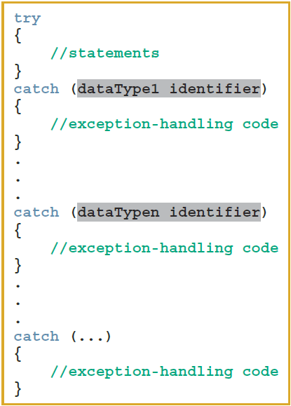
try/catch Block – 1
catch block:
Specifies the type of exception it can catch
Contains an exception handler
If the heading of a catch block contains ... (ellipses) in place of parameters:
Block can catch exceptions of all types
If no exception is thrown in a try block:
All catch blocks are ignored
Execution resumes after the last catch block

Slide 79
try/catch Block – 2
If an exception is thrown in a try block:
Remaining statements (in block) are ignored
Program searches catch blocks in order, looking for an appropriate exception handler
If the type of thrown exception matches the parameter type in one of the catch blocks:
Code of that catch block executes
Remaining catch blocks are ignored
A catch block can have at most one catch block parameter
catch block parameter becomes a placeholder for the value thrown

Slide 80
Catching Exceptions
For more exception handling read https://www.learncpp.com/cpp-tutorial/142-basic-exception-handling/
try {
...
// do something with the result.
// (but jump over this - if you had an exception).
} catch (const std::out_of_range& e) {
cout << "out_of_range";
}

Slide 81
Order of catch Blocks
catch block can catch:
All exceptions of a specific type
All types of exceptions
A catch block with an ellipsis (...) catches any type of exception
If used, it should be the last catch block of that sequence
Be careful about the order in which you list catch blocks

Slide 82
Using C++ Exception Classes
Two subclasses of exception (defined in stdexcept):
logic_error includes subclasses:
invalid_argument: for use when illegal arguments are used in a function call
out_of_range: string subscript out of range error
length_error: if a length greater than the maximum allowed for a string object is used
runtime_error includes subclasses:
overflow_error and underflow_error

Slide 83
Creating Your Own Exception Classes
Can create your own exception classes to handle specific exceptions
C++ uses the same mechanism to process these exceptions
throw statement: used to throw your own exceptions
Any class can be an exception class
How you use the class makes it an exception class

Slide 84
Rethrowing and Throwing an Exception
Object being thrown can be:
A specific object
An anonymous object
A function specifies the exceptions it throws in its heading using the throw clause
Example:
void expThrowExcep(int x) throw (int, string, divisionByZero)
{
.
.
.
//include the appropriate throw statements
.
.
.
}

Slide 85
Exception-Handling Techniques
When an exception occurs, the programmer usually has three choices:
Terminate the program
Include code to recover from the exception
Log the error and continue
Notes:
In some cases, it is best to terminate the program when an exception occurs
Example: if an input file does not exist when the program executes
There is no point in continuing with the program
Program can output an appropriate error message and terminate
In some cases, you will want to handle the exception and let the program continue
Example: a user inputs a letter instead of a number
The input stream will enter the fail state
Can include the necessary code to keep prompting the user to input a number until the entry is valid
In other cases must register the error condition in a log. (Or terminate the program, if it is pointless to continue).

Slide 86
Stack Unwinding
When an exception is thrown in a function, the function can do the following:
Do nothing
Partially process the exception and throw a new one.
The function-call stack is unwound so that the exception can be caught in the next try/catch block
Stack unwinding continues until:
A try/catch handles the exception, or
The program does not handle the exception
The function terminate is called to terminate the program

Slide 87
Quick Review
An exception is event that does not return normal return value type.
assert checks whether an expression meets a specified condition; terminates if not met
try/catch block handles exceptions
Statements that may generate an exception are placed in a try block
A catch block specifies type of exception it can catch and contains an exception handler
If no exceptions are thrown in a try block, all catch blocks for that try block are ignored
Data type of catch block parameter specifies type of exception that catch block can catch
exception is the base class for exception classes
You can create your own exception classes

