Slide 1
Network Flows

Slide 2
Network Flows: Introduction
A network is a directed graph where each edge has a capacity and each edge receives a flow
The amount of flow on an edge cannot exceed the capacity of the edge
A flow must satisfy the restriction that the amount of flow into a node equals the amount of flow out of it, except when it is a source, which has more outgoing flow, or sink, which has more incoming flow
Flows model anything where something travels through a network of nodes
Delbert R. Fulkerson and Lester R. Ford, Jr. developed the first computational models of these flow problems in 1954

Slide 3
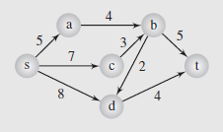
Maximum Flow Problem
The central problem of these network models is to maximize the flow over the edges from the source to the sink
This is referred to as the maximum flow (or max-flow) problem
Figure shows a small water-flow network of 8 pipes and 6 pumping stations; the edges are labeled with the capacity of the pipes in thousands of gallons

Slide 4
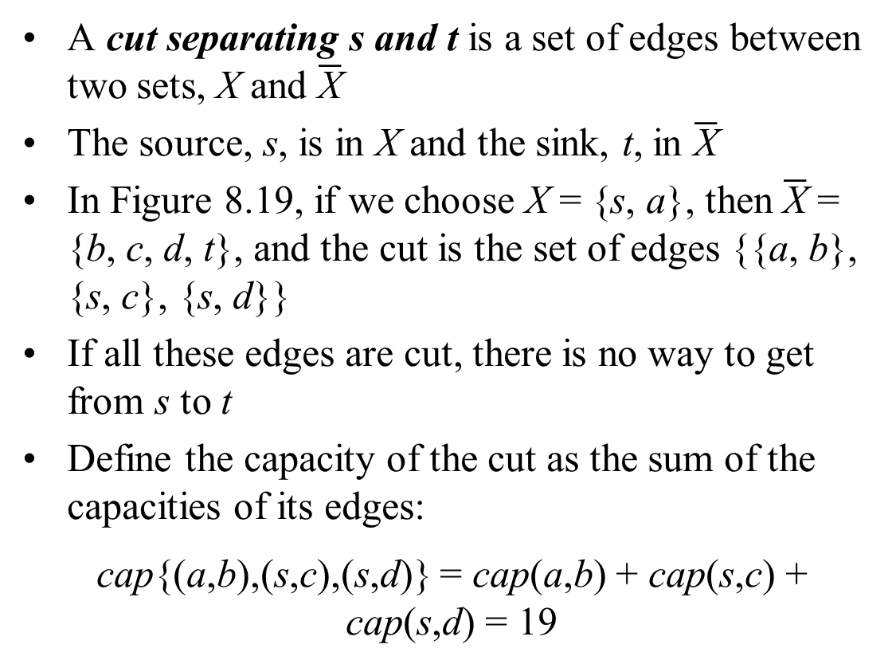
Cut in a Flow Network
A cut separating s and t is a set of edges between two sets, X and $\overline{\text{X}}$
The source, s, is in X and the sink, t, in $\overline{\text{X}}$
In Figure 8.19, if we choose X = {s, a}, then $\overline{\text{X}}$ = {b, c, d, t}, and the cut is the set of edges {{a, b}, {s, c}, {s, d}}
If all these edges are cut, there is no way to get from s to t
Define the capacity of the cut as the sum of the capacities of its edges:
cap{(a,b),(s,c),(s,d)} = cap(a,b) + cap(s,c) + cap(s,d) = 19

Slide 5
Max-Flow, Min-Cut Theorem
Theorem: In any network, the maximal flow from s to t is equal to the minimal capacity of any cut.
While there may be cuts with larger capacity, it is the cut with the smallest capacity that determines the flow of the network
Although the capacity of our earlier cut was 19, the two edges coming to the sink can’t transfer more than 9 units
So we have to search all the cuts to find the one with the smallest capacity, and transfer through this as many units as the capacity allows

Slide 6
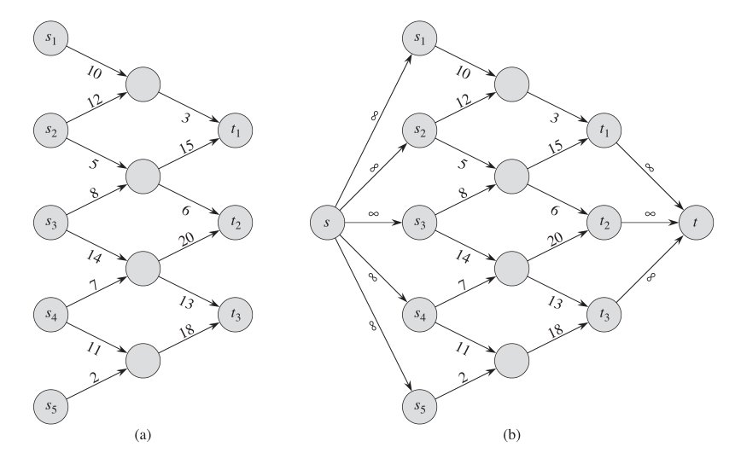
Multiple Sources or Sinks
Problems with multiple sources and sinks may exist, but they can be reduced to single source/sink.

Slide 7
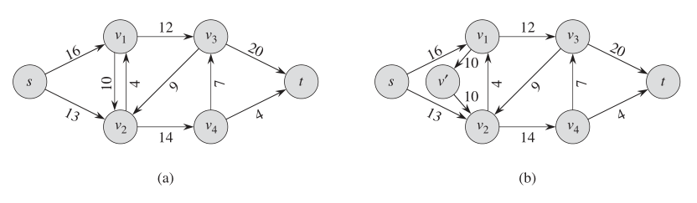
Flow Graph with Antiparallel Edges
Such graphs are not easy to handle
Convert them into graphs with no opposite arrows with non-zero capacities.

Slide 8
Flow Augmenting Path
A flow-augmenting path is a sequence of edges from s to t such that on any edge, e, in the path the flow f(e) on the forward edges is less than the capacity, cap(e), and greater than 0 on the backward edges
This means the path has excess capacity that isn’t being used
However if the flow for any edge in that path reaches capacity, the flow cannot be augmented
The path also does not have to exclusively use forward edges, so in Figure 8.19, we have paths s, a, b, t and s, d, b, t
Backward edges push back against the flow, decreasing the total flow of the network
Eliminating them can increase the overall flow in the network, so the goal of augmenting isn’t finished until the flows for those edges is 0

Slide 9
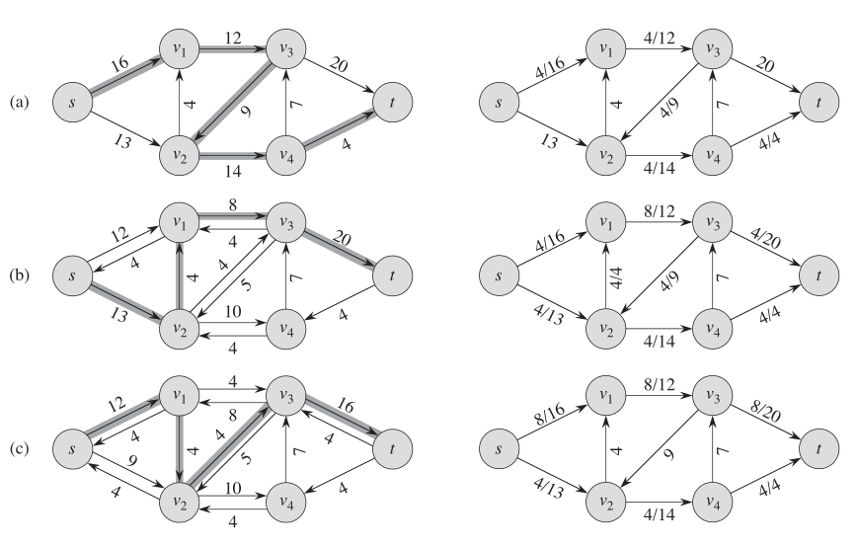
Ford-Fulkerson Example – 1

Slide 10
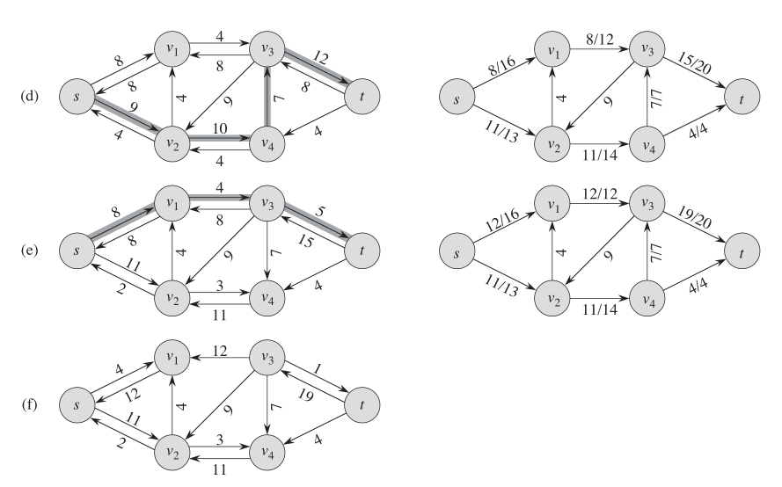
Ford-Fulkerson Example – 2

Slide 11
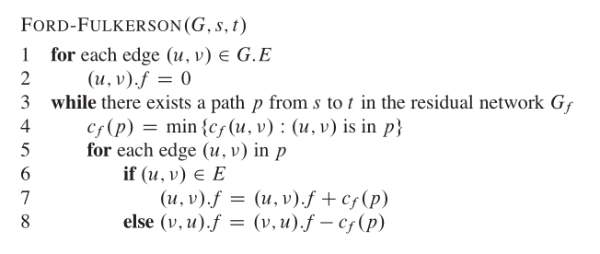
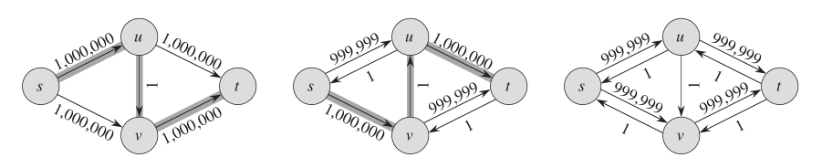
Ford-Fulkerson and Worst Case
Notes:
Maximum Flows (continue)
The task now is to find an augmenting path; however there may be a large number of paths from s to t, so this is a nontrivial problem
Ford and Fulkerson devised the first systematic algorithm for this in 1957
The first phase of the algorithm, labeling, assigns each vertex of the graph a label, defined as the pair label(v) = (parent(v), flow(v))
parent(v) is the node accessing v, and flow(v) is the flow amount from s to v
Forward and backward edges are treated differently; if v accesses vertex u via a forward edge, label(u) = (v⁺,min(flow(v),slack(edge(vu))))
Here, slack(edge(vu)) = cap(edge(vu)) – f(edge(vu)); this is the difference between the capacity of the edge vu and its current flow
Maximum Flows (continue)
Now if the edge between v and u is backward, then the value of label(u) = (v–,min(flow(v),f(edge(uv)))) where
flow(v) = min(flow (parent(v)), slack(edge(parent(v)v)))
Once a vertex is labeled, it is stored for subsequent processing
Only the vu edge is labeled in this activity, leaving open the ability to add more flow
This can be done for forward edges when slack(edge(vu)) > 0, and for backward edges when f(edge(uv)) > 0
However, finding this path may not complete the whole procedure
It is only finished if we are stuck somewhere in the network and unable to label any more edges
Maximum Flows (continue)
If we reach the sink, the flows in the augmenting path are adjusted by increasing flows on the forward edges, and decreasing them on the backward ones
Then we restart the task and look for another augmenting path
The pseudocode for the algorithm is presented on page 425
In examining the algorithm, notice there is no particular mechanism specified for scanning the graph
The question is in what order vertices should be added to labeled and detached from it; this implementation uses push and pop operations to process it depth-first
The operation of this algorithm in shown in Figure 8.20 on pages 426 and 427

Slide 12
Reasons why this is Slow
A major issue with this implementation is the depth-first approach, which has a significant impact on its efficiency
Since the depth-first algorithm tries to reach the sink as soon as possible, we may end up choosing the same augmenting path several times as the algorithm proceeds
A better approach is to try and find the shortest augmenting path, which suggests a breadth-first approach
This concept was developed by Jack Edmonds and Richard Karp in 1972
It uses the same approach as the Ford-Fulkerson algorithm, but the labeled structure is now a queue

Slide 13
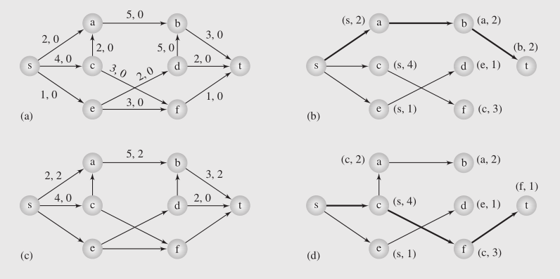
Edmonds-Karp Algorithm – 1

Slide 14
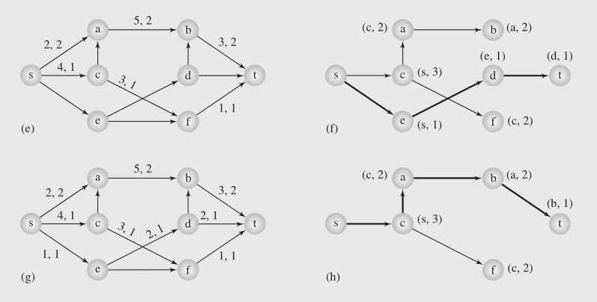
Edmonds-Karp Algorithm – 2

Slide 15
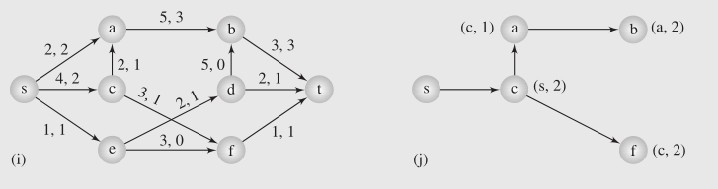
Edmonds-Karp Algorithm – 3
Finally there is no path from "s" to "t" anymore.
Can you identify the minimum-cut for the max flow obtained?

