Slide 1
Notes on Lab1-1, Container Classes ("Vector" from Scratch"), Templates

Slide 2

Git Command-line
cd Documents
git clone <git-url>
cd <repo-directory>
# do edits, run tests
git status
git add –u
git add <path/to/file.txt>
git commit -m "your message"
git push origin main

Slide 3
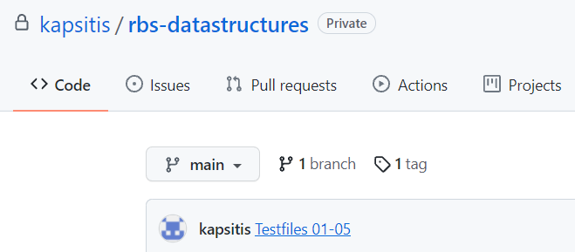
Git Tagging
https://stackoverflow.com/questions/18216991/create-a-tag-in-a-github-repository
https://devconnected.com/how-to-delete-local-and-remote-tags-on-git/
Add tag from command line (current branch+commit):
git tag submit-lab2-1
git push --tags
# Deleting tags:
git tag -d <tag_name>
git push --delete origin submit-lab-1

Slide 4
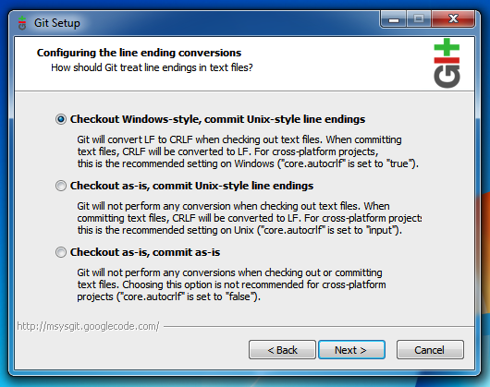
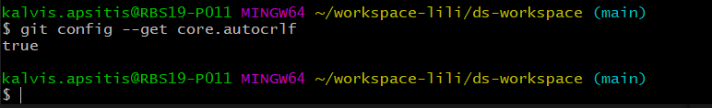
Linux vs. Windows Line Endings
Git for Windows installer has default option: core.autocrlf
Linux-style line endings ('\n' = LF) silently convert to Windows-style line endings: ('\r\n' = CRLF). And vice versa.

Slide 5
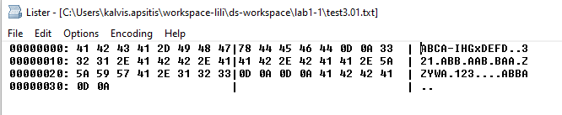
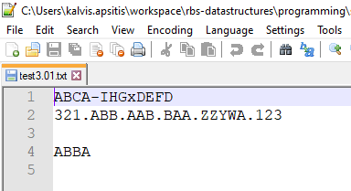
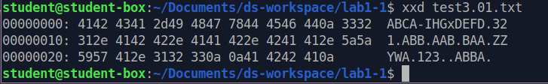
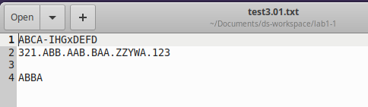
Line Endings in Action
Testfile on Windows (Inspect with Total Commander,
F3 (View), then
The same testfile checked
out on Linux:

Slide 6
Issues with the Code
while(arg[i] != '\n' && arg[i - 1] != '\n'){
//look if there are two new line symbols
→ Issue 1: This would work differently on Linux and Windows.
if (... arg[i - 1] == (arg[i] - 1))
→ Issue 2: This only compares to the previous letter (some testcases would fail)
void eraseChars(char* arg){ // ...
cout << '\n' << arg[i - 1];
→ Issue 3: This does not edit "arg" array, but prints directly to the output. (Lab description says that "arg" should be edited in eraseChars(...)).

Slide 7
"Platform-independent" main()
Rely on invariants (things that stay the same on both platforms):
int main() {
string line;
while (getline(cin, line)) {
// stop, if there is empty line
if (line == "") { break; }
// process line (it does not contain \n)
char* chars = const_cast<char*>(line.c_str());
eraseChars(chars);
// platform dependent linebreak
cout << chars << endl;
}
}

Slide 8
Simplistic eraseChars() – only compare with the previous char (fails most testcases)
simplisticEraseChars (char* arg):
1. print arg[0]
2. i := 1
3. while arg[i] != '\0' // (stop when there is the end of string):
4. if arg[i] is uppercase and arg[i-1] is uppercase and arg[i] <= arg[i-1]:
5. i := i+1 // skip printing; advance the counter
6. else
7. print arg[i]
8. i := i+1 // print and advance the counter

Slide 9
Better eraseChars() – if only the printing matters (could pass all testcases)
betterEraseChars (char* arg):
print arg[0]
i := 1; // forward counter
j := 0; // back counter (the last location that we did not skip and use for comparisons)
while arg[i] != '\0' // (stop when there is the end of string):
if arg[i] is uppercase and arg[j] is uppercase and arg[i] <= arg[j]:
i := i+1 // skip printing; advance the forward counter
else
print arg[i]
j = i // set back counter to the last non-skipped char position
i := i+1 // advance the counter, look at the next char

Slide 10
Actually, eraseChars() should edit char* "in place"
As in lab description: eraseChars() should modify its argument.
At start:
A
H
C
E
D
K
\0
char* arg
A
H
K
\0
D
K
\0
char* arg
Spoler alert: Next slide is the pseidocode for a proper eraseChars() function.
Try to figure it out before turning the page.

Slide 11
properEraseChars() – edits char* in place
properEraseChars (char* arg):
// skip arg[0]; it aways stays in the resulting arg.
i := 1 // forward counter (the location we read from)
j := 0 // back counter (the last location which we did not skip
while arg[i] != '\0' // (stop when there is the end of string):
if arg[i] is uppercase and arg[j] is uppercase and arg[i] <= arg[j]:
i := i+1 // skip printing; advance the forward counter
else
arg[j+1] = arg[i]
j = j+1 // back counter advances by 1 position (1 char inserted)
i := i+1 // advance the counter, look at the next char
arg[j] := '\0' // since the edited char* array may be shorted – manually insert terminating \0

Slide 12
What about "long-living" lines?
{ string line;
getline(cin, line);
char* chars = const_cast<char*>(line.c_str());
} // "line" out of scope; array "chars" becomes unusable
In some situations "chars" need to be saved for later processing:
vector<char*> lines; // accumulate all lines here
{ string line;
getline(cin, line);
char* chars = new char[line.length() + 1];
strcpy(chars, line.c_str());
lines.push_back(chars);
} // Array "chars" was reserved with "new"; it lives on

Slide 13
Option checkout/commit as-is?
^M is how terminal window displays '\r' (char ch = 0x0D;)
If carriage returns (not displayed on Windows) are copied to Linux "as-is", they make commands (such as shell script run-lab1-tests.sh) unusable.

Slide 14
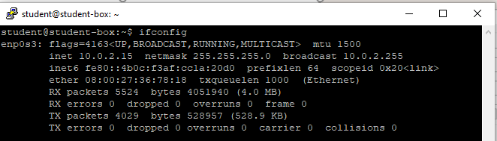
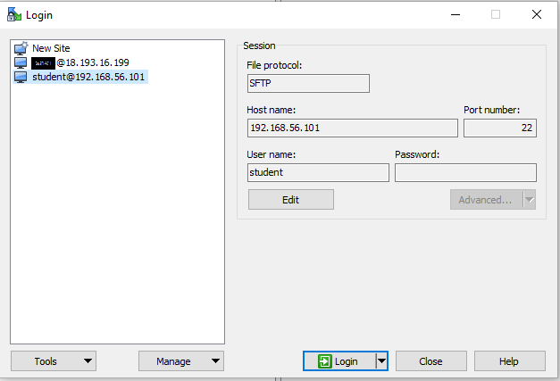
SSH: PuTTY and WinSCP
sudo apt-get install openssh-server
sudo systemctl enable ssh
sudo systemctl start ssh
WinSCP copies files with Linux scp utility.

Slide 15
Reminder
Why look at the vector implementation?
To see how the standard library vector really works
To introduce basic concepts and language features
Free store (heap)
Copy and move
Dynamically growing data structures
To see how to directly deal with memory
To see the techniques and concepts you need to understand C
Including the dangerous ones
To demonstrate class design techniques
To see examples of “neat” code and good design

Slide 16
Vector of doubles from the Scratch
class vector {
int sz; // the size
double* elem; // pointer to elements
public:
vector(int s) :sz{s}, elem{new double[s]} { } // constructor
// new allocates memory
~vector() { delete[ ] elem; } // destructor
// delete[] deallocates memory
double get(int n) { return elem[n]; } // access: read
void set(int n, double v) { elem[n]=v; } // access: write
int size() const { return sz; } // the number of elements
};

Slide 17
Initialization: initializer lists
We would like simple, general, and flexible initialization
So we provide suitable constructors, including
class vector {
// …
public:
vector(int s); // constructor (s is the element count)
vector(std::initializer_list<double> lst); // initializer-list constructor
// …
};
vector v1(20); // 20 elements, each initialized to 0
vector v2 {1,2,3,4,5}; // 5 elements: 1,2,3,4,5

Slide 18
Initialization: initializer lists
We would like simple, general, and flexible initialization
So we provide suitable constructors
vector::vector(int s) // constructor (s is the element count)
:sz{s}, elem{new double[s]} { }
{
for (int i=0; i<sz; ++i) elem[i]=0;
}
vector::vector(std::initializer_list<double> lst) // initializer-list constructor
:sz{lst.size()}, elem{new double[sz]} { }
{
std::copy(lst.begin(),lst.end(),elem); // copy lst to elem
}
vector v1(20); // 20 elements, each initialized to 0
vector v2 {1,2,3,4,5}; // 5 elements: 1,2,3,4,5

Slide 19
Initialization: lists and sizes
If we initialize a vector by 17 is it
17 elements (with value 0)?
1 element with value 17?
By convention use
() for number of elements
{} for elements
For example
vector v1(17); // 17 elements, each with the value 0
vector v2 {17}; // 1 element with value 17

Slide 20
Initialization: explicit constructors
A problem
A constructor taking a single argument defines a conversion from the argument type to the constructor’s type
Our vector had vector::vector(int), so
vector v1 = 7; // v1 has 7 elements, each with the value 0 void do_something(vector v) do_something(7); // do_something() with a vector of 7 elements
This is very error-prone.
Unless, of course, that’s what we wanted
For example
complex<double> d = 2.3; // convert from double to complex<double>

Slide 21
Initialization: explicit constructors
Declare constructors taking a single argument explicit
unless you want a conversion from the argument type to the constructor’s type
class vector {
// ...
public:
explicit vector(int s); // constructor (s=element count)
// ...
};
vector v1 = 7; // error: no implicit conversion from int
void do_something(vector v); do_something(7); // error: no implicit conversion from int

Slide 22
A problem
Copy doesn’t work as we would have hoped (expected?)
void f(int n) {
vector v(n); // define a vector
vector v2 = v; // what happens here?
// what would we like to happen?
vector v3;
v3 = v; // what happens here?
// what would we like to happen?
}
Ideally: v2 and v3 become copies of v (that is, = makes copies)
And all memory is returned to the free store upon exit from f()
That’s what the standard vector does,
but it’s not what happens for our still-too-simple vector

Slide 23
Naïve copy initialization (the default)
By default “copy” means “copy the data members”
void f(int n)
{
vector v1(n);
vector v2 = v1; // initialization:
// by default, a copy of a class copies its members
// so sz and elem are copied
}
v1:
3
v2:
3
Disaster when we leave f()! v1’s elements are deleted twice (by the destructor)

Slide 24
Naïve copy assignment (the default)
3
void f(int n)
{
vector v1(n);
vector v2(4);
v2 = v1; // assignment:
// by default, a copy of a class copies its members
// so sz and elem are copied
}
v1:
2nd
1st
v2:
4→3
Disaster when we leave f()! v1’s elements are deleted twice (by the destructor) memory leak: v2’s elements are not deleted

Slide 25
Copy constructor (initialization)
class vector {
int sz;
double* elem;
public:
vector(const vector&) ; // copy constructor: define copy (below)
// …
};
vector::vector(const vector& a): sz{a.sz}, elem{new double[a.sz]}
// allocate space for elements, then initialize them (by copying)
{
for (int i = 0; i<sz; ++i) elem[i] = a.elem[i];
}

Slide 26
Copy with copy constructor
void f(int n)
{
vector v1(n);
vector v2 = v1; // copy using the copy constructor
// the for loop copies each value from v1 into v2
}
v1:
3
v2:
3
The destructor correctly deletes all elements (once only for each vector)

Slide 27
Copy assignment
class vector {
int sz;
double* elem;
public:
vector& operator=(const vector& a); // copy assignment: define copy (below) // …
};
x=a;
a:
3
8
4
2
1st
x:
4 3
1
2
3
4
2nd
Memory leak? (no)
8
4
2
Operator = must copy a’s elements

Slide 28
Copy assignment
vector& vector::operator=(const vector& a)
// like copy constructor, but we must deal with old elements
// make a copy of a then replace the current sz and elem with a’s
{
double* p = new double[a.sz]; // allocate new space
for (int i = 0; i<a.sz; ++i) p[i] = a.elem[i]; // copy elements
delete[ ] elem; // deallocate old space
sz = a.sz; // set new size
elem = p; // set new elements
return *this; // return a self-reference
// The this pointer is explained in Lecture 19
// and in 17.10
}

Slide 29
Copy with copy assignment
void f(int n)
{
vector v1 {6,24,42};
vector v2(4);
v2 = v1; // assignment
}
v1:
3
6
24
42
delete[ ]d by =
No memory Leak
1st
v2:
4 3
2nd
6
24
42

Slide 30
Copy terminology
Shallow copy: copy only a pointer so that the two pointers now refer to the same object
What pointers and references do
Deep copy: copy what the pointer points to so that the two pointers now each refer to a distinct object
What vector, string, etc. do
Requires copy constructors and copy assignments for container classes
Must copy “all the way down” if there are more levels in the object
Copy of x:
x:
Copy of x:
x:
y:
y:
Copy of y:
Shallow copy
Deep copy

Slide 31
Deep and shallow copy
2
v2:
2
v1:
vector<int> v1 {2,4};
vector<int> v2 = v1; // deep copy (v2 gets its own copy of v1’s elements)
v2[0] = 3; // v1[0] is still 2
2
4
2 3
4
int b = 9;
int& r1 = b;
int& r2 = r1; // shallow copy (r2 refers to the same variable as r1)
r2 = 7; // b becomes 7
r2:
r1:
b:
9 7

Slide 32
Move
Consider
vector fill(istream& is)
{
vector res;
for (double x; is>>x; ) res.push_back(x);
return res; // returning a copy of res could be expensive
// returning a copy of res would be silly!
}
void use()
{
vector vec = fill(cin);
// … use vec …
}

Slide 33
What we want: Move
Before return res; in fill()
After return res;
(after vector vec = fill(cin); )
vec:
uninitialized
res:
3
vec:
3
res:
0
nullptr

Slide 34
Move Constructor and assignment
Define move operations to “steal” representation
class vector {
int sz;
double* elem;
public:
vector(vector&&); // move constructor: “steal” the elements
vector& operator=(vector&&); // move assignment: // destroy target and “steal” the elements
// . . .
};
&& indicates “move”

Slide 35
Move implementation
vector::vector(vector&& a) // move constructor
:sz{a.sz}, elem{a.elem} // copy a’s elem and sz
{
a.sz = 0; // make a the empty vector
a.elem = nullptr;
}

Slide 36
Move implementation
vector& vector::operator=(vector&& a) // move assignment
{
delete[] elem; // deallocate old space
elem = a.elem; // copy a’s elem and sz
sz = a.sz;
a.elem = nullptr; // make a the empty vector
a.sz = 0;
return *this; // return a self-reference (see §17.10)
}

Slide 37
Essential operations
Constructors from one or more arguments
Default constructor
Copy constructor (copy object of same type)
Copy assignment (copy object of same type)
Move constructor (move object of same type)
Move assignment (move object of same type)
Destructor
If you define one of the last 5, define them all

Slide 38
Vector (primitive access)
// a very simplified vector of doubles:
vector v(10);
for (int i=0; i<v.size(); ++i) { // pretty ugly:
v.set(i,i);
cout << v.get(i);
}
for (int i=0; i<v.size(); ++i) { // we’re used to this:
v[i]=i;
cout << v[i];
}
10
0.0
1.0
2.0
3.0
4.0
5.0
6.0
7.0
8.0
9.0

Slide 39
Vector (we could use pointers for access)
// a very simplified vector of doubles:
class vector {
int sz; // the size
double* elem; // pointer to elements
public:
explicit vector(int s) :sz{s}, elem{new double[s]} { } // constructor
// …
double* operator[ ](int n) { return &elem[n]; } // access: return pointer
};
vector v(10);
for (int i=0; i<v.size(); ++i) { // works, but still too ugly:
*v[i] = i; // means *(v[i]), that is, return a pointer to
// the i^{th} element, and dereference it
cout << *v[i];
}
10
0.0
1.0
2.0
3.0
4.0
5.0
6.0
7.0
8.0
9.0

Slide 40
Vector (we use references for access)
// a very simplified vector of doubles:
class vector {
int sz; // the size
double* elem; // pointer to elements
public:
explicit vector(int s) :sz{s}, elem{new double[s]} { } // constructor
// …
double& operator[ ](int n) { return elem[n]; } // access: return reference
};
vector v(10);
for (int i=0; i<v.size(); ++i) { // works and looks right!
v[i] = i; // v[i] returns a reference to the i^{th} element
cout << v[i];
}
10
0.0
1.0
2.0
3.0
4.0
5.0
6.0
7.0
8.0
9.0

Slide 41
Templates
But we don’t just want vector of double
We want vectors with element types we specify
vector<double>
vector<int>
vector<Month>
vector<Record*> // vector of pointers
vector<vector<Record>> // vector of vectors
vector<char>
We must make the element type a parameter to vector
vector must be able to take both built-in types and user-defined types as element types
This is not some magic reserved for the compiler; we can define our own parameterized types, called “templates”

Slide 42
Templates
The basis for generic programming in C++
Sometimes called “parametric polymorphism”
Parameterization of types (and functions) by types (and integers)
Unsurpassed flexibility and performance
Used where performance is essential (e.g., hard real time and numerics)
Used where flexibility is essential (e.g., the C++ standard library)
Template definitions
template<class T, int N> class Buffer { /* … */ };
template<class T, int N> void fill(Buffer<T,N>& b) { /* … */ }
Template specializations (instantiations)
// for a class template, you specify the template arguments:
Buffer<char,1024> buf; // for buf, T is char and N is 1024
// for a function template, the compiler deduces the template arguments:
fill(buf); // for fill(), T is char and N is 1024; that’s what buf has

Slide 43
Parameterize with element type
// an almost real vector of Ts:
template<class T> class vector {
// …
};
vector<double> vd; // T is double
vector<int> vi; // T is int
vector<vector<int>> vvi; // T is vector<int>
// in which T is int
vector<char> vc; // T is char
vector<double*> vpd; // T is double*
vector<vector<double>*> vvpd; // T is vector<double>*
// in which T is double

Slide 44
Basically, vector<double> is
// an almost real vector of doubles:
class vector {
int sz; // the size
double* elem; // a pointer to the elements
int space; // size+free_space
public:
vector() : sz(0), elem(0), space(0) { } // default constructor
explicit vector(int s) :sz(s), elem(new double[s]), space(s) { } // constructor
vector(const vector&); // copy constructor
vector& operator=(const vector&); // copy assignment
~vector() { delete[ ] elem; } // destructor
double& operator[ ] (int n) { return elem[n]; } // access: return reference
int size() const { return sz; } // the current size
// …
};

Slide 45
Basically, vector<char> is
// an almost real vector of chars:
class vector {
int sz; // the size
char* elem; // a pointer to the elements
int space; // size+free_space
public:
vector() : sz{0}, elem{0}, space{0} { } // default constructor
explicit vector(int s) :sz{s}, elem{new char[s]}, space{s} { } // constructor
vector(const vector&); // copy constructor
vector& operator=(const vector&); // copy assignment
~vector() { delete[ ] elem; } // destructor
char& operator[ ] (int n) { return elem[n]; } // access: return reference
int size() const { return sz; } // the current size
// …
};

Slide 46
Basically, vector<T> is
// an almost real vector of Ts:
template<class T> class vector { // read “for all types T” (just like in math)
int sz; // the size
T* elem; // a pointer to the elements
int space; // size+free_space
public:
vector() : sz{0}, elem{0}, space{0}; // default constructor
explicit vector(int s) :sz{s}, elem{new T[s]}, space{s} { } // constructor
vector(const vector&); // copy constructor
vector& operator=(const vector&); // copy assignment
vector(const vector&&); // move constructor
vector& operator=(vector&&); // move assignment
~vector() { delete[ ] elem; } // destructor
// …
};

Slide 47
Basically, vector<T> is
// an almost real vector of Ts:
template<class T> class vector { // read “for all types T” (just like in math)
int sz; // the size
T* elem; // a pointer to the elements
int space; // size+free_space
public:
// … constructors and destructors …
T& operator[ ] (int n) { return elem[n]; } // access: return reference
int size() const { return sz; } // the current size
void resize(int newsize); // grow
void push_back(double d); // add element
void reserve(int newalloc); // get more space
int capacity() const { return space; } // current available space
// …
};

Slide 48
Templates
Problems (“there is no free lunch”)
Poor error diagnostics
Often spectacularly poor (but getting better in C++11; much better in C++14)
Delayed error messages
Often at link time
All templates must be fully defined in each translation unit
(So place template definitions in header files
Recommendation
Use template-based libraries
Such as the C++ standard library
E.g., vector, sort()
Soon to be described in some detail
Initially, write only very simple templates yourself
Until you get more experience

Slide 49
Range checking
// an almost real vector of Ts:
struct out_of_range { /* … */ };
template<class T> class vector {
// …
T& operator[ ](int n); // access
// …
};
template<class T> T& vector<T>::operator[ ](int n)
{
if (n<0 || sz<=n) throw out_of_range();
return elem[n];
}

