Slide 1
Data Structures Priority Queues and Heaps
Data Structures and Algorithms
Notes:
**Concepts:**
* Priority queue; rinda ar prioritāti (lv)
* Heap; kaudze (lv)

Slide 2
Why some uses of ordering do not require explicit sorting?
What is a priority queue?
What are the operations that can or cannot be performed in a priority queue?

Slide 3
Priority Queue
Characteristics of a priority queue
every element in the priority queue has
Key/priority K of type key
Information I of type info
Element is denoted by a pair <K, I>
Key K does not need to be unique
Element removal strategy defines how to remove the elements according to the priority (dependent on the key K).

Slide 4

Supported operations
Insert element $x$
View and return the minimum (maximum) element.
Remove and return the minimum (maximum) element.
Change the key of an element by $k$units. (Need to identify and to search elements for this).

Slide 5
Uses of Priority Queues
HeapSort algorithm
Dijkstra's algorithm for single-source shortest paths
Huffman's compression
Prim’s Minimal Spanning Tree algorithm
Many more piecemeal transformation and greedy tactics need this (but the above are mentioned in our course).

Slide 6
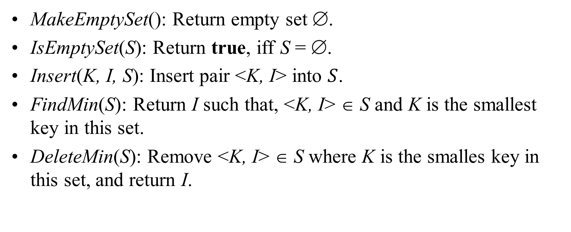
Priority Queues: ADT
MakeEmptySet(): Return empty set ∅.
IsEmptySet(S): Return true, iff S = ∅.
Insert(K, I, S): Insert pair <K, I> into $S$.
FindMin(S): Return I such that, <K, I> ∈ S and K is the smallest key in this set.
DeleteMin(S): Remove <K, I> ∈ S where K is the smalles key in this set, and return I.

Slide 7
Priority Queue Implementations
Unordered list (easy to build, but most operations are expensive)
Ordered list (some operations are still expensive)
Ordered tree (some overhead: Priority Queue does not need to be fully sorted)
Binary heap (binary tree)
Tree with pointers
Tree implemented as an array (most popular priority queue – Heap)

Slide 8
Binary Relations of Total Order
Keys in a priority queue can be arbitrary objects on which an order is defined
Two distinct entries in a priority queue can have the same key
Mathematical concept of total order relation ≤
Reflexive property: x ≤ x
Antisymmetric property: x ≤ y ∧ y ≤ x ⇒ x = y
Transitive property: x ≤ y ∧ y ≤ z ⇒ x ≤ z

Slide 9
Comparator ADT
Implements the boolean function isLess(p,q), which tests whether p < q
Can derive other relations from this:
(p == q) is equivalent to
(!isLess(p, q) && !isLess(q, p))
Can implement in C++ by overloading “()”
Two ways to compare 2D points:
class LeftRight { // left-right comparator
public:
bool operator()(const Point2D& p, const Point2D& q) const
{ return p.getX() < q.getX(); }
};
class BottomTop { // bottom-top
public:
bool operator()(const Point2D& p, const Point2D& q) const
{ return p.getY() < q.getY(); }
};

Slide 10
Priority Queue Sorting
We can use a priority queue to sort a set of comparable elements
Insert the elements one by one with a series of insert operations
Remove the elements in sorted order with a series of removeMin operations
The running time of this sorting method depends on the priority queue implementation
Algorithm PQ-Sort(S, C)
Input sequence S, comparator C for the elements of S
Output sequence S sorted in increasing order according to C
P ← priority queue with comparator C
while ¬S.empty ()
e ← S.front(); S.eraseFront()
P.insert (e, ∅)
while ¬P.empty()
e ← P.removeMin()
S.insertBack(e)

Slide 11
Sequence-based Priority Queue
Implementation with an unsorted list
Performance:
insert takes O(1) time since we can insert the item at the beginning or end of the sequence
removeMin and min take O(n) time since we have to traverse the entire sequence to find the smallest key
Implementation with a sorted list
Performance:
insert takes O(n) time since we have to find the place where to insert the item
removeMin and min take O(1) time, since the smallest key is at the beginning
4
5
2
3
1
1
2
3
4
5

Slide 12
Selection-Sort
Selection-sort is the variation of PQ-sort where the priority queue is implemented with an unsorted sequence
Running time of Selection-sort:
Inserting the elements into the priority queue with n insert operations takes O(n) time
Removing the elements in sorted order from the priority queue with n removeMin operations takes time proportional to 1 + 2 + …+ n
Selection-sort runs in O(n²) time

Slide 13
Selection-Sort Example
Sequence S Priority Queue P
Input: (7,4,8,2,5,3,9) ()
Phase 1
(a) (4,8,2,5,3,9) (7)
(b) (8,2,5,3,9) (7,4)
.. .. ..
(g) () (7,4,8,2,5,3,9)
Phase 2
(a) (2) (7,4,8,5,3,9)
(b) (2,3) (7,4,8,5,9)
(c) (2,3,4) (7,8,5,9)
(d) (2,3,4,5) (7,8,9)
(e) (2,3,4,5,7) (8,9)
(f) (2,3,4,5,7,8) (9)
(g) (2,3,4,5,7,8,9) ()

Slide 14
Insertion-Sort
Insertion-sort is the variation of PQ-sort where the priority queue is implemented with a sorted sequence
Running time of Insertion-sort:
Inserting the elements into the priority queue with n insert operations takes time proportional to
1 + 2 + …+ n
Removing the elements in sorted order from the priority queue with a series of n removeMin operations takes O(n) time
Insertion-sort runs in O(n²) time

Slide 15
Insertion-Sort Example
Sequence S Priority queue P
Input: (7,4,8,2,5,3,9) ()
Phase 1
(a) (4,8,2,5,3,9) (7)
(b) (8,2,5,3,9) (4,7)
(c) (2,5,3,9) (4,7,8)
(d) (5,3,9) (2,4,7,8)
(e) (3,9) (2,4,5,7,8)
(f) (9) (2,3,4,5,7,8)
(g) () (2,3,4,5,7,8,9)
Phase 2
(a) (2) (3,4,5,7,8,9)
(b) (2,3) (4,5,7,8,9)
.. .. ..
(g) (2,3,4,5,7,8,9) ()

Slide 16
In-place Insertion-Sort
Instead of using an external data structure, we can implement selection-sort and insertion-sort in-place
A portion of the input sequence itself serves as the priority queue
For in-place insertion-sort
We keep sorted the initial portion of the sequence
We can use swaps instead of modifying the sequence
5
4
2
3
1
5
4
2
3
1
4
5
2
3
1
2
4
5
3
1
2
3
4
5
1
1
2
3
4
5
1
2
3
4
5

Slide 17
Entry and Priority Queue ADTs
A priority queue stores a collection of entries
Typically, an entry is a pair (key, value), where the key indicates the priority
The priority queue is associated with a comparator C, that compares two entries
Priority Queue ADT:
insert(e) inserts entry e
removeMin() removes the entry with smallest key
min() returns, but does not remove, an entry with smallest key
size(), empty()

Slide 18
Example
Online trading system where orders to purchase and sell a stock are stored in two priority queues (one for sell orders and one for buy orders) as (p,s) entries:
The key, p, of an order is the price
The value, s, for an entry is the number of shares
A buy order (p,s) is executed when a sell order (p’,s’) with price p’<p is added (the execution is complete if s’>s)
A sell order (p,s) is executed when a buy order (p’,s’) with price p’>p is added (the execution is complete if s’>s)
What if someone wishes to cancel their order before it executes?
What if someone wishes to update the price or number of shares for their order?

Slide 19
Methods of the Adaptable Priority Queue ADT
insert(e): Insert the entry e into P and return a position referring to this entry
remove(p): Remove from P the entry referenced by position p
replace(p, e): Replace with e the element associated with the entry referenced by p and return the position of the altered entry

Slide 20
Example
Operation Output P
insert(5,A) p₁ (5,A)
insert(3,B) p₂ (3,B), (5,A)
insert(7,C) p₃ (3,B), (5,A), (7,C)
min() p₂ (3,B), (5,A), (7,C)
p₂.key() 3 (3,B), (5,A), (7,C)
remove(p₁) – (3,B), (7,C)
replace(p₂,(9,D)) p₄ (7,C), (9,D)
replace(p₃,(7,E)) p₅ (7,E), (9,D)
remove(p₄) – (7,D)

Slide 21
Locating Entries
In order to implement the operations remove(p) and replace(p), and we need fast ways of locating an entry p in a priority queue

Slide 22
Location-Aware Entries
A locator-aware entry identifies and tracks the location of its (key, value) object within a data structure
Intuitive notion:
Coat claim check
Valet claim ticket
Reservation number
Main idea:
Since entries are created and returned from the data structure itself, it can return location-aware entries, thereby making future updates easier

Slide 23
List Implementation
A location-aware list entry is an object storing
key
value
position (or rank) of the item in the list
In turn, the position (or array cell) stores the entry
Back pointers (or ranks) are updated during swaps
header
nodes/positions
trailer
2
c
4
c
5
c
8
c
entries

Slide 24
Heap Implementation
A location-aware heap entry is an object storing
key
value
position of the entry in the underlying heap
In turn, each heap position stores an entry
Back pointers are updated during entry swaps
2
d
4
a
6
b
8
g
5
e
9
c

Slide 25
Performance
Improved times thanks to location-aware entries are highlighted in red
Method Unsorted List Sorted List Heap
size, empty O(1) O(1) O(1)
insert O(1) O(n) O(log n)
min O(n) O(1) O(1)
removeMin O(n) O(1) O(log n)
remove O(1) O(1) O(log n)
replace O(1) O(n) O(log n)

Slide 26
Heap
Heap is a binary tree with elements with their priorities, but the nodes are ordered so that every node has priority less or equal with the priorities of its children.
Therefore at the top there is an element with the smallest priority and the priorities grow as we move down any path.
Implementation: Inserting an element; Removing the minimum-key element.

Slide 27
Implementing Heap
Implementation chances

Slide 28
Binary Heap
A heap with the minimum element at its root.
06
14
45
78
18
47
53
83
91
81
77
84
99
64

Slide 29
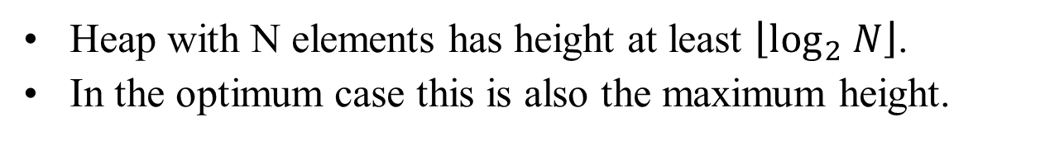
Properties of the binary heap
Heap with N elements has height at least $\left\lfloor \log_{2} N\right\rfloor$.
In the optimum case this is also the maximum height.
06
N = 14 Height = 3
14
45
78
18
47
53
83
91
81
77
84
99
64

Slide 30
Binary heap in an array
Parent(i) = ⎣(i-1)/2⎦
Left(i) = 2i + 1
Right(i) = 2i + 2
06
0
14
45
1
2
78
18
47
53
3
4
5
6
83
91
81
77
84
99
64
7
8
9
10
11
12
13

Slide 31
Inserting an element
Insert the new element (42) in the next free slot and, if necessary, raise it up to its permanent place.
06
14
45
78
18
47
53
83
91
81
77
84
99
64
42
Free slot

Slide 32
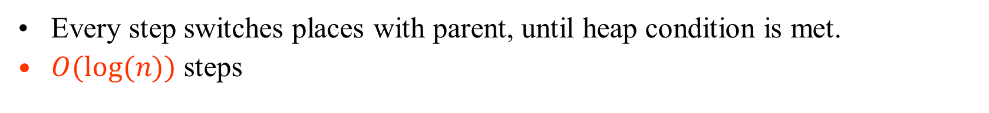
Inserting: Exchange with Parent
06
06
06
14
45
14
42
14
45
78
18
47
53
78
18
47
45
78
18
47
42
83
91
81
77
84
99
64
42
83
91
81
77
84
99
64
53
83
91
81
77
84
99
64
53
Stop, when the right
place has been reached.
Every step switches places with parent, until heap condition is met.
$O(log⁡(n))$ steps

Slide 33
Removing an element
The last leaf switches places with the (removed) root and then bubbles down to its proper place.
06
53
14
42
14
42
78
18
47
45
78
18
47
45
83
91
81
77
84
99
64
53
83
91
81
77
84
99
64
6

Slide 34
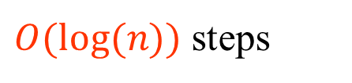
Removing an Element
53
14
14
14
42
53
42
18
42
78
18
47
45
78
18
47
45
78
53
47
45
83
91
81
77
84
99
64
83
91
81
77
84
99
64
83
91
81
77
84
99
64
Exchange with either child, if it is smaller
Stop, if the right place is reached
$O(log⁡(n))$ steps

Slide 35
Inserting an element
function HeapInsert(key K, info I, heap h):
// Add the pair <K,I> to the heap h.
H = Table(h)
n = Size(h)
if n = N then error // Heap is full. N – the length of array.
m = n // m is a pointer that moves up a tree branch
while m > 0 and K < Key(H[⎣(m-1)/2⎦]) do
H[m] = H[⎣(m-1)/2⎦] // Move some heap element down the tree.
m = ⎣(m-1)/2⎦ // Pointer m becomes Parent(m).
Key(H[m]) = K
Info(H[m]) = I // Insert the element into its proper location.
Size(h) = n+1

Slide 36
Removing an Element
procedure HeapDeleteMin(heap h): info
H = Table(h); n = Size(h)
if n = 0 then error {Heap is empty.}
I = Info(H[0]) {Element to be returned.}
K = Key(H[n-1]) {Priority of the element to be moved}
m = 0 {m is a pointer that traverses the tree.}
while 2m+1 < n and K > Key(H[2m+1]) or 2m+2 < n and K > Key(H[2m+2]) do
if 2m+2 < n then {Node m has two child nodes.}
if Key(H[2m+1]) < Key(H[2m+2]) then
p = 2m+1
else
p = 2m+2
else {Node m has just one child (the last leaf in the tree)}
p = n-1
H[m] = H[p] {Push child upwards}
m = p {Set the pointer downwards.}
H[m] = H[n-1] {Finally move the element to its position.}
Size(h) = n-1 {New size of the heap.}
return I

Slide 37
Recall Priority Queue ADT
A priority queue stores a collection of entries
Typically, an entry is a pair (key, value), where the key indicates the priority
Main methods of the Priority Queue ADT
insert(e) inserts an entry e
removeMin() removes the entry with smallest key
Additional methods
min() returns, but does not remove, an entry with smallest key
size(), empty()
Applications:
Standby flyers
Auctions
Stock market

Slide 38
Recall PQ Sorting
We use a priority queue
Insert the elements with a series of insert operations
Remove the elements in sorted order with a series of removeMin operations
The running time depends on the priority queue implementation:
Unsorted sequence gives selection-sort: O(n²) time
Sorted sequence gives insertion-sort: O(n²) time
Can we do better?
Algorithm PQ-Sort(S, C)
Input sequence S, comparator C for the elements of S
Output sequence S sorted in increasing order according to C
P ← priority queue with comparator C
while ¬S.empty ()
e ← S.front(); S.eraseFront()
P.insert (e, ∅)
while ¬P.empty()
e ← P.removeMin()
S.insertBack(e)

Slide 39
Heaps
A heap is a binary tree storing keys at its nodes and satisfying the following properties:
Heap-Order: for every internal node v other than the root, key(v) ≥ key(parent(v))
Complete Binary Tree: let h be the height of the heap
for i = 0, … , h − 1, there are 2^{i} nodes of depth i
at depth h − 1, the internal nodes are to the left of the external nodes
The last node of a heap is the rightmost node of maximum depth
2
5
6
9
7
last node

Slide 40
Height of a Heap
Theorem: A heap storing n keys has height O(log n)
Proof: (we apply the complete binary tree property)
Let h be the height of a heap storing n keys
Since there are 2^{i} keys at depth i = 0, … , h − 1 and at least one key at depth h, we have n ≥ 1 + 2 + 4 + … + 2^{h−1} + 1
Thus, n ≥ 2^{h} , i.e., h ≤ log n
depth
keys
0
1
1
2
h−1
2^{h−1}
h
1

Slide 41
Heaps and Priority Queues
We can use a heap to implement a priority queue
We store a (key, element) item at each internal node
We keep track of the position of the last node
(2, Sue)
(5, Pat)
(6, Mark)
(9, Jeff)
(7, Anna)

Slide 42
Insertion into a Heap
Method insertItem of the priority queue ADT corresponds to the insertion of a key k to the heap
The insertion algorithm consists of three steps
Find the insertion node z (the new last node)
Store k at z
Restore the heap-order property (discussed next)
2
5
z
6
9
7
insertion node
2
5
6
z
9
7
1

Slide 43
Upheap
After the insertion of a new key k, the heap-order property may be violated
Algorithm upheap restores the heap-order property by swapping k along an upward path from the insertion node
Upheap terminates when the key k reaches the root or a node whose parent has a key smaller than or equal to k
Since a heap has height O(log n), upheap runs in O(log n) time
2
1
5
1
5
2
z
z
9
7
6
9
7
6

Slide 44
Removal from a Heap (§ 7.3.3)
Method removeMin of the priority queue ADT corresponds to the removal of the root key from the heap
The removal algorithm consists of three steps
Replace the root key with the key of the last node w
Remove w
Restore the heap-order property (discussed next)
2
7
5
6
5
6
w
w
9
7
9
last node
new last node

Slide 45
Downheap
After replacing the root key with the key k of the last node, the heap-order property may be violated
Algorithm downheap restores the heap-order property by swapping key k along a downward path from the root
Upheap terminates when key k reaches a leaf or a node whose children have keys greater than or equal to k
Since a heap has height O(log n), downheap runs in O(log n) time
7
5
5
6
7
6
w
w
9
9

Slide 46
Updating the Last Node
The insertion node can be found by traversing a path of O(log n) nodes
Go up until a left child or the root is reached
If a left child is reached, go to the right child
Go down left until a leaf is reached
Similar algorithm for updating the last node after a removal

Slide 47
Heap-Sort
Consider a priority queue with n items implemented by means of a heap
the space used is O(n)
methods insert and removeMin take O(log n) time
methods size, empty, and min take time O(1) time
Using a heap-based priority queue, we can sort a sequence of n elements in O(n log n) time
The resulting algorithm is called heap-sort
Heap-sort is much faster than quadratic sorting algorithms, such as insertion-sort and selection-sort

Slide 48
Vector-based Heap Implementation
We can represent a heap with n keys by means of a vector of length n + 1
For the node at rank i
the left child is at rank 2i
the right child is at rank 2i + 1
Links between nodes are not explicitly stored
The cell of at rank 0 is not used
Operation insert corresponds to inserting at rank n + 1
Operation removeMin corresponds to removing at rank n
Yields in-place heap-sort
2
5
6
9
7
2
5
6
9
7
0
1
2
3
4
5

Slide 49
Merging Two Heaps
3
2
We are given two two heaps and a key k
We create a new heap with the root node storing k and with the two heaps as subtrees
We perform downheap to restore the heap-order property
8
5
4
6
7
3
2
8
5
4
6
2
3
4
8
5
7
6

Slide 50
Bottom-up Heap Construction
We can construct a heap storing n given keys in using a bottom-up construction with log n phases
In phase i, pairs of heaps with 2^{i} −1 keys are merged into heaps with 2^{i+1}−1 keys
2^{i} −1
2^{i} −1
2^{i+1}−1

Slide 51
Example
16
15
4
12
6
7
23
20
25
5
11
27
16
15
4
12
6
7
23
20

Slide 52
Example (contd.)
25
5
11
27
16
15
4
12
6
9
23
20
15
4
6
23
16
25
5
12
11
9
27
20

Slide 53
Example (contd.)
7
8
15
4
6
23
16
25
5
12
11
9
27
20
4
6
15
5
8
23
16
25
7
12
11
9
27
20

Slide 54
Example (end)
10
4
6
15
5
8
23
16
25
7
12
11
9
27
20
4
5
6
15
7
8
23
16
25
10
12
11
9
27
20

Slide 55
Analysis
We visualize the worst-case time of a downheap with a proxy path that goes first right and then repeatedly goes left until the bottom of the heap (this path may differ from the actual downheap path)
Since each node is traversed by at most two proxy paths, the total number of nodes of the proxy paths is O(n)
Thus, bottom-up heap construction runs in O(n) time
Bottom-up heap construction is faster than n successive insertions and speeds up the first phase of heap-sort

Slide 56
Heaps
A heap is a special type of binary tree with the following properties:
The value of each node is greater than or equal to the values stored in its children
The tree is perfectly balanced, and the leaves in the last level are leftmost in the tree
This actually defines a max heap; if “greater than” is replaced by “less than” in the first property, we have a min heap
Thus the root of a max heap is the largest element, and the root of a min heap the smallest
If each nonleaf of a tree exhibits the first property, the tree exhibits the heap property

Slide 57
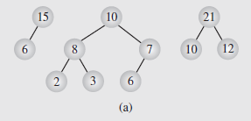
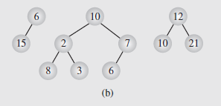
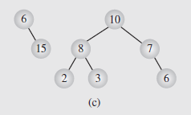
Heaps (continued)
Max-Heaps: The value of each node is greater than or equal to the values stored in its children

Slide 58
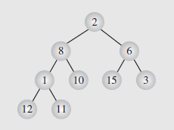
Heaps (continued)
Heaps can be implemented as arrays
As an example, consider the array data=[2 8 6 1 10 15 3 12 11] represented as a nonheap tree in Figure 6.52
Fig. 6.52 The array [2 8 6 1 10 15 3 12 11]
seen as a tree
The arrangement of the elements reflects the tree from top-to-bottom and left-to-right

Slide 59
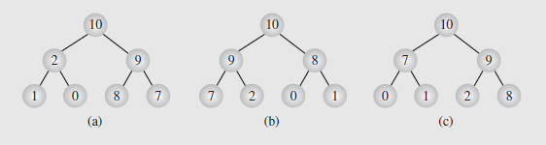
Heaps (continued)
Define a heap as an array heap of length n where
heap[i] > heap[2i + 1], for 0 < i < (n – 1)/2
and
heap[i] > heap[2i + 2], for 0 < i < (n – 2)/2
Elements in a heap are not ordered; we only know the root is the smallest (or largest in max-heap) and the descendants are less than or equal than parent.
The relationship in adjacent subtrees is undetermined.

Slide 60
Heaps (continued)
Heaps as Priority Queues
Heaps are ideal for implementing priority queues
We saw linked lists used to do this in section 4.3, but for large amounts of data, they can become inefficient
Because heaps are perfectly balanced trees, the inherent efficiency of searching such structures makes them more useful
We will need a couple of routines to enqueue and dequeue elements on the priority queue, though
To enqueue, the node is added at the end of the heap as the last leaf
If the heap needs to be restructured to preserve the heap property, it can be done by moving the node from last leaf towards the root

Slide 61
Heaps (continued)
Heaps as Priority Queues (continued)
The enqueuing algorithm is as follows:
heapEnqueue(el)
put el at the end of the heap;
while el is not in the root and el > parent(el)
swap el with its parent;
This is illustrated in Figure 6.54a, where the node 15 is added to the heap
Because this destroys the heap property, 15 is moved up the tree until it is either the root or finds a parent greater than or equal to 15
This is reflected in Figure 6.54b-d

Slide 62
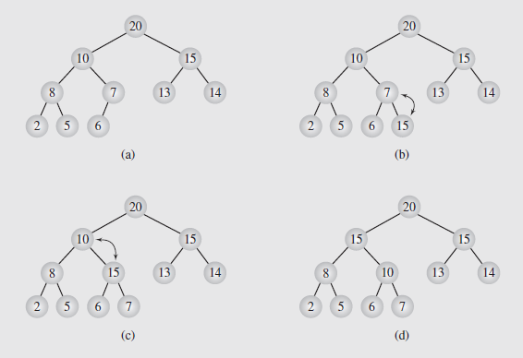
Heaps (continued)
Heaps as Priority Queues (continued)
Fig. 6.54 Enqueuing an element to a heap

Slide 63
Heaps (continued)
Heaps as Priority Queues (continued)
Dequeuing an element from a heap simply removes the root (since it is the largest value) and replacing it by the last leaf
Since this will most likely violate the heap property, the node is moved down the tree to the appropriate location
The algorithm for this looks like:
heapDequeue()
extract the element from the root;
put the element from the last leaf in its place;
remove the last leaf;
// both subtrees of the root are heaps
p = the root;
while p is not a leaf and p < any of its children
swap p with the larger child;

Slide 64
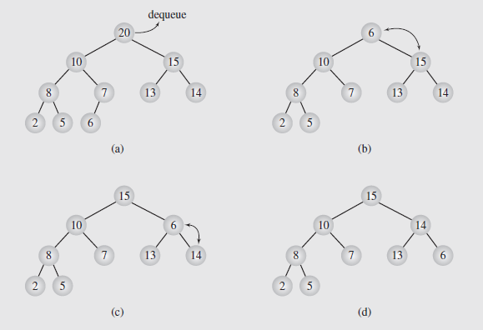
Heaps (continued)
Heaps as Priority Queues (continued)
This is shown in Figure 6.55; 20 is dequeued and 6 put in its place
This is then swapped with 15 (the larger child) and again with 14
Fig. 6.55 Dequeuing an element from a heap

Slide 65
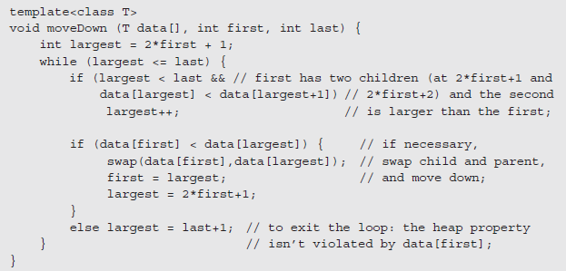
Heaps (continued)
Heaps as Priority Queues (continued)
The last three lines of this dequeuing algorithm can be used as a stand-alone routine to restore the heap property if it is violated by the root by moving it down the tree; a coded form is shown below:
Fig. 6.56 Implementation of an algorithm to move the root element down a tree

Slide 66
Heaps (continued)
Organizing Arrays as Heaps (continued)
A bottom-up approach that starts by forming small heaps and merging them into larger heaps was proposed by Robert Floyd
The algorithm follows:
FloydAlgorithm(data[])
for i = index of the last nonleaf down to 0
restore the heap property for the tree whose root is
data[i] by calling moveDown(data, i, n-1);
Figure 6.58 (page 275) shows an example of transforming the array data[] = [2 8 6 1 10 15 3 12 11] into a heap
The process is described in detail on pages 273 - 276

