Slide 1
Data Structures Balancing BSTs
Data Structures and Algorithms
http://linen-tracer-682.appspot.com/data-structures/index.html
Notes:
# Every module has the following content
* Title (1 slide)
* Table of Contents (1 slide) – where are we in the material?
* Motivation (1 slide) – why do we need this module?
* Anchor Task (1x) – introduce the key problem handled by this module
* Objectives (1x)
* Theory Section (1 subtitle + more slides) or Demo Section (1 subtitle + more slides)
* Summary (1x) * References (1x)

Slide 2
Why care about code on text-based input/output?
Binary Search Trees – node order invariant.
Performance Issues – Skinny vs. Bushy trees
Balancing techniques.
Notes:
* For people who want to become professionals = can create systems that others will use
* For people who like to challenge themselves with difficult problems.
* For highly motivated people who also want to sleep; who take normal course-load, but typically do not work full-time yet.

Slide 3
Ordered Maps
Keys come from a total order
New operations:
Each returns an iterator to an entry:
firstEntry(): smallest key in the map
lastEntry(): largest key in the map
floorEntry(k): largest key ≤ k
ceilingEntry(k): smallest key ≥ k
All return end if the map is empty

Slide 4
Binary Search
Binary search can perform operations get, floorEntry and ceilingEntry on an ordered map implemented by means of an array-based sequence, sorted by key
similar to the high-low game
at each step, the number of candidate items is halved
terminates after O(log n) steps
Example: find(7)
0
1
3
4
5
7
8
9
11
14
16
18
19
l
m
h
0
1
3
4
5
7
8
9
11
14
16
18
19
l
m
h
0
1
3
4
5
7
8
9
11
14
16
18
19
l
m
h
0
1
3
4
5
7
8
9
11
14
16
18
19
l=m =h

Slide 5
Search Tables
A search table is an ordered map implemented by means of a sorted sequence
We store the items in an array-based sequence, sorted by key
We use an external comparator for the keys
Performance:
get, floorEntry and ceilingEntry take O(log n) time, using binary search
get takes O(n) time since in the worst case we have to shift n/2 items to make room for the new item
erase take O(n) time since in the worst case we have to shift n/2 items to compact the items after the removal
The lookup table is effective only for dictionaries of small size or for dictionaries on which searches are the most common operations, while insertions and removals are rarely performed (e.g., credit card authorizations)

Slide 6
Binary Search Trees
A binary search tree is a binary tree storing keys (or key-value entries) at its internal nodes and satisfying the following property:
Let u, v, and w be three nodes such that u is in the left subtree of v and w is in the right subtree of v. We have key(u) ≤ key(v) ≤ key(w)
External nodes do not store items
An inorder traversal of a binary search trees visits the keys in increasing order
6
2
9
1
4
8

Slide 7
Search
Algorithm TreeSearch(k, v)
if v.isExternal ()
return v
if k < v.key()
return TreeSearch(k, v.left())
else if k = v.key()
return v
else { k > v.key() }
return TreeSearch(k, v.right())
To search for a key k, we trace a downward path starting at the root
The next node visited depends on the comparison of k with the key of the current node
If we reach a leaf, the key is not found
Example: get(4):
Call TreeSearch(4,root)
The algorithms for floorEntry and ceilingEntry are similar
<
6
2
>
9
1
4
=
8

Slide 8
Insertion
<
6
To perform operation put(k, o), we search for key k (using TreeSearch)
Assume k is not already in the tree, and let w be the leaf reached by the search
We insert k at node w and expand w into an internal node
Example: insert 5
2
>
9
1
4
>
8
w
6
2
9
1
4
8
w
5

Slide 9
Deletion
<
6
To perform operation erase(k), we search for key k
Assume key k is in the tree, and let let v be the node storing k
If node v has a leaf child w, we remove v and w from the tree with operation removeExternal(w), which removes w and its parent
Example: remove 4
2
>
9
1
4
v
8
w
5
6
2
9
1
5
8

Slide 10
Deletion (cont.)
1
v
We consider the case where the key k to be removed is stored at a node v whose children are both internal
we find the internal node w that follows v in an inorder traversal
we copy key(w) into node v
we remove node w and its left child z (which must be a leaf) by means of operation removeExternal(z)
Example: remove 3
3
2
8
6
9
w
5
z
1
v
5
2
8
6
9

Slide 11
Performance
Consider an ordered map with n items implemented by means of a binary search tree of height h
the space used is O(n)
methods get, floorEntry, ceilingEntry, put and erase take O(h) time
The height h is O(n) in the worst case and O(log n) in the best case

Slide 12
Insertion
Searching a binary tree does not modify the tree
Traversals may temporarily modify the tree, but it is usually left in its original form when the traversal is done
Operations like insertions, deletions, modifying values, merging trees, and balancing trees do alter the tree structure
We’ll look at how insertions are managed in binary search trees first
In order to insert a new node in a binary tree, we have to be at a node with a vacant left or right child
This is performed in the same way as searching:
Compare the value of the node to be inserted to the current node
If the value to be inserted is smaller, follow the left subtree; if it is larger, follow the right subtree
If the branch we are to follow is empty, we stop the search and insert the new node as that child

Slide 13
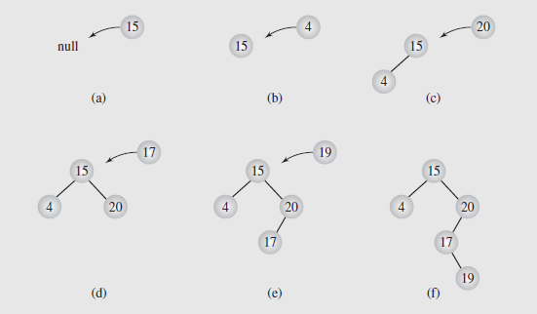
Insertion (continued)
This process is shown in Figure 6.22; the code to implement this algorithm shown in Figure 6.23
Fig. 6.22 Inserting nodes into binary search trees

Slide 14
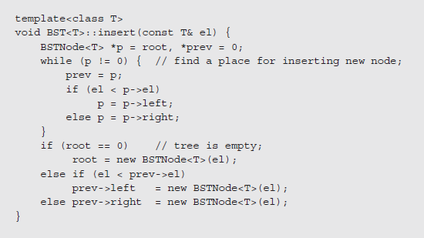
Insertion (continued)
Fig. 6.23 Implementation of the insertion algorithm

Slide 15
Insertion (continued)
In looking at tree traversal, we considered three approaches: stack-based, thread-based, and via transformations
Stack based traversals don’t change the trees; transformations change the tree but restore it when done
Threaded approaches, though, do modify the tree by adding threads to the structure
While it may be possible to add and remove the threads as needed, if the tree is processed frequently, we might want to make the threads a permanent part of the tree
This requires incorporating threads into the insertion process

Slide 16
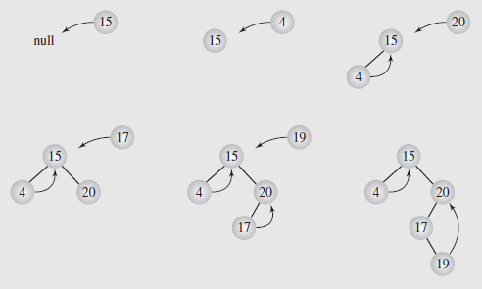
Insertion (continued)
The algorithm for inserting a node in a threaded tree is a simple modification of the original function that adjusts the threads where needed
The implementation of this algorithm is shown in Figure 6.24 on page 242; the first insertions are shown in Figure 6.25
Fig. 6.25 Inserting nodes into a threaded tree

Slide 17
Deletion
Deletion is another operation essential to maintaining a binary search tree
This can be a complex operation depending on the placement of the node to be deleted in the tree
The more children a node has, the more complex the deletion process
This implies three cases of deletion that need to be handled:
The node is a leaf; this is the easiest case, because all that needs to be done is to set the parent link to null and delete the node (Figure 6.26)
The node has one child; also easy, as we set the parent’s pointer to the node to point to the node’s child (Figure 6.27)

Slide 18
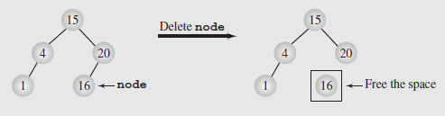
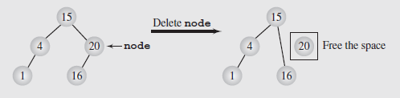
Deletion (continued)
Fig. 6.26 Deleting a leaf
Fig. 6.27 Deleting a node with one child
The third case, and most difficult to handle, is when the node has two children, as there is no one-step process; we’ll consider two options

Slide 19
Deletion (continued)
Deletion by Merging
The first approach, deletion by merging, works by making one tree out of the node’s two subtrees and attaching it to the node’s parent
This is accomplished by recalling that the value of every node in the right subtree is greater than the value of every node in the left subtree
So the rightmost node of the left subtree will be the largest value in that subtree, and it will become the parent of the right subtree
To do this, we start at the root of the left subtree and follow right links until we encounter a node with an empty right pointer
This node will then set that pointer to the right subtree, and the parent of the left subtree is promoted to replace the deleted node
This entire operation is shown in Figure 6.28; Figure 6.29 (pages 245 and 246) shows the code for the algorithm

Slide 20
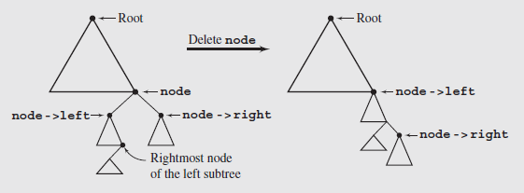
Deletion (continued)
Deletion by Merging (continued)
Fig. 6.28 Summary of deleting by merging
The individual steps in the process are shown in Figure 6.30
The numbers in the figure correspond to the numbers in the comments of the code in Figure 6.29

Slide 21
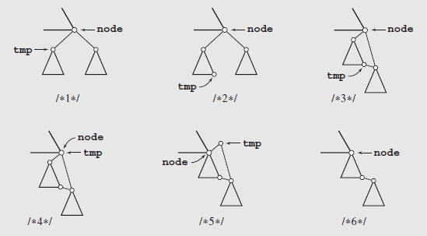
Deletion (continued)
Fig. 6.30 Details of deleting by merging

Slide 22
Deletion (continued)
Deletion by Merging (continued)
The tree that results from merging may have a very different structure from the original tree
In some cases it can be taller, even skewed; occasionally it can be shorter
This does not mean the algorithm is inefficient; but we do need to try and find a way to maintain some type of balance in the tree
Figure 6.31 illustrates these issues; 6.31a shows the type of imbalance that may occur, and 6.31b shows a “shorter” tree

Slide 23
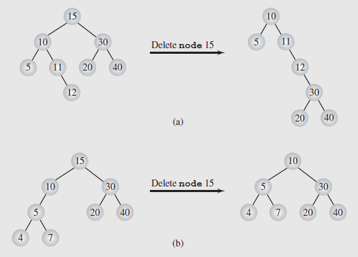
Deletion (continued)
Fig. 6.31 The height of a tree can be (a) extended
or (b) reduced after deleting by merging

Slide 24
Deletion (continued)
Deletion by Copying
Another approach to handling deleting is called deletion by copying and was proposed by Thomas Hibbard and Donald Knuth in the 1960s
Initially, this works much like the merging process
We locate the node’s predecessor by searching for the rightmost node in the left subtree
The key of this node replaces the key of the node to be deleted
We then recall the two simple cases of deletion: if the rightmost node was a leaf, we delete it; if it has one child, we set the parent’s pointer to the node to point to the node’s child
This way, we delete a key k₁ by overwriting it by a key k₂ and then deleting the node holding k₂

Slide 25
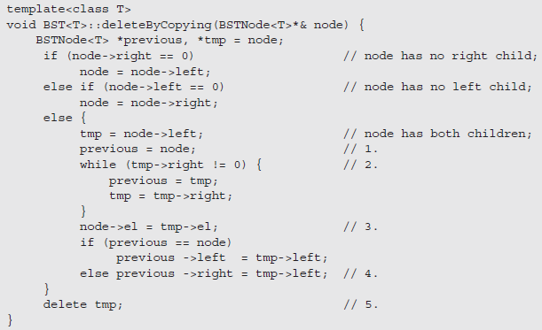
Deletion (continued)
Deletion by Copying (continued)
This algorithm is implemented by two functions, the first of which is shown in Figure 6.32
Fig. 6.32 Implementation of an algorithm for deleting by copying

Slide 26
Deletion (continued)
Deletion by Copying (continued)
The second function works like the merging function of Figure 6.29, except it calls the deleteByCopying()function rather than deleteByMerging()
A trace of this process is shown in Figure 6.33
The numbers in the diagrams refer to the numbers in the code of Figure 6.32
This algorithm avoids the height increase problem of merging, but problems can still result
Since the algorithm always deletes the immediate predecessor of the key being replaced, the left subtree can shrink while the right subtree is unchanged, making the algorithm asymmetric

Slide 27
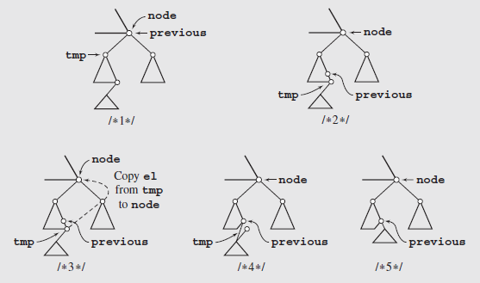
Deletion (continued)
Figure 6.33 Deleting by copying

Slide 28
Deletion (continued)
Deletion by Copying (continued)
Eventually the tree becomes unbalanced to the right, and the right subtree is bushier and larger than the left
A simple improvement can make this symmetric; we alternately delete the node’s predecessor from the left subtree and its successor from the right subtree
This provides significant improvements; however the analysis has proven to be extremely complex, and most studies focus on simulations

Slide 29
AVL Tree Definition
Georgij Adelson-Velski + Evgeny Landis (1962)
AVL trees are balanced
An AVL Tree is a binary search tree such that for every internal node v of T, the heights of the children of v can differ by at most 1
An example of an AVL tree where the heights are shown next to the nodes:

Slide 30
Height of an AVL Tree
Fact: The height of an AVL tree storing n keys is O(log n).
Proof: Let us bound n(h): the minimum number of internal nodes of an AVL tree of height h.
We easily see that n(1) = 1 and n(2) = 2
For n > 2, an AVL tree of height h contains the root node, one AVL subtree of height n-1 and another of height n-2.
That is, n(h) = 1 + n(h-1) + n(h-2)
Knowing n(h-1) > n(h-2), we get n(h) > 2n(h-2). So
n(h) > 2n(h-2), n(h) > 4n(h-4), n(h) > 8n(n-6), … (by induction),
n(h) > 2^{i}n(h-2i)
Solving the base case we get: n(h) > 2 ^{h/2-1}
Taking logarithms: h < 2log n(h) +2
Thus the height of an AVL tree is O(log n)
n(2)
3
4
n(1)

Slide 31
Insertion
Insertion is as in a binary search tree
Always done by expanding an external node.
Example:
44
44
17
78
17
78
c=z
a=y
32
50
88
32
50
88
48
62
48
62
b=x
54
w
before insertion
after insertion

Slide 32
Trinode Restructuring
let (a,b,c) be an inorder listing of x, y, z
perform the rotations needed to make b the topmost node of the three
(other two cases are symmetrical)
a=z
a=z
case 2: double rotation
(a right rotation about c, then a left rotation about a)
b=y
T₀
c=y
T₀
c=x
b=x
T₃
T₁
b=y
T₁
T₂
b=x
T₂
T₃
a=z
c=x
a=z
c=y
case 1: single rotation
(a left rotation about a)
T₀
T₁
T₂
T₃
T₀
T₁
T₂
T₃

Slide 33
Insertion Example, continued
unbalanced...
T
4
1
44
2
3
x
17
y
62
z
1
2
2
32
50
78
1
1
1
...balanced
48
54
88
T
2
T
0
T
1
T
3

Slide 34
Restructuring (as Single Rotations)
Single Rotations:

Slide 35
Restructuring (as Double Rotations)
double rotations:

Slide 36
Removal
Removal begins as in a binary search tree, which means the node removed will become an empty external node. Its parent, w, may cause an imbalance.
Example:
44
44
17
62
17
62
32
50
78
50
78
48
54
88
48
54
88
before deletion of 32
after deletion

Slide 37
Rebalancing after a Removal
Let z be the first unbalanced node encountered while travelling up the tree from w. Also, let y be the child of z with the larger height, and let x be the child of y with the larger height
We perform restructure(x) to restore balance at z
As this restructuring may upset the balance of another node higher in the tree, we must continue checking for balance until the root of T is reached
62
a=z
44
w
b=y
44
78
17
62
c=x
17
50
88
50
78
48
54
48
54
88

Slide 38
AVL Tree Performance
a single restructure takes O(1) time
using a linked-structure binary tree
find takes O(log n) time
height of tree is O(log n), no restructures needed
put takes O(log n) time
initial find is O(log n)
Restructuring up the tree, maintaining heights is O(log n)
erase takes O(log n) time
initial find is O(log n)
Restructuring up the tree, maintaining heights is O(log n)
6
v
3
8
z
4

Slide 39
Balancing a Tree
Two arguments have been presented in favor of trees:
They represent hierarchical data particularly well
Searching trees is much faster than searching lists
However, this second point depends on the structure of the tree
As we’ve seen, skewed trees search no better than linear lists
Three situations are presented in Figure 6.34
A fairly well-balanced tree (Figure 6.34a)
A right unbalanced tree (Figure 6.34b)
A right skewed tree (Figure 6.34c)
Neither of the last two situations occur in balanced trees

Slide 40
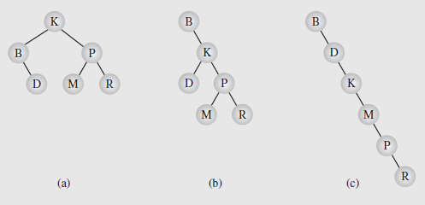
Balancing a Tree (continued)
Fig. 6.34 Different binary search trees with the same information
A binary tree is height balanced (or simply, balanced) if the difference in height of the subtrees of any node in the tree is zero or one
It is perfectly balanced if it is balanced and all leaves are on one or two levels

Slide 41
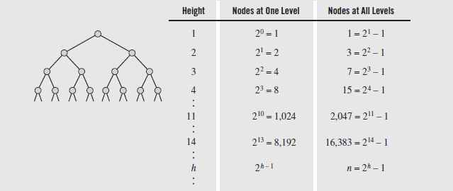

Balancing a Tree (continued)
The number of nodes that can be stored in binary trees of different heights is shown in Figure 6.35
Fig. 6.35 Maximum number of nodes in binary trees of different heights
From this we can see that if we store n elements in a perfectly balanced tree, the height is $\left\lceil \text{lg}\left(n+1\right)\right\rceil$

Slide 42
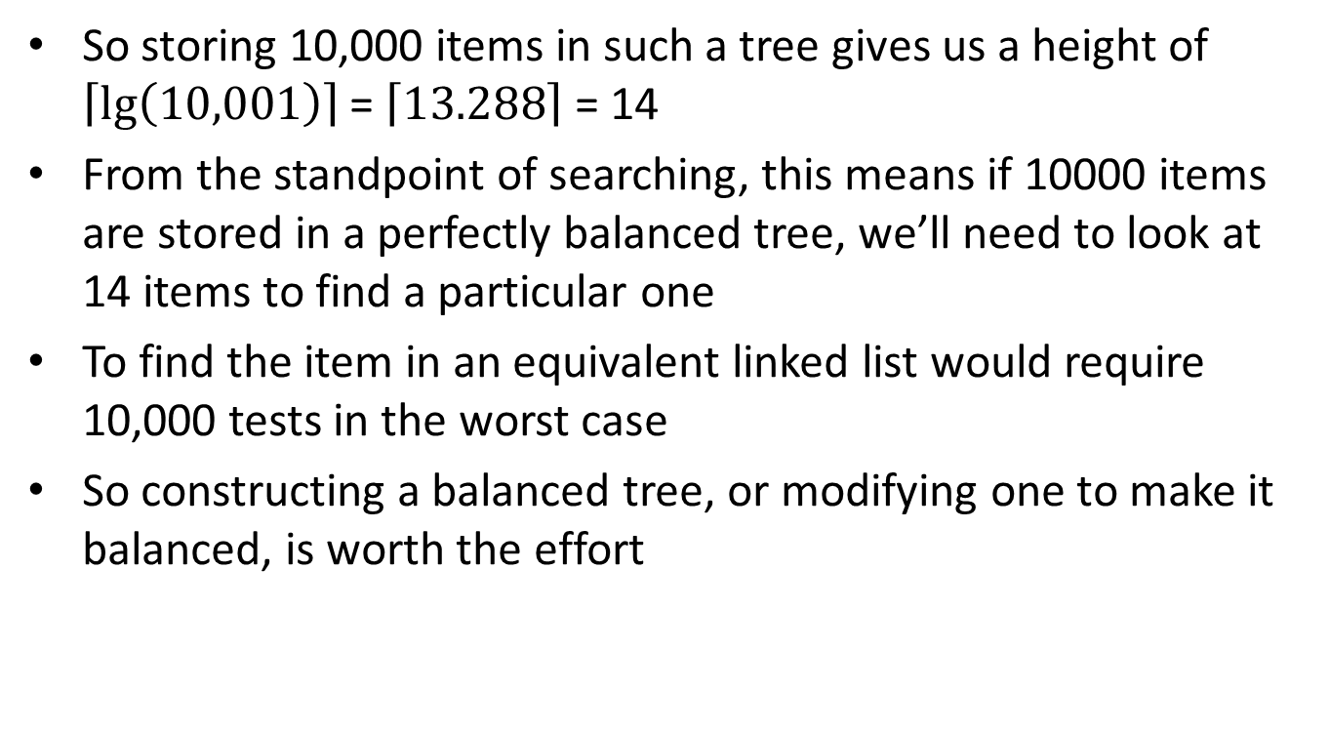
Balancing a Tree (continued)
So storing 10,000 items in such a tree gives us a height of $\left\lceil \text{lg}\left(10,001\right)\right\rceil$ = $\left\lceil 13.288\right\rceil$ = 14
From the standpoint of searching, this means if 10000 items are stored in a perfectly balanced tree, we’ll need to look at 14 items to find a particular one
To find the item in an equivalent linked list would require 10,000 tests in the worst case
So constructing a balanced tree, or modifying one to make it balanced, is worth the effort

Slide 43
Balancing a Tree (continued)
There are many techniques for balancing a tree
Some monitor the tree as items are added, and restructure the tree when it becomes unbalanced
Others reorder the data being processed and then build the tree, if the reordering leads to the construction of a balanced tree
We’ll first consider a process based on this latter technique
In looking at Figure 6.34, notice that the structure of the trees resulted from the order in which the data was placed
In 6.34c, data was in ascending order, resulting in a right skewed tree
In 6.34b, “B” arrived first, and since only “A” is less than “B”, all the other nodes were placed in the right subtree
In 6.34c, the root was near the middle of the list, resulting in a more balanced tree

Slide 44
Balancing a Tree (continued)
This last arrangement suggests using an algorithm based on the binary search technique to construct the tree
The data is stored in an array as it arrives, then sorted
The element in the middle of the array is designated as the root
The elements in the middle of the left and right subarrays become the roots of the left and right subtrees, etc.
As this proceeds we build the tree one level at a time; first the root, then its left and right children, etc.
If we modify this to insert the root, then its left child, then the left child’s child, etc., we can create a simple recursive algorithm

Slide 45
Balancing a Tree (continued)
template <class T>
void BST<T>::balance(T data[], int first, int last) {
if (first <= last) {
int middle = (first = last)/2;
insert(data[middle]);
balance(data, first, middle-1);
balance(data, middle+1, last);
}
}
An application of this algorithm is shown in Figure 6.36

Slide 46
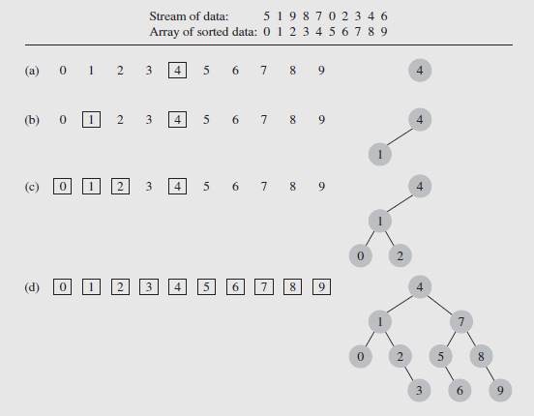
Balancing a Tree (continued)
Fig. 6.36 Creating a binary search tree from an ordered array

Slide 47
Balancing a Tree (continued)
This algorithm does suffer from one significant drawback
All the data needs to be in the array before the tree can be created
So it can be unsuitable for a tree that needs to be used while it is being constructed
On the other hand, an unbalanced tree can be balanced easily by carrying out an inorder traversal and writing the output to an array
This array can then be used to create a balanced version of the tree

Slide 48
Balancing a Tree (continued)
The DSW Algorithm
The previous algorithm is rather inefficient due to the need for an auxiliary array to handle data storage during construction or reorganization of the tree
Thus it should only be used for fairly small trees
There are other algorithms that use little extra storage and do not require sorting, however
One such algorithm was developed by Colin Day and modified by Quentin F. Stout and Bette L. Warren; it is called the DSW algorithm
Key to the behavior of this algorithm is the idea of rotation, introduced by Adel’son-Vel’skii and Landis in 1962
Two types of rotation can occur, left and right, which are symmetric

Slide 49
Balancing a Tree (continued)
The DSW Algorithm (continued)
The right rotation of a node Ch around its parent Par is performed as follows:
rotateRight(Gr, Par, Ch)
if Par is not the root of the tree //i.e.,if Gr is not null
grandparent Gr of child Ch becomes Ch’s parent;
right subtree of Ch becomes left subtree of Ch’s parent Par;
node Ch acquires Par as its right child;
The steps of this are shown in Figure 6.37; note that the heart of this process is the third step, when parent and child swap roles
The first and second steps ensure that the tree remains a search tree after the rotation is completed

Slide 50
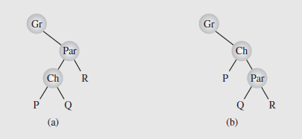
Balancing a Tree (continued)
The DSW Algorithm (continued)
Fig. 6.37 Right rotation of child Ch about parent Par
Essentially, the algorithm transforms an arbitrary binary search tree into a linked list-like structure called a backbone or vine
This is further transformed into a perfectly balanced tree by rotating every second node of the backbone around its parent

Slide 51
Balancing a Tree (continued)
The DSW Algorithm (continued)
The algorithm to create the backbone, which is the first step of the process, is as follows:
createBackbone(root)
tmp = root;
while (tmp != 0)
if tmp has a left child
rotate this child about tmp; // hence the left child
// becomes parent of tmp
set tmp to the child that just became parent;
else set tmp to its right child;
Figure 6.38 illustrates the operation of this algorithm; notice since rotation requires knowing about the parent of tmp, another pointer has to be used

Slide 52
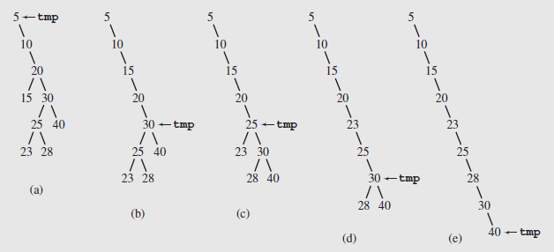
Balancing a Tree (continued)
Fig. 6.38 Transforming a binary search tree into a backbone

Slide 53
Balancing a Tree (continued)
The DSW Algorithm (continued)
In the second step of the transformation, the backbone is transformed into a perfectly balanced tree
In each pass down the backbone, every second node is rotated about its parent
The first pass handles the difference between the number of nodes in the backbone and the number of nodes in the closest complete binary tree
Overflowing nodes are treated separately
An example of this is shown in Figure 6.39
The backbone from Figure 6.38e is transformed in the first pass to the backbone of Figure 6.39b; then two additional passes are executed

Slide 54
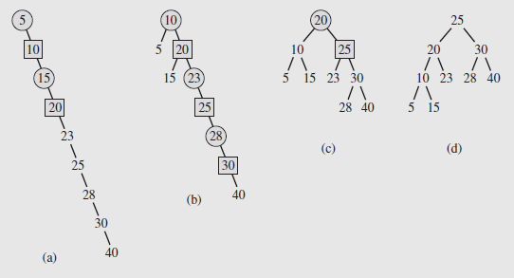
Balancing a Tree (continued)
The DSW Algorithm (continued)
Fig. 6.39 Transforming a backbone into a perfectly balanced tree
In these diagrams, the nodes being promoted one level by left rotations are shown as squares
The circles are the parents about which they are rotated

Slide 55
Balancing a Tree (continued)
The DSW Algorithm (continued)
The algorithm for this operation is shown following:
createPerfectTree()
n = number of nodes;
m = ;
make n-m rotations starting from the top of backbone;
while(m > 1)
m = m / 2;
make m rotations starting from the top of backbone;

Slide 56
Balancing a Tree (continued)
AVL Trees
The balancing algorithms we’ve looked at so far can potentially involve the entire tree
However, rebalancing can be performed locally if the insertions or deletions impact only a portion of the tree
One well-known method is based on the work of Adel’son-Vel’skii and Landis, and is named for them: the AVL tree
An AVL tree (also called an admissible tree) is one where the height of the left and right subtrees of every node differ by at most one
Examples of AVL trees are shown in Figure 6.40
Numbers in the nodes are the balance factors, which is the difference between the height of the right and left subtrees and should be +1, 0, or -1 for AVL trees

Slide 57
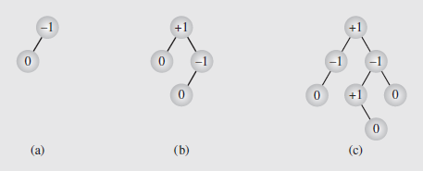
Balancing a Tree (continued)
AVL Trees (continued)
Fig. 6.40 Examples of AVL trees
Notice that while the definition of an AVL tree is the same as that of a balanced tree, the model implicitly includes the balancing techniques
In addition, the process of balancing an AVL tree does not guarantee a perfectly balanced tree
The minimum number of nodes in an AVL tree is determined by:
AVL_{h} = AVL_{h-1} + AVL_{h-2} + 1

Slide 58
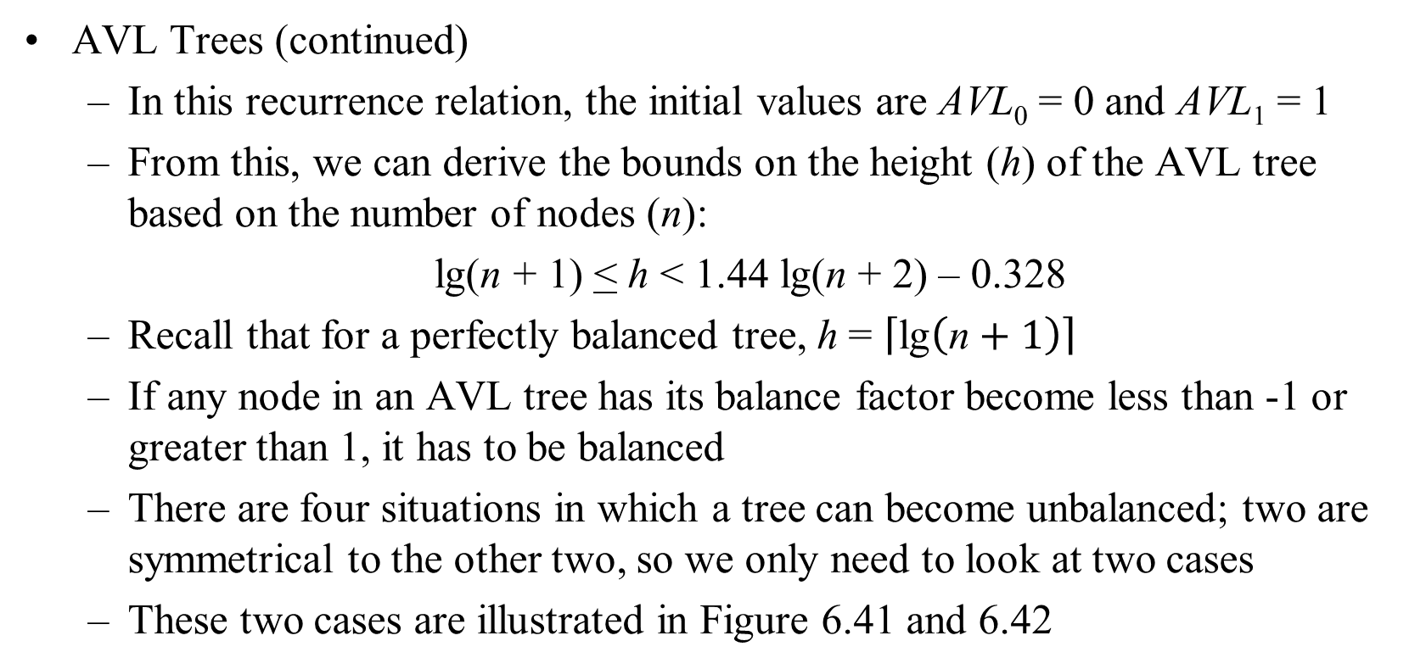
Balancing a Tree (continued)
AVL Trees (continued)
In this recurrence relation, the initial values are AVL₀ = 0 and AVL₁ = 1
From this, we can derive the bounds on the height (h) of the AVL tree based on the number of nodes (n):
lg(n + 1) < h < 1.44 lg(n + 2) – 0.328
Recall that for a perfectly balanced tree, h = $\left\lceil \text{lg}\left(\text{n}+1\right)\right\rceil$
If any node in an AVL tree has its balance factor become less than -1 or greater than 1, it has to be balanced
There are four situations in which a tree can become unbalanced; two are symmetrical to the other two, so we only need to look at two cases
These two cases are illustrated in Figure 6.41 and 6.42

Slide 59
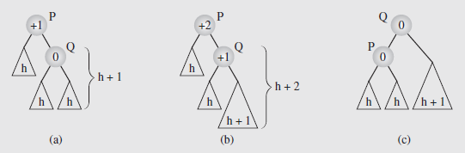
Balancing a Tree (continued)
AVL Trees (continued)
The first case, shown in Figure 6.41, occurs when a node is inserted in the right subtree of the right child
Fig. 6.41 Balancing a tree after insertion of a node in the right subtree of node Q
The subtrees involved in the rotation have their heights indicated
After a new node is inserted somewhere in the right subtree of Q to unbalance the tree, Q rotates around is parent P to rebalance the tree
This is illustrated in Figure 6.41b and Figure 6.41c

Slide 60
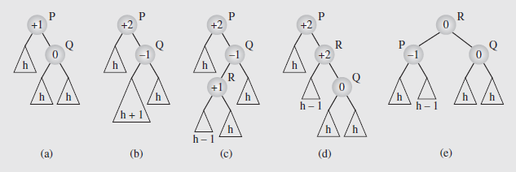
Balancing a Tree (continued)
AVL Trees (continued)
The second case, shown in Figure 6.42, occurs when a node is inserted in the left subtree of the right child, and is more complicated
Fig. 6.42 Balancing a tree after insertion of a node in the left subtree of node Q
A node is inserted in Figure 6.42a, resulting in the tree in Figure 6.42b
The derail of this is in Figure 6.42c; note the subtrees of R could be reversed, giving R a value of -1
The imbalance is solved by a double rotation: first R around Q (Figure 6.42d), then R around P (Figure 6.42e)

Slide 61
Balancing a Tree (continued)
AVL Trees (continued)
These examples treat P as a stand-alone tree; however it could be part of a larger tree, perhaps a child of another node
As Figures 6.41 and 6.42 imply, the changes made to the subtree originally rooted at P are sufficient to restore balance to the tree
The problem then is to find the node P in the tree that becomes imbalanced after an insertion
This can be accomplished by moving back up the tree from the point of insertion, updating the balance factors until one becomes ± 2
This node then becomes P, the root of the subtree that needs to be rebalanced
The algorithm to accomplish the balance updates is shown as pseudocode on pages 258 and 259

Slide 62
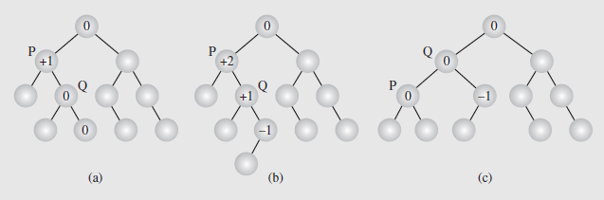
Balancing a Tree (continued)
AVL Trees (continued)
Figure 6.43 illustrates what happens when a node is inserted and the resulting updates cause a node to become imbalanced
Figure 6.43 An example of inserting (b) a new node in (a) an AVL tree,
which requires one rotation (c) to restore the height balance
It is also possible that an insertion will only cause the balance factors to be updated; in this case the path is followed back to the root
This is shown in Figure 6.44

Slide 63
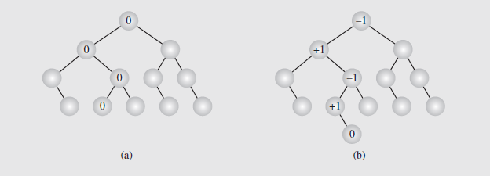
Balancing a Tree (continued)
AVL Trees (continued)
Fig. 6.44 In an (a) AVL tree a (b) new node is inserted requiring no height adjustments
Deleting a node may require more work
The deleteByCopying()algorithm is applied to delete the node
The balance factors of all nodes from the parent of the deleted node to the root are then updated
Each node whose balance factor becomes ± 2 will be rebalanced

Slide 64
Balancing a Tree (continued)
AVL Trees (continued)
This must be done for the entire path because deletion may not cause an imbalance in a parent, but in a grandparent
We’ll only consider those cases (four, with four symmetric cases) which necessitate immediate rotation
In each case, the assumption is the left child of the node P is deleted
These cases are illustrated in Figure 6.45 on page 261
In the first case, P’s balance factor is +1, and its right child, Q, is also at +1; this is shown in Figure 6.45a
Deleting a node from P’s left child leads to the tree in Figure 6.45b, with P at +2; this is rebalanced by rotating P around Q (Figure 6.45c)

Slide 65
Balancing a Tree (continued)
AVL Trees (continued)
In the second case, P’s balance factor is +1, and its right child, Q, is 0; this is shown in Figure 6.45d
Deleting a node from P’s left child leads to the tree in Figure 6.45e, with P at +2; this is rebalanced as in the first case by rotating P around Q (Figure 6.45f)
So the first two cases, with Q either +1 or 0, can be handled in the same way
If the initial balance factor of Q is -1, which is true in the other two cases, the process of rebalancing is more complex
The third case arises when the left subtree of Q, rooted at R, has a balance factor of -1 (Figure 6.45g)
Rebalancing after deletion requires a double rotation; first of R about Q and then of R about P (Figures 6.45h and 6.45i)

Slide 66
Balancing a Tree (continued)
AVL Trees (continued)
The fourth case is similar to the third, but differs in that the balance factor of R is +1, rather than -1
However, rebalancing can be done with the same two rotations as the third case so the third and fourth can be handled together (Figures 6.45j – l)

