Slide 1
Data Structures 3.5. Balancing BSTs
Data Structures and Algorithms
http://linen-tracer-682.appspot.com/data-structures/index.html
Notes:
# Every module has the following content
* Title (1 slide)
* Table of Contents (1 slide) – where are we in the material?
* Motivation (1 slide) – why do we need this module?
* Anchor Task (1x) – introduce the key problem handled by this module
* Objectives (1x)
* Theory Section (1 subtitle + more slides) or Demo Section (1 subtitle + more slides)
* Summary (1x) * References (1x)

Slide 2
Table of Contents
3.1 List-like structures
3.2 Tree-like structures
3.3 Priority queues and heaps
3.4 Maps and dictionaries
3.5 Balancing BST
3.6 Sorting algorithms
3.7 Sets and hashing
3.8 Graphs and traversals
3.9 Shortest Paths and MST
Part 1: Use C++ and Object Orientation (6 modules, 3W)
Part 2: Express algorithms with Abstract Data Types (ADTs) and libraries (5 modules, 2W)
Part 3: Analyze the implementations of some data structures (10 modules, 5W)
Part 4: Introduce general paradigms for algorithms (7 modules, 3W)

Slide 3
Why care about code on text-based input/output?
Binary Search Trees – node order invariant.
Performance Issues – Skinny vs. Bushy trees
Balancing techniques.
Notes:
* For people who want to become professionals = can create systems that others will use
* For people who like to challenge themselves with difficult problems.
* For highly motivated people who also want to sleep; who take normal course-load, but typically do not work full-time yet.

Slide 4
Splay Trees are BSTs (also w/ repetitive keys)
BST (Binary Search Trees):
entries stored only at internal nodes
keys stored at nodes in the left subtree of v are less than or equal to the key stored at v
keys stored at nodes in the right subtree of v are greater than or equal to the key stored at v
An inorder traversal will return the keys in order
(20,Z)
(10,A)
(35,R)
(7,T)
(14,J)
(21,O)
(37,P)
(1,Q)
(40,X)
(8,N)
(36,L)
(1,C)
(5,H)
(7,P)
(10,U)
(2,R)
(5,G)
(5,I)
(6,Y)

Slide 5
Search in a Splay Tree – 1
Starts same as in a general BST
Search proceeds down the tree to found item or an external node.
Example: Search with key 11.
Example: Search with key 5 or 7. (Repetitive nodes).
(20,Z)
(10,A)
(35,R)
(7,T)
(14,J)
(21,O)
(37,P)
(1,Q)
(40,X)
(8,N)
(36,L)
(1,C)
(5,H)
(7,P)
(10,U)
(2,R)
(5,G)
(5,I)
(6,Y)

Slide 6
Search in a Splay Tree – 2
Search for key 8, ends at an internal node.
(20,Z)
(10,A)
(35,R)
(7,T)
(14,J)
(21,O)
(37,P)
(1,Q)
(40,X)
(8,N)
(36,L)
(1,C)
(5,H)
(7,P)
(10,U)
(2,R)
(5,G)
(5,I)
(6,Y)

Slide 7
Splay Trees do Rotations after Every Operation (Even Search)
new operation: splay
splaying moves a node to the root using rotations
right rotation
makes the left child x of a node y into y’s parent; y becomes the right child of x
left rotation
makes the right child y of a node x into x’s parent; x becomes the left child of y
y
x
a right rotation about y
a left rotation about x
x
T₃
T₁
y
x
y
T₁
T₂
T₁
y
T₂
T₃
x
T₃
T₂
T₃
T₁
T₂
(structure of tree above y is not modified)
(structure of tree above x is not modified)

Slide 8
Splaying:
“x is a left-left grandchild” means x is a left child of its parent, which is itself a left child of its parent
p is x’s parent; g is p’s parent
start with node x
is x a left-left grandchild?
is x the root?
yes
zig-zig
stop
yes
right-rotate about g, right-rotate about p
no
is x a right-right grandchild?
is x a child of the root?
zig-zig
no
yes
left-rotate about g, left-rotate about p
yes
is x a right-left grandchild?
is x the left child of the root?
zig-zag
no
yes
left-rotate about p, right-rotate about g
is x a left-right grandchild?
zig
zig
zig-zag
yes
right-rotate about the root
left-rotate about the root
yes
right-rotate about p, left-rotate about g

Slide 9
Visualizing the Splaying Cases
zig-zag
x
z
z
y
z
y
y
T₄
T₁
x
T₄
T₁
T₂
T₃
T₄
x
T₃
T₂
T₃
T₁
T₂
zig-zig
x
y
zig
T₁
y
x
T₄
x
T₂
z
w
w
y
T₃
T₃
T₄
T₁
T₂
T₃
T₄
T₁
T₂

Slide 10
Splaying node "8": Zig-Zag Part 1
let x = (8,N)
x is the right child of its parent, which is the left child of the grandparent
left-rotate around p, then right-rotate around g
(20,Z)
(20,Z)
g
(10,A)
(35,R)
(10,A)
(35,R)
p
(7,T)
(14,J)
(21,O)
(37,P)
(8,N)
(14,J)
(21,O)
(37,P)
(1,Q)
(8,N)
x
(36,L)
(40,X)
(7,T)
(10,U)
(36,L)
(40,X)
(1,Q)
(7,P)
(1,C)
(5,H)
(7,P)
(10,U)
(1,C)
(5,H)
(2,R)
(5,G)
(5,I)
(6,Y)
(2,R)
(5,G)
(5,I)
(6,Y)

Slide 11
Splaying node "8": Zig-Zag Part 2
(20,Z)
(20,Z)
(10,A)
(35,R)
x
(8,N)
(35,R)
(8,N)
(14,J)
(21,O)
(37,P)
g
p
(7,T)
(10,A)
(21,O)
(37,P)
(7,T)
(10,U)
(36,L)
(40,X)
(1,Q)
(7,P)
(14,J)
(36,L)
(40,X)
(1,Q)
(7,P)
(5,H)
(1,C)
(5,H)
(10,U)
(1,C)
(2,R)
(5,G)
(2,R)
(5,G)
(5,I)
(6,Y)
(5,I)
(6,Y)

Slide 12
Splaying node "8": Zig
now x is the left child of the root
right-rotate around root.
x
(8,N)
p
(20,Z)
(7,T)
(20,Z)
p
x
(8,N)
(35,R)
(1,Q)
(7,P)
(10,A)
(35,R)
(7,T)
(10,A)
(21,O)
(37,P)
(1,C)
(5,H)
(14,J)
(21,O)
(37,P)
(1,Q)
(7,P)
(14,J)
(36,L)
(40,X)
(2,R)
(5,G)
(10,U)
(36,L)
(40,X)
(1,C)
(5,H)
(10,U)
(5,I)
(6,Y)
(2,R)
(5,G)
(5,I)
(6,Y)

Slide 13
Tree may not become more balanced
For example, splay (40,X)
before, the depth of the shallowest leaf is 3 and the deepest is 7
after, the depth of shallowest leaf is 1 and deepest is 7.
(40,X)
(20,Z)
(20,Z)
(20,Z)
(10,A)
(35,R)
(10,A)
(40,X)
(10,A)
(37,P)
(14,J)
(7,T)
(14,J)
(37,P)
(14,J)
(7,T)
(21,O)
(37,P)
(7,T)
(35,R)
(1,Q)
(8,N)
(35,R)
(1,Q)
(8,N)
(36,L)
(40,X)
(1,Q)
(8,N)
(21,O)
(36,L)
(1,C)
(5,H)
(7,P)
(10,U)
(21,O)
(36,L)
(1,C)
(5,H)
(7,P)
(10,U)
(1,C)
(5,H)
(7,P)
(10,U)
(2,R)
(5,G)
(2,R)
(5,G)
(2,R)
(5,G)
(5,I)
(6,Y)
(5,I)
(6,Y)
(5,I)
(6,Y)

Slide 14
Splay Tree Definition
a splay tree is a binary search tree where a node is splayed after it is accessed (for a search or update)
deepest internal node accessed is splayed
splaying costs O(h), where h is height of the tree – which is still O(n) worst-case
O(h) rotations, each of which is O(1)

Slide 15
Splay Trees & Ordered Dictionaries
which nodes are splayed after each operation?
method
splay node
if key found, use that node
if key not found, use parent of ending external node
get(k)
put(k,v)
use the new node containing the entry inserted
use the parent of the internal node that was actually removed from the tree (the parent of the node that the removed item was swapped with)
erase(k)

Slide 16
Amortized Analysis of Splay Trees
Running time of each operation is proportional to time for splaying.
Define rank(v) as the logarithm (base 2) of the number of nodes in subtree rooted at v.
Costs: zig = $1, zig-zig = $2, zig-zag = $2.
Thus, cost for playing a node at depth d = $d.
Imagine that we store rank(v) cyber-dollars at each node v of the splay tree (just for the sake of analysis).

Slide 17
Cost per zig
Doing a zig at x costs at most rank’(x) - rank(x):
cost = rank’(x) + rank’(y) - rank(y) - rank(x) < rank’(x) - rank(x).
y
zig
x
T₄
x
w
T₃
w
y
T₁
T₂
T₃
T₄
T₁
T₂

Slide 18
Cost per zig-zig and zig-zag
Doing a zig-zig or zig-zag at x costs at most 3(rank’(x) - rank(x)) - 2
z
x
y
T₄
zig-zig
T₁
y
x
T₃
T₂
z
T₁
T₂
T₃
T₄
z
zig-zag
x
y
z
y
T₁
x
T₄
T₁
T₂
T₃
T₄
T₂
T₃

Slide 19
Cost of Splaying
Cost of splaying a node x at depth d of a tree rooted at r:
at most 3(rank(r) - rank(x)) - d + 2:
Proof: Splaying x takes d/2 splaying substeps:

Slide 20
Performance of Splay Trees
Recall: rank of a node is logarithm of its size.
Thus, amortized cost of any splay operation is O(log n)
In fact, the analysis goes through for any reasonable definition of rank(x)
This implies that splay trees can actually adapt to perform searches on frequently-requested items much faster than O(log n) in some cases

Slide 21
Self-Adjusting Trees
The focus of our efforts in balancing trees has been to keep the trees properly structured
Consequently, whenever a newly inserted node threatens a tree’s balance, action is taken to correct the imbalance
This can be done for the entire tree, using the DSW technique, or locally, using the AVL process
Is correcting the imbalance always necessary?
Since trees are used to handle items quickly, it is the speed of operations and not the tree’s structure that is critical

Slide 22
Self-Adjusting Trees (continued)
Consider the idea that not all items in a tree are likely to be used with equal frequency
If we keep track of the most frequently accessed items, and structure the tree to improve access to them, we can improve performance
This is the basis for self-adjusting trees
The strategy is to migrate up the tree those elements used most often, creating a “priority tree”

Slide 23
Self-Adjusting Trees (continued)
We can keep track of frequency in a number of ways
Each node could have a counter to record accesses; the tree could be rearranged to move highest counts up in the tree
A second approach is based on the assumption that an item that has been accessed will be accessed soon again
Each time an element is accessed, it is moved up the tree
New elements are simply added where appropriate without restructuring
Although this could promote infrequently accessed objects, over a period of use the more frequently used items will occupy the higher levels of the tree

Slide 24
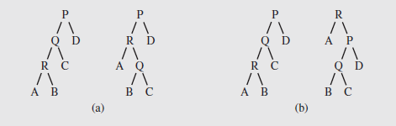
Self-Adjusting Trees (continued)
Self-Restructuring Trees
Brian Allen, Ian Munroe, and James Bitner proposed a strategy with two possibilities, shown in Figure 6.46
Single rotation – if an element in a child is accessed, rotate the child around the parent, unless it is the root (Figure 6.46a)
Moving to the root – the parent-child rotation is repeated until the element that was accessed is the root (Figure 6.46b)
Fig. 6.46 Restructuring a tree by (a) using a single rotation
or (b) moving to the root when accessing node R

Slide 25
Self-Adjusting Trees (continued)
Self-Restructuring Trees (continued)
In the single-rotation approach, the more often an item is accessed the closer it moves to the root, so access to the element improves
With move-to-the-root, the assumption is the accessed element will be accessed soon again, so it immediately moves to the root
Even if the item isn’t used right away, it will remain close to the root for further access
Unfortunately, these strategies don’t work well in the case of skewed trees such as we’ve seen earlier; although they will improve slowly
This situation is displayed in Figure 6.47

Slide 26
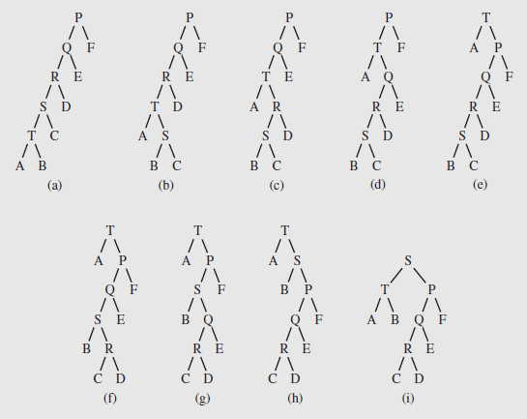
Self-Adjusting Trees (continued)
Self-Restructuring Trees (continued)
Fig. 6.47 (a–e) Moving element T to the root
and then (e–i) moving element S to the root

Slide 27
Self-Adjusting Trees (continued)
Splaying
Robert Tarjan and Daniel Sleator developed an alternative to the move-to-the-root technique in 1985
Called splaying, it applies single rotations in pairs; using an order determined by the links between child, parent, and grandparent
First we distinguish from among three cases, based on the relationship between a node R, its parent Q, and grandparent P (if they exist)
Case 1 – The root node is R’s parent
Case 2 – Called the homogeneous configuration, R is the left child of Q, and Q is the left child of P (or, R and Q are right children)
Case 3 – Called the heterogeneous configuration, R is the right child of Q and Q is the left child of P (or R is the left child of Q and Q is the right child of P)

Slide 28
Self-Adjusting Trees (continued)
Splaying (continued)
The algorithm to manipulate the node in the tree is as follows:
Splaying (P,Q,R)
while R is not the root
if R’s parent is the root
perform a singular splay, rotate R about its parent; (Figure 6.48a)
else if R is in a homogeneous configuration with its predecessors
perform a homogeneous splay, first rotate Q about P
and then R about Q; (Figure 6.48b)
else // R is in a heterogeneous configuration with its predecessors
perform a heterogeneous splay, first rotate R about Q
and then about P; (Figure 6.48c)

Slide 29
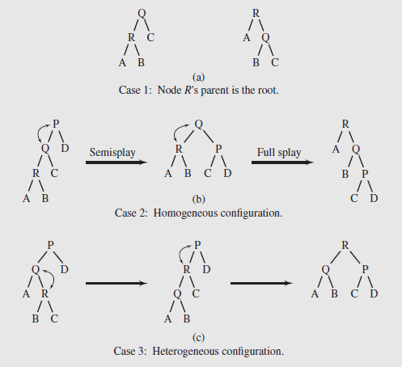
Self-Adjusting Trees (continued)
Splaying (continued)
Fig. 6.48 Examples of splaying

Slide 30
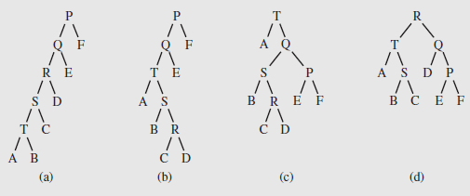
Self-Adjusting Trees (continued)
Splaying (continued)
The difference in applying this technique to the tree of Figure 6.47a is shown on Figure 6.49
In accessing the node T in the fifth level of the tree, the shape is improved a great deal; after accessing R, the improvement is dramatic
Restructuring a tree with splaying (a–c) after accessing T and (c–d) then R

Slide 31
Self-Adjusting Trees (continued)
Splaying (continued)
Even though splaying is a combination of two rotations (except when next to the root), they are not necessarily bottom-up
For homogeneous cases (left-right or right-right), the parent and grandparent node are rotated, then the node and its parent
The effect of this is both to move the node towards the root and to flatten the tree, which improves access
Splaying focuses on the elements rather than tree shape, so typically it performs better when some elements are used more frequently
If all the elements are accessed with about the same frequency, it will not be as useful
In those cases an alternative approach that focuses on balancing the tree is better

Slide 32
Self-Adjusting Trees (continued)
Splaying (continued)
A modification called semisplaying is illustrated in Figure 6.48b
It requires one rotation for a homogeneous splay, and continue splaying with the parent of the node, rather than the node itself
Figure 6.50 illustrates the application of semisplaying
The tree of Figure 6.49a becomes more balanced after accessing node T using this technique (Figures 6.50a – c)
After T is accessed a second time, the resulting tree (Figure 6.50d) is structurally similar to Figure 6.46a
Although theoretical results are favorable, empirical results for various trees show that AVL tress work better than self-modifying ones; many times even a regular binary tree outperforms these

Slide 33
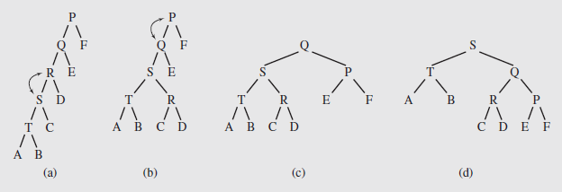
Self-Adjusting Trees (continued)
Splaying (continued)
(a–c) Accessing T and restructuring the tree with semisplaying;
(c–d) accessing T again

