Slide 1
Data Structures 3.5. Balancing BSTs
Data Structures and Algorithms
http://linen-tracer-682.appspot.com/data-structures/index.html
Notes:
# Every module has the following content
* Title (1 slide)
* Table of Contents (1 slide) – where are we in the material?
* Motivation (1 slide) – why do we need this module?
* Anchor Task (1x) – introduce the key problem handled by this module
* Objectives (1x)
* Theory Section (1 subtitle + more slides) or Demo Section (1 subtitle + more slides)
* Summary (1x) * References (1x)

Slide 2
Multi-Way Search Tree
A multi-way search tree is an ordered tree such that
Each internal node has at least two children and stores d −1 key-element items (k_{i}, o_{i}), where d is the number of children
For a node with children v₁ v₂ … v_{d} storing keys k₁ k₂ … k_{d−1}
keys in the subtree of v₁ are less than k₁
keys in the subtree of v_{i} are between k_{i−1} and k_{i} (i = 2, …, d − 1)
keys in the subtree of v_{d} are greater than k_{d−1}
The leaves store no items and serve as placeholders
11 24
2 6 8
15
27 32
30

Slide 3
Multi-Way Inorder Traversal
We can extend the notion of inorder traversal from binary trees to multi-way search trees
Namely, we visit item (k_{i}, o_{i}) of node v between the recursive traversals of the subtrees of v rooted at children v_{i} and v_{i} ₊ ₁
An inorder traversal of a multi-way search tree visits the keys in increasing order
11 24
8
12
2 6 8
15
27 32
2
4
6
10
14
18
30
1
3
5
7
9
11
13
16
19
Leaves are visited, but produce no output during inorder traversal.
15
17

Slide 4
Multi-Way Searching
Similar to search in a binary search tree
A each internal node with children v₁ v₂ … v_{d} and keys k₁ k₂ … k_{d−1}
k = k_{i} (i = 1, …, d − 1): the search terminates successfully
k < k₁: we continue the search in child v₁
k_{i−1} < k < k_{i} (i = 2, …, d − 1): we continue the search in child v_{i}
k > k_{d−1}: we continue the search in child v_{d}
Reaching an external node terminates the search unsuccessfully
Example: search for 30
11 24
2 6 8
15
27 32
30

Slide 5
(2,4) Trees
A (2,4) tree (also called 2-4 tree or 2-3-4 tree) is a multi-way search with the following properties
Node-Size Property: every internal node has at most four children
Depth Property: all the external nodes have the same depth
Depending on the number of children, an internal node of a (2,4) tree is called a 2-node, 3-node or 4-node
10 15 24
2 8
12
18
27 32

Slide 6
Height of a (2,4) Tree
Theorem: A (2,4) tree storing n items has height O(log n)
Proof:
Let h be the height of a (2,4) tree with n items
Since there are at least 2^{i} items at depth i = 0, … , h − 1 and no items at depth h, we have n ≥ 1 + 2 + 4 + … + 2^{h−1} = 2^{h} − 1
Thus, h ≤ log (n + 1)
Searching in a (2,4) tree with n items takes O(log n) time
depth
items
0
1
1
2
h−1
2^{h−1}
h
0

Slide 7
Insertion
We insert a new item (k, o) at the parent v of the leaf reached by searching for k
We preserve the depth property but
We may cause an overflow (i.e., node v may become a 5-node)
Example: inserting key 30 causes an overflow
10 15 24
v
2 8
12
18
27 32 35
10 15 24
v
2 8
12
18
27 30 32 35

Slide 8
Overflow and Split
We handle an overflow at a 5-node v with a split operation:
let v₁ … v₅ be the children of v and k₁ … k₄ be the keys of v
node v is replaced nodes v' and v"
v' is a 3-node with keys k₁ k₂ and children v₁ v₂ v₃
v" is a 2-node with key k₄ and children v₄ v₅
key k₃ is inserted into the parent u of v (a new root may be created)
The overflow may propagate to the parent node u
u
u
15 24
15 24 32
v
v'
v"
12
18
27 30 32 35
12
18
27 30
35
v₁
v₂
v₃
v₄
v₅
v₁
v₂
v₃
v₄
v₅

Slide 9
Analysis of Insertion
Algorithm put(k, o)
1. We search for key k to locate the insertion node v
2. We add the new entry (k, o) at node v
3. while overflow(v)
if isRoot(v)
create a new empty root above v
v ← split(v)
Let T be a (2,4) tree with n items
Tree T has O(log n) height
Step 1 takes O(log n) time because we visit O(log n) nodes
Step 2 takes O(1) time
Step 3 takes O(log n) time because each split takes O(1) time and we perform O(log n) splits
Thus, an insertion in a (2,4) tree takes O(log n) time

Slide 10
Deletion
We reduce deletion of an entry to the case where the item is at the node with leaf children
Otherwise, we replace the entry with its inorder successor (or, equivalently, with its inorder predecessor) and delete the latter entry
Example: to delete key 24, we replace it with 27 (inorder successor)
10 15 24
2 8
12
18
27 32 35
10 15 27
2 8
12
18
32 35

Slide 11
Underflow and Fusion
Deleting an entry from a node v may cause an underflow, where node v becomes a 1-node with one child and no keys
To handle an underflow at node v with parent u, we consider two cases
Case 1: the adjacent siblings of v are 2-nodes
Fusion operation: we merge v with an adjacent sibling w and move an entry from u to the merged node v'
After a fusion, the underflow may propagate to the parent u
u
u
9 14
9
w
v
v'
2 5 7
10
2 5 7
10 14

Slide 12
Underflow and Transfer
To handle an underflow at node v with parent u, we consider two cases
Case 2: an adjacent sibling w of v is a 3-node or a 4-node
Transfer operation:
1. we move a child of w to v
2. we move an item from u to v
3. we move an item from w to u
After a transfer, no underflow occurs
u
u
4 9
4 8
w
v
w
v
2
6 8
2
6
9

Slide 13
Analysis of Deletion
Let T be a (2,4) tree with n items
Tree T has O(log n) height
In a deletion operation
We visit O(log n) nodes to locate the node from which to delete the entry
We handle an underflow with a series of O(log n) fusions, followed by at most one transfer
Each fusion and transfer takes O(1) time
Thus, deleting an item from a (2,4) tree takes O(log n) time

Slide 14
Comparison of Map Implementations
 | Find | Put | Erase | Notes
Hash Table | 1 expected | 1 expected | 1 expected | no ordered map methods simple to implement
Skip List | log n high prob. | log n high prob. | log n high prob. | randomized insertion simple to implement
AVL and (2,4) Tree | log n worst-case | log n worst-case | log n worst-case | complex to implement

Slide 15
From (2,4) to Red-Black Trees
A red-black tree is a representation of a (2,4) tree by means of a binary tree whose nodes are colored red or black
In comparison with its associated (2,4) tree, a red-black tree has
same logarithmic time performance
simpler implementation with a single node type
4
3 5
2 6 7
4
5
3
6
OR
3
5
2
7

Slide 16
Red-Black Trees
A red-black tree can also be defined as a binary search tree that satisfies the following properties:
Root Property: the root is black
External Property: every leaf is black
Internal Property: the children of a red node are black
Depth Property: all the leaves have the same black depth
9
4 9
4
15
2
6 7
12 15 21
2
6
12
21
7

Slide 17
Height of a Red-Black Tree
Theorem: A red-black tree storing n entries has height O(log n)
Proof:
The height of a red-black tree is at most twice the height of its associated (2,4) tree, which is O(log n)
The search algorithm for a binary search tree is the same as that for a binary search tree
By the above theorem, searching in a red-black tree takes O(log n) time

Slide 18
Insertion
To perform operation put(k, o), we execute the insertion algorithm for binary search trees and color red the newly inserted node z unless it is the root
We preserve the root, external, and depth properties
If the parent v of z is black, we also preserve the internal property and we are done
Else (v is red ) we have a double red (i.e., a violation of the internal property), which requires a reorganization of the tree
Example where the insertion of 4 causes a double red:
6
6
v
v
3
8
3
8
z
z
4

Slide 19
Remedying a Double Red
Consider a double red with child z and parent v, and let w be the sibling of v
Case 1: w is black
The double red is an incorrect replacement of a 4-node
Restructuring: we change the 4-node replacement
Case 2: w is red
The double red corresponds to an overflow
Recoloring: we perform the equivalent of a split
w
4
v
w
4
v
2
z
7
2
z
7
6
6
4 6 7
2 4 6 7
.. 2 ..

Slide 20
Case 1: Restructuring
A restructuring remedies a child-parent double red when the parent red node has a black sibling
It is equivalent to restoring the correct replacement of a 4-node
The internal property is restored and the other properties are preserved
z
4
6
w
v
v
2
7
4
7
z
w
6
2
4 6 7
4 6 7
.. 2 ..
.. 2 ..

Slide 21
Restructuring (cont.)
There are four restructuring configurations depending on whether the double red nodes are left or right children
2
6
6
2
6
2
4
4
4
4
2
6
4
2
6

Slide 22
Recoloring
A recoloring remedies a child-parent double red when the parent red node has a red sibling
The parent v and its sibling w become black and the grandparent u becomes red, unless it is the root
It is equivalent to performing a split on a 5-node
The double red violation may propagate to the grandparent u
w
4
v
w
4
v
2
z
7
2
z
7
6
6
4
2 4 6 7
2
6 7

Slide 23
Analysis of Insertion
Algorithm put(k, o)
1. We search for key k to locate the insertion node z
2. We add the new entry (k, o) at node z and color z red
3. while doubleRed(z)
if isBlack(sibling(parent(z)))
z ← restructure(z)
return
else { sibling(parent(z) is red }
z ← recolor(z)
Recall that a red-black tree has O(log n) height
Step 1 takes O(log n) time because we visit O(log n) nodes
Step 2 takes O(1) time
Step 3 takes O(log n) time because we perform
O(log n) recolorings, each taking O(1) time, and
at most one restructuring taking O(1) time
Thus, an insertion in a red-black tree takes O(log n) time

Slide 24
Deletion
To perform operation erase(k), we first execute the deletion algorithm for binary search trees
Let v be the internal node removed, w the external node removed, and r the sibling of w
If either v of r was red, we color r black and we are done
Else (v and r were both black) we color r double black, which is a violation of the internal property requiring a reorganization of the tree
Example where the deletion of 8 causes a double black:
6
6
v
r
3
8
3
r
w
4
4

Slide 25
Remedying a Double Black
The algorithm for remedying a double black node w with sibling y considers three cases
Case 1: y is black and has a red child
We perform a restructuring, equivalent to a transfer , and we are done
Case 2: y is black and its children are both black
We perform a recoloring, equivalent to a fusion, which may propagate up the double black violation
Case 3: y is red
We perform an adjustment, equivalent to choosing a different representation of a 3-node, after which either Case 1 or Case 2 applies
Deletion in a red-black tree takes O(log n) time

Slide 26
Red-Black Tree Reorganization
Insertion | remedy double red
Red-black tree action | (2,4) tree action | result
restructuring | change of 4-node representation | double red removed
recoloring | split | double red removed or propagated up
Deletion | remedy double black
Red-black tree action | (2,4) tree action | result
restructuring | transfer | double black removed
recoloring | fusion | double black removed or propagated up
adjustment | change of 3-node representation | restructuring or recoloring follows

Slide 27
Objectives
Looking ahead – in this chapter, we’ll consider
The Family of B-Trees
Tries

Slide 28
Introductory Remarks
In chapter 6, a tree was defined as either an empty structure or one whose children were the disjoint trees t₁, … t_{m}
Although we focused on binary trees and binary search trees, we can use this definition to describe trees with multiple children
Such trees are called multiway trees of order m or m-way trees
Of more use is the case where an order is imposed on the keys in each node, creating a multiway search tree of order m, or an m-way search tree

Slide 29
Introductory Remarks (continued)
This type of multiway tree exhibits four characteristics:
Each node has m children and m – 1 keys
The keys in each node are in ascending order
The keys in the first i children are smaller than the i^{th} key
The keys in the last m – i children are larger than the i^{th} key
M-way search trees play an analogous role to binary search trees; fast information retrieval and updates
However, they also suffer from the same problems
Consider the tree in Figure 7.1; it is a 4-way tree where accessing the keys may require different numbers of tests
In particular, the tree is unbalanced

Slide 30
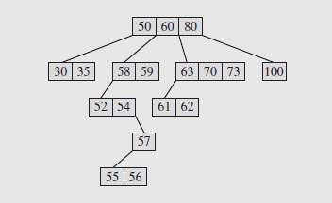
Introductory Remarks (continued)
Fig. 7.1 A 4-way tree
The balance problem is of particular importance in applying these trees to secondary storage access, which can be costly
Thus, building these trees requires a more careful strategy

Slide 31
The Family of B-Trees
The basic unit of data transfer associated with I/O operations on secondary storage devices is the block
Blocks are transferred to memory during read operations and written from memory during write operations
The process of transferring information to and from storage involves several operations
Since secondary storage involves mechanical devices, the time required can be orders of magnitude slower than memory operations
So any program that processes information on secondary storage will be significantly slowed

Slide 32
The Family of B-Trees (continued)
Thus the properties of the storage have to be taken into account in designing the program
A binary tree, for example, may be spread over a large number of blocks on a disk file, as shown in Figure 7.2
In this case two blocks would have to be accessed for each search conducted
If the tree is used frequently, or updates occur often, the program’s performance will suffer
So in this case the binary tree, well-suited for memory processing, is a poor choice for secondary storage access

Slide 33
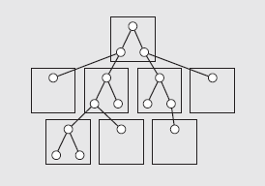
The Family of B-Trees (continued)
Fig. 7.2 Nodes of a binary tree can be
located in different blocks on a disk
It is also better to transfer a large amount of data all at once than to have to jump around on the disk to retrieve it
This is due to the high cost of accessing secondary storage
If possible, data should be organized to minimize disk access

Slide 34
The Family of B-Trees (continued)
B-Trees
We can conclude from the previous section that the time to access secondary storage can be reduced by proper choice of data structures
B-trees, developed by Rudolf Bayer and Edward McCreight in 1972, are one such structure
B-trees work closely with secondary storage and can be adjusted to reduce issues associated with this type of storage
For example, the size of a B-tree node can be as large as a block
The number of keys can vary depending on key sizes, data organization, and block sizes
As a consequence, the amount of information stored in a node can be substantial

Slide 35
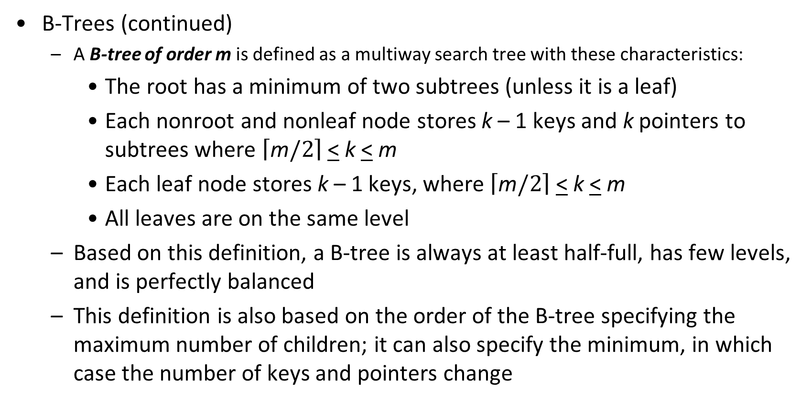
The Family of B-Trees (continued)
B-Trees (continued)
A B-tree of order m is defined as a multiway search tree with these characteristics:
The root has a minimum of two subtrees (unless it is a leaf)
Each nonroot and nonleaf node stores k – 1 keys and k pointers to subtrees where $\left\lceil \text{m}/2\right\rceil$ < k < m
Each leaf node stores k – 1 keys, where $\left\lceil \text{m}/2\right\rceil$ < k < m
All leaves are on the same level
Based on this definition, a B-tree is always at least half-full, has few levels, and is perfectly balanced
This definition is also based on the order of the B-tree specifying the maximum number of children; it can also specify the minimum, in which case the number of keys and pointers change

Slide 36
The Family of B-Trees (continued)
B-Trees (continued)
The nodes in B-trees are typically implemented as classes
Among the data members are an array of m – 1 cells for keys, an array of m cells for pointers, and other miscellaneous information
It can be defined as:
template <class T, int M>
class BTreeNode {
public:
BTreeNode();
BTreeNode(const T&);
private:
bool leaf;
int keyTally;
T keys[M-1];
BTreeNode *pointers[M];
friend Btree<T,M>;
};

Slide 37
The Family of B-Trees (continued)
B-Trees (continued)
The value for m is usually large so the information in one page or block of secondary storage can fit in one node
Figure 7.3a shows a B-tree of order 7 storing code for some items
Although this makes it appear the keys are the only things of interest, in reality the codes would be fields of larger structures
In cases like this, the array of keys stores structures that contain a unique identifier plus an address of a record in secondary storage
This is shown in Figure 7.3b
If the contents of that node is also in secondary storage, each key access requires two secondary storage accesses; however, in the long run this is better than keeping the records in the nodes because the nodes could hold very few records

Slide 38
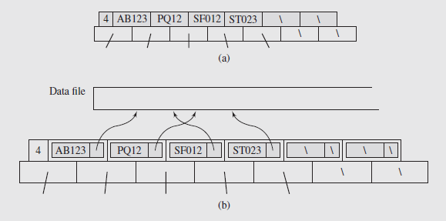
The Family of B-Trees (continued)
The resulting B-tree is deeper, with longer search paths, than a B-tree with just addresses
One node of a B-tree of order 7 (a) without and (b) with an additional indirection
Notes:
Fig 7.3?

Slide 39
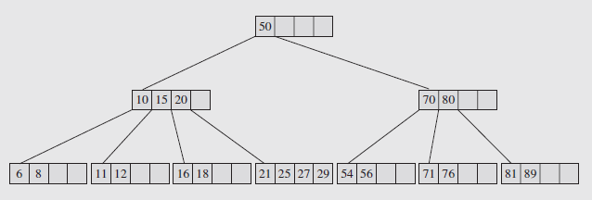
The Family of B-Trees (continued)
B-Trees (continued)
To simplify things, B-trees will be shown as in Figure 7.4, without the key count or the pointer fields
Fig. 7.4 A B-tree of order 5 shown in an abbreviated form

Slide 40
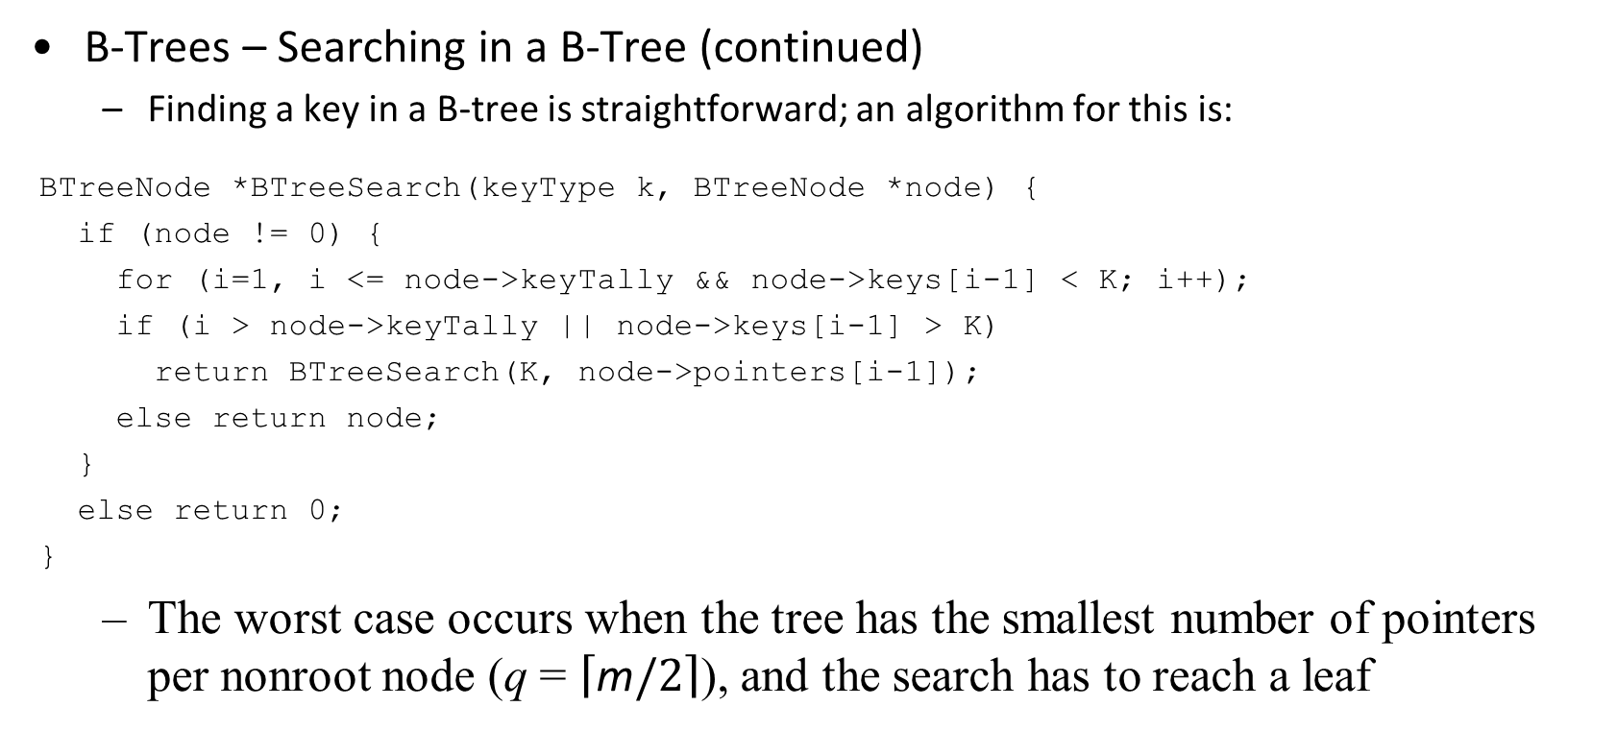
The Family of B-Trees (continued)
B-Trees – Searching in a B-Tree (continued)
Finding a key in a B-tree is straightforward; an algorithm for this is:
BTreeNode *BTreeSearch(keyType k, BTreeNode *node) {
if (node != 0) {
for (i=1, i <= node->keyTally && node->keys[i-1] < K; i++);
if (i > node->keyTally || node->keys[i-1] > K)
return BTreeSearch(K, node->pointers[i-1]);
else return node;
}
else return 0;
}
The worst case occurs when the tree has the smallest number of pointers per nonroot node (q = $\left\lceil \text{m}/2\right\rceil$), and the search has to reach a leaf

Slide 41
The Family of B-Trees (continued)
B-Trees – Searching in a B-Tree (continued)
The analysis on page 324 establishes the relationship between the number of keys on each level of the B-tree and its height
It illustrates that for a sufficiently large order, m, the height is small
If m = 200 and n (the number of keys) is 2,000,000, for instance, the value of h < 4
This means that even in the worst case, finding a key in the B-tree would require 4 seeks
In addition, if the root of the tree can be retained in memory, only three seeks need be performed in secondary storage

Slide 42
The Family of B-Trees (continued)
B-Trees – Inserting a Key Into a B-Tree (continued)
Given that all leaf nodes have to be at the last level of a B-tree, the task of inserting or deleting appears somewhat daunting
This becomes simpler if we recall that a tree can be built bottom-up, so that the root is resolved at the end of all the insertions
It is this strategy that will be used to insert keys into B-trees
Using this approach, an incoming key is immediately place in a leaf if room is available
When the leaf is full, another leaf is created, keys are divided between these leaves, and one key becomes the parent
If the parent is full, this process repeats until we reach the root and create a new root

Slide 43
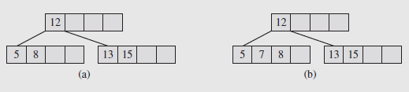
The Family of B-Trees (continued)
B-Trees – Inserting a Key Into a B-Tree (continued)
We can approach this more systematically if we consider what occurs when a key is inserted; three cases occur commonly:
In the first case, a key is placed in a leaf that still has room (Figure 7.5)
Fig. 7.5 A B-tree (a) before and (b) after insertion of the
number 7 into a leaf that has available cells
Notice that in adding the new key, 7, to the node, we shift the key 8 to the right to preserve order

Slide 44
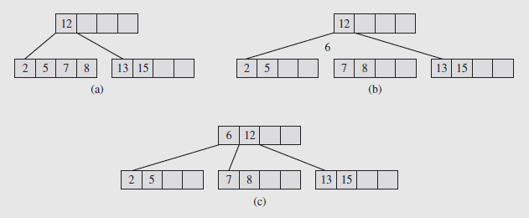
The Family of B-Trees (continued)
B-Trees – Inserting a Key Into a B-Tree (continued)
In the second case, the leaf where the key should be inserted is full (Figure 7.6)
Fig. 7.6 Inserting the number 6 into a full leaf
In this case the leaf is split, and half the keys are moved to a new leaf

Slide 45
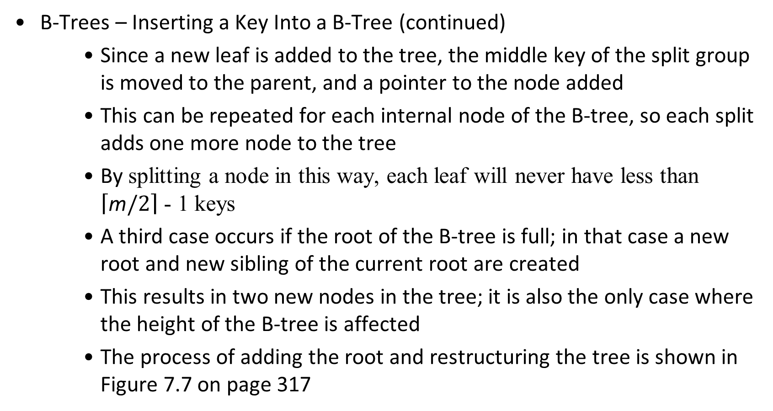
The Family of B-Trees (continued)
B-Trees – Inserting a Key Into a B-Tree (continued)
Since a new leaf is added to the tree, the middle key of the split group is moved to the parent, and a pointer to the node added
This can be repeated for each internal node of the B-tree, so each split adds one more node to the tree
By splitting a node in this way, each leaf will never have less than $\left\lceil \text{m}/2\right\rceil$ - 1 keys
A third case occurs if the root of the B-tree is full; in that case a new root and new sibling of the current root are created
This results in two new nodes in the tree; it is also the only case where the height of the B-tree is affected
The process of adding the root and restructuring the tree is shown in Figure 7.7 on page 317

Slide 46
The Family of B-Trees (continued)
B-Trees – Inserting a Key Into a B-Tree (continued)
Figure 7.8 on page 318 shows how a B-tree grows during the insertion of new keys
Notice how it remains perfectly balanced at all times
There is a variation of this called presplitting which can be used
In this case, as a search is conducted top-down for a specific key, any full nodes are split; this way no split is propagated upward
Of interest in all this is considering how often splits occur
Splitting the root requires the creation of two nodes; all other splits add only a single node to the B-tree

Slide 47
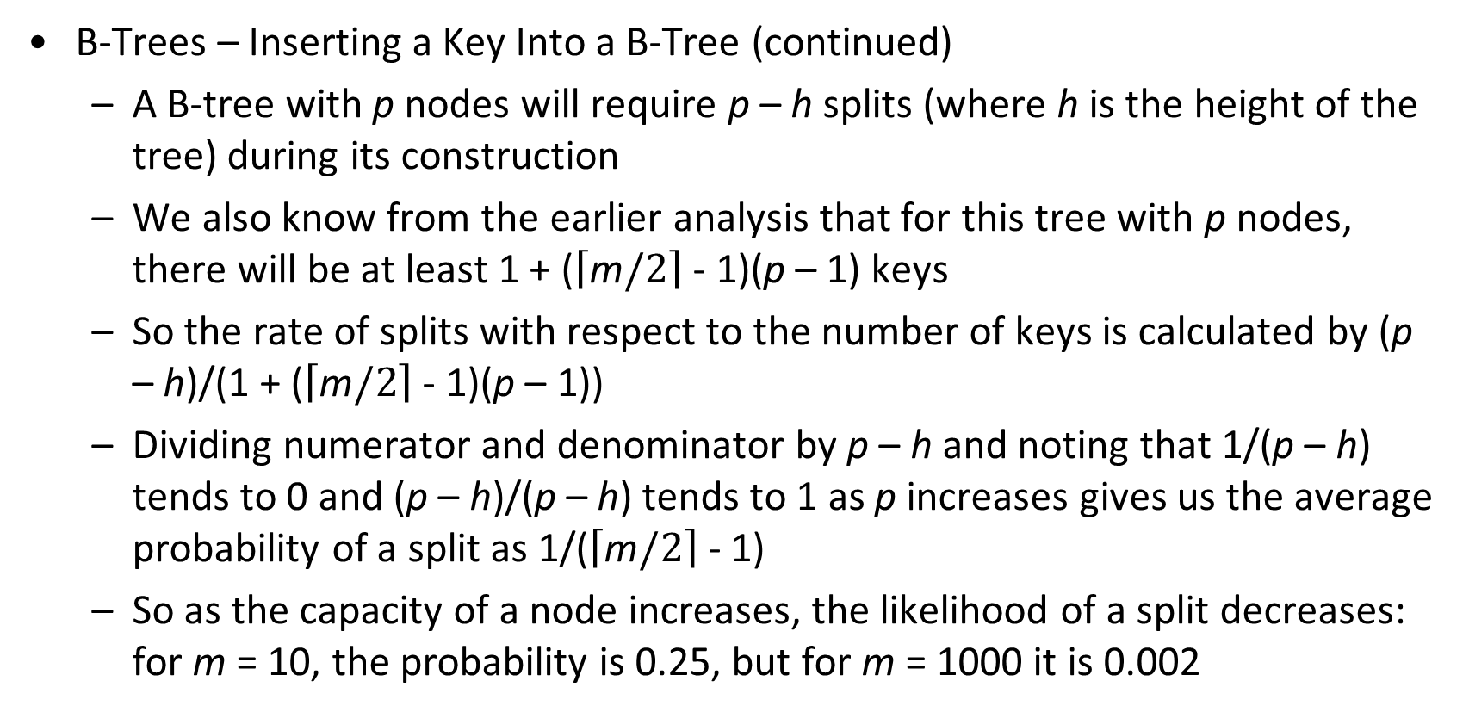
The Family of B-Trees (continued)
B-Trees – Inserting a Key Into a B-Tree (continued)
A B-tree with p nodes will require p – h splits (where h is the height of the tree) during its construction
We also know from the earlier analysis that for this tree with p nodes, there will be at least 1 + ($\left\lceil \text{m}/2\right\rceil$ - 1)(p – 1) keys
So the rate of splits with respect to the number of keys is calculated by (p – h)/(1 + ($\left\lceil \text{m}/2\right\rceil$ - 1)(p – 1))
Dividing numerator and denominator by p – h and noting that 1/(p – h) tends to 0 and (p – h)/(p – h) tends to 1 as p increases gives us the average probability of a split as 1/($\left\lceil \text{m}/2\right\rceil$ - 1)
So as the capacity of a node increases, the likelihood of a split decreases: for m = 10, the probability is 0.25, but for m = 1000 it is 0.002

Slide 48
The Family of B-Trees (continued)
B-Trees – Deleting a Key From a B-Tree (continued)
Deletion is basically the reverse of insertion, although there are several special cases to be considered
In particular, care has to be taken that no node is less than half full after deletion, which may require that nodes be merged
The process is spelled out in detail on pages 319 – 321
By definition, B-trees are guaranteed to be at least 50% full, but the question is, how full can they become and how much space is wasted
Analysis and empirical studies show that over a series of operations the B-tree approaches 69% full, but changes little after that
So if space utilization is a concern, other considerations need to be made

Slide 49
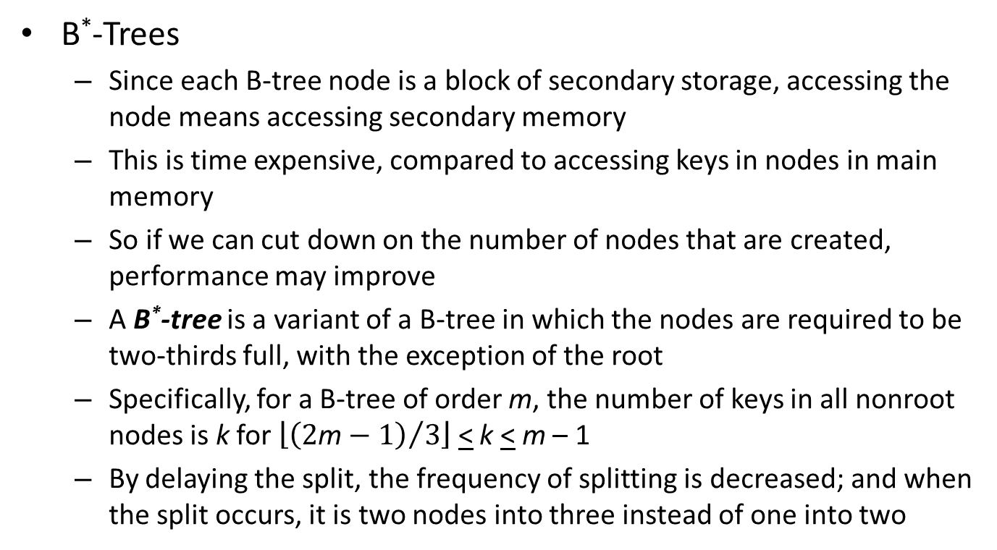
The Family of B-Trees (continued)
B*-Trees
Since each B-tree node is a block of secondary storage, accessing the node means accessing secondary memory
This is time expensive, compared to accessing keys in nodes in main memory
So if we can cut down on the number of nodes that are created, performance may improve
A B*-tree is a variant of a B-tree in which the nodes are required to be two-thirds full, with the exception of the root
Specifically, for a B-tree of order m, the number of keys in all nonroot nodes is k for $\left\lfloor {\left(2\text{m}−1\right)}/3\right\rfloor$ < k < m – 1
By delaying the split, the frequency of splitting is decreased; and when the split occurs, it is two nodes into three instead of one into two

Slide 50
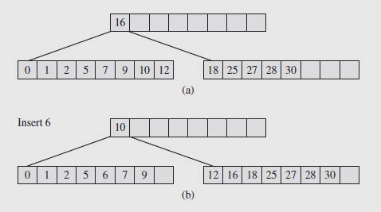
The Family of B-Trees (continued)
B*-Trees (continued)
Due to these modifications, the average utilization of a B*-tree is 81%
Splits are delayed by trying to redistribute keys between a node and its sibling when overflow occurs; this is illustrated in Figure 7.10
Fig. 7.10 Overflow in a B*-tree is circumvented by redistributing
keys between an overflowing node and its sibling

Slide 51
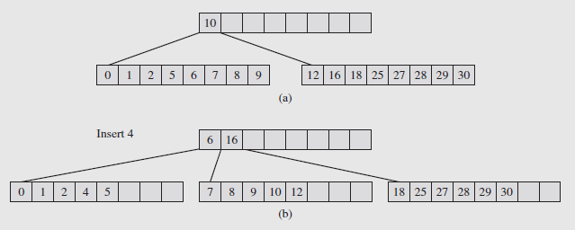
The Family of B-Trees (continued)
B*-Trees (continued)
Here, the node 6 was to be added to the left node; instead of splitting, the keys are redistributed, and the median key (10) is put in the parent
If the sibling is also full, a split occurs and a new node is created, as shown in Figure 7.11
Fig. 7.11 If a node and its sibling are both full in a B*-tree, a split occurs:
a new node is created and keys are distributed between three nodes

Slide 52
The Family of B-Trees (continued)
B*-Trees (continued)
When the split occurs the keys from the node and its sibling, along with the separating key from the parent, are evenly redistributed
Then two separating keys are placed in the parent
All three nodes in the split are then guaranteed to be two-thirds full
The fill factor can be modified, and some systems allow it to be chosen by the user
For a B-tree whose nodes should be 75% full, there is a designation as a B**-tree that is used
This can be generalized to define a B^{n}-tree as a tree whose fill factor is defined to be (n + 1)/(n + 2)

Slide 53
The Family of B-Trees (continued)
B⁺-Trees
Since nodes in B-trees represent pages or blocks, the transition from one node to another requires a page change, which is a time consuming operation
If for some reason we needed to access the keys sequentially, we could use an inorder traversal, but accessing nonterminal nodes would require substantial numbers of page changes
For this reason, the B⁺-tree was developed to improve sequential access to data
Any node in a B-tree can be used to access data, but in a B⁺-tree only the leaf nodes can refer to data
The internal nodes, called the index set, are indexes used for fast access to the data

Slide 54
The Family of B-Trees (continued)
B⁺-Trees (continued)
The leaves are structured differently from the other nodes, and usually are linked sequentially to form a sequence set
That way scanning the list of leaves produces the data in ascending order
So the name B⁺-tree is appropriate, since it is implemented as a B-tree plus a linked list; this is illustrated in Figure 7.12
In examining this figure, notice internal nodes contain keys, pointers, and a key count
The leaf nodes store keys, references to records in a file associated with the keys, and pointers to the next leaf

Slide 55
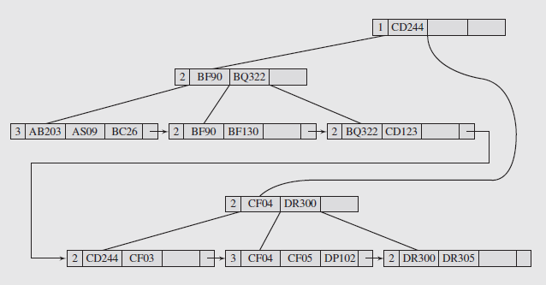
The Family of B-Trees (continued)
Fig. 7.12 An example of a B+-tree of order 4

Slide 56
The Family of B-Trees (continued)
B⁺-Trees (continued)
The operations on B⁺-trees are very similar to those on B-trees
Inserting a key into a leaf with room requires putting the keys in order; no changes are made to the index set portion of the tree
If the leaf is full, the node is split and the new node is added to the sequence set, with the keys distributed to the two nodes and the first key of the new node copied to the parent
If the parent is not full, key reorganization may be required there as well; if it is, splitting works in the same way as B-trees
This process is shown in Figure 7.13
A deletion from a leaf node that doesn’t result in underflow will simply require reorganizing the keys; no changes to the indexes are required

Slide 57
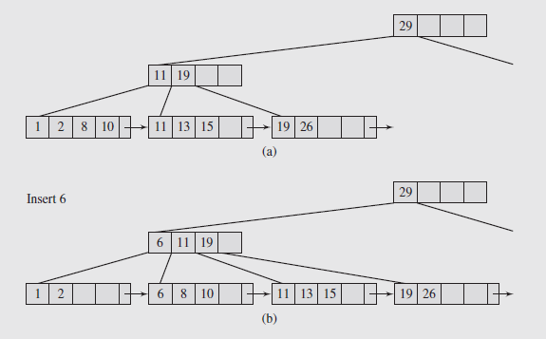
The Family of B-Trees (continued)
Fig. 7.13 An attempt to insert the number 6 into the first leaf of a B+-tree

Slide 58
The Family of B-Trees (continued)
B⁺-Trees (continued)
Notice this means that a key deleted from a leaf node can remain in an index node, since it serves as a guide in navigating the tree
Figure 7.14a results from the tree of 7.13b when the key 6 is deleted; notice it remains in the internal node
If the deletion of a key causes an underflow, either the keys from the current leaf and its sibling are redistributed between the two leaves or the leaf is deleted and any remaining keys are placed in the sibling
Figure 7.14b illustrates this situation
Either of these may require updating the separator in the parent; it may also trigger merges in the index set

Slide 59
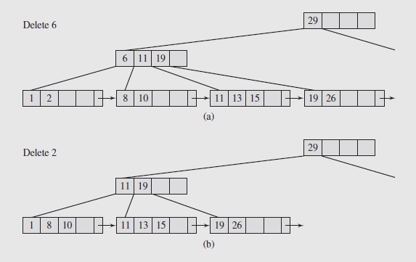
The Family of B-Trees (continued)
Fig. 7.14 Actions after deleting the number 6 from the B+-tree in Figure 7.13b

Slide 60
The Family of B-Trees (continued)
Prefix B⁺-Trees
As we’ve seen, if a key is in a leaf and internal node of a B⁺-tree, it is sufficient to delete the key from the leaf
So it makes little difference if a key in an internal node is in a leaf or not
What is important is that it serve as a separator between keys in adjacent children; for keys K₁ and K₂ it must satisfy K₁ < s < K₂
This property as a separator is preserved even if we reduce the size of the keys in internal nodes by eliminating any redundancies while still preserving the structure of the B⁺-tree
In applying this idea to B⁺-trees, we choose the shortest prefixes that allow distinguishing between neighboring index keys
The result is called a simple prefix B⁺-tree

Slide 61
The Family of B-Trees (continued)
Prefix B⁺-Trees (continued)
Reducing the size of the separators to a minimum doesn’t change the result of the search, just the size of the separators
This means more separators (and more children) per node, reducing the number of levels in the tree and the branching factor
Consequently the processing of the tree will go faster
This technique is not limited to the parents of leaf nodes; it can be extended throughout the tree as shown in Figure 7.15
Operations on simple prefix B⁺-trees are similar to those on B⁺-trees with changes to handle the prefixes being used as separators
For example, after a split, the shortest prefix that differentiates the first key of the new node from the last key in the old node is found and placed in the parent

Slide 62
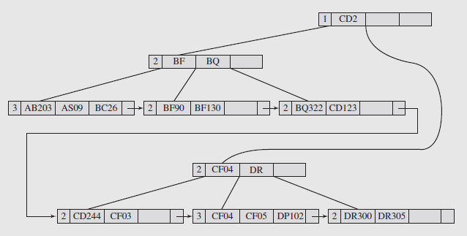
The Family of B-Trees (continued)
Prefix B⁺-Trees (continued)
For deletion, some separators left in the index may turn out to be too long; however they don’t need to be shortened immediately
Fig. 7.15 A B+-tree from Figure 7.12 presented as a simple prefix B+-tree

Slide 63
The Family of B-Trees (continued)
Prefix B⁺-Trees (continued)
The idea of prefixes as separators can be extended further if we notice that prefixes of prefixes can be omitted from lower levels of the tree
This is the idea behind a prefix B⁺-tree
The idea works particularly well if the prefixes are long and repetitious, and is shown in Figure 7.16 on page 328
Based on experimental results, the efficiency of simple prefix B⁺-trees and B⁺-trees are similar, but prefix B⁺-trees need much more time
For disk accesses, the trees behave identically for trees of 400 nodes or smaller
For 400 to 800 nodes, simple prefix B⁺-trees and prefix B⁺-trees are about 25% faster

Slide 64
The Family of B-Trees (continued)
K-d B-Trees
There is a multiway version of the k-d trees seen earlier called a k-d B-tree, where each leaf can hold up to a points of a k-dimensional space
The nonterminal nodes hold up to b regions; for parents of leaves, these are regions of points, and for other nodes, regions of regions
As with other tree structures we’ve looked at, trying to insert an a + 1st node into a leaf causes a split
This is reflected in the reorganization of the region containing information about the leaf, and in the placement of information into the parent node
Also as before, if the parent node is full, it must split, and so on up to the root of the tree
Consequently, handling splits in this type of tree is considerably more complicated than B-tree splits

Slide 65
The Family of B-Trees (continued)
K-d B-Trees (continued)
Splitting a leaf, however, is relatively simple, as the following algorithm illustrates:
splitPointNode (p, el_{n}, i)
p_{right} = new kdBTreeNode();
move to p_{right} elements with key_{i} > el_{n}.key_{i}; // old node p
return p_{right}; // is p_{left}
The examples shown in Figure 7.17 (pages 331-333) assume a leaf with a capacity of four elements (a = 4) and a region with a capacity of 3 regions (b = 3)
In Figure 7.17a, we have a situation where there is only one node in the tree, so it is the root and a leaf at the same time
Attempting to add a new element, “E”, causes a split to occur

Slide 66
The Family of B-Trees (continued)
K-d B-Trees (continued)
The split is determined by a specific discriminator (in this example, the x-coordinate) and a specific element
The element should be chosen to make the break as even as possible, although in practice it can be any element
A new leaf gets created, and the elements divided up between the two leaves using the discriminator (in this case the x-coordinate of “E”, which is 60), resulting in Figure 7.17b
Splitting a region, however, is quite complicated, as the algorithm and discussion on page 321 -- together with Figures 7.17d-e -- illustrate
With insertion of new nodes, we also have to be concerned about the possibility of overflows
In this case, the node is split and the parent receives information about the split

Slide 67
The Family of B-Trees (continued)
K-d B-Trees (continued)
This can cause the parent to split and so on up the tree to the root
The pseudocode on page 300 illustrates this process, together with Figures 7.17a-f
The implication of this is that insertion can cause a series of cascading overflows upwards in the tree, resulting in a number of splits
As opposed to insertion, deletion can be relatively simple, if no consideration is given to the degree of space utilization
The consequences of this are a large but sparse tree, but the effort to deal with this requires complicated manipulation of the region nodes
There are variations of k-d trees to address this, including hB-trees, that use nonrectangular regions; this is illustrated in Figure 7.18 on page 334

Slide 68
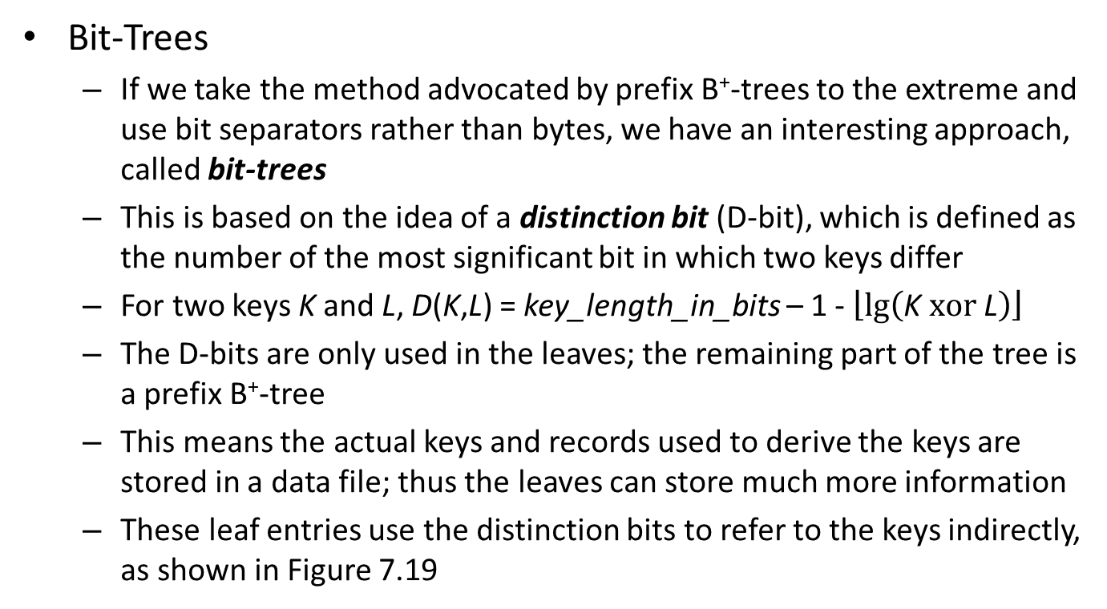
The Family of B-Trees (continued)
Bit-Trees
If we take the method advocated by prefix B⁺-trees to the extreme and use bit separators rather than bytes, we have an interesting approach, called bit-trees
This is based on the idea of a distinction bit (D-bit), which is defined as the number of the most significant bit in which two keys differ
For two keys K and L, D(K,L) = key_length_in_bits – 1 - $\left\lfloor \text{lg}\left(\text{K} \text{xor} \text{L}\right)\right\rfloor$
The D-bits are only used in the leaves; the remaining part of the tree is a prefix B⁺-tree
This means the actual keys and records used to derive the keys are stored in a data file; thus the leaves can store much more information
These leaf entries use the distinction bits to refer to the keys indirectly, as shown in Figure 7.19

Slide 69
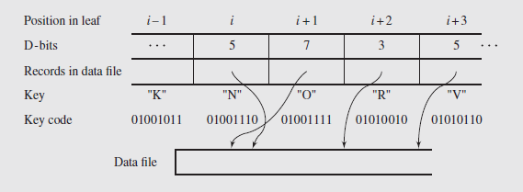
The Family of B-Trees (continued)
Bit-Trees (continued)
Fig. 7.19 A leaf of a bit-tree
The algorithm for searching this tree is shown on page 335
Using this, and assuming i – 1 = 0, i + 3 is the last entry in the leaf, R = R₀ and i = 1, we can show how to search for “V” in the bit leaf

Slide 70
The Family of B-Trees (continued)
Bit-Trees (continued)
The first time through the for loop, bit D₁ (5) in key “V” is checked; since it is a “1”, R is assigned R₁
In the second iteration, bit D₂ (7) is checked; it is a “0”, but the skipping required by the else statement is not processed, because immediately a D-bit is found that is smaller
The third pass: Bit D₃ (3) is checked, and is “1”, so R becomes R₃
The fourth pass: Bit D₄ (5) gets checked again, and since it is “1”, R becomes R₅
This is the last entry in the leaf, so the algorithm finishes at this time and R₅ is returned
If the record is not found, the algorithm checks the record found to see if it corresponds with the key, and if not, returns a negative value

Slide 71
The Family of B-Trees (continued)
R-Trees
In areas such as CAD, VLSI design, and geographical data, we frequently encounter spatial data
This requires special data structures be created in order to be processed efficiently, and one such type is the R-tree, developed by Antonin Guttman in 1984
An R-tree of order m is a B-tree like structure that has at least m entries in one node for some m < maximum number allowable for one node (other than the root)
Consequently, an R-tree is not required to be at least half full
The leaves of the tree contain entries of the form (rect, id) where rect = is an n-dimensional rectangle
The c values are coordinates along the same axis, and id is a pointer to a record in a data file

Slide 72
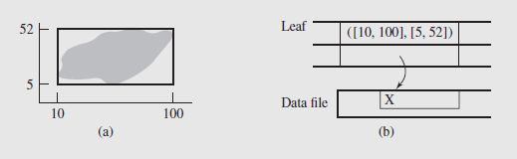
The Family of B-Trees (continued)
R-Trees (continued)
rect is the smallest rectangle containing the object id
In Figure 7.20 for example, the entry corresponding to object X on a Cartesian plane is [(10, 100), (5, 52), X)
Fig. 7.20 Area X on Cartesian plane enclosed tightly by rectangle ([10,100], [5,52]);
the rectangle parameters and the area identifier are stored in a leaf of an R-tree
Nonleaf node cells have the form (rect, child), where rect defines the smallest rectangle containing all the rectangles in child
An R-tree’s structure is not like that of a B-tree; it can be looked at as a series of n keys and n pointers associated with those keys

Slide 73
The Family of B-Trees (continued)
R-Trees (continued)
New rectangles are inserted in an R-tree like a B-tree, with splitting and redistribution
Figure 7.21 on page 338 illustrates adding four rectangles to an R-tree
A rectangle, R, can be encompassed in a number of other rectangles, but can be stored only once in a leaf
As a result, a search for R may take the wrong path at a level h when it sees that R is in another rectangle stored in a node on that level
For R-trees that are large and high, this overlap can become excessive
A modification to R-trees, called R⁺-trees, removes the overlap; encompassing rectangles no longer overlap, and each is associated with all the rectangles it intersects

Slide 74
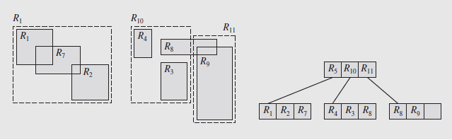
The Family of B-Trees (continued)
R-Trees (continued)
However, now there is a possibility a data rectangle can be in more than one leaf
Figure 7.22 shows an R⁺-tree from the R-tree in Figure 7.21c after data rectangle R₉ is inserted into it; this figure replaces 7.21d
Fig. 7.22 R+-tree representation of Fig. 7.21d R-tree after inserting rectangle R9 in Fig. 7.21c tree
Notice that R₈ is in two leaves, because it is intersected by R₁₀ and R₁₁

Slide 75
The Family of B-Trees (continued)
2-4 Trees
A special case of the B-tree, the B-tree of order 4, was introduced by Rudolf Bayer in 1972, who called it a symmetric binary B-tree
More frequently, it is referred to as a 2-3-4-tree or simply a 2-4-tree
Unlike B-trees, which can store an entire disk block in a node, 2-4 trees can store at most 3 elements per node
Thus, while of little use for secondary storage, it may offer an alternative to binary trees for memory structures
B-trees do offer advantages in this respect; because they are balanced as they are built, no special processing is needed
Thus, instead of binary search trees, we could use small-order B-trees like 2-4 trees

Slide 76
The Family of B-Trees (continued)
2-4 Trees (continued)
There are implementation issues associated with using a B-tree structure in memory however
If done this way there are three locations per node to store up to three keys, and four locations per node to store up to four pointers
Worst case is that half of these are unused; on the average 69% are used
This is inadequate memory utilization for main memory, where space is at a premium
So to avoid this, 2-4 trees are transformed into binary trees with one key per node
This is done in such a way that the original B-tree can be restored

Slide 77
The Family of B-Trees (continued)
2-4 Trees (continued)
To handle this transformation, two types of links are used between nodes
One indicates links between nodes that represent the keys belonging to the same node of the 2-4 tree
The other represents parent-child links
Bayer called these horizontal and vertical links; in their 1978 treatment, Leonidas Guibas and Robert Sedgewick called them red and black
In addition to the naming difference, the trees are represented differently
Figure 7.23 shows nodes with two and three keys, called 3-nodes and 4-nodes, and their equivalents; the dashed lines represent red links

Slide 78
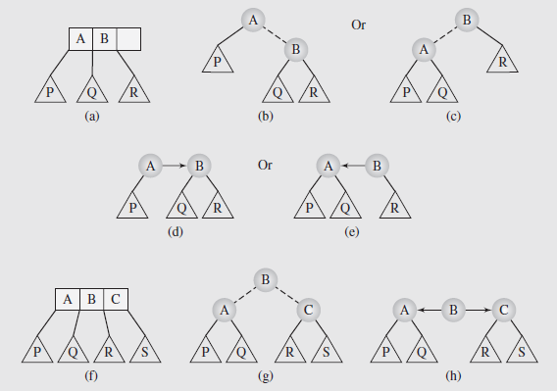
The Family of B-Trees (continued)
Fig. 7.23 (a) 3-node represented (b–c) in 2 possible ways by red-black trees & (d–e) in two
possible ways by vh-trees; (f) 4-node represented (g) by red-black tree and (h) by vh-tree

Slide 79
The Family of B-Trees (continued)
2-4 Trees (continued)
Figure 7-24 on page 341 shows a complete 2-4 tree along with its binary tree equivalents
The red-black tree better represents the structure of the binary tree
The vertical-horizontal- (or vh-) trees are better in handling the 2-4 trees and in having leaves shown as if they were on the same level
Vh-trees are also capable of representing B-trees of any order, while red-black trees do not
Both of these types of trees are binary trees; each node has two pointers that can be used in two way, so a flag is used to discriminate
Vh-trees have two important properties:
The path from the root to any null node has the same number of vertical links
No path from the root can have two horizontal links in a row

Slide 80
The Family of B-Trees (continued)
2-4 Trees (continued)
Because they are essentially binary trees, the operations performed on vh-trees should be the same
The implementation of these operations, however, is more complicated; only searching is the same
For example, insertions add a node and a link to the tree, so it has to be decided if the link should be horizontal or vertical
Likewise, deletions remove a node and a link, which could lead to two consecutive horizontal links
The discussion on pages 343-353, together with the accompanying figures, details these operations

Slide 81
The Family of B-Trees (continued)
Sets and Multisets in the Standard Template Library
A set is an abstract data structure that can store certain values, without any particular order, and no repeated values
In the STL, the set container is designed using a red-black tree, and the elements of the set are sorted
The use of the red-black tree improves the efficiency of inserting and deleting, but does decrease the flexibility of the set
Member functions of the set container are shown in Figure 7.34 on pages 354 and 355
As opposed to a set, a multiset allows for duplicates
Multisets use the same methods as sets, with two changes: set constructors are replaced by multiset constructors, and the iterator referencing a newly inserted element is modified, since multisets allow duplicates

Slide 82
The Family of B-Trees (continued)
Sets and Multisets in the STL (continued)
The operation of some of these methods is shown in Figure 7.35 on pages 355 and 356
Sets and multisets are ordered by default by the relation less<int>, however the user can specify the relation, if so desired
A new number can be inserted into a set if it is not already in the set
Membership can be checked so the insertion method will return a Boolean value to indicate success or failure
If the element to be added to the set has multiple parts, it is called a compound object
In this case, membership and ordering can be determined by the values of some of the parts, allowing duplicates of the non-sort fields

Slide 83
The Family of B-Trees (continued)
Sets and Multisets in the STL (continued)
Ironically, set-related operations cannot be used on sets because of the structure of the underlying tree
If we want to perform those types of manipulations, we need to change the underlying implementation to a structure such as an array, vector, or list

Slide 84
The Family of B-Trees (continued)
Maps and Multimaps in the Standard Template Library
A map is a generalization of an array that can be indexed by any data type
Maps utilize keys that behave as indexes, and store elements that are accessed by the keys
The keys are unique in that they have a one-to-one correspondence with the elements that are stored
So maps are also a generalization of a set; like a set they are implemented using red-black trees
However unlike the trees used to implement sets, map trees store <key, element> pairs that are ordered on the keys only
This allows the elements to be modified (which cannot be done in sets), however the keys cannot be changed

Slide 85
The Family of B-Trees (continued)
Maps and Multimaps in the STL (continued)
This property results in having two versions of many of the methods shown in Figure 7.36 on pages 359 – 361
An example program, utilizing a map cities indexed by objects of type person, is shown in Figure 7.37 on pages 362 and 363
New elements can be inserted with the insert() method; Figure 7.37 shows this being done in two ways:
In the first, the pair is generated with value_type, which is defined as another name for the <key, element> pair
In the second, the pair is explicitly created
Both attempts try to enter data for an already existing key, so they fail, even though the element (the city name) is different
If we want to update an element in the map, and explicit assignment is needed, use the element’s key to index the map

Slide 86
The Family of B-Trees (continued)
Maps and Multimaps in the STL (continued)
A multimap is a map that allows for duplicate keys
The multimap class generally uses the same methods as the map class, with a few exceptions
Modifying an element in a multimap can be done with the find() method, illustrated in Figure 7.37
However, this only modifies the first element found; to find the others, a loop needs to be used

Slide 87
Concluding Remarks
The treatment of multiway trees in this chapter is by no means complete; the number of varieties of such trees is large
The author’s goal here is to highlight the variety of uses of these trees and to show how the same tree can be applied to different applications
One tree in particular, the B-tree, is of special interest, due to its many variations
B⁺ trees in particular are useful in implementing indexes in relational databases, because of the flexibility in handling both random and sequential access
These trees are not limited to secondary storage, though; a variation, 2-4 trees, are useful for information processing in memory

Slide 88
Concluding Remarks (continued)
Another useful variant is the trie, a different type of tree with a wide variety of applications
The case study at the end of the chapter illustrates one particular and useful application of tries

