Slide 1
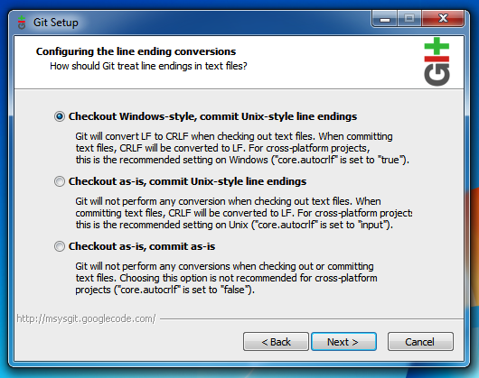
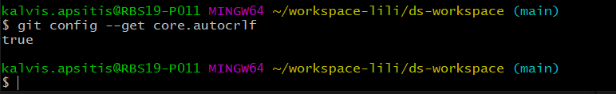
Linux vs. Windows Line Endings
Git for Windows installer has default option: core.autocrlf
Linux-style line endings ('\n' = LF) silently convert to Windows-style line endings: ('\r\n' = CRLF). And vice versa.

Slide 2
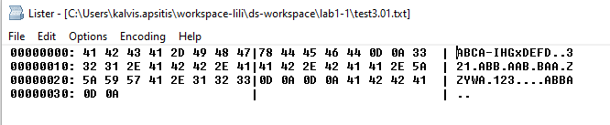
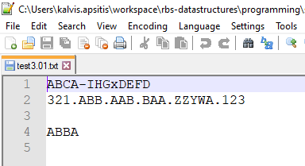
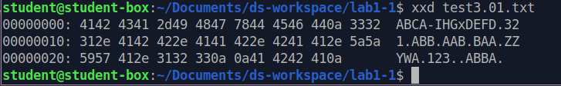
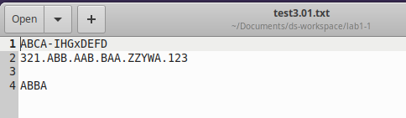
Line Endings in Action
Testfile on Windows (Inspect with Total Commander,
F3 (View), then
The same testfile checked
out on Linux:

Slide 3
Issues with the Code
while(arg[i] != '\n' && arg[i - 1] != '\n'){
//look if there are two new line symbols
→ Issue 1: This would work differently on Linux and Windows.
if (... arg[i - 1] == (arg[i] - 1))
→ Issue 2: This only compares to the previous letter (some testcases would fail)
void eraseChars(char* arg){ // ...
cout << '\n' << arg[i - 1];
→ Issue 3: This does not edit "arg" array, but prints directly to the output. (Lab description says that "arg" should be edited in eraseChars(...)).

Slide 4
"Platform-independent" main()
Rely on invariants (things that stay the same on both platforms):
int main() {
string line;
while (getline(cin, line)) {
// stop, if there is empty line
if (line == "") { break; }
// process line (it does not contain \n)
char* chars = const_cast<char*>(line.c_str());
eraseChars(chars);
// platform dependent linebreak
cout << chars << endl;
}
}

Slide 5
Simplistic eraseChars() – only compare with the previous char (fails most testcases)
simplisticEraseChars (char* arg):
1. print arg[0]
2. i := 1
3. while arg[i] != '\0' // (stop when there is the end of string):
4. if arg[i] is uppercase and arg[i-1] is uppercase and arg[i] <= arg[i-1]:
5. i := i+1 // skip printing; advance the counter
6. else
7. print arg[i]
8. i := i+1 // print and advance the counter

Slide 6
Better eraseChars() – if only the printing matters (could pass all testcases)
betterEraseChars (char* arg):
print arg[0]
i := 1; // forward counter
j := 0; // back counter (the last location that we did not skip and use for comparisons)
while arg[i] != '\0' // (stop when there is the end of string):
if arg[i] is uppercase and arg[j] is uppercase and arg[i] <= arg[j]:
i := i+1 // skip printing; advance the forward counter
else
print arg[i]
j = i // set back counter to the last non-skipped char position
i := i+1 // advance the counter, look at the next char

Slide 7
Actually, eraseChars() should edit char* "in place"
As in lab description: eraseChars() should modify its argument.
At start:
A
H
C
E
D
K
\0
char* arg
A
H
K
\0
D
K
\0
char* arg
Spoler alert: Next slide is the pseidocode for a proper eraseChars() function.
Try to figure it out before turning the page.

Slide 8
properEraseChars() – edits char* in place
properEraseChars (char* arg):
// skip arg[0]; it aways stays in the resulting arg.
i := 1 // forward counter (the location we read from)
j := 0 // back counter (the last location which we did not skip
while arg[i] != '\0' // (stop when there is the end of string):
if arg[i] is uppercase and arg[j] is uppercase and arg[i] <= arg[j]:
i := i+1 // skip printing; advance the forward counter
else
arg[j+1] = arg[i]
j = j+1 // back counter advances by 1 position (1 char inserted)
i := i+1 // advance the counter, look at the next char
arg[j] := '\0' // since the edited char* array may be shorted – manually insert terminating \0

Slide 9
(Not needed for sample3, but sometimes used) What about "long-living" lines?
{ string line;
getline(cin, line);
char* chars = const_cast<char*>(line.c_str());
} // "line" now out of scope; array "chars" becomes unusable
In some situations "chars" need to be saved for later processing:
vector<char*> lines; // accumulate all lines here
{ string line;
getline(cin, line);
char* chars = new char[line.length() + 1];
strcpy(chars, line.c_str());
lines.push_back(chars);
} // Array "chars" was reserved with "new"; it lives on

