Slide 1
Week03 Other Complexity Models

Slide 2
Objectives
The limitations of the traditional "worst case" deterministic model.
The model of average-case complexity (input probabilities)
Amortized complexity model (multiple operations in a row)
The model of probabilistic algorithms
The model of non-deterministic algorithms

Slide 3
Weights by Input Probability
To be more precise, we need to weight the number of steps that occur for a given input by the probability of that input occurring, and sum this over the number of inputs:
In probability theory, this defines the expected value, which assumes the probabilities can be determined and their distribution known
Because p is a probability distribution, it satisfies two constraints:
The function p can never be negative
The sum of all the probabilities is equal to 1

Slide 4
Weights by Input Probability
Algorithm: Sequentialy search an unordered array to find a target value
What is the best case (and its complexity)?
What is the worst case (and its complexity)?
If we assume a uniform distribution of n values, then the probability of finding the target in any one location is 1/n.
Can we find the expected time complexity? (The average case complexity)

Slide 5
Best, Average, and Worst Cases (continued)
So we would find the target in the first location with p = 1/n, in the second location with p = 1/n, etc.
Since the number of steps required to get to each location is the same as the location itself, our sum becomes:
1/n * (1 + 2 + … + n) = (n + 1) / 2
This is based on an equally likely chance of finding the target in any cell (If the probabilities differ, the computation changes too.)

Slide 6
Amortized Complexity
In many cases, data structures are manipulated by sequences of operations
We could accumulate the (worst-case) performance for each operation and multiply with their count. This can give very inaccurate results.
More useful approach: Consider the overall cost of a sequence of operations
This approach is referred to as amortized analysis
The idea is that while some operations may be costly, they do not occur frequently enough to bias the entire program
This is because less costly operations will outnumber the costly ones in the long run, "paying back" the program over a number of iterations
Notes:
Consider a dynamic array application where we double the size of the array each time it fills up
Array reallocation may be required, so in the worst case insertion may be O(n)
Yet because remaining insertions are done in constant time, a sequence of n insertions can always be done in O(n) time
Consequently, the n insertions can be completed in O(n) time
So the amortized time per operation is O(n) / n = O(1)

Slide 7
Example: Class ArrayList
Arrays are fast, but not very flexible.
We want "stretchable" array – that can increase/decrease its size.
An element can be accessed, inserted or removed by specifying its index (number of elements preceding it)
Exception is thrown if an incorrect index is given (negative index or more than the current size)
Main methods:
at(integer i): object – returns the element at index i without removing it
set(integer i, object o) – replaces the element at index i with o
insert(integer i, object o) – inserts a new element o to have index i
erase(integer i) – removes element at index i
Additional methods:
size(): int – returns the size of list
createEmpty(): List<object> - creates a new/empty list to store object types.

Slide 8
Array-based Implementation
Use an array A of size N
A variable n keeps track of the size of the array list (number of elements stored)
Operation at(i) is implemented in O(1) time by returning A[i]
Operation set(i,o) is implemented in O(1) time by performing A[i] = o
A
0
1
2
i
n

Slide 9
Insertion
In operation insert(i, o), we need to make room for the new element by shifting forward the n − i elements A[i], …, A[n − 1]
In the worst case (i = 0), this takes O(n) time
A
0
1
2
i
n
A
0
1
2
i
n
A
o
0
1
2
i
n

Slide 10
Element Removal
In operation erase(i), we need to fill the hole left by the removed element by shifting backward the n − i − 1 elements A[i + 1], …, A[n − 1]
In the worst case (i = 0), this takes O(n) time
A
o
0
1
2
i
n
A
0
1
2
i
n
A
0
1
2
i
n

Slide 11
Performance
In the array based implementation of an array list:
The space used by the data structure is O(n)
size, empty, at and set run in O(1) time
insert and erase run in O(n) time in worst case
In an insert operation, when the array is full, instead of throwing an exception, we can replace the array with a larger one
Notes:
If we use the array in a circular fashion, operations insert(0, x) and erase(0, x) run in O(1) time. Can you verify this?

Slide 12
Growable Array-based Array List
In an insert(o) operation (without an index), we always insert at the end
When the array is full, we replace the array with a larger one
How large should the new array be?
Incremental strategy: increase the size by a constant c
Doubling strategy: double the size
Algorithm insert(o)
if t = S.length − 1 then
A ← new array of
size …
for i ← 0 to n−1 do
A[i] ← S[i]
S ← A
n ← n + 1
S[n−1] ← o

Slide 13
Comparison of the Strategies
We compare the incremental strategy and the doubling strategy by analyzing the total time T(n) needed to perform a series of n insert(o) operations
We assume that we start with an empty stack represented by an array of size 1
We call amortized time of an insert operation the average time taken by an insert over the series of operations, i.e., T(n)/n

Slide 14
Incremental Strategy Analysis
We replace the array k = n/c times
The total time T(n) of a series of n insert operations is proportional to
n + c + 2c + 3c + 4c + … + kc =
n + c(1 + 2 + 3 + … + k) =
n + ck(k + 1)/2
Since c is a constant, T(n) is O(n + k²), i.e., O(n²)
The amortized time of an insert operation is O(n²)

Slide 15
Doubling Strategy Analysis
We replace the array k = log₂ n times
The total time T(n) of a series of n insert operations is proportional to
n + 1 + 2 + 4 + 8 + …+ 2^{k} = n + 2^{k + 1} − 1 =
3n − 1
T(n) is O(n)
The amortized time of an insert operation is O(1)
geometric series
2
4
1
1
8

Slide 16
Probabilistic Algorithms
Probabilistic algorithms violate the principle of "determinism" – all steps of the algorithm are unambiguous and will repeat every time in the same way.
They can "toss the coin" or generate random numbers.
Famous example – Primality test by Miller-Rabin.

Slide 17
The Selection Problem
Example: The Selection Problem
Given an integer k and n elements x₁, x₂, …, x_{n}, taken from a total order, find the k-th smallest element in this set.
Of course, we can sort the set in O(n log n) time and then index the k-th element.
Can we solve the selection problem faster?
k=3
7 4 9 6 2 → 2 4 6 7 9

Slide 18
Quick-Select
Quick-select is a randomized selection algorithm based on the prune-and-search paradigm:
Prune: pick a random element x (called pivot) and partition S into
L: elements less than x
E: elements equal x
G: elements greater than x
Search: depending on k, either answer is in E, or we need to recur in either L or G
x
x
L
G
E
k < |L|
k > |L|+|E|
k’ = k - |L| - |E|
|L| < k < |L|+|E|
(done)

Slide 19
Partition
Algorithm partition(S, p)
Input sequence S, position p of pivot
Output subsequences L, E, G of the elements of S less than, equal to, or greater than the pivot, resp.
L, E, G ← empty sequences
x ← S.erase(p)
while ¬S.empty()
y ← S.eraseFront()
if y < x
L.insertBack(y)
else if y = x
E.insertBack(y)
else { y > x }
G.insertBack(y)
return L, E, G
We partition an input sequence as in the quick-sort algorithm:
We remove, in turn, each element y from S and
We insert y into L, E or G, depending on the result of the comparison with the pivot x
Each insertion and removal is at the beginning or at the end of a sequence, and hence takes O(1) time
Thus, the partition step of quick-select takes O(n) time

Slide 20
Quick-Select Visualization
An execution of quick-select can be visualized by a recursion path
Each node represents a recursive call of quick-select, and stores k and the remaining sequence
k=2
k=5, S=(7 4 9 3 2 6 5 1 8)
(2 1)
3
(7 4 9 6 5 8)
k=2, S=(7 4 9 6 5 8)
k=2
(7 4 6 5)
8
(9)
k=2, S=(7 4 6 5)
k=1
( )
4
(7 6 5)
k=1, S=(7 6 5)
( )
5
(7 6)
5

Slide 21
Expected Running Time – 1
Consider a recursive call of quick-select on a sequence of size s
Good call: the sizes of L and G are each less than 3s/4
Bad call: one of L and G has size greater than 3s/4
A call is good with probability 1/2
1/2 of the possible pivots cause good calls:
7 2 9 4 3 7 6 1 9
7 2 9 4 3 7 6 1
2 4 3 1
6
7 9 7 1 → 1
1
7 2 9 4 3 7 6
Good call
Bad call
1 2 3 4 5 6 7 8 9 10 11 12 13 14 15 16
Bad pivots
Good pivots
Bad pivots

Slide 22
Expected Running Time – 2
Probabilistic Fact #1: The expected number of coin tosses required in order to get one head is two
Probabilistic Fact #2: Expectation is a linear function:
E(X + Y ) = E(X ) + E(Y )
E(cX ) = cE(X )
Let T(n) denote the expected running time of quick-select.
By Fact #2,
T(n) < T(3n/4) + bn*(expected # of calls before a good call)
By Fact #1,
T(n) < T(3n/4) + 2bn
That is, T(n) is a geometric series:
T(n) < 2bn + 2b(3/4)n + 2b(3/4)²n + 2b(3/4)³n + …
So T(n) is O(n).
We can solve the selection problem in O(n) expected time.

Slide 23
NP Complexity Class
Informally, a deterministic algorithm is one that behaves predictably
Given a particular input, the underlying algorithm has only one way to decide what step to perform at any given point
As opposed to this, a nondeterministic algorithm can “guess” what to do next when a decision is made
It can exhibit different behaviors on different runs
For example, concurrent algorithms may experience race conditions (some unpredictability).

Slide 24

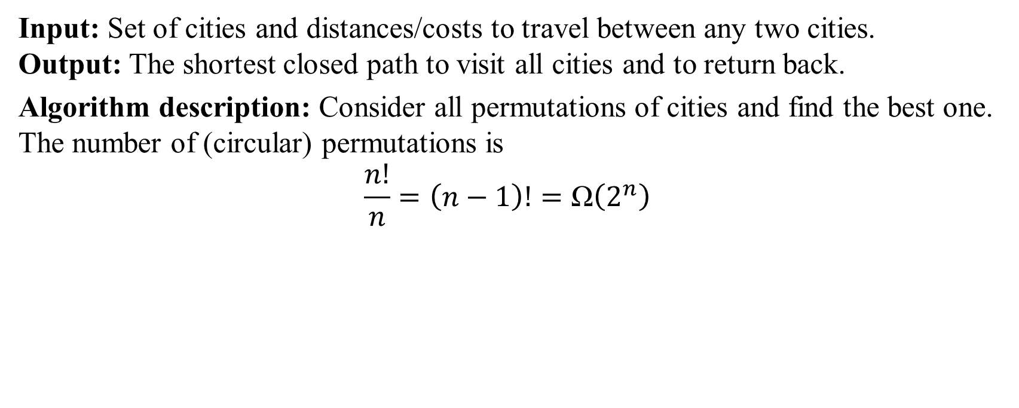
Problem: Traveling Salesman
Input: Set of cities and distances/costs to travel between any two cities. Output: The shortest closed path to visit all cities and to return back.
Algorithm description: Consider all permutations of cities and find the best one. The number of (circular) permutations is
$$\frac{n!}{n}=\left(n−1\right)!=\text{Ω}\left(2^{n}\right)$$
Notes:
A decision problem is any arbitrary yes-or-no question on an infinite set of inputs
Because of this, it can be defined equivalently as the set of inputs for which the problem returns yes
A nondeterministic algorithm can solve a decision problem if there is a path in the decision tree of the algorithm that leads to a “yes” answer; otherwise it would answer “no”.
Can a traveling salesman make a cycle to visit all vertices in a weighted graph (and have the total weight of the edges on the cycle < N?)
YES/NO decision problem – can be solved by a non-deterministic algorithm in a polynomial time.

Slide 25
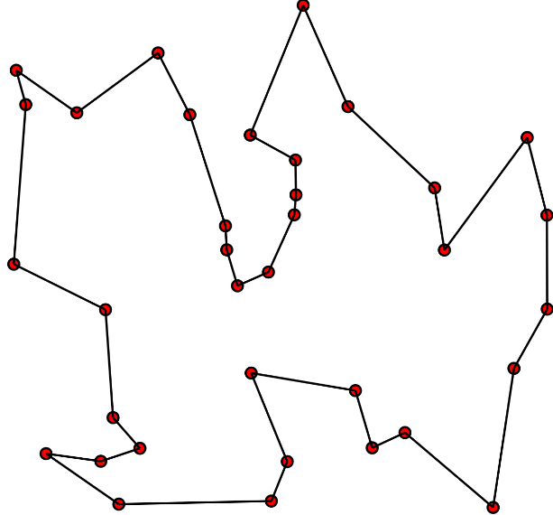


Traveling Salesman Revisited
Traveling Salesman (as a YES/NO problem): Given a weighted graph $G$ and a number $M$: Can you have a circular path in $G$ cheaper or equal to $M$?
(Imagine that the traveling salesman has an "oracle" that always can tell, if in the given graph there is a Hamiltonian path cheaper or equal to M. Can s/he use this information for actual travelling?)
Rule of Thumb: Polynomial-time algorithms are considered efficient, but superpolinomial or exponential-time algorithms are not.
$T≈1000000∙n^{1000000}$ is still good
$T=O\left(n^{\log{\log{n}}}\right)$ is bad.
Notes:
Adleman–Pomerance–Rumely primality test is a superpolynomial time algorithm (but not an exponential one).

Slide 26
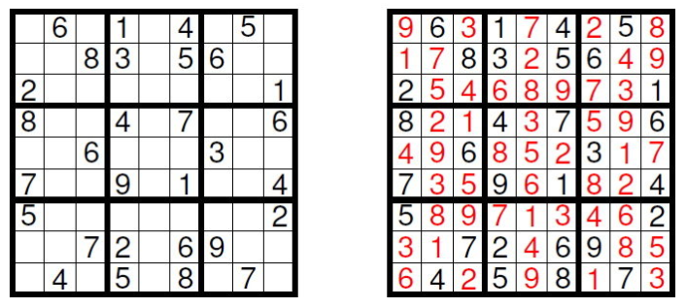
Non-deterministic Time Analysis
Nondeterministic algorithm (not to be confused with probabilistic) assumes that it is incredibly lucky. It can generate answer randomly – then checks it.
For a decision problem (YES/NO question) there exists a way to guess so as to say YES (but can also fail). If the true answer is NO, it always fails.
(c) Calimeri2013
Notes:
[The Eternal Battle between Determinism and Non-Determinism by Francesco Calimeri](https://www.researchgate.net/figure/Example-of-Sudoku-puzzle-left-with-its-solution-right_fig1_301551207).

Slide 27
NP-Completeness (continued)
Problems that can be solved by a deterministic algorithm in polynomial time belong to a class P (polynomial time) problems.
It is generally believed that P ≠ NP, although this is a famous open problem.

Slide 28
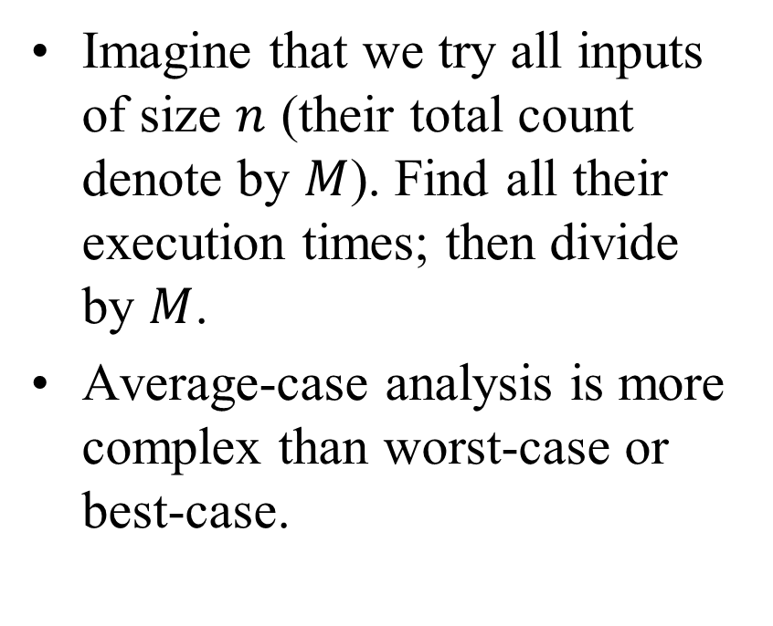
Average-case Analysis
Imagine that we try all inputs of size $n$ (their total count denote by $M$). Find all their execution times; then divide by $M$.
Average-case analysis is more complex than worst-case or best-case.
Assume inputs to be random, but the algorithm itself is still deterministic.
Probabilistic algorithms may use random number generators to operate (and they are sometimes allowed to return wrong answers) →
Not covered in this course.
Notes:
Sometimes the analysis assumes that the input data is generated accordingly to some probability distribution (uniform? normal?). With additional assumptions the evaluation may become easier.

Slide 29
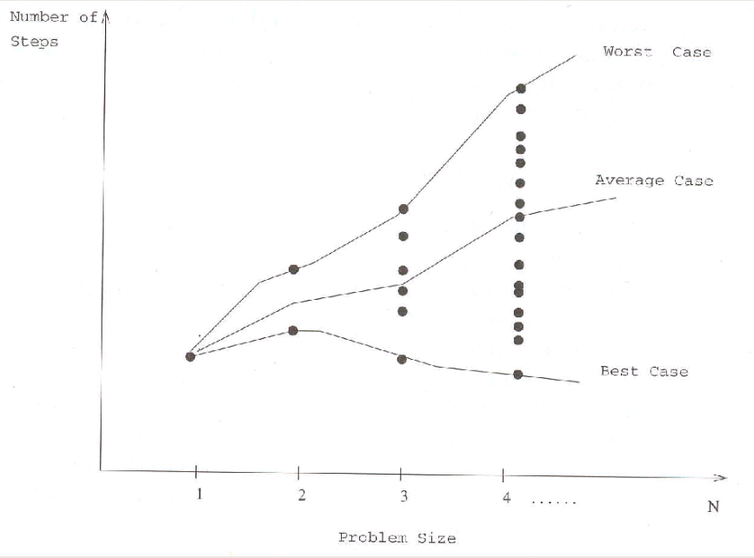
Best/Worst/Average Analysis

Slide 30
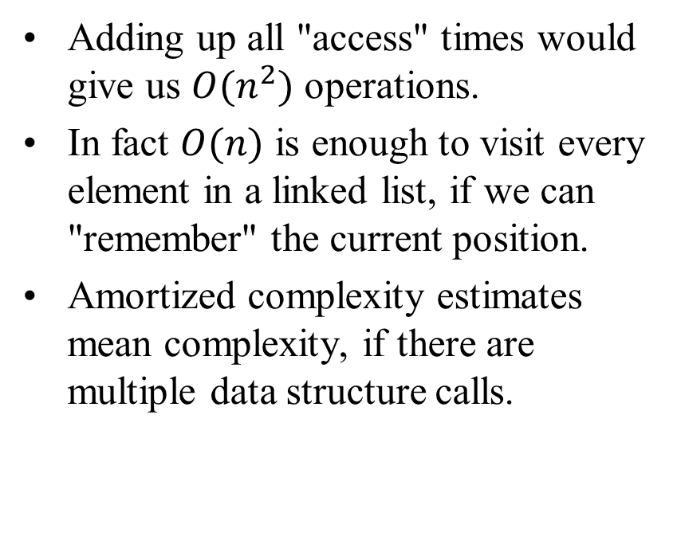
Amortized Complexity
Estimate (worst-case or average-case) may not reflect the reality.
In a linked list accessing the i-th element takes O(n) – worst and average.
function visitAll (L):
for i=0 to n-1 do:
e = access(L,i)
visit(v)
Adding up all "access" times would give us $O(n^{2})$ operations.
In fact $O(n)$ is enough to visit every element in a linked list, if we can "remember" the current position.
Amortized complexity estimates mean complexity, if there are multiple data structure calls.
Same as amortization in accounting, e.g. car purchase and maintenance costs are distributed evenly.

