Slide 1
Midterm Exam Answers and Criteria
April 12, 2023; 5 problems.
E-Studijas problems are graded with 0 – 10 points.
All midterm grades are added up (the total is 0 – 50).
Multiply by 2/5 to get percentage points (0 – 20).

Slide 2
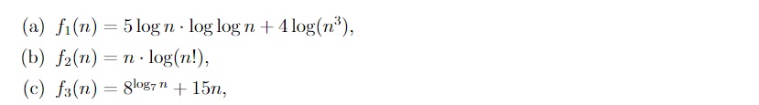
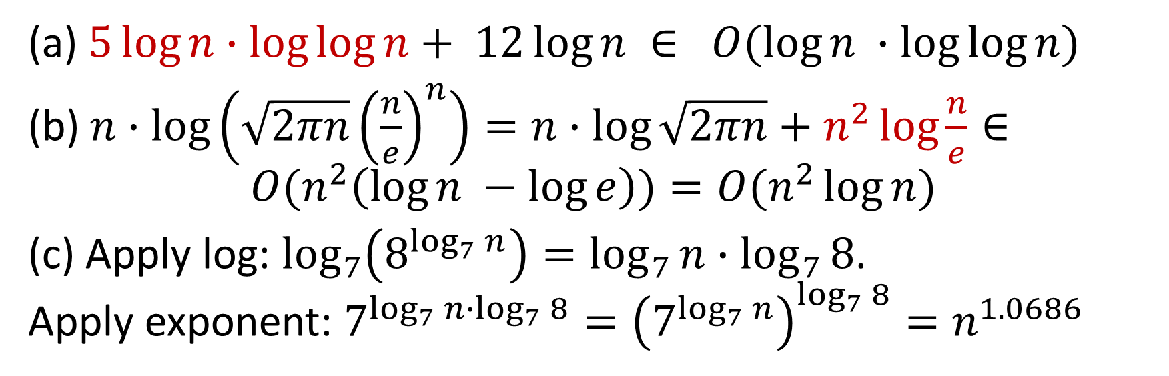
Problem 1, (a), (b), (c)
Algebra (log of power) + dominant term
Stirling's approximation + dominant term
Algebra (change log base) + dominant term
(a) $5\log{n}∙\log{\log{n}}+ 12\log{n} ∈ O(\log{n ∙\log{\log{n)}}}$
(b) $n∙log\left(\sqrt{2πn}{\left(\frac{n}{e}\right)}^{n}\right)=n∙\log{\sqrt{2πn}}+n^{2}\log{\frac{n}{e}}∈⁡$
$$O(n^{2}\left(\log{n −\log{e}}\right))=O(n^{2}\log{n})$$
(c) Apply log: $\log_{7}\left(8^{\log_{7}{n}}\right)=\log_{7}{n}∙\log_{7}{8}$. Apply exponent: $7^{\log_{7}{n}∙\log_{7}{8}}={\left(7^{\log_{7}{n}}\right)}^{\log_{7}{8}}=n^{1.0686}$

Slide 3
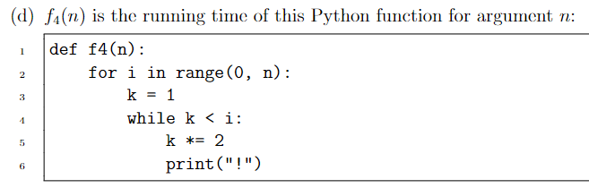
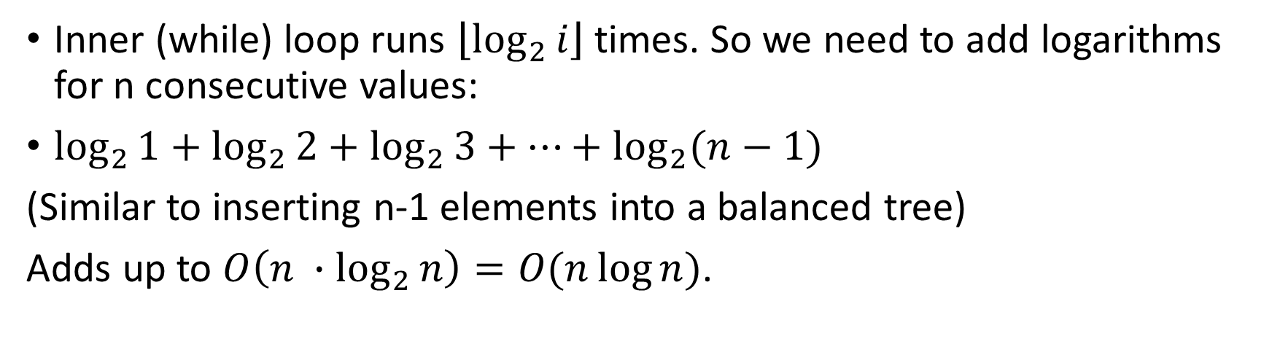
Problem 1, (d)
Inner (while) loop runs $\left\lfloor \log_{2}{i}\right\rfloor$ times. So we need to add logarithms for n consecutive values:
$\log_{2}{1}+\log_{2}{2}+\log_{2}{3}+⋯+\log_{2}{(n−1)}$
(Similar to inserting n-1 elements into a balanced tree)
Adds up to $O\left({n ∙log}_{2}{n}\right)=O(n\log{n})$.

Slide 4
Problem 1 (Grading Criteria)
(a), (b), (c) – analytically defined funcions
Correct answer: 1 point
Justification (may have wrong algebra): 1 point
(d) – code snippet
Correct answer: 2 points
Justification: 2 points

Slide 5
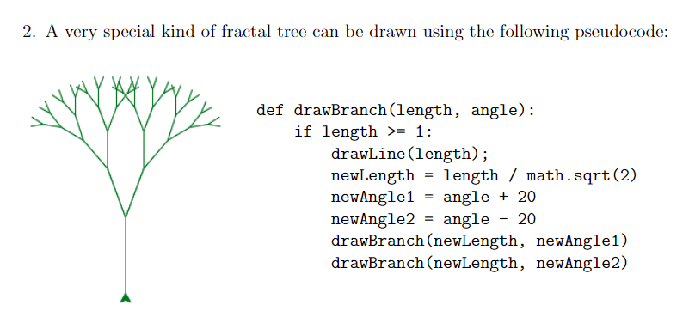
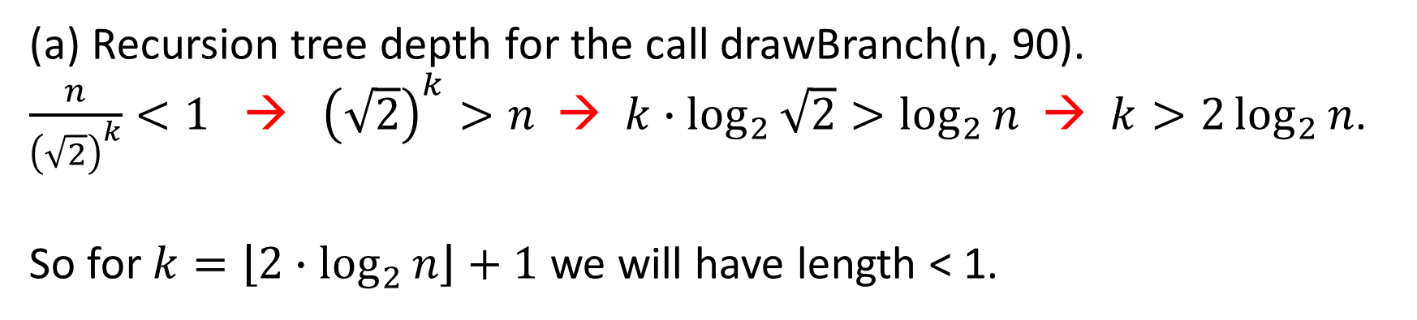
Problem 2(a)
(a) Recursion tree depth for the call drawBranch(n, 90).
$\frac{n}{{\left(\sqrt{2}\right)}^{k}}<1$ → ${\left(\sqrt{2}\right)}^{k}>n$ → $k∙\log_{2}{\sqrt{2}}>\log_{2}{n}$ → $k>2\log_{2}{n}$.
So for $k=\left\lfloor 2∙\log_{2}{n}\right\rfloor +1$ we will have length < 1.

Slide 6


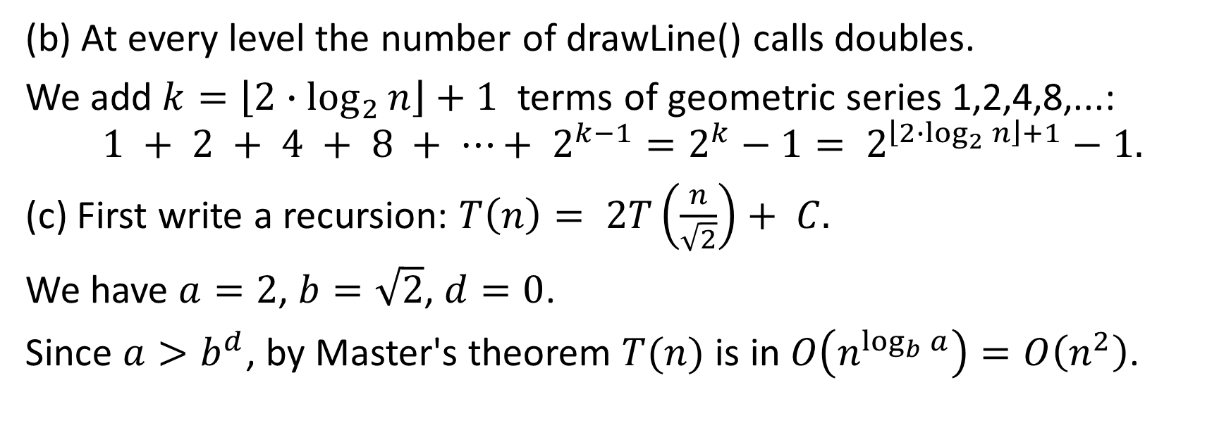

Problem 2(b),(c)
(b) At every level the number of drawLine() calls doubles.
We add $k=\left\lfloor 2∙\log_{2}{n}\right\rfloor +1$ terms of geometric series 1,2,4,8,...:
$$1 + 2 + 4 + 8 + ⋯+ 2^{k−1}=2^{k}−1= 2^{\left\lfloor {2∙log}_{2}{n}\right\rfloor +1}−1.$$ (c) First write a recursion: $T\left(n\right)= 2T\left(\frac{n}{\sqrt{2}}\right)+ C.$
We have $a=2$, $b=\sqrt{2}$, $d=0$.
Since $a>b^{d}$, by Master's theorem $T(n)$ is in $O\left(n^{\log_{b}{a}}\right)=O\left(n^{2}\right)$.
$$→$$

Slide 7
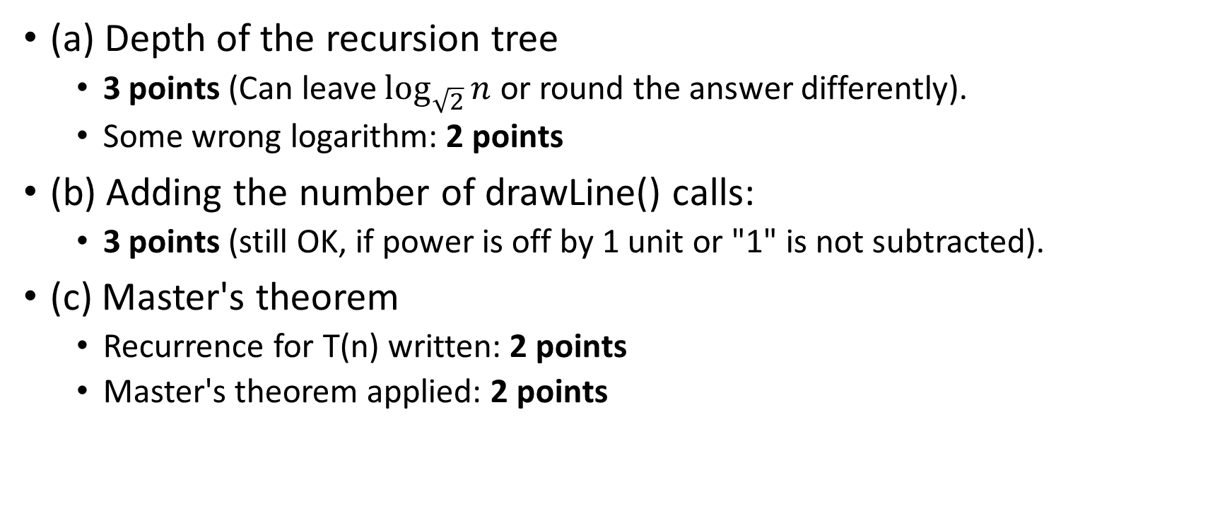
Problem 2 (Grading Criteria)
(a) Depth of the recursion tree
3 points (Can leave $\log_{\sqrt{2}}{n}$ or round the answer differently).
Some wrong logarithm: 2 points
(b) Adding the number of drawLine() calls:
3 points (still OK, if power is off by 1 unit or "1" is not subtracted).
(c) Master's theorem
Recurrence for T(n) written: 2 points
Master's theorem applied: 2 points

Slide 8
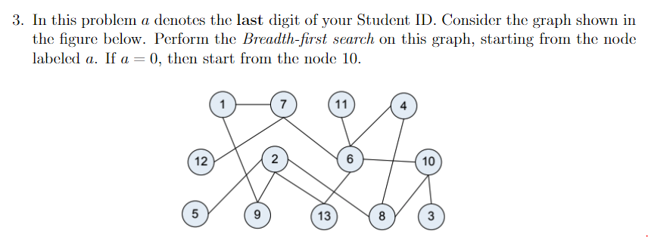
Problem 3
1
7
9
6
12
2
4
10
11
13
5
8
"Unfriendly" tree picture (considered valid)
"Friendlier" tree picture
3
The visited nodes:
1 7 9 6 12 2 4 10 11 13 5 8 3

Slide 9
Problem 3 (Grading Criteria)
(a) Redraw the graph
4 points, if the graph is correct
2 points, if the graph is still a tree with source as root, but not a BST tree
(b) List the visited vertices
6 points, if the sequence is correct
4 points, if the sequence is mostly correct, but children are not visited in increasing order.

Slide 10
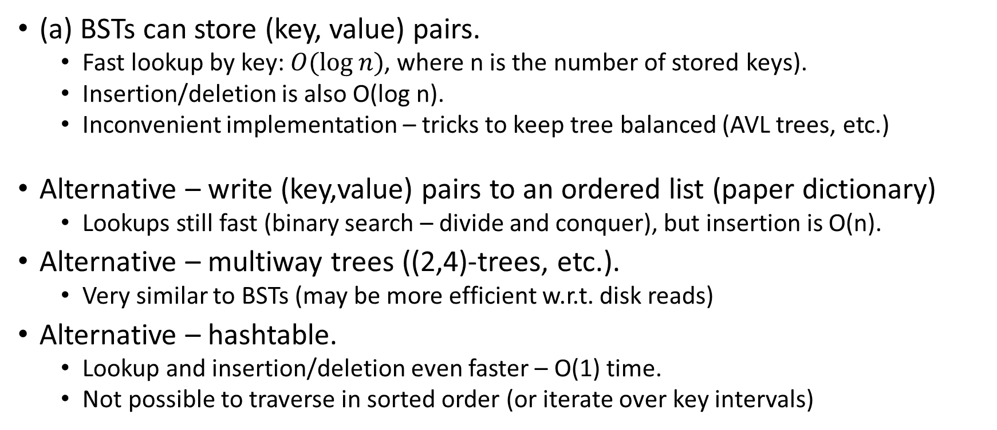
Problem 4(a)
(a) BSTs can store (key, value) pairs.
Fast lookup by key: $O(log⁡n)$, where n is the number of stored keys).
Insertion/deletion is also O(log n).
Inconvenient implementation – tricks to keep tree balanced (AVL trees, etc.)
Alternative – write (key,value) pairs to an ordered list (paper dictionary)
Lookups still fast (binary search – divide and conquer), but insertion is O(n).
Alternative – multiway trees ((2,4)-trees, etc.).
Very similar to BSTs (may be more efficient w.r.t. disk reads)
Alternative – hashtable.
Lookup and insertion/deletion even faster – O(1) time.
Not possible to traverse in sorted order (or iterate over key intervals)

Slide 11
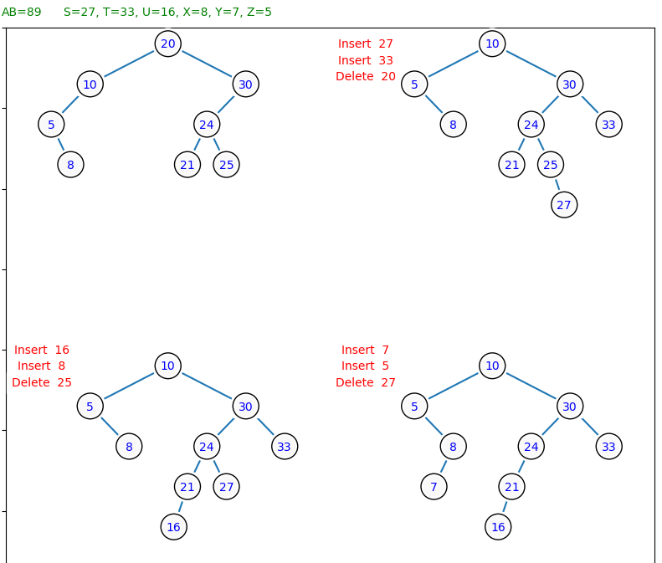
Problem 4(b)
BST delete alternatives:
Replace by in-order predecessor
Replace by in-order successor

Slide 12
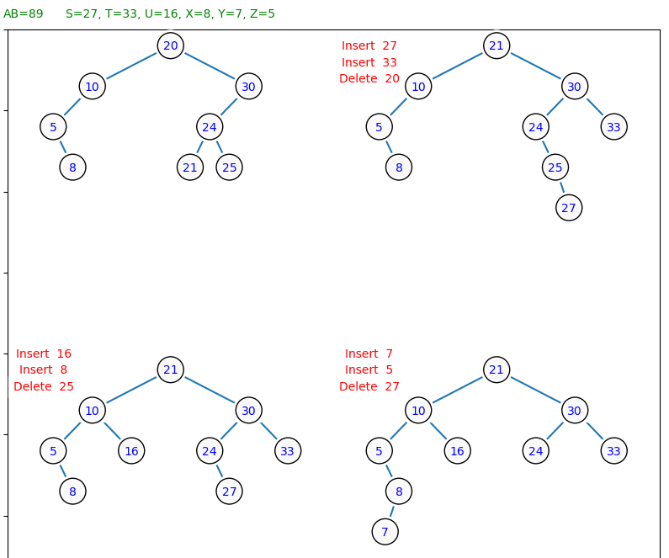
Problem 4(b)
BST delete alternatives:
Replace by in-order predecessor
Replace by in-order successor

Slide 13
Problem 4 (Grading Criteria)
(a) 5 points, if at least two alternatives mentioned
3 points, if only one alternative is mentioned.
(b) 5 points, if all operations done correctly (any flavor of BST delete)
(1-2 points may be subtracted for inconsequential mistakes, if the BST tree invariant is not broken).
2 points, if only inserts are correct
0 points, if BST tree was broken: in-order traversal does not return keys in sorted order.

Slide 14
Problem 5,(a)
def canSetNumbers():
global N = readNumber(); E = readNumber()
global adjacencyLists = []*N # initialize with N empty lists
global colors = (-1)*N # list of N colors (not set to white or black)
for k in range(0,N):
i = readNumber(); j = readNumber()
adjacencyLists[i-1].append(j-1)
adjacencyLists[j-1].append(i-1)
for i in range(N):
if colors[i] == -1:
if not dfsVisit(adjacencyList, colors, i, 0):
return False
return True

Slide 15
Problem 5(a), continued
def dfsVisit(currentNode, theColor):
if colors[currentNode] != -1:
return colors[currentNode] == theColor
colors[currentNode] = theColor
for neighbor in adjacencyList[currentNode]:
if not dfsVisit(adjacencyList, colors, neighbor, 1 - theColor):
return False
return True

Slide 16
Problem 5(b)
Time complexity is O(N+E)
(For very sparse graphs N could be larger than E).
Building the adjacency list takes O(E) – add every edge.
The function iterates through all N nodes and calls the `dfsVisit` function for each unvisited node.
The `dfsVisit` function performs a depth-first search on the connected component of the graph; visit each node and edge no more than once.

Slide 17
Problem 5 (Grading Criteria)
(a) 5 points, if algorithm is correct for all kinds of graphs.
3 points, if it works for additional assumptions (e.g. only connected graph etc.)
2 points, if it still traverses all nodes, but can mishandle some edges.
(b) 4 points if the time complexity is O(N+E) or O(E) (mostly same as O(N+E) except very sparse graphs)
3 points, if time complexity is O(N^2) – slightly inefficient adjacency matrix solution.

