Slide 1
Chapter 3
Input/Output

Slide 2
Objectives
In this chapter, you will:
Learn about input and output streams
Read data from STDIN
Use predefined functions and objects in a program (#include ...)
Use the input stream functions get, ignore, peek
Write to STDOUT, STDERR

Slide 3
I/O Streams and Standard I/O Devices
Stream is a sequence of bytes received from source to destination
Bytes can be text, but can be binary (to write archives, images, etc.)
Input stream: sequence of characters from an input device to the computer
Output stream: sequence of characters from the computer to an output device

Slide 4
I/O Streams and Standard I/O Devices
Use iostream header file to receive data from keyboard and send output to the screen
Contains definitions of two data types:
istream: input stream
ostream: output stream
Has two variables: cin and cout
istream cin: stands for common input
ostream cout: stands for common output

Slide 5
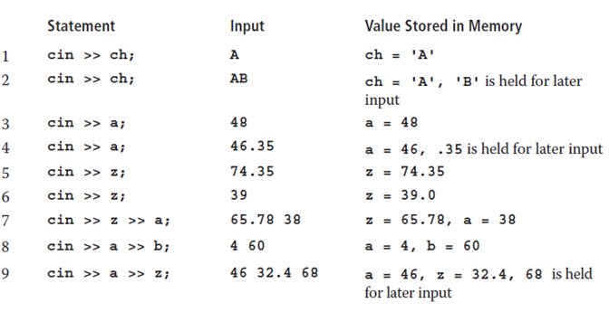
cin and Operator >>
char ch; int a, b; double z;

Slide 6
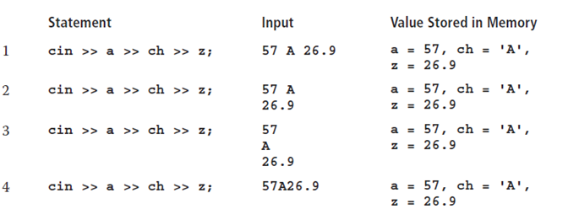
cin and the Extraction Operator >>
char ch; int a, b; double z;

Slide 7
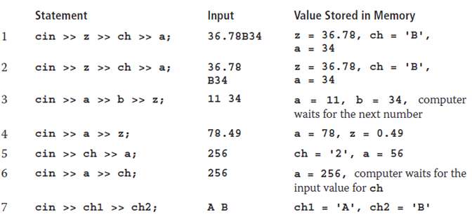
cin and the Extraction Operator >>
char ch, ch1, ch2; int a, b; double z;

Slide 8

cin and the get Function
The get function
Inputs next character (including whitespace)
Stores in memory location indicated by its argument
The syntax of cin and the get function
varChar is a char variable
It is the argument (or parameter) of the function

Slide 9
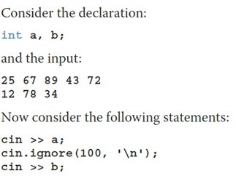

cin and the ignore Function (1 of 2)
ignore function
Discards a portion of the input
intExp is an integer expression
chExp is a char expression
If intExp is a value m, the statement says to ignore the next m characters or all characters until the character specified by chExp

Slide 10


The putback and peek Functions
Syntax for putback (Places previous character extracted by the get function)
istreamVar: an input stream variable (such as cin)
ch is a char variable
Syntax for peek (next character from the input stream; does not remove)
istreamVar: an input stream variable (such as cin)
ch is a char variable

Slide 11

Input Failure
Trying to read a letter into an int or double results in an input failure
If an error occurs when reading data
Input stream enters the fail state
The clear function restores the input stream to a working state
The syntax of the function clear is:

Slide 12

setprecision Manipulator
Syntax
Outputs decimal numbers with up to n decimal places
Must include the header file iomanip
#include <iomanip>

Slide 13

Input/Output and the string Type
An input stream variable (such as cin) and >> operator can read a string into a variable of the data type string
The extraction operator:
Skips any leading whitespace characters
Stops reading at a whitespace character
The function getline reads until end of the current line

Slide 14
Quick Review (1 of 3)
Stream: sequence of characters from a source to a destination
Input stream: from a source to a computer (like cin)
Output stream: from a computer to a destination (like cout)
get reads data character-by-character
ignore skips data in a line
putback puts last character retrieved by get back to the input stream
peek returns next character from input stream, but does not remove it
Include iomanip for the "manipulator" setprecision

Slide 15
Chapter 4
Conditional Statements

Slide 16
Objectives
In this chapter, you will:
Learn about control structures
Examine relational operators, bool data types, logical operators
relational operators work with the string type
Use short-circuit Boolean evaluation
Use conditional structures if, if…else; conditional operator, ?:,
Use a switch statement in a program
Use assert function to terminate a program

Slide 17
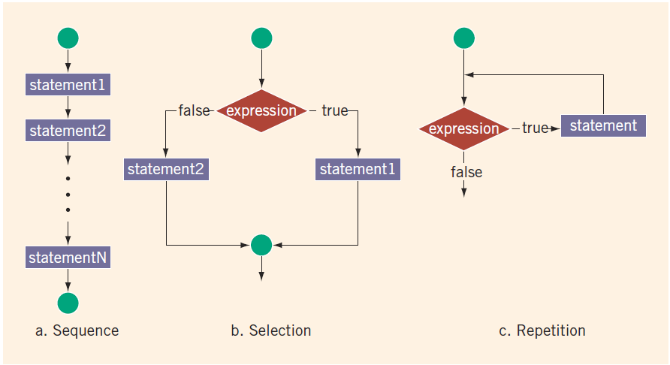
Control Structures

Slide 18
Relational Operators
Each relational operator is a binary operator (requires two operands)
Expressions using these operators always evaluate to true or false
Operator | Description
== | equal to
!= | not equal to
< | less than
<= | less than or equal to
> | greater than
>= | greater than or equal to

Slide 19
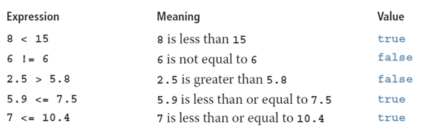
Relational Operators on Simple Data Types

Slide 20
Comparing Characters
In an expression of char values using relational operators:
The result depends on the machine’s collating sequence
ASCII character set
Logical (Boolean) expressions:
Include expressions such as 4 < 6 and 'R' > 'T’
Return an integer value of 1 if the logical expression evaluates to true
Return an integer value of 0 otherwise

Slide 21

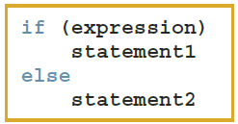
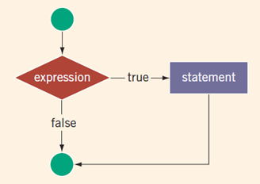
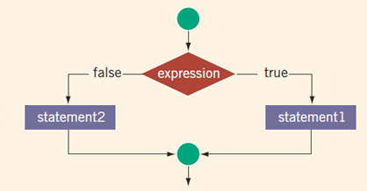
One-Way and Two-Way Conditionals

Slide 22
int vs. bool in Boolean Expressions
Logical expressions evaluate to either 1 (true) or 0 (false)
Boolean value can be stored in a variable of the data type int
Can use int data type (4 bytes) to manipulate logical (Boolean) expressions.
Better use bool (1 byte) that also has values true and false
bool, true, and false are reserved words
The identifier true has the value 1
The identifier false has the value 0

Slide 23

Logical Negation (!)
Expression | !(Expression)
true (nonzero) | false (0)
false (0) | true (1)

Slide 24
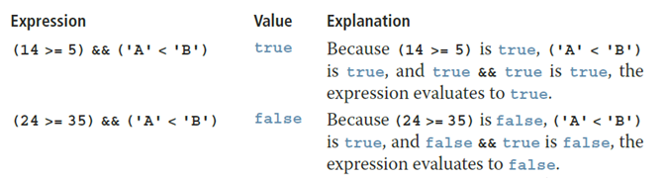
Logical Conjunction (&&)
Expression1 | Expression2 | Expression1 && Expression2
true (nonzero) | true (nonzero) | true (1)
true (nonzero) | false (0) | false (0)
false (0) | true (nonzero) | false (0)
false (0) | false (0) | false (0)

Slide 25
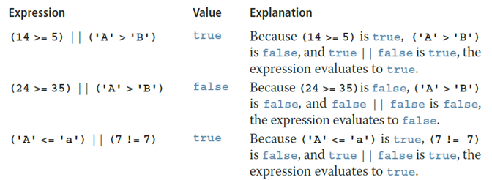
Logical Disjunction (||)
Expression1 | Expression2 | Expression1 || Expression2
true (nonzero) | true (nonzero) | true (1)
true (nonzero) | false (0) | true (1)
false (0) | true (nonzero) | true (1)
false (0) | false (0) | false (0)

Slide 26
Order of Precedence
Operators | Precedence
!, +, - (unary operators) | first
*, /, % | second
+, - | third
<, <=, >=, > | fourth
==, != | fifth
&& | sixth
|| | seventh
= (assignment operator) | last
Notes:
Relational and logical operators are evaluated from left to right
The associativity is left to right
Parentheses can override precedence

Slide 27
Relations on string
Expression | Value/Explanation
str1 < str2 | true str1 = "Hello" and str2 = "Hi". The first character of str1 and str2 are the same, but the second character 'e' of str1 is less than the second character 'i' of str2.
str1 > "Hen" | false str1 = "Hello". The first two characters of str1 and "Hen" are the same, but the third character 'l' of str1 is less than the third character 'n' of "Hen".
str3 < "An" | true str3 = "Air". The first characters of str3 and "An" are the same, but the second character 'i' of "Air" is less than the second character 'n' of "An".
Notes:
Relational operators can be applied to variables of type string
Strings are compared character by character, starting with the first character
Comparison continues until either a mismatch is found or all characters are found equal
If two strings of different lengths are compared and the comparison is equal to the last character of the shorter string
The shorter string is less than the larger string

Slide 28
Relations on string
Expression | Value/Explanation
str1 == "hello" | false str1 = "Hello". The first character 'H' of str1 is less than the first character 'h' of "hello" because the ASCII value of 'H' is 72, and the ASCII value of 'h' is 104.
str3 <= str4 | true str3 = "Air" and str4 = "Bill". The first character 'A' of str3 is less than the first character 'B' of str4.
str4 >= "Billy" | false str4 = "Bill". It has four characters and "Billy" has five characters. Therefore, str4 is the shorter string. All four characters of str4 are the same as the corresponding first four characters of "Billy", and "Billy" is the larger string.

Slide 29
Nested if and Dangling else
else associates with the closest unmatched if ("dangling else")
if (C1)
if (C2) { f(); }
else { g(); }
Subcase | What is called?
C1==true; C2==true | ?
C1==true; C2==false | ?
C1==false; C2==true | ?
C1==false; C2==false | ?

Slide 30
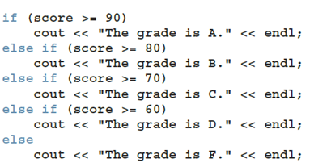
Cascading if-else
When one control statement is located within another, it is said to be nested.
Can make longer "cascades" or "chains" of if-else.

Slide 31
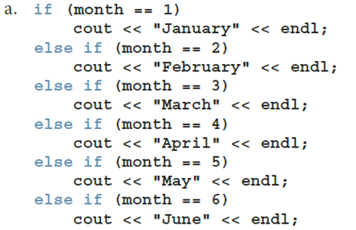
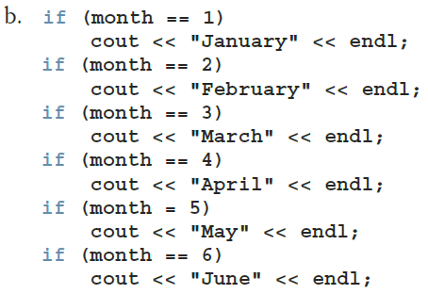
Comparing if…else with if

Slide 32
Short-Circuit Evaluation
Short-circuit evaluation: evaluation of a logical expression stops as soon as the value of the expression is known.
if (x != 0 && y%x != 0) { ... }
If x is 0, never test the remainder dividing by x.
if (person.age < 12 || person.vaccinated()) { ... }
If person is younger than 12, do not care about checking vaccination.

Slide 33
Comparing Floating-Point Numbers with "Tolerance Value"
Equality of floating-point numbers is risky
Example:
1.0 == 3.0/7.0 + 2.0/7.0 + 2.0/7.0 evaluates to false
Why? 3.0/7.0 + 2.0/7.0 + 2.0/7.0 = 0.99999999999999989
A solution is checking for a tolerance value
Example: if (fabs(x – y) < 1E-7) { ... }

Slide 34
Associativity of Relational Operators
num = 5
num = 20
0 <= num <= 10 | = 0 <= 5 <= 10
 | = (0 <= 5) <= 10 | (Because relational operators are evaluated from left to right)
 | = 1 <= 10 | (Because 0 <= 5 is true, 0 <= 5 evaluates to 1)
 | = 1 (true)
0 <= num <= 10 | = 0 <= 20 <= 10
 | = (0 <= 20) <= 10 | (Because relational operators are evaluated from left to right)
 | = 1 <= 10 | (Because 0 <= 20 is true, 0 <= 20 evaluates to 1)
 | = 1 (true)

Slide 35
Avoiding Bugs by Avoiding Partially Understood Concepts and Techniques
Must use concepts and techniques correctly
Otherwise solution will be either incorrect or deficient
If you do not understand a concept or technique completely
Do not use it
Save yourself an enormous amount of debugging time

Slide 36
Input Failure and the if Statement
If an input stream enters a fail state:
All subsequent input statements associated with that stream are ignored
Program continues to execute
The code may produce erroneous results
Use if statements to check status of input stream
If the input stream enters the fail state, include instructions that stop program execution

Slide 37
Confusion Between the Equality (==) and Assignment (=) Operators
C++ allows you to use any expression that can be evaluated to either true or false as an expression in the if statement
if (x = 5)
cout << "The value is five." << endl;
Since value 5 is not 0, this evaluates to true and always succeeds (and assigns)
Appearance of = in place of == is a semantical error. (Frequent cause for "silent bugs" – as it is syntactically correct.)

Slide 38
Conditional Operator (?:)
Conditional operator (?:)
Ternary operator: takes three arguments
Syntax for the conditional operator
If expression1 is true, the result of the conditional expression is expression2
Otherwise, the result is expression3
Example: max = (a >= b) ? a : b;

Slide 39
Program Style and Form (Revisited): Indentation
A properly indented program:
Helps you spot and fix errors quickly
Shows the natural grouping of statements
Insert a blank line between statements that are naturally separate
Two commonly used styles for placing braces
On a line by themselves
Or left brace is placed after the expression, and the right brace is on a line by itself

Slide 40
Using Pseudocode to Develop, Test, and Debug a Program
Pseudocode (or just pseudo) is an informal mixture of C++ and ordinary language
Helps you quickly develop the correct structure of the program and avoid making common errors
Use a wide range of values in a walk-through to evaluate the program

Slide 41
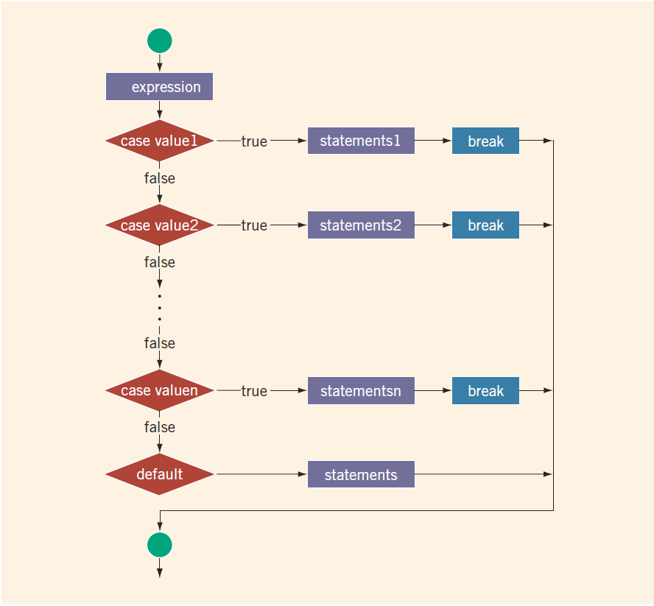
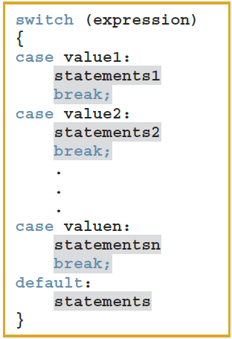
switch Structures – 1

Slide 42
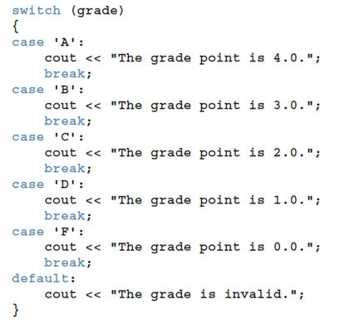
switch Structures – 2
Could we rewrite?
if (grade == 'A') {...} else if (grade == 'B') { ... } else if (grade =='C') {...}
...
else { ... }
What is the difference?

Slide 43

The assert Function
Syntax
expression is any logical expression
If expression evaluates to true, the next statement executes
If expression evaluates to false, the program terminates and indicates where in the program the error occurred
To use assert, include cassert header file
After developing and testing a program, remove or disable assert statements
The preprocessor directive #define NDEBUG must be placed before the directive #include <cassert> to disable the assert statement

Slide 44
Quick Review
Control structures alter normal control flow (Conditionals and Loops)
Relational operators: ==, <, <=, >, >=, !=
Bool values 1 (true) or 0 (false), operators ! (not), && (and), || (or)
The expression in an if or if...else structure is usually a logical expression
Using assignment (=) in place of the equality (==) creates a semantic error
The execution of a switch structure handles multiway selection
The execution of a break statement ends a switch statement
Use assert to terminate a program if certain conditions are not met

Slide 45
Chapter 5
Control Structures II (Repetition)

Slide 46
Objectives
In this chapter, you will:
Learn about repetition (looping) control structures
Learn how to use a while loop in a program
Explore how to construct and use counter-controlled, sentinel-controlled, flag-controlled, and EOF-controlled repetition structures
Learn how to use a for loop in a program
Learn how to use a do…while loop in a program
Examine break and continue statements
Discover how to form and use nested control structures
Learn how to avoid bugs by avoiding patches
Learn how to debug loops

Slide 47

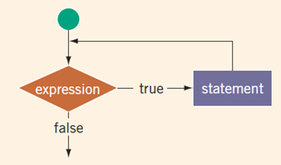
while Looping (Repetition) Structure (2 of 3)
Notes:
All three loops have their place in C++
If you can determine in advance the number of repetitions needed, the for loop is the correct choice
If you do not know and cannot determine in advance the number of repetitions needed, and it could be zero, use a while loop
If you do not know and cannot determine in advance the number of repetitions needed, and it is at least one, use a do...while loop

Slide 48
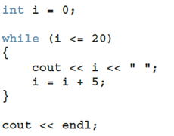
while loop with a counter
Produce this output:
0 5 10 15 20
With the loop control variable (LCV) can also imitate for-loops.

Slide 49
while loop with a sentinel
A sentinel variable is tested in the condition
The loop ends when the sentinel is encountered
cin >> variable; //initialize the loop control variable
while (variable != sentinel) //test the loop control variable
{
.
.
.
cin >> variable; //update the loop control variable
.
.
.
}

Slide 50

while loop with a bool flag
Flag-controlled while loop: uses a bool variable to control the loop
bool isFound = false; //initialize the flag
while (!isFound) //test the flag
{
...
if (expression)
isFound = true; //update the flag
...
}

Slide 51
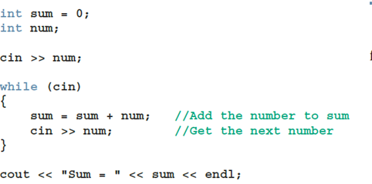
while loops controlled by EOF
The function eof can determine the end of file status
eof is a member of data type istream
Syntax for the function eof: cin.eof()

Slide 52
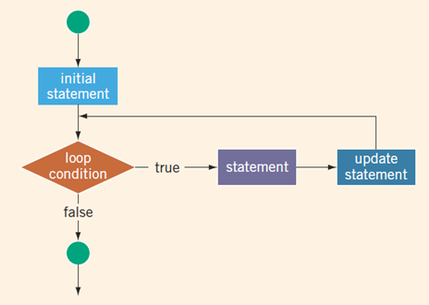
for Loops – 1
If you need multiple statements in the loop – should write curly brackets:
for (i = 0; i < 10; i++) {
int val = f(i);
cout << val << endl;
}

Slide 53
for Loops – 2
The following is a "semantic error":
for (int i = 0; i < 5; i++);
cout << "*" << endl;
The following is a legal (but infinite) for loop:
for (;;)
cout << "Hello" << endl;

Slide 54
for Loops – 3
for (int i=10; i>=1; i--)
{
cout << " " << i;
}
cout << endl;
Output: 10 9 8 7 6 5 4 3 2 1
for (int i=10; i>=1; --i)
{
cout << " " << i;
}
cout << endl;
What would change in this case?

Slide 55
do…while Looping (Repetition) Structure (1 of 6)
Syntax of a do...while loop
The statement executes first, and then the expression is evaluated
As long as expression is true, loop continues
To avoid an infinite loop, body must contain a statement that makes the expression false

Slide 56
do…while Looping (Repetition) Structure (2 of 6)
The statement can be simple or compound
Loop always iterates at least once

Slide 57
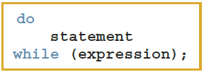
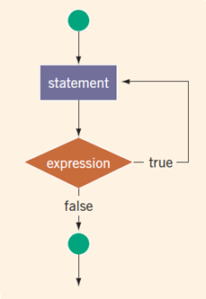
do…while Loops

Slide 58
do…while Loops
Note that while and for loops are pretest loops
It is possible that these loops many never activate due to entry conditions
In contrast, do. . .while loops are posttest loops
These loops always execute at least once
int i = 0;
do {
cout << i << " ";
i += 5;
} while (i <= 20);

Slide 59
break and continue Statements (2 of 2)
continue is used in while, for, and do…while structures
When executed in a loop
It skips remaining statements and proceeds with the next iteration of the loop
You can only break/continue the innermost loop

Slide 60
Nested Control Structures (1 of 2)
To create the following pattern:
*
**
***
****
*****
We can use the following code:
for (i = 1; i <= 5; i++) {
for (j = 1; j <= i; j++)
cout << "*";
cout << endl;
}

Slide 61
Nested Control Structures (2 of 2)
What is the result if we replace the first for statement with this?
for (i = 5; i >= 1; i--)
Answer:
*****
****
***
**
*

Slide 62
Avoiding Bugs by Avoiding Patches
A software patch is a piece of code written on top of an existing piece of code
Intended to fix a bug in the original code
Some programmers address the symptom of the problem by adding a software patch
A programmer should instead resolve the underlying issue

Slide 63
Quick Review
C++ has three looping (repetition) structures:
while, for, and do…while
while and for loops are called pretest loops
do...while loop is called a posttest loop
while and for may not execute at all, but do...while always executes at least once
while loops can be counter-controlled; sentinel-controlled; EOF-controlled (In the Windows console, the end-of-file marker is entered using Ctrl+z)
A break statement in the body of a loop immediately terminates the loop
A continue statement in the body of a loop skips to the next iteration

Slide 64
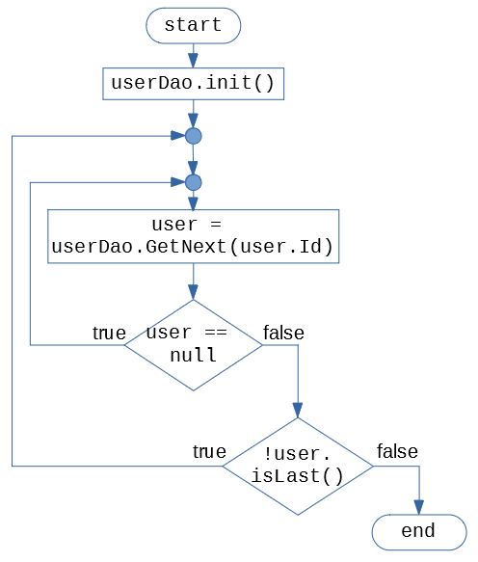
Flowchart to Code
Does this flowchart need conditionals? (What kind is better – If? If/else? Switch?)
Does this flowchart need loops? (What kind fits better – For? While? Do-While?). Any "break" or "continue"?
Write main() function that runs this flowchart (assume that all the functions referred here are implemented somewhere).

Slide 65
Flowchart to Code: Solution
int main() {
userDao.init();
do {
user = userDao.getNext();
if (user == null) { continue;
}
} while (!user.isLast());
}

Slide 66
Chapter 6
User-Defined Functions

Slide 67
Objectives
In this chapter, you will:
Use predefined functions
Use user-defined functions
Examine void and value-returning functions
Distinguish function prototypes/declarations and definitions.
Distinguish between value and reference parameters
Learn function overloading

Slide 68
Introduction
Functions allow complicated programs to be divided into manageable pieces
In C++, a function is similar to that of a function in algebra
It has a name
It does some computation
Some of the predefined mathematical functions are:
pow(x, y), sqrt(x), floor(x)
C++ is not algebra – functions not only return values; they may have "side-effects" (sometimes they even change the parameter passed to that function).

Slide 69
Value-Returning Functions (3 of 3)
Heading (or function header): the first line of the function
Example: int abs(int number) { ... }
Formal parameter: a variable declared in the heading
Example: number
Actual parameter: a variable or expression listed in a call to a function
Example: x = abs(v)

Slide 70
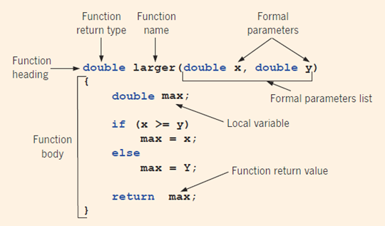
Parts of the Function Definition
int a = 3;
int b = 7;
double r = larger(a,b);
Variables a,b are actual parameters.
They are copied during the function call.

Slide 71
Value-Returning Functions
int secret(int x) {
if (x > 5)
return 2*x;
}
int funcRet2(int z) {
int a = 2;
int b = 3;
return 2*a+b, z+b;
}
Need to return value on all branches of a function. (Compilation should fail.)
This example compiles, but only returns the last value.
Problem: What if 2 numbers should be returned?

Slide 72
Command return similar to break
char courseGrade(int score) {
switch (score / 10) {
case 1:
case 2:
case 3:
case 4:
case 5:
return 'F';
case 6:
return 'D';
case 7:
return 'C';
case 8:
return 'B';
case 9:
case 10:
return 'A';
}
}
No need to write "break" (as "return" immediately jumps out from the function – not just the switch or the loop).

Slide 73
Function Declaration Order Matters
Tricky, if functions are mutually recursive (not clear, which goes above).
Function declarations often appear before the definitions.
For example, a "void" functions are placed after the function main
The function prototype must be placed before the function main
class Hofstadter {
public:
static int F(int n);
static int M(int n);
};
int Hofstadter::F(int n) {
if ( n == 0 ) return 1;
return n - M(F(n-1));
}
int Hofstadter::M(int n) {
if ( n == 0 ) return 0;
return n - F(M(n-1));
}

Slide 74
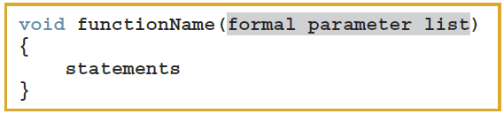
Void Functions (1 of 4)
User-defined void functions can be placed either before or after the function main
If user-defined void functions are placed after the function main
The function prototype must be placed before the function main
A void function does not have a return type
A return statement without any value is typically used to exit the function early

Slide 75
Scope of an Identifier
Scope of an identifier: where in the program the identifier is accessible
Local identifier: identifiers declared within a function (or block)
Global identifier: identifiers declared outside of every function definition
C++ does not allow nested functions
Definition of one function cannot be included in the body of another function

Slide 76
Static and Automatic Variables
Automatic variable: memory is allocated at block entry and deallocated at block exit
By default, variables declared within a block are automatic variables
Static variable: memory remains allocated as long as the program executes
Global variables declared outside of any block are static variables

Slide 77
Function Overloading: An Introduction
In a C++ program, several functions can have the same name
Function overloading (or overloading a function name) occurs when creating several functions with the same name
Two functions should have different formal parameter lists
The signature: does not include the return type of the function
int max(int a, int b) { ... }
int max(int a, int b, int c) {... }
double max(double a, double b) { ... }

Slide 78
Parameter passing by value/by reference
#include <iostream>
void swap(int* a, int b, int c) {
int temp = a[0];
a[0] = a[1];
a[1] = temp;
temp = b;
b = c;
c = temp;
}
using namespace std;
int main() {
int arr[] = {1,2};
int b = 4, c = 5;
swap(arr, b, c);
}
Question: (1) What are the values of arr,b,c at the end of main()?
(2) What happens as we change function to:
void swap(int*& a, int& b, int& c) {
// same code }

Slide 79
Quick Review
Functions divide a program into manageable tasks
There are Value-returning functions and void functions
Params in heading are formal parameters; in call are called actual parameters
A prototype/declaration is the function heading without the body
An automatic variable is a variable for which memory is allocated on function/block entry and deallocated on function/block exit
A static variable is a variable for which memory remains allocated throughout the execution of the program

Slide 80
Chapter 6
User-Defined Functions

Slide 81
Objectives
In this chapter, you will:
Use predefined functions
Use user-defined functions
Examine void and value-returning functions
Distinguish function prototypes/declarations and definitions.
Distinguish between value and reference parameters
Learn function overloading

Slide 82
Introduction
Functions allow complicated programs to be divided into manageable pieces
In C++, a function is similar to that of a function in algebra
It has a name
It does some computation
Some of the predefined mathematical functions are:
pow(x, y), sqrt(x), floor(x)
C++ is not algebra – functions not only return values; they may have "side-effects" (sometimes they even change the parameter passed to that function).

Slide 83
Value-Returning Functions (3 of 3)
Heading (or function header): the first line of the function
Example: int abs(int number) { ... }
Formal parameter: a variable declared in the heading
Example: number
Actual parameter: a variable or expression listed in a call to a function
Example: x = abs(v)

Slide 84
Parts of the Function Definition
int a = 3;
int b = 7;
double r = larger(a,b);
Variables a,b are actual parameters.
They are copied during the function call.

Slide 85
Value-Returning Functions
int secret(int x) {
if (x > 5)
return 2*x;
}
int funcRet2(int z) {
int a = 2;
int b = 3;
return 2*a+b, z+b;
}
Need to return value on all branches of a function. (Compilation should fail.)
This example compiles, but only returns the last value.
Problem: What if 2 numbers should be returned?

Slide 86
Command return similar to break
char courseGrade(int score) {
switch (score / 10) {
case 1:
case 2:
case 3:
case 4:
case 5:
return 'F';
case 6:
return 'D';
case 7:
return 'C';
case 8:
return 'B';
case 9:
case 10:
return 'A';
}
}
No need to write "break" (as "return" immediately jumps out from the function – not just the switch or the loop).

Slide 87
Function Declaration Order Matters
Tricky, if functions are mutually recursive (not clear, which goes above).
Function declarations often appear before the definitions.
For example, a "void" functions are placed after the function main
The function prototype must be placed before the function main
class Hofstadter {
public:
static int F(int n);
static int M(int n);
};
int Hofstadter::F(int n) {
if ( n == 0 ) return 1;
return n - M(F(n-1));
}
int Hofstadter::M(int n) {
if ( n == 0 ) return 0;
return n - F(M(n-1));
}

Slide 88
Void Functions (1 of 4)
User-defined void functions can be placed either before or after the function main
If user-defined void functions are placed after the function main
The function prototype must be placed before the function main
A void function does not have a return type
A return statement without any value is typically used to exit the function early

Slide 89
Scope of an Identifier
Scope of an identifier: where in the program the identifier is accessible
Local identifier: identifiers declared within a function (or block)
Global identifier: identifiers declared outside of every function definition
C++ does not allow nested functions
Definition of one function cannot be included in the body of another function

Slide 90
Static and Automatic Variables
Automatic variable: memory is allocated at block entry and deallocated at block exit
By default, variables declared within a block are automatic variables
Static variable: memory remains allocated as long as the program executes
Global variables declared outside of any block are static variables

Slide 91
Function Overloading: An Introduction
In a C++ program, several functions can have the same name
Function overloading (or overloading a function name) occurs when creating several functions with the same name
Two functions should have different formal parameter lists
The signature: does not include the return type of the function
int max(int a, int b) { ... }
int max(int a, int b, int c) {... }
double max(double a, double b) { ... }

Slide 92
Parameter passing by value/by reference
#include <iostream>
void swap(int* a, int b, int c) {
int temp = a[0];
a[0] = a[1];
a[1] = temp;
temp = b;
b = c;
c = temp;
}
using namespace std;
int main() {
int arr[] = {1,2};
int b = 4, c = 5;
swap(arr, b, c);
}
Question: (1) What are the values of arr,b,c at the end of main()?
(2) What happens as we change function to:
void swap(int*& a, int& b, int& c) {
// same code }

Slide 93
Quick Review
Functions divide a program into manageable tasks
There are Value-returning functions and void functions
Params in heading are formal parameters; in call are called actual parameters
A prototype/declaration is the function heading without the body
An automatic variable is a variable for which memory is allocated on function/block entry and deallocated on function/block exit
A static variable is a variable for which memory remains allocated throughout the execution of the program

