Slide 1
Chapter 7
enum Types, Namespaces, and the string Type

Slide 2
Objectives
In this chapter, you will:
Learn how to create user-defined enumeration type
Use arithmetic and relational operators with enum types
Use for loops with enum types; input and output data.
Define variables and write functions to process enum types
Become familiar with anonymous types
Become familiar with the typedef statement
Learn about the namespace mechanism
Use string functions to manipulate strings

Slide 3

Enumeration Type
You can specify the name and the values, but not the operations
The syntax for enumeration type is:
enum colors {BROWN, BLUE, RED, GREEN, YELLOW};
Identifiers that are constants are usually capitalized
BROWN gets value 0, BLUE gets value 1, etc.

Slide 4
Operations on Enumeration Types
enum sports {BASKETBALL, FOOTBALL, HOCKEY, BASEBALL, SOCCER, VOLLEYBALL};
Can declare variables e.g.: sports mySport;
No arithmetic operations are allowed on enumeration types
mySport = popularSport + 2; //illegal
popularSport = FOOTBALL + SOCCER; //illegal
popularSport = popularSport * 2; //illegal
++ and -- are illegal, too
popularSport++; //illegal
popularSport--; //illegal
The solution is applying the cast operator
popularSport = FOOTBALL;
popularSport = static_cast<sports>(popularSport + 1);

Slide 5
Relational Operators
An enumeration type is an ordered set of values:
FOOTBALL <= SOCCER is true
HOCKEY > BASKETBALL is true
BASEBALL < FOOTBALL is false

Slide 6

typedef Statement
The typedef statement is used to create synonyms or aliases to a data type
The syntax of the typedef statement is:
typedef does not create any new data types
Only creates an alias to an existing data type

Slide 7
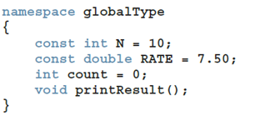
Namespaces
cout << globalType::N << endl;
globalType::printResult();
OR
using namespace globalType;
cout << N << endl;
printResult();

Slide 8
string Type
To use data type string, a program must include the header file string
A string is a sequence of zero or more characters
The first character is in position 0
The second character is in position 1, etc.
Binary operator + performs the string concatenation operation
Array subscript operator [] allows access to an individual character in a string

Slide 9
Quick Review
Enumeration type: set of ordered values
Reserved word enum creates an enumeration type
No arithmetic operations are allowed on the enumeration type
Relational operators can be used with enum values
Enumeration types can be passed as parameters to functions
Reserved word typedef creates synonyms or aliases to previously defined data types
A namespace member is usually a named constant, variable, function, or another namespace

Slide 10
Chapter 8
Arrays, Char Arrays, and Strings

Slide 11
Objectives
In this chapter, you will:
Learn the reasons for arrays
Explore how to declare and manipulate data into arrays
Understand the meaning of ‘‘array index out of bounds’’
Learn how to declare and initialize arrays
Discover how to pass an array as a parameter to a function
Loop over arrays
Use multidimensional arrays

Slide 12
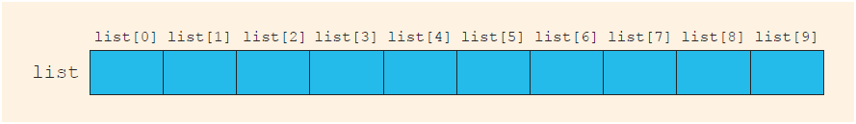
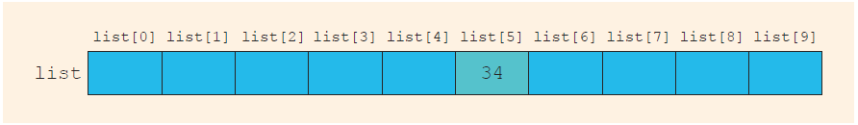
Accessing Array Components (2 of 3)
This statement declares an array of 10 components: int list[10];
list[5] = 34; stores 34 in list[5], the sixth component of the array list

Slide 13
Processing One-Dimensional Arrays
int list[100];
//array of size 100
for (int i = 0; i < 100; i++)
cin >> list[i]; // fill in values
In this array the first element is list[0]; the last one is list[99]
In C++, there is no guard against indices that are out of bounds
This check is solely the programmer’s responsibility

Slide 14
Array Initialization During Declaration
Arrays can be initialized during declaration
Example 1
double sales[5] = {12.25, 32.50, 16.90, 23, 45.68}
Example 2:
double sales[] = {12.25, 32.50, 16.90, 23, 45.68}

Slide 15
Arrays as Parameters to Functions
Arrays are passed by reference only
The size of the array is usually omitted in the array parameter
If provided, it is ignored by the compiler
The following example illustrates a function header, which includes an array parameter and a parameter specifying the number of elements in the array:
void initialize(int list[], int listSize)
Same as this:
void initialize(int* list, int listSize)
int* means "address/pointer to an integer"

Slide 16
Constant Arrays as Formal Parameters
Can prevent a function from changing the actual parameter when passed by reference. Use const in the declaration of the formal parameter
Example
void example(int x[], const int y[], int sizeX, int sizeY)

Slide 17
Functions Cannot Return Arrays
C++ does not allow functions to return a value of type array
C++ can return pointers to arrays.

Slide 18
C-Strings (Character Arrays) – 1
A character array is an array whose components are of type char
C-strings are null-terminated ('\0') character arrays
Examples
'A' is the character A
"A" is the C-string A
Note: "A" represents two characters, 'A' and '\0'
This is an example of a C-string declaration:
char name[16];
Since C-strings are null terminated and name has 16 components, the largest string it can store has 15 characters

Slide 19
C-Strings (Character Arrays) – 2
The size of an array can be omitted if the array is initialized during declaration
char name[] = "John";
Declares an array of length 5 and stores the C-string "John" in the array
Useful string manipulation functions include:
strcpy
strncpy
strcmp
strlen

Slide 20
String Comparison
C-strings are compared character by character using the collating sequence of the system
Use the function strcmp
If using the ASCII character set:
"Air" < "Boat"
"Air" < "An"
"Bill" < "Billy"
"Hello" < "hello"

Slide 21
Reading and Writing Strings
Most rules for arrays also apply to C-strings (which are character arrays)
Aggregate operations, such as assignment and comparison, are not allowed on arrays
C++ does allow aggregate operations for the input and output of C-strings

Slide 22
String Input
This is an example of string input:
cin >> name;
Stores the next input C-string into name
To read strings with blanks, use the function get:
cin.get(str, m+1);
When executed , the statement stores the next m characters into str, but the newline character is not stored in str
If input string has fewer than m characters, reading stops at the newline character

Slide 23
String Output
Example
cout << name;
Outputs the content of name on the screen
<< continues to write the contents of name until it finds the null character
If name does not contain the null character, then strange output may occur since << continues to output data from memory adjacent to name until a '\0' is found

Slide 24
Specifying Input/Output Files at Execution Time
User can specify the name of an input and/or output file at execution time
cout << "Enter the input file name: ";
cin >> fileName;
infile.open(fileName); //open the input file
.
.
.
cout << "Enter the output file name: ";
cin >> fileName;
outfile.open(fileName); //open the output file

Slide 25
string Type and Input/Output Files
Argument to the open function must be a null-terminated string (a C-string)
If using a string variable for the name of an I/O file, the value must first be converted to a C-string before calling open
Use the c_str function to convert
The syntax to use the function c_str is:
strVar.c_str()
Where strVar is a variable of type string

Slide 26
Parallel Arrays
Two (or more) arrays are called parallel if their corresponding components hold related information
The following example illustrates two parallel arrays:
int studentId[50];
char courseGrade[50];
With the following sample data to enter into the arrays:
studentId courseGrade
23456 A
86723 B
22356 C
92733 B
11892 D

Slide 27
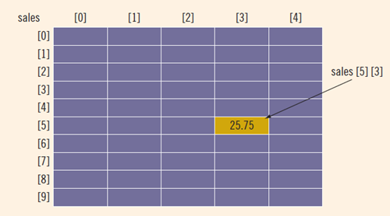
Accessing Array Components (2 of 2)
Example: sales[5][3] = 25.75;

Slide 28
Two-Dimensional Arrays
Two-dimensional arrays can be initialized when they are declared
Elements of each row are enclosed within braces and separated by commas
All rows are enclosed within braces
For number arrays, unspecified elements are set to 0
An example of two-dimensional array initialization is shown below:
int board[4][3] = {{2, 3, 1},
{15, 25, 13},
{20, 4, 7},
{11, 18, 14}};

Slide 29
Initialization
An example initializing row number 4 (fifth row) to 0:
row = 4;
for (col = 0; col < NUMBER_OF_COLUMNS; col++)
matrix[row][col] = 0;
An example initializing the entire matrix to 0
for (row = 0; row < NUMBER_OF_ROWS; row++)
for (col = 0; col < NUMBER_OF_COLUMNS; col++)
matrix[row][col] = 0;

Slide 30
Sum by Row
The following example shows how to find the sum of row number 4:
sum = 0;
row = 4;
for (col = 0; col < NUMBER_OF_COLUMNS; col++)
sum = sum + matrix[row][col];

Slide 31
Sum by Column
The following example illustrates finding the sum of each individual column:
//Sum of each individual row
for (row = 0; row < NUMBER_OF_ROWS; row++)
{
sum = 0;
for (col = 0; col < NUMBER_OF_COLUMNS; col++)
sum = sum + matrix[row][col];
cout << "Sum of row " << row + 1 << " = " << sum << endl;
}

Slide 32
Largest Element in Each Row and Each Column
The following example finds the largest element in each row:
//Largest element in each row
for (row = 0; row < NUMBER_OF_ROWS; row++)
{
largest = matrix[row][0]; //Assume the first element
//of the row is the largest.
for (col = 1; col < NUMBER_OF_COLUMNS; col++)
if (matrix[row][col] > largest)
largest = matrix[row][col];
cout << "The largest element in row " << row + 1
<< " = " << largest << endl;
}

Slide 33
Passing Two-Dimensional Arrays as Parameters to Functions
Two-dimensional arrays are passed by reference as parameters to a function
The base address is passed to the formal parameter
Two-dimensional arrays are stored in row order form
When declaring a two-dimensional array as a formal parameter, you can omit the size of the first dimension, but not the second

Slide 34
Question #1: Nested Loops
Problem: Write a C++ function that receives a 2D array of integers (and its width/height). It should print those row numbers where all array entries are equal.
Rewrite this pseudocode entirely in C++
printEqual(arr, rows, cols):
outer: for i in range(0,rows):
first = arr[i][0]
inner: for j in range(0,cols):
if (arr[i][j] != first):
continue outer loop;
print(i)
arr[0][0]=1 | arr[0][1]=3 | arr[0][2]=2
arr[1][0]=17 | 17 | 17
arr[2][0]=3 | 3 | 2
For this array should print: 1

Slide 35
Question #1: Nested Loops
Start with a correct
prototype/declaration of this function:
void printEqual( int** arr, int rows,
int cols);
http://www.cplusplus.com/forum/articles/17108/
(Why multidimensional arrays are not same as pointers to pointers.)
Three ways to write breaking out of a nested loop:
Could write using "goto"
Could set a bool flag (and change inner for-loop to a while-loop)
Could have one more function: bool allEqualOnRow(int* row, int cols); Returns "true" if all elements equal. (No nested loops)

Slide 36
Question #2: Lvalues, Rvalues
#include<iostream>
using namespace std;
int& left(int i, int* a) {
cout << "In left i=" << i << endl;
return a[i];
}
int right(int i, int* a) {
cout << " In right i=" << i << endl;
return a[i];
}
int main() {
int mm [] = {10,11,12,13,14};
int a = 0;
//left(a++, mm) = right(a++, mm)+5;
//left(a++, mm) = right(++a, mm)+5;
//left(++a, mm) = right(a++, mm)+5;
//left(++a, mm) = right(++a, mm)+5;
for (int i = 0; i < 5; i++) {
cout << " " << mm[i];
}
cout << endl;
}
In right i = 2
In left i = 2
10 11 17 13 14
Which line do you uncomment to get this output:

Slide 37
Question #2: Lvalues, Rvalues
Answer. 4th line left(++a, mm) = right(++a, mm)+5;
Expressions in C++ can have side-effects (as you evaluate them, some variables change during the evaluation itself).
Evaluation order for an assignment operator:
Compute actual parameters (pre-increment increments a two times)
Evaluate the right-hand side.
Evaluate the left-hand side (must be int& or similar "lvalue").
Assign right to the left.
In right i = 2
In left i = 2
10 11 17 13 14

Slide 38
Question #3: Arrays as Function Params or Return Values
Write a C++ function that receives a variable size 2-dimensional array of int as a parameter and returns a pointer to a 1-dimensional array (containing max values for each column).

Slide 39
Question #3: Arrays as Function Params or Return Values
Function prototype/declaration
Function body
Declare the return array
Define the initial values in the return array
Compute the correct values in the return array
Return
int* findMaxByRow(int** arr,
int nRows, int nCols) {
int* result = new int[nCols];
for (int j = 0; j < nCols; j++) {
result[j] = arr[0][j];
for (int i=0; i < nRow; i++) {
if (arr[i][j] > result[j]) {
result[j] = arr[i][j];
}
}
return result;
}

Slide 40
Quick Review
An array is a structured data type with a fixed number of components of the same type
Elements of a one-dimensional array are arranged in the form of a list
An array index is between 0 and size-1.
The base address of an array is the address of the first array component
When passing an array as an actual parameter, use only its name
In C++, C-strings are null terminated and are stored in character arrays
Commonly used C-string manipulation functions include: strcpy, strncpy, strcmp, strncmp, and strlen

Slide 41
Chapter 9
Records (structs)

Slide 42
Objectives
In this chapter, you will:
Learn about records (structs)
Examine various operations on a struct
Explore ways to manipulate data using a struct
Learn about the relationship between a struct and functions
Examine the difference between arrays and structs
Discover how arrays are used in a struct
Learn how to create an array of struct items
Learn how to create structs within a structs

Slide 43
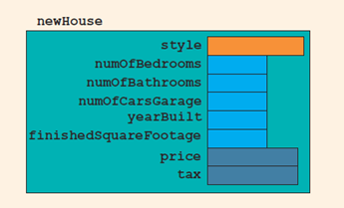
Records (structs)
A struct is a definition, not a declaration
Must declare a variable of that type to use it
struct houseType
{
string style;
int numOfBedrooms;
int numOfBathrooms;
int numOfCarsGarage;
int yearBuilt;
int finishedSquareFootage;
double price;
double tax;
};
//variable declaration
houseType newHouse;

Slide 44
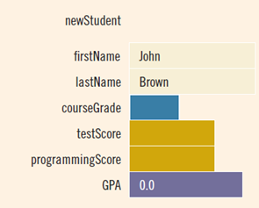
Accessing struct Members (2 of 2)
To initialize the members of newStudent:
newStudent.GPA = 0.0;
newStudent.firstName = "John";
newStudent.lastName = "Brown";

Slide 45
Assignment of structs
The assignment statement:
student = newStudent;
is equivalent to the following statements:
student.firstName = newStudent.firstName;
student.lastName = newStudent.lastName;
student.courseGrade = newStudent.courseGrade;
student.testScore = newStudent.testScore;
student.programmingScore = newStudent.programmingScore;
student.GPA = newStudent.GPA;

Slide 46
Comparison (Relational Operators)
Compare struct variables member-wise
No aggregate relational operations are allowed
To compare the values of student and newStudent:
if (student.firstName == newStudent.firstName &&
student.lastName == newStudent.lastName)
.
.
.

Slide 47
Input/Output
No aggregate input/output operations are allowed on a struct variable
Data in a struct variable must be read or written one member at a time
The following code would output newStudent contents:
cout << newStudent.firstName << " " << newStudent.lastName
<< " " << newStudent.courseGrade
<< " " << newStudent.testScore
<< " " << newStudent.programmingScore
<< " " << newStudent.GPA << endl;

Slide 48
struct Variables and Functions
A struct variable can be passed as a parameter by value or by reference
A function can return a value of type struct
The following function displays the contents a struct variable of type studentType:
void printStudent(studentType student)
{
cout << student.firstName << " " << student.lastName
<< " " << student.courseGrade
<< " " << student.testScore
<< " " << student.programmingScore
<< " " << student.GPA << endl;
}

Slide 49
Arrays versus structs
Data Type | Array | struct
Arithmetic | No | No
Assignment | No | Yes
Input/output | No (except strings) | No
Comparison | No | No
Parameter passing | By reference only | By value or by reference
Function returning a value | No | Yes

Slide 50
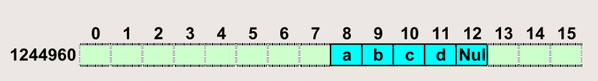
Char Array in Machine Memory – 1
char aString[5] = "abcd";

Slide 51
Char Array in Machine Memory – 2
fprintf(outFile, "aString char value: \t%s\n", aString);
fprintf(outFile, "aString[0] char value: \t%c\n", aString[0]);
fprintf(outFile, "aString[1] char value: \t%c\n", aString[1]);
fprintf(outFile, "aString[2] char value: \t%c\n", aString[2]);
fprintf(outFile, "aString[3] char value: \t%c\n", aString[3]);
fprintf(outFile, "aString[4] char value: \t%c\n", aString[4]);
fprintf(outFile, "aString value address: \t\t%u\n", &aString);
fprintf(outFile, "aString value length: \t\t%u\n", sizeof(aString));
fprintf(outFile, "\n");
aString char value: abcd
aString[0] char value: a
aString[1] char value: b
aString[2] char value: c
aString[3] char value: d
aString[4] char value: NUL
aString value address : 1244968
aString value length : 5

Slide 52
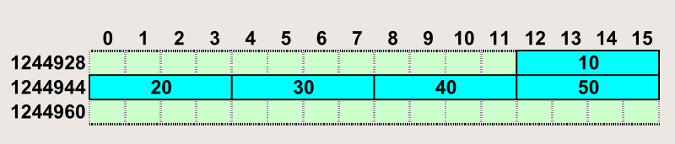
Array (int) in Machine Memory – 1
int intArray[5];
intArray[0] = 10;
intArray[1] = 20;
intArray[2] = 30;
intArray[3] = 40;
intArray[4] = 50;

Slide 53
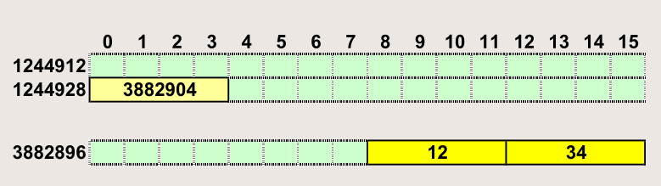
Struct "point" in memory – 1
struct point { int x; int y;};
point* aPoint;
aPoint = new point;
aPoint->x = 12;
aPoint->y = 34;

Slide 54
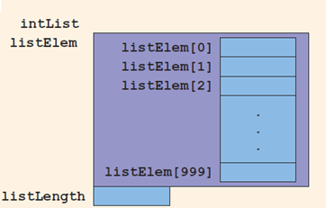
Arrays in structs (1 of 3)
Two items are associated with a list:
Values (elements)
Length of the list
Define a struct containing both items:
const int ARRAY_SIZE = 1000;
struct listType {
int listElem[ARRAY_SIZE];
int listLength;
};

Slide 55
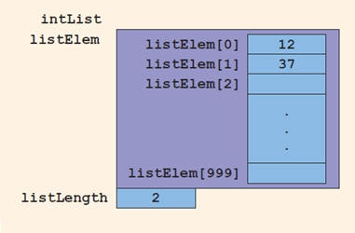
Arrays in structs (3 of 3)
Consider these statements and refer to the figure below showing the results following execution of the statements:
intList.listLength = 0;
intList.listElem[0] = 12;
intList.listLength++;
intList.listElem[1] = 37;
intList.listLength++;

Slide 56
structs in Arrays – 1
struct employeeType
{
string firstName;
string lastName;
int personID;
string deptID;
double yearlySalary;
double monthlySalary
double yearToDatePaid;
double monthlyBonus;
};

Slide 57
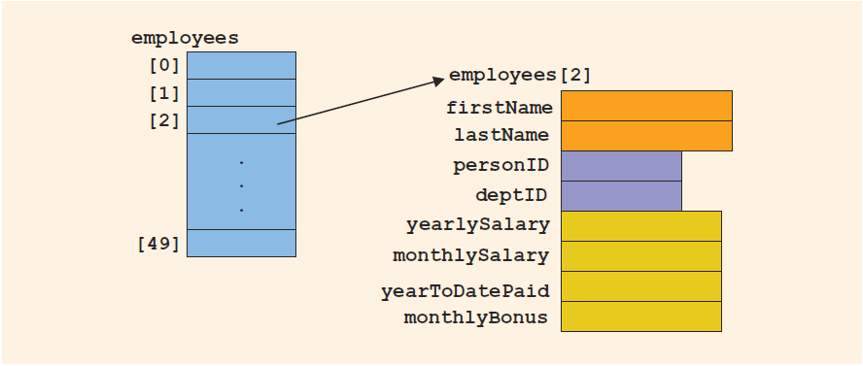
structs in Arrays – 2
employeeType employees[50]
Declares the array employees of 50 components of type employeeType

Slide 58
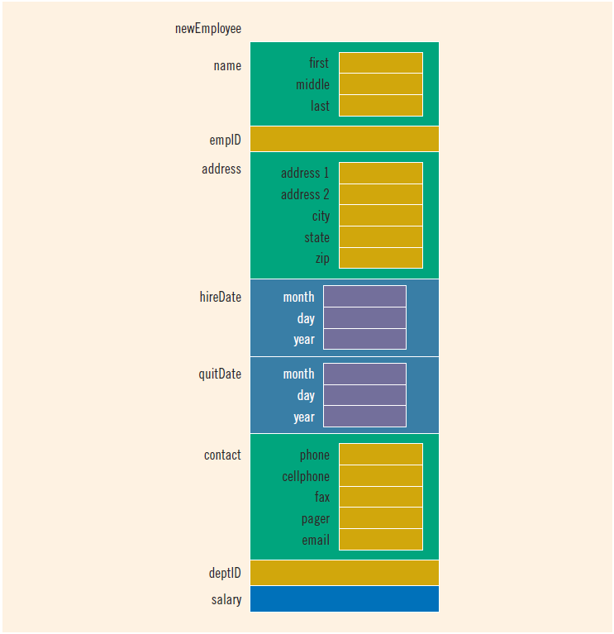
structs within a struct

Slide 59
Self-Referencing data types – 1
struct node {char info; node* next;};
node aNode_1;
node aNode_2;
node aNode_3;
aNode_1.info = 'a';
aNode_1.next = &aNode_2;
aNode_2.info = 'b';
aNode_2.next = &aNode_3;
aNode_3.info = 'c';
aNode_3.next = 0;

Slide 60
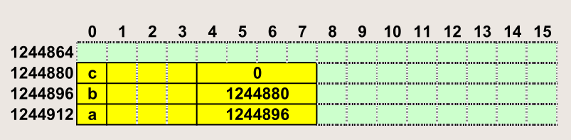
Self-Referencing data types – 2

Slide 61
struct Node in Machine Memory – 1
struct node {char info; node* next;};
node* aNode_4;
node* aNode_5;
node* aNode_6;
aNode_4 = new node;
aNode_5 = new node;
aNode_6 = new node;

Slide 62
struct Node in Machine Memory – 2
fprintf(outFile, "aNode_4 value : \t\t%u\n", aNode_4);
fprintf(outFile, "aNode_5 value : \t\t%u\n", aNode_5);
fprintf(outFile, "aNode_6 value : \t\t%u\n", aNode_6);
fprintf(outFile, "aNode_4 address : \t\t%u\n", &aNode_4);
fprintf(outFile, "aNode_5 address : \t\t%u\n", &aNode_5);
fprintf(outFile, "aNode_6 address : \t\t%u\n", &aNode_6);
aNode_4 value : 3882960
aNode_5 value : 3876560
aNode_6 value : 3876616
aNode_4 address : 1244868
aNode_5 address : 1244856
aNode_6 address : 1244844

Slide 63
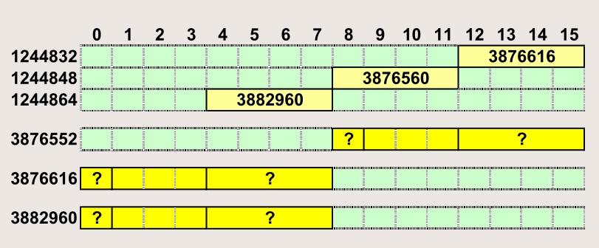
struct Node in Machine Memory – 3

Slide 64
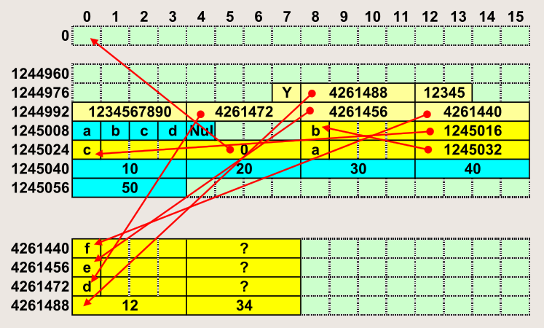
Atmiņas izmantošanas kopskats Release režīms
aNode_4.info->"d"; aNode_5.info->"e"; aNode_6.info->"f";

Slide 65
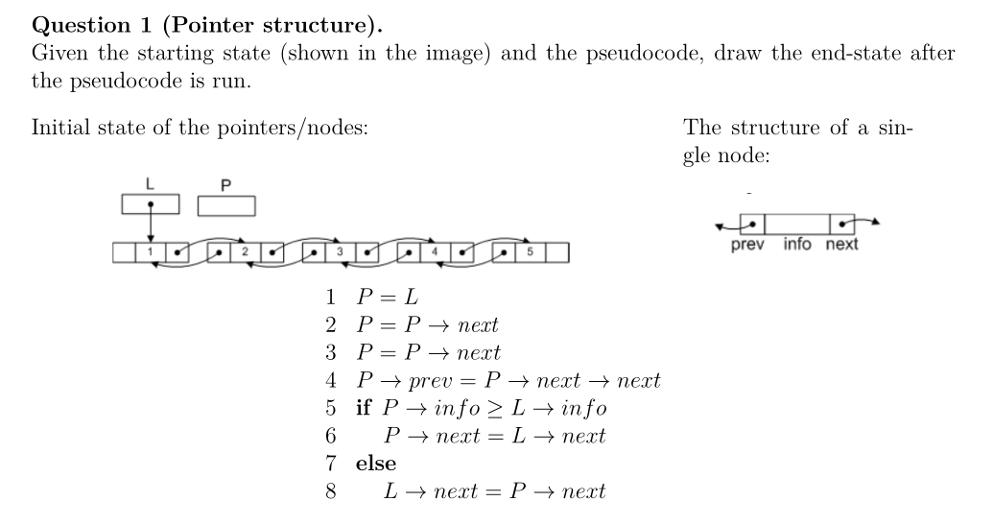
Question#1: Pointer Operations

Slide 66
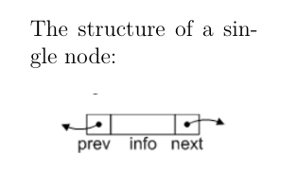
Question #2: Pointer Structure in C++
Define the C++ struct type to implement this pointer structure.

Slide 67
Quick Review
A struct is a collection of a fixed number of components
Components of a struct can be of different types called by name
Memory is allocated only when struct variables are declared
In C++, the dot (.) operator is called the member access operator
Used to access members of a struct
A struct can be passed by value or reference
A function can return a value of type struct
A struct can be a member of another struct
The only built-in operations on a struct are the assignment and member access operations

