Slide 1
Data Structures Self-Adjusting BSTs
Data Structures and Algorithms
Notes:
# Every module has the following content
* Title (1 slide)
* Table of Contents (1 slide) – where are we in the material?
* Motivation (1 slide) – why do we need this module?
* Anchor Task (1x) – introduce the key problem handled by this module
* Objectives (1x)
* Theory Section (1 subtitle + more slides) or Demo Section (1 subtitle + more slides)
* Summary (1x) * References (1x)

Slide 2
Self-Adjusting Trees (continued)
Since trees are used to handle items quickly, it is the speed of operations and not the tree’s structure that is critical
Not all items in a tree are likely to be used with equal frequency
Improving access to frequently searched items can improve the average-case time complexity. This is the basis for self-adjusting trees
Each node could count # of accesses. Or the assumption that an item that has been accessed will be accessed soon again.

Slide 3
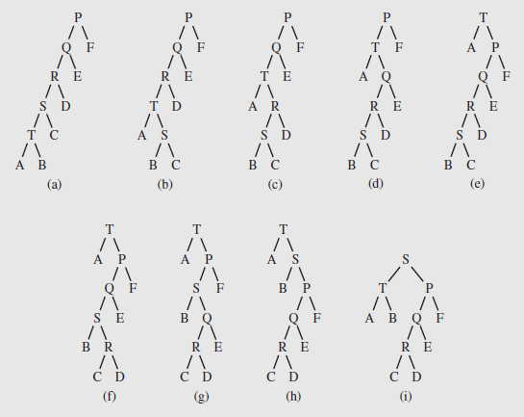
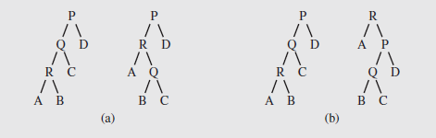
"Rotate to Root" – Approach #1
Brian Allen, Ian Munroe [1978], and James Bitner [1979] proposed two strategies:
Single rotation – if an element in a child is accessed, rotate the child around the parent, unless it is the root
Moving to the root – the parent-child rotation is repeated until the element that was accessed is the root.
These strategies don’t work well in the case of skewed trees; tree might slowly improve its structure:
T to root
S to root
Notes:
Still has the worst-case amortized cost O(n) per operation (because the tree can become, and remain, very unbalanced)

Slide 4
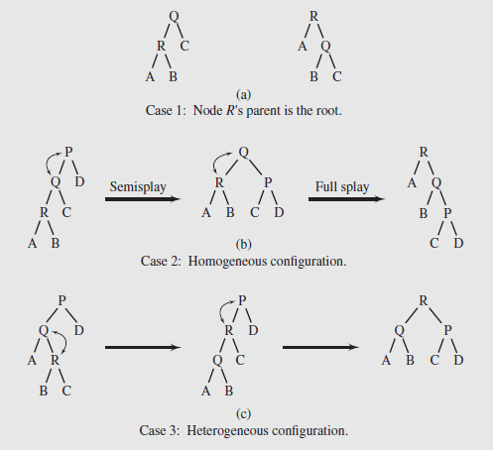
"Splaying" – Approach #2
Robert Tarjan and Daniel Sleator, 1985
Splaying applies single rotations in pairs; using an order determined by the links between child, parent, and grandparent
3 cases based on relationships between a node R, its parent Q, and grandparent P (if exists)
Case 1 – The root node is R’s parent
Case 2 – Called the homogeneous configuration, R is the left child of Q, and Q is the left child of P (or, R and Q are right children)
Case 3 – Called the heterogeneous configuration, R is the right child of Q and Q is the left child of P (or R is the left child of Q and Q is the right child of P)

Slide 5
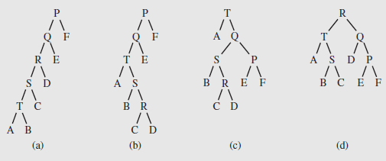
Splaying to Improve Tree Structure
In accessing the node T in the fifth level of the tree, the shape is improved: After accessing R, the height is considerably smaller.
Notes:
Even though splaying is a combination of two rotations (except when next to the root), they are not necessarily bottom-up
For homogeneous cases (left-right or right-right), the parent and grandparent node are rotated, then the node and its parent
The effect of this is both to move the node towards the root and to flatten the tree, which improves access
Splaying focuses on the elements rather than tree shape, so typically it performs better when some elements are used more frequently
If all the elements are accessed with about the same frequency, it will not be as useful
In those cases an alternative approach that focuses on balancing the tree is better
A modification called semisplaying is illustrated in Figure 6.48b
It requires one rotation for a homogeneous splay, and continue splaying with the parent of the node, rather than the node itself

Slide 6
BST Example (w/ repetitive keys)
BST (Binary Search Trees):
entries stored only at internal nodes
keys stored at nodes in the left subtree of v are less than or equal to the key stored at v
keys stored at nodes in the right subtree of v are greater than or equal to the key stored at v
An inorder traversal will return the keys in order
(20,Z)
(10,A)
(35,R)
(7,T)
(14,J)
(21,O)
(37,P)
(1,Q)
(40,X)
(8,N)
(36,L)
(1,C)
(5,H)
(7,P)
(10,U)
(2,R)
(5,G)
(5,I)
(6,Y)

Slide 7
Same BST as a Splay Tree – 1
Starts same as in a general BST
Search proceeds down the tree to found item or an external node.
Example: Search with key 11.
Example: Search with key 5 or 7. (Repetitive nodes).
(20,Z)
(10,A)
(35,R)
(7,T)
(14,J)
(21,O)
(37,P)
(1,Q)
(40,X)
(8,N)
(36,L)
(1,C)
(5,H)
(7,P)
(10,U)
(2,R)
(5,G)
(5,I)
(6,Y)

Slide 8
Same BST as a Splay Tree – 2
Search for key 8, ends at an internal node.
(20,Z)
(10,A)
(35,R)
(7,T)
(14,J)
(21,O)
(37,P)
(1,Q)
(40,X)
(8,N)
(36,L)
(1,C)
(5,H)
(7,P)
(10,U)
(2,R)
(5,G)
(5,I)
(6,Y)

Slide 9
Splay Trees do Rotations after Every Operation (Even Search)
new operation: splay
splaying moves a node to the root using rotations
right rotation
makes the left child x of a node y into y’s parent; y becomes the right child of x
left rotation
makes the right child y of a node x into x’s parent; x becomes the left child of y
y
x
a right rotation about y
a left rotation about x
x
T₃
T₁
y
x
y
T₁
T₂
T₁
y
T₂
T₃
x
T₃
T₂
T₃
T₁
T₂
(structure of tree above y is not modified)
(structure of tree above x is not modified)

Slide 10
Splaying:
“x is a left-left grandchild” means x is a left child of its parent, which is itself a left child of its parent
p is x’s parent; g is p’s parent
start with node x
is x a left-left grandchild?
is x the root?
yes
zig-zig
stop
yes
right-rotate about g, right-rotate about p
no
is x a right-right grandchild?
is x a child of the root?
zig-zig
no
yes
left-rotate about g, left-rotate about p
yes
is x a right-left grandchild?
is x the left child of the root?
zig-zag
no
yes
left-rotate about p, right-rotate about g
is x a left-right grandchild?
zig
zig
zig-zag
yes
right-rotate about the root
left-rotate about the root
yes
right-rotate about p, left-rotate about g

Slide 11
Visualizing the Splaying Cases
zig-zag
x
z
z
y
z
y
y
T₄
T₁
x
T₄
T₁
T₂
T₃
T₄
x
T₃
T₂
T₃
T₁
T₂
zig-zig
x
y
zig
T₁
y
x
T₄
x
T₂
z
w
w
y
T₃
T₃
T₄
T₁
T₂
T₃
T₄
T₁
T₂

Slide 12
Splaying node "8": Zig-Zag Part 1
let x = (8,N)
x is the right child of its parent, which is the left child of the grandparent
left-rotate around p, then right-rotate around g
(20,Z)
(20,Z)
g
(10,A)
(35,R)
(10,A)
(35,R)
p
(7,T)
(14,J)
(21,O)
(37,P)
(8,N)
(14,J)
(21,O)
(37,P)
(1,Q)
(8,N)
x
(36,L)
(40,X)
(7,T)
(10,U)
(36,L)
(40,X)
(1,Q)
(7,P)
(1,C)
(5,H)
(7,P)
(10,U)
(1,C)
(5,H)
(2,R)
(5,G)
(5,I)
(6,Y)
(2,R)
(5,G)
(5,I)
(6,Y)

Slide 13
Splaying node "8": Zig-Zag Part 2
(20,Z)
(20,Z)
(10,A)
(35,R)
x
(8,N)
(35,R)
(8,N)
(14,J)
(21,O)
(37,P)
g
p
(7,T)
(10,A)
(21,O)
(37,P)
(7,T)
(10,U)
(36,L)
(40,X)
(1,Q)
(7,P)
(14,J)
(36,L)
(40,X)
(1,Q)
(7,P)
(5,H)
(1,C)
(5,H)
(10,U)
(1,C)
(2,R)
(5,G)
(2,R)
(5,G)
(5,I)
(6,Y)
(5,I)
(6,Y)

Slide 14
Splaying node "8": Zig
now x is the left child of the root
right-rotate around root.
x
(8,N)
p
(20,Z)
(7,T)
(20,Z)
p
x
(8,N)
(35,R)
(1,Q)
(7,P)
(10,A)
(35,R)
(7,T)
(10,A)
(21,O)
(37,P)
(1,C)
(5,H)
(14,J)
(21,O)
(37,P)
(1,Q)
(7,P)
(14,J)
(36,L)
(40,X)
(2,R)
(5,G)
(10,U)
(36,L)
(40,X)
(1,C)
(5,H)
(10,U)
(5,I)
(6,Y)
(2,R)
(5,G)
(5,I)
(6,Y)

Slide 15
Tree may not become more balanced
For example, splay (40,X)
before, the depth of the shallowest leaf is 3 and the deepest is 7
after, the depth of shallowest leaf is 1 and deepest is 7.
(40,X)
(20,Z)
(20,Z)
(20,Z)
(10,A)
(35,R)
(10,A)
(40,X)
(10,A)
(37,P)
(14,J)
(7,T)
(14,J)
(37,P)
(14,J)
(7,T)
(21,O)
(37,P)
(7,T)
(35,R)
(1,Q)
(8,N)
(35,R)
(1,Q)
(8,N)
(36,L)
(40,X)
(1,Q)
(8,N)
(21,O)
(36,L)
(1,C)
(5,H)
(7,P)
(10,U)
(21,O)
(36,L)
(1,C)
(5,H)
(7,P)
(10,U)
(1,C)
(5,H)
(7,P)
(10,U)
(2,R)
(5,G)
(2,R)
(5,G)
(2,R)
(5,G)
(5,I)
(6,Y)
(5,I)
(6,Y)
(5,I)
(6,Y)

Slide 16
Splay Tree Definition
a splay tree is a binary search tree where a node is splayed after it is accessed (for a search or update)
deepest internal node accessed is splayed
splaying costs O(h), where h is height of the tree – which is still O(n) worst-case
O(h) rotations, each of which is O(1)

Slide 17
Splay Trees & Ordered Dictionaries
which nodes are splayed after each operation?
method
splay node
if key found, use that node
if key not found, use parent of ending external node
get(k)
put(k,v)
use the new node containing the entry inserted
use the parent of the internal node that was actually removed from the tree (the parent of the node that the removed item was swapped with)
erase(k)

Slide 18
Amortized Analysis of Splay Trees
Running time of each operation is proportional to time for splaying.
Define rank(v) as the logarithm (base 2) of the number of nodes in subtree rooted at v.
Costs: zig = $1, zig-zig = $2, zig-zag = $2.
Thus, cost for playing a node at depth d = $d.
Imagine that we store rank(v) cyber-dollars at each node v of the splay tree (just for the sake of analysis).

Slide 19
Cost per zig
Doing a zig at x costs at most rank’(x) - rank(x):
cost = rank’(x) + rank’(y) - rank(y) - rank(x) < rank’(x) - rank(x).
y
zig
x
T₄
x
w
T₃
w
y
T₁
T₂
T₃
T₄
T₁
T₂

Slide 20
Cost per zig-zig and zig-zag
Doing a zig-zig or zig-zag at x costs at most 3(rank’(x) - rank(x)) - 2
z
x
y
T₄
zig-zig
T₁
y
x
T₃
T₂
z
T₁
T₂
T₃
T₄
z
zig-zag
x
y
z
y
T₁
x
T₄
T₁
T₂
T₃
T₄
T₂
T₃

Slide 21
Cost of Splaying
Cost of splaying a node x at depth d of a tree rooted at r:
at most 3(rank(r) - rank(x)) - d + 2:
Proof: Splaying x takes d/2 splaying substeps:

Slide 22
Performance of Splay Trees
Recall: rank of a node is logarithm of its size.
Thus, amortized cost of any splay operation is O(log n)
In fact, the analysis goes through for any reasonable definition of rank(x)
This implies that splay trees can actually adapt to perform searches on frequently-requested items much faster than O(log n) in some cases

Slide 23
Self-Adjusting Trees (continued)
Since trees are used to handle items quickly, it is the speed of operations and not the tree’s structure that is critical
Not all items in a tree are likely to be used with equal frequency
Improving access to frequently searched items can improve the average-case time complexity. This is the basis for self-adjusting trees
Each node could count # of accesses. Or the assumption that an item that has been accessed will be accessed soon again.

Slide 24
"Rotate to Root" – Approach #1
Brian Allen, Ian Munroe [1978], and James Bitner [1979] proposed two strategies:
Single rotation – if an element in a child is accessed, rotate the child around the parent, unless it is the root
Moving to the root – the parent-child rotation is repeated until the element that was accessed is the root.
These strategies don’t work well in the case of skewed trees; tree might slowly improve its structure:
T to root
S to root
Notes:
Still has the worst-case amortized cost O(n) per operation (because the tree can become, and remain, very unbalanced)

Slide 25
"Splaying" – Approach #2
Robert Tarjan and Daniel Sleator, 1985
Splaying applies single rotations in pairs; using an order determined by the links between child, parent, and grandparent
3 cases based on relationships between a node R, its parent Q, and grandparent P (if exists)
Case 1 – The root node is R’s parent
Case 2 – Called the homogeneous configuration, R is the left child of Q, and Q is the left child of P (or, R and Q are right children)
Case 3 – Called the heterogeneous configuration, R is the right child of Q and Q is the left child of P (or R is the left child of Q and Q is the right child of P)

Slide 26
Self-Adjusting Trees (continued)
In accessing the node T in the fifth level of the tree, the shape is improved a great deal; after accessing R, the improvement is dramatic
Notes:
Even though splaying is a combination of two rotations (except when next to the root), they are not necessarily bottom-up
For homogeneous cases (left-right or right-right), the parent and grandparent node are rotated, then the node and its parent
The effect of this is both to move the node towards the root and to flatten the tree, which improves access
Splaying focuses on the elements rather than tree shape, so typically it performs better when some elements are used more frequently
If all the elements are accessed with about the same frequency, it will not be as useful
In those cases an alternative approach that focuses on balancing the tree is better
A modification called semisplaying is illustrated in Figure 6.48b
It requires one rotation for a homogeneous splay, and continue splaying with the parent of the node, rather than the node itself

